Slide 1
Annealing
Charity Fischer

Slide 2
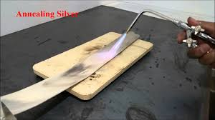
What annealing is used for
The process can be used to reverse the effects of plastic deformation; decrease in ductility, distortion of grain boundaries, and an increase in strength

Slide 3
What annealing is used for
Process of softening a material, metal, or an alloy to make it less brittle by (1) heating it to a particular temperature, (2) maintaining it at that temperature for a particular duration, and (3) cooling it slowly to normal temperature at a particular rate.
Businessdictionary.com

Slide 4
Why annealing is used
Recovery
  Stresses are relieved
  Subgrain boundaries form
Recrystallization
  New grains are formed
Grain Growth
  Grains become larger
Notes:
Three main things happen at the same time during annealing

Slide 5
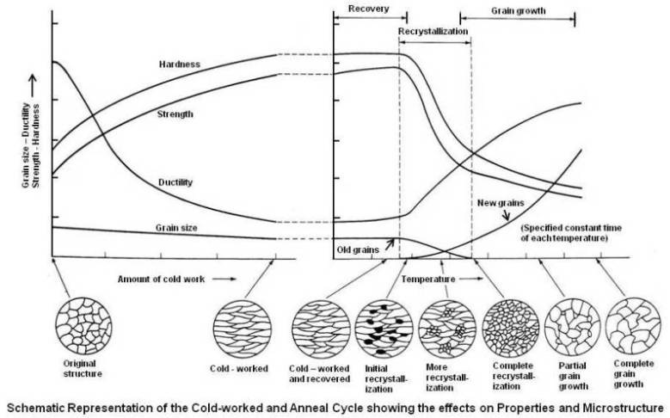
Why annealing is used

Slide 6
What annealing is used on
Glass
Metals such as cast iron
Alloys such as steel

Slide 7
References
Manufacturing, Engineering, and Technology, Kalpakjian and Schmid, (p. 49)
Businessdictionary.com
practicalmaintenance.net

