Slide 1
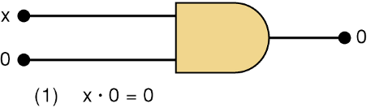
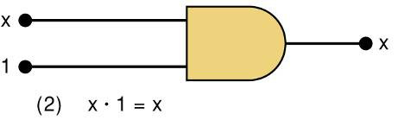
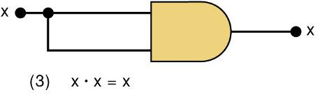
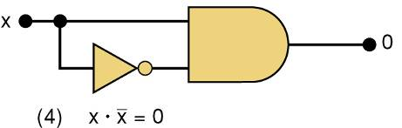
3-10 Boolean Theorems
Theorem (1) states that if any variable is ANDed with 0, the result must be 0.
Theorem (2) is also obvious by comparison with ordinary multiplication.
Prove Theorem (3) by trying each case. If x = 0, then 0 • 0 = 0
If x = 1, then 1 • 1 = 1
Thus, x • x = x
Theorem (4) can be proved in the same manner.

Slide 2
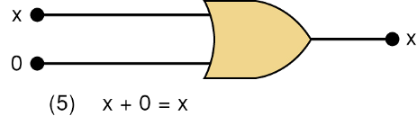
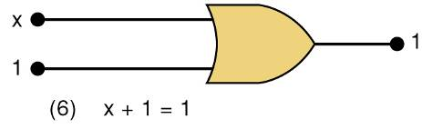
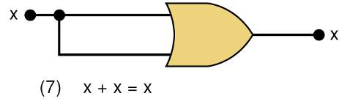
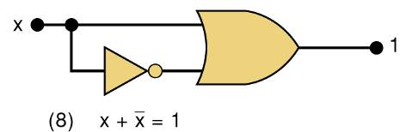
3-10 Boolean Theorems
Theorem (5) is straightforward, as 0 added to anything does not affect value, either in regular addition or in OR addition.
Theorem (6) states that if any variable is ORed with 1, the is always 1.
Check values: 0 + 1 = 1 and 1 + 1 = 1.
Theorem (7) can be proved by checking for both values of x: 0 + 0 = 0 and 1 + 1 = 1.
Theorem (8) can be proved similarly.

Slide 3
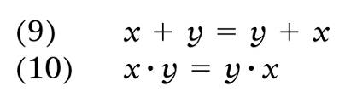


3-10 Boolean Theorems
Multivariable Theorems
Commutative laws
Associative laws
Distributive law

Slide 4
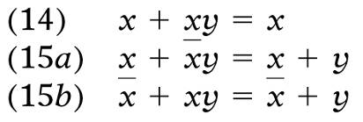
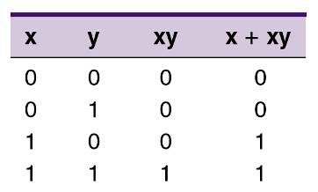

3-10 Boolean Theorems
Multivariable Theorems
Theorems (14) and (15) do not have counterparts in ordinary algebra. Each can be proved by trying all possible cases for x and y.
Analysis table & factoring for Theorem (14)

Slide 5


3-11 DeMorgan’s Theorems
DeMorgan’s theorems are extremely useful in simplifying expressions in which a product or sum of variables is inverted.
Theorem (16) says inverting the OR sum of two variables is the same as inverting each variable individually, then ANDing the inverted variables.
Theorem (17) says inverting the AND product of two variables is the same as inverting each variable individually and then ORing them.
Each of DeMorgan’s theorems can readily be proven by checking for all possible combinations of x and y.

