Slide 1
Lab Notebook
METC-143
08/01/2013

Slide 2
Lab #8
Cantilever Frequency
7/30/13

Slide 3
Lab #8 continued
Formula: f=((#oscillations)*(frames/second))/(#frames)

Slide 4
Lab #8 continued

Slide 5

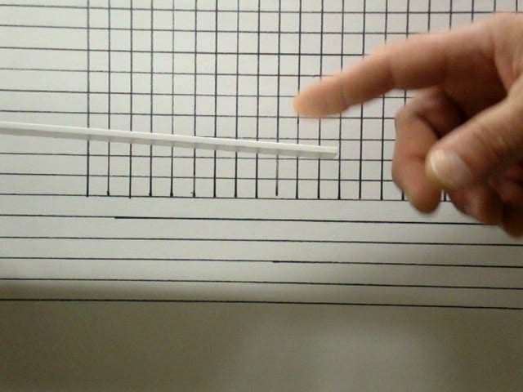
Lab #8 continued
Video of Test of Thinner Material without any units added

