Slide 1
Lab NoteBOOK
METC 143

Slide 2
Lab #8 7/30/13
In this lab we tested the frequency of two materials using the Cantilever Test. My Hypothesis is that the thinner specimen would have a higher frequency than the thicker one. To preform this test you will need material wood, plastic, etc…, a piece of board with horizontal lines on it, a digital camera, a camera tripod, and video software. First clamp down the specimen to the table so that the specimen is in front of the lined board. Push down on the specimen so it oscillates and using the digital camera count the number of times it oscillates in 5 seconds. I did 10 different tests for each specimen. After the test were complete I made a spreadsheet in excel. Using the equation OSC x Frames per sec. / Frames = Frequency I found the change in frequency when weight was added to the specimen.

Slide 3
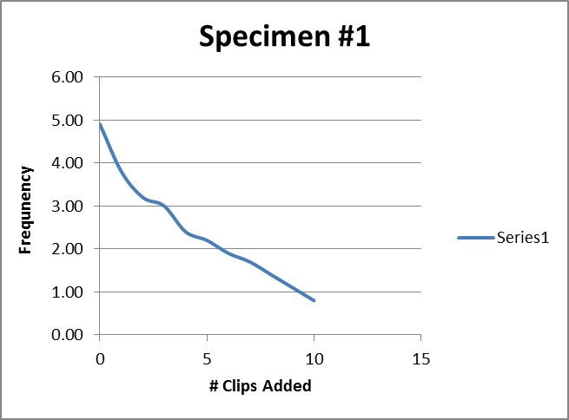
Lab #8 Continued
My hypothesis was correct and the thinner specimen did in fact have a higher frequency than the thicker one.

Slide 4
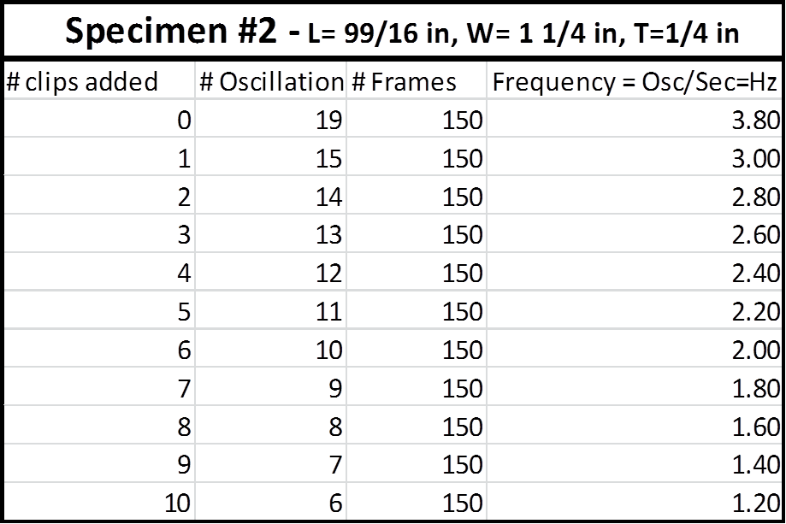
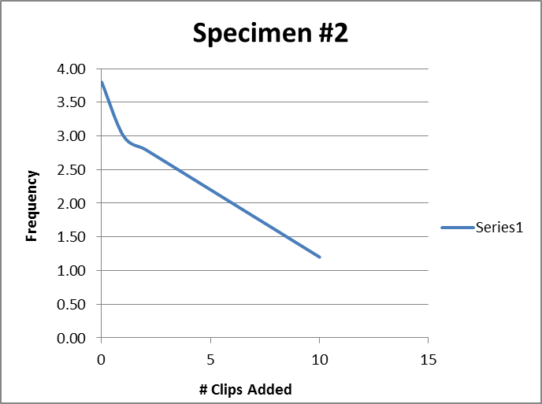
Lab #8 Continued

