Slide 1




Parallax BASIC Stamp® Tutorial
Developed by:
Electronic Systems Technologies College of Applied Sciences and Arts
Southern Illinois University Carbondale
http://www.siu.edu/~imsasa/est Martin Hebel mhebel@siu.edu
With support from: Will Devenport, Mike Palic and Mike Sinno
Sponsored by:
Parallax, Inc.
http://www.parallax.com/
Updated: 1/6/03 Version 0.96

Slide 2
Copyright Notice
Copyright 2002, Parallax, Inc. BASIC Stamp is a registered trademark of Parallax, Inc.
Parallax, Inc. and participating companies are not responsible for special, incidental, or consequential damages resulting from any breach of warranty, or under any legal theory, including lost profits, downtime, goodwill, damage to or replacement of equipment or property, nor any costs of recovering, reprogramming, or reproducing any data stored in or used with Parallax products.
Unmodified distribution of this tutorial is allowed.
Modifications to this tutorial are authorized for educational use internal to the school’s program of study. This copyright notice and development credits must remain.

Slide 3
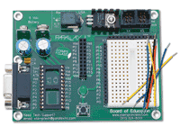
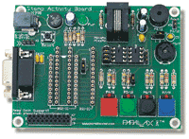
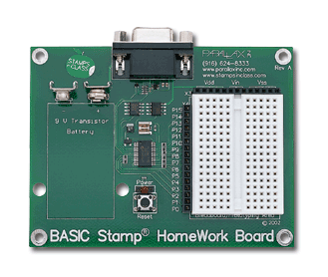
Use of the Tutorial
This tutorial is for novices in programming the BS2 from Parallax, Inc. For advanced use please refer to your BASIC Stamp Manual, help files and other sources.
The tutorial uses the Board of Education (BOE) as the primary carrier board for the BS2, though other boards and configurations may also be used.
The majority of the tutorial is compatible with the HomeWork board and the BASIC Stamp Activity Board except where noted.
We welcome any constructive feedback you wish to provide. A feedback page and survey are located at: http://imsinet.casa.siu.edu/bs2_tutorial/feedback.htm If this link is no longer active, please contact Parallax at stampsinclass@parallax.com.

Slide 4
Parts Required
This tutorial was written to use a minimum number of inexpensive components as possible in teaching the basic principles.
The following are recommended:
A BASIC Stamp 2 and a carrier board, such as the BOE, HomeWork Board, Activity Board or NX-1000, cables and software.
Parts for sections 4-7:
(3) 220 Ohm Resistors (2) LEDs (2) N.O. Momentary Pushbuttons
Additional Parts for Sections 8,9
(1) 10K Ohm Resistor (1) 10uF Capacitor (1) ADC0831 (1) LM34 Temperature Sensor
(2) 1K Ohm Resistors (1) 0.1 microfarad capacitor (1) 10K Ohm Potentiometer (1) Piezoelectric Speaker

Slide 5
Contents
1: BASIC Stamp Anatomy & BOE
7: Math and Data Operations
Go
Operation, Device I/O,
Memory, Serial Programming,
Versions, BOE
Go
DEBUG Modifiers, Math Operations,, Boolean operations, LOOKUP, WRITE & READ, DATA
2: Other Carrier Boards
8: Communications and Control
Go
Power, I/O Connections,
HomeWork Board, BSAC, NX-1000, OEM, Solder Boards
Go
SHIFTIN, SHIFTOUT SERIN, SEROUT PULSEIN, PULSOUT, PWM
3: BASIC Stamp Editor
9: Data Acquisition
Go
Physical Connection, Verifying Connection Writing Code, ‘Running’ Code, Using Help
Go
StampPlot Lite, Standard/Pro StampDAQ OPTAScope
4: Input, Processing, and Output
Home
Schematics Sec. 4-7
Digital Outputs: HIGH/LOW, OUTPUT, OUT. Digital Inputs: INPUT, IN. DEBUG, DIRS Analog Input: RCTIME
Frequency Output: FREQOUT
Go
Links
Schematics Sec. 8
5: Variables and Aliases
App. A: Number Systems
Go
Memory Variables, Constants, I/O Aliases
Go
Decimal, Binary , Hexadecimal Binary Coded Decimal ASCII
6: Program Flow
Sequential flow, Branching and Looping. Conditionals: GOTO, IF.. THEN, FOR.. NEXT. Subroutines: GOSUB BRANCH Power Saving: END, SLEEP
Go
Notes:
None

Slide 6
Section 1: BASIC Stamp 2 Anatomy
Microcontrollers
BASIC Stamp Components
BASIC Stamp 2 Pins
BASIC Stamp 2 Versions
Running a Program
Carrier and Experiment Boards
Power Connections
Data Connections
Serial Data Connectors
I/O Connections
Component Power Connections
Connecting Components
Breadboard Connections
Other Features

Slide 7
Microcontrollers
Microcontrollers can be thought of as very small computers which may be programmed to control systems such as cell phones, microwave ovens, toys, automotive systems, etc.
A typical household has upwards of 25 to 50 microcontrollers performing embedded control in numerous appliances and devices.
The BASIC Stamps are hybrid microcontrollers which are designed to be programmed in a version of the BASIC programming language called PBASIC.
Hardware support on the module allows fast, easy programming and use.

Slide 8
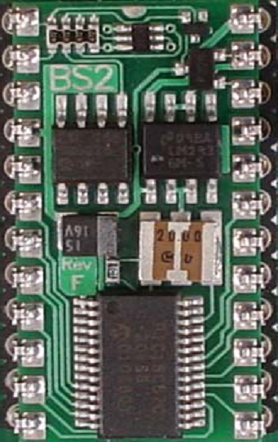
BASIC Stamp Module Components
Serial Signal Conditioning Conditions voltage signals between PC serial connection (+/- 12V) and BASIC Stamp (5V)
5V Regulator Regulates voltage to 5V with a supply of 5.5VDC to 15VDC
EEPROM Stores the tokenized PBASIC program.
Resonator Sets the speed at which instructions are processed.
Interpreter Chip Reads the BASIC program from the EEPROM and executes the instructions.

Slide 9
BASIC Stamp 2 Pins
Pin 1: S_{OUT}
Transmits serial data during programming and using the DEBUG instruction
Pin 24. V_{IN}
Un-regulated input voltage
(5.5-15V)
Pin 2: S_{IN}
Receives serial data during programming
Pin 23. V_{SS}
Ground (0V)
Pin 22. RES
Reset- LOW to reset
Pin 3: ATN
Uses the serial DTR line to gain the Stamps attention for programming.
Pin 21. V_{DD}
Regulated 5V.
Pin 4. V_{SS}
Communications Ground (0V).
P0
P15
P1
P14
P2
P13
P3
P12
Pins 5-20: Input/Output (I/O) pins P0 through P15
P4
P11
P5
P10
P6
P9
P7
P8

Slide 10
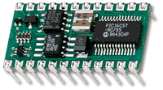
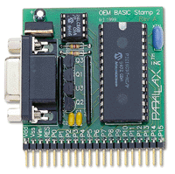
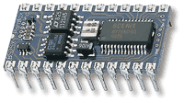
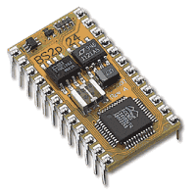
BASIC Stamp 2 Versions
There are several versions of the BASIC Stamp. This tutorial has been written for the BASIC Stamp 2 (BS2) series of controllers.
Each BASIC Stamp has different features, below are the most popular:
 | Version | Memory | Speed | Additional Features
 | BS2 | 2K Bytes 500 lines of code | 20MHz 4000 instructions/ second | 26 Bytes of RAM
 | BS2 OEM | 2K Bytes 500 lines of code | 20MHz 4000 instructions/ second | 26 Bytes of RAM Less expensive, easy to replace components.
 | BS2sx | 16K Bytes in 8 2K banks. 4000 lines of code | 50MHz 10,000 instructions/ second | 26 Bytes of RAM 63 bytes of scratchpad memory
 | BS2p 24 and 40 pins versions | 16K Bytes in 8 2K banks. 4000 lines of code. | 20 MHz Turbo | I2C, Dallas 1- Wire, LCD, polling capabilities. 16 extra I/O on 40 pin version.

Slide 11
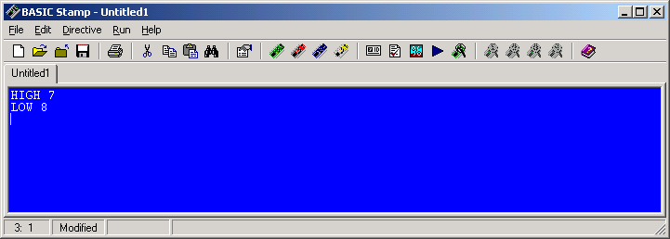
Running a Program
A program is written in the BASIC Stamp Editor
The program is tokenized, or converted into symbolic format.
The tokenized program is transmitter through the serial cable and stored in EEPROM memory.
Tokenizer
The Interpreter Chip reads the program from EEPROM and executes the instructions reading and controlling I/O pins. The program will remain in EEPROM indefinitely with or without power applied.

Slide 12
Carrier and Experiment Boards
The user may engineer their own power, communications and control circuits for the BASIC Stamp, but for beginners an assortment of carrier and experimenter boards are available for ease of development and testing.
The Board of Education (BOE) is one such board and will be the focus for this tutorial.
Note the notch at the top of the BASIC Stamp and socket indicating module direction.

Slide 13
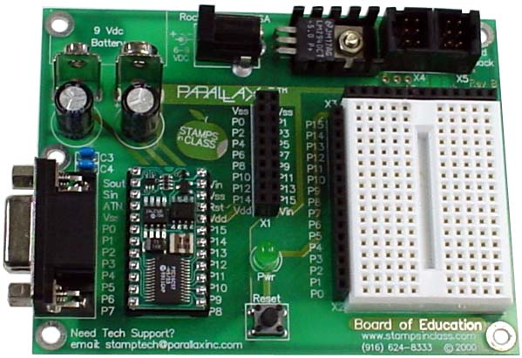
Power Connections
Many carrier boards, such as the BOE, have an additional 5V regulator to supplement the on-module regulator.
The Board of Education may be powered from either:
6-15VDC
Wall Transformer, center positive.
9V Battery

Slide 14
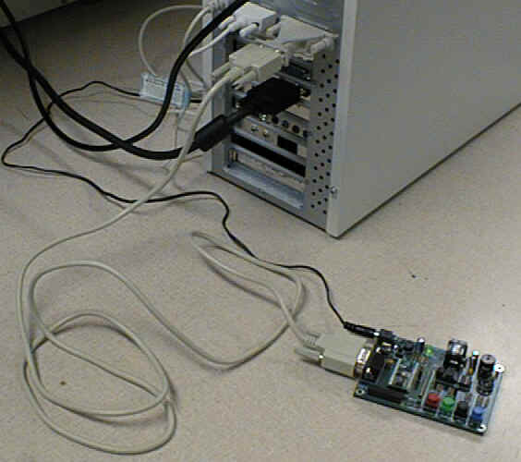
Data Connections
A serial cable (modem cable) is connected between BASIC Stamp and the computer’s serial communication port (COM port).
Serial means that data is sent or received one bit at a time.
The serial cable is used to download the stamp with the program written in the text editor and is sometimes used to display information from the BASIC Stamp using the DEBUG instruction.
Ensure that you use are using a Straight-Through cable (pins 2 and 3 do not cross from end-to-end) as opposed to a Null-Modem cable (pins 2 and 3 cross).
There are different connectors for different computer hardware.

Slide 15
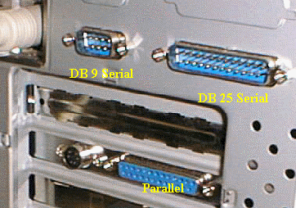
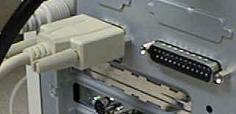

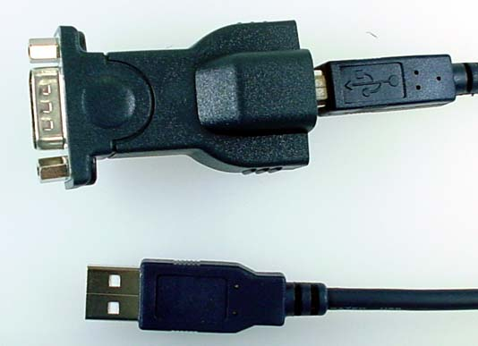
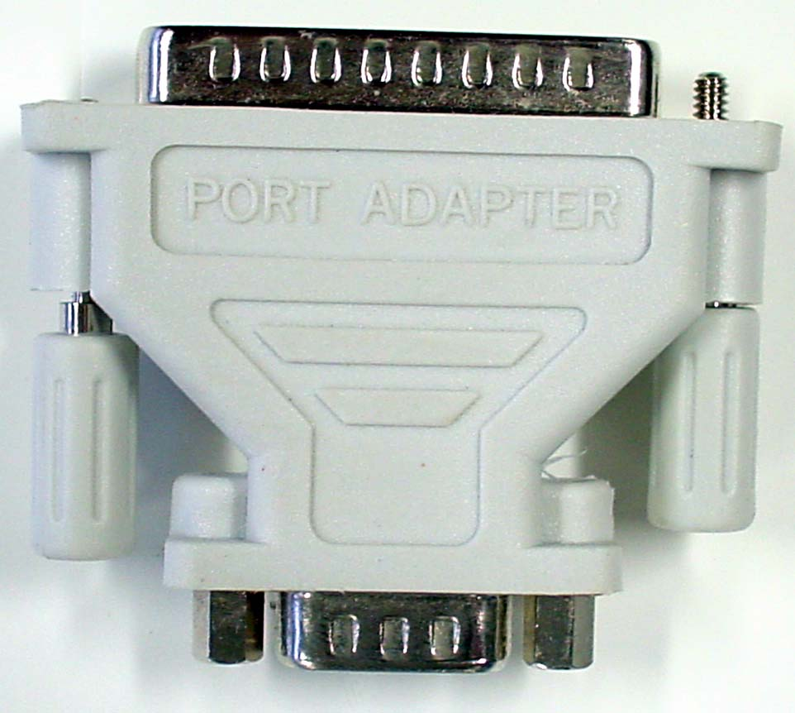
Serial Data Connectors
The cable is typically connected to an available DB 9 COM port.
Newer systems may only have USB ports and require a USB-to-
Serial Adapter.
A DB 25 to DB 9 adapter may be needed on older systems

Slide 16
I/O Connections
Code, such as HIGH 8 will be written for the BASIC Stamp. This instruction will control a device connected to P8 of the controller.
A connection to the I/O pins is also available on the ‘App-Mod’ header.
The P8 connection is available on the header next to the breadboard area.

Slide 17
Component Power Connections
Power for the components are available on headers also.
+5V (Vdd)
0V or ground (Vss)
Supply Voltage (Vin)
NOTE: Use of Vin may cause damaging voltages to be applied to the BASIC Stamp. Use only under directed use!

Slide 18
Connecting Components
Of course, an important aspect to any BASIC Stamp project are the components that will be connected to the I/O pins of the Stamp.
The carrier boards allow quick connections for the components.

Slide 19
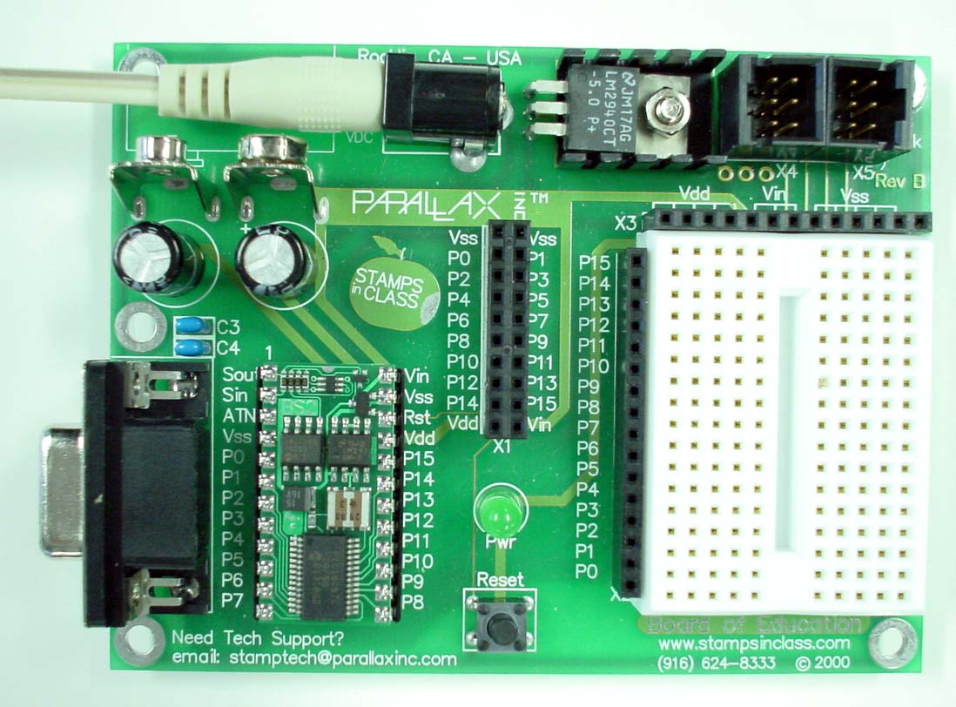
Breadboard Connections
Breadboard are rows of connectors used to electrically connect components and wiring.
Each row in each half of the breadboard are electrically the same point.
There exist no connections between the headers and the breadboards or in columns on the breadboard.
Components are connected between rows and to the headers to make electrical connections.
Components should NOT be connected on a single row or they will be shorted out of the circuit.

Slide 20
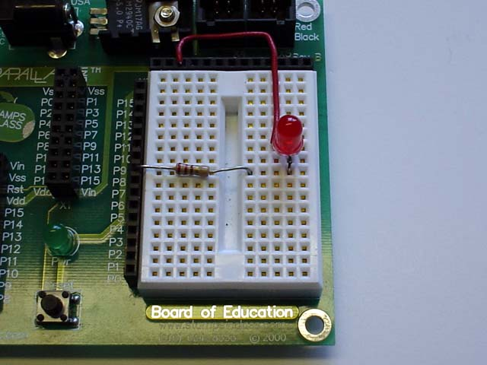
This image is the Board of Education with several components connected.
The connections on the breadboard create a complete path for current to flow.
Vdd (5V)
I/O Pin

Slide 21
Other Features
Servo Header Connectors
Programming Port
Power-On LED
Reset Button to restart the program on the BASIC Stamp

Slide 22
Section 2: Other Carrier Boards
Basic Stamp HomeWork Board
BASIC Stamp Activity Board
NX-1000
Solder Carrier Board
OEM module

Slide 23
Other Programming Boards
While this tutorial focuses on the Board of Education (BOE) carrier board, there are many others which may be used.
All the boards have:
Power Connectors.
Communications ports.
P-numbered I/O connections.
Many have a separate 5V regulator for devices.

Slide 24
BASIC Stamp HomeWork Board
The HomeWork Board is an inexpensive alternative for student projects.
The BASIC Stamp is integral to the board instead of a separate module.
All I/O have 220 ohm current limiting resistors. This means that the 220 ohm resistors used for connections in this tutorial may be omitted.

Slide 25
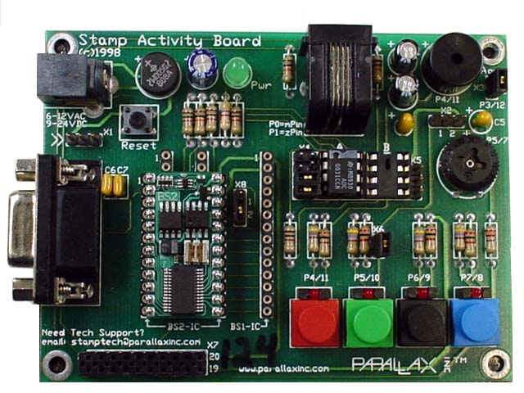
BASIC Stamp Activity Board
The BASIC Stamp Activity Board is great board for novice users because it has commonly used devices which are pre-connected to the BASIC Stamp allowing quick program testing.
On-Board devices:
4 buttons
4 LEDs
Speaker
Potentiometer
X10 power line interface
Sockets for specific add-on ICs

Slide 26

Each device is numbered, such as the blue button/LED with P7/8 (the switch is used for input, the LED is used for output).
The 1st number is the I/O number if you are using a BASIC Stamp I.
The 2nd number is the I/O number if you are using the BASIC Stamp 2 family.
Code such as HIGH 8 will operate the blue button/LED combination with the BS2.
Code in this tutorial is compatible with this board except where noted.
Programs in this tutorial will not work with the BS1.

Slide 27
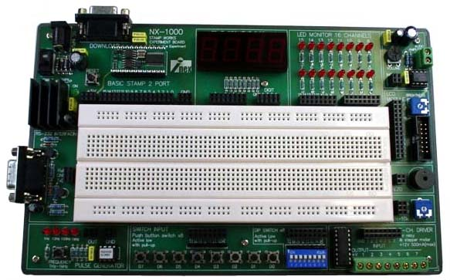
NX-1000
This board is a great experimenter's board. It has a wide variety of devices which are NOT pre-connected.
A large breadboard area accommodates many other devices.
Jumper wires are used between headers to connect desired devices to I/O pins.
7-Segment LED Display
Current- Limited LEDs
Audio Amp
LCD Header
Spare Serial Connector
Speaker & Pot
Oscillator
Active-Low switches
High-Current Drivers

Slide 28
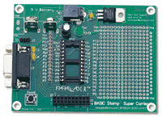
Through-Hole Solder Carrier Board
For more permanent construction, boards with solder connections are available.

Slide 29
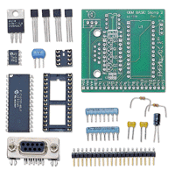
OEM module
The BASIC Stamp 2 OEM is a discreet component version of the BS2 which may be purchased in kit form.
The male header provides the means to ‘plug-it’ into your own board, or connect to other boards.
P0-P15 I/O
Reset Input (RES)
5.5 – 15V input (Vin)
Ground- 0V (Vss)
Regulated 5V (Vdd)

Slide 30
End of Section 2

Slide 31
Section 3: BASIC Stamp Editor
BASIC Stamp Editor
Identifying the BASIC Stamp
Writing the Program
Downloading or Running Code
Tokenizing and Errors
Commenting Code
DEBUG Window
Memory Map
Preferences
Help Files
Instruction Syntax Convention

Slide 32

BASIC Stamp Editor
The BASIC Stamp Editor is the application that is used to write, edit, and download the PBASIC programs for the BASIC Stamp.
The software may be downloaded for free from Parallax. Some installations of Windows 95 and 98 may require an additional file to be installed. Please see the information on the download page for more information.
Once installed, the Stamp Editor will be available on your desktop, and as a menu option under Start → Program Files → Parallax Inc

Slide 33
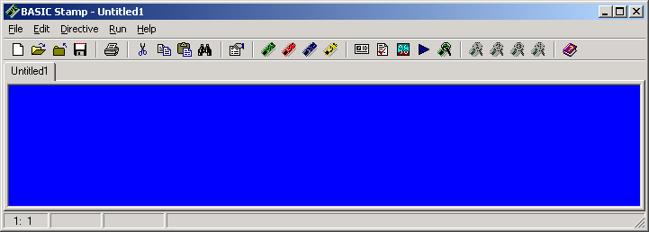
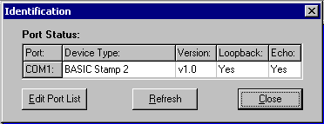
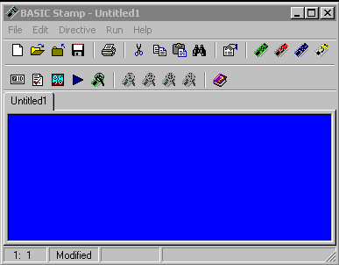
Identifying the BASIC Stamp
Connect the BASIC Stamp carrier board to your computer with a serial cable.
Power-up your BASIC Stamp carrier board.
Use the Identify button to verify communications to your BASIC Stamp.

Slide 34
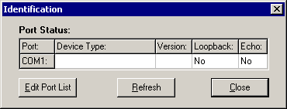
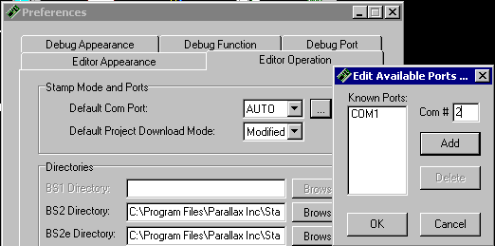
Identification Errors
If the ID shows:
No Device Type
No Loopback
No Echo It usually means the BASIC Stamp is not connected properly to the computer with a serial cable.
Verify the carrier board is connected to the computer with a serial cable, full-modem variety (not null-modem).
If your computer has multiple COM ports, try another.
If the COM port you are using is not listed, try adding it to the Stamp Editor using Edit→Preferences.

Slide 35

If the ID shows:
No Device Type
Loopback - Yes
Echo – Yes It usually means the BASIC Stamp is connected, but it has no power.
Verify the carrier board has power supplied and the power light is on (if available).

Slide 36
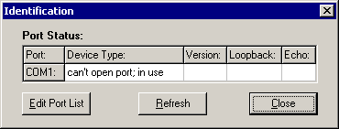
If the COM port cannot be opened, it usually means another program has control of the port.
Close any applications which may be using the port, including terminal programs, dial-up programs, Palm Pilot programs, PC Anywhere, StampPlot and other communication programs.
If you cannot resolve the problem, if possible:
Test another person’s operational board on your computer using their cable and yours.
Test your board on another computer, preferably one that had a working BASIC Stamp.
Contact Parallax support: support@parallax.com

Slide 37
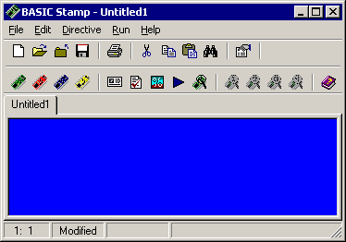
Writing the Program
BASIC Stamp programs are written in a version of BASIC called PBASIC entered into the BASIC Stamp Editor.
A program typically reads inputs, processing data, and controls outputs.
Programs must conform to the rules of syntax so that the BASIC Stamp can understand what you are telling it.
DEBUG “Hello World”

Slide 38
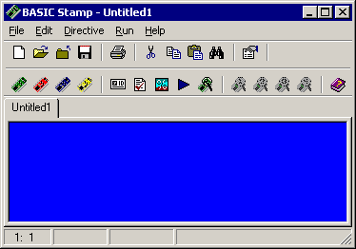
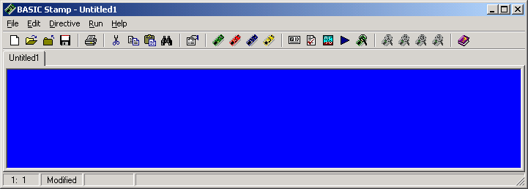
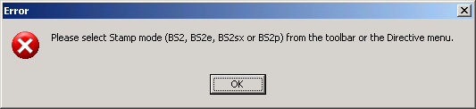
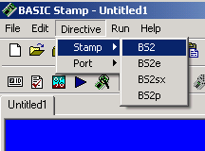
Downloading or Running Code
Once a program is entered, the Run button (or Ctrl-R) is used to tokenize and download the program to the BASIC Stamp.
The Editor will request you indicate the style of BASIC Stamp you are using.
‘{$STAMP BS2}
DEBUG “Hello World”
DEBUG “Hello World”
The style may be selected from the menu, or by selecting your ‘color’ of your BASIC Stamp on the button bar.
A directive will be added to the top of your code.

Slide 39
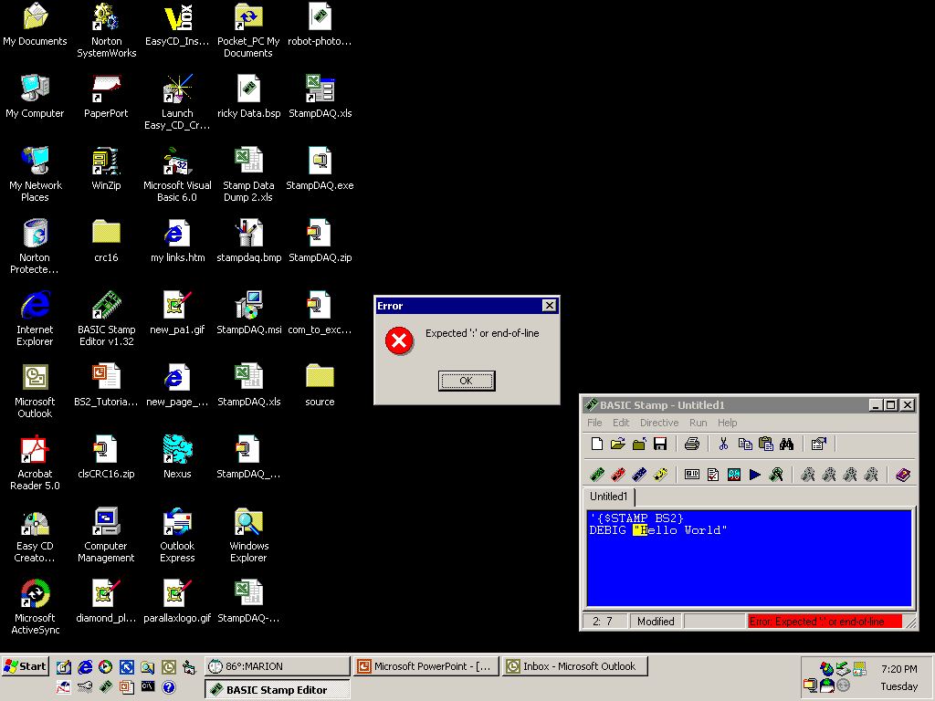
Tokenizing and Errors
When a program is ‘Ran’ the PBASIC code is converted to symbolic format called tokens. These are stored in ROM memory on your BASIC Stamp.
In order to tokenize your program, the code must to conform to the rules of syntax for the language.
If there are errors:
An error message will appear indicating a problem, the status turns red and code is highlighted.
Generally, the error can be found by looking before the highlighted area.
Read your code carefully looking for the syntax error or bug. In this example DEBUG is incorrectly spelled.
Code may be syntax checked without downloading by using the Syntax Check button.

Slide 40
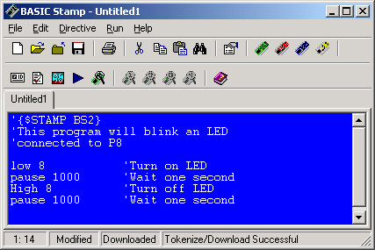
Commenting Code
Comments, or remarks, are descriptions or explanations the programmer puts in the code to clarify what it is doing.
Comments are signified by leading with an apostrophe.
Comments are NOT syntax checked, nor do they increase the size of your program. So comment often and at length!

Slide 41
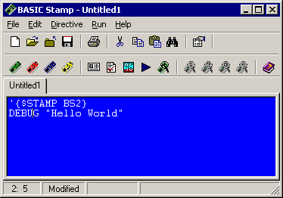
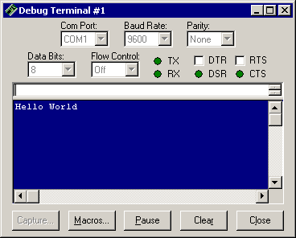
DEBUG Window
Programs may contain a DEBUG instruction. This instruction sends serial data back to the computer on the serial cable.
When DEBUG is present in a program, a DEBUG window will open in the Editor to view the returning data.
The DEBUG button may be used to manually open a DEBUG window.

Slide 42
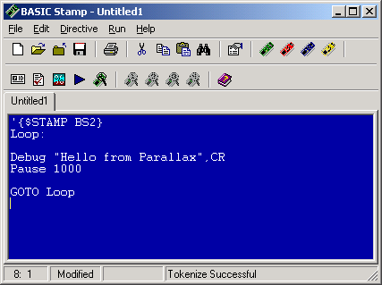
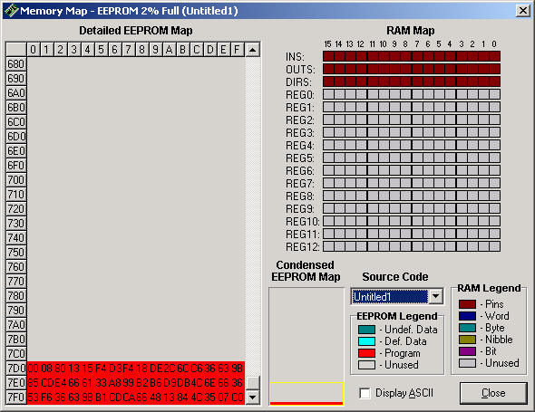
Memory Map
The Memory Map button will open the BASIC Stamp window.
This window shows how program (EEPROM) and variable memory (RAM) is being utilized.
Note that the program is stored in memory from bottom-up.
RAM Memory:
I/O Control
RAM Memory:
Variables
EEPROM Memory: Program space of tokenized program

Slide 43
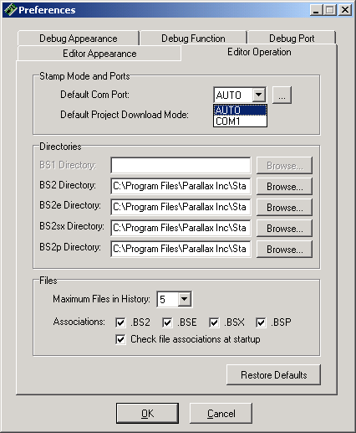
Preferences
Under the Preferences button you may:
Change color, font, and tab spacing for the text editor and debug screen.
Set the COM port on which the stamp is connected to, or be in automatic detection mode.
Modify the DEBUG settings.
You are encouraged to look through the available settings to become familiar with them.

Slide 44
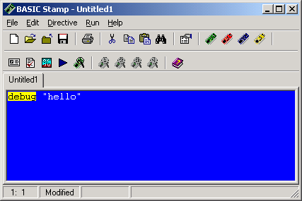
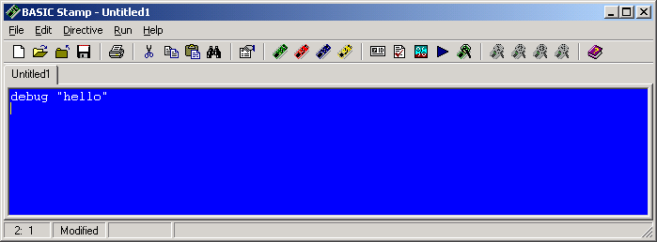
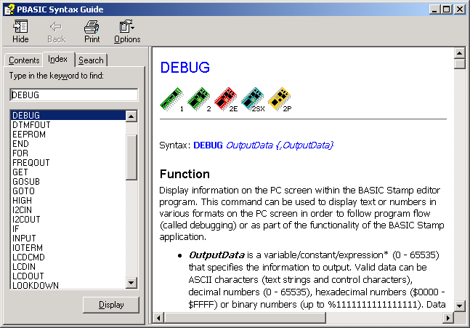
Help Files
There exists a help file that is very thorough at assisting you with any problems or questions you might have about instruction syntax or use while programming.
By highlighting an instruction and pressing F1, the help files will open to display information on that instruction.
Help provides a description, syntax (format) and example for each instruction.

Slide 45
Instruction Syntax Convention
BASIC Stamp instructions follow a common code convention for parameters (parts) of instructions.
Take for example the FREQOUT instructions, which may be used to generate tones from a speaker: FREQOUT Pin, Period, Freq1 {, Freq2}
The instruction requires that the Pin, Period, and Freq1 is supplied and that each are separated by commas.
Optionally, the user MAY provide Freq2 indicated by braces { }.
While PBASIC is NOT case-sensitive, the common convention is to capitalize instructions, and use 1st letter upper-case for all other code.

Slide 46
End of Section 3

Slide 47
Section 4: Input, Output, and Processing
Inputs, Processing, and Outputs
Stamp I/O
Output - Connecting an LED
Blinking the LED with HIGH, LOW
Blinking the LED with OUTPUT and OUT
Debugging
DEBUG Instruction
DEBUG for Program Flow Information
Using DEBUG ? to Display Status
Digital Inputs
Connecting an Active-Low Switch
Reading the Switch
Controlling Outputs with Inputs
DIRS, INS, OUTS
Reading Analog Values with RCTime
Frequency Output

Slide 48
Inputs, Processing, and Outputs
Any system or program accepts input, process information, and controls outputs.
The BASIC Stamp, and other microcontrollers, specialize in using input devices such as switches, and controlling output devices such as LEDs (Light Emitting Diodes).
A program, written in a form of the BASIC language called PBASIC, is used for processing by writing code that instructs the BS2 what actions to take.
Input
Processing
Output

Slide 49
Stamp I/O
There are 16 I/O (Input/Output) pins on the BS2 labeled P0 to P15. These are the pins through which input and output devices may be connected.
Depending on the code that is written, each pin may act as an input to read a device, or as an output to control a device.
We will begin by using a very common and simple output device, the LED.

Slide 50
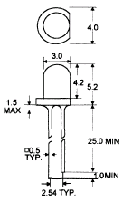
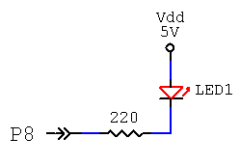
Output - Connecting an LED
Connect an LED to P8 as shown:
In this configuration a LOW, or 0V, at P8 will allow current to flow through the LED to Vdd (+5V) lighting it. When P8 is HIGH (+5V), no current will flow and the LED will not light. The LED is Active Low.
Vdd, NOT Vin.
Note cathode: the ‘flat side’ of LED
Connected on P8. Angle of shot makes it appear
to be on P9.
220 ohm = RED RED BROWN GOLD
An LED is a diode, meaning electrons can flow in only one direction, so polarity is important. The LED should have a flat side indicating the cathode or negative terminal. Also, the anode (positive terminal) generally has a longer lead than the cathode.

Slide 51
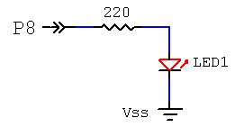
Another configuration that could be used is to have the LED Active-High. In this configuration the LED will light when the output is HIGH, or +5V. Current flows from ground or Vss (0V) to the 5V output on P8.
The 220 resistor will limit current flow to approximately 20mA . The output current from a BS2 pin should be limited to 20mA maximum. The maximum current for an LED is generally 30mA.

Slide 52
Blinking the LED with HIGH, LOW
Use the Stamp Editor to enter the following program:
Download or run the program.
Monitor the LED. It should blink at a rate of 1 second OFF, 5 seconds ON. If not, check your configuration and code.
‘Prog 4A: Blink LED program
Main:
HIGH 8 'Turn off LED
PAUSE 1000 'Wait 1 second
LOW 8 'Turn on LED
PAUSE 5000 'Wait 5 seconds
GOTO Main 'Jump back to beginning

Slide 53
Code Discussion
HIGH defines the pin to be an output and sets it to a HIGH state, digital 1 or 5V.
HIGH pin 0-15
HIGH 8
LOW defines the pin to be an output and sets it to a LOW state, digital 0 or 0V.
LOW pin 0-15
LOW 8
PAUSE instructs the BS2 to wait for the defined number of milliseconds (1/1000 seconds).
PAUSE time in milliseconds 0-65535
PAUSE 1000
GOTO instructs the BS2 to jump to the defined label. More about this will be covered in Programming Structures.
GOTO Label

Slide 54
Blinking the LED with OUTPUT and OUT
The HIGH and LOW instructions perform 2 actions:
Sets direction of the I/O pin to an output.
Sets the state of the output to be 0 or 1 (0V or 5V)
Another means to perform the same process is to use code to set the direction, then the state.
Enter and run this example.
' Prog 4B: Blink LED program using OUTPUT and OUT
OUTPUT 8 'Set P8 to be an output
Main:
OUT8 = 1 'Turn off LED1
PAUSE 1000 'Wait 1 second
OUT8 = 0 'Turn on LED1
PAUSE 5000 'Wait 5 seconds
GOTO Main 'Jump back to beginning

Slide 55
Code Discussion
OUTPUT sets the pin to act as an output.
OUTPUT pin
OUTPUT 8
The BS2 on startup sets all I/O pins to inputs.
OUT sets the state of the output.
OUTpin = 1 or 0
OUT8 = 1
1 sets the output HIGH (5V – Digital High or 1).
0 sets the output LOW (0V – Digital Low or 0).
Depending on program need, sometimes it is better to use the HIGH and LOW instructions, and other times to use OUTPUT and OUT.

Slide 56
Challenge 4A: Blink a 2nd LED
Connect a second active-low LED2 on P9.
Code a program to blink only this LED using HIGH and LOW instructions.
Code a program to blink only this LED using OUTPUT and OUT instructions.
Solution
Solution
Solution

Slide 57
Challenge 4B: LED Cycling
Code a program to perform the following sequence (use HIGH and LOW):
LED1 on P8 ON, LED2 on P9 OFF
Wait 2 seconds
LED1 on P8 ON, LED2 on P9 ON
Wait 1 second
Both LEDs OFF
Wait one-half second
Repeat
Solution

Slide 58
Debugging
Debugging refers to the act of finding errors in code and correcting them. There are 2 types of errors which can be made when coding: Syntax errors and Logical errors.
Syntax errors are those that occur when the editor/compiler does not understand the code written. An example would be: GO TO Main The PBASIC tokenizer, which takes our code and puts it in a form the BS2 understands, does not have an instruction called GO TO (it has one called GOTO). This section of code would be flagged as having a syntax problem, which we identify and correct.

Slide 59
Logical errors are those which have a valid syntax, but fail to perform the action we desire. For example, our program runs, but it seems the LED is off an abnormally long time. Looking at the code we find the bug: PAUSE 50000 instead of PAUSE 5000. The PBASIC compiler was perfectly happy with a 50 second pause, but logically it was not what we wanted to happen.
Syntax errors are easily flagged when we try to run the program. Logical errors are more difficult because they require the programmer to analyze the code and what is occurring to determine the ‘bug’.

Slide 60
DEBUG Instruction
The DEBUG instruction provides a valuable tool for the programmer.
It provides a means of real-time feedback in debugging to:
Observe program execution.
Observe program values.
It also allows the programmer to use a very sophisticated output device – A computer monitor.
When a DEBUG instruction used, the Stamp Editor’s DEBUG window will open and display the data.

Slide 61
When we run, or download, a program to the BS2, the program is transferred serially from Stamp Editor though a serial COM port to the BASIC Stamp.
Using the same serial connection, the BS2 can transfer data back to the Stamp Editor to be displayed.
Throughout this tutorial we will use DEBUG for various indications and describe the syntax used.

Slide 62
DEBUG for Program Flow Information
Sometimes it is difficult to analyze a problem in the code because we have no indication where in the program the BS2 is currently at. A simple DEBUG in the code can provide feedback as to flow.
DEBUG “A description of code to be performed”,CR CR is short for carriage return to move the cursor to the next line.
DEBUG could be used to help identify the ‘bug’ where 50000 was typed instead of 5000.

Slide 63
By placing some key DEBUG statements, we can observe the flow of the program. Of course, in most cases you may want to only place a DEBUG in the most likely areas based on observation.
'Prog 4C: Blink LED program with DEBUG location
OUTPUT 8 'Set P8 to output
Main:
DEBUG " Turn Off LED",CR
OUT8 = 1 'Turn off LED
DEBUG " Wait 1 second",CR
PAUSE 1000 'Wait 1 second
DEBUG " Turn Off LED",CR
OUT8 = 0 'Turn on LED
DEBUG " Wait 5 seconds",CR
PAUSE 50000 'Wait 5 seconds
DEBUG " Go repeat program",CR
GOTO Main 'Jump back to beginning

Slide 64
Using DEBUG ? to Display Status
Another simple use of DEBUG is to indicate the status of an output or input.
DEBUG ? OUTpin
Say for example the P8 LED was not lighting. Is it a code problem (OUT8 not going low?) or an electronics problem (LED in backwards?).
Using DEBUG in key spots, the status of P8 can be verified.
'Prog 4D: Blink LED program with DEBUG value
Main:
HIGH 8 'Turn off LED1
DEBUG ? OUT8 PAUSE 1000 'Wait 1 second
LOW 8 'Turn on LED1
DEBUG ? OUT8
PAUSE 5000 'Wait 5 seconds
GOTO Main 'Jump back to beginning

Slide 65
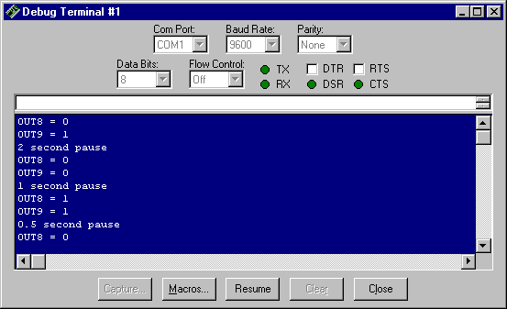
Challenge 4C: Debugging
Modify the code from Challenge 4B to indicate the status of P8 and P9 and describe the number of seconds of the pause.
Example output:
Solution

Slide 66
Digital Inputs
Just as P0 – P15 on the BASIC Stamp can act as outputs to control devices, they can act as inputs to read devices, such as switches.
By default, the BASIC Stamp I/O pins will act as inputs unless specifically set to be an output. In our code we specify the I/O as inputs out of good programming habits.
INPUT pin
INPUT 10

Slide 67
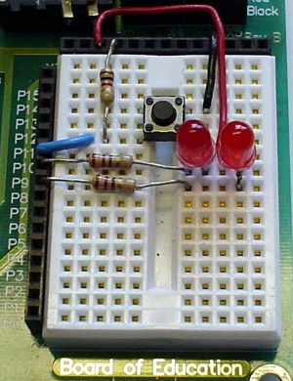
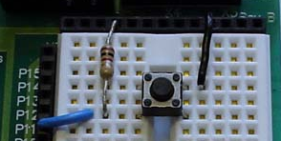
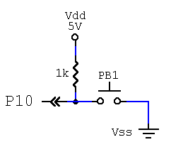
Connecting an Active-Low Switch
Connect a push-button switch to P10 as shown:
The push-buttons used in this tutorial have 4 terminals. 2 are electrically connected on one side of the button, and the other 2 on the other side. By wiring to opposing corners we ensure the proper connection independent of button rotation.
1K = Brown Black Red Gold
The push-button is a momentary normally-open (N.O.) switch. When the button IS NOT pressed (open), P10 will sense Vdd (5V, HIGH, 1) because it is pulled-up to Vdd.
When PB1 IS pressed (closed), P10 will sense Vss (0V, LOW, 0) making it Active-Low.
Button alone

Slide 68
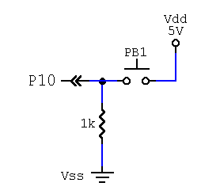
Active-High Push-Button Switch
Another configuration that could have been used is shown here. Notice that the position of the switch and resistor have been reversed.
When the button IS NOT pressed (open), P10 will sense Vss (0V, LOW, 0) because it is pulled-down to Vss.
When PB1 IS pressed (closed), P10 will sense Vdd (5V, HIGH, 1) making it Active-High.
The BASIC Stamp has uncommitted inputs. That is, when an I/O pin is not connected and acting as an input, it cannot be assured to be either HIGH or LOW. Pull-up and pull-down resistors are needed to commit the input to the non-active (open) state for switches.
The 1K resistor is used to prevent a short-circuit between Vdd and Vss when the switch is closed.

Slide 69
Reading the Switch
The digital value of an input can be read using the INpin instruction.
A 1 or 0 will be returned indicating a HIGH or LOW state on the input.
This program uses DEBUG to display the digital value. Enter and Run the program. Note the value displayed when the push-button is in the down and up states.
'Prog 4E: Display the status of PB1 on P10
INPUT 10 'Set P10 to be an input
Main:
DEBUG ? IN10 'Display status of P10
PAUSE 500 'Short pause
GOTO Main 'Jump back to beginning

Slide 70
Challenge 4D: Reading a 2nd Button
Add a second active-low push-button switch on P11.
Code a program to display the status of only PB2 on P11.
Code a program to display the status of BOTH switches.
Solution
Solution
Solution

Slide 71
Controlling Outputs with Inputs
Now that we can control outputs and read inputs, it's time to perform a little processing and put the pieces together.
The state of an input may be read with INpin.
The state of an output may be controlled with OUTpin.
Here is a program that will use the input pushbutton PB1 on P10 to control output LED1 on P8.
'Prog 4F: Controlling LED1 with input PB1
INPUT 10 'Set P10 to be an input
OUTPUT 8 'Set P8 to be an output
Main:
OUT8 = IN10 'Set LED1 = PB1
GOTO Main 'Jump back to beginning

Slide 72
Challenge 4E: Switch & LED Control
Code a program that will control LED2 on P9 with PB2 on P11.
Code a program that will control: LED1 on P8 with PB2 on P11 LED2 on P9 with PB1 on P10
Code a program that will control: LED1 and LED 2 on P8 and P9 with button PB1 on P10.
Solution
Solution
Solution

Slide 73
DIRS, INS, OUTS
Up to this point I/O have been set as inputs or outputs, and states set or read individually.
Looking at the Memory Map, there are 3 16-bit registers which set the direction for the I/O, and which are read or written to.
Note: The colors of these registers are not affected by the code.
IN10 reads the value in the 10th bit (P10) of INS.
OUT9 =1 sets the output state in the OUTS register for bit 9 (P9).
OUTPUT 8 sets bit 8 (P8) for output in the DIRS register. This may also be written as DIR8=1 (1=output, 0 = input).

Slide 74
The I/O can also be addressed as nibbles, bytes or the entire word.
IN15 OUT15 DIR15
IN0 OUT0 DIR0
TO
As BITS
IND OUTD DIRD
INC OUTC DIRC
INB OUTB DIRB
INA OUTA DIRA
As NIBBLES
(High Byte) INH OUTH DIRH
(Low Byte) INL OUTL DIRL
As BYTES
INS OUTS DIRS
As 16-Bit WORDS

Slide 75
In our circuit, there are output devices on P8 and P9, and input devices on P10 and P11. P8 – P11 make up nibble C.
The direction of the I/O can be set as a nibble with: DIRC = %0011 in binary. It may also be written as DIRC = 3 in decimal, but the binary form is much easier to read for determining individual bit states.
This will set the DIRS nibble C for input (P11), input (P10), output (P9), output (P8).
Note that the bit positions are most-significant bit (MSB) to least-significant bit (LSB).

Slide 76
Some various examples to illustrate the flexibility, code savings, and increased speed possibilities:
To read the entire lower byte (P0-P7) as inputs: DIRL=%00000000 X = INL
To count up in binary on 8 LEDs connected on P8 to P15: DIRH = %11111111 FOR X = 0 to 255 OUTH = X NEXT
To set 4 outputs on P4-P7 equal to 4 inputs on P12-P15: DIRS = %0000000011110000 OUTB = INDD

Slide 77
Reading Analog Values with RCTime
A very simple method of bringing analog data into the BASIC Stamp is through the use of an instruction called RCTime.
RCTime requires a capacitor and a resistor network, either of which may be variable (adjustable). Common variable resistance devices include:
Variable-Turn Resistors (Potentiometers)
Photo-Resistors
Temperature sensing devices such as thermistors
Using RCTime with any of these devices can provide real-time analog data input.

Slide 78



Connecting the RC Network
Connect the Resistor-Capacitor (RC) network:
Resistor, capacitor and center pin of potentiometer on same row.
RC Network alone
Full Circuit with RC Network
RCTime measures the time to charge the capacitor through the resistor. The higher the resistance, the longer the time. For a full discussion on RCTime, please see your editor help files or BASIC Stamp Manual.
Notes:
Add 220 ohm from P7 to node

Slide 79
RCTime Code
Enter and run the following code.
Adjust the resistor full each direction and monitor the value. The full range should be approximately 0-5000.
'Prog 4G: Monitoring RCTime
Pot VAR WORD 'Variable to hold results
Main:
HIGH 7 'Discharge network
PAUSE 1 'Time to fully discharge
RCTIME 7,1,Pot 'Read charge time and store in Pot
DEBUG ? Pot 'Display value of Pot
PAUSE 500 'Short pause
GOTO Main 'Jump back to beginning

Slide 80
RCTime Code Discussion
Pot VAR WORD defines a variable named Pot. More about variables will be discussed in the next section.
HIGH 7 places +5V on pin 7, discharging the capacitor.
PAUSE 1 provides time to allow the capacitor to fully discharge.
RCTIME 7,1,Pot instructs the BS2 to time on pin 7 how long it takes leave the specified state (1) and store the results into the variable Pot.
RCTIME pin, state, variable

Slide 81

RCTime Graph
Begin RCTime sensing
HIGH 7
Threshold Crossed
PAUSE 1
Time to cross
Measured at P7
In digital, a HIGH (1) or LOW (0) is commonly denoted by Vdd or Vss (5V and 0V), but there exists a threshold voltage, above which the controller senses a HIGH, and below which the controller senses a low.
The threshold voltage for the BASIC Stamp is around 1.7V.
1V/div
Vss
0.5mS/div

Slide 82

RCTime Graph Comparison
With a high resistance, the current is low and the capacitor takes a relatively long time to charge.
As resistance decreases the current increases allowing the capacitor to charge more quickly.
A value proportional to the time to reach the new state is stored.

Slide 83


Frequency Output
The PBASIC instruction FREQOUT can be used to easily drive a speaker for sound-effects.
Connect the components to the circuit.
NOTE: If you are using the BASIC Stamp
Activity Board, the speaker is on P11. You will need to adjust the code used in
this part accordingly.

Slide 84
Frequency Output Code
Enter and run the following code:
If all went well you should be hearing a tone.
The syntax of FREQOUT is:
FREQOUT pin, duration in milliseconds, frequency in Hertz
The allowable duration and frequency is 0 – 32767 though your speaker will only have decent tone generation between 500-4000Hz or so.
'Prog 4G: Simple Frequency Generation
'Activity Board -- use FREQOUT 11 for pin 11.
Main:
FREQOUT 1, 2000, 1000 'Tone at 1000Hz for 2 seconds
PAUSE 1000 'Short pause
GOTO Main 'Jump back to beginning

Slide 85
Challenge 4F: Variable Frequency Control
Combine what was learned in using RCTIME and FREQOUT to code a program which changes the tone of the speaker in relation to the potentiometer setting.
Hint
Solution

Slide 86
End of Section 4

Slide 87
Section 5: Variables and Aliases
Variables
RAM Memory
Variable Types
Variable Declaration
Variable Conventions
Coding with Variables
Constants
Coding with Constants
I/O Aliases
Coding using I/O Aliases
Common Circuit Declarations

Slide 88
Variables Overview
Variables are needed when a program requires a value to be stored.
Variables correspond to a memory location which we can read from and write to (Random Access Memory – RAM).
Variables allow the programmer to use descriptive words to indicate the contents of the memory location.
Aliases may also be declared for I/O control to allow descriptive words to indicate device connections.

Slide 89


RAM Memory
Once a program in entered, the Memory Map button on the toolbar may be clicked to view the contents of the code memory (EEPROM Map) and the variable memory (RAM Map).
In the BS2, the code space is 2K bytes (2048 bytes) in size and fills from the bottom up.
The RAM for variable storage is 26 bytes in size.

Slide 90
INS, OUTS and DIRS are the registers (RAM locations) which hold the status of the I/O pins.
REG0 – REG12 are 16-bit registers (word sized) used for general variable storage.
The variable registers may hold:
13 16-bit variables (Words)
26 8-bit variables (Bytes)
52 4-bit variables (Nibbles)
208 1-bit variables (Bits)
OR
Any combination of the above within memory size constraints.

Slide 91
Variable Types
A variable may be declared to be a word, byte, nibble or bit. To maximize the limited memory, programmers use the smallest size that will meet the needs of the variable requirements.
The maximum number of unique states (modulus) for each size is: 2^{n} where n is the number of bits. i.e.: A byte, with 8 bits, has 2⁸ unique values or 256.
In binary, the maximum value for each size is: 2^{n}-1 where n is the number of bits. i.e.: A byte, with 8 bits, can hold 0 to 2⁸-1, or 0 to 255.
Bit | 2¹ | 0 or 1
Nibble (Nib) | 2⁴ | 0 to 15
Byte | 2⁸ | 0 to 255
16-bit Word | 2¹⁶ | 0 to 65535 unsigned -32768 to +32767 signed

Slide 92
Variable Declaration
A variable in PBASIC is declared with the syntax of: variableName VAR size
For example, the following will declare a variable named 'Temperature' and allocate a byte of memory for it. This 8-bit location can be used to hold values between 0 and 255. Temperature VAR BYTE
'Prog 5A: Test of variable declaration
' *************** Declare Variables
Temperature VAR BYTE
My_Count VAR WORD
Switch1 VAR BIT
ButtonNum VAR NIB
Temperature = 100

Slide 93

Open the Memory Map to see how the RAM was allocated for the various declarations:
Temperature 8-bit Byte
My_Count 16-bit Word
ButtonNum 4-bit Nibble
Switch1 1-bit
Memory is allocated top to bottom, left to right from largest variables to smallest independent of the order declared.

Slide 94
Variables can be read and modified. Enter and run the following code. Monitor the values of each as to when they overflow the limits of their size.
'Prog 5B: Test of variable sizes
' *********************** Declare Variables
ByteCount VAR BYTE
WordCount VAR WORD
BitCount VAR BIT
NibCount VAR NIB
Main:
WordCount = WordCount + 1000 'Add to each variable
ByteCount = ByteCount + 20
NibCount = NibCount + 1
BitCount = BitCount + 1
DEBUG CLS 'Clear the screen
DEBUG ? WordCount : DEBUG ? ByteCount: DEBUG ? NibCount: DEBUG ? BitCount
PAUSE 500
GOTO Main
Colons may be used to separate instructions on a single line

Slide 95
Variable Conventions
Good variable naming and commenting is important and there are certain rules in naming:
Variables cannot contain special characters such as !,@,$ except for an underscore, _. My_Variable
Variables may contain numbers but cannot start with a number. Freq1
Variable names cannot be a PBASIC instruction.
Variables should have descriptive names. Generally, capitalize the 1st character of each word. CountOfPresses
Declare all variables at the top of your code and comment their use.
Size the variable appropriate to its use conserving memory whenever possible.
Re-use variables for common tasks such as multiple loops in the code.

Slide 96
'Sample program with variables
' ****************** Declarations **************************
' ****************** Variables
x VAR BYTE 'General use variable
PressCount VAR WORD 'Holds number of times button is pressed
Pot_Value VAR WORD 'Value of Pot from RCTIME
Switch1 VAR BIT 'Value of switch 1
All the variables in the above code fragment are legally named and follow good convention.
Examples of illegal variable names:
My Count Space in name
1Switch Starts with a value
Stop! Invalid name character
Count PBASIC instruction
Due to space constraints, the tutorial examples may be briefer in commenting than good practice dictates.

Slide 97
Challenge 5A: Variable Naming
Declare variables for the following requirements:
To hold the number of seconds in a minute.
To hold the number of dogs in a litter.
To hold the count of cars in a 50 car garage.
To hold the status of an output.
To hold the indoor temperature.
To hold the temperature of a kitchen oven.
Solution

Slide 98
Coding with Variables
To assign a variable a value, an equation sets it equal to a value: VariableName = value
Once assigned a value, variables may be used in place of values for any number of purposes.
Enter and test this program by slowly and quickly adjusting the potentiometer.
'Prog 5C: Play tone based on amount of potentiometer movement
'Activity board users use FREQOUT 11 instead of 1
'****************** Declarations ************************
'****************** Variables
Pot_Current VAR WORD 'Current value of potentiometer
Pot_Last VAR WORD 'Last value of potentiometer
Freq_Play VAR WORD 'Tone to sound speaker
Main:
HIGH 7: PAUSE 1 ' Read Potentiometer using RCTIME
RCTIME 7,1,Pot_Current ' and store as current pot value
Freq_Play = Pot_Current - Pot_Last ' Determine amount of change since last reading
FREQOUT 1,500,Freq_Play ' Play tone based on change
Pot_Last = Pot_Current ' Save current pot value for last value
GOTO Main

Slide 99
Constants
Constants provide the ability to assign names to values that do not change. They allow an easier reading of code.
Unlike variables, which are used at run-time, constants are used when the program is compiled or tokenized and use no additional memory.
Common uses of constants:
Naming of I/O pin numbers.
Naming of values which will not change such as PI (Note: the BS2 operates on whole numbers only).
Constant names follow the same rules as variables and are declared as follows: constantName CON value
An example may be in Program 5C of naming the pin to which the speaker is connected: Speaker CON 1

Slide 100
Coding with Constants
In fact, let's clean up program 5C using constants.
By using constants the code is more readable, and if we need to change a pin connection, only the constant value needs to be updated.
'Prog 5D: Play tone based on amount of potentiometer movement using constants
'****************** Declarations ************************
'****************** Variables
Pot_Current VAR WORD 'Current value of potentiometer
Pot_Last VAR WORD 'Last value of potentiometer
Freq_Play VAR WORD 'Tone to sound speaker
'****************** Constants
Speaker CON 1 ' Speaker pin (Activity board users use 11)
PotPin CON 7 ' Potentiometer pin
SpeakerDur CON 500 ' Duration to sound speaker
Main:
HIGH PotPin : PAUSE 1 ' Read Potentiometer using RCTIME
RCTIME PotPin,1,Pot_Current ' and store as current pot value
Freq_Play = Pot_Current - Pot_Last ' Determine amount of chance since last reading
FREQOUT Speaker, SpeakerDur, Freq_Play ' Play tone based on change
Pot_Last = Pot_Current ' Save current pot value for last value
GOTO Main

Slide 101
Challenge 5B: LED Constants
Below is the challenge solution to blink 2 LEDs. Modify the code to use constant names for LED pin connections.
'** 4B Challenge Solution – Blink second LED **
Main:
LOW 8 'LED1 on
HIGH 9 'LED2 off
PAUSE 2000 'Wait 2 seconds
LOW 9 'LED2 ON (P9 LED stays on)
PAUSE 1000 'Wait 1 second
HIGH 8 'LED1 off
HIGH 9 'LED2 off
PAUSE 500 'Wait one-half second
GOTO Main
Solution

Slide 102
I/O Aliases
Just as names can be assigned to RAM memory locations using the VAR instruction, VAR can be used to assign names to the status of I/O when using the IN and OUT instructions. This creates an alias name for the I/O. AliasName VAR INpin AliasName VAR OUTpin
Example: PB1 VAR IN10
This allows for cleaner code and does not use any additional memory.

Slide 103
Coding using I/O Aliases
Let's modify a previous program to make it a bit more readable using I/O aliases.
Notice that OUTPUT and INPUT could not be made more readable without first assigning constants to the pin numbers.
'{$STAMP BS2}
'Prog 5E: Controlling output LED1 with PB1 using I/O Variables
' **************** Declarations **************
' **************** I/O Aliases
PB1 VAR IN10 ' Pushbutton input pin
LED1 VAR OUT8 ' LED1 output pin
'**************** Set I/O Directions
INPUT 10 'Set P10 to be an input
OUTPUT 8 'Set P8 to be an output
Main:
LED1 = PB1 'Set LED state = pushbutton state
GOTO Main 'Jump back to beginning

Slide 104
Challenge 5C: I/O Aliases
Code a program that will control: LED2 on P9 with the PB1 on P10 LED1 on P8 with the PB2 on P11
Solution

Slide 105
Common Circuit Declarations
For the remainder of this section, a common section of declarations will apply to all the programs to minimize the amount of coding and space required.
In some cases an LED may be controlled with HIGH and LOW, other times it may be controlled with IN and OUT. Note that these 2 uses require 2 different variables. If only LED1 VAR OUT8 were used, a line of code such as HIGH LED1 would really mean HIGH 1 or HIGH 0 since LED1 would return the value of OUT8.

Slide 106
' *********Section 5 Common Circuit Declarations ***********
' ***************** I/O Aliases *******************
LED1 VAR OUT8 'LED 1 pin I/O
LED2 VAR OUT9 'LED 2 pin I/O
PB1 VAR IN10 'Pushbutton 1 pin I/O
PB2 VAR IN11 'Pushbutton 2 pin I/O
Pot VAR WORD ‘Potentiometer value
' **************** Constants ************************
LED1_Pin CON 8 ' Constant to hold pin number of LED 1
LED2_Pin CON 9 ' Constant to hold pin number of LED 2
PB1_Pin CON 10 ' Constant to hold pin number of pushbutton 1
PB2_Pin CON 11 ' Constant to hold pin number of pushbutton 2
Speaker CON 1 ' Speaker Pin ***** Activity board users set to 11 ******
Pot_Pin CON 7 ' Input for Potentiometer RCTIME network
PB_On CON 0 ' Constant for state of pressed switch (Active-Low)
PB_Off CON 1 ' Constant for state of un-pressed switch
LED_On CON 0 ' Constant for state to light an LED (Active-Low)
LED_Off CON 1 ' Constant for state to turn off an LED
' **************** Set common I/O directions ********
OUTPUT LED1_Pin 'Set pin for LED1 to be an output
OUTPUT LED2_Pin 'Set pin for LED2 to be an output
INPUT PB1_Pin 'Set pin for pushbutton 1 to be an input
INPUT PB2_Pin 'Set pin for pushbutton 2 to be an input
' **************** Example uses ***********************
'LED2 = LED_On 'OUT9 = 0
'LED1 = PB1 'OUT8 = IN10
'HIGH LED1_Pin 'HIGH 8

Slide 107
End of Section 5

Slide 108
Section 6: Program Flow
Introduction to Flow
Program Planning – Pseudo-Code & Flowcharts
Sequential Flow
Sequential Flow Example
Branching Overview
Looping with GOTO
Looping Flow Example
Conditionals Overview
IF-THEN
IF-THEN Example: Alarm
Looping with a Counter
Repeating Alarm
FOR-NEXT
Repeating Alarm with FOR-Loop
Speaker Tone with FOR-Loop
Subroutines
Cleaner Coding with GOSUBS
Sounding Alarms with GOSUB
Using the BRANCH Instruction
Saving Power – END & Sleep

Slide 109
Introduction to Flow
The programs in the tutorial have been relatively easy and follow a sequence of steps from top to bottom. At the end of each program, GOTO Main has been used to loop the program back to the start.
Virtually all microcontroller programs will continually repeat since they are typically embedded in processes to be operated continually.
Sequential flow (top to bottom), looping, unconditional branching, and conditional branching will be explored in this section.

Slide 110
Program Planning – Pseudo-Code & Flowcharts
Depending on your proficiency, a little planning can help a lot in developing programs.
Plan your device placement carefully for good layout and utilization of I/O.
Decide on variables needed for storage or manipulation.
Plan the flow of your program. Use pseudo-code and/or flowcharts to structure the code properly.

Slide 111
Pseudo-Code
Pseudo-Code are English statements describing what steps the program will take. They are not programmable code, but a guide in writing the code.
For example, a program is needed to control the temperature of an incubator at 101F. Without even knowing code, a general outline can be made in pseudo-code.

Slide 112
Start of program
Measure temperature
Temperature < 100 F?
Yes, Turn on heat
Temperature > 102 F?
Yes, Turn on cooling fan
Go back to start.

Slide 113
Flowcharts
Flowcharts are means of developing the flow of a program visually.
Symbols are used to indicate the type of operation.
Start/Stop | Input/Output | Process
Decision | Connector | Pre-Defined Process

Slide 114
Start
Measure Temperature
Temp. < 100
Energize Heater
Temp. > 102
Energize Fan
Start

Slide 115
Sequential Flow
Sequential flow of code begins at the top with the first instruction, then the next in line, then the next and so on.
When there exist logical errors in the code, one of the best means is to manually step through it by looking at each line and analyzing what it performs, then moving to the next appropriate line. At some point the programmer may see a flaw in the flow of the program.
Sequential flow is the easiest to program and debug.

Slide 116
Sequential Flow Example
Flowchart:
Pseudo-Code:
Start of program
Turn off LED 1
Turn off LED 2
Pause for 2 seconds
Light LED 1
Pause for 2 seconds
Light LED 2
End of program
Start
Code:
Turn OFF LED1
' <<<< INSERT COMMON
' CIRCUIT DECLARATIONS >>>>
'Prog 6A: Example of sequential flow
' ****** Main program ************
LED1 = LED_Off 'Turn off LED 1
LED2 = LED_Off 'Turn off LED 2
PAUSE 2000 'Pause for 2 sec.
LED1 = LED_On 'Light LED 1
PAUSE 2000 'Pause for 2 sec.
LED2 = LED_On 'Light LED 2
END
Turn OFF LED2
2 Second Pause
Turn ON LED1
2 Second Pause
Turn ON LED2
End

Slide 117
Sequential Flow Example Discussion
In all three, the flow of the program was from the top to the bottom with no branches, loops, or decisions. Even though most programs will contain loops and branches, sections of the program will be sequential.
The previous program only performs the routine once, because there is no looping. It will perform the routine when the program is downloaded (ran) or any time the BS2 is reset.
After the program is complete, the circuit speaker may click and the LED’s may blink briefly.
In many cases, the code comments may be the flowchart text or pseudo-code descriptions.

Slide 118
Challenge 6A : Sequential Code
Write and test code for the following operation (use the common circuit variables and constants).
START
LED1 OFF
LED1 ON
LED2 OFF
Sound Speaker at 1000Hz for 2 sec.
Sound Speaker at 1000Hz for 2 sec.
LED2 ON
Solution
END

Slide 119
Branching Overview - GOTO
Branching is the act of breaking out of a sequence to perform code in another location of the program.
The simplest form of branching is to use the GOTO instruction: GOTO label
A label is a name given to a certain location in the program. The labels follow the same naming convention that variables and constants do. They should be representative of the code to be performed.

Slide 120
Looping with GOTO
Looping is the act of repeating a section of code.
Our programs in section 4 used looping with GOTOs extensively so the programs would repeat.
Let's modify program 6A to include looping.

Slide 121
Looping Flow Example
Flowchart:
Code:
Pseudo-Code:
Start of program
Turn off LED 1
Turn off LED 2
Pause for 2 seconds
Light LED 1
Pause for 2 seconds
Light LED 2
Go back to start
Start
Turn OFF LED1
' <<<< INSERT COMMON
' CIRCUIT DECLARATIONS >>>>
'Prog 6B: Example of sequential flow
' with looping
' ****** Main program ************
Main:
LED1 = LED_Off 'Turn off LED 1
LED2 = LED_Off 'Turn off LED 2
PAUSE 2000 'Pause for 2 sec.
LED1 = LED_On 'Light LED 1
PAUSE 2000 'Pause for 2 sec.
LED2 = LED_On 'Light LED 2
GOTO Main 'Repeat sequence
Turn OFF LED2
2 Second Pause
Turn ON LED1
2 Second Pause
Turn ON LED2

Slide 122
Looping Flow Discussion
' <<<< INSERT COMMON
' CIRCUIT DECLARATIONS >>>>
'Prog 6B: Example of sequential flow
' with looping
' ****** Main program ************
Main:
LED1 = LED_Off 'Turn off LED 1
LED2 = LED_Off 'Turn off LED 2
PAUSE 2000 'Pause for 2 sec.
LED1 = LED_On 'Light LED 1
PAUSE 2000 'Pause for 2 sec.
LED2 = LED_On 'Light LED 2
GOTO Main 'Repeat sequence
The program will be in a continual loop.
Enter and run the program.
Is the lighting of LED 2 noticeable? Why not? How could the program be modified to be better?
Execution begins
Sequence of steps
Branch back to main for loop

Slide 123
Conditionals Overview
The previous example is an unconditional branch; the program will branch back to Main regardless of any code parameters.
In a conditional branch a decision is made based on a current condition to branch or not to branch.
As humans, we constantly make decisions based on input as to what to perform. Shower too cold? Turn up the hot. Shower too hot? Turn down the hot water.
Microcontrollers can be programmed to act based on current conditions. Switch closed? Sound an alarm!

Slide 124
IF-THEN
The IF-THEN is the primary means of conditional branching. IF condition THEN addressLabel
If the condition is evaluated to be true, execution will branch to the named address label.
If the condition is not true, execution will continue to the next step in the program sequence.
A condition is typically an equality: value1 = value2 value1 > value2 value1 < value2 IN8 = 1
Compared to many versions of BASIC and other languages, the PBASIC implementation of the IF-THEN is fairly limited.

Slide 125
IF-THEN Example: Alarm
This program will sound the alarm as long as pushbutton 1 is pressed.
Flowchart
Program Code
Main
' <<<< INSERT SECTION 5 COMMON
' CIRCUIT DECLARATIONS >>>>
'Prog 6C: Conditional Branching Alarm
Main:
' If pushbutton 1 is pressed,
' then go sound alarm
IF PB1 = PB_On THEN Alarm
GOTO Main
Alarm:
'Sound the alarm
FREQOUT Speaker, 1000, 2000
GOTO Main
Button 1 Pressed
Pseudo-Code
False
True
Start:
Is button 1 pressed?
Yes, Go sound Alarm
No, Go back to start
Alarm
Sound speaker
Go back to start of program
Speaker 2000Hz for 1 second
Main

Slide 126
IF-THEN Code Discussion
Without button 1 pressed, the condition would be false, (PB1 = 1, PB_On = 0) and the flow of our code would follow this path:
Execution begins
Main:
' If switch 1 is pressed,
' then go sound alarm
IF PB1 = PB_On THEN Alarm
GOTO Main
Alarm:
'Sound the alarm
FREQOUT Speaker, 1000, 2000
GOTO Main
Condition is false, continue to next line
Go back to start of program
And so it would repeat as long as the switch is not pressed.

Slide 127
With button 1 pressed, the condition would be true (PB1 = 0, PB_On = 0) and the flow of our code would follow this path:
Execution begins
Main:
' If switch 1 is pressed,
' then go sound alarm
IF PB1 = PB_On THEN Alarm
GOTO Main
Alarm:
'Sound the alarm
FREQOUT Speaker, 1000, 2000
GOTO Main
Condition is true, GOTO the address label of alarm
Follow the sequence
Go back to start of program
And so it would repeat as long as the button is pressed.

Slide 128
Challenge 6B: Potentiometer Alarm
Code a program to perform the following:
If the value of the potentiometer is greater than 2000, sound the speaker at 2000 Hz for 1 second.
If the value of the potentiometer is less than 1000, sound the speaker at 1000 Hz for 0.5 seconds.
Use the flowchart in programming your code.
Main
Read Potentiometer
Pot > 2000
True
Sound speaker 2000Hz for 1 second
Main
False
Solution
False
Pot < 1000
True
Sound speaker 1000Hz for 0.5 second
Main

Slide 129
Challenge 6C: Lock-in Alarm
Code a program that will sound a 2000Hz, 1 second tone if PB1 is pressed. The alarm will lock-in and repeat until PB2 is pressed. Follow the following flowchart.
Main
Pushbutton 1 Pressed
Sound speaker 2000Hz for 1 Second
False
True
Pause 0.5 Seconds
Pushbutton 2 Pressed
False
True
Solution
Main

Slide 130
Looping with a Counter
In many circumstances a program needs to keep count of an event, such as the number of times a button is pressed. A counter may also be used to perform an action a specific number of times.
A counter is simply a variable which is incremented or decremented each instance (typically by 1).
Steps in using counters:
Declare a variable for the counter
Reset or initialize the counter
Update the counter
Act upon value of count

Slide 131
Repeating Alarm
This example uses a counter to sound the speaker 5 times when PB1 is pressed.
Main
False
Pushbutton 1 Pressed
True
Set Counter to 0
' <<<< INSERT SECTION 5 CIRCUIT DECLARATIONS
'Prog 6D: Looping with counter Alarm
Counter VAR NIB 'Variable for counting
Main:
' If pushbutton 1 is pressed,
' then go sound alarm
IF PB1 = PB_On THEN Alarm
GOTO Main
Alarm:
Counter = 0 'Initialize counter
Alarm_Again:
FREQOUT Speaker, 500, 2000 'Sound the alarm
PAUSE 500
Counter = Counter + 1 'Increment Counter
IF Counter < 5 THEN Alarm_Again 'Check counter
GOTO Main
Sound Speaker 200Hz for 0.5 Seconds
Increment Counter by 1
Pause for 0.5 Seconds
True
Counter < 5
False
Main

Slide 132
Repeating Alarm Major Points
' <<<< INSERT SECTION 5 CIRCUIT DECLARATIONS
'Prog 6D: Looping with counter Alarm
Counter VAR NIB 'Variable for counting
Main:
' If pushbutton 1 is pressed,
' then go sound alarm
IF PB1 = PB_On THEN Alarm
GOTO Main
Alarm:
Counter = 0 'Initialize counter
Alarm_Again:
FREQOUT Speaker, 500, 2000 'Sound the alarm
PAUSE 500
Counter = Counter + 1 'Increment Counter
IF Counter < 5 THEN Alarm_Again 'Check counter
GOTO Main
A variable appropriately sized is declared.
Counter is reset to 0
Upon entering routine.
Counter is updated within loop.
Counter is checked. If not at full count, loop back AFTER the reset point.
Insert DEBUG ? Counter after the update to view the count

Slide 133
FOR-NEXT
Since looping routines using counters is so prevalent, a specialized loop called the FOR-Loop or FOR-NEXT can be used in many instances.
The general structure of a FOR-Loop is:
FOR variable = start_value TO end_value 'Block of code to be repeated
NEXT
The above example will increment or update by +1 each repetition starting from the start_value to the end_value. An optional STEP value may be used to update by other increments:
FOR variable = start_value TO end_value STEP value 'Block of code to be repeated
NEXT

Slide 134
Repeating Alarm with FOR-Loop
This example uses a FOR-Loop counter to sound the speaker 5 times when PB1 is pressed.
Main
False
Pushbutton 1 Pressed
True
' <<<< INSERT SECTION 5 COMMON CIRCUIT DECLARATIONS >>>>>>
'Prog 6E: Looping with Counter Alarm using FOR-Loop
Counter VAR NIB 'Variable for counting
Main:
' If pushbutton 1 is pressed, then go sound alarm
IF PB1 = PB_On THEN Alarm
GOTO Main
Alarm:
FOR Counter = 0 to 4
FREQOUT Speaker, 500, 2000 'Sound the alarm
PAUSE 500
NEXT
GOTO Main
Set Counter to 0
Sound Speaker 200Hz for 0.5 Seconds
Increment Counter by 1
Pause for 0.5 Seconds
True
Counter < 5
False
Main
Note that the flowchart has not changed, only the method to code it.

Slide 135
Repeating Alarm with FOR-Loop Major Points
' <<<< INSERT SECTION 5 COMMON CIRCUIT DECLARATIONS
'Prog 6E: Looping with Counter Alarm using FOR-Loop
Counter VAR NIB 'Variable for counting
Main:
' If pushbutton 1 is pressed,
' then go sound alarm
IF PB1 = PB_On THEN Alarm
GOTO Main
Alarm:
FOR Counter = 0 to 4
FREQOUT Speaker, 500, 2000 'Sound the alarm
PAUSE 500
NEXT
GOTO Main
A variable appropriately sized is declared.
Counter is set to start value (0) upon start of FOR-Loop
Counter is updated by 1. If the count has not exceeded the end value (4), repeat sequence.

Slide 136
Speaker Tone with FOR-Loop
The counter value in the FOR-Loop is often used within the code. Enter and run this example. Analyze it to determine how it works.
' <<<< INSERT SECTION 5 COMMON CIRCUIT DECLARATIONS >>>>
'Prog. 6F: Using FOR-Loop for frequency generation
Freq VAR WORD
FOR Freq = 500 to 4000 Step 100
FREQOUT Speaker, 50, Freq
NEXT
END

Slide 137
Challenge 6D: Count to Presses with FOR-Loop
Code a program that will keep track of the total number of times PB1 was pressed, and sound that number of tones (pressed once→ one beep, pressed twice → two beeps, etc) up to 15. A flow chart is provided to guide you. Use a FOR-Loop and a variable to keep track of total times pressed.
Main
Sound Speaker 2000Hz for 0.5 Seconds
False
Pushbutton 1 Pressed
Increment Counter by 1
True
Increment Presses by 1
Pause for 0.5 Seconds
Set Counter to 0
Counter <= Presses
True
Solution
False
Main

Slide 138
Subroutine Overview
So far in the examples a GOTO has been used to branch to another routine. When the code in the routine is complete, a GOTO was used to go to a specific label, namely Main.
Often times a routine is called by multiple locations in a program, but instead of always branching back to a specific location, we need to the code to return to where it branched from.
A GOSUB is a special type of branching instruction to call a routine. When the routine is complete, execution returns to the next statement after a call.
The routine called by a GOSUB is known as a subroutine (GO SUBroutine).

Slide 139
The basic structure and flow of a GOSUB call is:
code before
GOSUB address_label
code after
address_label: subroutine code
RETURN
1. Call the subroutine
2. Process the subroutine
3.Return from the subroutine
Every GOSUB must end with a RETURN. The return points are maintained in what is called a stack. GOSUBs add to the stack, RETURNs take from the stack. GOSUBs without returns cause the stack to overflow and cause problems. Have you ever had your computer crash due to a 'Stack Overflow'?

Slide 140
Cleaner Coding with GOSUBS
A good program should be easy to read. Often the main loop only consists of GOSUB calls. The subroutines perform various actions required by the program. By reading through the main loop, the basic operation of the program can often be determined.
Main: GOSUB ReadInputDevice GOSUB ControlOutputDevice
GOTO Main
ReadInputDevice: 'code
RETURN
ControlOutputDevice: 'code
RETURN
Another good practice is to write subroutines that fit entirely on a single screen (25 lines) for easier reading and debugging.

Slide 141
Sounding Alarms with GOSUB
This program uses GOSUBs to sound the speaker if either pushbutton is pressed.
The 'Pre-Defined Process' block is used to denote a subroutine call, which is written as separate routine.
Main
Check Button 1
Check Button 1
Button 1 Pressed
True
False
Set Freq to 1000
Check Button 2
Sound Speaker
Return
Check Button 2
Sound Speaker
Button 2 Pressed
True
Sound Speaker at Freq for 1 second
False
Set Freq to 2000
Sound Speaker
Return
Return

Slide 142
' <<<< INSERT SECTION 5 COMMON CIRCUIT DECLARATIONS
'Prog 6G: Sounding alarm with GOSUBs
Freq VAR Word
Main:
GOSUB Check_PB1 'Call subroutine for PB1
GOSUB Check_PB2 'Call subroutine for PB2
GOTO Main
Check_PB1: ' *** Sound alarm if PB1 pressed
If PB1 = PB_Off THEN Check1_Done ' If NOT pressed, jump
Freq = 1000 ' Set Tone GOSUB Sound_Speaker ' over GOSUB
Check1_Done:
RETURN
Check_PB2: ' *** Sound alarm if PB2 pressed
If PB2 = PB_Off THEN Check2_Done ' If NOT pressed, jump Freq = 2000 ' Set Tone
GOSUB Sound_Speaker ' over GOSUB
Check2_Done:
RETURN
Sound_Speaker: ' *** Sound speaker for alarm
FREQOUT Speaker, 1000,Freq 'Sound speaker
RETURN
Enter and run.
Since the conditional IF-THEN calls a routine directly the code jumps over the GOSUB if the button is NOT pressed.
With structured code it is easier to read and modify individual routines and add routines.

Slide 143
Flow with no buttons pressed.
Main:
GOSUB Check_PB1 'Call subroutine for PB1
GOSUB Check_PB2 'Call subroutine for PB2
GOTO Main
Check_PB1: ' *** Sound alarm if PB1 pressed
If PB1 = PB_Off THEN Check1_Done 'If NOT pressed, jump
GOSUB Sound_Speaker ' over GOSUB
Check1_Done:
RETURN
Check_PB2: ' *** Sound alarm if PB2 pressed
If PB2 = PB_Off THEN Check2_Done 'If NOT pressed, jump
GOSUB Sound_Speaker ' over GOSUB
Check2_Done:
RETURN
Sound_Speaker: ' *** Sound speaker for alarm
FREQOUT Speaker, 1000,2000 'Sound speaker
RETURN

Slide 144
Flow with PB1 pressed
Main:
GOSUB Check_PB1 'Call subroutine for PB1
GOSUB Check_PB2 'Call subroutine for PB2
GOTO Main
Check_PB1: ' *** Sound alarm if PB1 pressed
If PB1 = PB_Off THEN Check1_Done 'If NOT pressed, jump
GOSUB Sound_Speaker ' over GOSUB
Check1_Done:
RETURN
Check_PB2: ' *** Sound alarm if PB2 pressed
If PB2 = PB_Off THEN Check2_Done 'If NOT pressed, jump
GOSUB Sound_Speaker ' over GOSUB
Check2_Done:
RETURN
Sound_Speaker: ' *** Sound speaker for alarm
FREQOUT Speaker, 1000,2000 'Sound speaker
RETURN

Slide 145
Challenge 6E: Adding a Subroutine Routine
Add an alarm-operational indicator to Program 6G.
Code a subroutine to light LED1 for 0.25 seconds. Call the subroutine from your main loop.
Draw the modified main loop and new routine in flowchart form.
NOTE: The controller may operate so quickly you may not discern the LED blinking. Add a one second pause in the main loop to help see the blink.
Solution

Slide 146
Using the BRANCH Instruction
It is common for programs to need to take a different action based on the value of some variable. Using IF-THEN’s a sample program snippet may be:
The BRANCH instruction may be used for much simpler (and memory-saving) way:
IF X=0 THEN Routine0 IF X=1 THEN Routine1 IF X=2 THEN Routine2 … and so on
BRANCH X,[Routine0,Routine1,Routine2]

Slide 147
The structure of BRANCH is: BRANCH offset,[label0,label1,label2…]
Based on the value of the offset (0 to 255), execution will branch to the defined label.
BRANCH X, [Label0, Label1, Label2]
Label0: … Label1: … Label2: …
X = 0
X = 1
X = 2

Slide 148
The following program will use PB1 to increment a variable, Press_Count, to a maximum value of 3 and branch to a routine based on X.
' <<<< COMMON CIRCUIT DECLARATIONS ‘Prog 6H: Using BRANCH for display and sounds Press_Count VAR NIB
X VAR BYTE
Main:
GOSUB Butn_UP_Count 'Go check if PB1 pressed
GOSUB Run_Routine 'Go run routine for sounds/display
GOTO Main
Butn_Up_Count:
IF PB1 = PB_OFF THEN End_Up_Count 'If button not pressed, end routine
FREQOUT Speaker,500,4000 'Beep speaker to indicate button is down
Press_Count = Press_Count + 1 'Add one to count
IF Press_Count <4 THEN End_Up_Count 'If < 4, ok, otherwise reset
Press_Count = 0 'Reset count to 0
END_Up_Count:
Return 'Return from routine
Code continues on next screen

Slide 149
Run_Routine:
BRANCH Press_Count, [Blink, Wink, Cycle, Quiet] 'Branch based on offset
Return
Blink: 'Routine blinks LEDs and plays one tone
TOGGLE LED1_Pin : TOGGLE LED2_Pin
FREQOUT Speaker, 100,500
PAUSE 250
Return
Wink: 'Routine winks each LED and plays 2 tones
LED1 = LED_On : LED2 = LED_Off
FREQOUT Speaker, 500,4000
LED1 = LED_Off : LED2 = LED_On
FREQOUT Speaker, 500,2000
Return
Cycle: 'Blinks LED and cycles frequency up
FOR X = 1 to 20
TOGGLE LED1_PIN TOGGLE LED2_PIN
FREQOUT Speaker, X * 10, 200 * X
NEXT
PAUSE 500
Return
Quiet: 'Peaceful silence
LED1 = LED_Off : LED2 = LED_Off
PAUSE 500
Return
In Program 6H, as PB1 is pressed, the LEDs and speaker will provide 4 unique behaviors.

Slide 150
Challenge 6F: Adding a Branch Routine
Add a 5th routine unique routine to Program 6H.
Solution

Slide 151
Saving Power – END & SLEEP
We may not think much about the power used by the BS2 when running off a wall outlet, but when running on batteries it doesn't take long to deplete them.
If our program doesn't need to operate continually, we can END it saving power.
Also, our program may not need to be performing tasks continually. There may be times it may 'sleep' saving power.

Slide 152
END
When the BS2 is running and performing instructions, it uses 8mA of current.
By ending a program (using END), the BS2 goes into a low power mode and stops all instruction processing, consuming only 40uA of current. That's 200 times less current. Note: This current draw does NOT take into account any loads being driven, such as LEDs.
The BS2 will not wake again until power is cycled or it is reset.

Slide 153
Sleep
Sleep allows the BASIC Stamp to go into a low power mode for a set period of time. Sleep Period
Period is the amount of seconds to sleep, rounded up to the nearest 2.3 seconds.
When 'Sleeping' the BASIC Stamp will wake momentarily every 2.3 seconds. During this time, all I/O will be switched back to inputs momentarily. This may have negative effects in some systems.
In many cases, PAUSE can be replaced with SLEEP to conserve power.

Slide 154
End of Section 6

Slide 155
Section 7: Math and Data Operations
Math Overview
DEBUG Modifiers
Basic Math Operations
Integer Math and Variable Sizes
Precedence of Operations
Maximum Workspace Limit
Signed Math Operations
Boolean Operations and Math
Boolean Evaluations
Bitwise Boolean Operators
LOOKUP Table
Writing and Reading EEPROM
DATA Statement

Slide 156
Math Overview
The BASIC Stamp can perform many math operations. Some important limitations are:
The BASIC Stamp operates in integer math, meaning it does not calculate with decimal places.
In order to store negative values, WORD sized variables are required. Not all math operations support negative values.
The largest value of intermediate math operations is 65,535.
Math operations in a line of code are performed from left to right, not based on operator precedence, though parenthesis may be used for precedence.
There are ways around many math limitation discussed in this section, but they are beyond the scope of this tutorial.

Slide 157
DEBUG Modifiers
So far this tutorial has been using DEBUG ? to display the contents of I/O or variables.
The DEBUG instruction is quite flexible in the way it can display and format data by using modifiers.
Data may be displayed as:
ASCII characters (No modifier).
Decimal values (DEC).
Hexadecimal values (HEX).
Binary values (BIN).

Slide 158
DEBUG Modifies Examples
Modifier Code | Output | Explanation
DEBUG 65 | A | ASCII Value
DEBUG DEC 65 | 65 | Decimal Value
DEBUG SDEC -65 | -65 | Signed Decimal
DEBUG BIN 65 | 1000001 | Binary
DEBUG IBIN 65 | %1000001 | Indicated Binary - %
DEBUG IBIN8 65 | %01000001 | Indicated Binary with 8 places
DEBUG IHEX2 65 | $41 | Indicated Hexadecimal -$ with 2 places

Slide 159
DEBUG Formatting
Strings of text may be displayed by enclosing in Double-Quotes. DEBUG "Hello"
Use predefined constants for formatting lines and the screen: CR – Carriage Return to move to next line. HOME – Cursor to home position. CLS – Clear Screen
Separate multiple values with commas. DEBUG CLS,"The value is ", DEC 65, CR

Slide 160
DEBUG Values Example
'Prog 7A: Displaying values from Potentiometer
'Adjust potentiometer to view values.
Pot VAR WORD
Main:
HIGH 7 : PAUSE 10 'Prepare capacitor
RCTIME 7,1,Pot 'Read RC Time
Pot = Pot / 20 'Scale
'Display Header
DEBUG CLS, "ASCII VALUE BINARY HEXADECIMAL", CR
'Display Values
DEBUG Pot," ", DEC3 Pot, " ", IBIN8 Pot, " ", IHEX2 Pot
PAUSE 1000
GOTO Main

Slide 161
Basic Math Operations
The BASIC Stamp can perform many math operations, such as:
+ Add
- Subtract
* Multiple
/ Divide
Operations can be used in assignment to a variable: X = Y * 2
Operations may also be used in instructions such as DEBUG: DEBUG DEC Y * 2

Slide 162
Integer Math and Variable Sizes
The BASIC Stamp works in Integer Math, that is it does not compute with decimal places. DEBUG DEC 100 / 3 Result: 33
When assigning data to variables, ensure the variable is large enough to hold the result. X VAR BYTE X = 100 X = X * 3 DEBUG DEC X Result: 44. Why?

Slide 163
Precedence of Operations
Math operations are performed from left to right of the equation and NOT based on precedence of operators. DEBUG DEC 10 + 5 * 2 Result: 30
Parenthesis may be used to set precedence in calculations. DEBUG DEC 10 + ( 5 * 2 ) Result: 20

Slide 164
Maximum Workspace Limit
The maximum value for any intermediate operation is 65,535. Care should be taken when performing complex calculations to ensure this value is not exceeded: DEBUG DEC 5000 * 100 / 500 Result: 82 → 5000 * 100 exceeded limit.
Grouping will not help in this case: DEBUG DEC 5000 * (100 / 500) Result: 0 → (100/500) is 0.2, or integer 0.
Write the equation to prevent overflow or underflow without losing too much accuracy: DEBUG DEC 5000 / 500 * 100 Result: 1000

Slide 165
Signed Math Operations
The BASIC Stamp can work with negative values:
Word sized variables must be used to hold results for a range of –32,768 to +32,767.
Operations on negative values is limited, and generally should only be used with +, - and * when working with signed values.
Use the DEBUG SDEC (signed decimal) modifier to view signed values. X VAR WORD X = 100 * -20 DEBUG SDEC X,CR Result: -2000

Slide 166
Some Other Math Functions
PBASIC has a variety of other math functions. The following is a partial list.
ABS | Returns the absolute value | DEBUG DEC ABS -50 Result: 50
SIN, COS | Returns trigonometric value in binary radians from -128 to 128 over 0 to 360 degrees | DEBUG DEC SIN 180 Result: -122
SQR | Returns the square root integer value. | DEBUG DEC SQR 100 Result: 10
MIN, MAX | Returns the value limited to the specified minimum or maximum. | X = 80 DEBUG DEC X MIN 100 Result: 100
// | Modulus -- Returns the remainder. What is left after all the possible whole quantities are taken out? | DEBUG DEC 40 // 6 Result: 4 (40-36)

Slide 167

Challenge 7A: Scaling the Potentiometer
Scale the input data from the potentiometer to display its position in degrees from 0 at the minimum position to 300 (or what you feel is appropriate for the movement of your potentiometer) at the maximum position.
Show the value in the DEBUG window as a decimal value with 3 places ( i.e: 090 ).
Always display the data on the 1st line of the DEBUG window.
Hint: To scale the data, multiply the value by the new maximum and divide by the old maximum, but be careful of the math constraints!
Due to the non-linearity of the RCTIME results, your program will not be entirely accurate.
Solution

Slide 168
Boolean Operations and Math
The BASIC Stamp can perform Boolean operations in 2 ways:
Evaluation of expressions
Bit manipulation
States:
A state can either be considered TRUE or FALSE, or the bit states of 1 and 0 respectively.
If an input returns a 1, it would be considered to be TRUE.

Slide 169
Summary of Boolean Operation
T = TRUE (or 1) F = FALSE (or 0)
NOT | Inverts the state | F = NOT T T = NOT F
AND | All must be true for the result to be true (need this AND that). | F = F AND F F = F AND T F = T AND F T = T AND T
OR | Any must be true for the result to be true (need this OR that) | F = F OR F T = F OR T T = T OR F T = T OR 1
XOR | Exclusive OR: Either, but not both, must be true for the result to be true | F = F XOR F T = F XOR T T = T XOR F F = T XOR T

Slide 170
Boolean Evaluations
AND, OR and XOR may be used in IF-THEN statements to evaluate multiple conditions.
In an IF-THEN, a value is true if it is greater than 0.
IF PB1 THEN Routine ' True if button is not pressed (Active-Low)
IF Pot THEN Routine ' True if Pot > 0
Comparisons are evaluated to be 1 or True when the condition is met.
IF (PB1=PB_On) THEN Routine ' True if button is pressed ' (0 = 0 for Active Low)
IF (POT > 1000) THEN Routine ' True if potentiometer > 1000

Slide 171
Using Boolean math, the results of individual evaluations are combined using the logic rules for an overall result.
The following program will sound the speaker when BOTH pushbuttons are pressed (PB1 AND PB2 must be pressed).
'Program 7A: Boolean Evaluations
'*** Insert Common Circuit Declarations ***
Main:
'Sound Alarm if both buttons are pressed
IF (PB1=PB_On) AND (PB2=PB_On) THEN Alarm
GOTO Main
Alarm:
FREQOUT Speaker,100,2000
GOTO Main

Slide 172
If neither button is pressed: (PB1=PB_On) AND (PB2=PB_On)
1 = 0
1 = 0
False
False
False AND False = False
If only PB1 button is pressed: (PB1=PB_On) AND (PB2=PB_On)
0 = 0
1 = 0
True
False
True AND False = False
If both buttons are pressed: (PB1=PB_On) AND (PB2=PB_On)
0 = 0
0 = 0
True
True
True AND True = True

Slide 173
Challenge 7B:Boolean Evaluations
Use AND and OR evaluations:
Modify Program 7A to sound the alarm when either button is pressed.
Modify Program 7A to sound the alarm if the potentiometer is greater than 500 or PB1 is pressed.
Modify Program 7A to sound the alarm if the potentiometer is greater than 500 but only if PB2 is not pressed.
Solution
Solution
Solution

Slide 174
Bitwise Boolean Operators
While AND, OR, NOT and XOR may be used to evaluate expressions, there exist the Bitwise Boolean operators which may be used to evaluate or modify groups of bits.
The bitwise operators also perform AND, OR, NOT and XOR, but on one or more bits in a nibble, byte or word length value in binary.

Slide 175
Each bit in one expression is logically evaluated with the same bit position in a second expression.
Take for example: %1010 | %1110 (| = OR) Each bit in the first nibble is OR'd with the same bit position in the second nibble (% indicates a binary value).
%1010
%1110
%1110
Where either column has a 1, the result has a 1.

Slide 176
The following are the bitwise operators: & = AND | = OR (Typically Shift \ Key to get a bar - |) ^ = XOR ~ = NOT
What would be the result of %1111 & %0100 ? Click for answer.
%0100

Slide 177
Inverting an Input
One common use is to invert the state of a Active-Low input: IF IN8 = 0 THEN ….
It just doesn't seem 'natural' in programming sometimes to be active-low. When a button is pressed, it is more natural to want a HIGH than a LOW (active-low buttons and LEDs are common because of electrical properties of many devices).
By using a bitwise NOT to invert the data: IF ~IN8 = 1 THEN ….

Slide 178
Masking BITs
Bit masking is used to force a single bit, or bits, in a byte to a certain state using the Boolean bit-wise operators.
For example, given any byte value, bit position 3 (starting with 0) may be force on with: ByteVal = ByteVal | %00001000.
Program 7B will count from 0 to 255 in binary, and use the various operators for masking. Note the effect of the mask for each.

Slide 179
'Prog. 7B – Byte Masking X VAR BYTE
MASK CON %00111100
DEBUG CLS
Main:
FOR X = 0 TO 255
DEBUG HOME, " AND & OR | XOR ^",CR
DEBUG " VALUE ",IBIN8 X," ",IBIN8 X," ",IBIN8 X,CR
DEBUG " MASK ",IBIN8 MASK," ",IBIN8 MASK," ",IBIN8 MASK,CR
DEBUG "RESULT ",IBIN8 X & MASK," ",IBIN8 X | MASK," ",IBIN8 X^MASK,CR
PAUSE 1000
NEXT
GOTO Main

Slide 180

Use & 0 to force a bit LOW, | 1 to force a bit HIGH, and ^ 1 to complement (toggle) a bit.
The BASIC Stamp works in bits naturally, and can actually change any bit state using a Bit modifier: ByteVal.BIT3 = 1.
Masking is used more heavily in microprocessor based systems which are not bit-oriented.

Slide 181
LOOKUP Table
A Lookup table is similar to branching in that a table is indexed, but in this case a value is stored in the variable. LOOKUP index,[value0,value2,…],variable
For example, given the following: LOOKUP I,[85,123,210,15],R If I = 0, 85 would be stored in R If I = 1, 123 would be stored in R and so on….
0

Slide 182
Playing a Tune with Lookup
This program uses a table to look up 29 notes used to play a song. Notice how constants are used to define the frequency for each note.
Can you recognize the song?
'Prog. 7C – Playing a tune with LOOKUP I VAR BYTE ' Counter for position in tune.
Freq VAR WORD ' Frequency of note for Freqout.
C CON 523 ' C note
D CON 587 ' D note
E CON 659 ' E note
G CON 784 ' G note
R CON 0 ' Silent pause (rest).
FOR I = 0 to 28 ' Play the 29 notes of the Lookup table.
LOOKUP I, [E,D,C,D,E,E,E,R,D,D,D,R,E,G,G,R,E,D,C,D,E,E,E,E,D,D,E,D,C], Freq
FREQOUT 1,350,Freq ' *** Use 11 instead of 1 for Activity Board
NEXT

Slide 183
Challenge 7D: Playing Charge! Using Lookup
The following program plays the Charge! Tune.
Write a new program that uses 2 lookup tables to get the note's frequency AND duration and plays the tune (don't worry about using note constants).
Speaker CON 1 '11 for Activity board
FREQOUT Speaker, 150, 1120
FREQOUT Speaker, 150, 1476
FREQOUT Speaker, 150, 1856
FREQOUT Speaker, 300, 2204
FREQOUT Speaker, 9, 255
FREQOUT Speaker, 200,1856
FREQOUT Speaker, 600, 2204
Solution
There also exists an instruction called LOOKDOWN. Use your help files to investigate the use of this instruction!

Slide 184
Writing and Reading EEPROM
Data is typically stored using variables in RAM memory. RAM is volatile memory, in that when power is lost, the contents of RAM is destroyed.
EEPROM memory is persistent in that it will maintain its contents in the event of a power failure. In fact, this is where your BS2 program is stored.
WRITE and READ are instructions that allow the programmer to store and recall data in this non-volatile memory.

Slide 185
WRITE allows the storage of a byte value into a memory address: WRITE address, byte value
READ reads the contents of a memory address and stores it into the specified variable READ address, variable
EEPROM has a finite number of WRITE cycles ( > 1000). Continual, long term-use of WRITE is not recommended.

Slide 186

'Store 10 in address 1 WRITE 1,10
'Read contents of address 1 'and store in variable X READ 1, X
10
There are 2048 memory locations in the BS2.
Program memory is stored from bottom of memory up. Writing over program space will corrupt your program.
Memory address are shown in Hexadecimal. Hex may be used in memory addresses:
10
'Store 10 in address $0FF WRITE $0FF,10

Slide 187
Testing READ and WRITE
Enter and run the Program 7D on the next slide. program.
It will display the current contents of the 1st 10 memory locations, write new values to those address, and re-read.
Power down and back up the BASIC Stamp. Note that the values have not changed when power was removed.
The Memory Map window of the Editor does NOT show changes to memory caused by WRITE.

Slide 188
'Program 7D: Reading and Writing to EEPROM
Addr VAR BYTE
Value VAR BYTE
DEBUG CR,"READING MEMORY ",CR :
GOSUB ReadMemory
PAUSE 2000 : DEBUG CR,"WRITING VALUES TO EEPROM ",CR
GOSUB WriteMemory
PAUSE 2000 : DEBUG CR,"READING MEMORY AGAIN ",CR
GOSUB ReadMemory
END
ReadMemory: FOR Addr = 0 TO 9 ' Cycle through 10 addresses
READ Addr, Value ' Read value from EEPROM address, store in Value
DEBUG DEC Value," " ' Display contents of Value
NEXT RETURN
WriteMemory: FOR Addr = 0 TO 9 ' Cycle through 10 addresses
Value = Addr ' Set value equal to address to get a unique value
WRITE Addr, Value ' Store contents of Value into EEPROM address
NEXT
RETURN

Slide 189
Storing a tune in EEPROM
Program 7E puts READ and WRITE to use by storing notes (frequency values) in EEPROM memory to be played back as a 'tune'. Once the program is running:
Adjust the potentiometer to a desired frequency.
Press PB1 to store the note. LED1 will blink.
Store as many notes as you desire (up to 255).
Press PB2 to play your tune.
Power down and up, press PB2 to play your tune again.
You may test your tune, then store more notes.
When storing a note, the next address is filled with a 0 to mark the end of tune.
Since the address is defined as a byte variable, the maximum number of notes is 256 and well clear of the program storage area.

Slide 190
' Prog 7E: Stores notes for creating a tune. ' INSERT COMMON CIRCUIT DECLARATIONS Addr VAR BYTE 'EEPROM Address
Freq VAR WORD 'Frequency
LED1 = LED_Off : LED2 = LED_Off
Main:
GOSUB FindTone
IF PB1=PB_ON THEN StoreNote
IF PB2=PB_ON THEN PlayTune
GOTO Main
FindTone: 'Play note based on pot. Position
HIGH Pot_PIN : PAUSE 1
RCTIME Pot_Pin,1, Freq
FREQOUT Speaker, 500, Freq
RETURN
StoreNote: ' Store freq. In EEPROM.
' Divide by 25 to condense to byte
WRITE Addr, Freq / 25 MIN 1 MAX 255
Addr = Addr + 1 ' Next address
WRITE Addr, 0 ' Store 0 to mark end
LED1 = LED_On ' Blink LED1
PAUSE 500 : LED1 = LED_Off
GOTO Main
PlayTune:
LED2 = LED_On 'Turn on LED2
PAUSE 1000
Addr = 0 ' Start of EEPROM
TuneLoop:
READ Addr, Freq 'Read EEPROM
IF Freq = 0 THEN EndTune ' 0 = end of tune
FREQOUT Speaker, 500,Freq * 25 'Play note
Addr = Addr + 1 ' Increment and do next note
GOTO TuneLoop
EndTune:
PAUSE 2000
LED2 = LED_Off 'LED2 off
GOTO Main

Slide 191
DATA Statement
The DATA statement may used to predefine the contents of EEPROM memory locations. The general format of a DATA Statement is: Label DATA value, value, value or Label DATA "String" The use of Labels is optional: DATA "String"
The values specified are stored starting at the 'top' (address 0) of the BASIC Stamp's EEPROM unless a starting address is provided: Label DATA @address,"String"
The starting EEPROM address may then be accessed by use of the READ instruction: READ 0,variable READ Label, variable
Label points to the STARTING address. Subsequent addresses can be accessed by adding to the starting address: READ Label+1, variable

Slide 192


' Prog. 7F: Using DATA to store
X VAR NIB
Value VAR BYTE
' Store string starting at address 0 ' or next available location
MSG1 DATA "HELLO",CR
' Store string starting at address Hex $20
MSG2 DATA @$020,66,89,69,13
' Loop through and read/display
' data in MSG1
FOR X = 0 to 5
READ MSG1+X, Value
DEBUG Value
NEXT
' Loop through and read/display
' data in MSG1
FOR X = 0 to 3
READ MSG2+X, Value
DEBUG Value
NEXT
Open the Memory Map to see where the data is stored. Note unused bytes in the row are filled with binary 0 (null).
Check 'Display ASCII' to view data as ASCII Characters.

Slide 193
Using DATA for a Phonebook Dialer
The code on the following screen uses DATA Statements to create a phone book program.
The user selects a name using PB1, then dials that person's number using PB2.
The DTMFOUT instruction generates tones used in dialing a telephone. NOTE: This is for simulation only. Refer to your BASIC Stamp Manual for instructions on interfacing the BS2 to the telephone system!

Slide 194
'Prog. 7G: DATA Phonebook Dialer
' INSERT COMMON CIRCUIT DECLARATIONS DATA @$00,"BILL"
DATA @$10,"555-1234"
DATA @$20,"PARALLAX"
DATA @$30,"1-888-512-1024"
DATA @$40,"JIM" DATA @$50,"555-4567"
DATA @$60,0
Name VAR BYTE X VAR BYTE C VAR BYTE Name = $00
Main: DEBUG CLS,"Press PB1 to select name.",CR DEBUG "Press PB2 to dial number.",CR FOR X = 0 TO 15 READ Name+X,C IF C = 0 THEN EndName DEBUG C NEXT EndName: PAUSE 1000 IF PB1=PB_ON THEN NextName IF PB2=PB_ON THEN DialNumber GOTO Main
NextName: Name = Name + $20 READ Name,C IF C <> 0 THEN Main Name = $00
GOTO Main
DialNumber: DEBUG CR FOR X = 0 to 15 READ Name+$10+X,C IF C = 0 THEN EndDIAL DTMFOUT Speaker,[C] DEBUG C NEXT EndDial: PAUSE 1000 GOTO Main

Slide 195
Challenge 7E: Analyze and Modify Phonebook
1) Analyze program 7G and answer the following questions:
How does the program identify the end of the name or number?
How does the program move to the next name in the listing?
How does the program access the correct number to dial?
2) Add an entry for your own name and number and test.
Solution
Solution

Slide 196
Section 8: Data Communications & Control
Data Communications Overview
Parallel Communications
Serial Communications
Synchronous Communications – SHIFTIN
ADC0831 8-Bit Serial A/D
Reading the ADC0831 with SHIFTIN
O-Scope Capture of SHIFTIN
SHIFTOUT
Asynchronous Serial
SERIN Instruction
Controlling the Buzzer's Tone
Typical Asynchronous Timing
RS-232 Standards
SEROUT
Pulse Width Data
Using PULSOUT
O-Scope Capture of PULSOUT
Positioning a Servo with PULSOUT
Pulse Train Capture
PULSIN
Pulse Width Modulation
PWM Instruction
PWM Waveforms
Filtering PWM

Slide 197
Data Communications Overview
Simple devices such as switches, LEDs, and buzzers are pretty simple to control or read since the data is very simple – On or Off.
More sophisticated devices require the transfer of larger amounts of data. These devices include Analog to Digital converters, real time clocks, numerous other devices and, of course, other controllers.

Slide 198
There are 2 primary means to transfer data between devices:
Parallel: All bits are transferred simultaneously. Printers using the Centronics printer port and internal computer data transfers are examples of parallel communication.
Serial: Bits are transferred one at a time. Serial transfer examples include your mouse, USB ports, TV remote controls, and programming of your BASIC Stamp through the serial port.

Slide 199
Parallel Communications
In parallel communications as many data lines are required as needed to transfer the entire 'chunk' of data.
Transferring a nibble? 4 data lines are required.
Transferring a byte? 8 data lines are required.
Transferring a 16-bit word? 16 data lines are required.
Additional lines may be needed for common grounds, synchronization and control.

Slide 200

The image below shows the parallel transfer of a nibble. At any point the individual bits comprise a value.
(MSB) Data 3
Data 2
Data 1
(LSB) Data 0
Binary: 0011 Decimal: 3
Binary: 1101 Decimal: 13
Binary: 1111 Decimal: 15

Slide 201
BASIC Stamp Parallel Communications
In this example, parallel communications will be performed to send data from one BASIC Stamp to another.
In this section, we will be modifying the circuit, and we can use unpopulated boards for this example.
Following this, the board will be re-populated with 1 LED (P8), and the buzzer.

Slide 202
Connect lines between 2 BASIC Stamps as follows:
Stamp #1 – Transmitter P0 P1 P2 P3 Vss
Stamp #2 – Receiver P4 P5 P6 P7 Vss

Slide 203
Program each BASIC Stamp with the appropriate program. Monitor the the DEBUG window from the receiver. Since only 4 bits are used, only 16 unique combinations may be transferred.
' Program 8A-T: Nibble Parallel Transmitter
X VAR NIB 'Variable for counting
DIRA = %1111 'Set nibble A as outputs
'(P0 – P3)
Main:
FOR X = 0 to 15 ' Count 0 to15
OUTA = X ' Place data on Nibble A
PAUSE 500
NEXT
GOTO Main
' Program 8A-R: Nibble Parallel Receiver
Y VAR NIB
DIRB = %0000 ' Set nibble B as inputs
' (P4 - P7)
Main:
Y = INB ' Read nibble B
DEBUG ? Y ' Display incoming data
GOTO Main

Slide 204
When program 8A is ran, and the receiver is monitored, a long stream of 0's, then 1's, then 2's, etc, is seen. This is because there are no means in the example to inform the receiver when it it getting new data.
A control line, or lines, could be used to control flow and have the devices communicate when new data is ready and when it has been read.

Slide 205

Many devices transfer data in parallel formats. An example is the ADC0801 Analog to Digital converter which converts an analog voltage to a Parallel byte.
The ADC0801 has a number of control pins for communication control. Please see an ADC0801 data sheet for more information. Link to datasheet
Analog Voltage In
Digital Data Out

Slide 206
Parallel Transfer Summary
Parallel data transfer is very simple and very fast. Data is simply placed-on or read-from a 'bus'. Microcomputers use parallel data transfers between the microprocessors and all the internal devices such as memory, sound cards, hard drives, CD-ROMS, etc.
A major disadvantage is the large number of lines (and thus I/O) required. This method does not loan itself to communications over any appreciable distance.

Slide 207
Serial Communications
Serial communications sends a 'chunk' of data a single bit at a time. →01101010→ This alleviates the need for numerous data lines, but leads to other problems.
Identify the data bits on the following trace:
Is the data 01? 000111? 00001111? Without more information, we really can't say for sure… and neither can a controller.

Slide 208
In serial communications there are 2 major categories:
Synchronous: Transmitter and receiver are locked and synchronized in the transfer of data.
Asynchronous: Transmitter and receiver are not locked, but in agreement of the transmission timing.

Slide 209
Synchronous Communications - SHIFTIN
In synchronous communications often a separate clock line is used to lock the transmitter and receiver together.
One or the other sends clock pulses indicating individual bit transfers.
We will work with a device that transfers data to the BASIC Stamp using synchronous communications. The ADC0831 serial analog to digital (A/D) converter. Link to data sheet

Slide 210


ADC0831 8-Bit Serial A/D
Connect the ADC0831 as follows:
Note that the IC is placed with top-down (notch at bottom) for easier wiring.
The Activity Board can accept an ADC0831. Note that slightly different I/O are used in the code.
Vin+

Slide 211
The ADC 0831 converts an analog voltage, typically 0-5V, to an 8-bit digital value.
Pin descriptions:
CS: Chip Select – Enables operation. Active low to enable.
Vin+: Analog voltage input to be converted.
Vin-: Negative reference (ground for this circuit).
CLK: Clock pulses are applied here to shift out each bit.
D0: Data Output - Data appears at this output following each clock pulse.
Vref: Upper reference voltage (+5V for this circuit).

Slide 212


Connecting a Temperature Sensor
Now that an A/D is connected, we need some source of voltage to convert. A source could be a voltage divider, a potentiometer, or many varieties of sensors.
One such sensor is the LM34, which converts temperature to a voltage where the output is 0.01V per degree Fahrenheit. At 100F, the output will be 1.0 Volt. Connect the LM34 as indicated.
After connecting, if the LM34 becomes very warm, disconnect and reverse the power leads. (It is common for people to get these backwards). Operational temperature for a common LM34 style is +32F to 300F.
Vdd
Vin+ of ADC0831
Vss
Leaded LM34 from Parallax

Slide 213
Reading the ADC0831 with SHIFTIN
'Prog. 8B: Use SHIFTIN command to read the ADC0831 serial ADC
ADres VAR BYTE ' A/D result (8 bits)
ADcs CON 12 ' A/D enable (low true)
ADdat CON 15 ' A/D data line *** Activity board use 14
ADclk CON 14 ' A/D clock *** Activity board use 15
Main:
LOW ADcs ' Enable ADC
SHIFTIN ADdat,ADclk,msbpost,[ADres\9] ' Shift in the data
HIGH ADcs ' Disable ADC
DEBUG CLS,"Dec: ", DEC ADres ' Display the result in decimal
DEBUG " Bin: ", IBIN8 ADres ' Display the result in binary
' Display in hundredths of volts
' Current Value * New Maximum (500) / Old Maximum (255) or 50/26
DEBUG " Hundredths of Volt = ", DEC ADres * 50/26 ,CR
PAUSE 500 ' Wait a 0.5 Seconds
GOTO Main

Slide 214
A general form of SHIFTIN is: SHIFTIN Dpin, Cpin, Mode, [Variable {\Bits}]
Dpin defines the pin what will contain the data.
Cpin defines the pin that will be used for clocking.
Mode defines the format the data will take in relation to the clock (more on this soon).
Variable is the variable to hold the data being clocked-in.
Bits defines the number of bits to be shifted – thus the number of clock pulses to send.

Slide 215
The example code is: LOW ADcs ' Enable ADC SHIFTIN ADdat,ADclk,msbpost,[ADres\9] ' Shift in the data HIGH ADcs ' Disable ADC
When the SHIFTIN instruction is performed, the BASIC Stamp will send clock pulses on ADclk (P14), accept the data on ADdat (P15), and shift the results into variable ADres for 9 bits. The 1st bit is unused, providing 8 bits of data.
ADcs (P12) is set low to enable the IC.

Slide 216

O-Scope Capture of SHIFTIN
First Pulse
Clock 9 times
P14 – ADclk: Clock line
Read Data after each clock pulse
P15 – ADdat: Data line
ADres =
0 1st bit is not valid data
0 MSB
0
1
0
1
0
1
0 LSB
= decimal 42 * 5V / 255 to scale = 0.82V
At 100uS/Divisions, the data rate is approximately 17,000 bits per second or 17 Kbps

Slide 217
Notice that first a clock pulse was sent, then the data was read on the data line from MSB to LSB. This is why the setting of MSBPOST was used in the SHIFTIN mode. MSB is first data, read after pulse (post).
The other options for the mode are: MSBPRE LSBPOST LSBPRE

Slide 218
Program 8B displays the temperature in hundredths of volts. ADres * 50 / 26 Since 1V = 100F this calculation can also be used to calculate the temperature from the byte value.
With a total maximum range of 0 – 500F, and an 8-Bit A/D which has a maximum value of 255, the resolution of our circuit is: 500 / 255 or 1.96F (2F in integer math)
The LM34 cannot measure 500F, but the A/D is scaled for 0-5V so 500 is used in the calculations.

Slide 219
SHIFTOUT
SHIFTOUT works similarly to SHIFTIN, but is used to send data to a device, such as an external serial EEPROM. SHIFTOUT Dpin, Cpin, Mode, [OutputData {\Bits}]
Note that in both instructions, the BASIC Stamp has control of the clock line.

Slide 220
Synchronous Communications Summary
Using SHIFTIN and SHIFTOUT for synchronous communications, separate clock and data lines are required. The clock is used to signal the position of each bit.
Since a separate line is used for bit position signaling, relatively high data rates can be achieved.
This mode of communication still requires at least 2 lines – Data and Clock.

Slide 221
Challenge 8A: Temperature Alarm
Program the BASIC Stamp to monitor the temperature and alarm the buzzer at 2000Hz for 1 second if a temperature exceeds 100.
Solution

Slide 222
Asynchronous Communications
Using Asynchronous communications, a single line may be used. The position of each bit in the data stream is based upon an agreement in timing between the transmitter and receiver.
This is a very popular form of serial communications between devices, such as the serial port on your computer. When you program the BS2 or use DEBUG, the BASIC Stamp is using RS-232 Asynchronous communication.
Another means is using the SEROUT and SERIN instructions.

Slide 223
SERIN Instruction
A general form of the SERIN instruction is: SEROUT Tpin Baudmode, Timeout, Label,[Variable ]
Where:
Tpin is the pin to transmit out from. 16 may be used to transmit from the programming port.
Baudmode is a value which defines characteristics of the data transmission, such as baud rate.
Timeout is the length of time to wait for data before continuing.
Label defines where to branch to if a timeout occurs.
Variable holds the incoming data.
Let's test a program that uses SERIN to control the frequency of the buzzer.

Slide 224
Controlling the Buzzer's Tone
'Prog. 8C: Use SERIN instruction to control buzzer's tone
Rpin CON 16 ' From programming port
BMode CON 84 ' BAUD mode -- Use 240 for BS2SX, BS2P
MaxTime CON 3000 ' Timeout Value – 3 seconds
Freq VAR WORD ' Hold incoming data
Main:
DEBUG CLS,"Enter a frequency and press return ",CR ' Request Freq
SERIN RPin, BMode, MaxTime, Timeout, [DEC freq] ' Await serial data
DEBUG "Playing tone at ", DEC Freq, "Hz.",CR ' Notify user
FREQOUT 1,1000,Freq ' Play tone
GOTO Main
Timeout:
DEBUG "Timeout!", CR ' Notify user of timeout
PAUSE 500 ' Short wait
GOTO Main

Slide 225

When the program runs, enter a value in the text box and hit Enter.
Notice what occurs when 3 seconds elapses without entering data.

Slide 226
When data is entered in the textbox, it is transmitted from the serial port to the BASIC Stamp which accepts it with the SERIN instruction.
As each character is entered it is seen in the Debug window output because the programming port echoes data back.
The SERIN instruction uses [DEC Freq] to accept a string of characters for a value. If [Freq] were only used, only one character of data would be accepted.
The BASIC Stamp does NOT buffer data. The SERIN instruction must be awaiting data for it to be processed.

Slide 227
When the transmitter sends data, it begins by sending a start-bit, then the data bits (LSB to MSB) at set intervals, and finally a stop-bit to complete the frame of data.
Transmission speeds are described by a BAUD rate. A common BAUD rate is 9600. This correlates to 9600 bits per second for RS-232. The inverse of this value (1/9600) is 104uS which is width of each bit, or bit interval.
The receiver will sense the start-bit:
The first bit will be collected at the 1.5x the interval to be at the center of the first data bit (1.5 x 104uS = 156uS).
Each successive bit will be collected at the transmitted interval.

Slide 228

Typical Asynchronous Timing
Voltage = 5V/Division Time = 200uS/Division
Total byte transmission = 10 * 104uS = 1.04mS
156uS
104
104
104
104
104
104
104
104
Start-Bit
Stop-Bit
1 LSB
0
1
1
0
0
1
0 MSB
Value = 01001101 Binary or 77 Decimal

Slide 229
RS-232 Standards
While serial communication may be performed using any of the standard I/O, they are not fully compliant with the RS-232 standard.
RS-232 defines a logic level 0 as +3 to +25V, and a logic level 1 as –3V to –25V. This is an inverted signal with non-TTL voltage levels.
The programming port has circuitry to invert the signal to make it more RS-232 compliant.
The BS2 can send data as inverted or non-inverted (true). This example used non-inverted since the programming port inverts it with hardware.

Slide 230
Other major factors in defining the transmission are:
Baud Rate – Speed at which the data is transmitted.
Number of data bits – Typically 8.
Number of Stop bits – Typically 1.
Whether Parity is used. Parity is an additional bit sent to check the data frame for errors. Even (E), Odd (O) or None (N) are common choices. Typically error checking is performed in other ways and the parity bit is not used.
A short hand method of summarizing the transmission mode is: Baud Bits-Parity-stop bits 9600 8-N-1

Slide 231

The mode used in transmitting or receiving are defined with a unique number.
The help files summarize common values. Note that since different BS2 styles operate at different speeds, it is important to ensure you are using the correct table.

Slide 232

SEROUT
Just as SERIN can be used to accept data, SEROUT can be used to transmit data. SEROUT Tpin, Baudmode, [OutputData]
In our example, DEBUG was used to send data to the computer. DEBUG is simply a specialized SEROUT which is defined for P16, 9600 8-N-1.
DEBUG also automatically opens the DEBUG window. Using SEROUT we must manually open and configure the DEBUG Window.

Slide 233
Challenge 8B: Using SEROUT
1) Program 8C used DEBUG to send data to the PC.
Replace all DEBUG instructions with SEROUT instructions.
Sample: DEBUG "The value is: ", DEC X,CR
Would become:
SEROUT TPIN, BMode, ["The value is: ", DEC X,CR]
P16 is used for both transmitting and receiving with the
programming port. Test your program with the DEBUG
window.
2) Change the BAUD rate to 1200 BAUD, 8-N-1, True for tranmission and reception. Test.
Solution
Solution

Slide 234
Other SEROUT Uses
Since SEROUT only requires a single line for data transfers, it is a very popular choice for communications.
Data may be easily transferred between BASIC Stamps electrically:
BASIC Stamp #1 P0 Vss
BASIC Stamp #2 P1 Vss
.
.
SEROUT 0,84,[DataOut] .
.
.
.
SERIN 1,84,[DataIn] .
.

Slide 235




Optically, such as using infrared. LINK
Using RF Transmitters/Receivers Link
For Modems Link

Slide 236


For Serial LCD Modules Link
With Motor Controls Link
And many other devices including digital voltmeters and GPS units.

Slide 237
Asynchronous Summary
Asynchronous communications are very popular because of the ability to transfer data with only a single line, making RF, optical and other forms possible easily.
The data transfer is based on agreed timings and other characteristics.
It is good for moderate data transfer speeds.

Slide 238
Pulse Width Data
Sometimes data may be represented by the width of a byte instead of bits within a stream.
Some devices operate on sending or receiving a pulse width.
The BASIC Stamp can generate a pulse using PULSOUT and capture a pulse using PULSIN.

Slide 239
Using PULSOUT
PULSOUT sends a pulse for the defined period. PULSOUT pin, period
The pulse will be the opposite state of the current state of the output.
The period is a value between 1 and 65535. The length of the period is dependent on the style of BS2:
BS2 and BS2E: 2uS
BS2SX: 0.8uS
BS2P: 0.75uS

Slide 240
The following is a simple program to light the LED using PULSOUT over a range of periods.
How would the operation of this circuit be different if it began with LOW 8?
'Prog. 8D – Lighting an LED with PULSOUT
X VAR WORD
HIGH 8 'Start the LED in OFF state
Main:
FOR X = 1 to 65000 STEP 1000
PULSOUT 8, X ' Pulse LED for period of X
DEBUG ? X ' Display value of X
PAUSE 500 ' Short Pause
NEXT
GOTO Main

Slide 241

O-Scope Capture of PULSOUT
With the BS2, a period of 1 is 2uS. If this pulse lasts 20mS (5mS/div), what was the period?
10,000

Slide 242
Positioning a Servo with PULSOUT
A very common use of PULSOUT is in motion control of a servo.
A non-modified servo operates by moving the rotor to an absolute position defined by the length of a pulse.
A pulse width from 1mS to 2mS define a position for the servo between 0 and 180 degrees.

Slide 243

1.5mS Pulses
1.0mS Pulses
2.0mS Pulses

Slide 244

The servos is powered from a high-current Vdd source (+5), though it can handle up to 6V for greater force. The on-chip BS2 regulator does NOT supply sufficient current to drive the servo. If your board has a separate regulator, you will be able to drive the servo.
The pulse stream is directly from a BS2 I/O.

Slide 245
The BOE has headers for direct servo connections from P12-P15.
The power connection to the servo header is Vin. If you are powering your BOE from a source greater than 6V the servo will be damaged. 4AA batteries are the recommended source of power.
Lead Color Code: White Red Black

Slide 246
Controlling Servo Position
With the BS2 and BS2 the period over which the servo is controllable for 1mS – 2mS is 500 to 1000. For the BS2SX and BS2P the period is 1250-2500.
Program 8E uses serial communications with the DEBUG window to allow you to enter the angle to move the servo.
Notice that a pulse train is sent by looping the PULSOUT to provide the servo time to move to the position. A pause of at least 20mS is required between pulses.

Slide 247
'Prog. 8D: Controlling a servo using PULSOUT
Rpin CON 16 ' From programming port
BMode CON 84 ' BAUD mode -- Use 240 for BS2SX, BS2P
MaxTime CON 3000 ' Timeout Value – 3 seconds
Servo CON 13 ' Servo I/O
Angle VAR WORD ' Hold incoming data
Period VAR WORD ' Hold conversion to period
X VAR NIB ' Counting variable
LOW SERVO ' Start I/O out low for HIGH pulses
Main:
DEBUG CLS,"Enter an angle (0-180) and press return ",CR ' Request angle
SERIN RPin, BMode, MaxTime, Timeout, [DEC Angle] ' Await serial data
Period = Angle * 28 / 10 + 500 ' Convert to persiod (BS2/E)
' Period = Angle * 7 + 1250 ' Convert to period (BS2SX/P)
DEBUG ? Period ' Display period
FOR X = 0 to 15 ' Send pulse train of 16 pulses
PULSOUT Servo, Period
Pause 20 ' Pause between pulses
NEXT
Pause 1000
GOTO Main
Timeout:
DEBUG "Timeout!", CR ' Notify user of timeout
PAUSE 500 ' Short wait
GOTO Main

Slide 248

Pulse Train Capture
Pulse Width

Slide 249

Modified Servos
The standard servo has motion only over a limited range (0-180 degrees). Internal to the servos is a feedback system and mechanical stops.
In modified version used by the Boe-Bot robot, the feedback network and stops are removed for full, continuous motion as use as a wheel motor. The center value (750) is a dead stop, above and below this values will turn clockwise or counter clockwise at different speeds.

Slide 250
PULSIN
The BASIC Stamp also support the measuring of a pulse using PULSIN. PULSIN Pin, State, Variable
Pin is the pin on which the pulse will be measured.
State is the desired pulse state to measure. 1 for a HIGH pulse, 0 for a LOW Pulse.
Variable is where the period of the pulse is stored.

Slide 251

Several sensors report their readings by way of a pulse proportional to their reading.
Ultra Sonic Range Finder LINK
PULSOUT and PULSIN can also be used for effective communications between BASIC Stamps, though 'Stretching" the pulse slightly is recommended for accuracy.
BASIC Stamp #1 P0 Vss
BASIC Stamp #2 P1 Vss
.
PULSOUT 0, DataOut * 10 .
.
PULSIN 1,DataIn DataIn = DataIn/10.
.

Slide 252
Pulse Width Modulation
Pulse Width Modulation is used for device control at varying levels.
Instead of having an output ON or OFF, PWM pulses the output to effectively control the percentage of time the output is on.
This output may be used to drive DC loads at a variable rate or voltage.

Slide 253
PWM works by controlling the HIGH to LOW ratio in a period of time.
In this wave form, it is high 25% of the time and low 75% of the time. The average power applied to a load would be 25% of maximum. The average voltage would be 25% of the maximum. Vave = %Duty * Vmax = 25% * 5V = 1.25V

Slide 254
Alternately, a 75% duty cycle would be high 75% of the time. 75% * 5V = 3.75V
When controlling the BASIC Stamp, Duty is expressed as a value from 0 (0%) to 255 (100%).
The BASIC Stamp PWM waves produced will not be as 'clean' as discussed, but will produce the desired effects.

Slide 255
PWM Instruction
PWM Pin, Duty, Cycles
Pin is the pin to use for output.
Duty is the value from 0 to 255 which defines the amount of time high.
Cycles is the number of repetitions to drive the output, 0-255.
Program 8E will once again use the DEBUG interface to allow entering a PWM value for testing.
An LED does not have good linearity for brightness, but a high duty will cause the LED to light dimly, and a low duty will light it more brightly. Remember, the LED is active low.

Slide 256
Driving an LED with PWM
'Prog. 8E: Controlling an LED with PWM
Rpin CON 16 ' From programming port
BMode CON 84 ' BAUD mode -- Use 240 for BS2SX, BS2P
MaxTime CON 3000 ' Timeout Value – 3 seconds
Duty VAR Byte ' Hold incoming data for duty
X VAR NIB ' Counting variable
Main:
DEBUG CLS,"Enter a PWM duty (0-255) and press return ",CR ' Request duty
SERIN RPin, BMode, MaxTime, Timeout, [DEC Duty] ' Await serial data
FOR X = 0 to 5 ' PWM LED 5 times
PWM 8,Duty, 255
NEXT
Pause 1000
GOTO Main
Timeout:
DEBUG "Timeout!", CR ' Notify user of timeout
PAUSE 500 ' Short wait
GOTO Main

Slide 257

PWM Waveforms
PWM duty of 25 (out of 255). Note average voltage of 0.68V.

Slide 258

PWM duty of 225 (out of 255). Note average voltage of 4.21V

Slide 259


Filtering PWM
By adding a low-pass filter to the circuit, the PWM may be converted to an analog voltage, though without buffering will be able to drive very few devices without degrading the signal.
The capacitor is an Electrolytic style and is polarity sensitive. Be sure to connect (–) to Vss
10K ohm is Brown-Black-Orange

Slide 260

'Prog 8F: Cycle through PWM for Analog output
X VAR BYTE
Main:
FOR X = 0 TO 255
PWM 6,X,10 '***Activity board use P12
NEXT
GOTO Main
Duty = 0
Duty = 255
PWM at I/O Output
Filtered PWM at Vout

Slide 261
End of Section 8

Slide 262
Section 9: Data Acquisition
The DEBUG window is a great simple method of monitoring data, but there are several software and hardware tools which can be of benefit also for monitor your system.
This section will take a brief look at StampPlot Lite, StampPlot Pro/Standard, StampDAQ, and the OPTAScope.

Slide 263

StampPlot ™ Lite
StampPlot Lite is a digital strip chart recorded for the BASIC Stamp and is freely distributed. Link
StampPlot Lite accepts serial data and takes the place of your DEBUG window for monitoring.

Slide 264
Some basic rules for using StampPlot:
To plot an analog value, DEBUG a decimal value. DEBUG DEC X,CR 50
To plot a digital value, send up to 8 bits starting with %. DEBUG IBIN4 INA,CR %1011
To control or configure the plot, send a plot instruction beginning with !. DEBUG "!SPAN 0,500",CR
Data strings not meeting the above will be sent to the message box. DEBUG "Hello World!",CR
All strings sent MUST end with a carriage return (CR).
Lite can also send data collected to text files for importing into other programs.

Slide 265
'Prog. 9A: Monitoring with StampPlot LIte
Temp VAR Word ' Holds converted temperature
ADres VAR BYTE ' A/D result (8 bits)
ADcs CON 12 ' A/D enable (low true)
ADdat CON 15 ' A/D data line *** Activity board use 14
ADclk CON 14 ' A/D clock *** Activity board use 15
LED CON 8
OUTPUT LED ' Set LED as output
PAUSE 1000 'Short pause for comms
DEBUG "!PNTS 500",CR 'Set number of data points
DEBUG "!RSET",CR 'Reset the plot
Main:
LOW ADcs ' Enable ADC
SHIFTIN ADdat,ADclk,msbpost,[ADres\9] ' Shift in the data
HIGH ADcs ' Disable ADC
Temp = ADres * 50/26 ' Calculate temperature
HIGH LED ' Turn off alarm LED
IF Temp < 100 THEN NoAlarm ' Is above alarm setpoint?
DEBUG "Over Temperature!",CR ' Add message
LOW 8 ' Light Alarm LED
NoAlarm:
DEBUG DEC Temp, CR ' Sent temperature
DEBUG IBIN1 OUT8,CR ' Send alarm bit as binary
PAUSE 500 ' Wait a 0.5 Seconds
GOTO Main

Slide 266

When the DEBUG Windows open, it's a good idea to make sure your data is properly formatted.
Then close the DEBUG window so StampPlot can access that COM port.
Control & Configuration
Analog Data
Digital Data

Slide 267


Connect and Plot Data
Select Port
Reset your BASIC Stamp and watch your data!

Slide 268
StampPlot ™ Standard/Pro
StampPlot Standard and Pro are compatible with Lite, but adds many features including Multiple analog channels and Stamp controlled Graphical User Interface (GUI) construction. Link
Multiple analog values can be plotted by separating with a comma. DEBUG DEC X, ",", DEC Y,CR 50,100
Plot Control Objects can be created and read with code.

Slide 269
'Prog. 8C: Plot and control with StampPlot Standard/Pro
Temp VAR Word ' Converted temperature
SetPoint VAR Byte ' Setpoint value
ADres VAR BYTE ' A/D result (8 bits)
ADcs CON 12 ' A/D enable (low true)
ADdat CON 15 ' A/D data line *** Activity board use 14
ADclk CON 14 ' A/D clock *** Activity board use 15
LED CON 8
OUTPUT LED ' Set LED as output
PAUSE 1000
DEBUG CR,"!POBJ Clear",CR ' Clear all plot control objects
DEBUG "!PPER 80,100",CR ' Set plot size
'Create a meter called Temp
DEBUG "!POBJ oMeter.Temp=80.,90.,20.,20.,0,200,0,200",CR
' Create a slider called SetP
DEBUG "!POBJ oHSlider.SetP=83.,68.,15.,5.,0,200,100",CR
DEBUG "!PNTS 500",CR ' Number of data points
DEBUG "!RSET",CR ' Reset Plot
SetPoint = 100 ' Set initial setpoint
Continued on next slide

Slide 270
Main:
GOSUB Read_Temp
GOSUB Get_SetPoint
GOSUB Update_Plot
PAUSE 500
GOTO Main
Read_Temp:
LOW ADcs ' Enable ADC
SHIFTIN ADdat,ADclk,msbpost,[ADres\9] ' Shift in the data
HIGH ADcs ' Disable ADC
Temp = ADres * 50/26 ' Convert to temperature
HIGH LED ' Alarm LED off
IF Temp < SetPoint THEN NoAlarm ' Check if below setpoint
LOW 8 ' Enable alarm if not below
NoAlarm:
Return
Get_SetPoint:
DEBUG "!READ (Setp)",CR ' Read setpoint from plot
SERIN 16,84,500, Timeout,[DEC SetPoint] ' Accept returning data
Timeout:
Return
Update_Plot:
DEBUG DEC Temp, ",", DEC SetPoint, CR ' Plot temp & setpoint
DEBUG IBIN1 OUT8,CR ' plot alarm bit
DEBUG "!POBJ Temp = ", DEC Temp,CR ' update meter reading
Return

Slide 271


Connect & Plot
Select Port
Adjust Setpoint

Slide 272


StampPlot Standard is free for use by home & educational BASIC Stamp users.
The Pro license adds the ability to perform drag and drop building of interfaces.

Slide 273
StampDAQ ™
StampDAQ is a macro for Excel® (2000 or higher) that may be used to bring data directly into a spread sheet for analysis. Link
Up to 10 values may be accepted. DEBUG "DATA,TIME,", DEC val1,",", DEC val2,CR DATA,TIME,50,100 TIME is replaced by current time by StampDAQ

Slide 274
'Prog. 9C: Sending data to StampDAQ
Temp VAR Word
SetPoint VAR Byte
ADres VAR BYTE ' A/D result (8 bits)
ADcs CON 12 ' A/D enable (low true)
ADdat CON 15 ' A/D data line *** Activity board use 14
ADclk CON 14 ' A/D clock *** Activity board use 15
LED CON 8
PAUSE 1000
DEBUG CR,"CLEARDATA",CR 'Clear columns
DEBUG "LABEL,TIME,Temperature,,,,,,,",CR 'Label columns
Main:
LOW ADcs ' Enable ADC
SHIFTIN ADdat,ADclk,msbpost,[ADres\9] ' Shift in the data
HIGH ADcs ' Disable ADC
Temp = ADres * 50/26 ' Calculate Temp
DEBUG "DATA,TIME,", DEC Temp, CR ' Send data
PAUSE 500
GOTO Main

Slide 275


Select COM port Settings
Connect and reset the BASIC Stamp
Select a Worksheet by dragging to 1st position

Slide 276

OPTAScope ®
Aside from using serial data, the OPTAScope is a great little inexpensive 2–Channel USB O-Scope.
The waveform captures in this tutorial were produced with it.
LINK

Slide 277
End of Section 9

Slide 278
Appendix A: Number Systems
Introduction to Number Systems
Decimal
Binary
Binary to Decimal
Bit Groupings
Hexadecimal
Hexadecimal to Decimal
Hexadecimal to Binary
Binary Coded Decimal (BCD)
Conversion Table
Conversion Calculators
ASCII Codes

Slide 279
Introduction to Number Systems
While we live in a world where the decimal number is predominant in our lives, computers and digital systems are much happier working in another number system – Binary.
This section will discuss various number systems you will commonly encounter when working with microcontrollers.

Slide 280
Decimal
It helps to first take a fresh look at a number system we are familiar with. Decimal.
Decimal is a Base-10 number system (Deci meaning 10). We use Base-10 because that is the number of units on the first counting device used…. Fingers!
In a Base-10 number system there are 10 unique symbols – 0 through 9.

Slide 281
Any position in a value can only contain one of these symbols, such as 1354. There are 4 places, each with one digit.
Each place to the left of the decimal point signifies a higher power of 10.
10³
10²
10¹
10⁰
= 1000
= 100
= 10
= 1

Slide 282
A number, such as 1354, is each place value multiplied weight of that position.
1
3
5
4
x1000
x100
x10
x 1
1000
300
50
4
Thus 1354 is 1000 + 300 + 50 + 4.

Slide 283
Binary
In digital systems, there only only states such as ON/OFF, TRUE/FALSE, HIGH/LOW, or any manner of other terms used… including only the digits of 0 and 1.
Having only 2 states or unique values creates a binary number system. In binary, we count and work with values in the same manner as decimal.

Slide 284
Just as in decimal, each place is a higher power, but not of 10, but 2 since binary is a 2-based system.
2³
2²
2¹
2⁰
= 8
= 4
= 2
= 1

Slide 285
Binary to Decimal
By taking the value,1001, and multiplying each digit by the weight of the position, we can convert a binary value to decimal.
1
0
0
1
x8
x4
x2
x 1
8
0
0
1
Thus %1001 in binary is 8 + 0 + 0 + 1 = 9 Decimal

Slide 286
If we see a number of 1001, is that decimal or binary, or some other number system?
When various number systems are used some means is used to denote the system.
Common ways to denote binary are: 1001₂ %1001 (Format used in programming the BASIC Stamp) 1001b
Decimal is typically not specially notated, but may be written as: 1001₁₀.

Slide 287
Bit Groupings
Often Bits (Binary Digits) are grouped to form specially sized combinations. Nibble – 4 Bits Byte – 8 Bits Word – 16 Bits
Word is actually used to refer to a pre-defined number of bits of any size (16-bit word, 24-Bit word, 32-Bit word, etc). In programming the BASIC Stamp, 16-bits will be a WORD.

Slide 288
In a nibble with 4-bits, the range of values is %0000 (Decimal 0) to %1111 (Decimal 15: 8+4+2+1). Note there are 16 values: 0 to 15.
In a byte with 8-bits, the range of values is %00000000 (Decimal 0) to %11111111 (Decimal 255: 128+64+32+16+8+4+2+1) Note there are 256 values: 0 to 255.
An equation to find the maximum count for any number of bits is: 2^{n}-1 where n = number of bits. 2⁸-1=255.

Slide 289
Hexadecimal
Digital systems work in binary because of their nature of having only 2 states, but as humans we have a difficulty dealing with numbers such as %01111101. It is long and difficult to read.
Hexadecimal is good middle between decimal and binary. It allows for easier use, $7C, and relates directly to binary.
Hexadecimal is a base-16 number system. It is denoted with by $7C, 7Ch or 7C₁₆.

Slide 290
Each place is a higher power of 16.
2³
16²
16¹
16⁰
= 4096
= 256
= 16
= 1
But since it is base-16, 16 unique digits are needed . The first 10 are carried over from decimal, 0-9. The last 6 borrow from the alphabet, A-F, where: $A = 10 $B = 11 $C = 12 $D = 13 $E = 14 $F = 15

Slide 291
Hexadecimal to Decimal
By taking the value,$7C, and multiplying each digit by the weight of the position, we can convert a hexadecimal value to decimal.
7
C (12)
x16
x 1
112
12
Thus $7C in Hexadecimal is 112 + 12 = 124 Decimal.

Slide 292
Hexadecimal to Binary
Because 16 (hex) is a whole power of 2 (binary), there is a direct correlation between a hexadecimal value and a binary value.
Each hex value corresponds to a unique binary nibble, since a nibble has 16 unique states.
Binary Hex
0000 0
0001 1
0010 2 0011 3 0100 4 0101 5 0110 6 0111 7 1000 8 1001 9 1010 A 1011 B 1100 C 1101 D 1110 E 1111 F

Slide 293
Because each nibble is a hexadecimal value, it is simple to convert binary to hexadecimal and vice-versa.
00101110
2
E
In programming or computer use many times values are represented in hexadecimal for a good human to computer interface number system. DIRS = $00F0 The COM1 address is $03F8 The MAC address is: $0C12CEF69B01

Slide 294
Binary Coded Decimal (BCD)
BCD is used by many devices to have a direct correlation between a binary nibble and a decimal value.
BCD is simply a subset of hexadecimal where A (%1010) through F (%1111) are invalid. It is denoted by 95_{BCD}.
%10010101
9 5 hexadecimal or BCD
128+0+0+16+0+4+0+1= 149 decimal

Slide 295
Conversion Table
Binary Hex BCD Decimal
0000 0 0 0
0001 1 1 1
0010 2 2 2 0011 3 3 3 0100 4 4 4 0101 5 5 5 0110 6 6 6 0111 7 7 7 1000 8 8 8 1001 9 9 9 1010 A Invalid 10 1011 B Invalid 11 0100 C Invalid 12 1101 D Invalid 13 1110 E Invalid 14 1111 F Invalid 15 00100110 26 26 38 11111111 FF Invalid 255

Slide 296

Conversion Calculators
Many scientific calculators can convert between various number systems. The Microsoft Windows® calculator is one example. It must first be placed in scientific mode.

Slide 297


Next, select the number system, enter a value, and select a new number system.
Oct is Octal, a Base-8 number system, 0 to 7, where each octal value represents 3 bits.

Slide 298
ASCII Codes
A values doesn't always represent a value. In many cases the value represents a code for a use, such as representing alpha-numeric characters. ASCII is one example.
ASCII is a 7-bit code where each value represents a unique character or control function for the transmission of data, such as a text message to terminal. With 7-bits, there are 128 unique codes or characters that may be represented. This is a standard and strictly adhered too.
Extended ASCII is an 8-bit code providing 256 unique characters or codes. Different systems use the upper 128 values as they desire.

Slide 299

From Page 337 of the BASIC Stamp Manual Version 2

Slide 300
End of Appendix A

Slide 302
Sections 4-7 Circuit
Parts for sections 4-7:
(3) 220 Ohm Resistors (2) Red LEDs (2) N.O. Momentary Pushbuttons
(2) 1K Ohm Resistors (1) 0.1 microfarad capacitor (1) 10K Ohm Potentiometer (1) Piezoelectric Speaker
These circuits are constructed in section 4.

Slide 303
Section 8,9 Circuit
Additional Parts for Sections 8,9
(1) 10K Ohm Resistors (1) 10uF Capacitor (1) ADC0831 (1) LM34 Temperature Sensor

Slide 304
Common Circuit Declarations
' *********Section 5 Common Circuit Declarations ***********
' ***************** I/O Aliases *******************
LED1 VAR OUT8 'LED 1 pin I/O
LED2 VAR OUT9 'LED 2 pin I/O
PB1 VAR IN10 'Pushbutton 1 pin I/O
PB2 VAR IN11 'Pushbutton 2 pin I/O
Pot VAR WORD 'Potentiometer value
' **************** Constants ************************
LED1_Pin CON 8 ' Constant to hold pin number of LED 1
LED2_Pin CON 9 ' Constant to hold pin number of LED 2
PB1_Pin CON 10 ' Constant to hold pin number of pushbutton 1
PB2_Pin CON 11 ' Constant to hold pin number of pushbutton 2
Speaker CON 1 ' Speaker Pin ***** Activity board users set to 11 ******
Pot_Pin CON 7 ' Input for Potentiometer RCTIME network
PB_On CON 0 ' Constant for state of pressed switch (Active-Low)
PB_Off CON 1 ' Constant for state of un-pressed switch
LED_On CON 0 ' Constant for state to light an LED (Active-Low)
LED_Off CON 1 ' Constant for state to turn off an LED
' **************** Set common I/O directions ********
OUTPUT LED1_Pin 'Set pin for LED1 to be an output
OUTPUT LED2_Pin 'Set pin for LED2 to be an output
INPUT PB1_Pin 'Set pin for pushbutton 1 to be an input
INPUT PB2_Pin 'Set pin for pushbutton 2 to be an input
' **************** Example uses ***********************
'LED2 = LED_On 'OUT9 = 0
'LED1 = PB1 'OUT8 = IN10
'HIGH LED1_Pin 'HIGH 8

Slide 305
Links

Slide 306


Challenge 4A-1: Solution
Anodes (to Vdd) on same row

Slide 307
Challenge 4A-2: Solution
'** 4A Challenge Solution – Blink second LED **
Main:
HIGH 9 'Turn off LED2
PAUSE 1000 'Wait 1 second
LOW 9 'Turn on LED2
PAUSE 5000 'Wait 5 seconds
GOTO Main 'Jump back to beginning

Slide 308
Challenge 4A-3: Solution
'** 4A Challenge Solution – Blink second LED **
OUTPUT 9 'Set P9 to output
Main:
OUT9 = 1 'Turn off LED2
PAUSE 1000 'Wait 1 second
OUT9 = 0 'Turn on LED2
PAUSE 5000 'Wait 5 seconds
GOTO Main 'Jump back to beginning

Slide 309
Challenge 4B: Solution
'** 4B Challenge Solution – Blink both LEDs **
Main:
LOW 8 'LED1
HIGH 9 'LED2
PAUSE 2000 'Wait 2 seconds
LOW 9 'LED2 ON (P9 LED stays on)
PAUSE 1000 'Wait 1 second
HIGH 8 'LED1 off
HIGH 9 'LED1 off
PAUSE 500 'Wait one-half second
GOTO Main
Did you waste code memory by turning on an already on P8 LED?

Slide 310
Challenge 4C: Solution
'{$STAMP BS2}
'** 4C Challenge Solution Example **
Main:
LOW 8 'LED1
HIGH 9 'LED2
DEBUG ? OUT8
DEBUG ? OUT9
DEBUG "2 second pause",CR
PAUSE 2000 'Wait 2 seconds
LOW 9 'LED2 ON (LED P11 stays on)
DEBUG ? OUT8
DEBUG ? OUT9
DEBUG "1 second pause",CR
PAUSE 1000 'Wait 1 second
HIGH 8 'LED1 off
HIGH 9 'LED2 off
DEBUG ? OUT8
DEBUG ? OUT9
DEBUG "0.5 second pause",CR
PAUSE 500 'Wait one-half second
GOTO Main

Slide 311


Challenge 4D-1: Solution
Add a second pushbutton

Slide 312
Challenge 4D-2: Solution
'Challenge 4D: Reading PB2 on P11
INPUT 11 'Set P11 to be an input
Main:
DEBUG ? IN11 'Display status of P11
PAUSE 500 'Short pause
GOTO Main 'Jump back to beginning

Slide 313
Challenge 4D-3: Solution
'Challenge 4D: Reading PBs on P10 and P11
INPUT 10 'Set P10 to be an input
INPUT 11 'Set P11 to be an input
Main:
DEBUG ? IN10 'Display status of P10
DEBUG ? IN11 'Display status of P11
PAUSE 500 'Short pause
GOTO Main 'Jump back to beginning

Slide 314
Challenge 4E-1: Solution
'Challenge: Controlling LED2 with PB2
INPUT 11 'Set P11 to be an input
OUTPUT 9 'Set P9 to be an output
Main:
OUT9 = IN11 'Set LED2 = PB2
GOTO Main 'Jump back to beginning

Slide 315
Challenge 4E-2: Solution
'Challenge: Control LED1 with input PB2
' Control LED2 with input PB1
OUTPUT 8 'Set P8 to be an output
OUTPUT 9 'Set P9 to be an output
INPUT 10 'Set P10 to be an input
INPUT 11 'Set P11 to be an input
Main:
OUT8 = IN11 'Set LED1 = PB2
OUT9 = IN10 'Set LED2 = PB1
GOTO Main 'Jump back to beginning

Slide 316
Challenge 4E-3: Solution
'Challenge: Controlling LED1 and LED2 with PB1
OUTPUT 8 'Set P8 to be an output
OUTPUT 9 'Set P9 to be an output
INPUT 10 'Set P10 to be an output
Main:
OUT8 = IN10 'Set LED1 = PB1
OUT9 = IN10 'Set LED2 = PB1
GOTO Main 'Jump back to beginning

Slide 317
Challenge 4F: Hint
Use the variable value of pot in the frequency portion of
the FREQOUT instruction.
For a better tracking, reduces duration to 250 (1/4 second) and remove the PAUSE before looping back.
Debugging out values slows down loop time.

Slide 318
Challenge 4F: Solution
'{$STAMP BS2}
'Challenge 4F Solution - your exact code may vary
'Activity Board users should have FREQOUT 11…
Pot VAR WORD 'Variable to hold results
Main:
HIGH 7 'Discharge network
PAUSE 10 'Time to fully discharge
RCTIME 7,1,Pot 'Read charge time and store in Pot
FREQOUT 1, 250, Pot 'Sound tone for 1/4 second at frequency of Pot
GOTO Main 'Jump back to beginning
TRY:
The FREQOUT instruction can play 2 frequencies at once for more interesting tones: FREQOUT pin, duration, freq1, freq2 Modify the code for this: FREQOUT 1,250,Pot,1000

Slide 319
Challenge 5A: Solution
Example Solutions: Your names will vary but size should not.
To hold the number of seconds in a minute. SecsInMin VAR BYTE
To hold the number of dogs in a litter. DogsInLitter VAR NIB
To hold the count of cars in a 50 car garage. Cars VAR BYTE
To hold the status of an output. PinOut VAR BIT
To hold the indoor temperature. TempInDoor VAR BYTE
To hold the temperature of a kitchen oven. Oven_Temp VAR WORD

Slide 320
Challenge 5B: Solution
'{$STAMP BS2}
'** 5B Challenge Solution – Blink second LED with Constants **
'********** Declarations *********
'********** Constants
LED1 CON 8 'LED 1 pin number
LED2 CON 9 'LED 2 pin number
Main:
LOW LED1 'LED P8 on
HIGH LED2 'LED P9 off
PAUSE 2000 'Wait 2 seconds
LOW LED1 'LED P8 ON (LED P9 stays on)
PAUSE 1000 'Wait 1 second
HIGH LED1 'LED P8 off
HIGH LED2 'LED P9 off
PAUSE 500 'Wait one-half second
GOTO Main

Slide 321
Challenge 5C: Solution
'Challenge 5C: Control output P8 with input P11
' Control output P9 with input P10
' ***************** I/O Variables *******************
LED1 VAR OUT8 'LED 1 pin I/O
LED2 VAR OUT9 'LED 2 pin I/O
PB1 VAR IN10 ‘PB1 pin I/O
PB2 VAR IN11 ‘PB2 pin I/O
' ************** Set I/O direction ****************
OUTPUT 8 'Set P8 to be an output
OUTPUT 8 'Set P9 to be an output
INPUT 10 'Set P10 to be an input
INPUT 11 'Set P11 to be an input
' ************* Main program *******************
Main:
LED1 = PB2 'Set P8 output = P11 input
LED2 = PB1 'Set P9 output = P10 input
GOTO Main ‘Loop back

Slide 322
Challenge 6A: Solution
' *************** Program Specific Declarations **************
'Challenge 6A: Sequential Flow
'*** Insert Common Circuit Declarations ***
' ****** Main program ************
LED1 = LED_Off 'Turn off LED 1
LED2 = LED_Off 'Turn off LED 2
FREQOUT Speaker,2000,1000 'Sound speaker 1000Hz, 2 sec.
LED1 = LED_On 'Light LED 1
FREQOUT Speaker,3000,2000 'Sound speaker 3000Hz, 2 sec.
LED2 = LED_On 'Light LED 2
END
Note: If using the Activity Board, the LED on P11 will light when the speaker sounds

Slide 323
Challenge 6B: Solution
'Challenge 6B: Dual Alarms
'*** Insert Common Circuit Declarations ***
Main:
HIGH Pot_Pin
PAUSE 10
RCTime Pot_Pin,1,Pot
IF Pot > 2000 THEN Alarm1 ' Pot > 2000? Sound alarm1
IF Pot < 1000 THEN Alarm2 ' Pot < 1000? Sound alarm2
GOTO Main
Alarm1:
FREQOUT Speaker, 1000, 2000 'Sound the alarm
GOTO Main
Alarm2:
FREQOUT Speaker, 500, 1000 'Sound the alarm
GOTO Main

Slide 324
Challenge 6C: Solutions
' Challenge 6C: Lock In Alarm
'*** Insert Common Circuit Declarations ***
Main:
' If pushbutton 1 is pressed,
' then go sound alarm
IF PB1 = PB_On THEN Alarm
GOTO Main
Alarm:
FREQOUT Speaker, 1000, 2000 'Sound the alarm
PAUSE 500
IF PB2 = PB_On THEN Main 'Check if PB2 is pressed to clear alarm
GOTO Alarm

Slide 325
Challenge 6D: Solution
'Challenge 6D: Sounding alarm to number of button presses.
'*** Insert Common Circuit Declarations ***
Counter VAR NIB 'Variable for counting
Presses VAR NIB 'Variable to hold number of presses
Main:
' If pushbutton 1 is pressed, then go sound alarm
IF PB1 = PB_On THEN Alarm
GOTO Main
Alarm:
Presses = Presses + 1 'Add 1 to number of presses
FOR Counter = 1 to Presses 'Count to number of presses
FREQOUT Speaker, 500, 2000 'Sound the alarm
PAUSE 500
NEXT
GOTO Main

Slide 326
Challenge 6E: Solution
'Challenge 6E: Addition of subroutine to blink LED1 '*** Insert Common Circuit Declarations ***
Main:
GOSUB Check_PB1 'Call subroutine for PB1
GOSUB Check_PB2 'Call subroutine for PB2
GOSUB Blink_LED1 'Call subroutine to blink LED1
PAUSE 1000 'Pause to allow blink to show
GOTO Main
' Check_PB1, Check_PB2, Sound_Speaker not shown to save space
Blink LED1:
LED1 = LED_ON
PAUSE 250 LED1 = LED_OFF
RETURN

Slide 327
Challenge 6F: Solution
' Modifications to program 6H for solution
.
.
.
IF Press_Count < 5 THEN End_Up_Count 'If < 5, ok, otherwise reset
.
.
.
BRANCH Press_Count, [Blink, Wink, Cycle, Quiet, New1] 'Branch based on offset
.
.
.
New1:
' Your control code
Return

Slide 328
Challenge 7A Solution
'Challenge 7A: Scaling Potentiometer '*** Insert Common Circuit Declarations ***
Degrees VAR WORD
Max_Degree CON 300
Max_Value CON 6000
Main:
HIGH Pot_Pin 'Read Potentiometer
RCTime Pot_Pin,1,Pot
'Scale Pot data by multiplying by new maximum and
'dividing by the old maximum. Not that both maximums were
'divided by 100 to prevent overflowing the 65,535 limit on math
Degrees = Pot * (Max_Degree/100) / (Max_Value/100)
'Display in home position the value with 3 places.
DEBUG HOME, "Angle = ", DEC3 Degrees ,CR
GOTO Main

Slide 329
Challenge 7B-1 Solution
'Challenge 7B-1: Boolean Evaluations
'*** Insert Common Circuit Declarations ***
Main:
'Sound Alarm if EITHER buttons is pressed
IF (PB1=PB_On) OR (PB2=PB_On) THEN Alarm
GOTO Main
Alarm:
FREQOUT Speaker,100,2000
GOTO Main

Slide 330
Challenge 7B-2 Solution
'Challenge 7B-2: Boolean Evaluations
'*** Insert Common Circuit Declarations ***
Main:
HIGH Pot_pin 'Read potentiometer
PAUSE 1 RCTIME Pot_pin,1,Pot
'Sound Alarm if Pot > 500 or PB1 pressed
IF (PB1=PB_On) OR (POT > 500) THEN Alarm
GOTO Main
Alarm:
FREQOUT Speaker,100,2000
GOTO Main

Slide 331
Challenge 7B-3 Solution
'Challenge 7B-3: Boolean Evaluations
'*** Insert Common Circuit Declarations ***
Main:
HIGH Pot_pin 'Read potentiometer
PAUSE 1 RCTIME Pot_pin,1,Pot
'Sound Alarm if Pot > 500 but PB2 is not pressed
IF (PB2=PB_Off) AND (POT > 500) THEN Alarm
GOTO Main
Alarm:
FREQOUT Speaker,100,2000
GOTO Main

Slide 332
Challenge 7D Solution
'Challenge 7D - Playing Charge with LOOKUP Tables.
Speaker CON 1
I VAR NIB 'Table Index
F VAR WORD 'Frequency
D VAR WORD 'Duration
FOR I = 0 to 7
' Read duration from the table
LOOKUP I,[150,150,150,300,9,200,600],D
' Read frequency from the table
LOOKUP I,[1120,1476,1856,2204,255,1856,2204],F
' Play the note
FREQOUT Speaker,D,F
Next

Slide 333
Challenge 7E-1 Solution
How does the program identify the end of the name or number? A byte of 0 is checked in the loops, and the listings, to identify the end.
How does the program move to the next name in the listing? Names are stored at $20 (20 Hex) increments ($00, $20,$40 ..). The NextName routine adds $20 to the Name variable and checks to see if the 1st character is a byte of 0, if it is, it goes back to $00 and starts over.
How does the program access the correct number to dial? The numbers are $10 above the name. By adding $10 to the current Name variable, the beginning of the number is addressed.

Slide 334
Challenge 7E-2 Solution
DATA @$00,"BILL"
DATA @$10,"555-1234"
DATA @$20,"PARALLAX"
DATA @$30,"1-888-512-1024"
DATA @$40,"JIM"
DATA @$50,"555-4567"
DATA @$60,"MARTIN"
DATA @$70,"555-9876"
DATA @$80,00

Slide 335
Challenge 8A-1 Solution
'Challenge 8A: Alarming Temperature detector
ADres VAR BYTE ' A/D result (8 bits)
ADcs CON 12 ' A/D enable (low true)
ADdat CON 15 ' A/D data line *** Activity board use 14
ADclk CON 14 ' A/D clock *** Activity board use 15
Speaker CON 1 ' Activity Board use 11
Temp VAR WORD ' Data converted to temperature
Main:
PAUSE 500 'Short Pause LOW ADcs ' Enable ADC
SHIFTIN ADdat,ADclk,msbpost,[ADres\9] ' Shift in the data
HIGH ADcs ' Disable ADC Temp = ADres * 50/26 ' Convert to temperature
DEBUG CLS, "Temperature = ", DEC Temp ' Display temperature
IF Temp <= 100 THEN Main ' If <= 100, back to main
FREQOUT Speaker, 1000,2000 ' If > 100, alarm
GOTO Main

Slide 336
Challenge 8B-1 Solution
'Solution 8B-1: Use SEROUT to send data to PC
Rpin CON 16 ' From programming port
TPin CON 16 ' To programming port
BMode CON 84 ' BAUD mode -- Use 240 for BS2SX, BS2P
MaxTime CON 3000 ' Timeout Value – 3 seconds
Freq VAR WORD ' Hold incoming data
Main:
SEROUT TPIN, BMode, [ CLS,"Enter a frequency and press return ",CR]
SERIN RPin, BMode, MaxTime, Timeout, [DEC freq]
SEROUT TPIN, BMode, [ "Playing tone at ", DEC Freq, "Hz.",CR]
FREQOUT 1,1000,Freq
GOTO Main
Timeout:
SEROUT TPIN, BMode, [ "Timeout!", CR]
PAUSE 500
GOTO Main

Slide 337
Challenge 8B-2 Solution
'Solution 8B-2: Communicate at 1200 8-N-1
Rpin CON 16 ' From programming port
TPin CON 16 ' To programming port
BMode CON 813 ' BAUD mode – Use 2063 for BS2SX, BS2P
MaxTime CON 3000 ' Timeout Value – 3 seconds
Freq VAR WORD ' Hold incoming data
Main:
SEROUT TPin, BMode, [ CLS,"Enter a frequency and press return ",CR]
SERIN RPin, BMode, MaxTime, Timeout, [DEC freq]
SEROUT TPin, BMode, [ "Playing tone at ", DEC Freq, "Hz.",CR]
FREQOUT 1,1000,Freq
GOTO Main
Timeout:
SEROUT TPIN, BMode, [ "Timeout!", CR]
PAUSE 500
GOTO Main
As you test this, observe the speed at which the text appears in the DEBUG Window.

Slide 338


Links
Southern Illinois University Carbondale Electronic Systems Technologies
Go
Go

Slide 339


Yahoo!® Discussion Groups
BASIC Stamps Group Great place to post questions & get answers from thousands of BASIC Stamp users including Parallax staff.
Parallax Educator's Group A dedicated group for educators using Parallax products in the classroom. Approval required to join – see home page.
Go
Go
Educational Curriculum
What is a Microcontroller
Basic Analog and Digital
Robotics!
Earth Measurements
Industrial Control
Advanced Robotics
Go
Software and other Downloads
Go
More Links from Parallax
Go

