Slide 1
Basic Stamp Quick Start

Slide 2
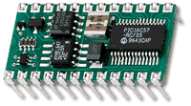
Basic Stamp II
Self contained computer
“Micro-controller”
Specialized for “embedded” computing (sensing and controlling things)
Built in programming language
PicBasic (interpreted)
Small programming environment runs on a PC
Connected with a serial cable

Slide 3
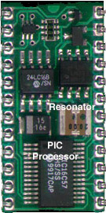
Parallax Basic Stamp II
PIC processor
(Very) roughly the computing power on the lunar module (much faster, but much less memory)
1 million instructions / sec
Non-volatile memory
Power regulation
Serial interface
{
}

Slide 4
Parallax Basic Stamp II
Input/output pins
16 total (P0…P15)
This is where the action is
Each pin can be accept input or produce output
Logic levels (0 or +5v)
Also “tricks” for sensing and producing values in between

Slide 5
Getting Started
Download the documentation
The Basic Stamp Manual v2.0 (2.0MB)
http://parallaxinc.com/downloads/Documentation/Basic%20Stamps/BASIC%20Stamp%20Manual%20v2.0.pdf
351 pages (probably worth printing [2up, double sided])
Basic Stamp I Application Notes
http://parallaxinc.com/downloads/Documentation/Basic%20Stamps/BASIC%20Stamp%201%20App%20Notes%20v1.9.pdf
Basic Stamp II Application Notes
http://parallaxinc.com/downloads/Documentation/Basic%20Stamps/BASIC%20Stamp%202%20App%20Notes%20v1.9.pdf
Download the programming environment
http://parallaxinc.com/downloads/software/BASIC_Stamps/Setup%20Stamp%20Editor.exe

Slide 6

Documentation
Manual Covers all types of Basic Stamps
BS1 older, smaller, slower, lesser lang, cheaper
BS2 what we are using, 26 bytes for vars
BS2e 8x instruction memory, more pin current +64 bytes RAM, a few extra features
BS2sx 2.5x faster than BS2
BS2p 24 3x faster than BS2, +128 bytes RAM many new language & I/O features
BS2p 40 BS2p with 32 I/O pins

Slide 7
Documentation
Manual
Covers basic setup
Power and serial connections
Mostly a language reference manual
Very simple (“krufty” / dumb) language
Think of it as a glue to hold together a nice I/O subroutine library
Applications Manual
Examples are here
Most are in BS1 (have to adapt code and pins)

Slide 8
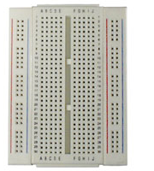
Let’s Build Stuff…
Solderless breadboard
Component pins / leads or wires push into the wholes
All main rows connected together
Four vertical buses also connected
Push the BS2 in at top
Rows 1…12 across gap
Pin 1 to the top-left
Note simulated notch

Slide 9
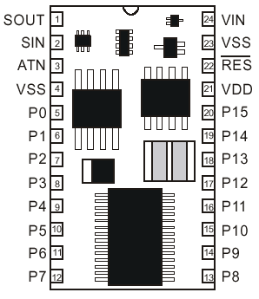
Pins on the BS2 package
(1) SOUT
(2) SIN
(3) ATN
Serial connection to PC
To DB9 pins 2,3,4
(4) Vss
Ground
Pin 5 on DB9
Also connect DB9 pin 6 to DB9 pin 7

Slide 10
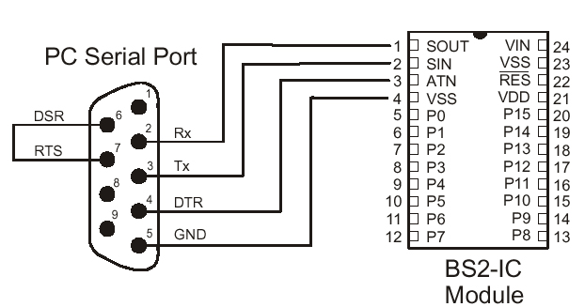
Pins on the BS2 package
(1) Sout
(2) Sin
(3) ATN
Serial connection to PC
To DB9 pins 2,3,4
(4) Vss
Ground
Pin 5 on DB9
Also connect DB9 pin 6 to DB9 pin 7

Slide 11
Pins on the BS2 package
(24) Vin
Power in
5.5-15v unregulated
Red wire of 9v battery
(23) Vss (same as pin 4)
Ground (black wire of 9v)
Connect to blue bus
(22) Vdd
+5v out (regulated)
Connect to red bus

Slide 12
Pins on the BS2 package
(5…12) I/O pins
P0…P7
Each has 20mA out limit
Each has 25mA in limit
50mA max total
(13…20) I/O pins
P8…P15
Same current limits

Slide 13
Connect and try it…
Run programming environment
Type in this program:
debug “Hello world!”, cr
end
Save your program! (ctrl-S)
Environment will hang on occasion
Run it
Type ctrl-R, press “play” icon, or choose from “Run” menu

Slide 14

Hardware Hello World
Pop quiz:
We want to drive this LED at about 10mA
What’s the value of the resistor?
P0

Slide 15
Hardware Hello World
500Ω (but only had 470Ω…)
Wire this…
Long wire on LED is positive side
Program
out_pin con 0
top:
high out_pin
pause 500
low out_pin
pause 500
goto top
P0

Slide 16
About the Program
out_pin con 0 ’const declaration
top: ’label
high out_pin ’pull pin high (+5v)
pause 500 ’delay 500ms
low out_pin ’pull pin low (0v)
pause 500 ’delay 500ms
goto top ’do it again

Slide 17
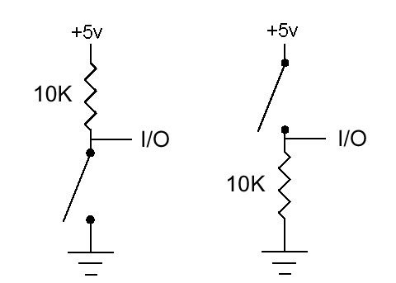
Push Button Input
What’s the difference?

Slide 18
Push Button Input
What’s the difference?
Active high (right) vs. active low (left)
Why 10K?

Slide 19
Push Button Input
What’s the difference?
Active high (right) vs. active low (left)
Why 10K?
Not critical,but don’t need much current
.

Slide 20
Push Button Input
What’s the difference?
Active high (right) vs. active low (left)
Why 10K?
Not critical,but don’t need much current
We’ll use this one

Slide 21
Push Button Input
Program
led var out0 ' declare out to be same as pin 0
sw var in1 ' declare in to be same as pin 1
cnt var byte ' counter var
input sw ' init pin directions and values
output led : low led
cnt=0
loop:
cnt = cnt + 1 ' count times through loop
led = sw & cnt ' LED when sw & every other loop
pause 100 ‘ leave LED on/off for a bit
goto loop

Slide 22
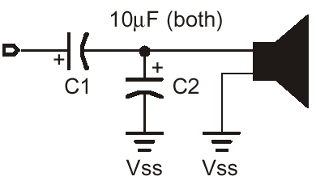
Sound output
FREQOUT Pin, Len, Freq1
FREQOUT Pin, Len, Freq1, Freq2
Len in ms
Freq in Hz
0 for off

Slide 23
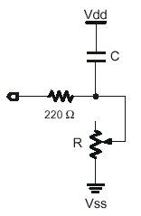
Measuring Resistance
220Ω for current limiting if R goes to 0
Most values in 100s ok
Different C’s and R’s will result in different time ranges
See manual
0.1 µF fine
rctime pin, 1, result
Returns time in 2 µsec units

Slide 24
How Does This Work?
Set pin to output and charge the capacitor
Flip pin to input and time how long until it drops below the minimum
Time depends on C and R
For fixed C, depends on R
See manual for formula

Slide 25
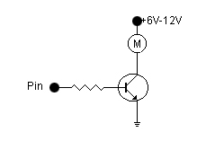
DC Motors
PWM: “Pulse Wave Modulation”
Turns pin on a certain % of the time
With proper filtering (or for slowly responding devices) gives you a good approximation to an analog output (0…5v)
PWM pin, duty, ms
Duty: 255 = 100%

Slide 26
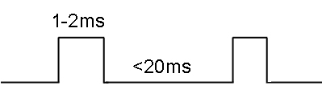
Servo Motors
Servo motors turn to specific angle and hold
~0…180°
Used for RC planes, etc.
Controlled based on pulses of a certain width (time)
1ms ≈ 0°
2ms ≈ 180°
Delivered at least every 20ms (exact timing there not critical)

Slide 27
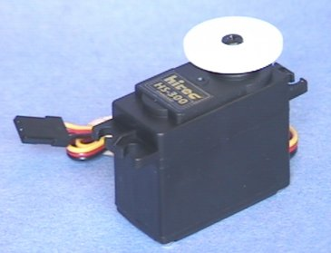
Servo Motors
pulseout pin, time
Delivers a pulse of given duration
time in units of 2 µsec
Servos have 3 wires
Power & Ground (to motor)
Typically red and black (brown on ours)
Control (to pin)
Typically some other color
Ordered: Ground, Power, Control on 3 pin connector

Slide 28
Other Requested Sensors or Actuators?

