Slide 1

Lab Notebook for EECT 101
Labs 0-7 plus Projects
By: Jarred Clark
My Lab partners were Henry Winicker and David Butz

Slide 2
Lab 0- Measuring three types of resistors Work done on bench 6 08-23-17
The purpose of this lab was to measure all of the 15 Resistors
The Three Resistors include: 1st resistor- 56k
2nd resistor- 3.3k
3rd resistor- 4.7k

Slide 3
Lab 0- Page 2
Results from the lab measured a little off than what the resistor said the tolerance was.
Color Bands of the Resistors
56k measured: 55.45k Green, Blue, Orange and Gold
3.3k measured: 3.243k Orange, Orange, Red, and Gold
4.7k measured: 4.692k Yellow, Brown, Red, and Gold

Slide 4
Lab 0- Page 3 Picture of the Spreadsheet

Slide 5
Lab 0.5- Measuring Resistance Values for 10 Resistors each containing a value of about 1k. 08-30-17 Work done on Bench 6
The purpose of this lab was to find the maximum and minimum and the average resistance values for a 1k resistor.
We took ten of the 1k ohm resistors and measured the resistance for the maximum and minimum and the average amount for each value.

Slide 6
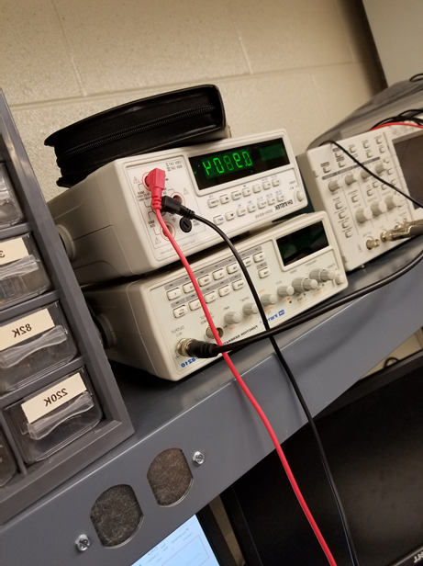
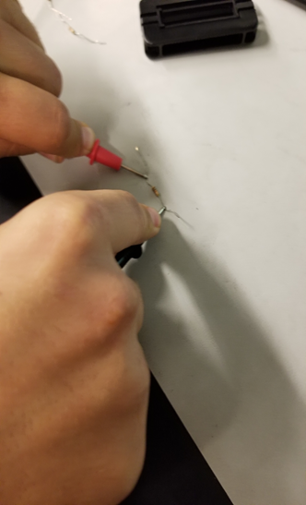
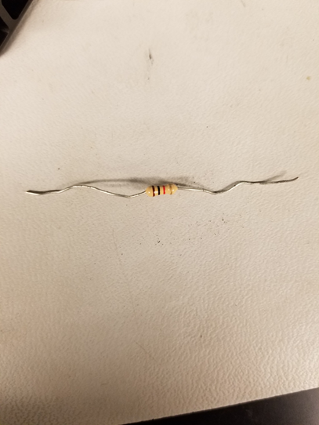
Lab 0.5 Page 2
For this image this was one of the values that we got from measuring a resistor on the digital Multimeter
This is an example of measuring a 1k resistor and using the prongs of the multimeter attached to each side of the resistor.
This one of the 1k resistors that we used

Slide 7
Lab 0.5- Page 3

Slide 8
Lab 0.5- Page 4
Observations:
All Resistors were in the resistance range and all 10 of them were the color code of Brown, Black, Red, and Gold
Min- 979.4
Max- 996.6
Average- 988.38
Stdev- 6.33891

Slide 9
Lab 1- Measuring all 15 resistors in our resistor kits and Determining if they are in tolerance or not 08-30-17 Performed on Bench 6
The purpose of this lab is to have all 15 different resistors in our resistor kits and we measured them and determined if they were in the 5% tolerance range.
R1= 100 R6= 2.2k R11= 33k
R2= 220 R7= 3.3k R12= 47k
R3= 330 R8= 4.7k R13= 100k
R4= 470 R9= 10k R14= 1M
R5= 1k R10=22k R15= 10M

Slide 10
Lab 1- Page 2
Actual Measurements for each Resistor in ohms
R1= 98.18 R6= 2112 R11=33116
R2= 216.98 R7= 3562 R12= 45867
R3= 326.95 R8= 4629 R13= 98610
R4= 469.18 R9= 9789 R14= 991000
R5= 998 R10=22062 R15= 10100000

Slide 11
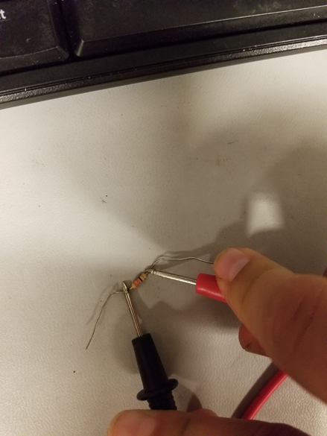
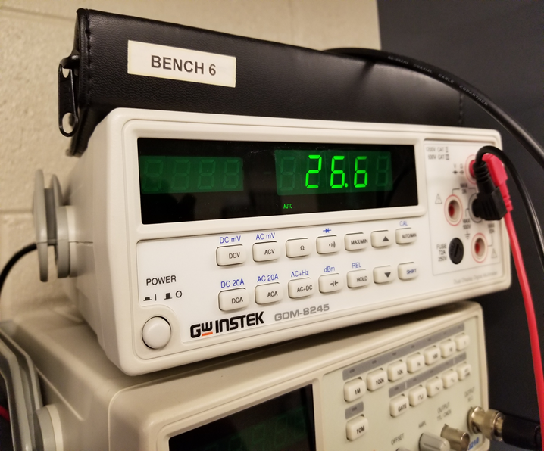
Lab 1- Page 3
This is a picture of us measuring a 330 ohm resistor.
This a measurement of one of the resistors

Slide 12
Lab 1- Page 4

Slide 13
Lab 1- Page 5
Observations: All Resistors were all in the 5% tolerance range.
The actual measurements for all resistors were all very close to what it said it was.

Slide 14
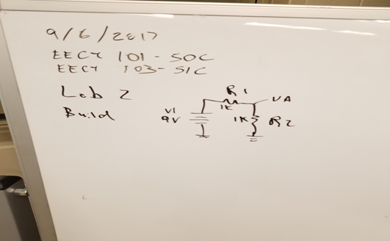
LAB 2- Building a Simple Circuit on a Breadboard My Lab Partners were David Butz and Henry Winicker 09-06-17 Work done on Bench 6
Purpose of the lab is to have us understand how to build a simple circuit using this schematic and transferring it onto a breadboard.
This schematic is built onto the bread board in Lab 2.

Slide 15
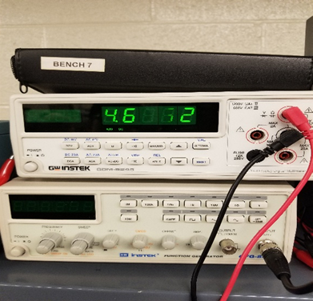
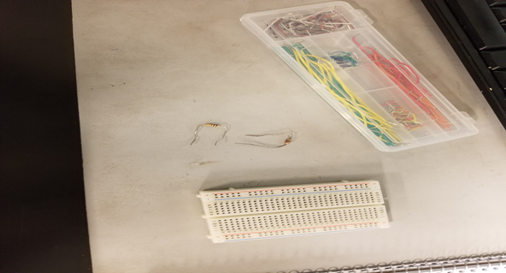
LAB 2 page 2
These are the two 1k ohm resistors we used along with the short wires and breadboard to create the circuit.
After the circuit was built, this was the output voltage reading.

Slide 16
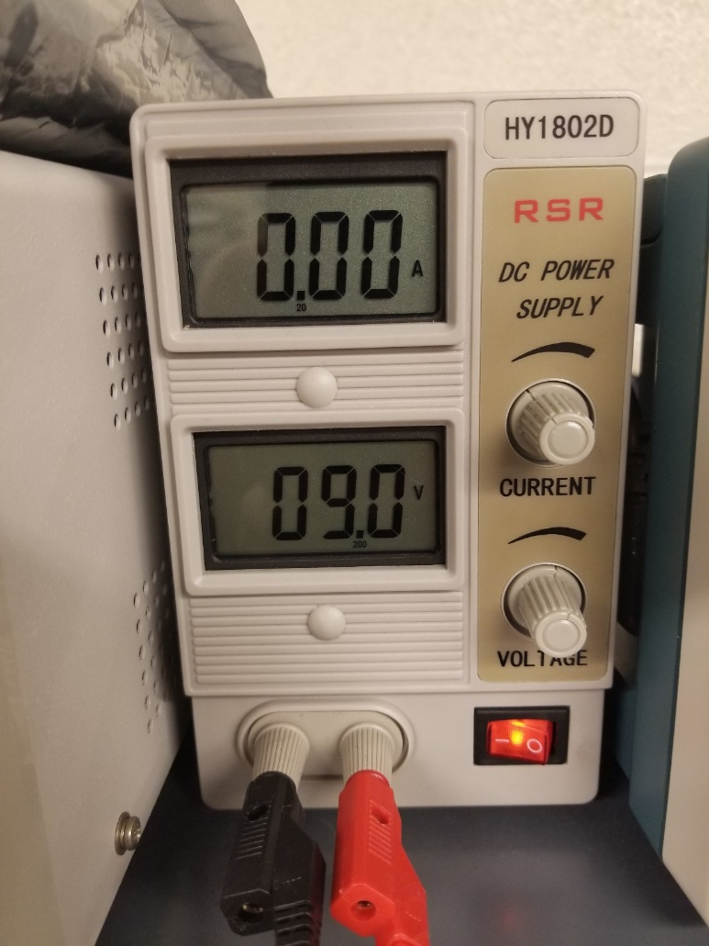
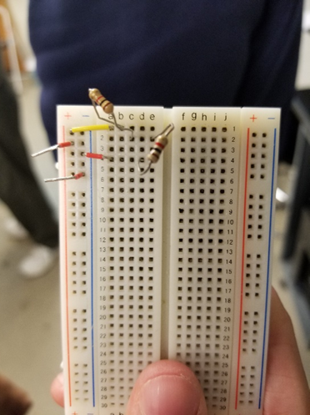
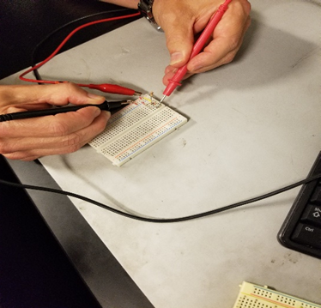
LAB 2 page 3
This is how we measured the circuit. We hooked up the red lead of the power to the positive lead of the circuit and the black lead to the black lead of the circuit. We then measured with the digital multimeter with the red lead to the first lead of the 2nd resistor and the black lead of the meter to the black lead of circuit.
Power supply was set to 9 volts and hooked up to circuit.
Circuit with two 1k ohm resistors placed on a breadboard.

Slide 17
LAB 2 page 4
Observations:
Each resistor lead must be in a separate row of the board for circuit to work.
For best reading of voltage, make wires connecting circuit together as short as possible.

Slide 18
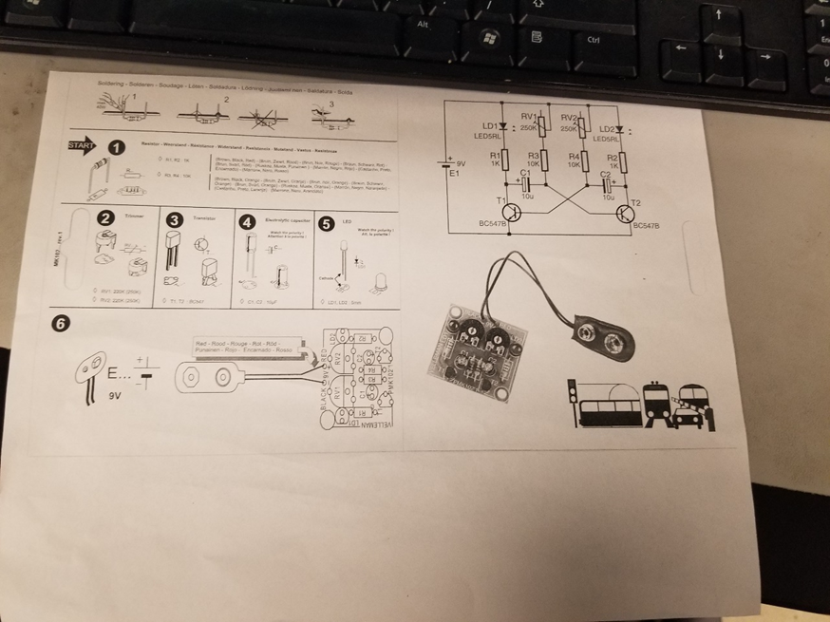
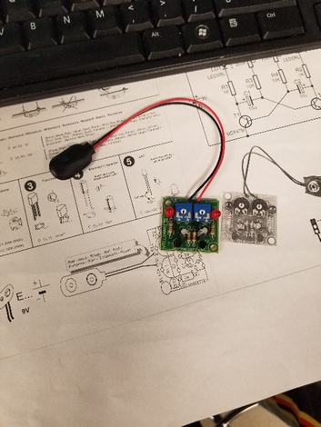
LAB 3- Building a Schematic and Testing a Circuit 09-13-17 Lab Partner was Henry Winicker Worked on Bench 6
Purpose of lab was to create a schematic of an already built circuit. And to test that circuit.
Directions sheet on how to build circuit from box.
Finished circuit that includes alternating flashing lights that are controllable via pots.

Slide 19
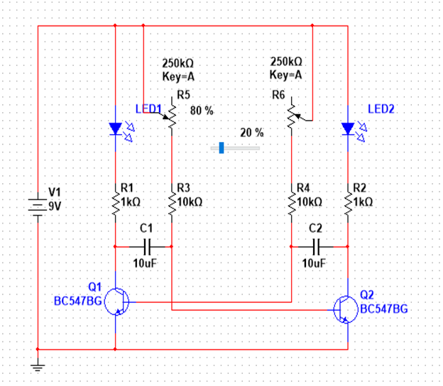
LAB 3 Page 2
Schematic shows how the circuit connects the power to the rest of the components.
Parts used include: 2 1k ohm resistors
2 10k ohm resistors
2 250k ohm resistors
2 LEDs
2 10uF capacitors
2 BC547BG Pots
All of these were connected to a 9 volt power supply.

Slide 20
LAB 3 page 3
Observations: to create the schematic we used the MultiSim program.
To get the transistors to face to correct direction we had to use the flip function.
To find and place a component we did this in order:
Place > component > all families > search: to find all components
To make the lights to alternate faster, lower the value on the variable resistor (turn it to the right) To make the lights alternate slower, increase the value on the variable resistor (turn it to the left).

Slide 21
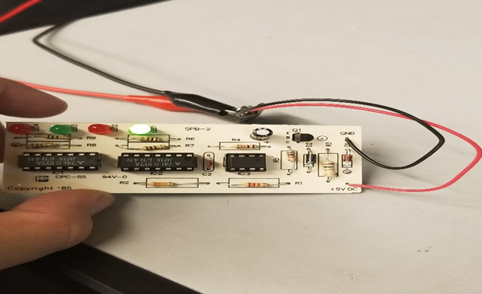
LAB 4- Solder Practice kit of a built circuit 09-20-17
Purpose of this lab was to inspect a circuit that had already been built and to evaluate the build quality of the board.

Slide 22
Lab 4- Page 2
This is the simulation from the back of the circuit. We followed the design on the back in order to build this multisim.

Slide 23
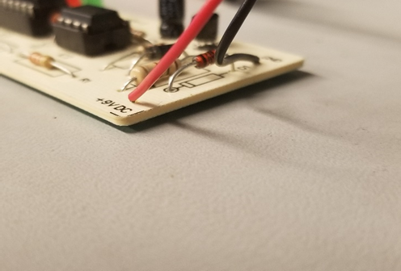
Lab 4- Page 3
The IN4735 zener diode is not soldered all the way down to the circuit board.
This is a picture of the IN4735 zener diode that is not soldered down enough and it is to far away from the board

Slide 24
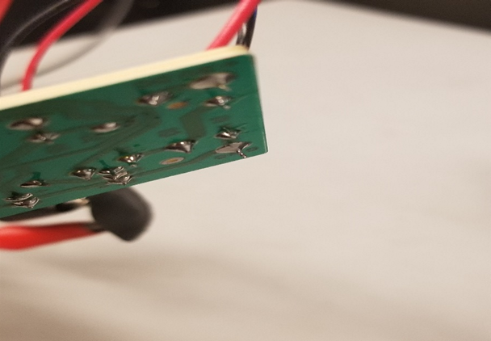
Lab 4- Page 4
On the back of the circuit board there are extra solder, and a couple of the resistors ends are sticking out
This is the solder ends that are not clipped short enough onto the circuit

Slide 25
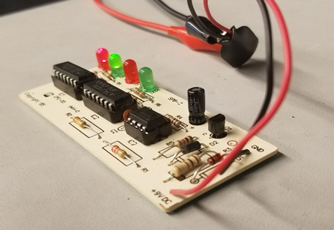
Lab 4- Page 5
When applied to the power supply operating at 9 volts, the all 4 lights are moving back and worth.
This is the zener diode that is corrected and soldered corrected
This is me tested the lights and the voltage of the circuit

Slide 26
Lab 5- learning and testing how to use each equipment in the lab. Work done at Bench 6 09-27-17 Lab Partners were David Butz and Henry Winicker
The purpose of this lab is to learn how to use the multimeter, function generator, oscilloscope, LCR meter.

Slide 27
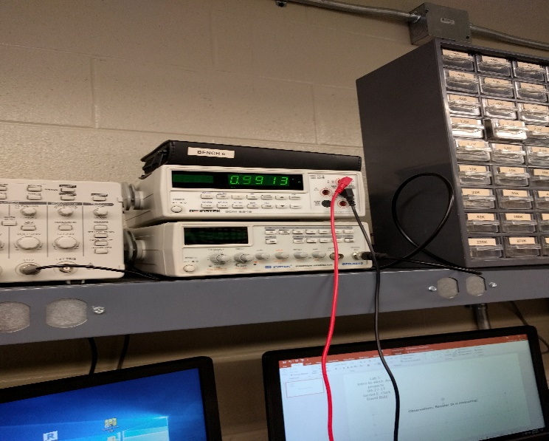
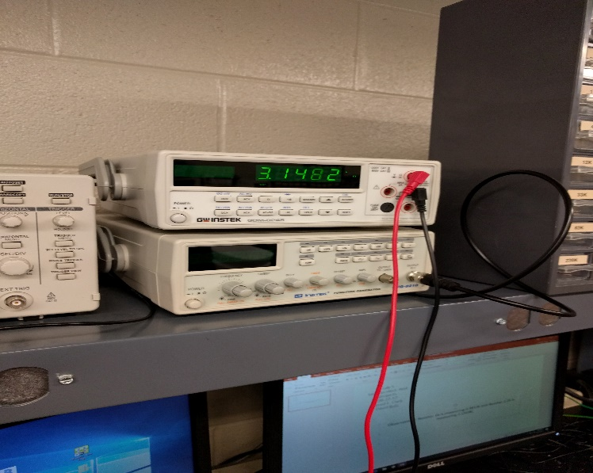
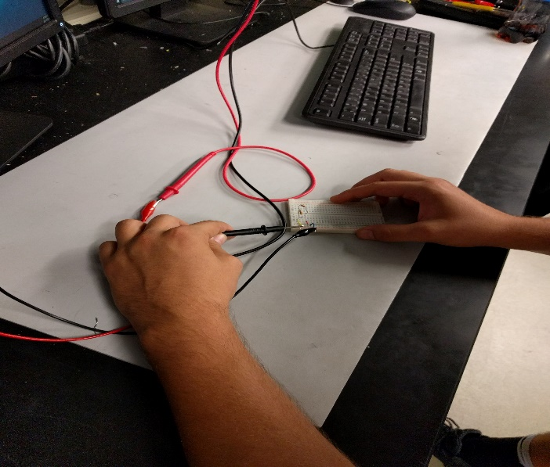
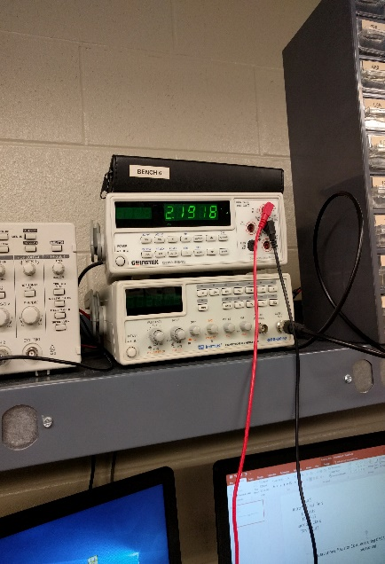
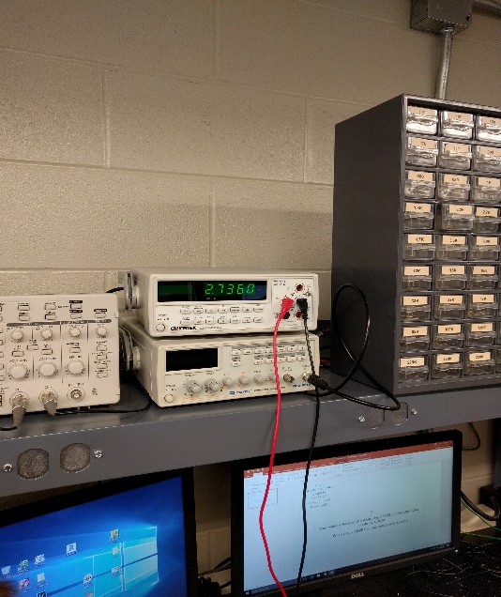

Lab 5
Page 2
Observations: Resistor 1k is measuring 0.9913k and Resistor 2.2k is measuring 2.1918k
When circuit is built the total resistance is 3.1482k
Circuit current is 2.7360 mA
To measure current, hook red lead of power supply to the red lead of the multimeter. Then hook black lead of power supply to ground of circuit
You then place the black lead of the multimeter to the red lead of the circuit

Slide 28
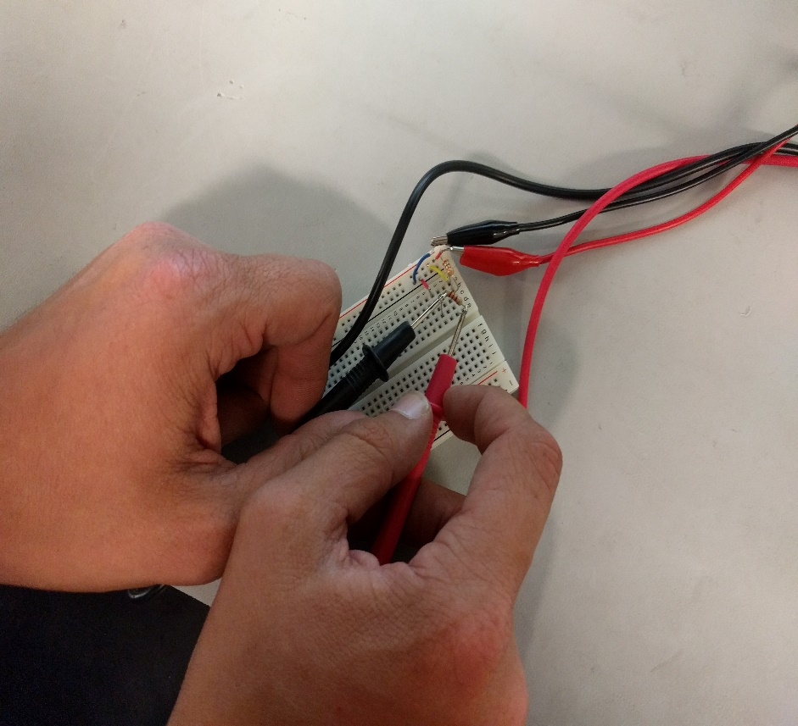
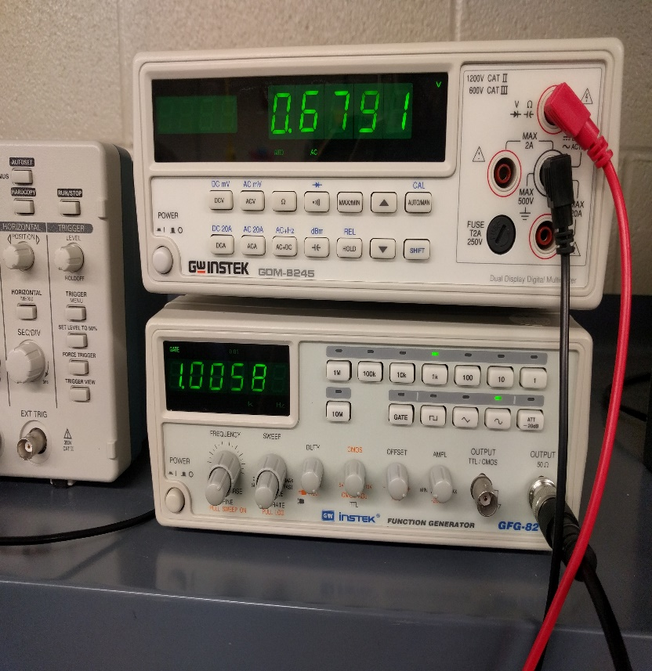
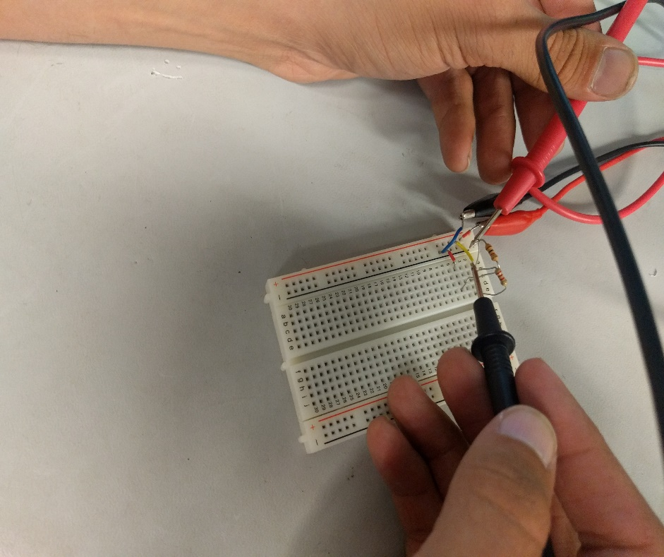
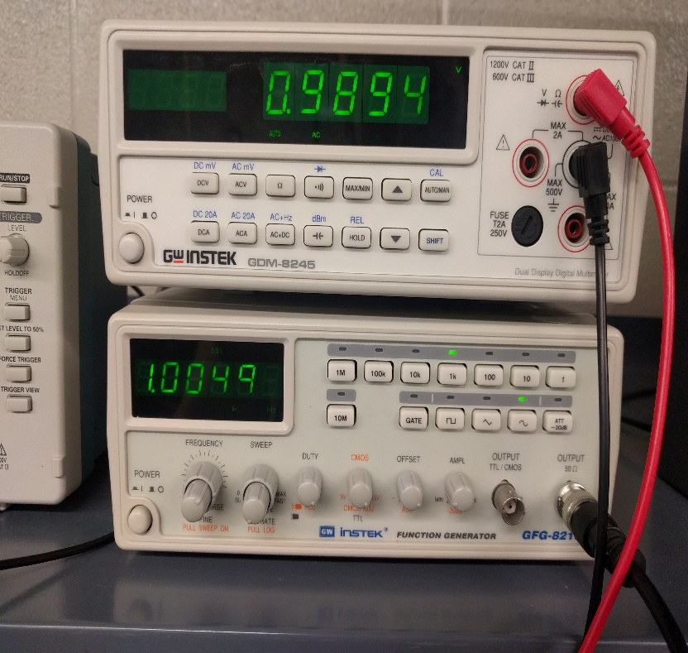
Using the function generator and multimeter
Lab 5- Page 3
The AC voltage entering through the circuit when the function generator is set at 1kHz at 1V = 989mV
The AC voltage leaving the circuit when the function generator is set at 1kHz at 1V= 679mV

Slide 29
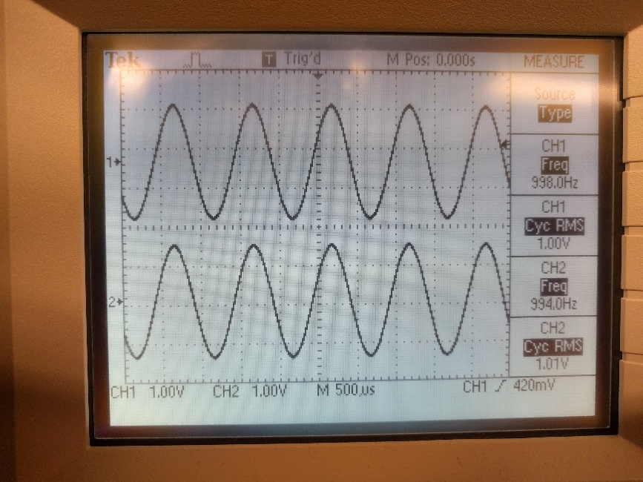
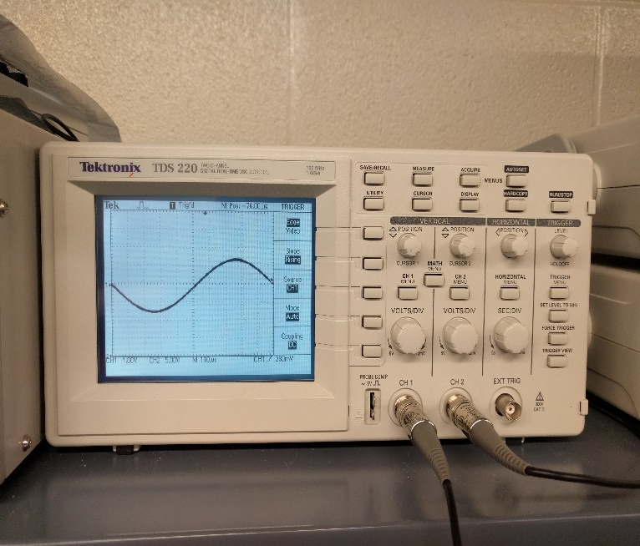
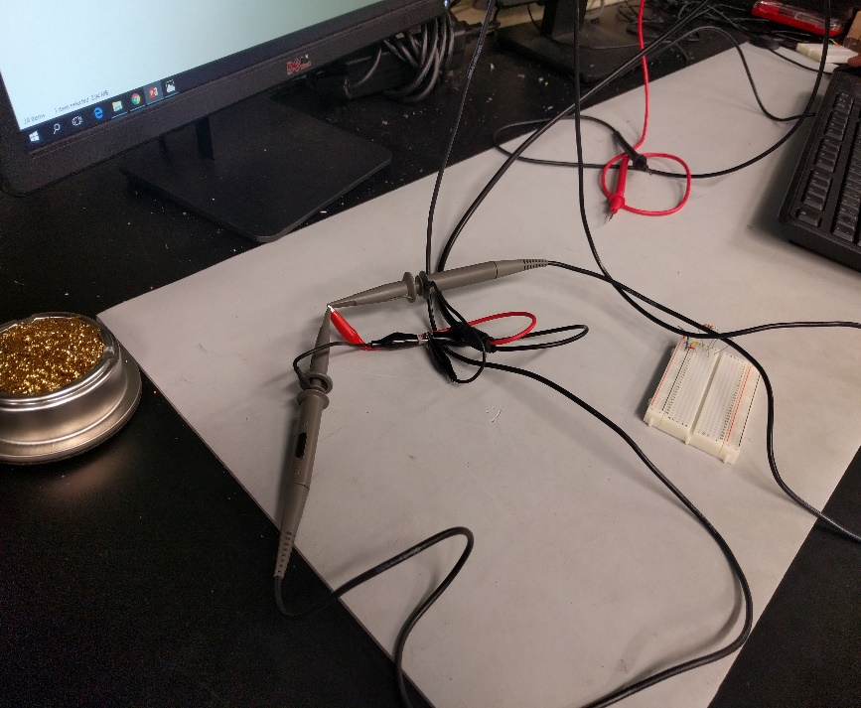
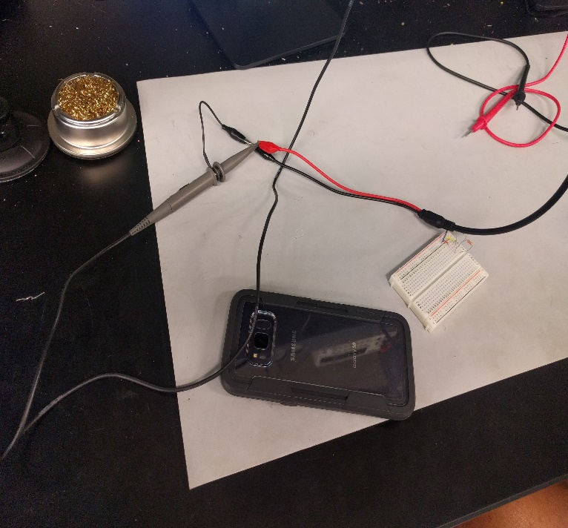
Oscilloscope and function generator
Lab 5- Page 4
We hooked up the ground together and then connected the ground lead to the lead of the oscilloscope. Then we adjusted it to fit on the screen evenly.
Channel 1 is measuring at 1.01 v RMS and 1Hz
When both channels are hooked up both Volts and RMS are closely the same and the Hz are still the same

Slide 30
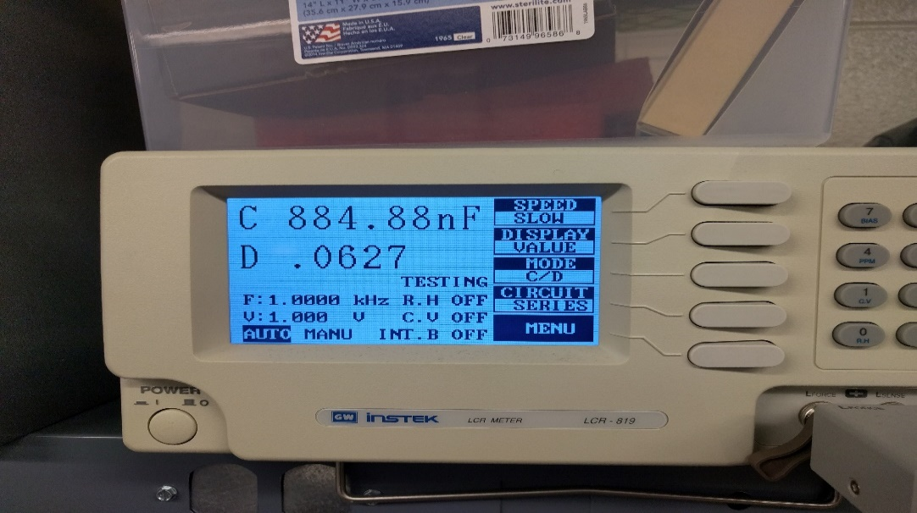
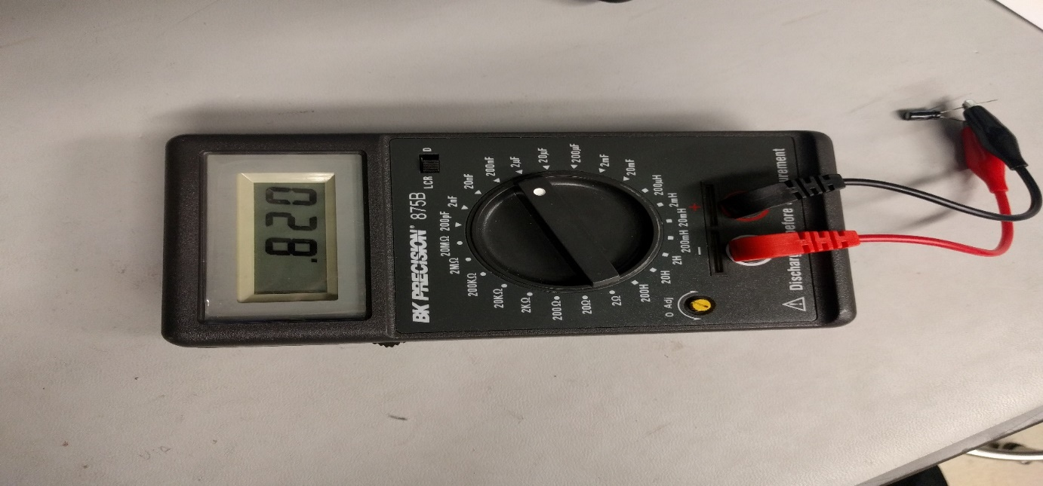
Using the LCR METER
Lab 5- Page 5
Digital: When the 1uF capacitor is hooked up to LCR meter it fluctuates over time but reads 894.26nF when the frequency is 1 kHz and the voltage is 1V
The Handheld: measures .820nF

Slide 31
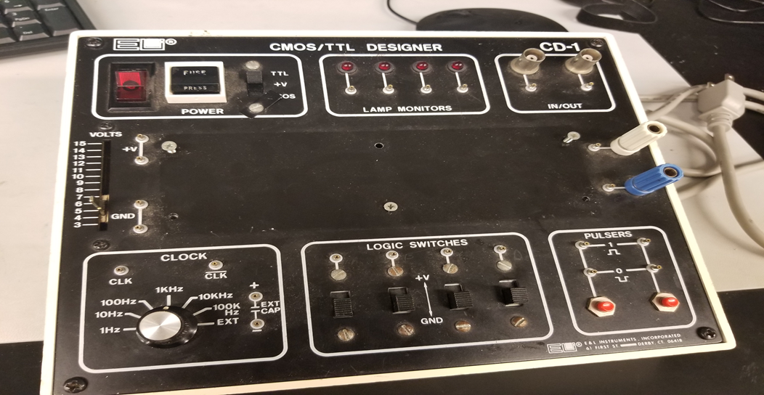

Lab 6- Examining the CMOS/TTL Designer Box Work done on Bench 6 10-11-17
The Purpose of this Lab is to examine, find problems, test and figure out how everything works on a CMOS/TTL Designer Box.
This is the CMOS/TTL Designer Box

Slide 32
Lab 6- Page 2
Problems that I ran into when observing the Box was that the fuse was hard to press, and the clock was hard to turn.
The observations that I figured out that worked correctly and the parts were there were
Power button runs smoothly
All leads are there Voltage Meter goes up/down smoothly
In/out puts are their
Pulsers are fine
Logic switches work

Slide 33
Lab 6- Page 3
When Voltage Levels were on TTL, the measurement was 4.9162V
When Voltage Levels were on CMOS: The minimum was 1.6322V and the maximum was at 14.860V.
When I jumpered the lights they all four would turn on between 3V and 15V
I found out that the External Clock was to remotely sync to an external source for them to function on the same hertz value.
In/out slot is the connection point for the cables that are from the device that is connected to it, and then it connects to a voltage meter and then you can adjust the voltage level to the device that is connected to it.

Slide 34
Lab 6- Page 4
When measuring with the oscilloscope from the clock for the frequency:
1khz 10hz
Channel 1=10.25hz
Channel 2=10.27hz
Channel 1= 1.376khz
Channel 2= 1.376khz
100khz
Channel 1=1.377khz
Channel 2=1.379khz
10khz
Channel 1=9.433khz
Channel 2=9.345khz Pulsers: When the hooks of the oscilloscope are hooked up to both pulsers, it shows that it is exactly how it shows on the ttl and cmos
designer
100hz
Channel 1=85.03hz
Channel 2=85.04hz

Slide 35
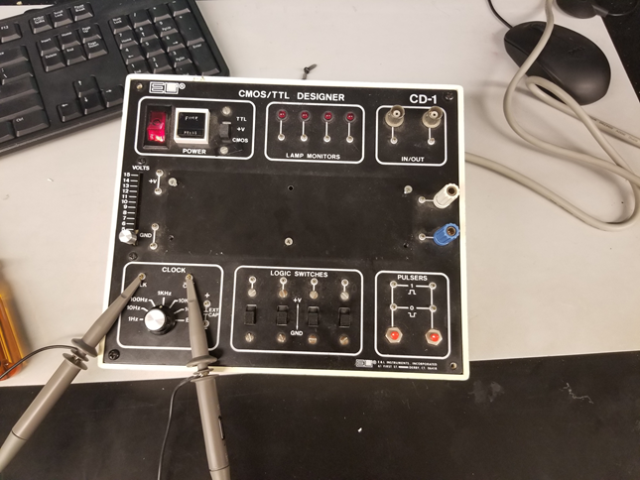
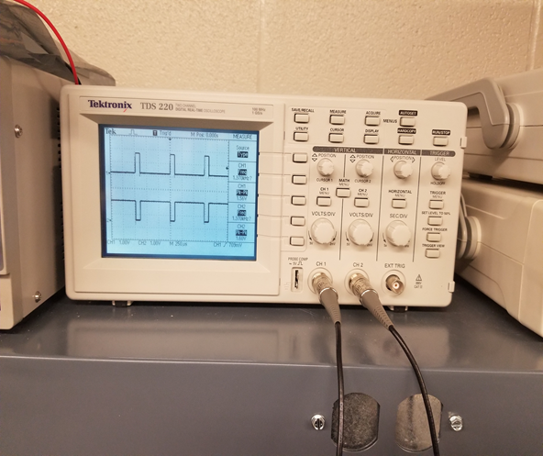
Lab 6- Page 5
This was when I tested the clock to see what it looked like on the Oscilloscope.
This was the result of testing the clock

Slide 36
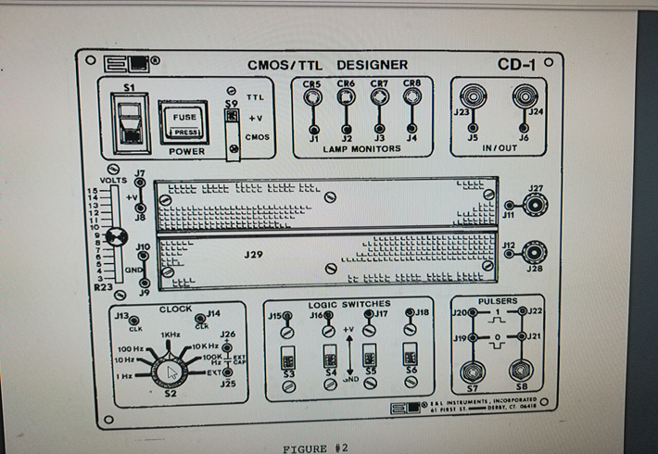
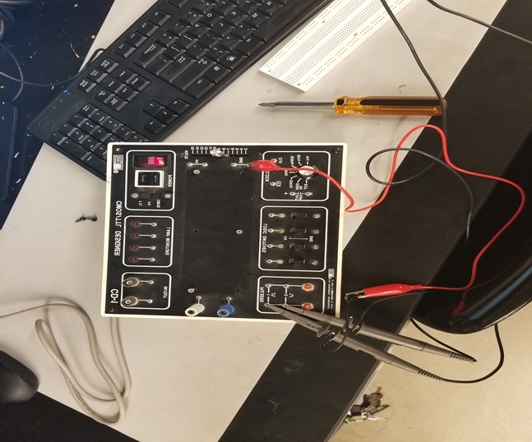
Lab 6- Page 6
Schematic of the outside of the box in the Instruction Manual
This was when I started to test the Pulsers

Slide 37
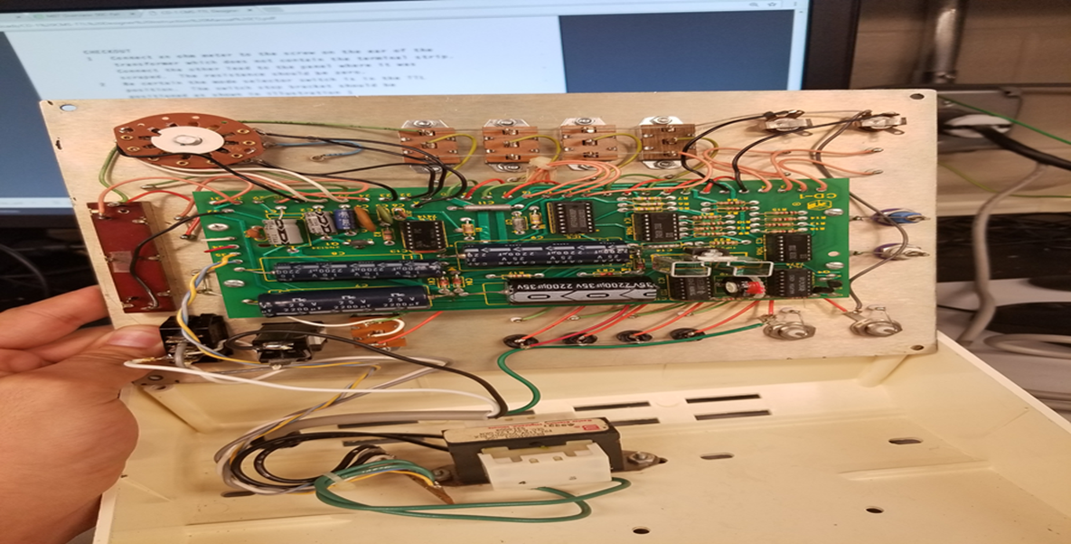
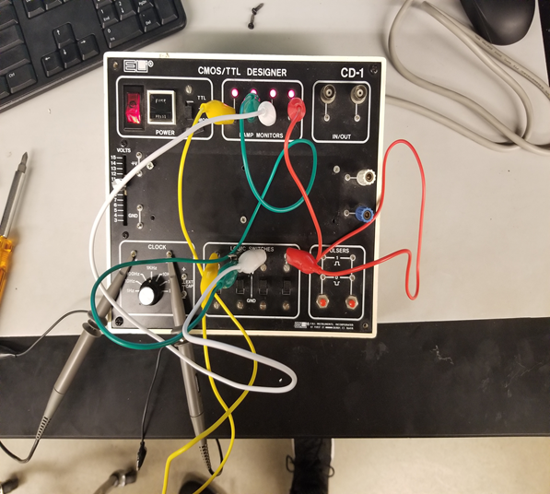
Lab 6- Page 7
I jumped all four of the logic switches in order to get power to the light and this when it would only light up between 3v and 15V.
This is when I opened up the box and was examining the hardware and the circuit board that made the CMOS/TTL Designer Box function.

Slide 38
Lab 6- Page 8

Slide 39
Lab 6- Page 9
Information datasheets and the Instruction Manual for the CMOS/TTL Designer
Click On Image to open up the Instruction Manual for the CMOS/TTL Designer Box

Slide 40
Lab 7- Soldering 10/18/2017
The purpose of this lab was to be introduce and learn soldering by soldering parts onto a small circuit board and make it work.

Slide 41
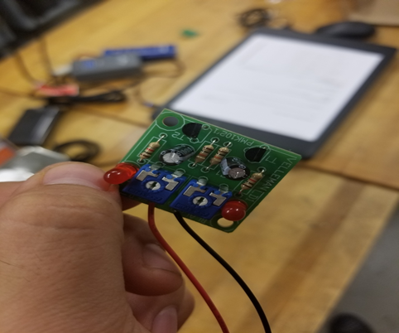
Lab 7- Page 2
When Soldering parts to a circuit board, you have to take your time and not rush things.
When you don’t take you time you can mess up where parts go, such as I switched the 1k and 10k resistors and put them In the wrong spot.
This is a picture of the completed circuit board

Slide 42
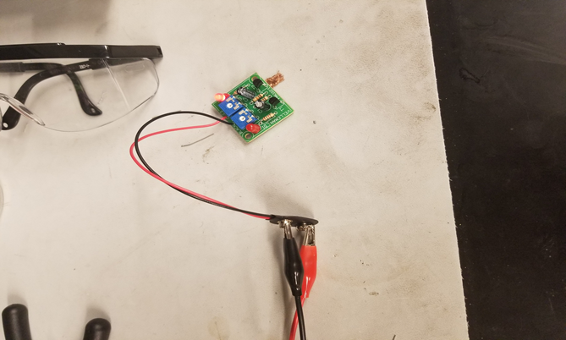
Lab 7- Page 3
You have to make sure that you get the right amount of solder on the circuit board and you have to get the parts as close to the board as possible
You have to clip the excess metal off of the solder
This is a picture of me testing the circuit and the alternating lights both worked

Slide 43
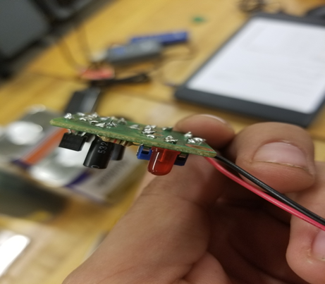
Lab 7 Page 4
I ran into some solder ends coming in contact with other ones, so I had to de-solder it and then redo it.
The finalize product was that the circuit worked the light were flashing back and fourth and when you turn the dial it goes either faster or slower.
This is the finished project for me soldering for the first time.

Slide 44
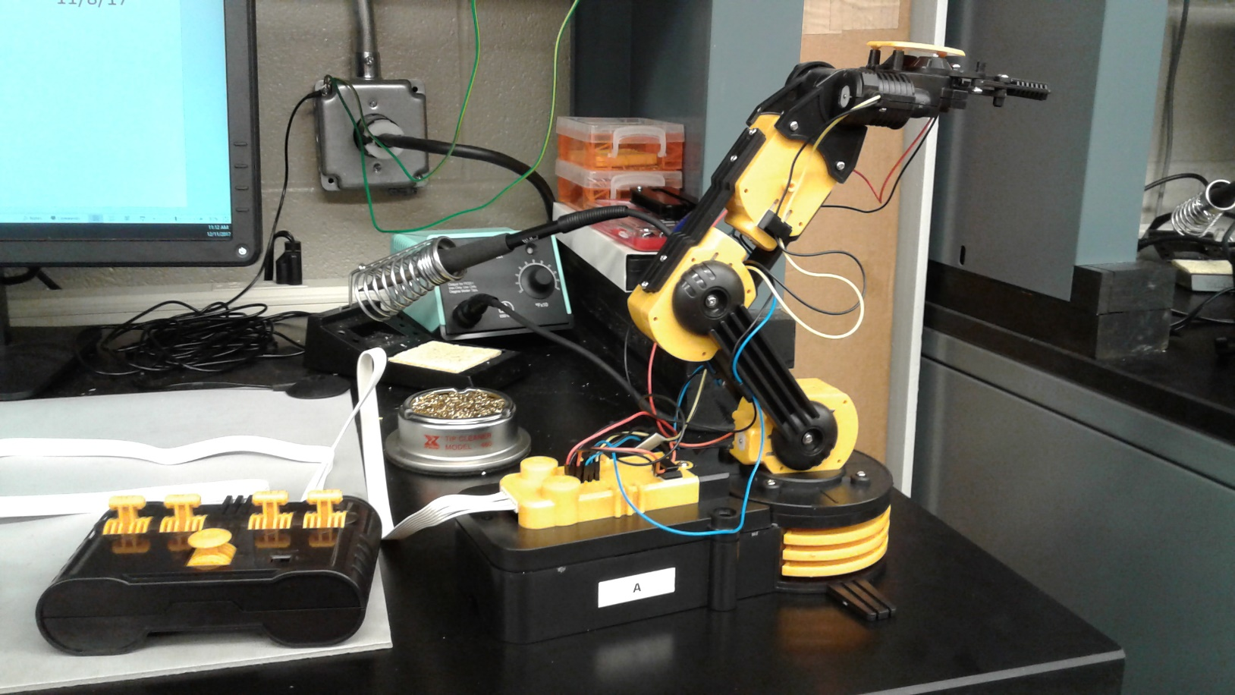
Project: Robotic Arm Edge
Done on bench 7
My Lab Partner was henry Winicker 11/8/17
Purpose of this project was to learn how to build, test, and operate a Robotic Arm Edge.

Slide 45
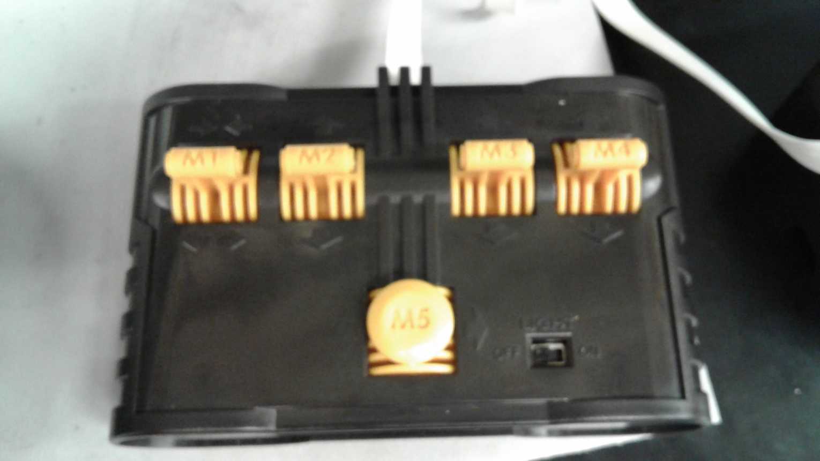
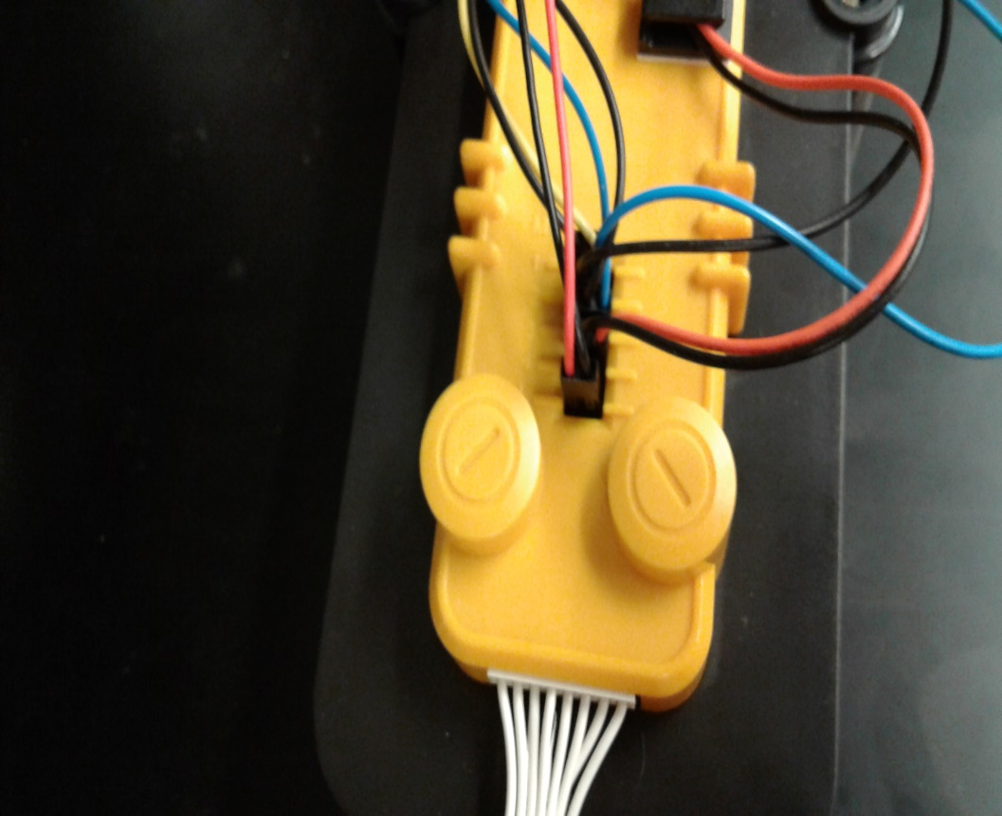
Project: Robotic Arm Edge -Page 2
Control board for Robotic Arm Edge. From left to right, M1 controls claw, M2 controls vertical axis movement of claw, M3 controls vertical axis of the top portion of the arm, M4 controls the bottom vertical axis movement of the arm, M5 controls the horizontal rotation of the entire arm, the black switch in the bottom right corner turns the LED on the claw on and off.
Terminal where every servo and the control board plugs into.

Slide 46
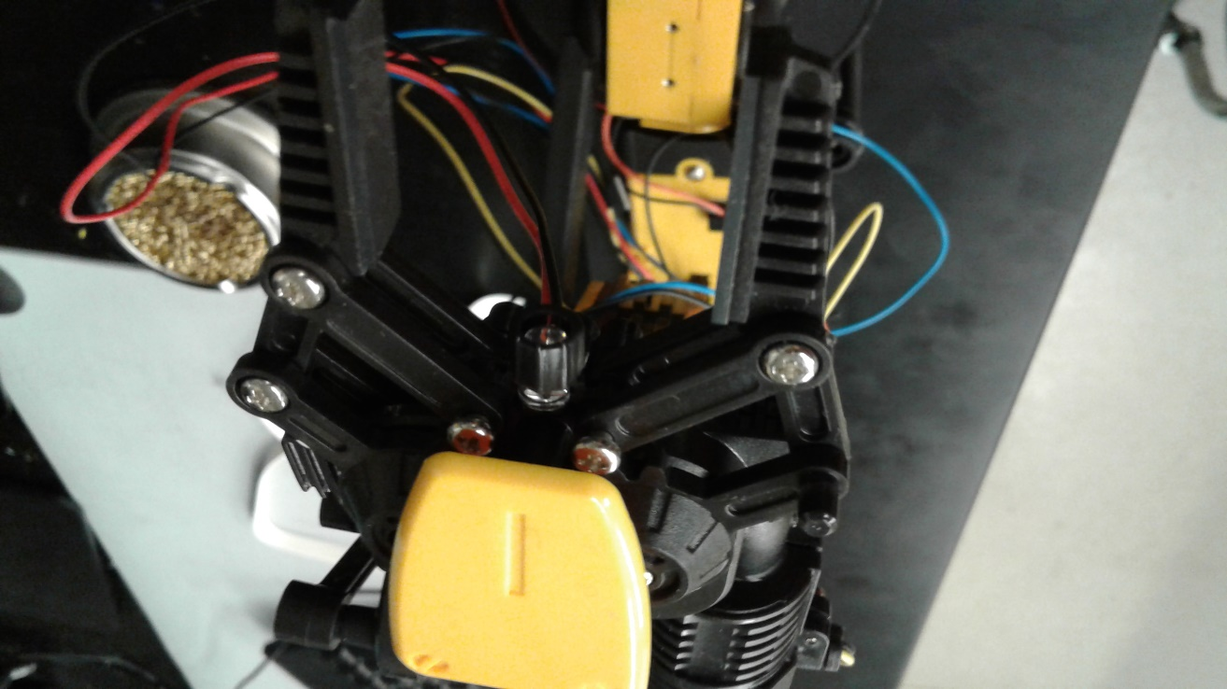
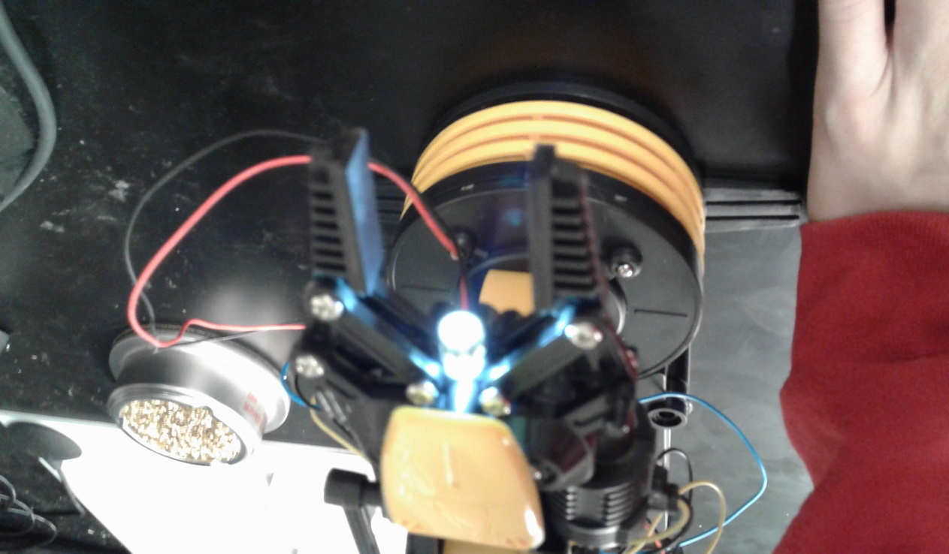
Project: Robotic Arm Edge -Page 3
Claw open with LED off.
Claw with LED turned on.

Slide 47
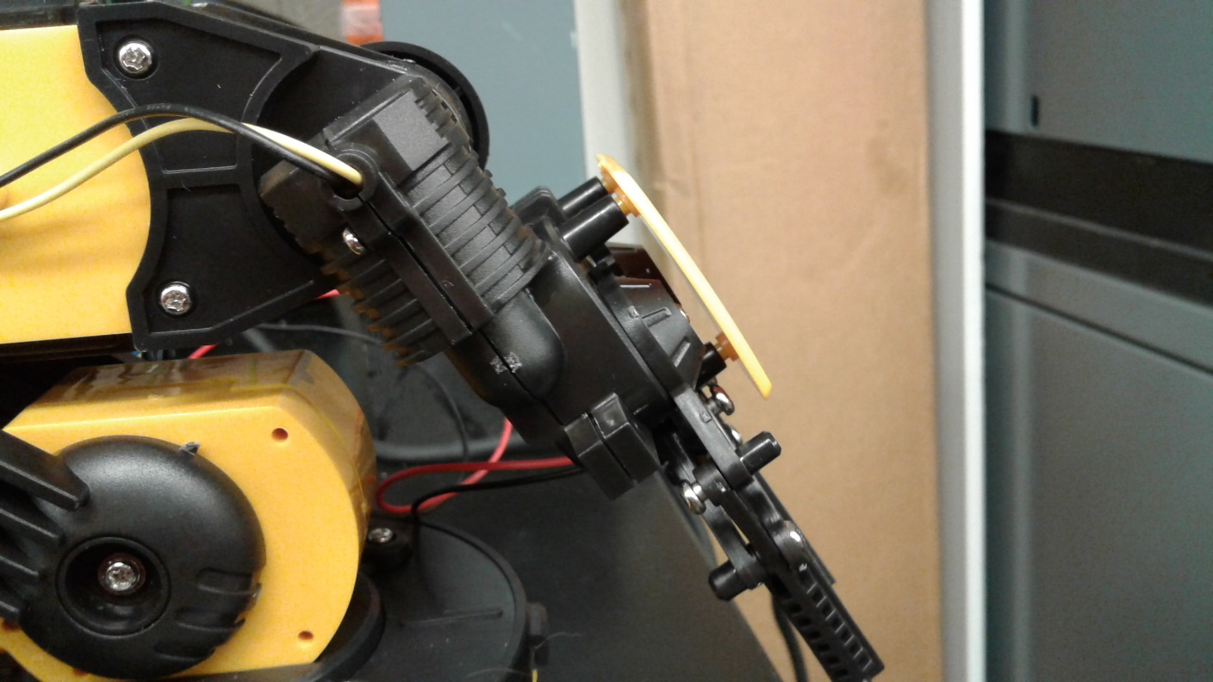
Project: Robotic Arm Edge -Page 4
Furthest down claw will rotate to.
Observation: Claw’s servo may be damaged if you try to make claw bend any lower.

Slide 48
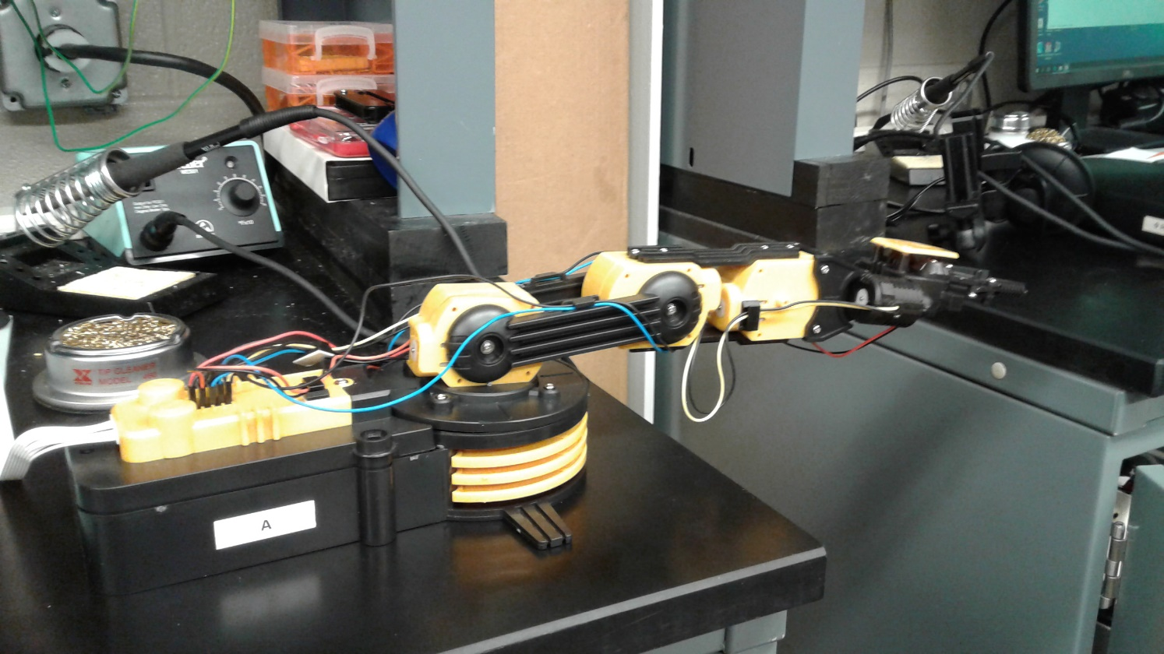

Project: Robotic Arm Edge -Page 5
Arm’s max extension horizontally.
Arm’s max extension vertically.

Slide 49

Project: Robotic Arm Edge -Page 6
Arm folded into it’s tightest position.

Slide 50


Project: Robotic Arm Edge -Page 7
Servo that allows the claw to move up and down.
Base houses a servo that has the capabilities of moving the arm a full 360 degrees.
Observation: DO NOT move arm the full 360 degrees, it will wrap the wires connecting servos to control panel and cause damage.

Slide 51


Project: Robotic Arm Edge -Page 8
Both of these servos allow for the arm to move up and down vertically.
Observations: The arm moves slowly by nature, if it seems extremely slow change the batteries.
Servos have a little bit of limited movement, do not try to make them move past their extent or you may damage the servo.
Construction of this arm is a little difficult, pay close attention to directions provided.

Slide 52

Project 17DOF Biped Robot
Work done on Bench 7 My Lab Partner was Henry Winicker 11/15/17 – 12/6/17
The purpose of this project was to build a 17DOF Biped robot from parts provided and with no instructions. We had to search videos and diagrams to construct the robot.
17DOF Biped robot standing on its own.

Slide 53




Project: 17DOF Biped Robot -Page 2
Left foot
Each foot of the robot should have the four holes facing forward for maximum stability when walking.
Right Foot
Use the large round headed screws to attach ALL servos to their mounting brackets. Use the screws provided with the servos to attach the horn to the U bracket.
Observation: DO NOT screw in the screws proved with the servos all the way in, they will rub against the servo box and may cause damage over time.
To install feet servos correctly, make sure the servo knob is facing away from the inside of the leg.
Large screws used to mount servo in mounting bracket.
Use flat head screws to attach foot to servo housing.

Slide 54


Project: 17DOF Biped Robot -Page 3
For each servo you must place the gold piece in the hole of the mounting bracket that is behind the servo knob. Then you place the bearing over the gold piece and attach your next piece over that bearing.

Slide 55


Project: 17DOF Biped Robot -Page 4
Ankle piece attached to foot with bearing.
Attach the two angled brackets with four flat head screws.
Observation: Every bracket attachment that requires screws should use flat head screws and small bolts due to possible clearance issues.

Slide 56



Project: 17DOF Biped Robot -Page 5
Knee brackets attach with 8 flat head screws and small bolts using the small double round ended flat piece.
Servo mounting brackets should have opening towards the inside of the leg.
To attach top servo to the thigh bracket use the large U bracket.
Observation: this was one of the hardest pieces to attach, multiple hands may be required.
Before attaching the large U bracket, attach a smaller U bracket as shown.
Left leg
Right leg

Slide 57


Project: 17DOF Biped Robot -Page 6
Servo brackets for thighs should open towards the front of the leg. (the same direction as the feet)
Inside of the waist bracket, attach the legs as shown (this is a rear view of the robot’s waist).
Observation: multiple hands will be useful in attaching the legs to the waist.

Slide 58


Project: 17DOF Biped Robot -Page 7
This is the beginning of the arm attachments (from the rear of the robot).
Observation: We used two screws each for mounting, but using four screws may be needed for stability.
Use a short L bracket to attach servo bracket to waist bracket.

Slide 59


Project: 17DOF Biped Robot -Page 8
Make sure the servo is opening outward from body to properly attach. The shoulder servo should open outwards towards the front of the robot.
Observation: Plastic horn is on too much stress here, replace with a metal horn. Without it the stability of the arm is questionable.
Use a large U bracket with a small L bracket on top to attach the arm to the shoulder.
Servo housing for arm should open up towards the BACK of the robot. The “hand” of the robot is a double round ended flat piece attached by two flat head screws.

Slide 60

Project: 17DOF Biped Robot -Page 9
Below is linked a video of this robot function its full range of motion.
We were not able to attach the board that will control this biped robot.
https://www.youtube.com/watch?v=EiJhlflpGEo

