Slide 1
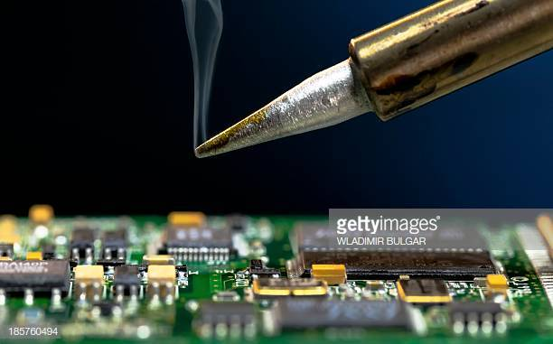
EECT 103 – Soldering
Fall 2019
By: Jarred Clark
Lab Partner Was Seth wills

Slide 2
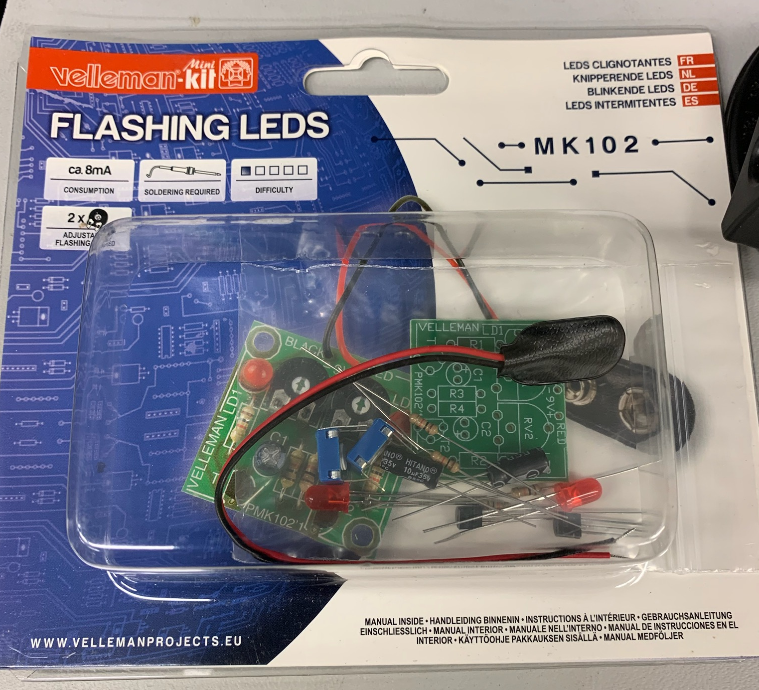
Lab 1 – Building the led Blinker kit
Lab Partner was seth wills
The purpose of this lab is to build the led blinker kit
Equipment needed:
Led blinker kit
weller wes51 soldering iron
60/40 solder
Soldering stand
Solder Wick
Solder paste
Desoldering pump
Soldering sponge
Dc Variable Power Supply

Slide 3
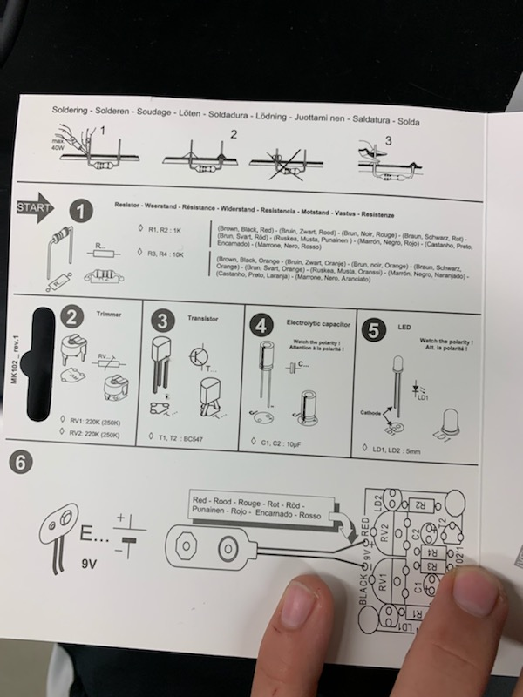
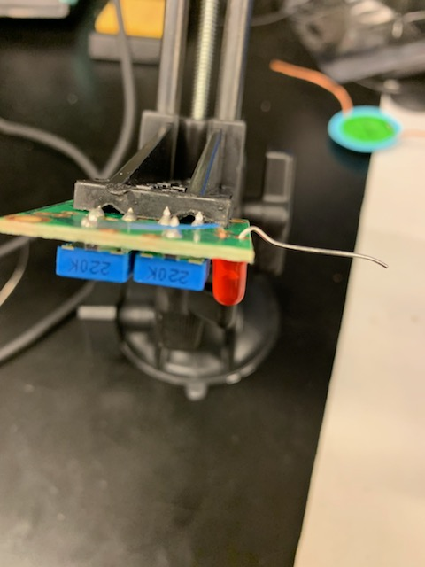
Lab 1- Part 2
This is the one of the steps in the process of soldering the Blinking LED kit

Slide 4
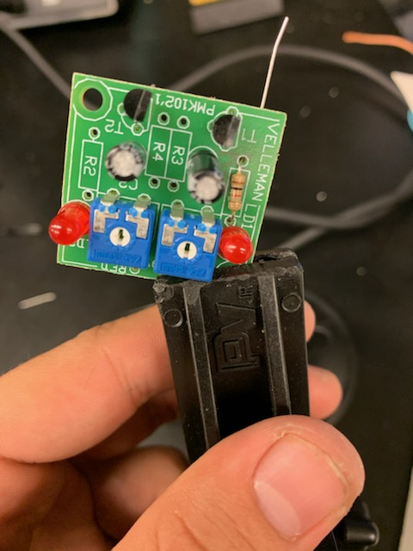
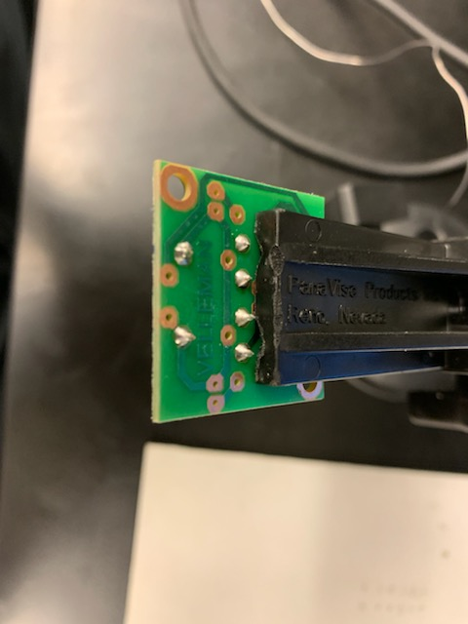
Lab 1- Part 3
This is the one of the end steps in the process of soldering the Blinking LED kit

Slide 5
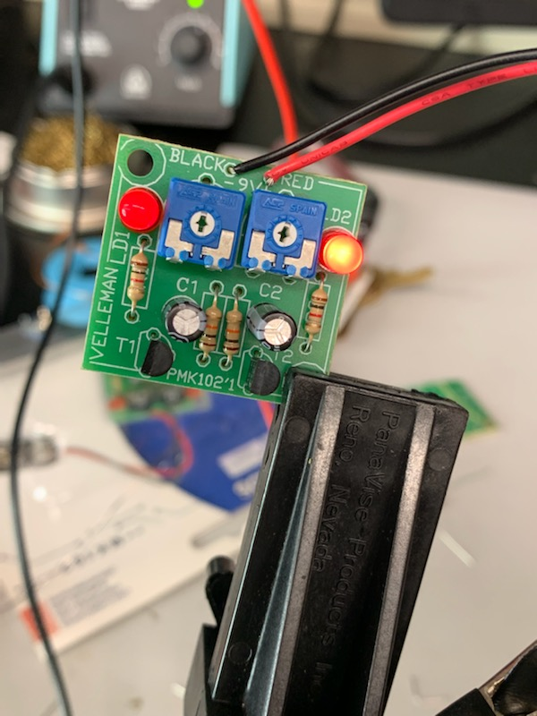
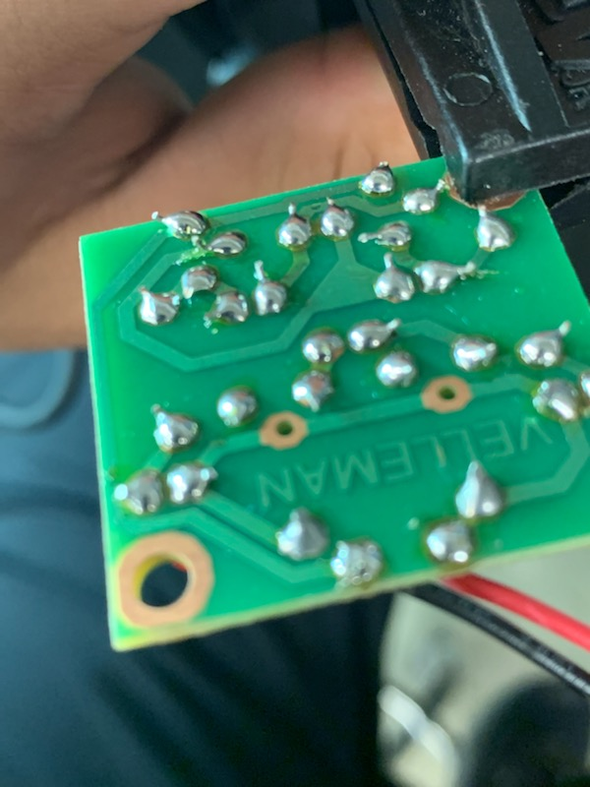
Lab 1- Part 4
This is the completed circuit board for the blinking LED kit

Slide 6
Lab 1 - observations
The input for the LED blinker is 9 volts and as you turn each potentiometer the led tend to flash back in forth faster and we also had to double check that we did not put the led’s or capacitors in backwards. Instead of using a the standard 9 volt battery we decided to use the dc variable power supply to apply 9 volts to our circuit.

Slide 7
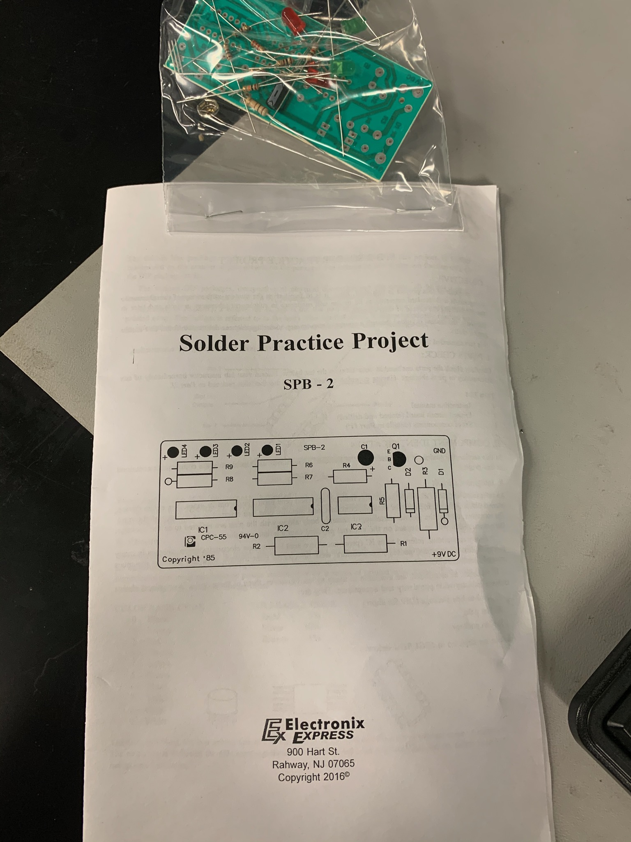
Lab 2 – Building the Solder Practice kit
Lab Partner was seth wills
The purpose of this lab is to build the solder practice kit
Equipment needed:
Solder practice kit
weller wes51 soldering iron
60/40 solder
Soldering stand
Solder Wick
Solder paste
Desoldering pump
Soldering sponge
Dc Variable Power Supply

Slide 8
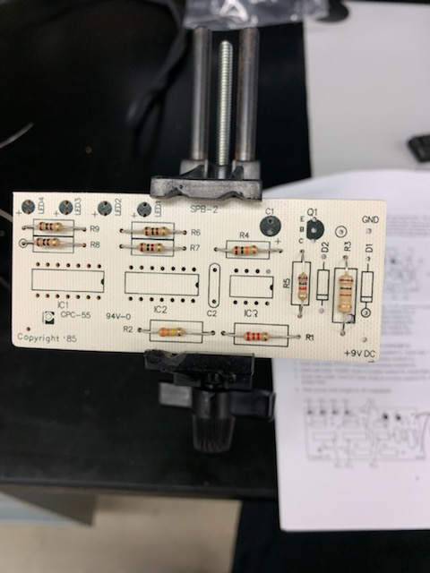
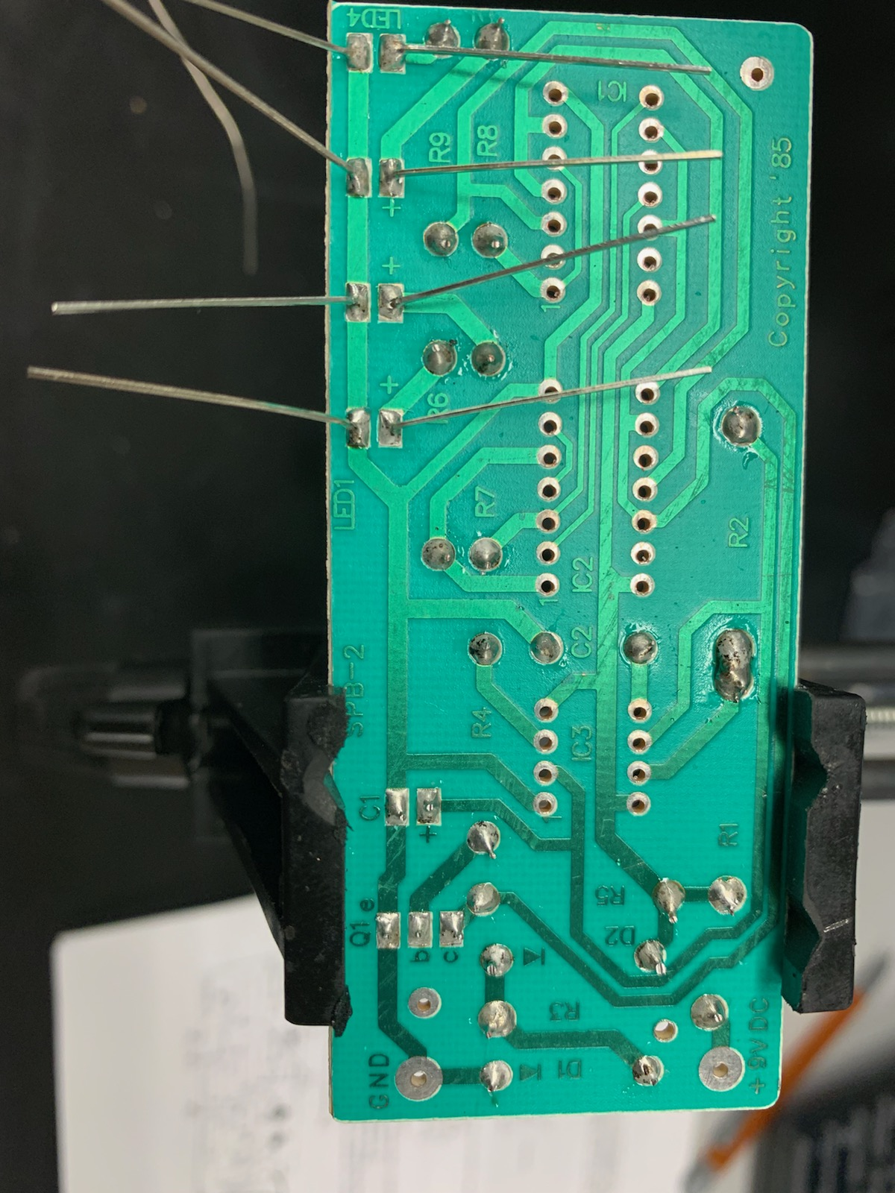
Lab 2 – part 2
This is the one of the steps in the process of soldering the solder practice kit

Slide 9
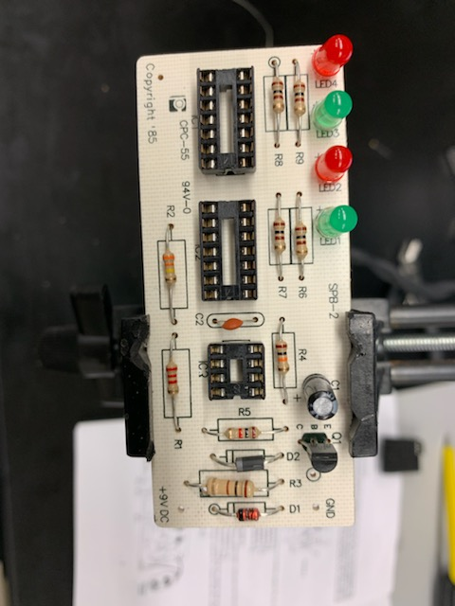
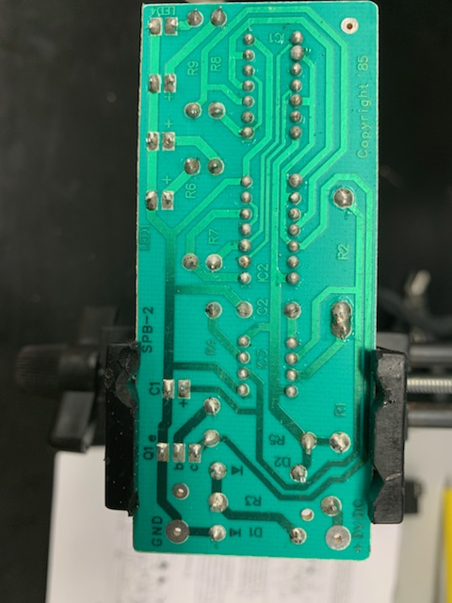
Lab 2 – part 3
This is the one of the end steps in the process of soldering the solder practice kit

Slide 10
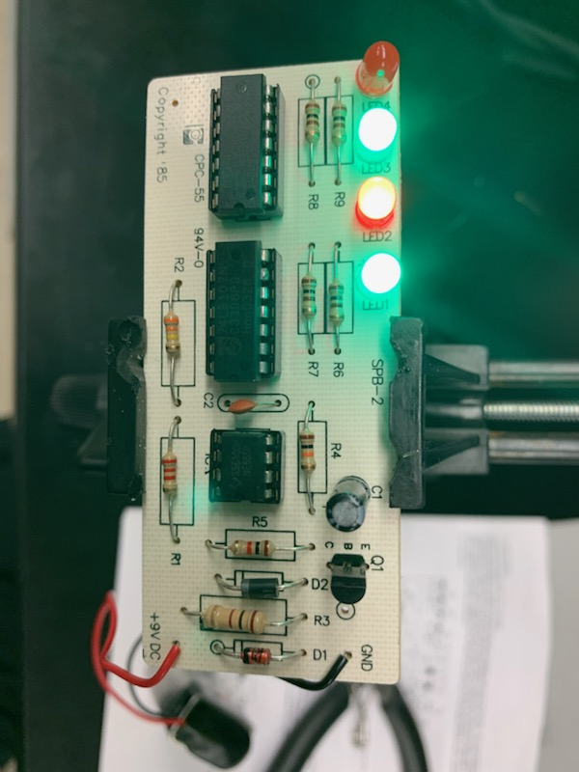
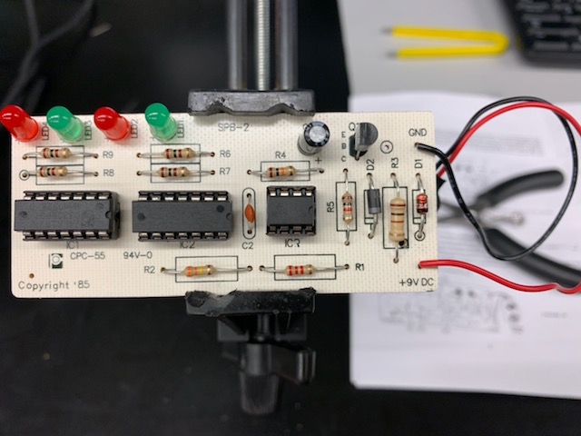
Lab 2 – part 4
This is the completed circuit board for the solder practice kit and fully functional

Slide 11
Lab 2 – Observations
Overall this lab was a success but we did find out that there is a manufacturing flaw with the board it self so it does not work properly. The issue is that it is missing trace. The led alternates back in forth. The majority of our kits have ice sockets so the chips are not directly on the board

Slide 12
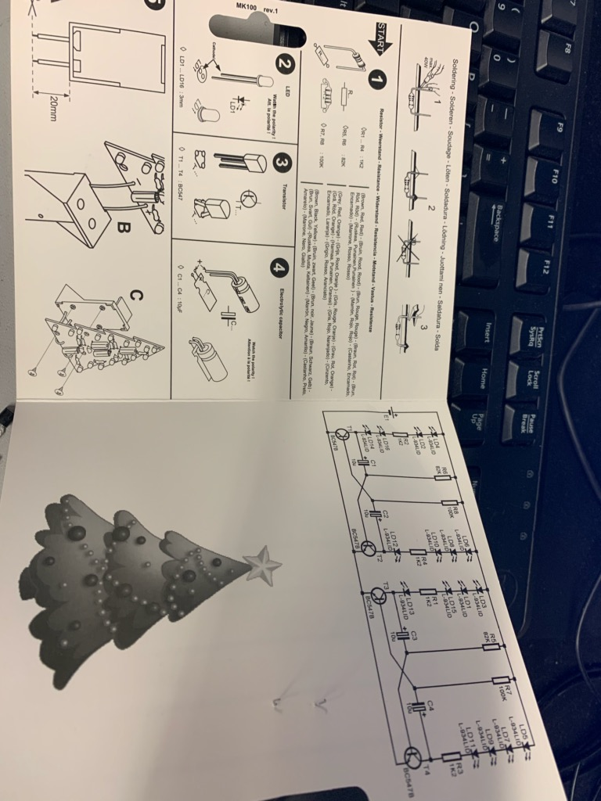
Lab 3 – Building the Christmas tree
Lab Partner was seth wills
The purpose of this lab is to build the Christmas tree kit
Equipment needed:
Christmas tree kit
weller wes51 soldering iron
60/40 solder
Soldering stand
Solder Wick
Solder paste
Desoldering pump
Soldering sponge
Dc Variable Power Supply

Slide 13
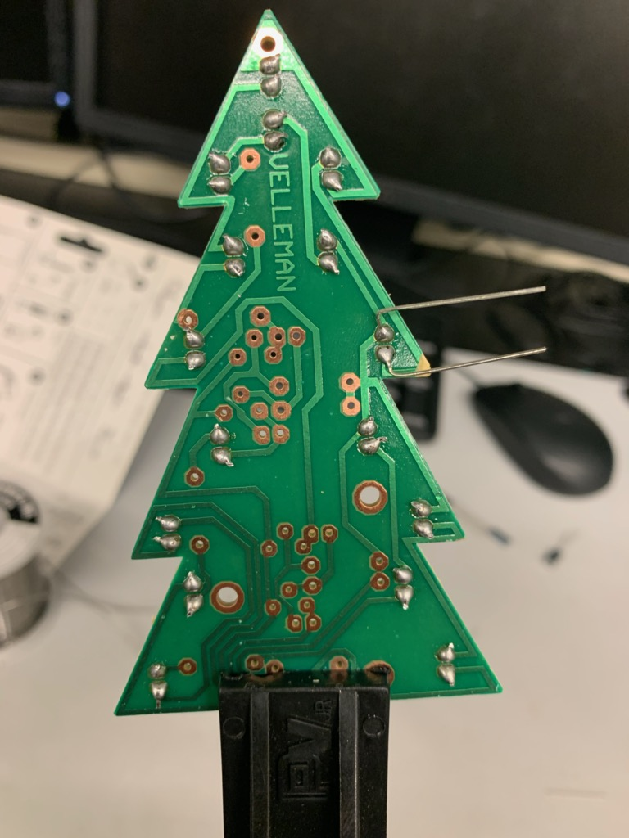
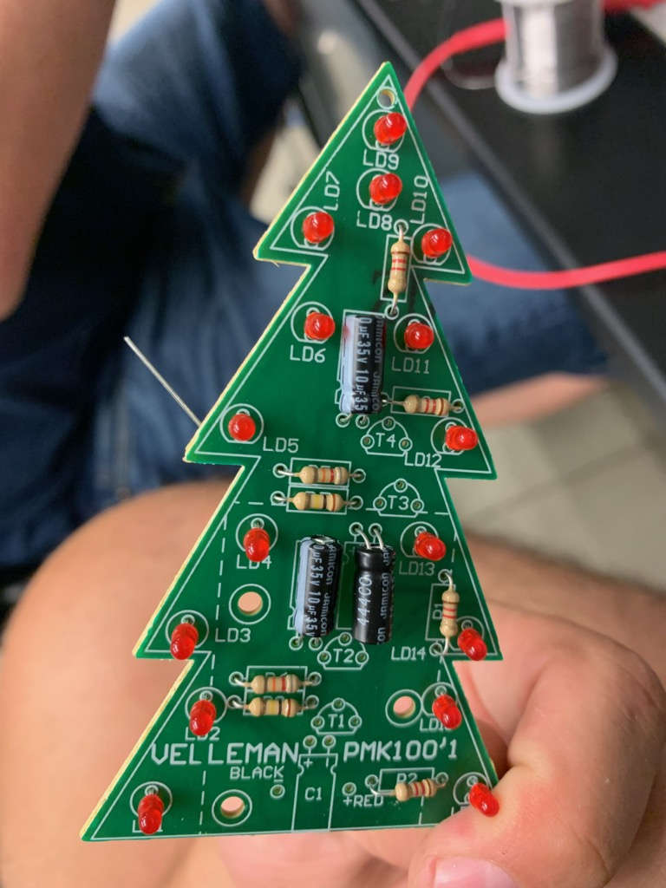
Lab 3 – Part 2
This is the one of the steps in the process of soldering the Christmas Tree

Slide 14
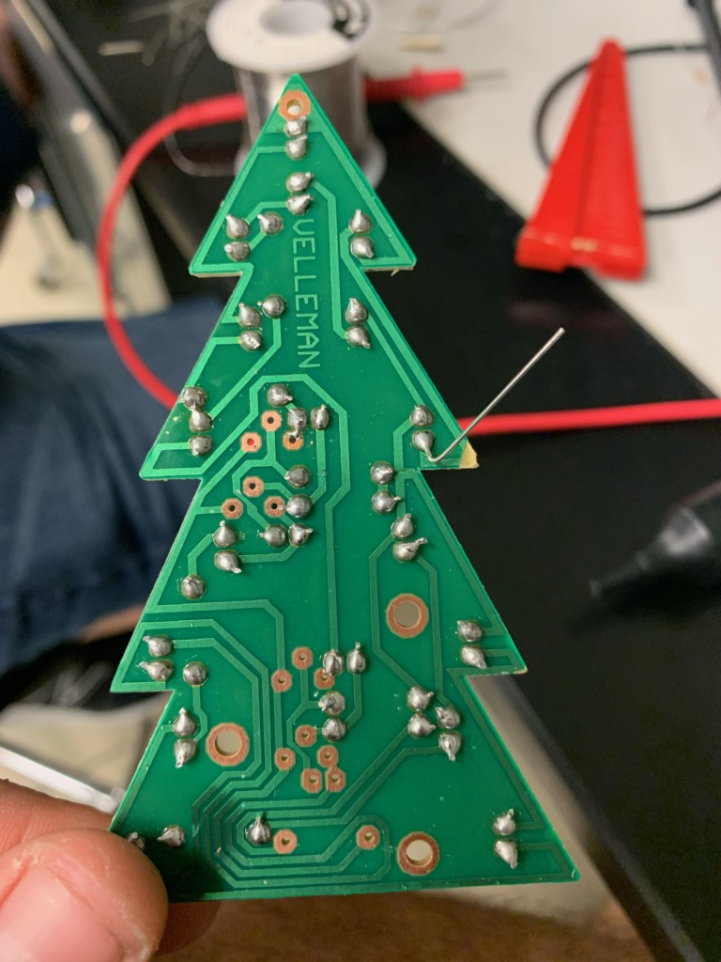
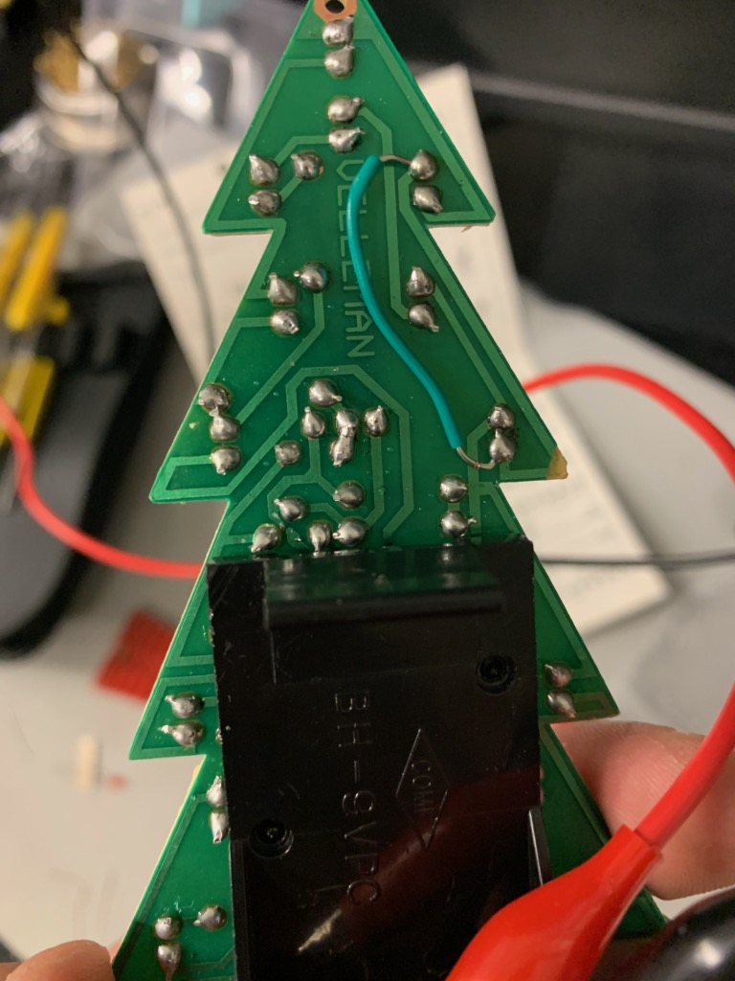
Lab 3 – Part 3
This is the one of the end steps in the process of soldering the Christmas tree

Slide 15
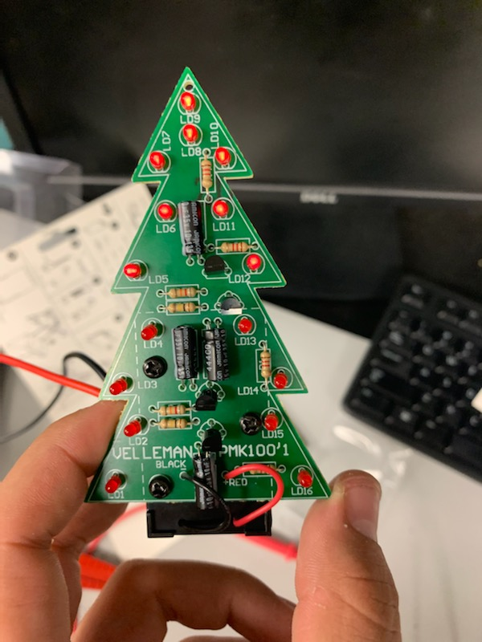
Lab 3 – Part 4
This is the fully function Christmas tree kit that has alternating LED’s

Slide 16
Lab 3 – observations
The Christmas tree kit did work. This particular kit acts like blinking tree. The red Led’s alternate illuminating lights. You had to be very careful of not putting leds in backwards because they will blow up the led’s. Once again we used the dc variable power supply instead of a 9 volt battery.

Slide 17
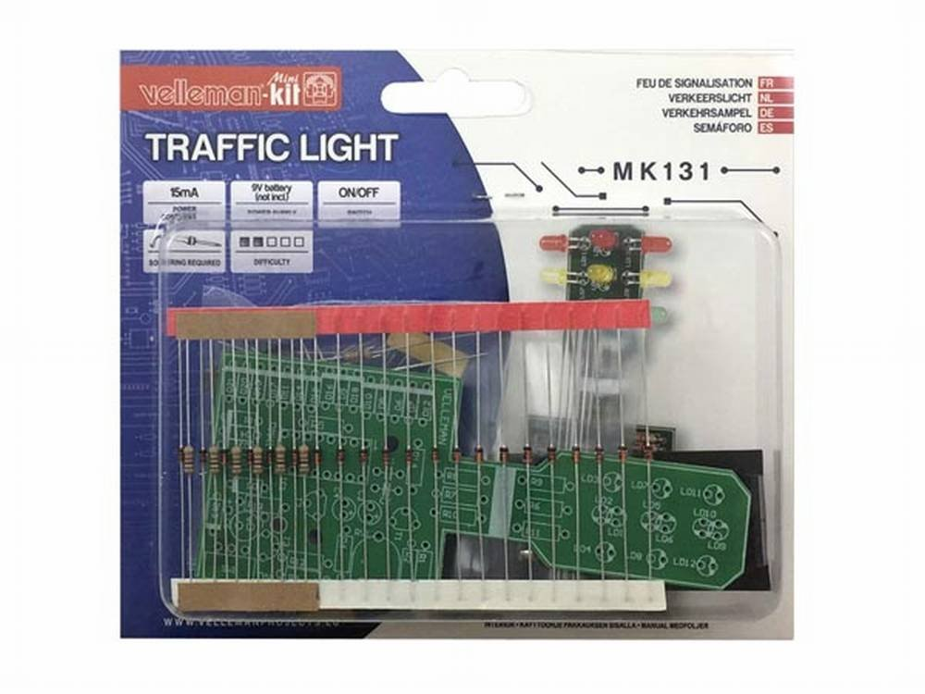
Lab 4 – Building the stop light kit
Lab Partner was seth wills
The purpose of this lab is to build the stop light kit
Equipment needed:
stop light kit
weller wes51 soldering iron
60/40 solder
Soldering stand
Solder Wick
Solder paste
Desoldering pump
Soldering sponge
Dc Variable Power Supply

Slide 18
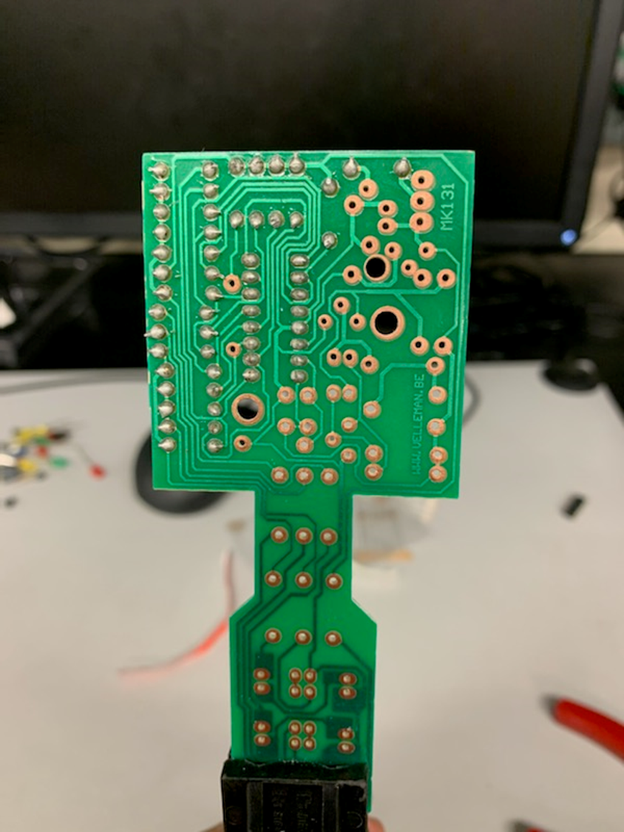
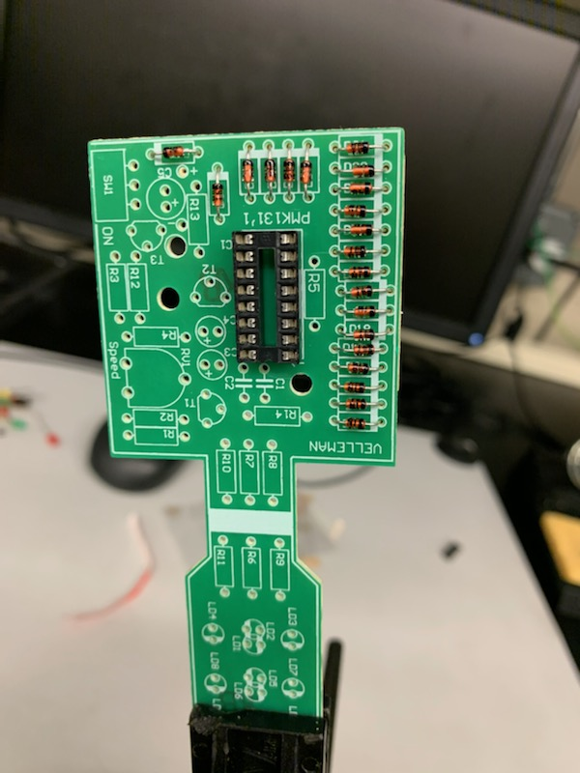
Lab 4 – Part 2
This is the one of the steps in the process of soldering the stop light

Slide 19
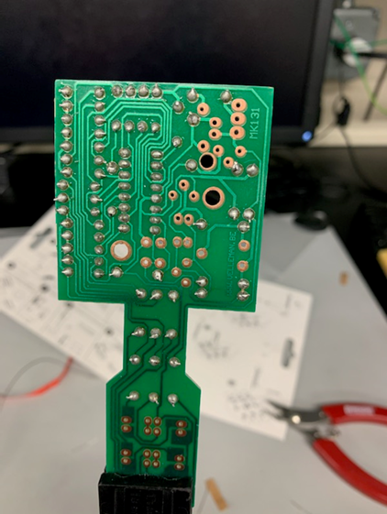
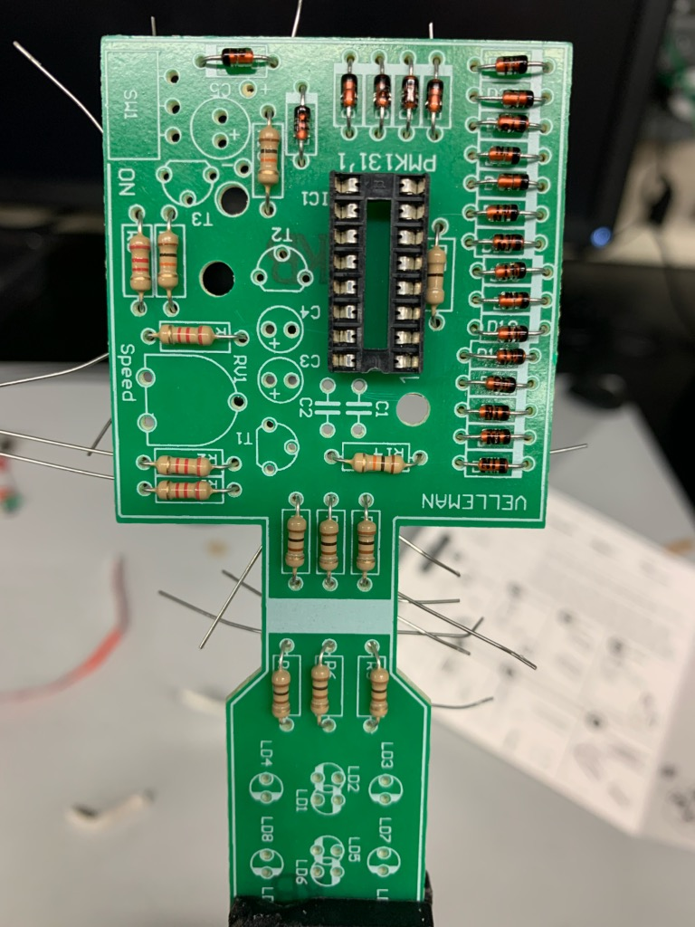
Lab 4 – Part 3
This is the one of the end steps in the process of soldering the stop light

Slide 20
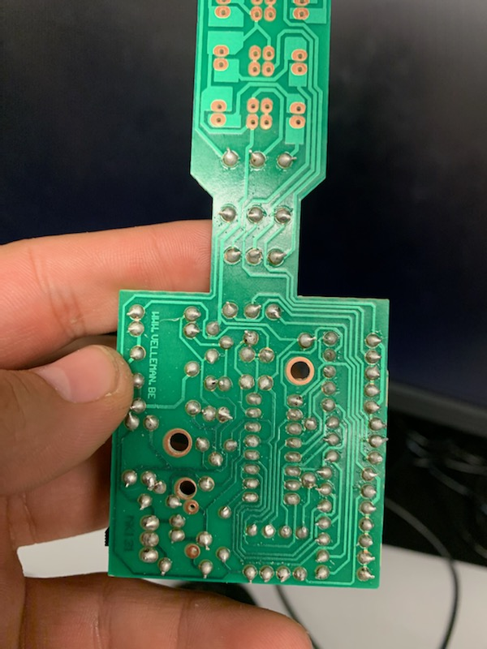
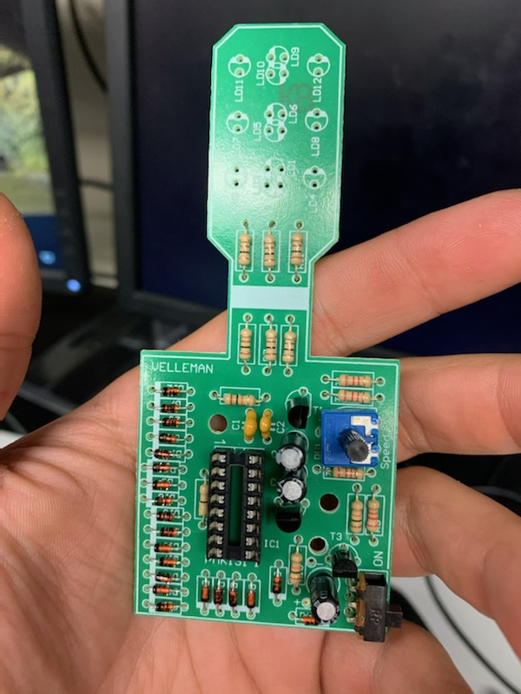
Lab 4 – Part 4
This is the one of the end steps in the process of soldering the stop light

Slide 21
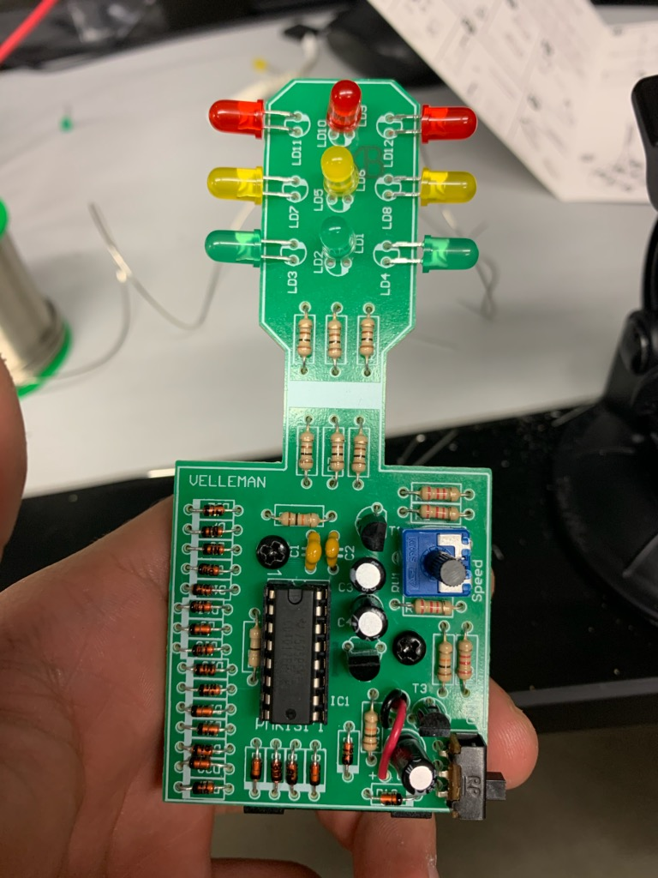
Lab 4 – Part 5
This is the completed stop light circuit

Slide 22
Lab 4 – Observations
Overall this kit was probably one of the difficult ones. We ran into some issues. The first issue was that we got confused that we had 3 extra led’s but those led’s actually go on the back of the board. This kit did not function correctly and we tried to trouble shoot the board but we were not successful.

Slide 23
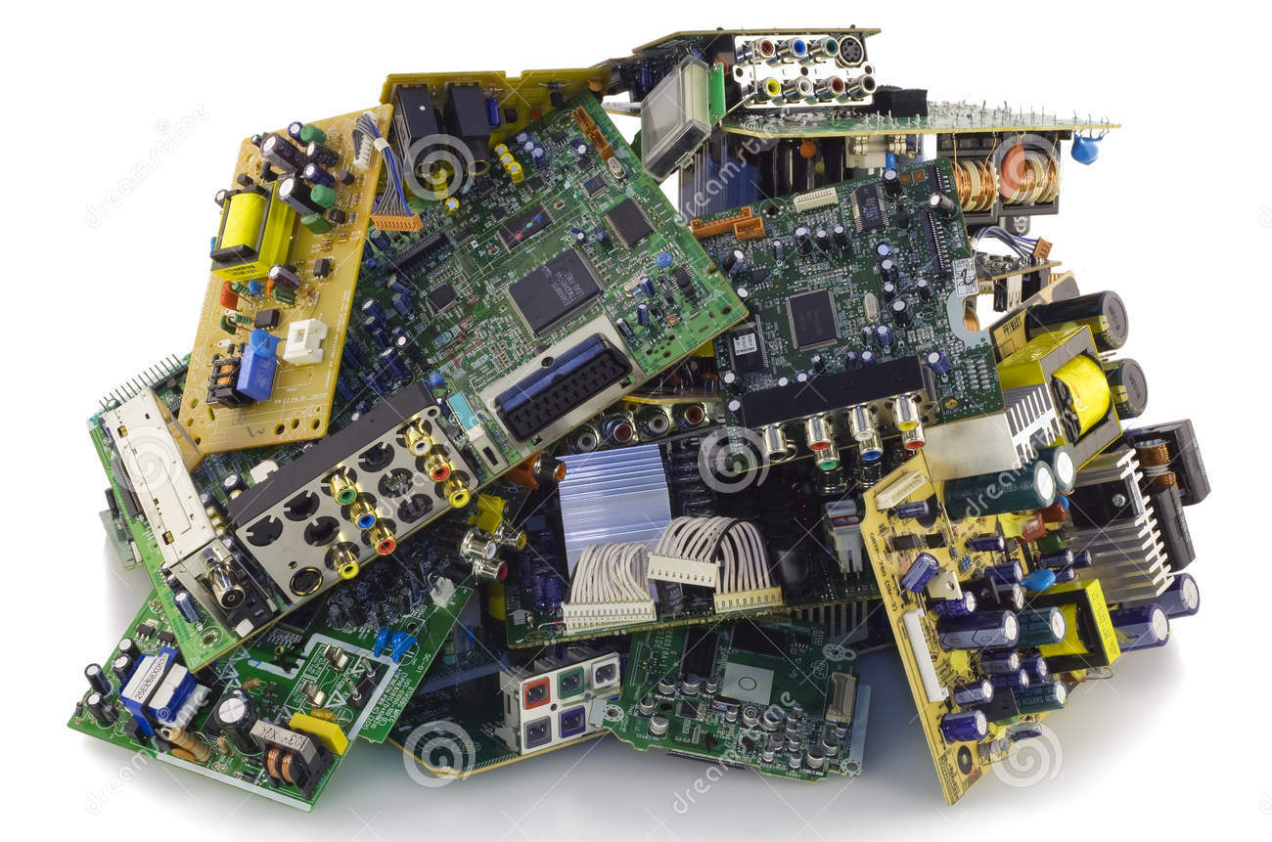
Lab 5 – Building the Fix broken items that instructor will give you.
Lab Partner was seth wills
The purpose of this lab is to Fix broken items that instructor will give you.
Equipment needed:
Various parts we fixed for Professor bell (PS Controller, Receiver for robot and alligator clip)
weller wes51 soldering iron
60/40 solder
Soldering stand
Solder Wick
Solder paste
Desoldering pump
Soldering sponge
Dc Variable Power Supply

Slide 24
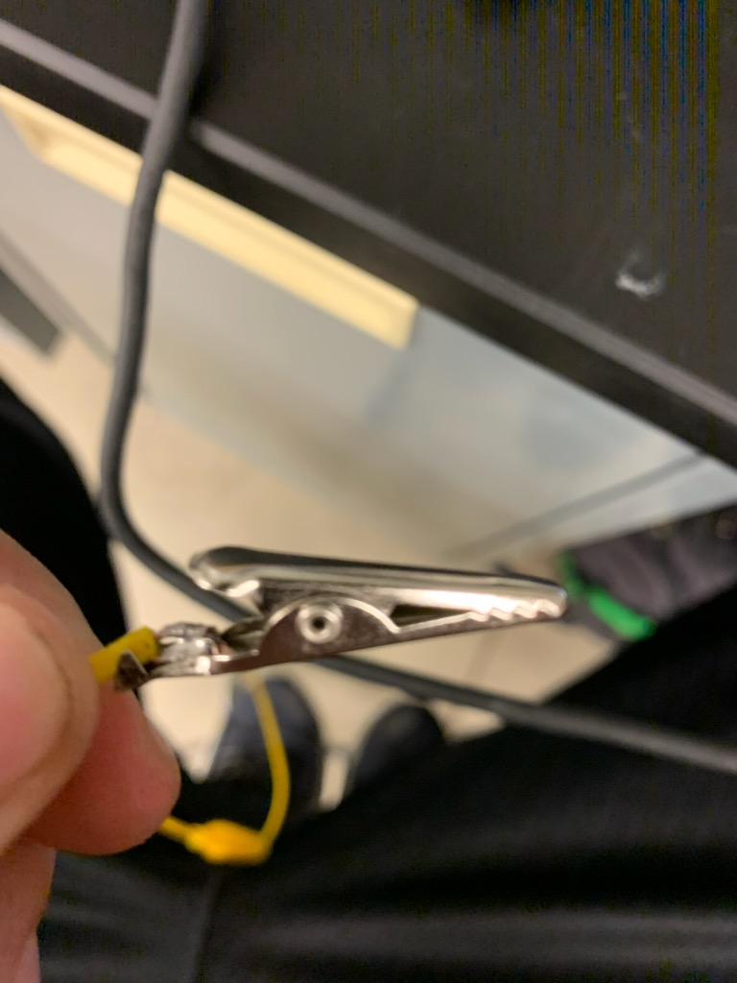
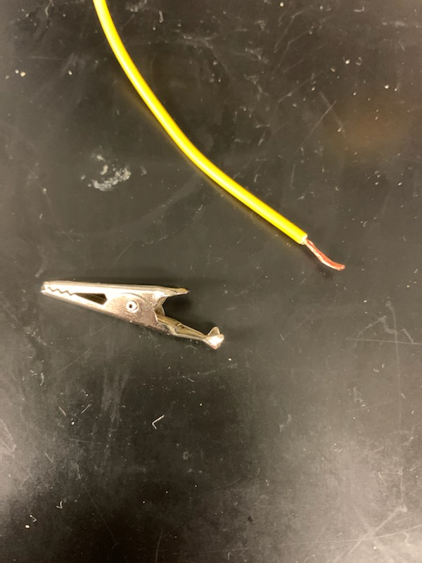
Lab 5 – Part 2
This is in the process of fixing the alligator clip lead

Slide 25
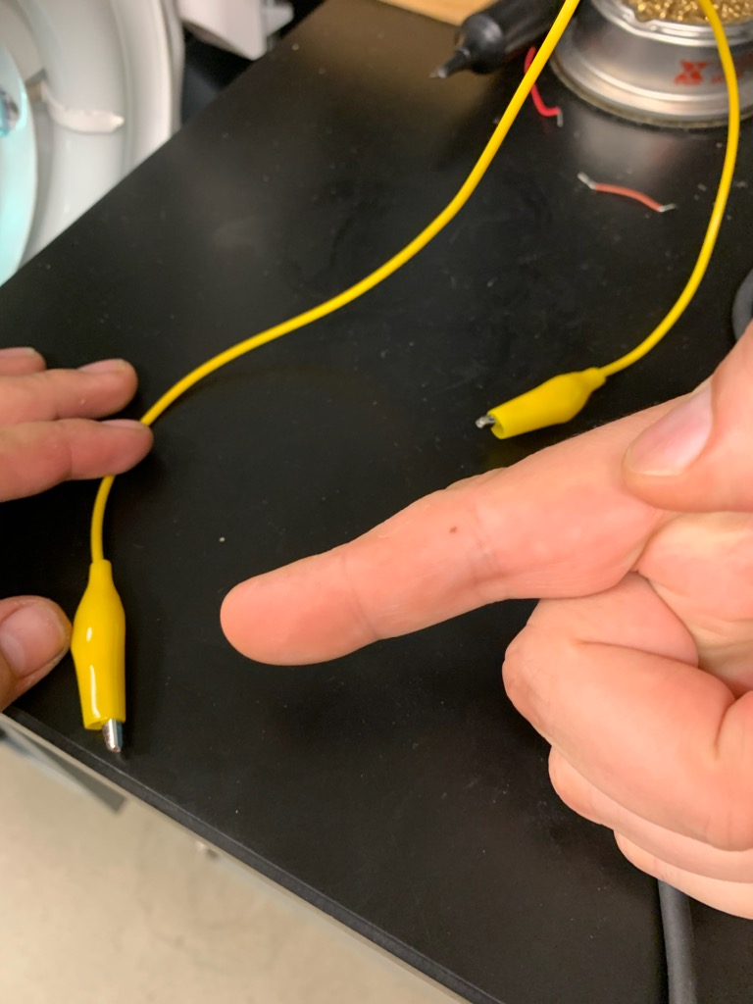
Lab 5 – Part 3
This is the fixed and fully functional alligator test lead

Slide 26
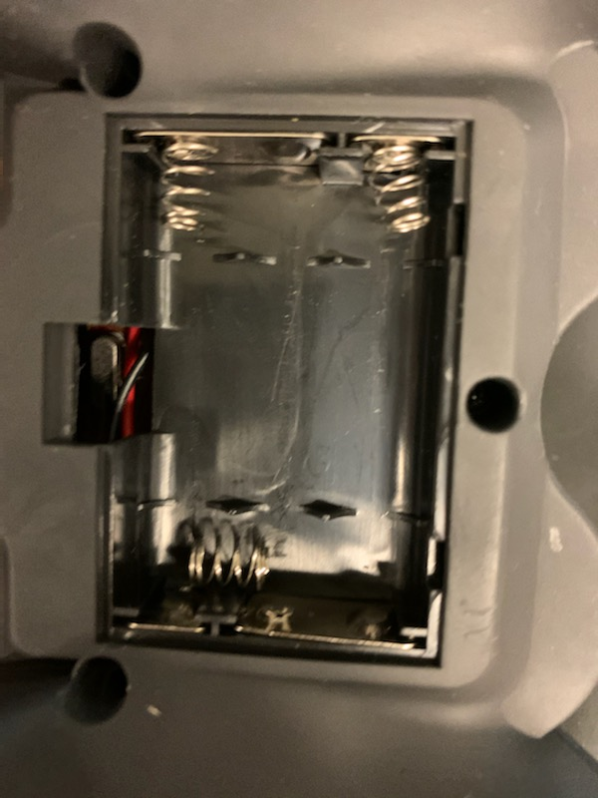
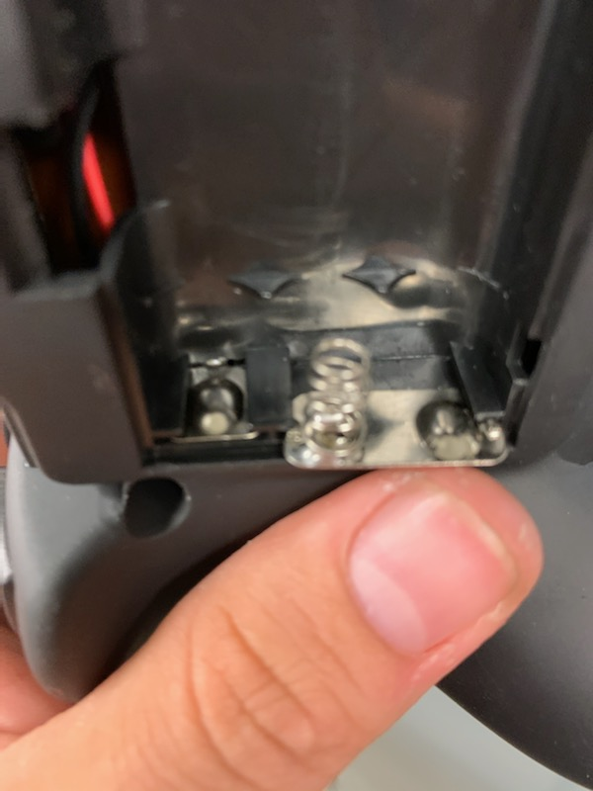
Lab 5 – Part 4
This is the fixed battery holder inside the controller

Slide 27
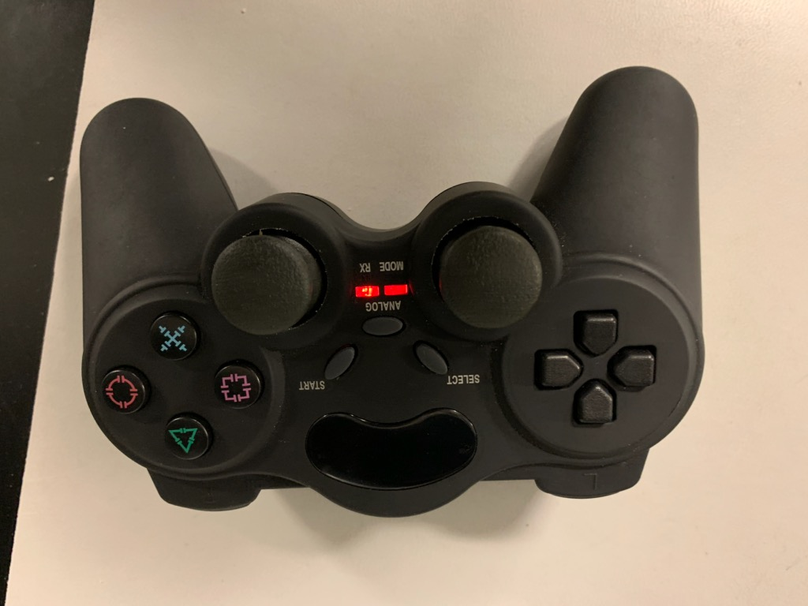
Lab 5 – Part 5
This is the controller turned on after having the spring fixed to hold the battery

Slide 28
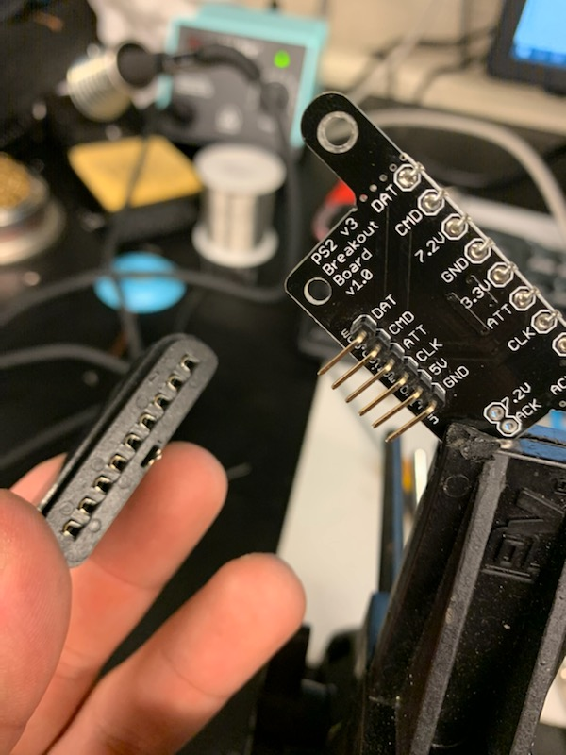
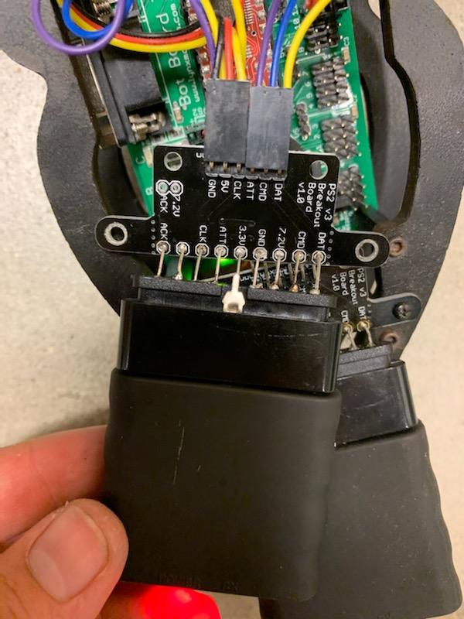
Lab 5 – Part 6
This is in the process of fixing the receiver

Slide 29
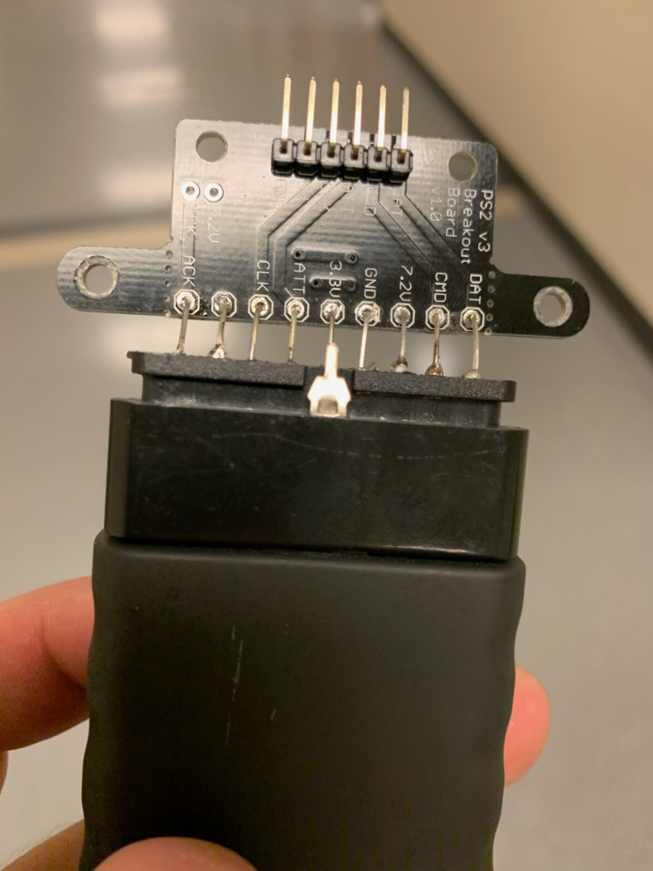
Lab 5 – Part 7
This is our completed fix receiver

Slide 30
Lab 5 - Observations
Overall, this was pretty easier the alligator clip was simple, and the controller was easy, all we had to do was resolder the spring onto the battery pack. The hardest part of this lab is the receiver for the robot because it required a lot of modifications to how we normally solder.

Slide 31
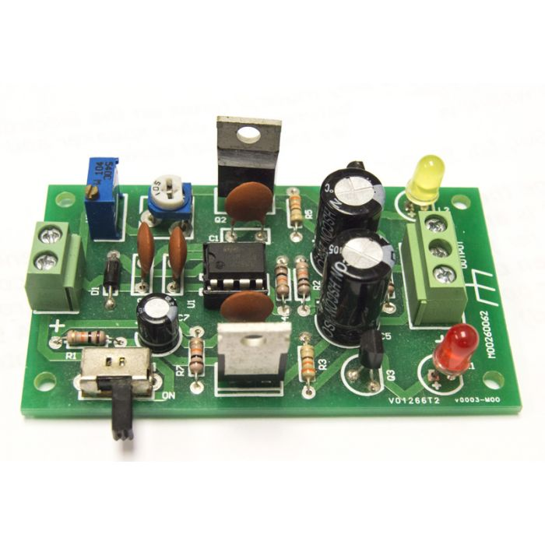
Lab 6 – Build and test the dual power supply
Lab Partner was seth wills
The purpose of this lab is Build and test the dual power supply
Equipment needed:
the dual power supply Kit
weller wes51 soldering iron
60/40 solder
Soldering stand
Solder Wick
Solder paste
Desoldering pump
Soldering sponge
Dc Power Supply

Slide 32
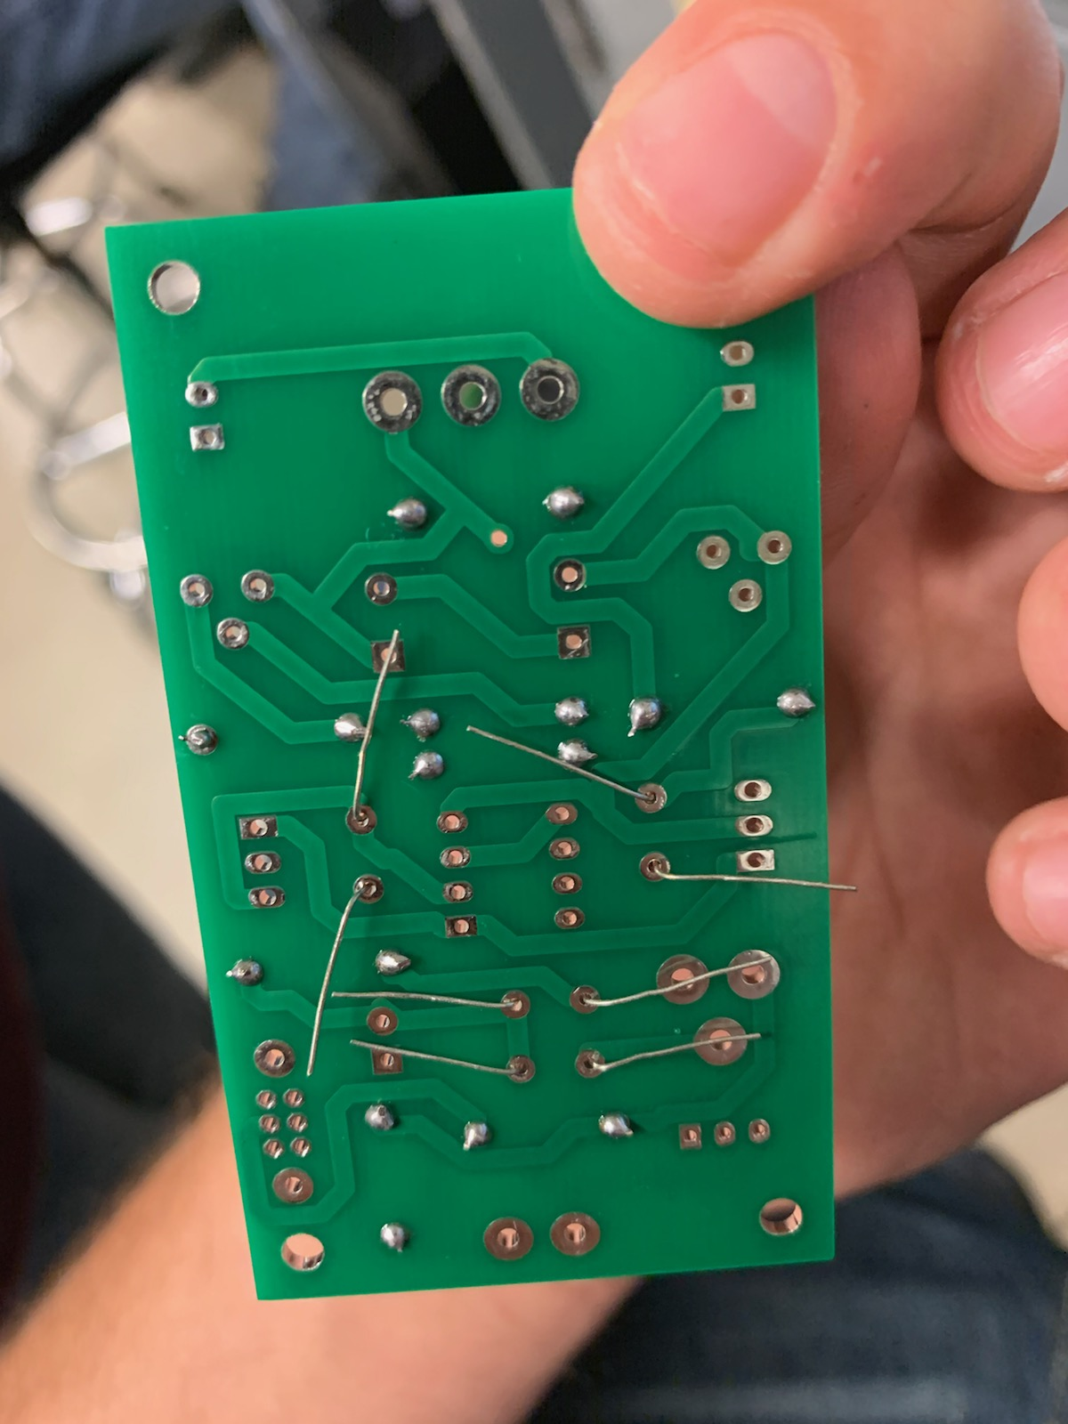
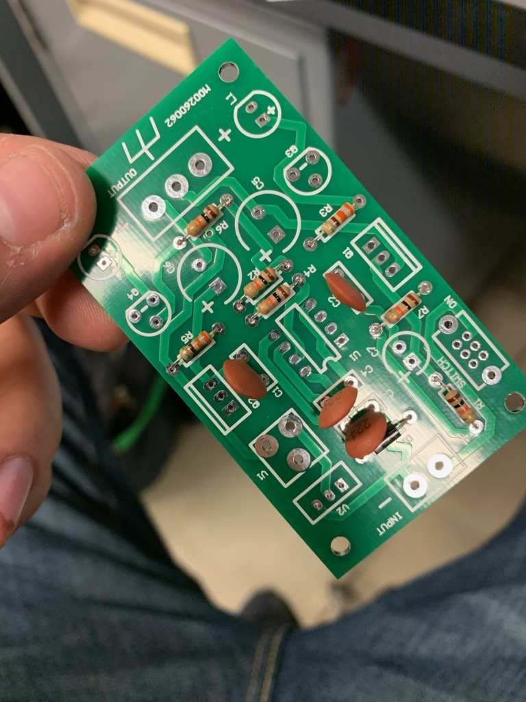
Lab 6 – Part 2
This is the front and back of the Dual Power Supply Kit

Slide 33
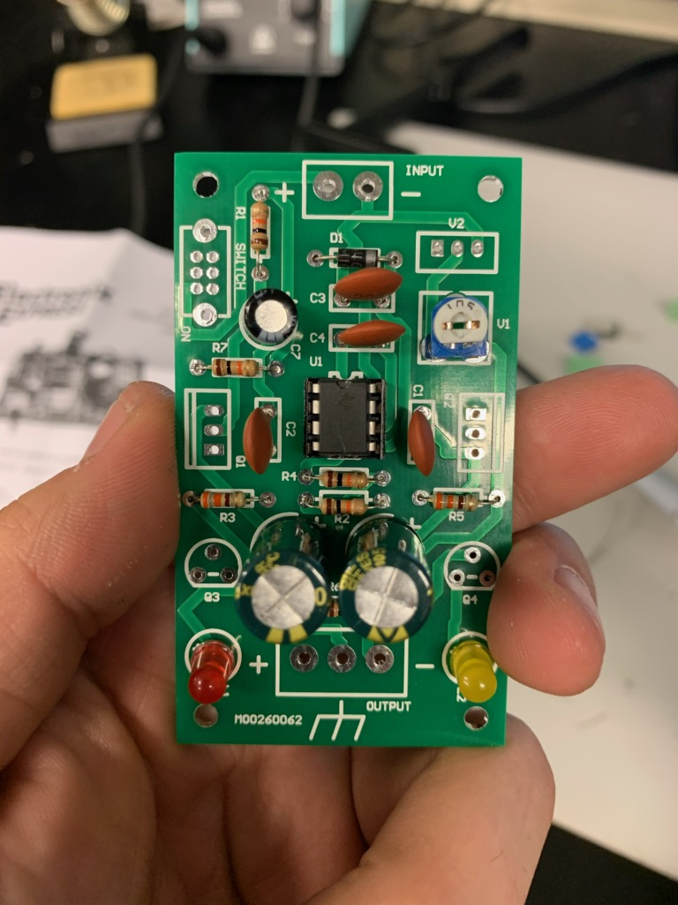
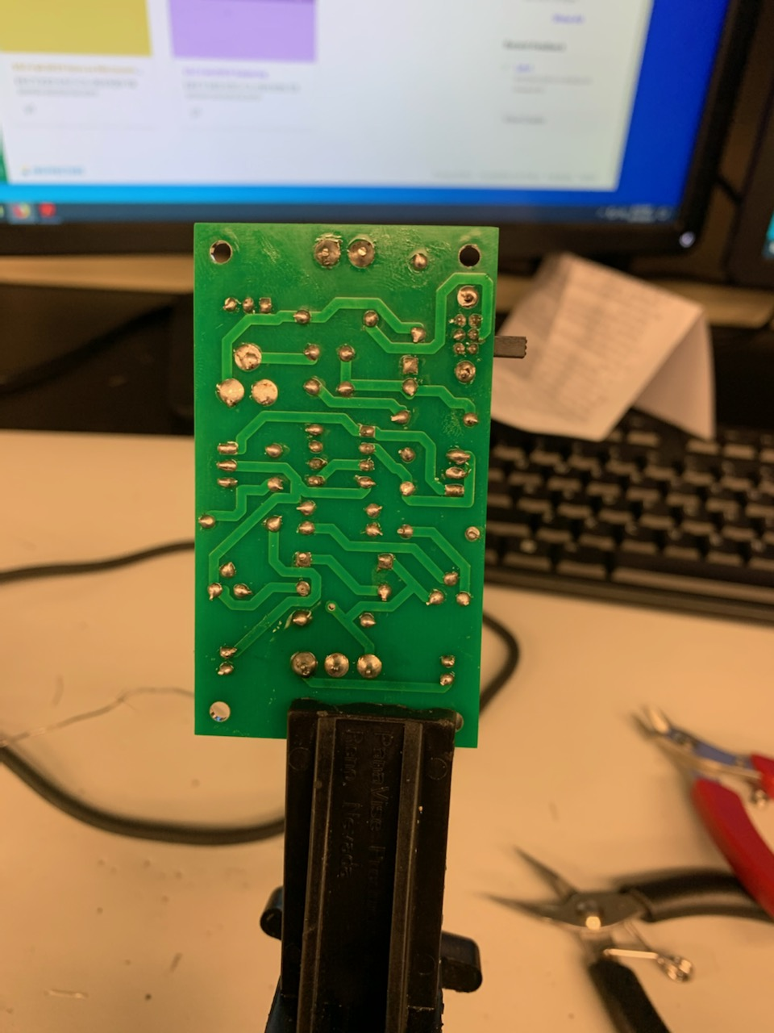
Lab 6 – Part 3
This is in the process of soldering the components onto the back of the circuit board

Slide 34
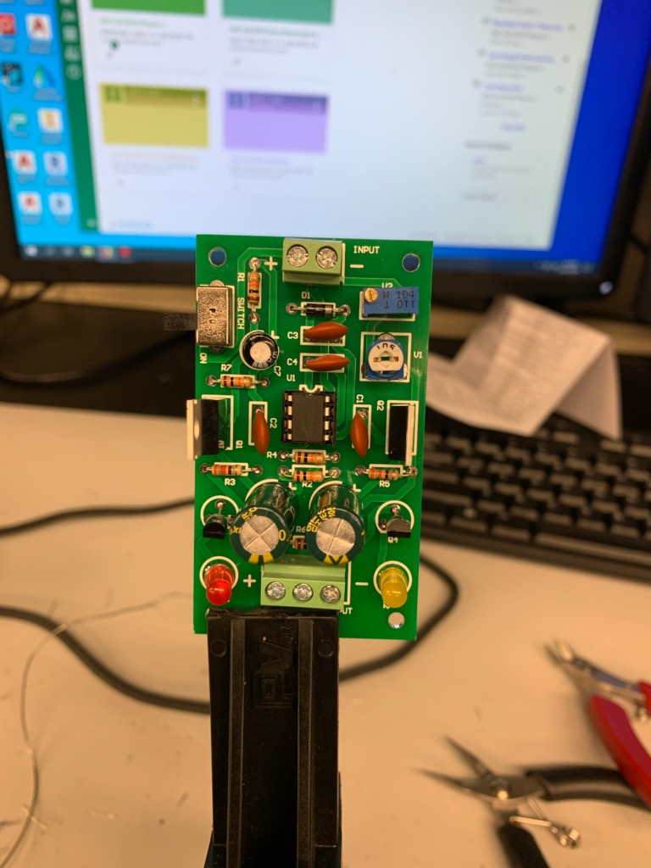
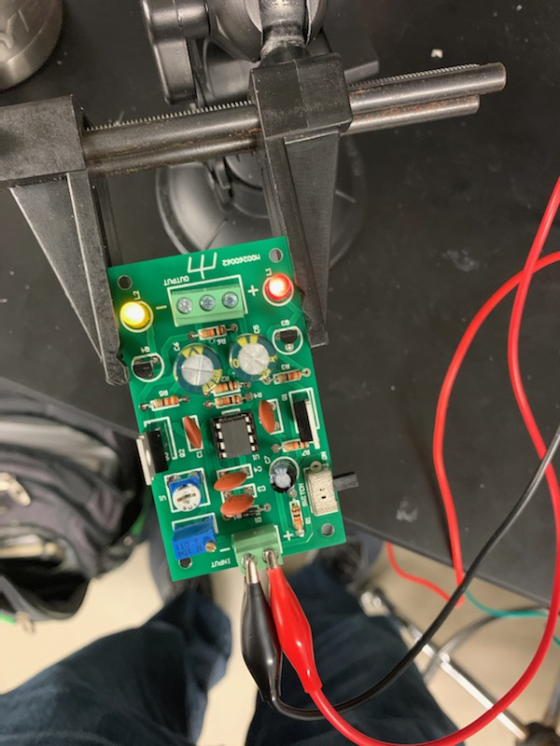
Lab 6 – Part 4
This is the completed circuit of the DC Dual Power supply fully functional

Slide 35
Lab 6 – Observations
Overall this was a fairly easy kit to build. The DC power Supply puts out a negative and a positive voltage. We had zero trouble doing this. When we hooked up the input voltage it was at 9 volts first and when we increased and decreases the voltage from the power supply, we could see the output voltage change drastically.

Slide 36
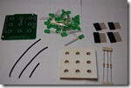
Lab 7 – 3x3x3 LED Cube Arduino Shield
Lab Partner was seth wills
The purpose of this lab is Build and test 3x3x3 LED Cube Arduino Shield
Equipment needed:
the 3x3x3 LED Cube Arduino Shield
weller wes51 soldering iron
60/40 solder
Soldering stand
Solder Wick
Solder paste
Desoldering pump
Soldering sponge
Arduino Uno

Slide 37
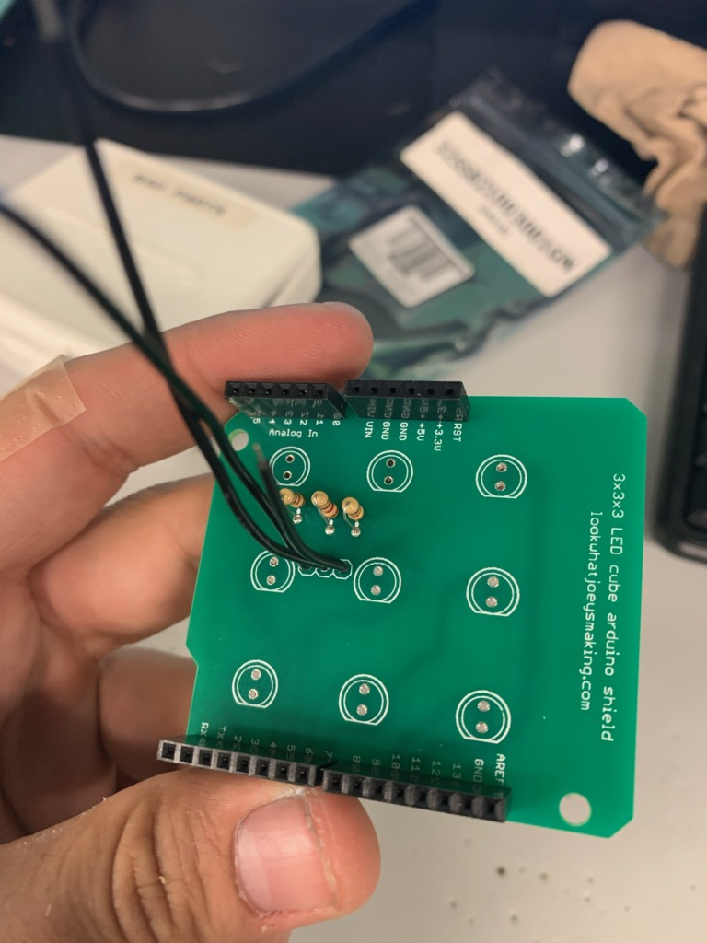
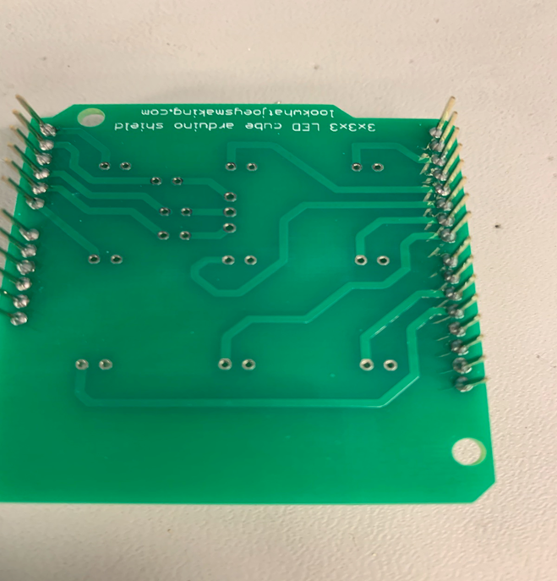
Lab 7 – Part 2
This is the front and back of the base circuit board

Slide 38
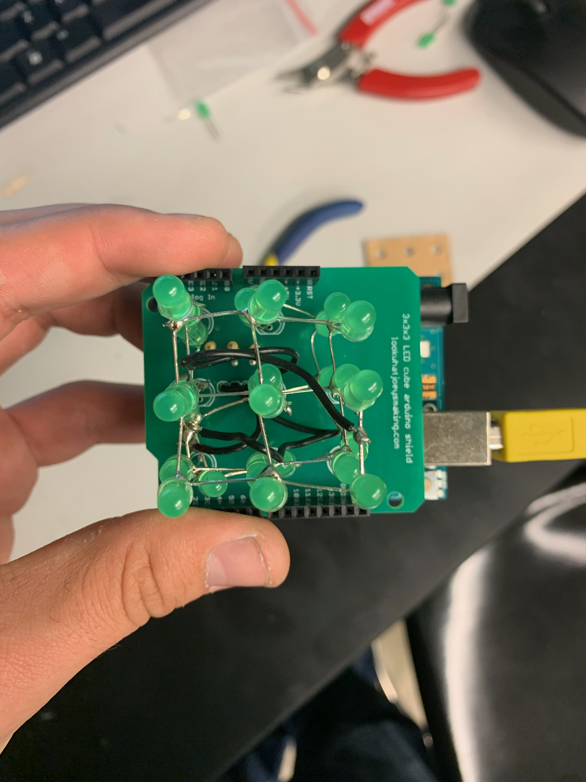

Lab 7 – Part 3
This the cube not assembled

Slide 39


Lab 7 – Part 4
This is our completed cube for the Arduino circuit

Slide 40

Lab 7 – Part 5
This is our completed circuit for the LED Cube

Slide 41
Lab 7 - Observations
Overall this was the most confusing and most difficult lab we did. The resources provided in order to build the cube wasn’t very stable. In order to code the Arduino we had to use a code off of the internet because you can make the cube do multiple things. Also the cube did not light up very bright. Were were not sure if that was the intent or something was wrong on the configuration.

Slide 42

Lab 8 – DC to DC Converter
Lab Partner was seth wills
The purpose of this lab is Build and test DC to DC Converter
Equipment needed:
DC to DC Converter
weller wes51 soldering iron
60/40 solder
Soldering stand
Solder Wick
Solder paste
Desoldering pump
Soldering sponge

Slide 43


Lab 8 – pArt 2
Front and back of the of the DC/DC Converter

Slide 44


Lab 8 – pArt 3
Front and back of the of the DC/DC Converter

Slide 45

Lab 8 – pArt 4
Front and back of the of the DC/DC Converter

Slide 46


Lab 8 – pArt 5

Slide 47
Lab 8 – Observations
Overall, this was a very simple lab. We primarily knew exactly how this worked. We did not have any issues with this lab. We tested this kit out to see if it actually worked and it did. The input was APPROCIMATLEY 11 AND -11 VOLTS.

Slide 48

Lab 9 – Am radio kit
Lab Partner was seth wills
The purpose of this lab is Build and test AM Radio Kit
Equipment needed:
AM Radio Kit
weller wes51 soldering iron
60/40 solder
Soldering stand
Solder Wick
Solder paste
Desoldering pump
Soldering sponge

Slide 49


Lab 9 – Part 2
This is in the process of soldering the AM Radio with the components

Slide 50


Lab 9 – Part 3
This is the back of the board in the soldering process

Slide 51


Lab 9 – Part 4
This is the AM Radio almost fully assembled

Slide 52


Lab 9 – Part 5
This is the completed AM Radio that eventually became fully functional due to troubleshooting

Slide 53
Lab 9 - Observations
Overall, this was one of the more difficult kits. The instructions for this kit was a little confusing. Soldering the parts onto the board and locating were the easiest parts. The Antenna could be better built because the signal from the kit would not stay stable to get a clear radio station.

Slide 54

Lab 10 – Piano Kit with 3 watt amplifier
Lab Partner was seth wills
The purpose of this lab is Build and test Piano Kit with 3 watt amplifier
Equipment needed:
Piano Kit with 3 watt amplifier
weller wes51 soldering iron
60/40 solder
Soldering stand
Solder Wick
Solder paste
Desoldering pump
Soldering sponge

Slide 55


Lab 10 – Part 2
This is the beginning of placing the parts through the board and soldering them

Slide 56


Lab 10 – Part 3

Slide 57


Lab 10 – Part 4
This is the piano fully soldered with all the components on the board

Slide 58


Lab 10 – Part 5

Slide 59


Lab 10 – Part 6
This the 3 watt amplifier and the fully built piano. We assembled both circuits together

Slide 60
Lab 10- Observations
Overall we combined the 3 watt amplifier and the piano kit to amplify the sound of the piano. We noticed that the sound quality of the piano is not very good or not even with each sound. What could be improved with this lab is to adjust the resister values to adjust the sound quality.

Slide 61

Lab 11 – Wemake Regulated DC Power supply
Lab Partner was seth wills
The purpose of this lab is Build and test Wemake Regulated DC Power supply Kit
Equipment needed:
Wemake Regulated DC Power supply
weller wes51 soldering iron
60/40 solder
Soldering stand
Solder Wick
Solder paste
Desoldering pump
Soldering sponge

Slide 62


Lab 11 – Part 2
Top and bottom of the power supply circuit board

Slide 63


Lab 11 – Part 3

Slide 64


Lab 11 – Part 4

Slide 65


Lab 11 – Part 5
Completed DC power supply

Slide 66


Lab 11 – Part 6
Power supply readings from taken from digital multi-meter

Slide 67

Lab 11 – Part 7
Completed audio detector being power by the assembled power supply

Slide 68
Lab 11- Observations
Overall this is one of the best labs that we did. We noticed after the power supply was built that instead of the variable measurement of 0 to 15 vdc. The power supply actually went up to 18 volts. We decided to test another circuit using the power supply to see if it was actually functional and it was. Assembling the inside of the power supply was a little difficult because the instruction weren’t very clear

Slide 69

Lab 12 – Siren Code Oscillator
Lab Partner was seth wills
The purpose of this lab is Build and test Siren Code Oscillator
Equipment needed:
Siren Code Oscillator
weller wes51 soldering iron
60/40 solder
Soldering stand
Solder Wick
Solder paste
Desoldering pump
Soldering sponge

Slide 70


Lab 12 – Part 1
Front and back of the siren circuit incomplete

Slide 71


Lab 12 – Part 2
This is the completed siren circuit

Slide 72
Lab 12 - Observations
This was one of the easiest labs that we did. The siren Oscillator depicts a siren as the output such as an emergency personnel vehicle and if you switch the switch it translates into mores code. The hardest part of this lab was soldering the wires to the components hanging outside the circuit board

Slide 73

Lab 13 – Tube Amplifier
Lab Partner was seth wills
The purpose of this lab is Build and test Tube Amplifier Kit
Equipment needed:
6n3-buf Tube Amplifier Kit
weller wes51 soldering iron
60/40 solder
Soldering stand
Solder Wick
Solder paste
Desoldering pump
Soldering sponge

Slide 74


Lab 13 part 1 – Tube Amplifier
Lab Partner was seth wills
FRONT AND BACK OF THE TUBE AMPLIFIER

Slide 75

Lab 13 part 2 – Tube Amplifier
Lab Partner was seth wills
COMPLETED TUBE AMPLIFIER

Slide 76
Lab 13 - Observations
This solder kit was missing directions. Found examples of the circuit but nothing that was applicable to the actual product. We could not test the circuit.

Slide 77

The completion of EECT 103

