Slide 1
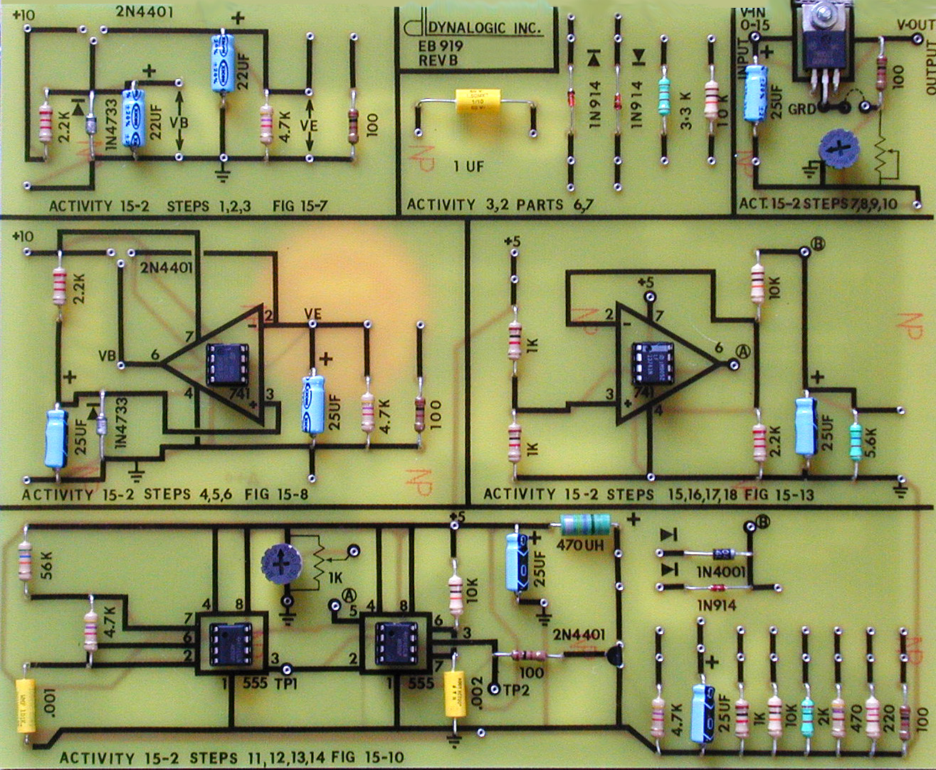
Lab Notebook for EECT 121
By: Jarred Clark
Lab Partner Were Seth Wills, Donald Stanley and Alex drummond Beside the +/- 9 Volt Power Supply

Slide 2
Lab 1: The Switching Diode Date: 09/05/18 Lab Partner was Seth wills, Donald Stanley and Alex Drummond
The Purpose Of this Lab was to:
Learn how a switching diode functions and build and test the diode while using multisim and using the equipment in the lab.
Equipment Needed:
Gwinsek GDM-8245 Multimeter
820 Ohm Resistor
1N4128 Se Switching Diode
1N4001 Switching Diode

Slide 3
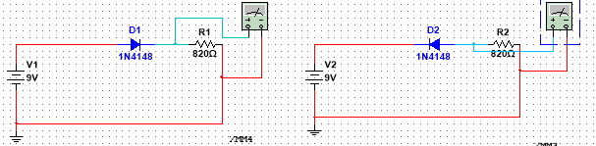
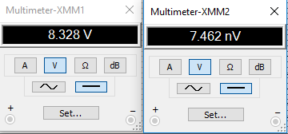
Lab 1: Part 2
Forward bias
Reverse bias
This multisim is a simulation of the 1N4148 diode in the forward and reverse bias. The diodes we used have a voltage drop of .7 volts. In the forward bias phase you get an output of a high (shown as 8.328 Volts)but in the reverse bias you get a low(shown as 7.462 NanoVolts) output.

Slide 4
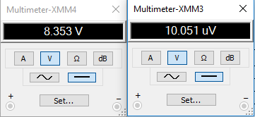
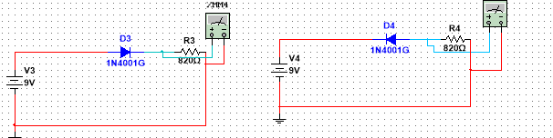
Lab 1:Part 3
Forward bias
Reverse bias
This multisim is a simulation of the 1N4001 diode in the forward and reverse bias. The diodes we used have a voltage drop of .7 volts. In the forward bias phase you get an output of a high (shown as 8.353 Volts)but in the reverse bias you get a low(shown as 10.051 MicroVolts) output.

Slide 5
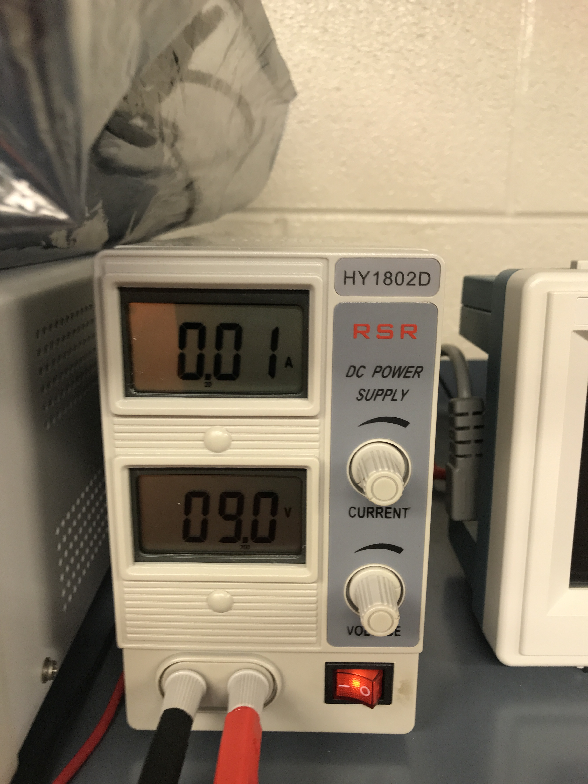
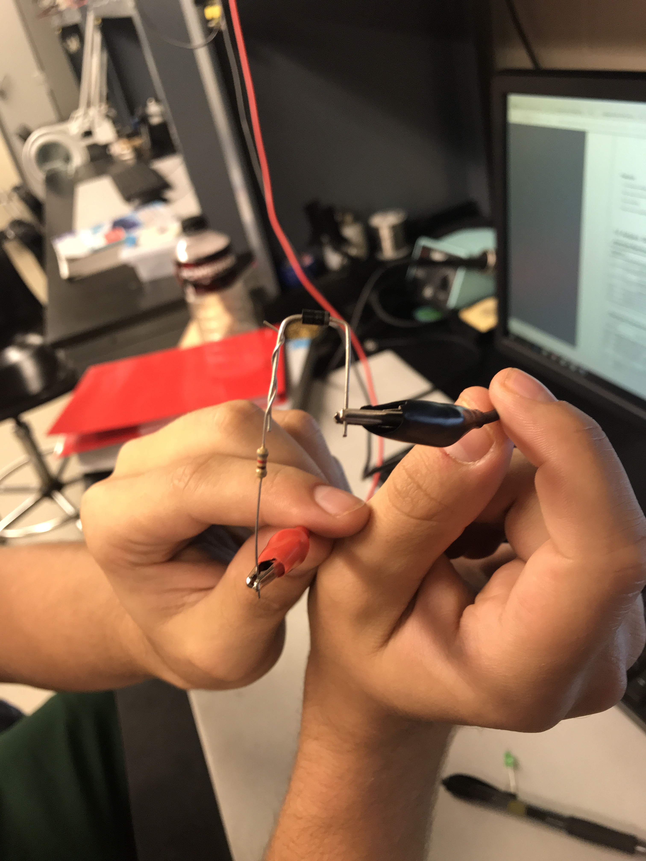
Lab 1: Part 4
Forward bias
Part: 1N4148
Applied voltage

Slide 6
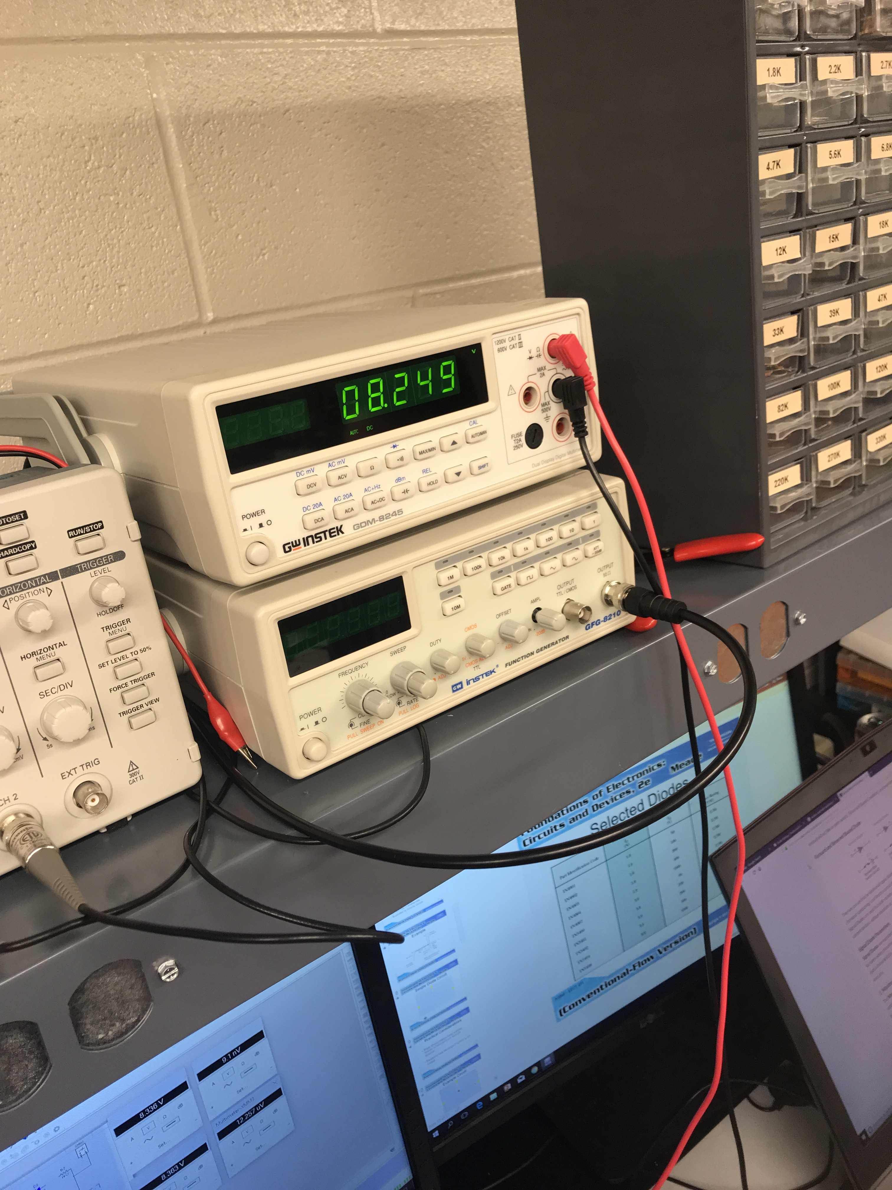
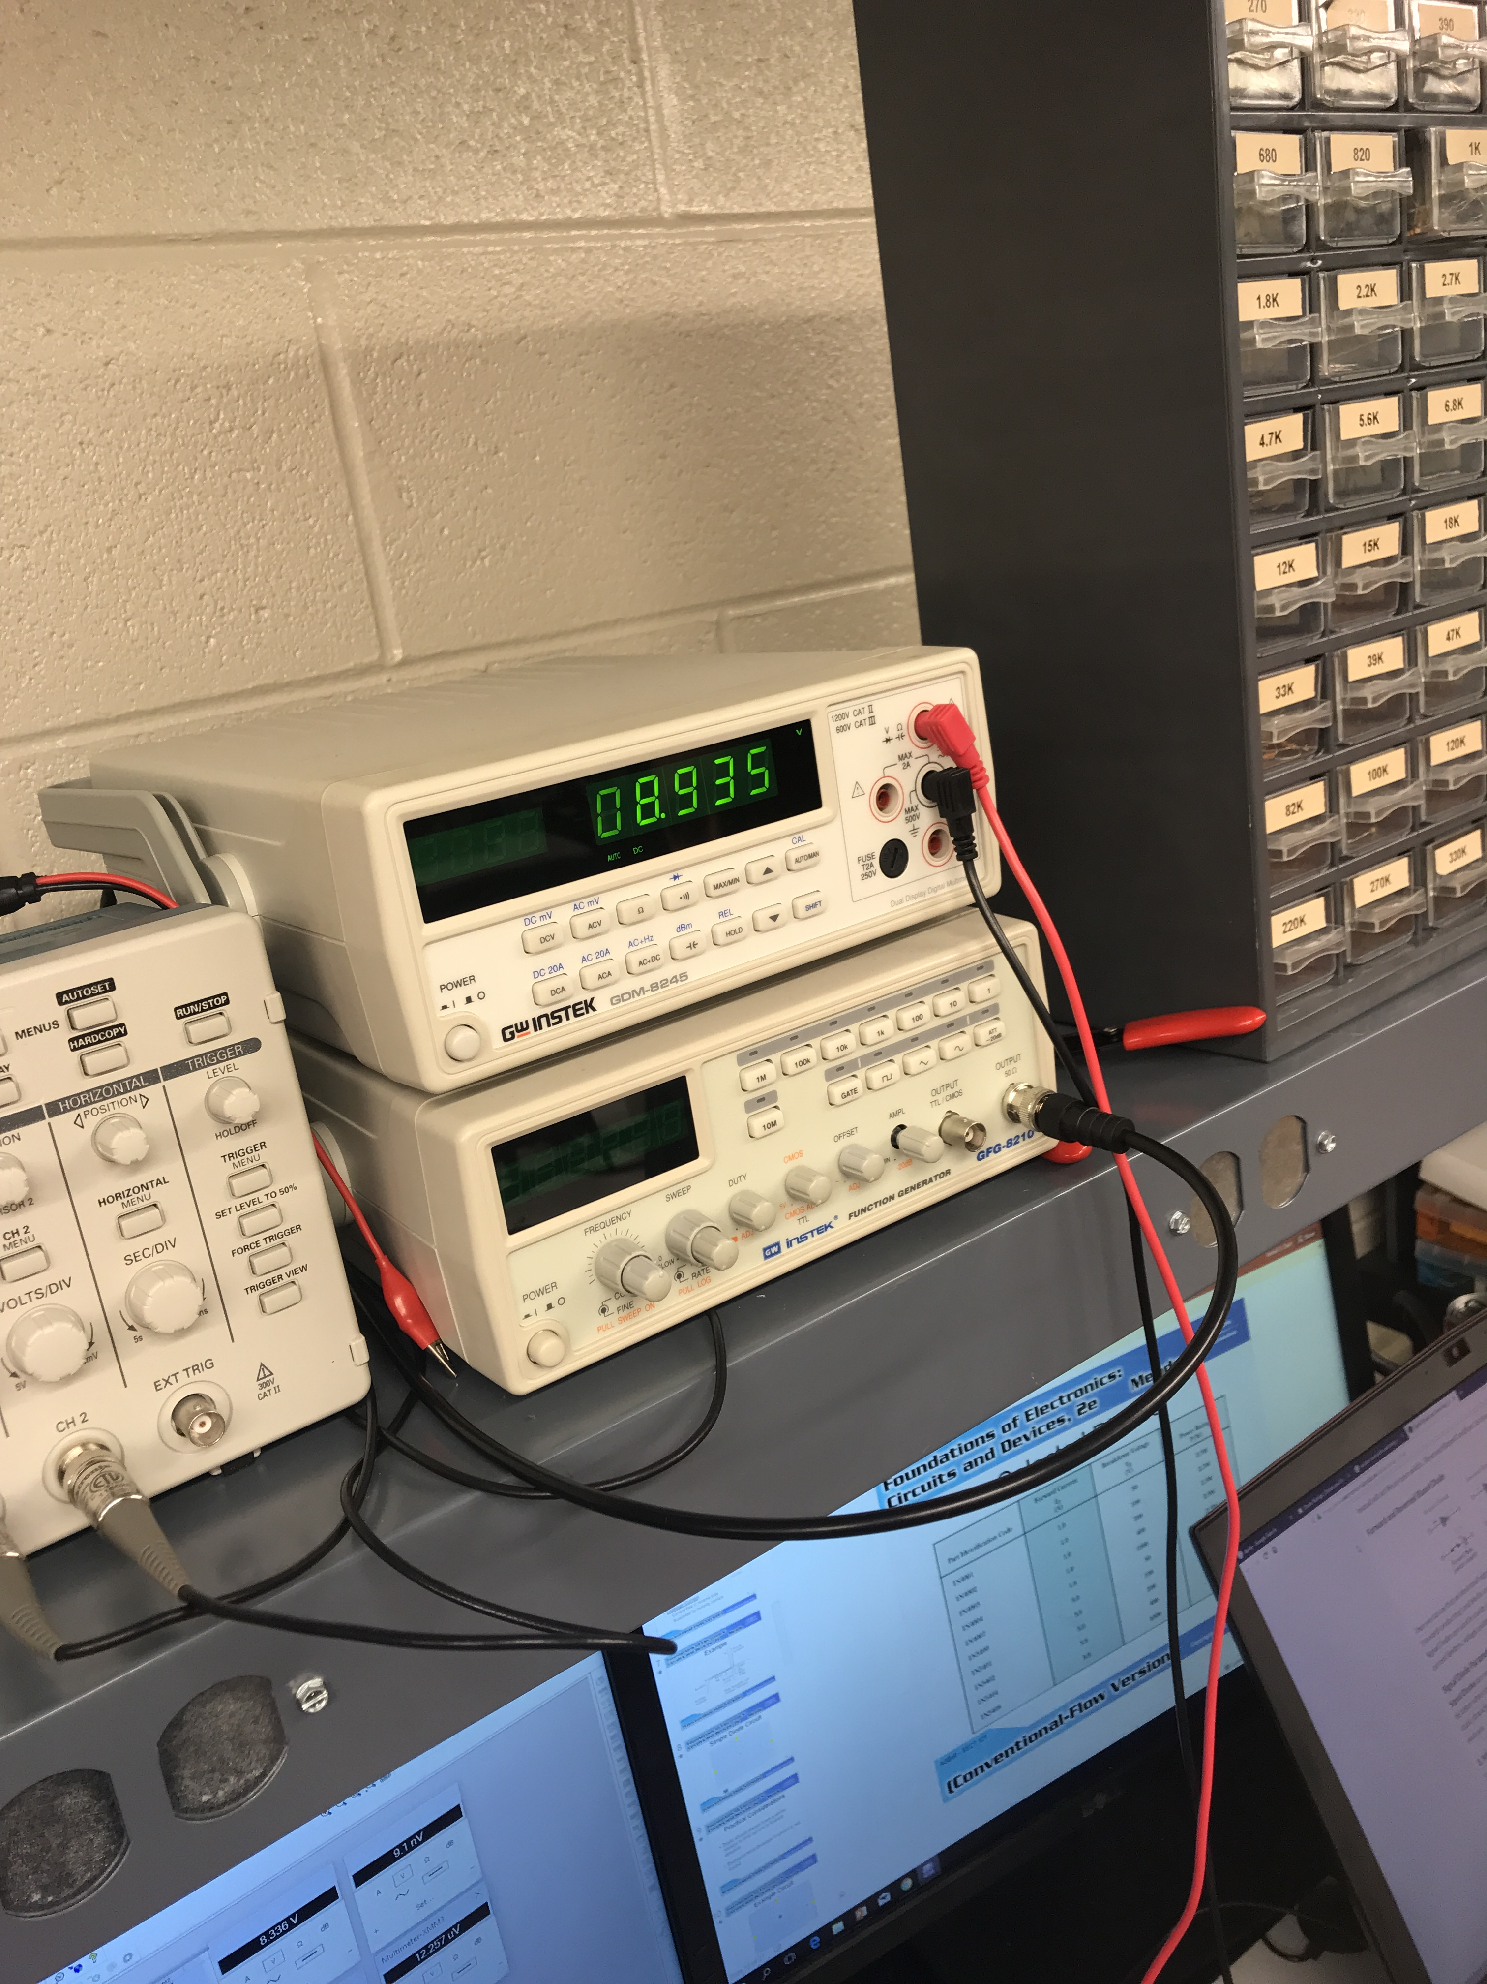
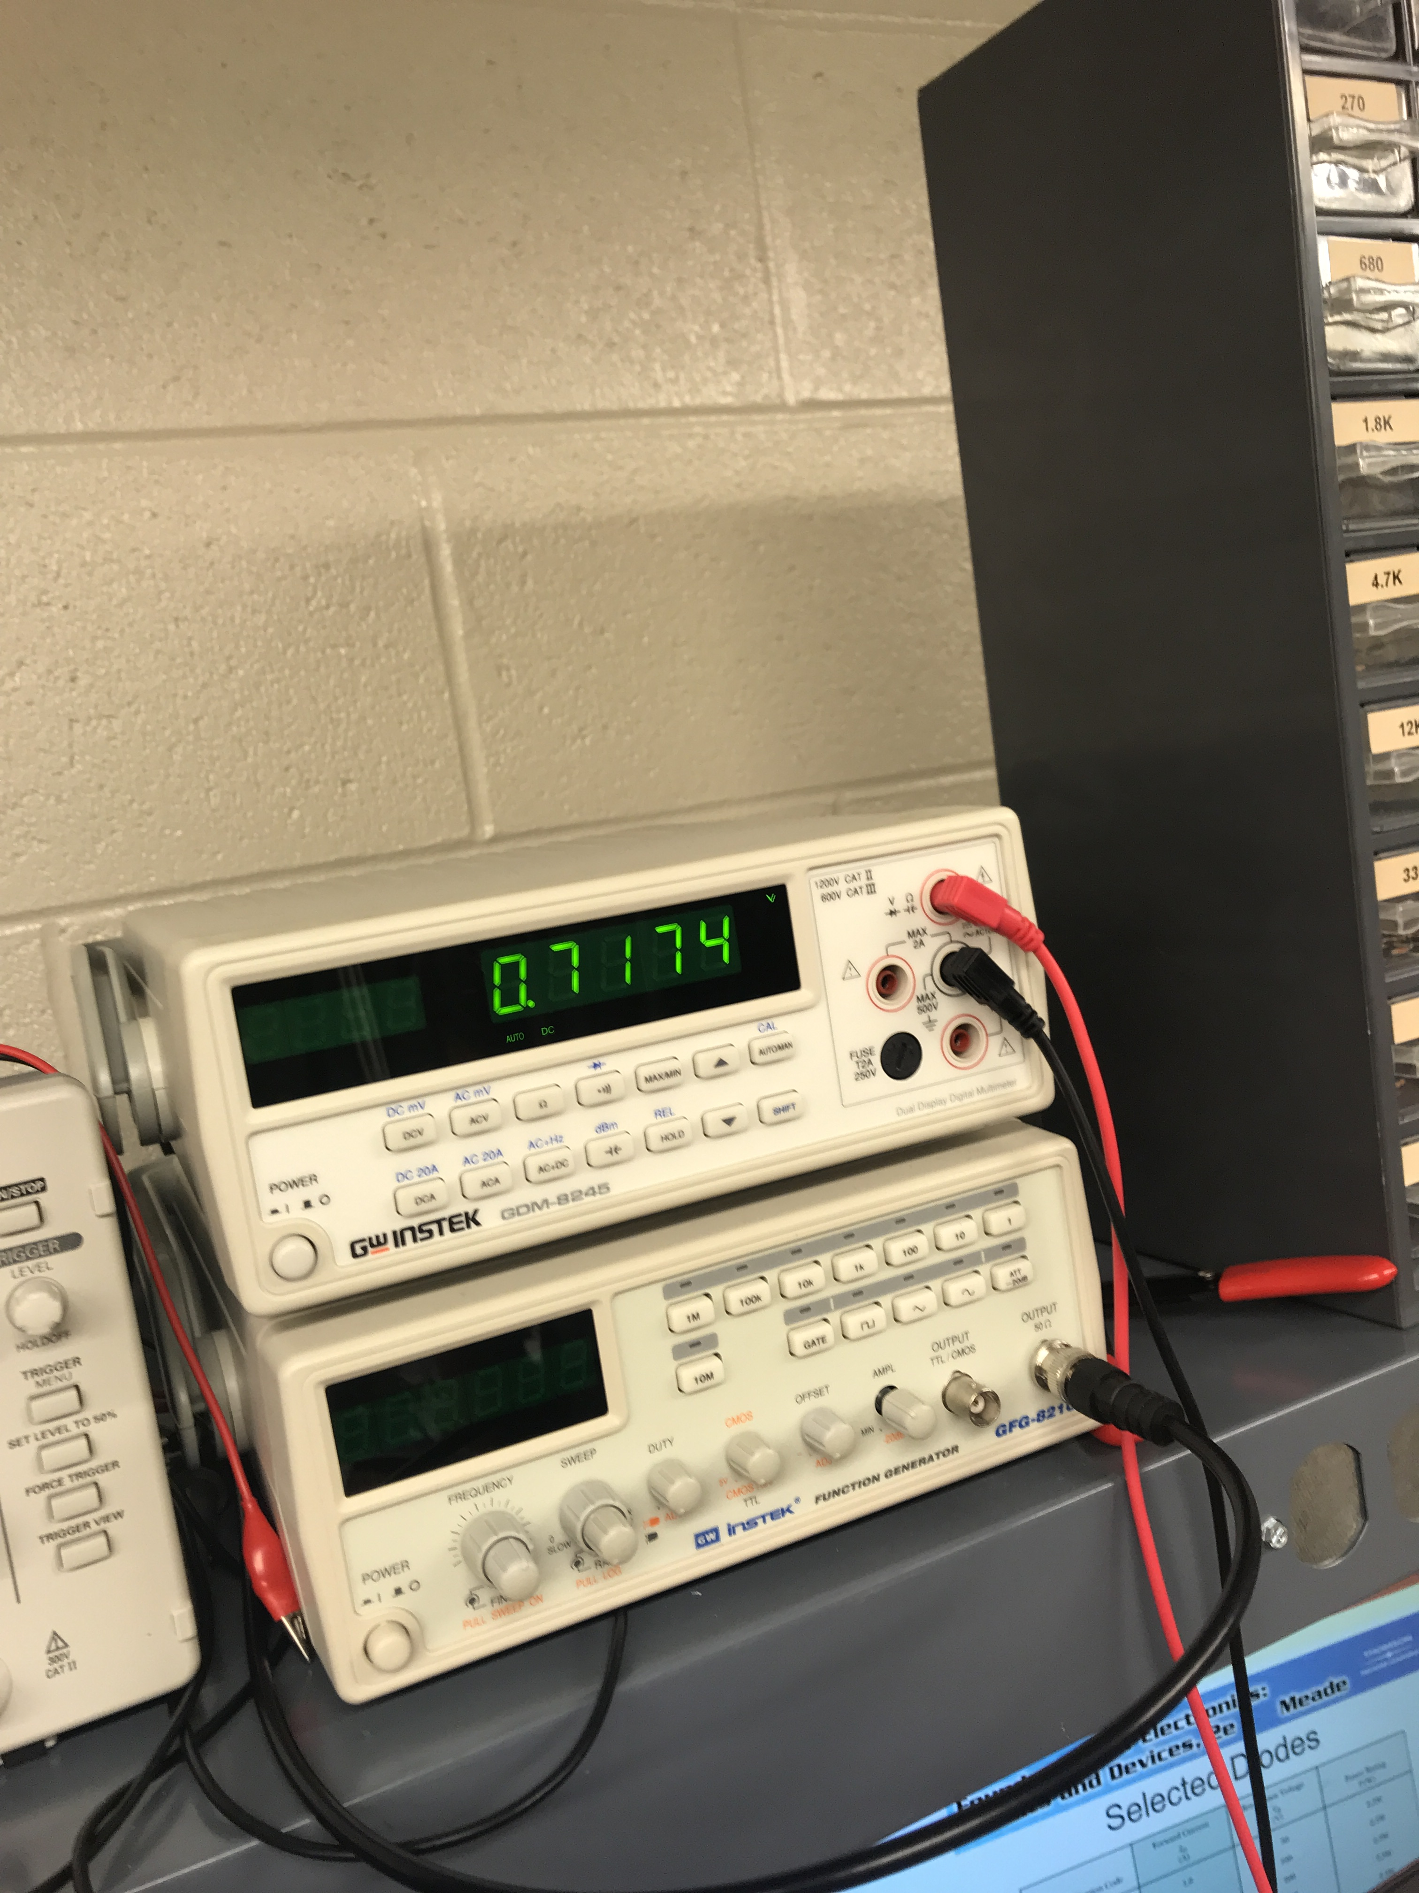
Lab 1
Output voltage in forward bias
Output voltage in forward bias #2
Output voltage in reverse bias

Slide 7
Lab 1: Part 7
Data sheet for the diode, displaying which side the cathode (black band)
PUT PICTURES HERE

Slide 8
Lab 1: Observation
A diode has two biases one is forward and one is reverse. When one is in forward bias it is considered on. When the diode is in reverse bias it is consider to be off.

Slide 9
Lab 2:LEDs Lab Partner was Seth wills, Donald Stanley and Alex Drummond Date: 09/05/18
The Purpose of this is to:
Learn how a LED functions and build and test the LEDS while using multisim and using the equipment in the lab.
Parts and Equipment Needed:
560 ohm Resistor
330 ohm Resistor
680 ohm Resistor
LED – 08L53GD - Green
LED – 08L53YD - Yellow
LED – 08L53ED – Amber (RED)
HY1802D DC Power Supply Gwinstek GDM-8245 Multimeter
Breadboard

Slide 10
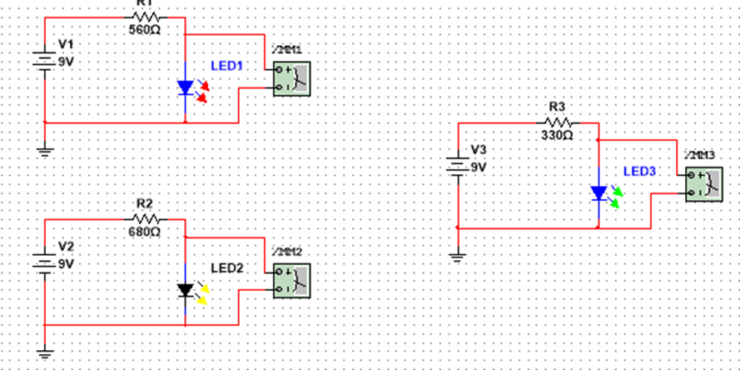
Lab 2: Part 2
This is the simulation of the three LEDs that we tested. The color were red, green, and yellow. We used 3 different resistors for each LED. For the red led we used 560 ohms, for the yellow led we used the 680 ohm resistors and for the green led we used the 330 ohm resistor.

Slide 11
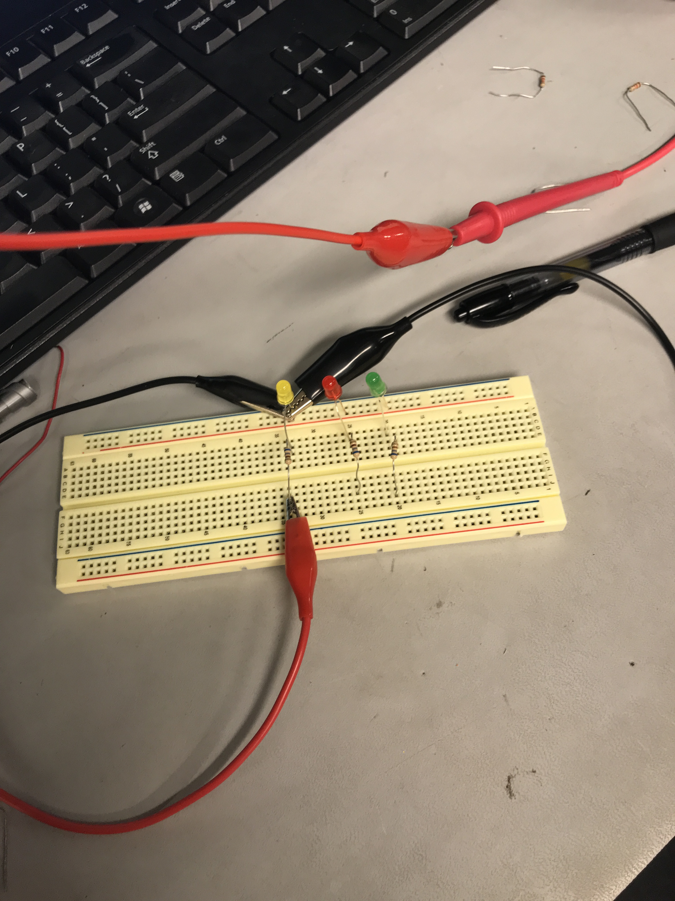
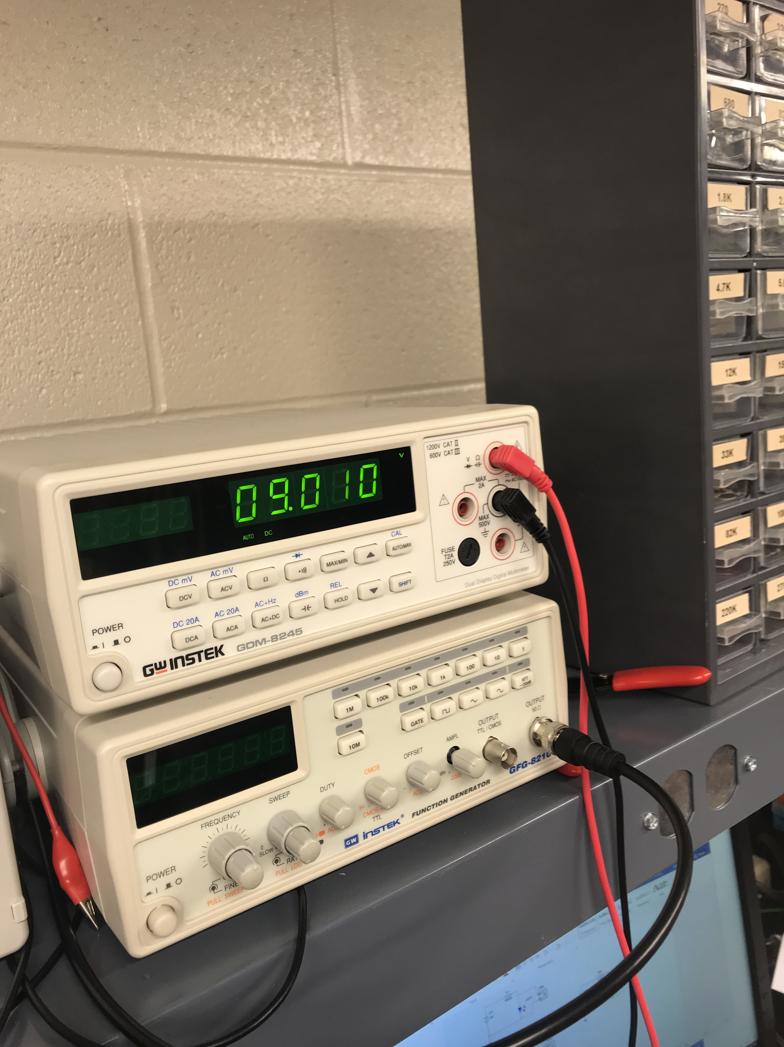
Lab 2: Part 3
circuit set up
Voltage before going to the LED

Slide 12
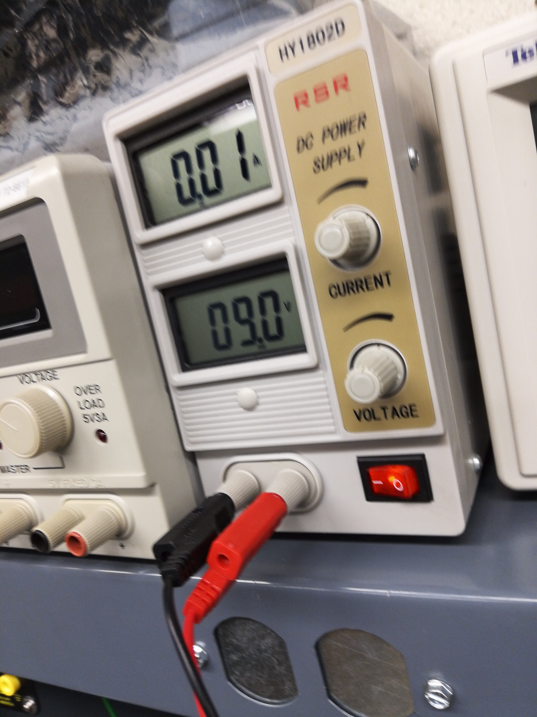
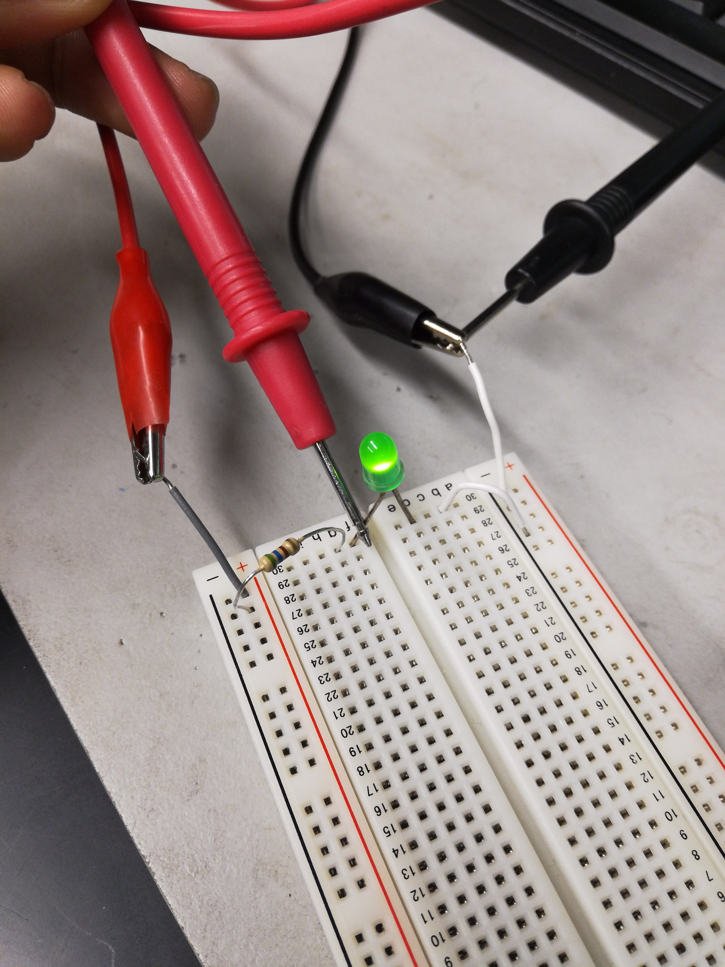
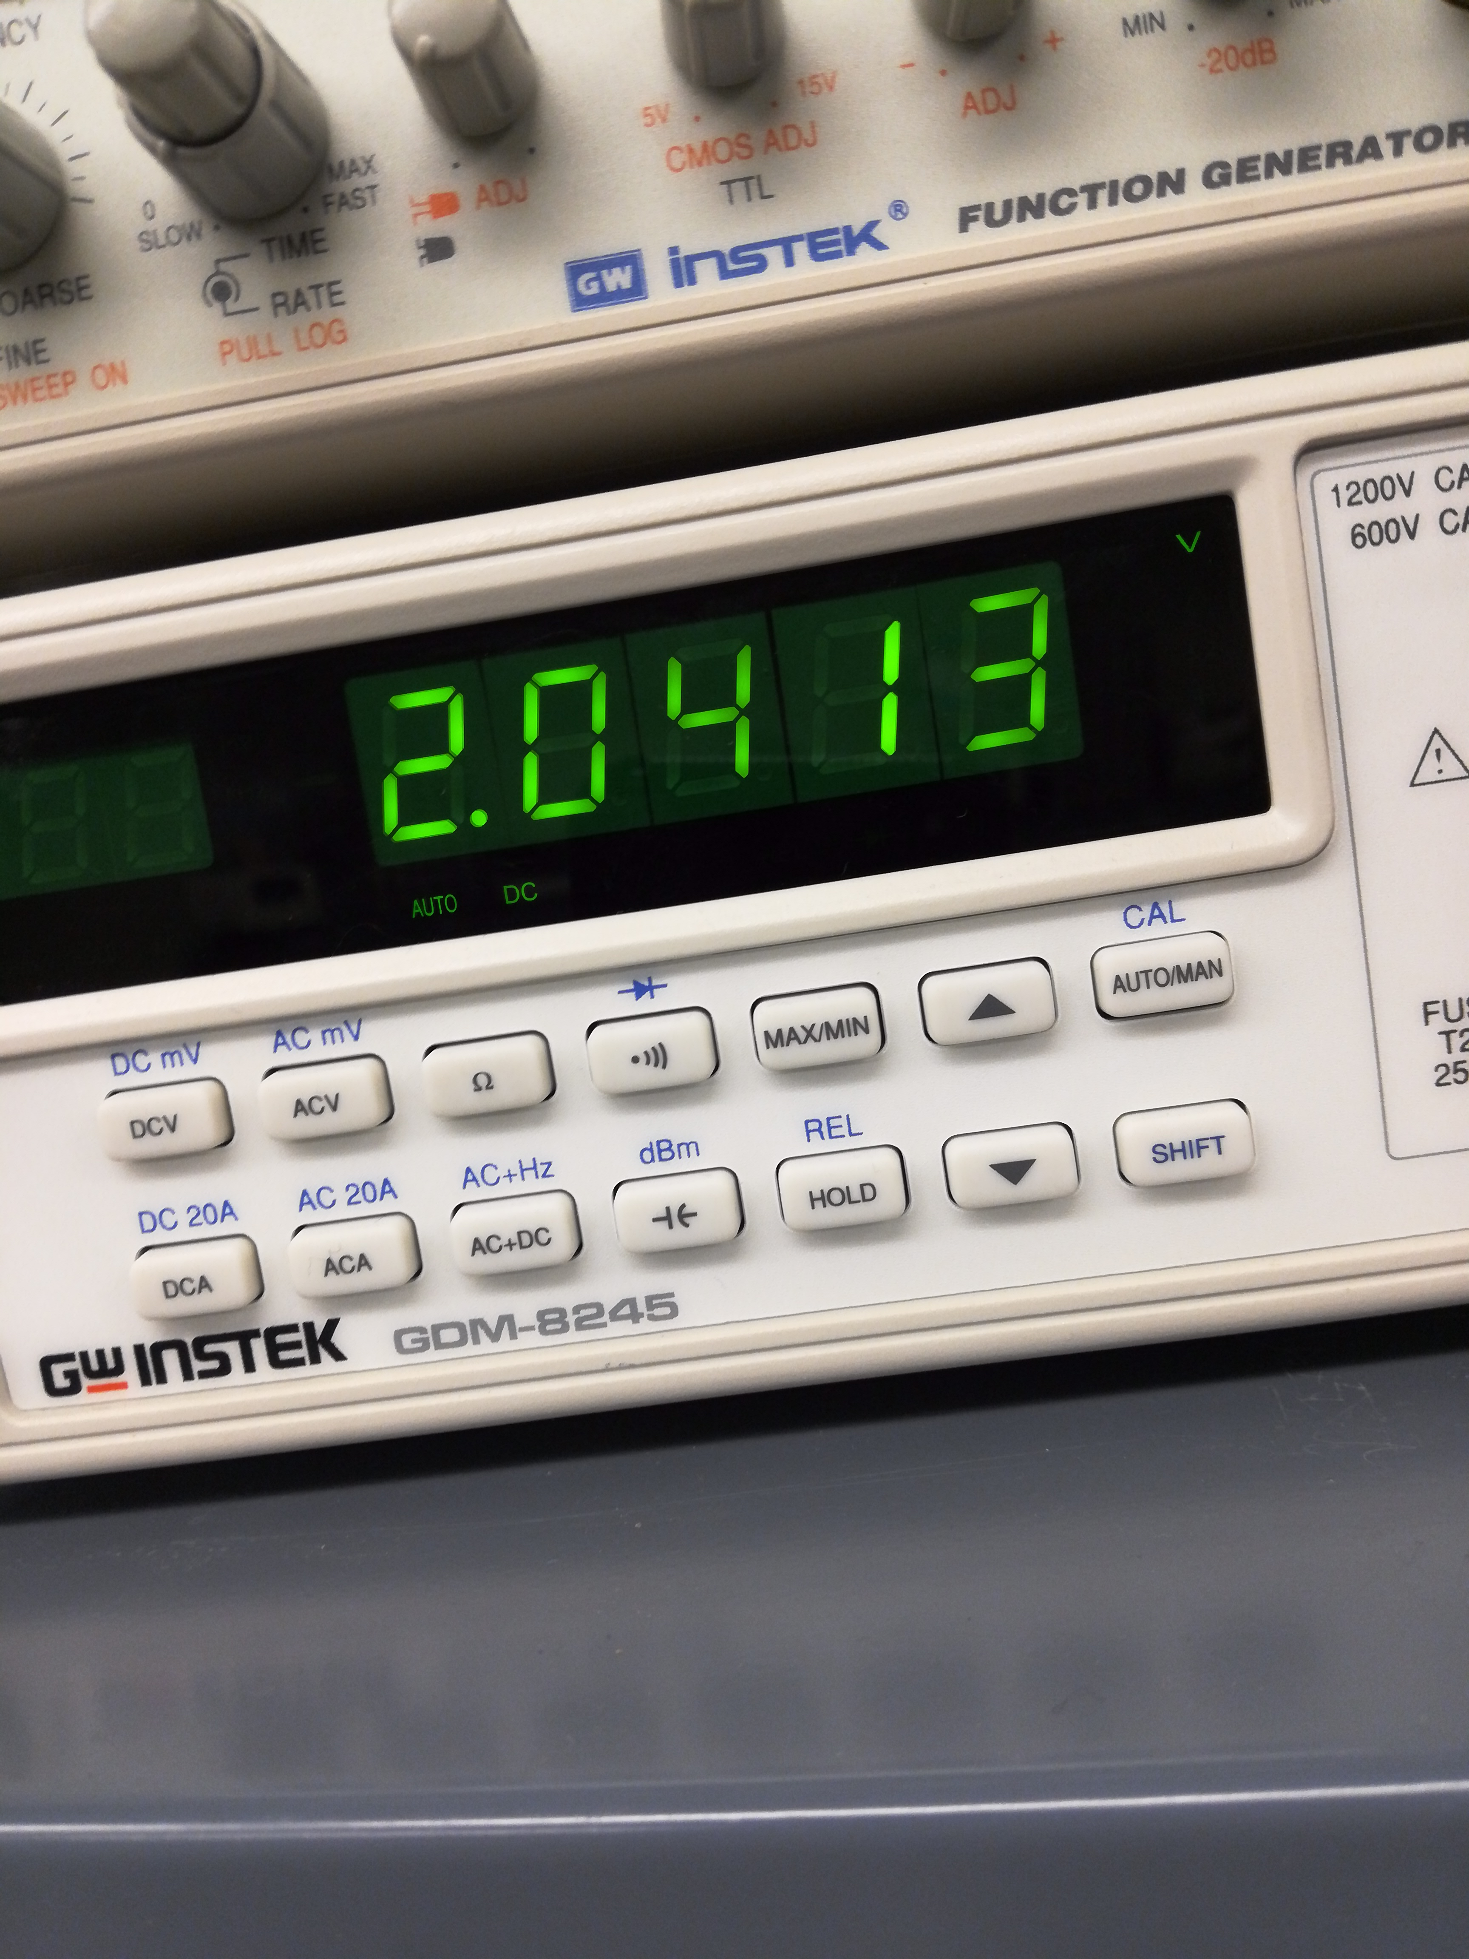
Lab 2: Part 4
Voltage before after resistor
Input voltage
& measurement before LED

Slide 13
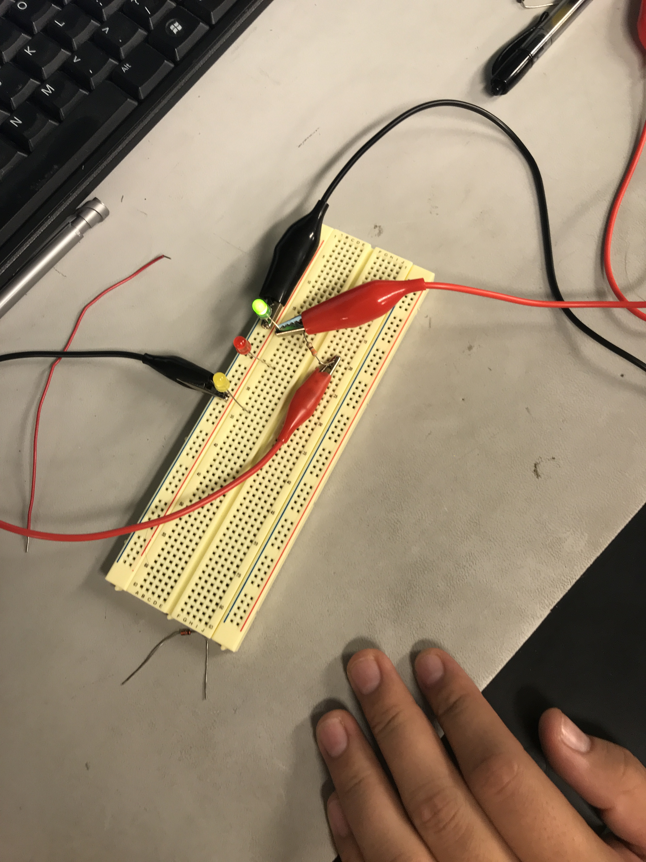
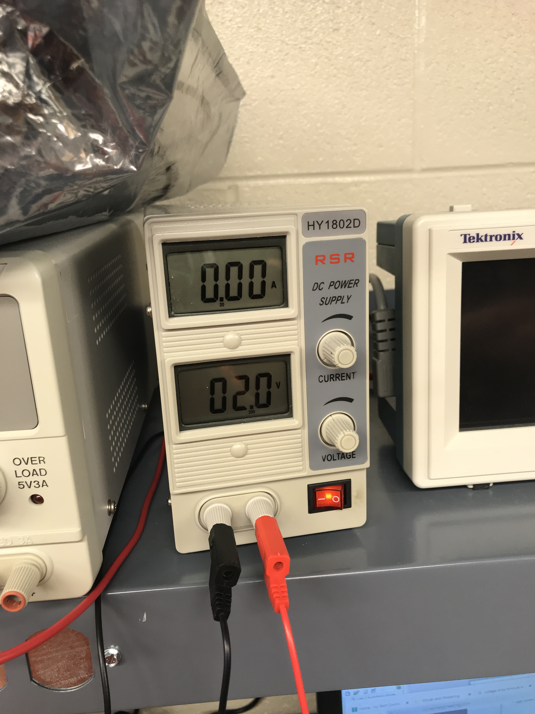
Lab 2 Part 5
Green LED
Voltage when the LED turns off

Slide 14
Lab 2: Observations
For each color of led we had to use a different resistors because each led needs more watts to have the light visible

Slide 15
LAB 3: Zener Diode Lab Partner was Seth wills, Donald Stanley and Alex Drummond
The purpose of this lab is to:
Learn how a Zener Diode functions and build and test the Zener Diodes while using multisim and using the equipment in the lab.
Parts needed:
1k Ohm Resistor
ZENER 1N4728A
ZENER, 1N4732A
ZENER, 1N4733A
ZENER 1N4735A
ZENER, 1N4736A
Equipment Needed:
1 – GDM-8245 Multi-meter
1 – HY1802D DC Power source
1 – Breadboard

Slide 16
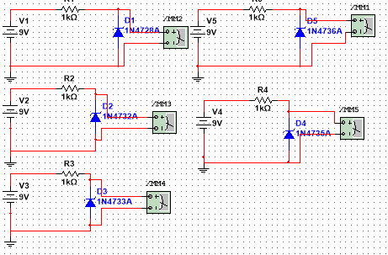
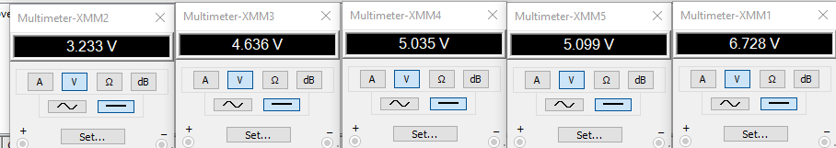
Lab 3: Part 2
This is the simulation and simulation results of 5 different zener diodes

Slide 17
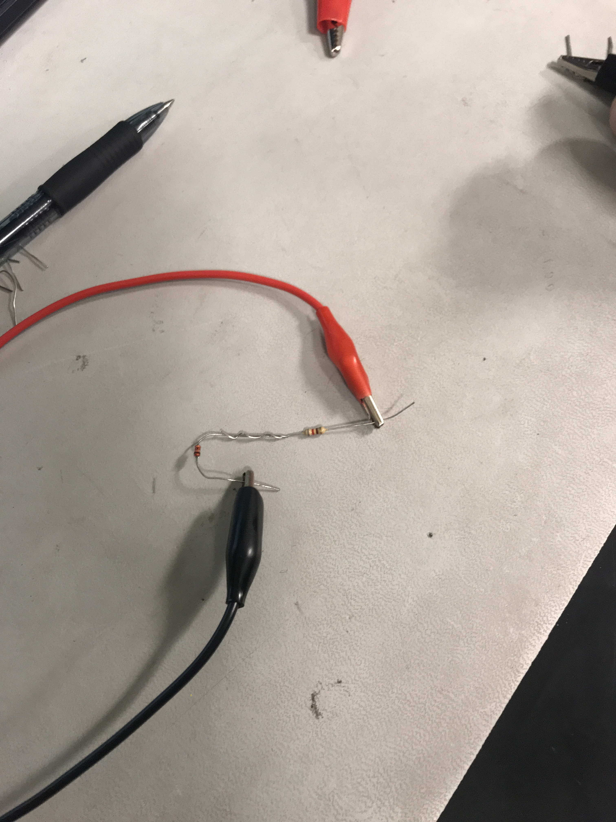
Lab 3: Part 3
ADD Pictures

Slide 18
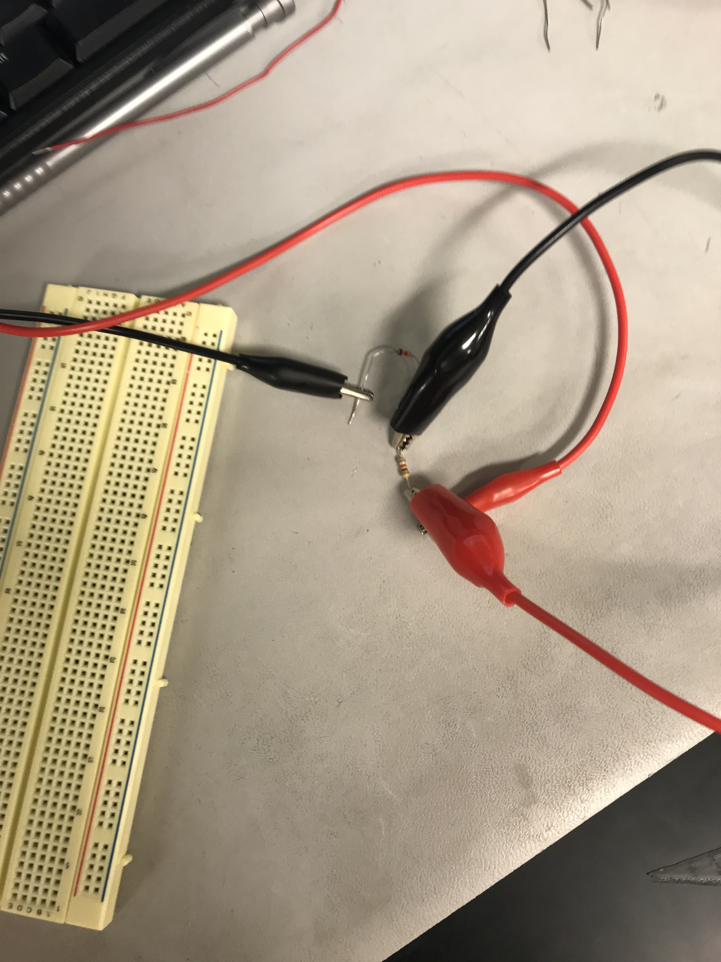
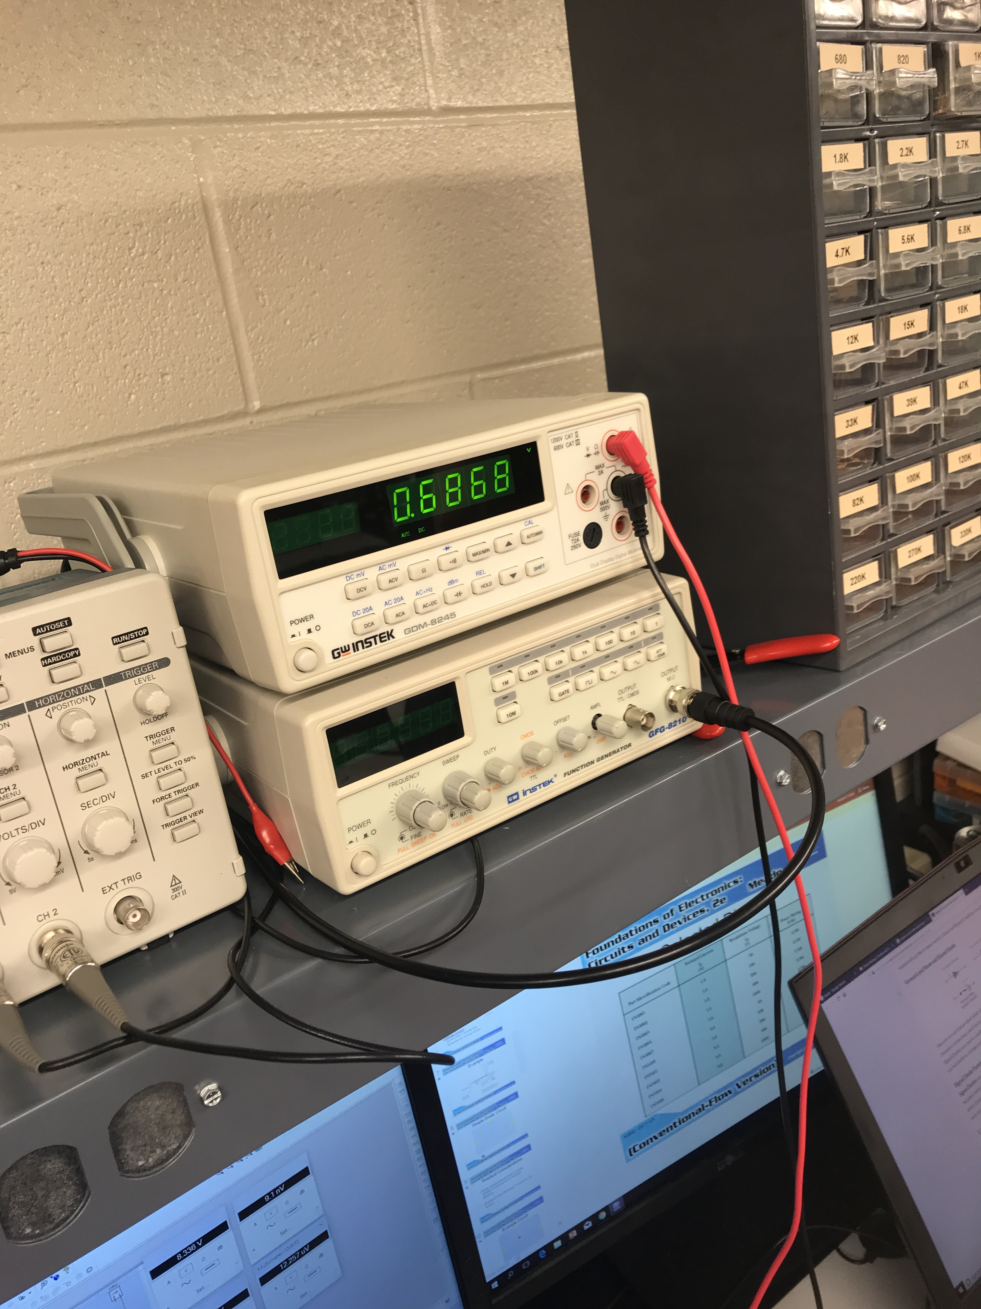
Lab 3: Part 4

Slide 19
Lab 3: Observations
I this lab we observed that zener diodes work differently then regular diodes in the previous labs. Zener diodes work in reverse bias instead of the forward bias. Zener diodes are used to regulate voltages in a small circuit.

Slide 20
Lab 4: 9V +/- Power Supply Lab Partner was Seth Wills
The Purpose of this Lab is to Build and design/test a +/- 9 Volts DC Power Supply
Equipment Needed:
HY1802D DC Power Supply Gwinstek GDM-8245 Multimeter
Circuit Board
Soldering Gun and Solder
12.6 volt Transformer
Fuse Holder/fuse
Switch
4-1N4007
4-400uf Capacitors
2- Orange LED’s
2-20 ohm Resistors
LM 317 and LM 337
2-330 Ohm Resistors
2- Potentiometers
2-240 Ohm Resistors
2-100uf Capacitors
2-90 Ohm resistors for the load
2-10 Ohm Resistors for the load

Slide 21
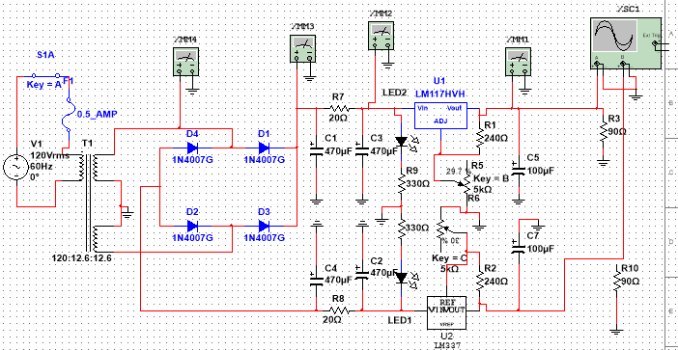
Lab 4: Part 2
This is the multisim built from scratch in order to create and build/Test the +/- 9 Volts DC Power Supply

Slide 22
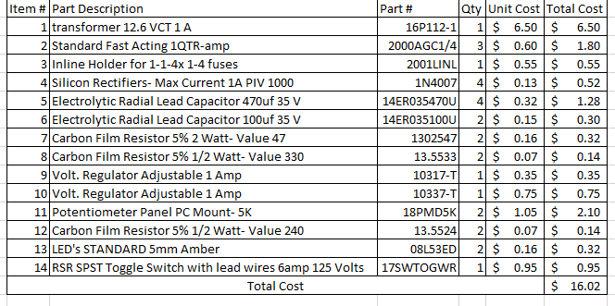
Lab 4: Part 3
This is our BOM (Bill of Materials) that we made in order to total up the cost and order all the parts for the Power Supply. Minimum cost was 25 dollars and we totaled up to $16.02

Slide 23
Lab 4: Part 4
Datasheet for LM337
Datasheet for LM317

Slide 24
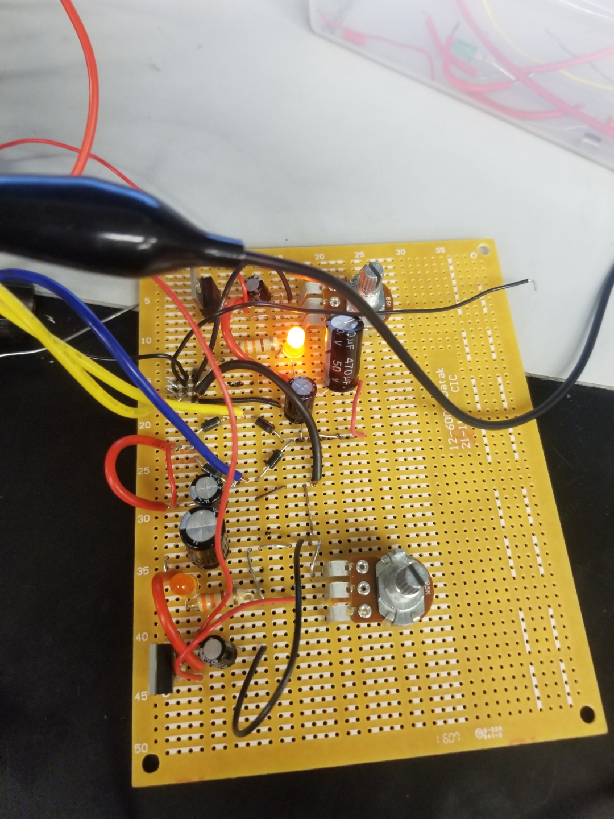
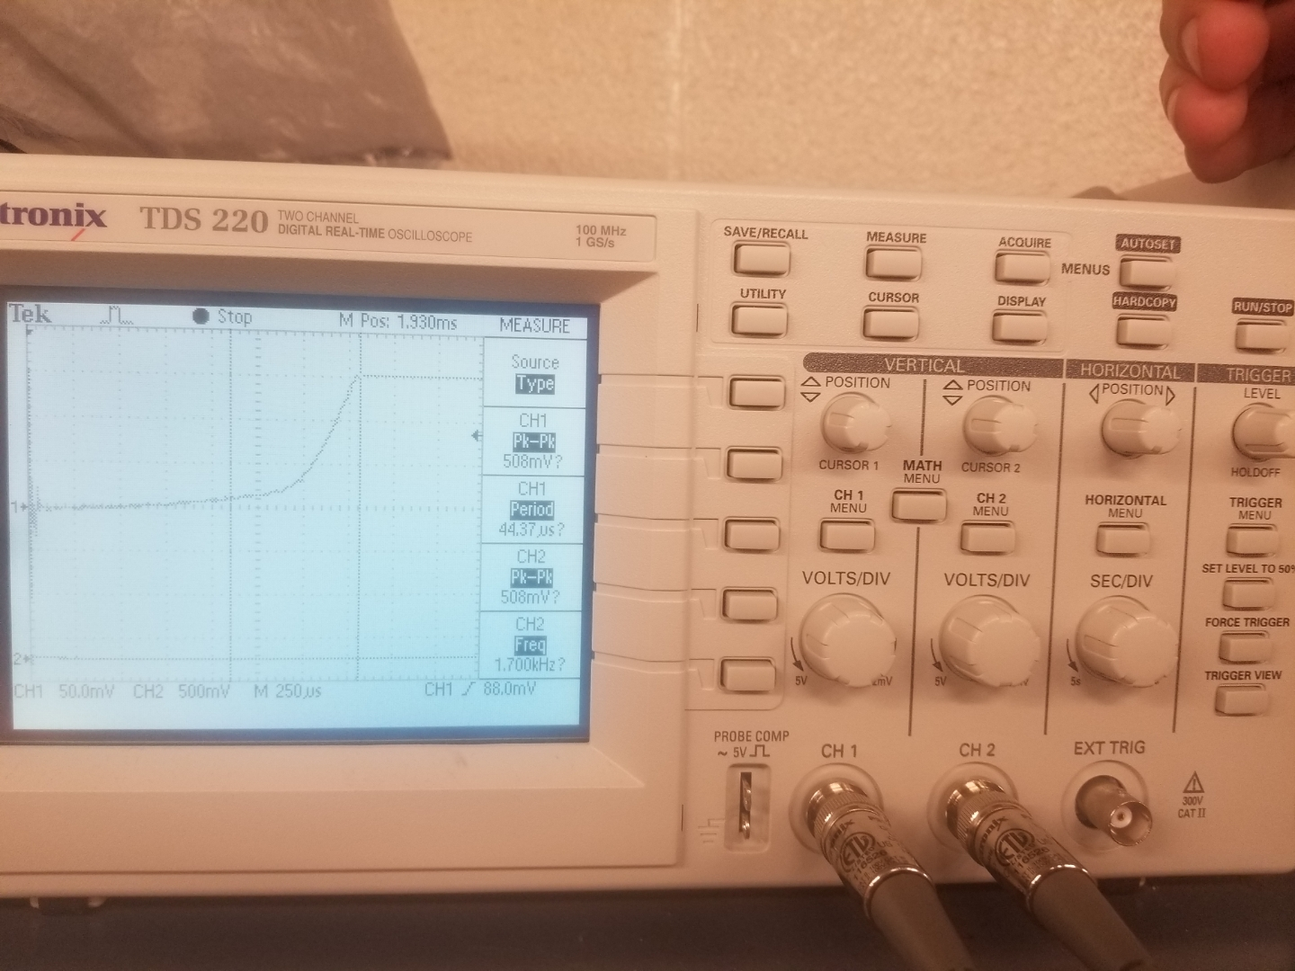
Lab 4: Part 5
This is the dc power supply with only the positive led working, but we found out in the negative side that we had a cold solder joint in the ground bus which caused the LED to become inactive
Our startup time for our power supply was 75 milliseconds

Slide 25
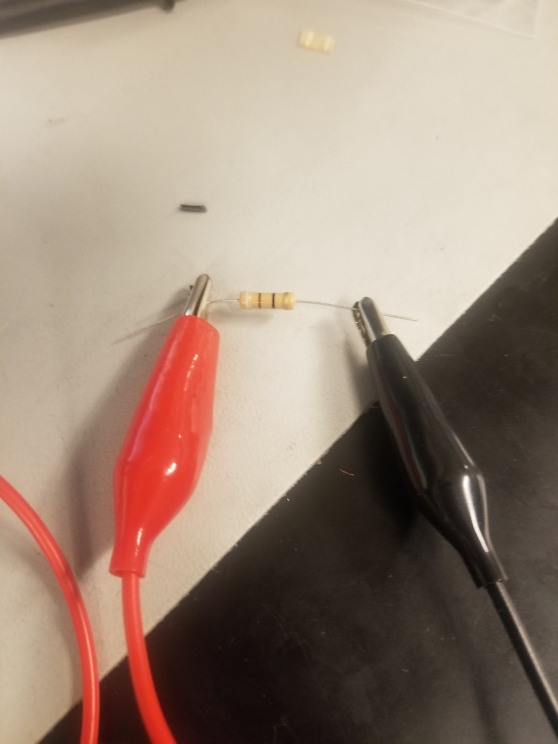
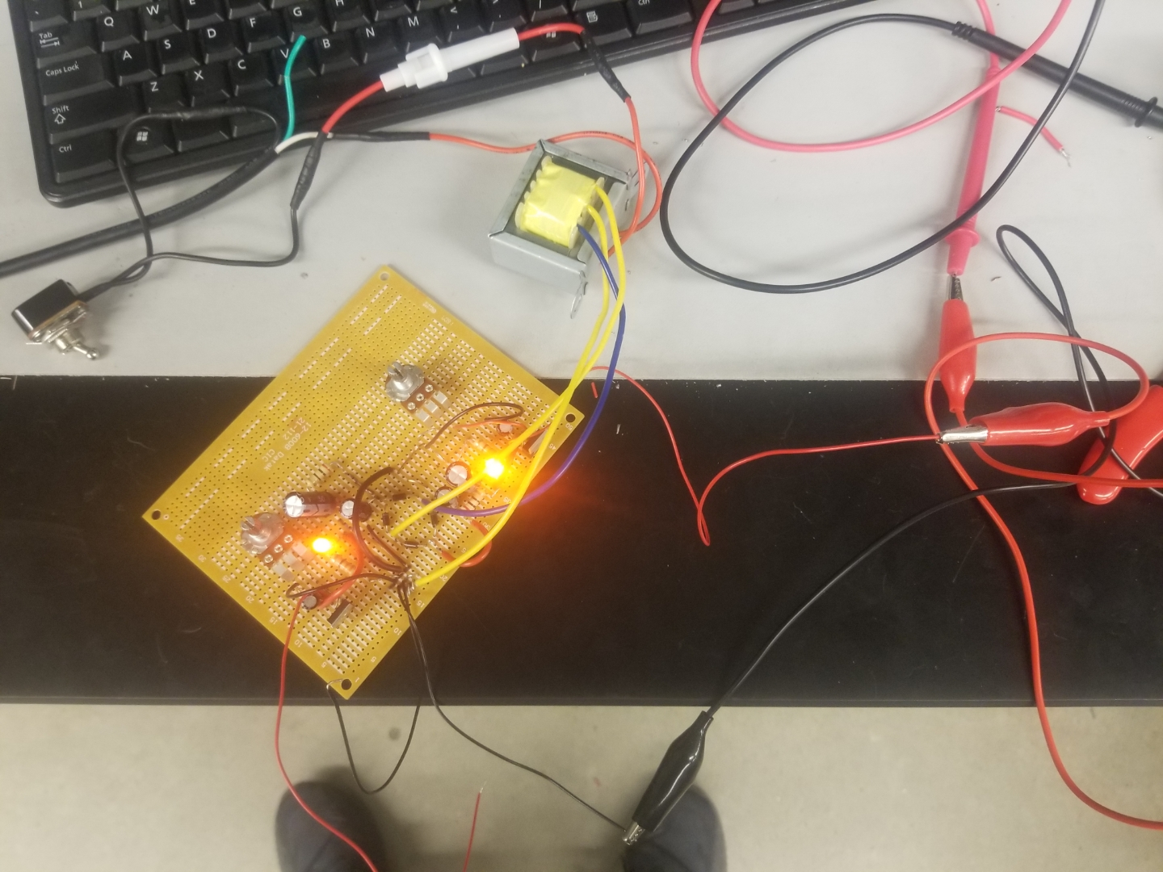
Lab 4: Part 6
Measuring the 91 ohm resistor which is the load
This is the complete build for the power supply after we fixed the cold solder joints in the ground bus

Slide 26
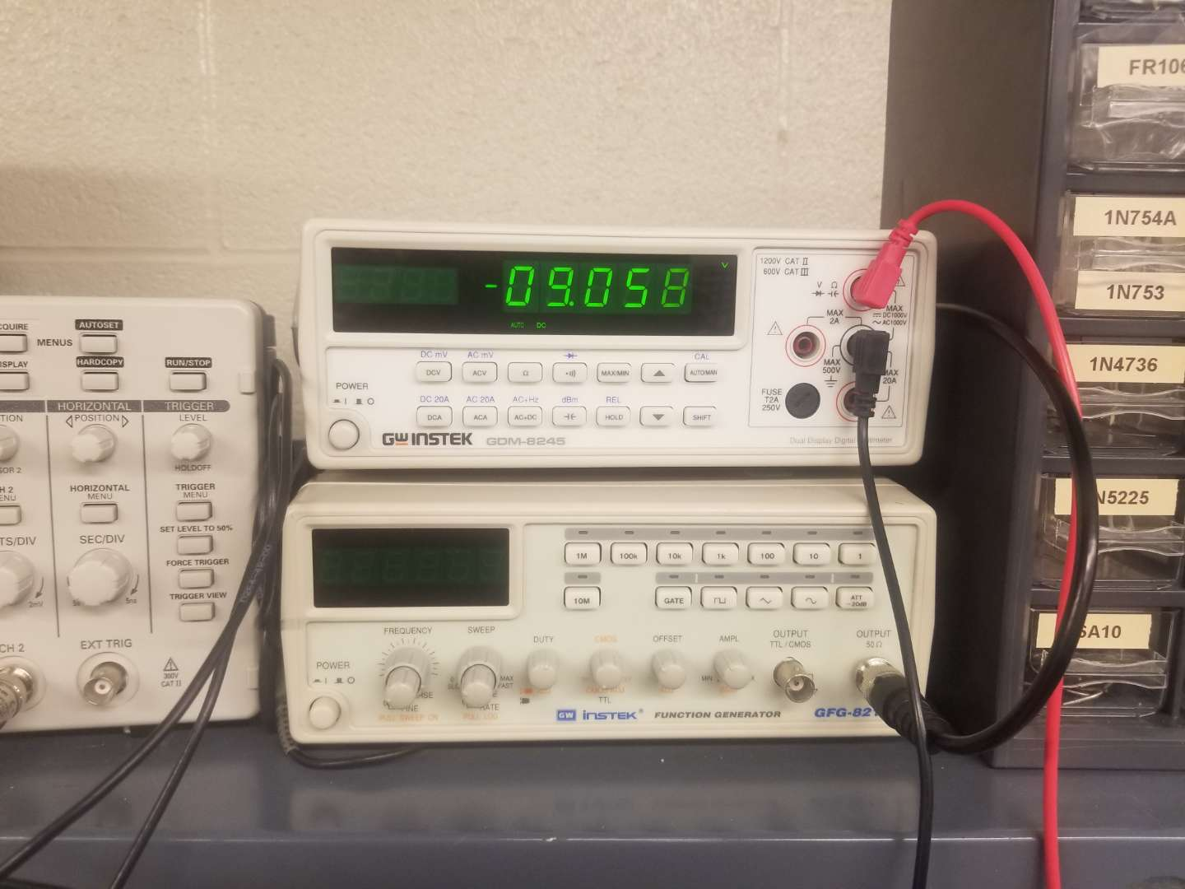
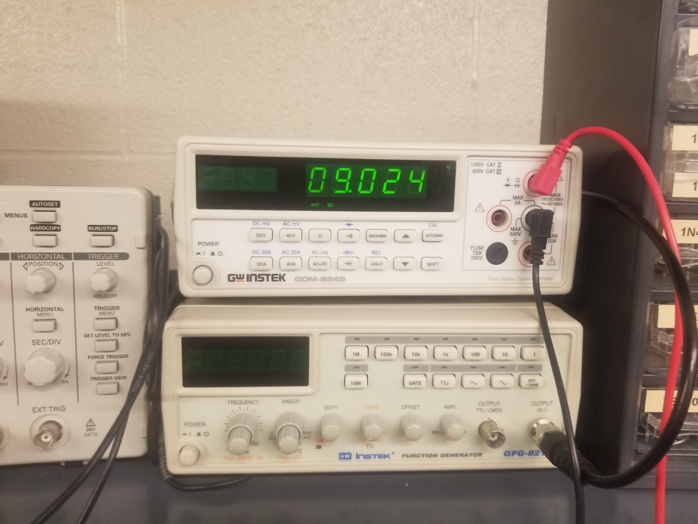
Lab 4: Part 7
This is the negative voltage coming from thee put of the power supply
This is the positive voltage coming from thee put of the power supply

Slide 27
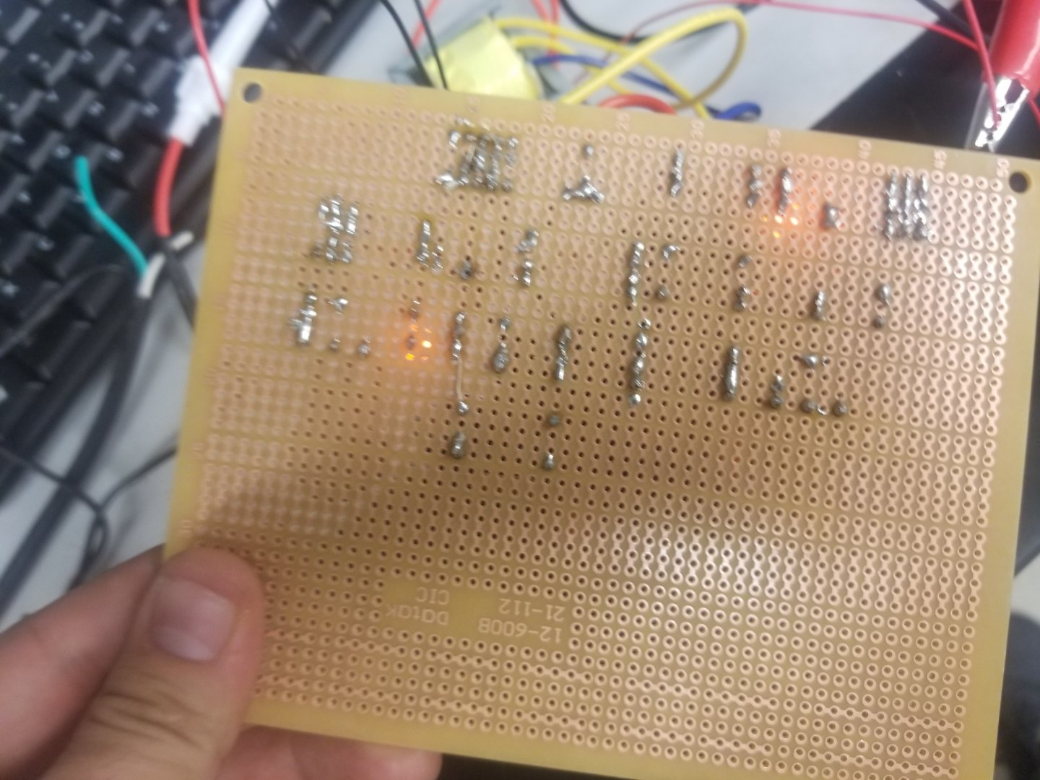
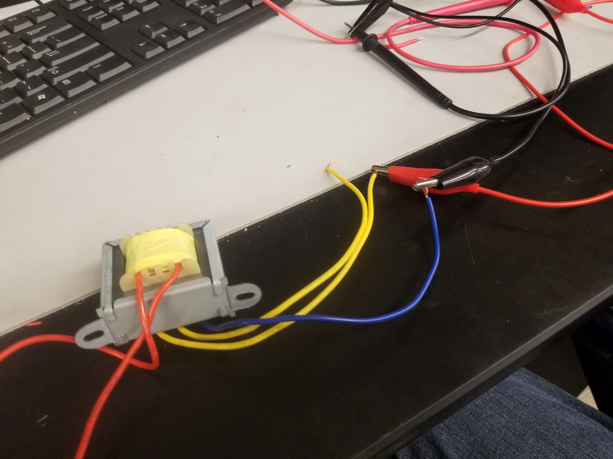
Lab 4: Part 8
This is the solder job done by Jarred Clark and Seth Wills.
The transformer that we received from electronix express was manufactured wrong where the blue wire is not the center tap but was one of the inputs to the rectifier

Slide 28
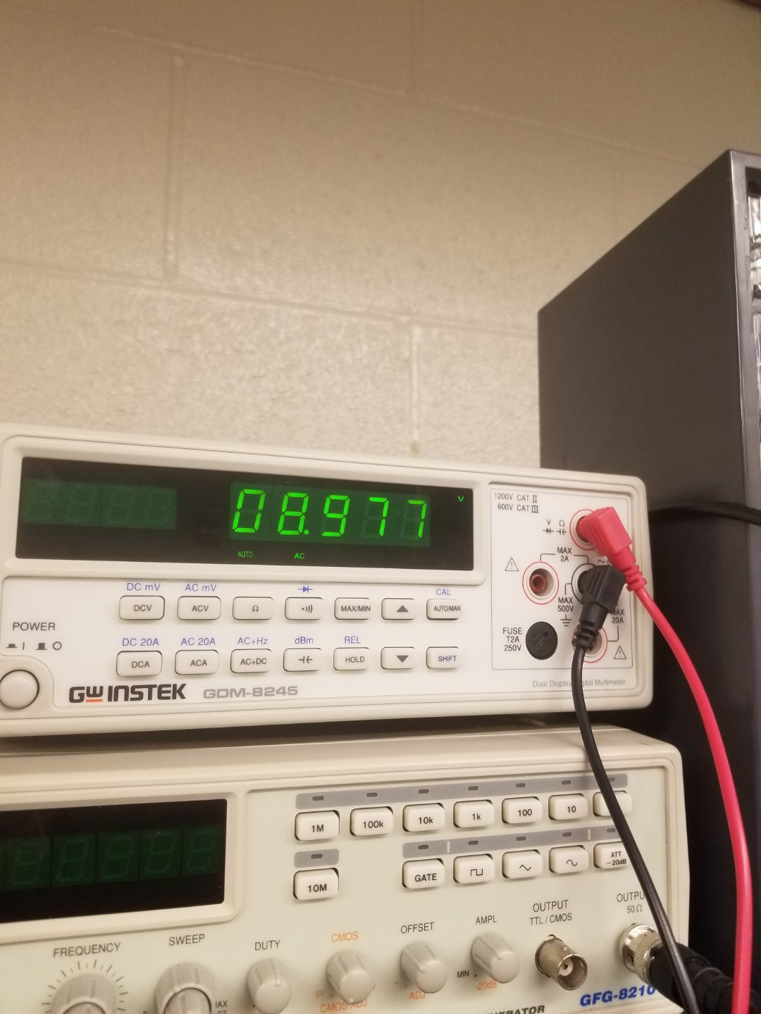
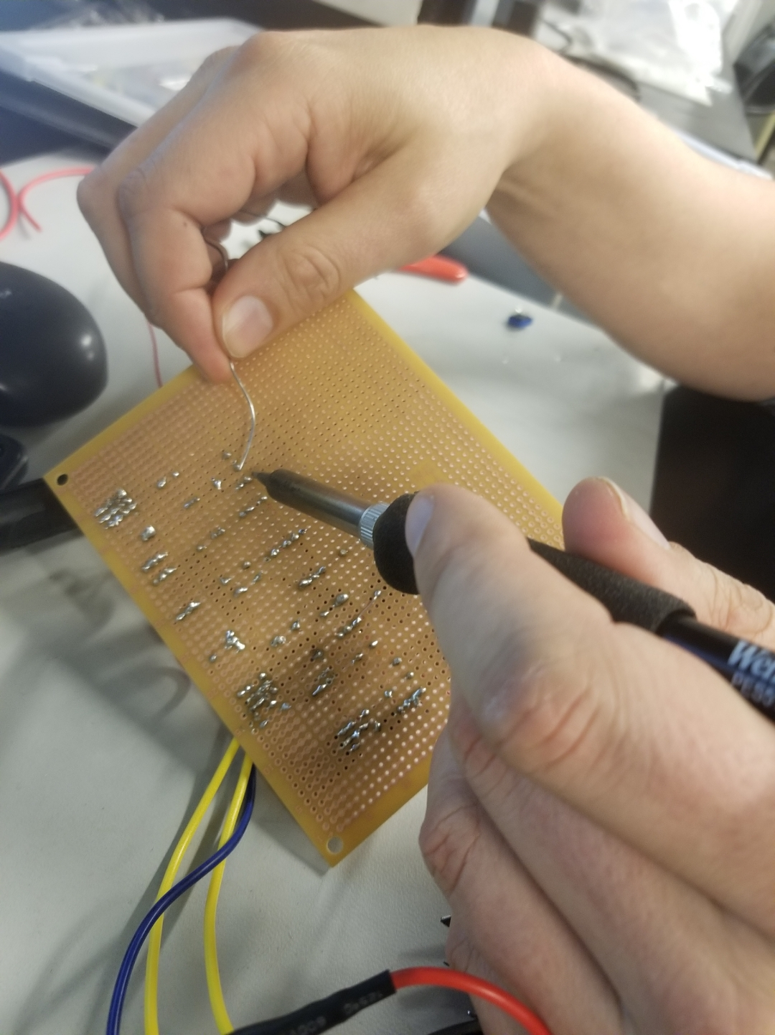
Lab 4: Part 8
This is the positive voltage after we applied the 91 ohm load
This is a picture of Seth and I soldering the components onto the board

Slide 29
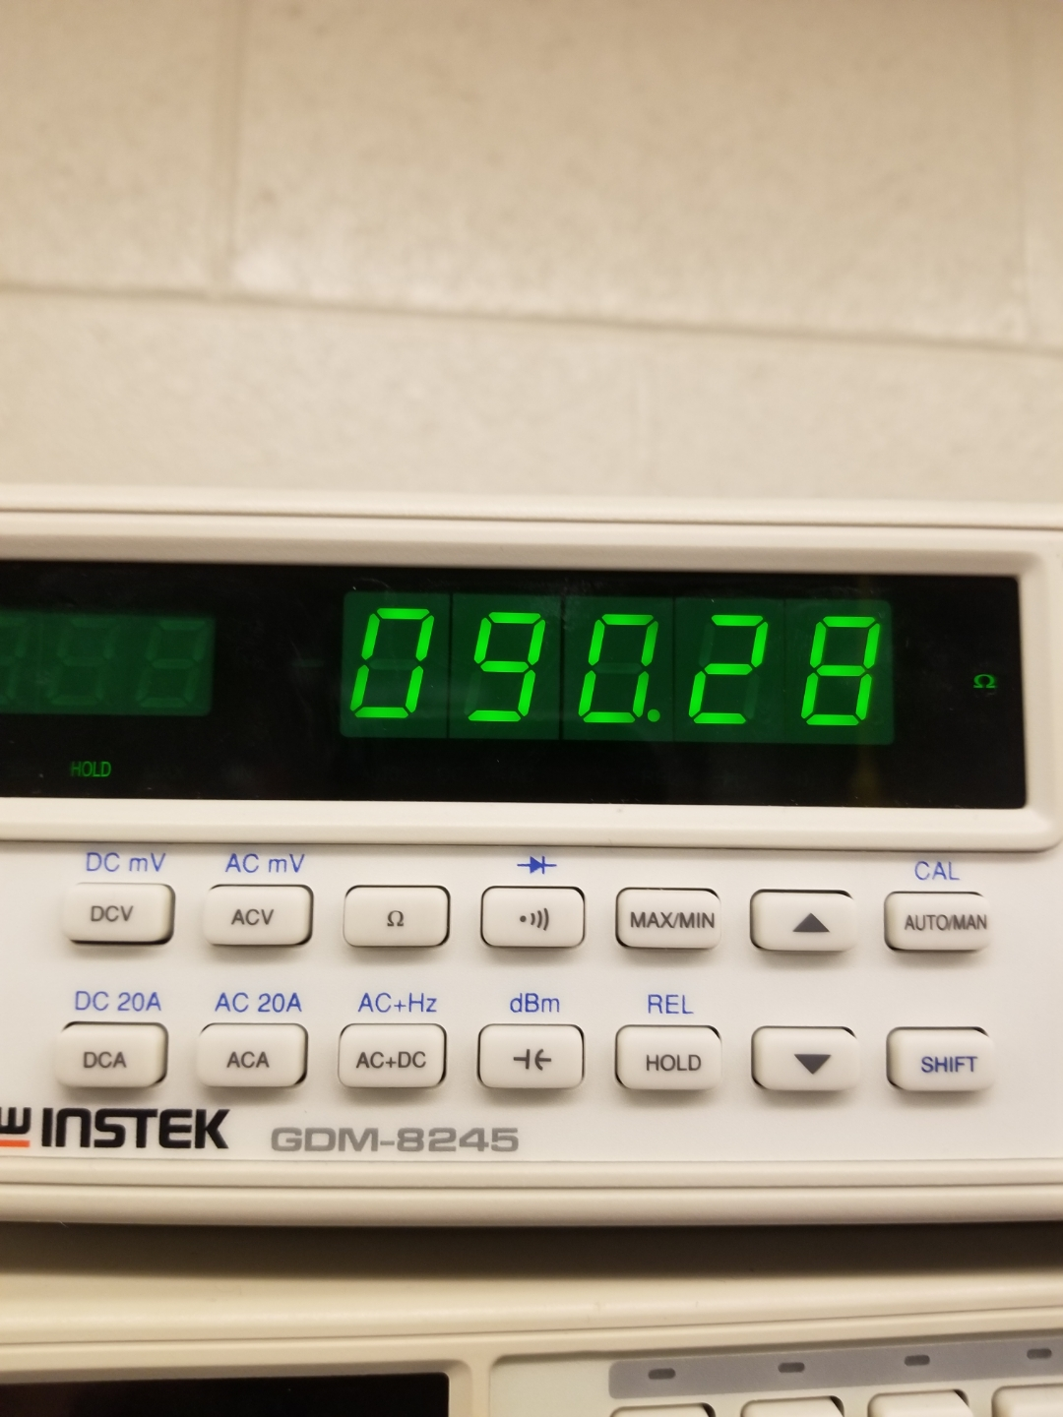
Lab 4: Part 9
The load resistance is measured from the multimeter of 90.28 ohms

Slide 30
Lab 4: Observations
When building the +/- 9 volts DC Power Supply we ran into multiple issues such as the transformer being manufactured wrong. The potentiometer were not adjusting the voltage for the output due to a cold solder joint in the ground bus. Their for at the beginning our negative LED was not work also due to a cold solder joint in the ground bus. The 20 Ohm resistor in our pi filter was causing to much of a voltage drop and only giving us 7 volts for the output so we replaced the resistor with a wire jumper and then the output turned to 9 volts and the potentiometer started to function right.

Slide 31
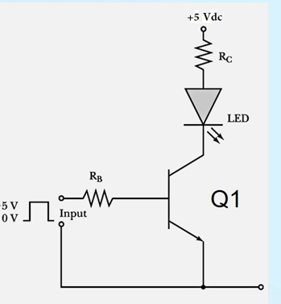
Lab 5: Common Emitter Amplifier Lab Partner was Seth wills and Alex Drummond and Donald Stanley
The purpose of this lab is to:
See how a common a transistor is used for a common emitter amplifier
Equipment Need:
1 – GDM-8245 Multi-meter
1 – HY1802D DC Power source
1 – Breadboard
1- LED
1-2N2222A Transistor
1- 220 ohm resistor
1- 500 resistors

Slide 32
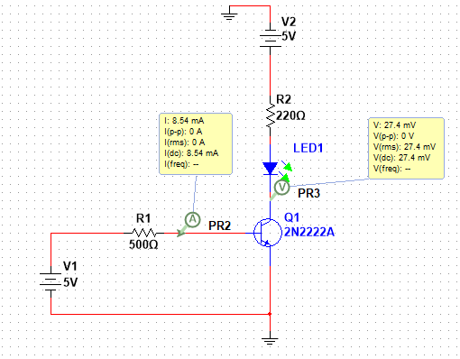
Lab 5: Common Emitter Amplifier
Insert Multisim for Lab 5

Slide 33
Lab 5 Part: 3
Vin= | 5
Q1= | 2N2222A
RB= | 220
RC= | 500
LED= | 08LX330 RED
LED Min Current= | 1 | A
LED VF= | 2.682 | V
VCE when LED is "on"= | 2.025 | V
VCE when LED is "off"= | 3.974 | V
This is the spreadsheet for the calculated results for Lab 5

Slide 34
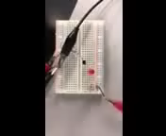
Lab 5: Part 3
This is a video of the transistor being used as a common emitter amplifier. We used a red led, 1 390 ohm resistor and 2 1k resistors in parallel

Slide 35
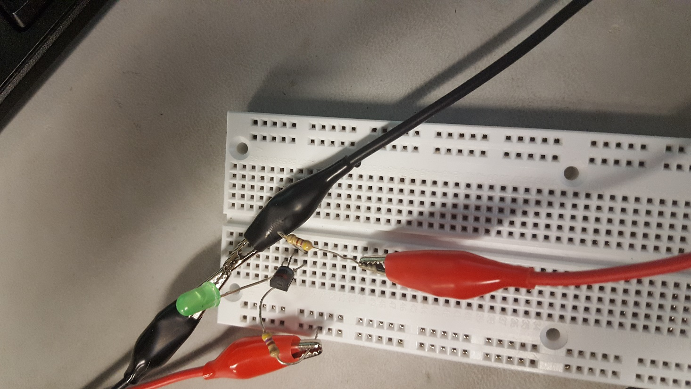
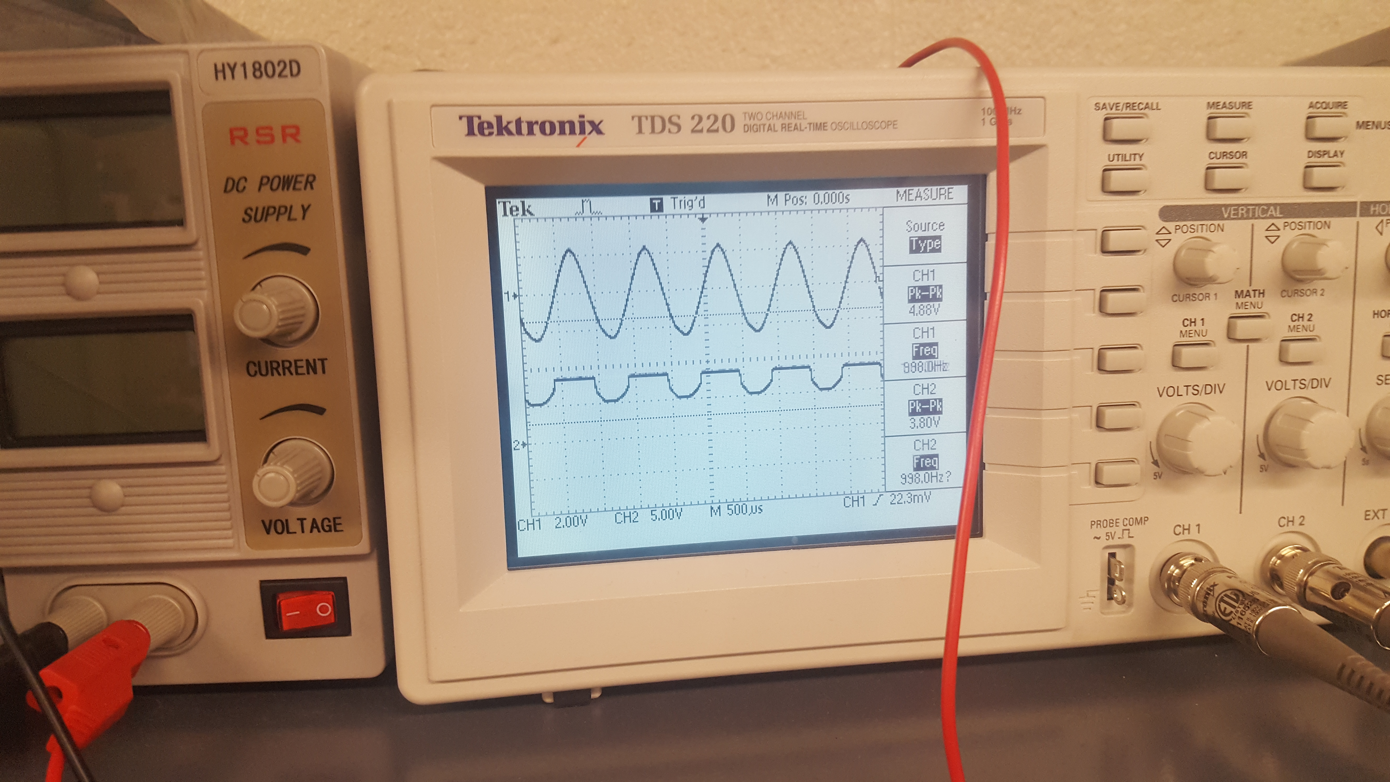
Lab 5: Part 4
This is the complete build of Lab 5’s Circuit
This is the Oscilloscope reading for Channel 1

Slide 36
Lab 5: Observations
We observed that one way to use the diode as a switch is by changing the collector voltage, in our case it was at 3V where it turned off.

Slide 37
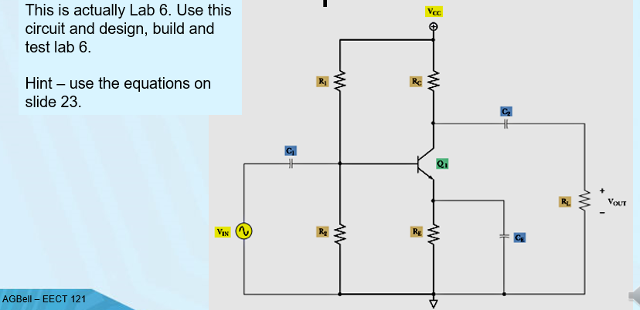
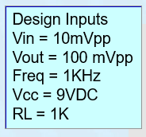
Lab 6: Common Emitter (CE) Amplifier Lab Partner was Seth wills and Alex Drummond and Donald Stanley
Equipment Need:
1 – GDM-8245 Multi-meter
1 – HY1802D DC Power source
1 – Breadboard
1-2N2222A Transistor
5- 1k, 220k, 50, 22k, 50 ohm resistors
3-1uf, 47uf and 47uf capacitor

Slide 38
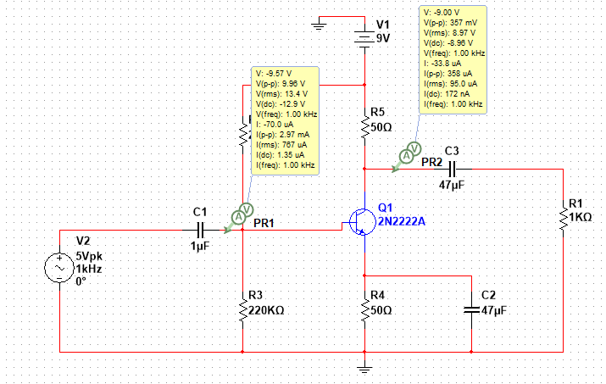
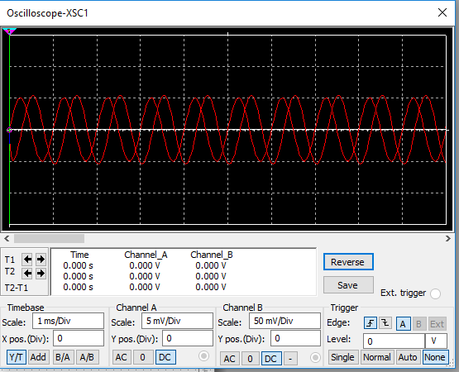
Lab 6: Part 2

Slide 39
Lab 6: Part 3
R1 | 2.20E+04
RC | 2.20E+05
R2 | 5.00E+01
RE | 5.00E+01
RL | 1.00E+03
VIN | 1.00E-03
VCC | 9
VOUT | 1.00E-01
C1 | 04.7E-06
C2 | 04.7E-06
CE | 01.0E-06
Q1 | 2N2222A
FREQ | 1.00E+03
IE
VC | 9
This is the Excel Sheet for the Calculation results for Lab 6

Slide 40
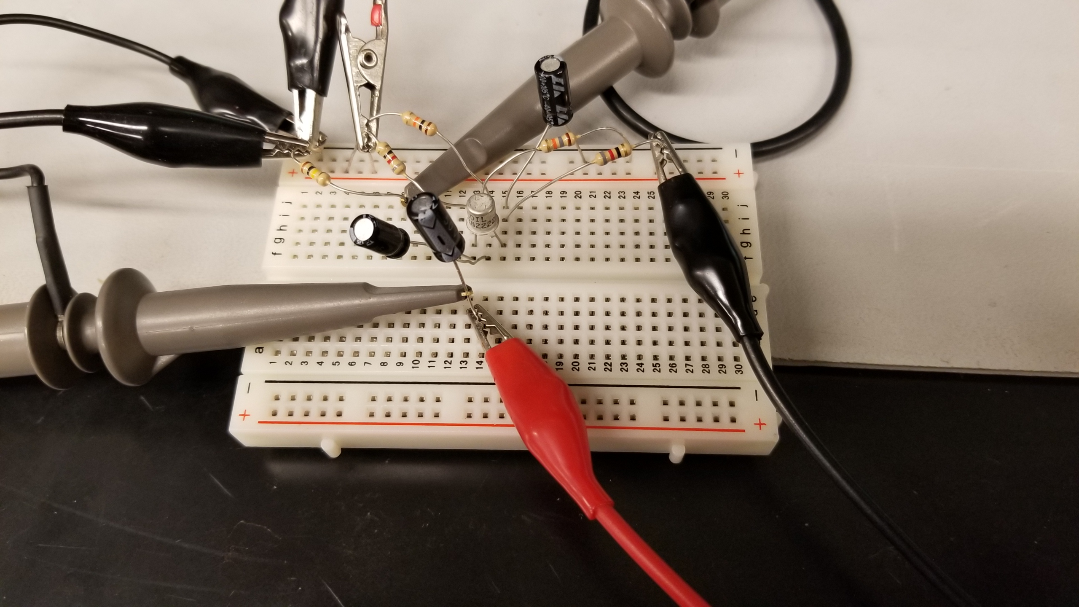
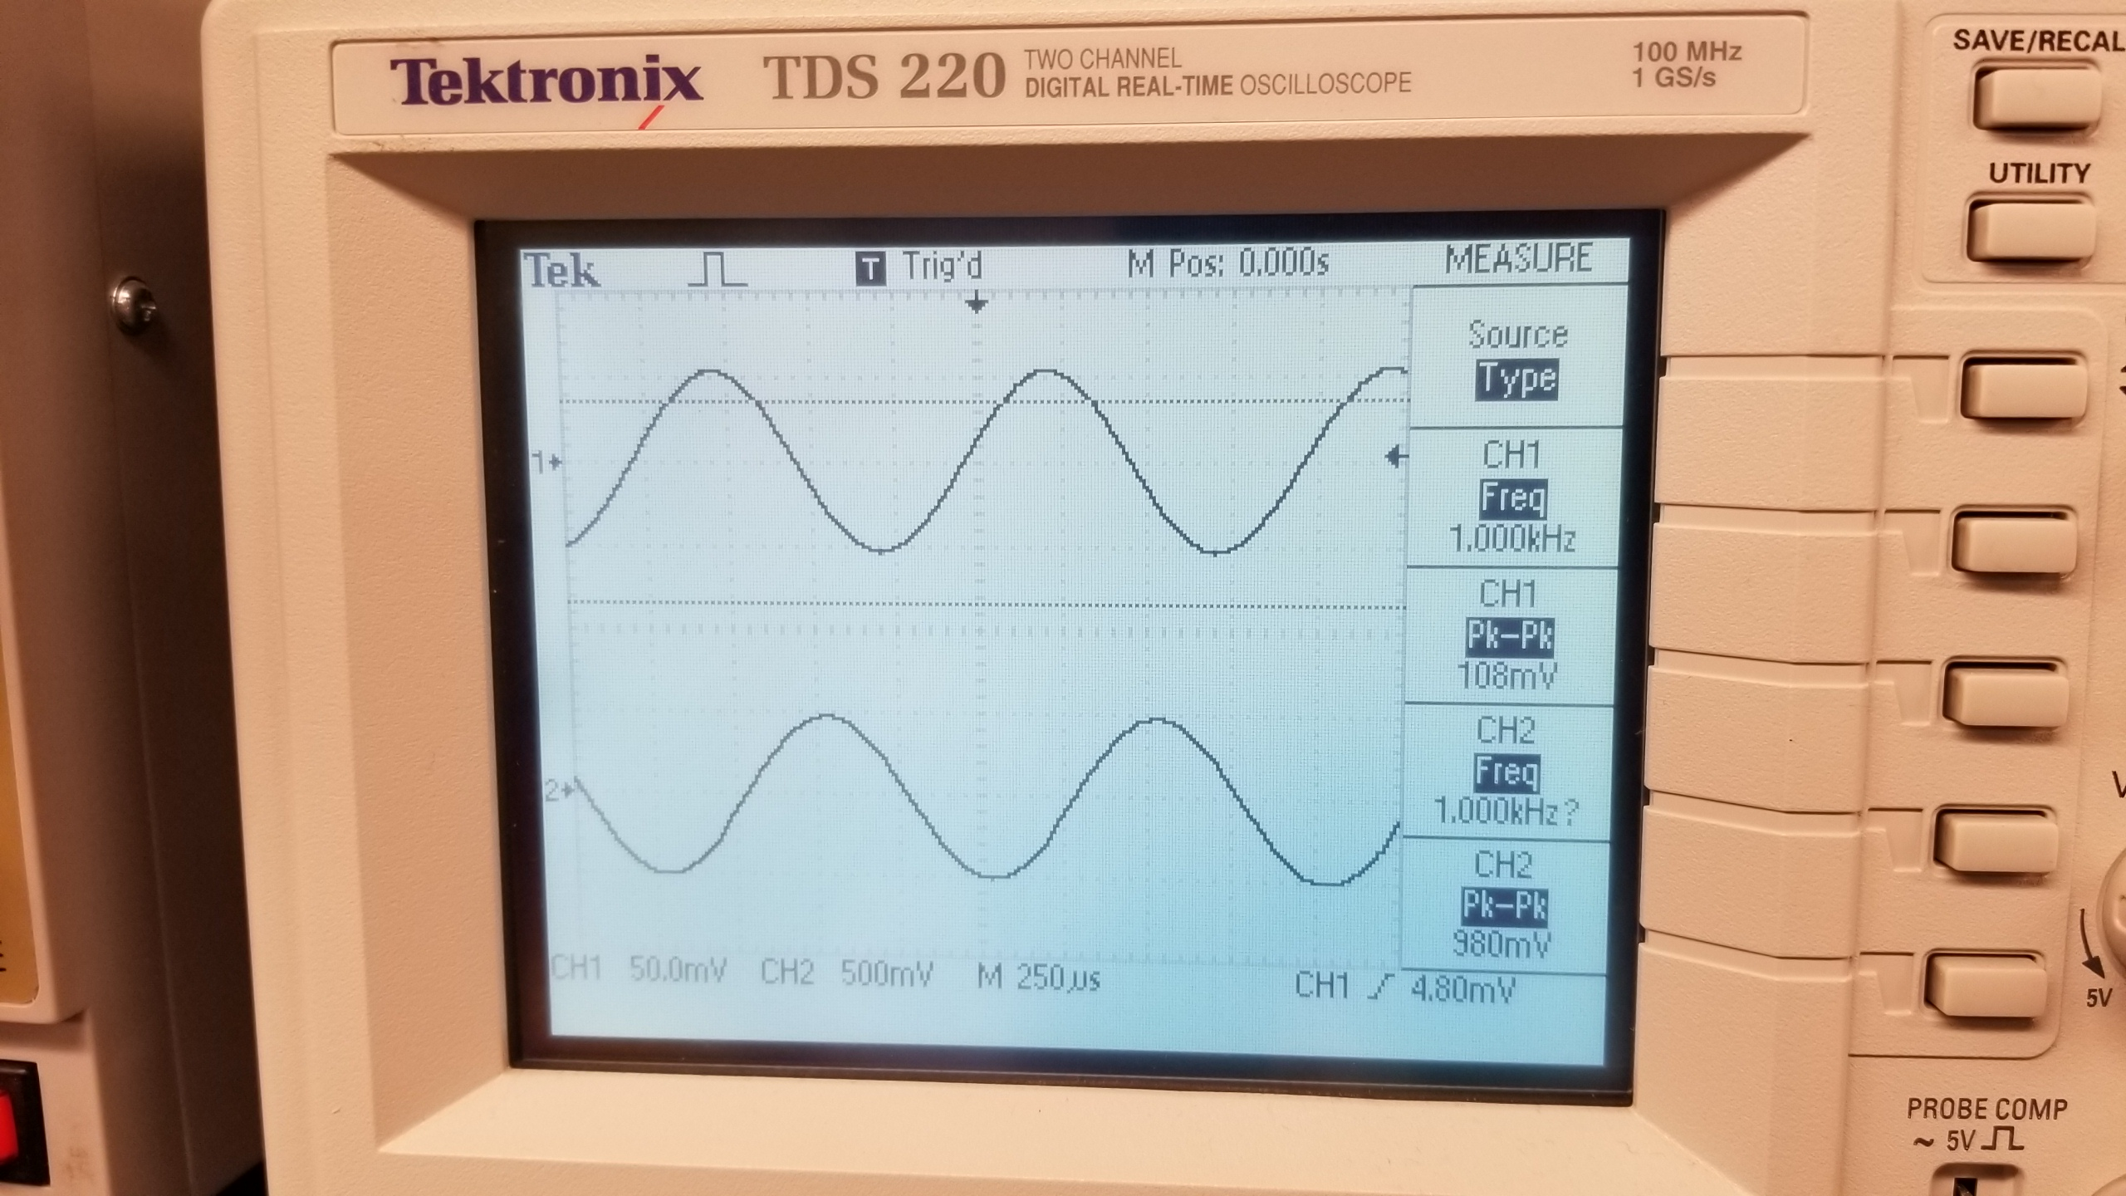
Lab 6: Part 4
This is the complete build for the circuit for lab 6
This is the Oscilloscope reading for channel1 for lab 6

Slide 41
Lab 6: Observations
We had a few issues calculating the resistor values and capacitor values, and it was a little difficult to build. We compared our results to the example lab notebook and we ended up getting a cleaner reading than they received on their oscilloscope

Slide 42
Lab 7: Using a JFET to flash an LED My Lab Partner was Alex Drummond and Seth Wills and Donald Stanley
The Purpose of this is lab is to design, build/test a JFET circuit and using it to flash an LED.
Equipment Needed:
1-2N5457 JFET Amplifier
2- 470 Ohm Resistors
1- Yellow LED
1- Gwinstek Function Generator
1 – GDM-8245 Multi-meter
1 – HY1802D DC Power source

Slide 43
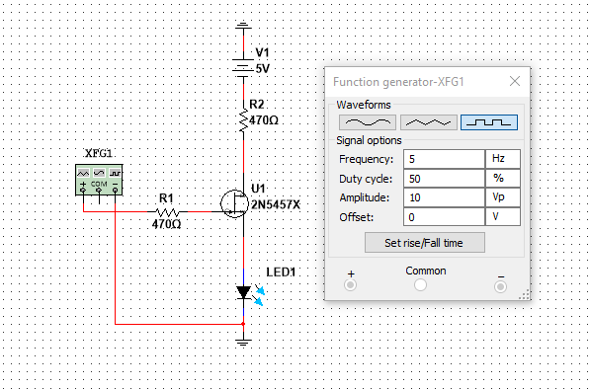
Lab 7: Part 2
We had to manually design the JFET in Multisim

Slide 44
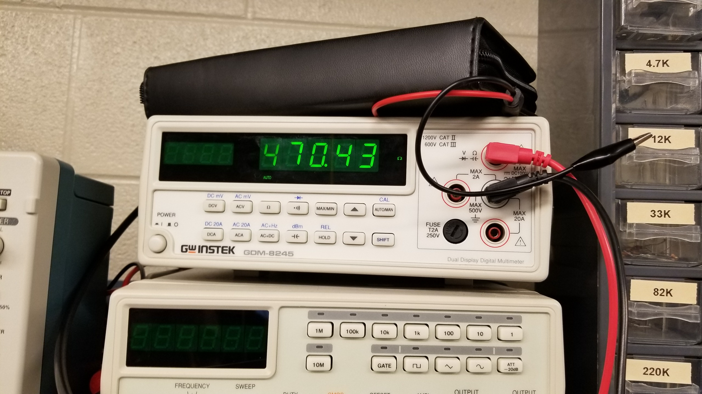
Lab 7: Part 3
The datasheet for the JFET
2N5457
This the multimeter for the 470 ohm resistor which is reading 470.43 Ohms

Slide 45
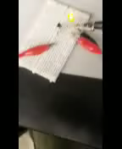

Lab 7: Part 4
Preview attachment 20181205_175347_001.mp4
20181205_175347_001.mp4
365 KB
This is the video showing the function generator and the Led flashing on and off
This is the Oscilloscope reading for the led turning on and off

Slide 46

Lab 7: Part 5
This is the picture of the complete build for Lab 7

Slide 47
Lab 7: Observations
The circuit was not too difficult to build. The only complication that we ran into is that we put the JFET in backwards. We changed the frequency to make it flash slower and faster.

Slide 48
Lab 8: Using the JFET as a Amplifier My Lab Partner was Seth Wills
The Purpose of this lab is to test and build an Amplifier circuit using a JFET
Equipment Needed:
1-2N5457 JFET Amplifier
1- Gwinstek Function Generator
1 – GDM-8245 Multi-meter
1 – Tenna Lab DC Power Supply
2- 1uf Capacitors
1-33uf capacitor
1-68k ohm resistor
1- 22k ohm resistor
1-100k resistor as a load
1- 3.3k ohm resistor

Slide 49


Lab 8: part 2
This is the multisim build for the incorrect try for lab 8 without the 5th resistor

Slide 50


Lab 8: Part 3
Measuring the 22k ohm resistor with the multimeter

Slide 51


Lab 8: Part 4
Measuring the 33k Ohm resistor using the multimeter
This is the frequency that was the input for the circuit which is a 1kHz

Slide 52


Lab 8: Part 5
This is the false circuit that was built that did not function correctly
The amplitude from the function generator was set to high which was causing the channel two to clip off

Slide 53


Lab 8: Part 6
This is the the second try circuit that is build that gave us the incorrect results
This is the incorrect reading for the second try for the oscilloscope which the two sine waves are almost 180 out of phase of eachother

Slide 54

Lab 8: Part 7
This is the picture of the Lab DC Power Supply which we used for the -5 volt and the 9 volt inputs

Slide 55

Lab 8: Part 8
This is the correct multisim for lab 8 that is fully functional

Slide 56


Lab 8: Part 9
These are the finalized pictures of the oscope and circuit that is fully functional

Slide 57
Lab 8: Observations
Used the power supply to produce -5 volts by switching the leads. Problems found with current limiter on the power supply was set to low. We had the JFET in the circuit backwards. We had to try the hook up multiple times, because we were getting no reading on the oscilloscope. And we were having trouble connecting the amount of alligator clips together because it was too many for a small circuit. We redid the circuit with a load and a few different resistor values and then it started to work correctly

Slide 58
Lab 9: High pass filter My Lab Partner was Alex Drummond, Donald Stanley and Seth Wills
The Purpose of this Lab was to build and calculated a high pass filter using multisim and excel, Which is used to filter frequencies above a set range

Slide 59


Lab 9: Part 2
This is the multisim simulation for Lab 9

Slide 60
Lab 9: pArt 3
HIGH PASS FILTER
A0= | 1
a1= | 1.4142
b1= | 1
C= | 100.0E-9
C1= | 100.0E-9
C2= | 100.0E-9
R1= | 2.3E+3
R2= | 1.1E+3
fc= | 1.0E+3 | Hz
This is the excel spreadsheet for Lab 9

Slide 61
Lab 10: Low pass filter My Lab Partners were Alex Drummond ,Donald Stanley and Seth wills
The Purpose of this Lab was to build and calculated a high pass filter using multisim and excel, Which is used to filter frequencies with a mid range

Slide 62


Lab 10: Part 2
This is the multisim simulation for Lab 10

Slide 63
Lab 10: Part 3
LOW PASS FILTER
A0= | 1
a1= | 1.4142
b1= | 1
C1= | 22.00E-9 | 4.7E-08
C2= | 44.00E-9
R1= | 3.82E+3
R2= | 6.41E+3
fc= | 1000 | Hz
This is the excel spreadsheet for Lab 10

Slide 64
Lab 11: Band-Pass Filter My lab partners were alex Drummond, Donald Stanley and seth wills
The Purpose of this Lab was to build and calculated a high pass filter using multisim and excel, Which is used to filter frequencies with a mid range and is considered a Mid-pass filter

Slide 65


Lab 11: Part 2
This is the multisim simulation for Lab 11

Slide 66
Lab 11: Part 3
R1 | 7.96E+03
R2 | 31.83E+3
R3 | 80.38
C | 100.0E-9
C1 | 100.0E-9
C2 | 100.0E-9
AM | -2.0
Q | 10.0
fm | 1000 | Hz
B | 157.08 | bandwidth
Q | 10.00E+0 | filter quality
Am | 2.00E+0 | gain at fm
This is the excel spreadsheet for Lab 11

Slide 67
Lab 12: Notch Filter My lab partners were alex Drummond, seth wills and Donald stanley
The Purpose of this Lab was to build and calculated a high pass filter using multisim and excel, The Notch filter is used to isolate specific frequencies in a circuit and filter them out.

Slide 68


Lab 12: Part 2
This is the multisim simulation for Lab 12

Slide 69
Lab 12: Part 3
fm= | 1000 |  | Mid Freq
G= | 5.7 |  | Inner Gain
A0= | 6 |  | Passband Gain
Q= | -135.14E-3 |  | Rejection Gain
C= | 100.00E-9
C1= | 100.00E-9
C2= | 100.00E-9
C3= | 200.00E-9
R= | 1.59E+3
R1= | 1000
R2= | 4700
R3= | 1.59E+3
R4= | 1.59E+3
R5= | 795.77E+0
This is the excel spreadsheet for Lab 12

