Slide 1

EECT 175: Intro to Sustainable Energy Lab Notebook
By: Jarred Clark

Slide 2
Table of Contents
Lab 1: Wind turbine using the Lego mind storm and the energy meter Page. 3
Lab 2: Measuring solar energy using the solar panel and measuring Page. 11
the charging voltage
of the energy meter
Lab 3: Discharging batteries and charging batteries Page. 19
Sight Audit for the Solar Panel at Ivy Tech Community College Page. 33
Lab 4: Solar Panel Build and testing Page. 43

Slide 3
Lab 1: Wind turbine using the lego Mindstorm and the energy meter
The purpose of this Lab was to demonstrate how to use the lego mindstorm. We created a schematic in order to download the material to the Nxt then the information was transmitted to the Energy meter which sent energy to the fan in ordered it to move in the direction desired.
Equipment Needed: Energy Meter
Mindstorm Programmer
Built construction of the Fan
Charging port for the Energy Meter
A DC Motor
Hypothesis: The Energy meters will run the fan with simultaneously movements and will move the fan in different periods of time

Slide 4
Lab 1: Part two
Research for the experiment: We used the instruction manual to learn what the basic functions were for the lego mindstorm. Then we also used a couple youtube videos in order to learn how it work.
https://www.youtube.com/watch?v=BPRCWqifcz0
https://www.youtube.com/watch?v=n1vphpzKJt0
After applying the power in order to charge the Energy Meter is instantly gave off 100 jolts.

Slide 5
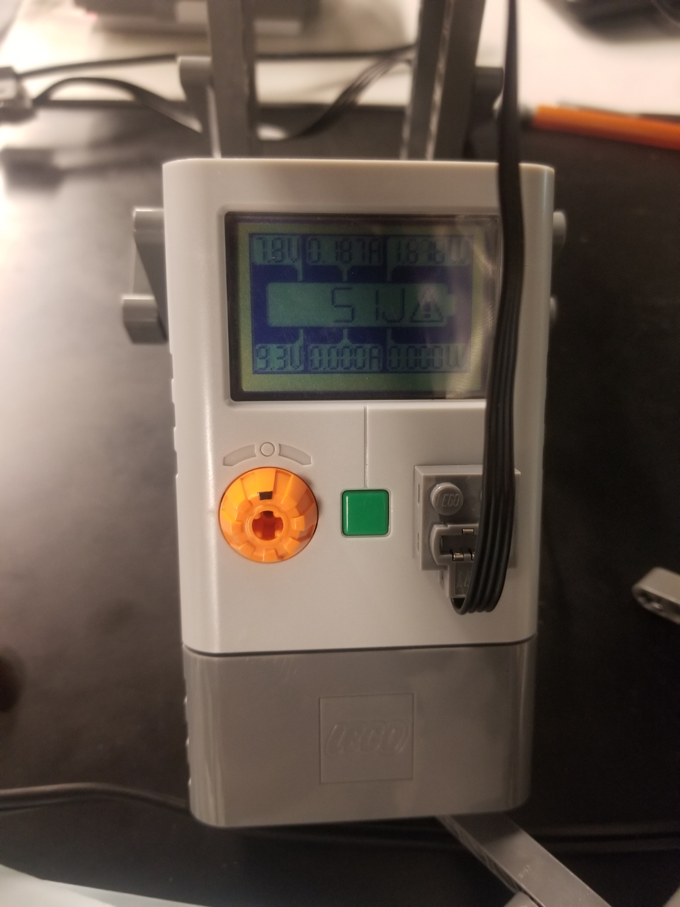
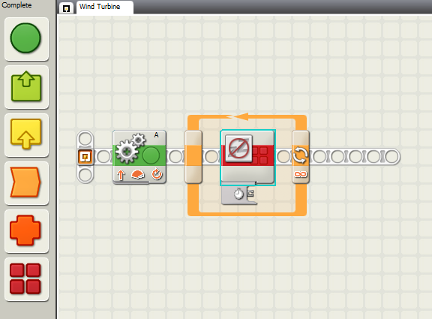
Lab 1: Part three
This is our schematic that we used to download to the lego Mindstorm Nxt
This is the picture of the Energy Meter reading 51 Jolts.

Slide 6
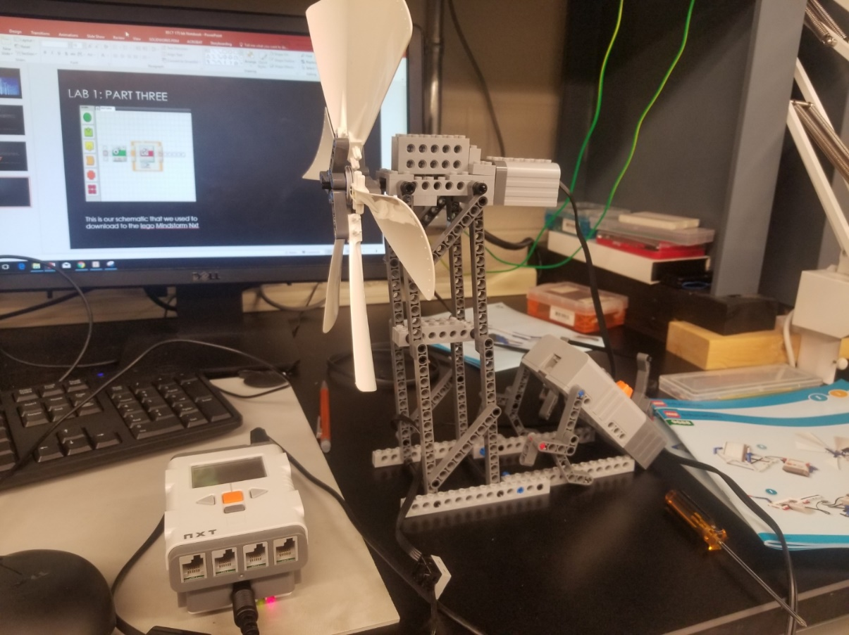
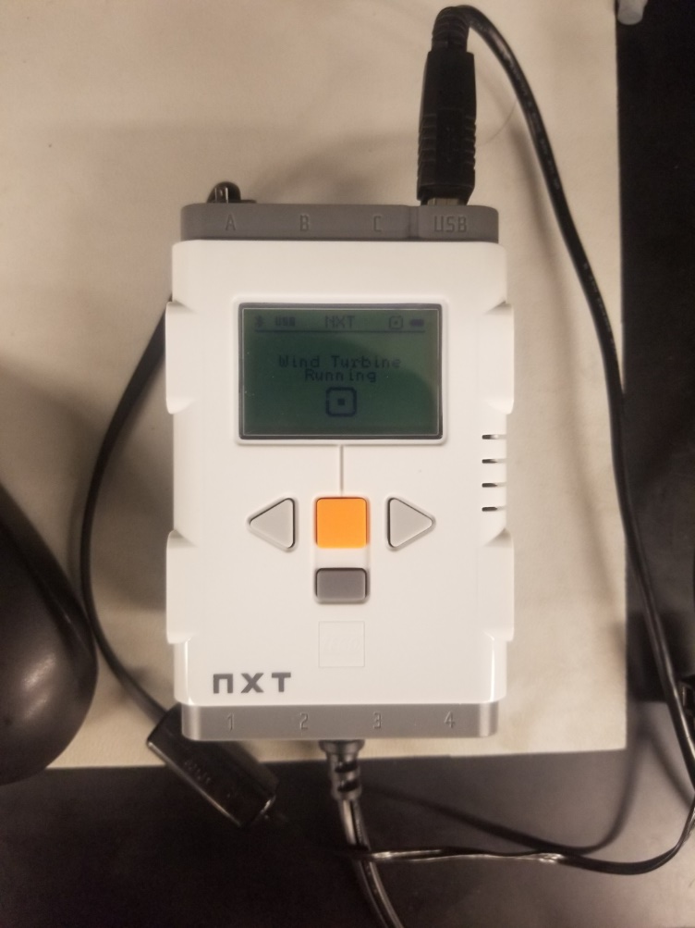
Lab 1: part Four
This the picture with the Lego Mindstorm, Energy meter and the fan hooked up.
This is a picture of the Lego Mindstorm Nxt.

Slide 7
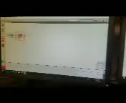
Lab 1: part five
This a video of the Wind Turbine in function

Slide 8
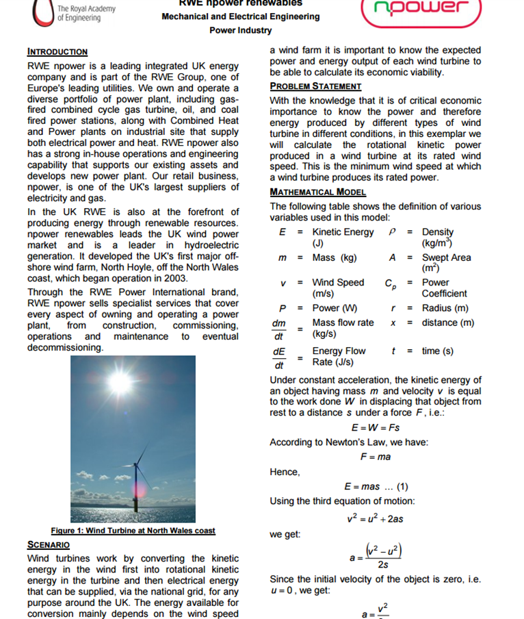
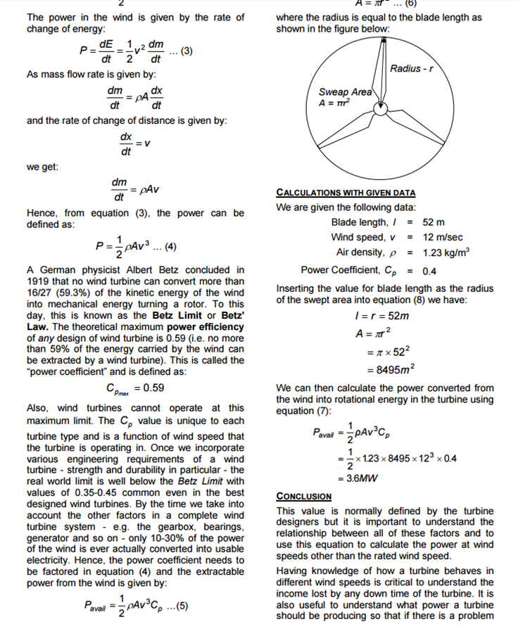
Lab 1 Part Six

Slide 9
Lab 1 Part seven
The datasheets on the Previous slide gave me some information about renewable energy using fans and also it gave me the right formulas to use for the calculations
Using the fan from the Lego mindstorms kit varies a lot from the actual numbers used for the big wind turbines
Depending on how fast the wind turns the turbine determines how much energy will be received from the desired turbine that is functioning

Slide 10
Lab 1: Observations
In order for the Wind Turbine to successfully work, You have to create a schematic on the Lego programmer to download onto the Nxt, so it knows the desired functionality to enable to the wind turbine to move. Also the energy meter sends energy to the Motor to move the Turbine in the desired directly that is switched to.

Slide 11
Lab 2: Measuring solar energy using the solar panel and measuring the charging voltage of the energy meter
The purpose of this lab is to test and design a solar panel using a lamp and the Lego mindtorm. Then determine the different measurements of how much power is coming off the solar panel depending on the angle of it. Also, to learn how to measure the charging voltage coming to the energy meter.
Equipment needed:
Energy Meter
LEGO® MINDSTORMS® NXT
Power Lamp
Lego Solar Panel
Gwinstek Multimeter
2- 1.2k ohm resistors

Slide 12
Lab 2: Part two
Hypothesis: Depending on what angle the solar panel is displayed, the different amount of energy it is going to give off.
Research Notes:
https://www.youtube.com/watch?v=BPRCWqifcz0&t=181s
https://le-www-live-s.legocdn.com/sc/media/files/user-guides/mm/9688-energy-meter-guide-e526319e083ac417918f4fa7c1563fc1.pdf
http://www.hdidakt.hu/adat/dw_anyagok/dw_55.pdf

Slide 13
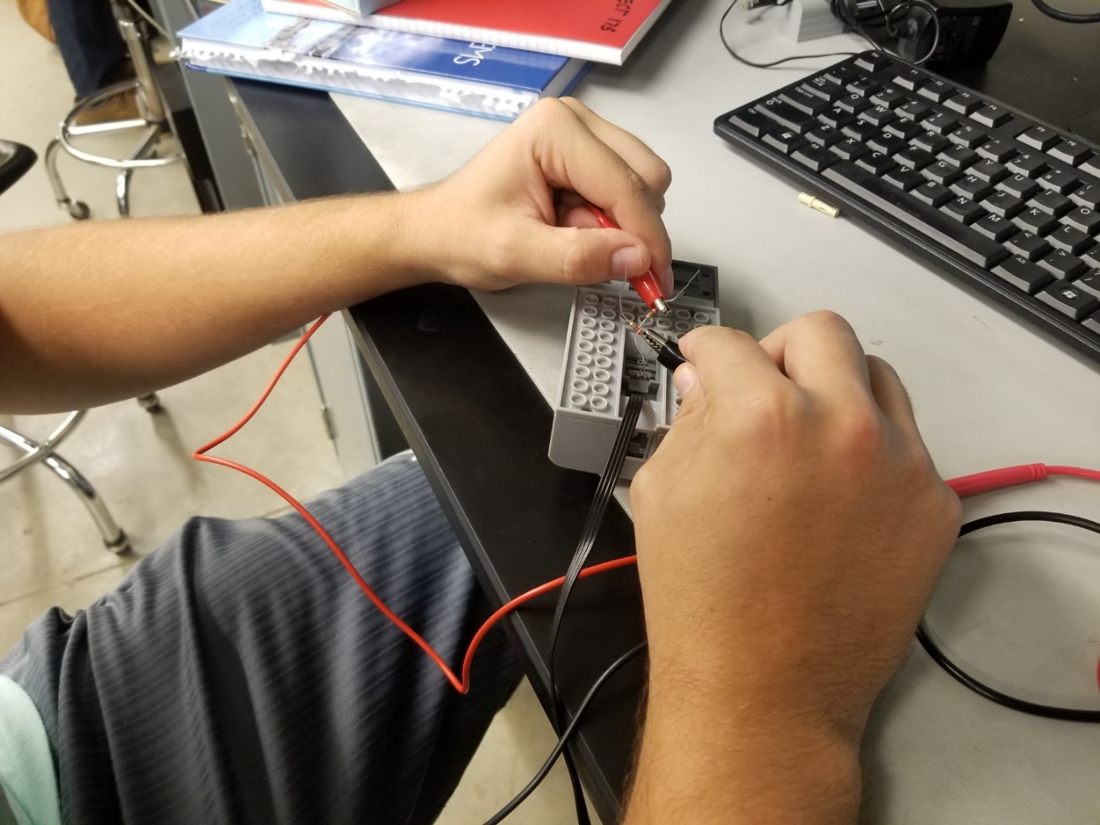
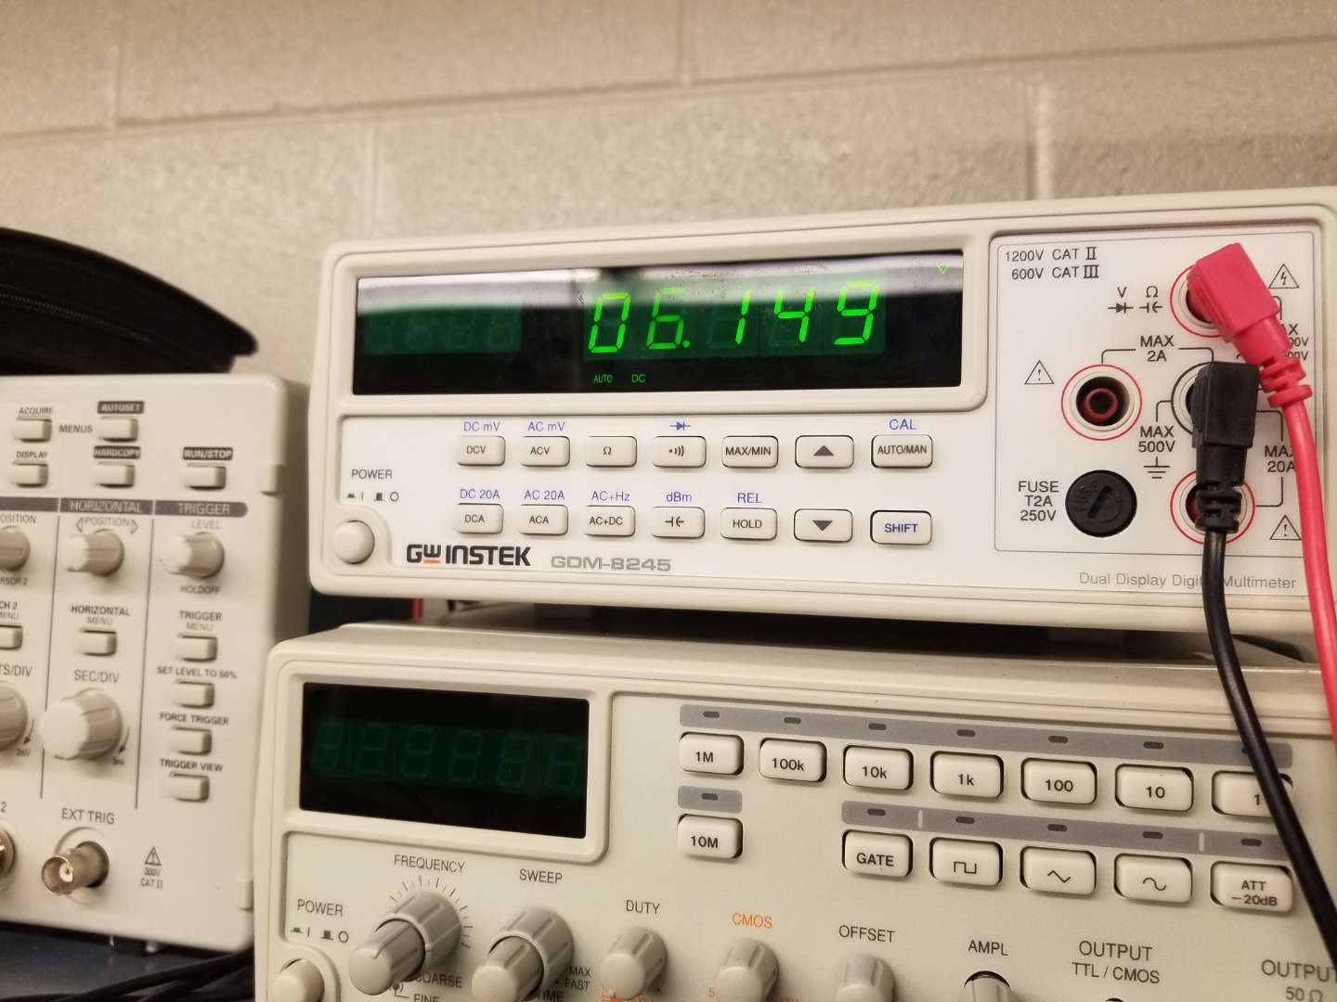
Lab 2: Part three
Charging the energy meter and measuring the voltage that it is receiving
This is the reading that we got from the energy meter which is 6.149 volts
This how we measured the output voltage
For charging the energy meter

Slide 14
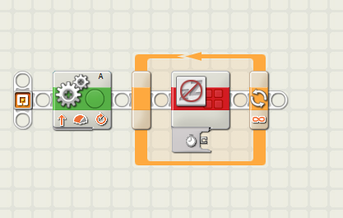
Lab 2: part Four
This is the Lego Mindstorm schematic that we used to continue charging the energy meter

Slide 15
Lab 2 Part five
Testing the Amount of Energy from the solar panel at different Angles.
There is direct light coming from the lamp to the solar panel, which is angled at 180 degrees
The Lamp is 6 inches from the solar panel
The Energy meter starts flickering and getting a read when the solar panel hits 90 degrees
You get very different calculations depending on the angle of the lamp and how far it is from the solar panel and measurements vary depending on the angle of the solar panel.

Slide 16
Lab 2: Part six
Angle of Solar Panel | Voltage | Amps | Wattage
0 degrees | 0 | 0 | 0
120 degrees | 2.7 | 0.009 | 0.018
145 degrees | 3.1 | 0.015 | 0.041
180 degrees | 3.3 | 0.023 | 0.068
220 Degrees | 2.4 | 0.011 | 0.026
Light Source | 60 Watts
This is a picture of the test data depending on the different variants of the location of the solar panel.
For these calculations, the lamp is direct light and 6 inches from the panel. The light already generated in the room has some effect on the measurements

Slide 17
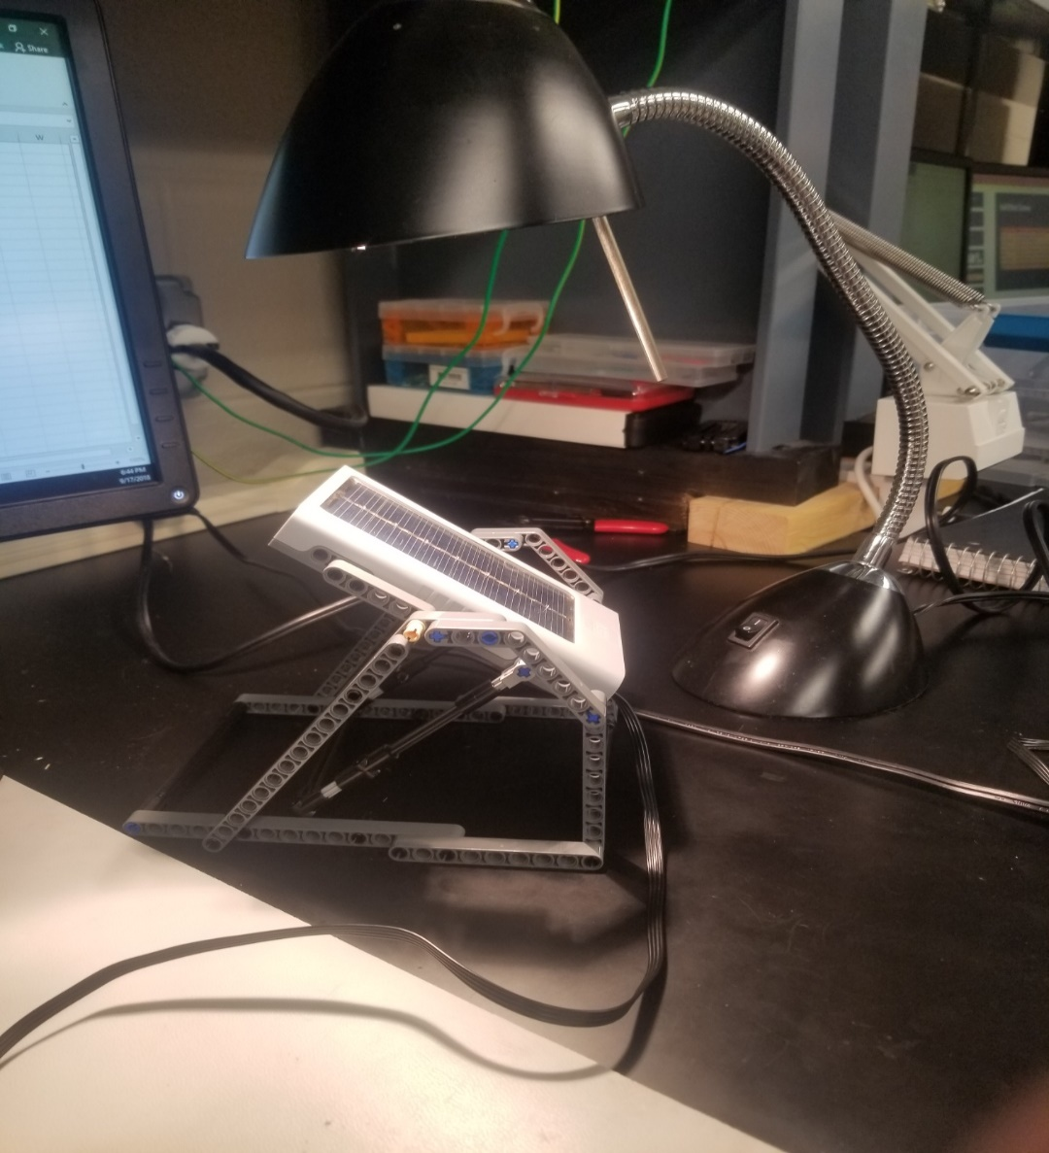
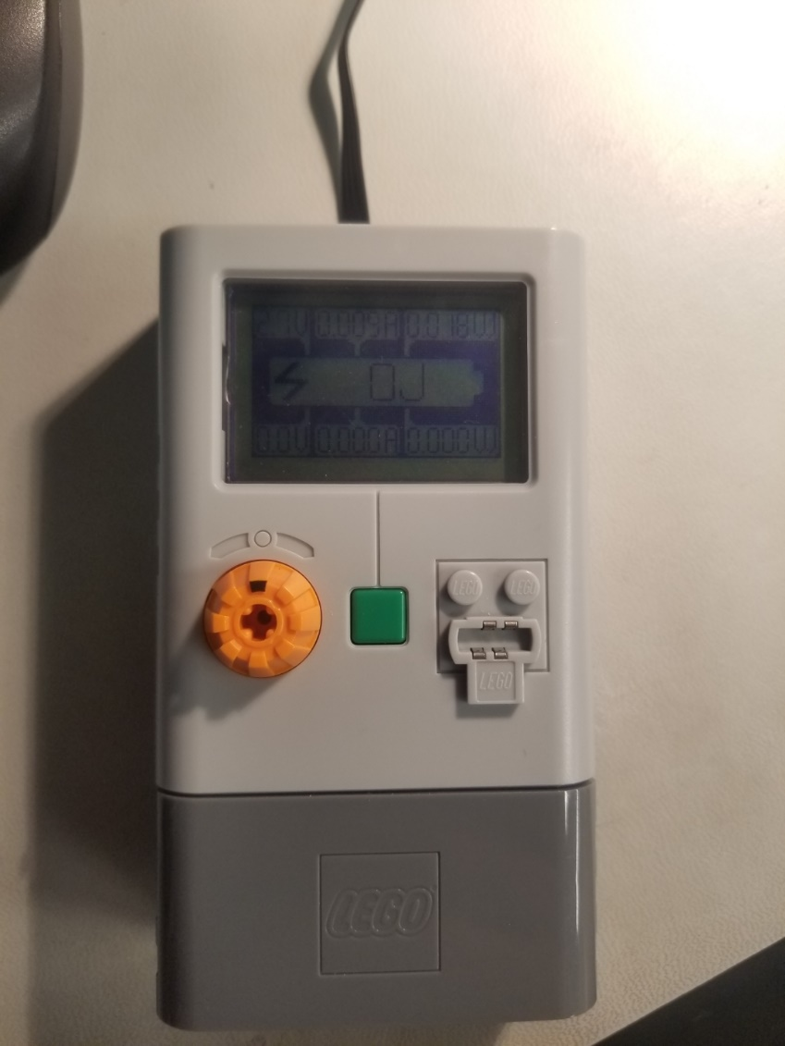
Lab 2 Part Seven
This is the experiment set up for measuring the solar energy
These are the measurements for the solar panel being at 120 degrees

Slide 18
Lab 2 Conclusion
There is a couple variations with the measurements. Depending on how far and what angle the light is to the solar panel, it gives off significantly different measurements. Also, the angle of the solar panel will give you different measurements as well. There were also a couple issues with the energy meter not reading any joules. Previous students have also determined that.

Slide 19
Lab 3: DISCHARGING BATTERIES and charging batteries
09-17-18
The purpose of this lab is to determine how much is taken away from the batteries voltage while being connected into a battery box.
Hypothesis: When the batteries are inserted into the battery box, they will have less voltage than first measured.
Equipment needed:
Gwinstek Digital Multimeter
Battery Pack
energizer AA Batteries
330 ohm resistor
Green LED
Datasheet for Batteries: http://data.energizer.com/pdfs/nh15-2300.pdf

Slide 20
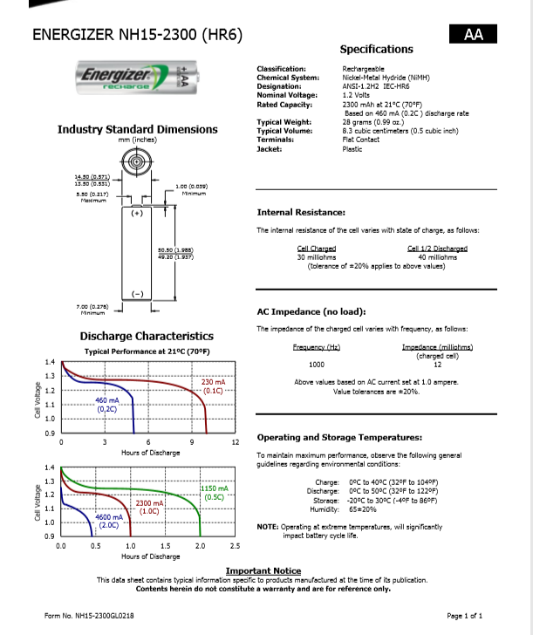
Lab 3 Part two
This is the datasheet for the energizer battery

Slide 21
Lab 3 Part three
We used an led and a resistor to drain the batteries. Each battery was reading roughly 1.2 volts. after that we have to check to see what the drainage voltage is of the batteries.
After the drainage and the recording of the batteries. We then will place the batteries in a solar 2 in 1 folding panel and then we will begin charging the batteries back up.
The Batteries drain very slowly with the circuit but we found out that it does work better than just a resistor

Slide 22
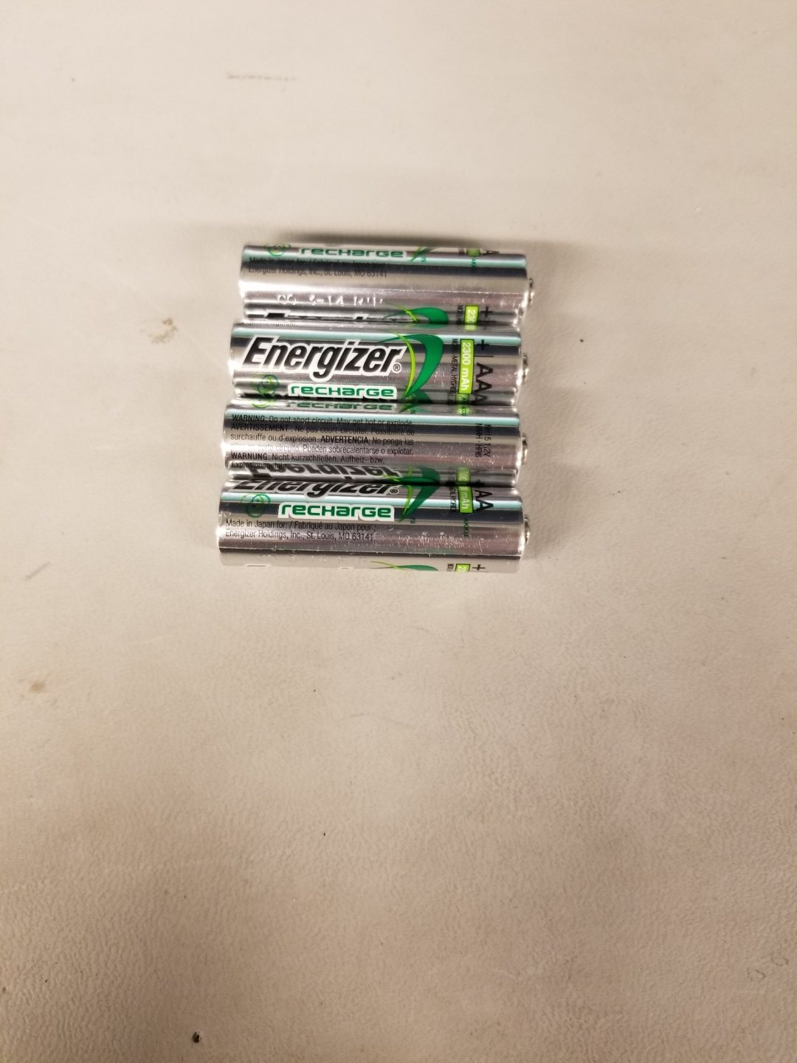
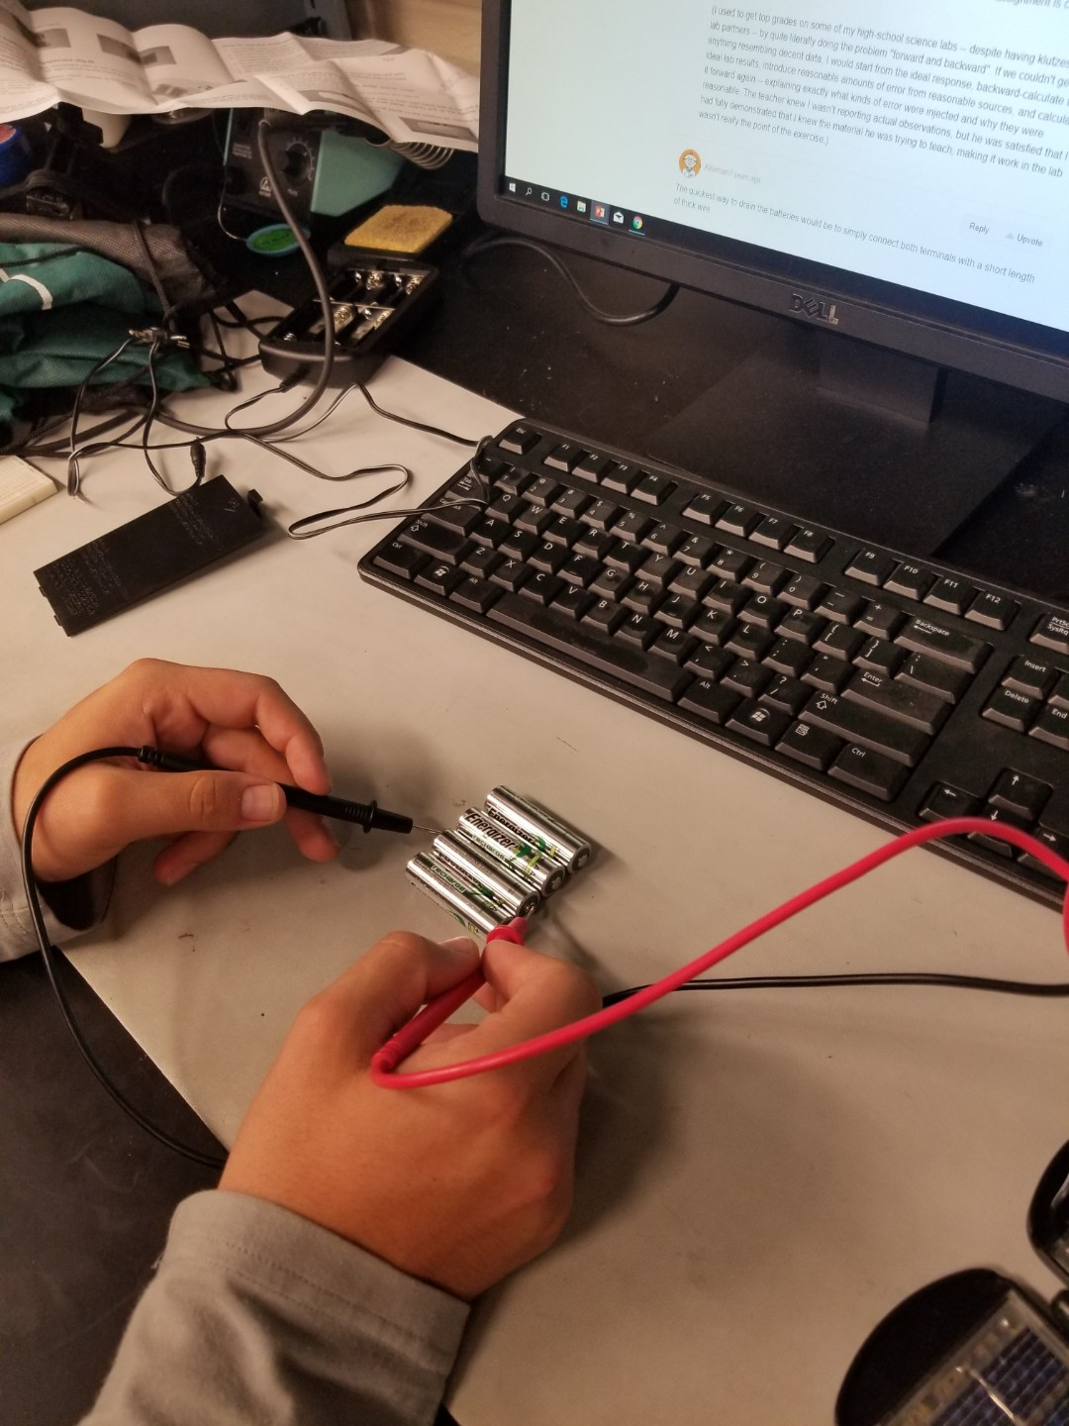
Lab 3 Part four
This is how we tested the voltage of each battery before we started the draining process
We used two of these four AA Batteries that were used in this experiment

Slide 23
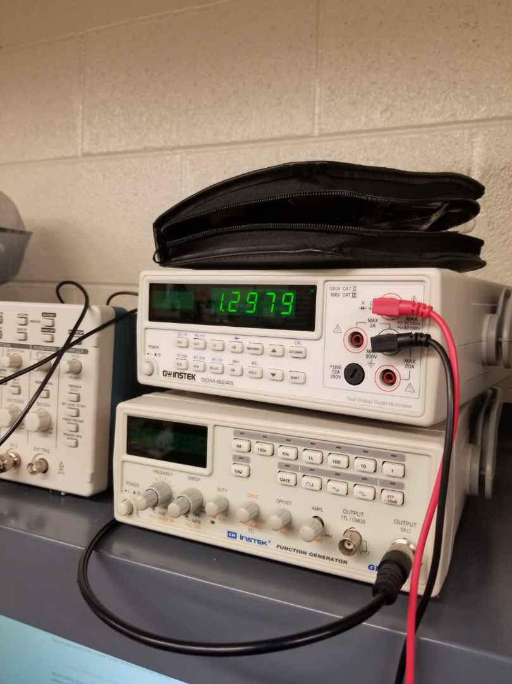
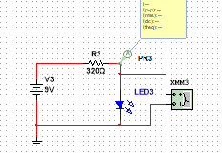
Lab 3 Part four
This is the schematic used for the circuit to drain the batteries
This is one of the readings from the batteries which is 1.2979 volts

Slide 24
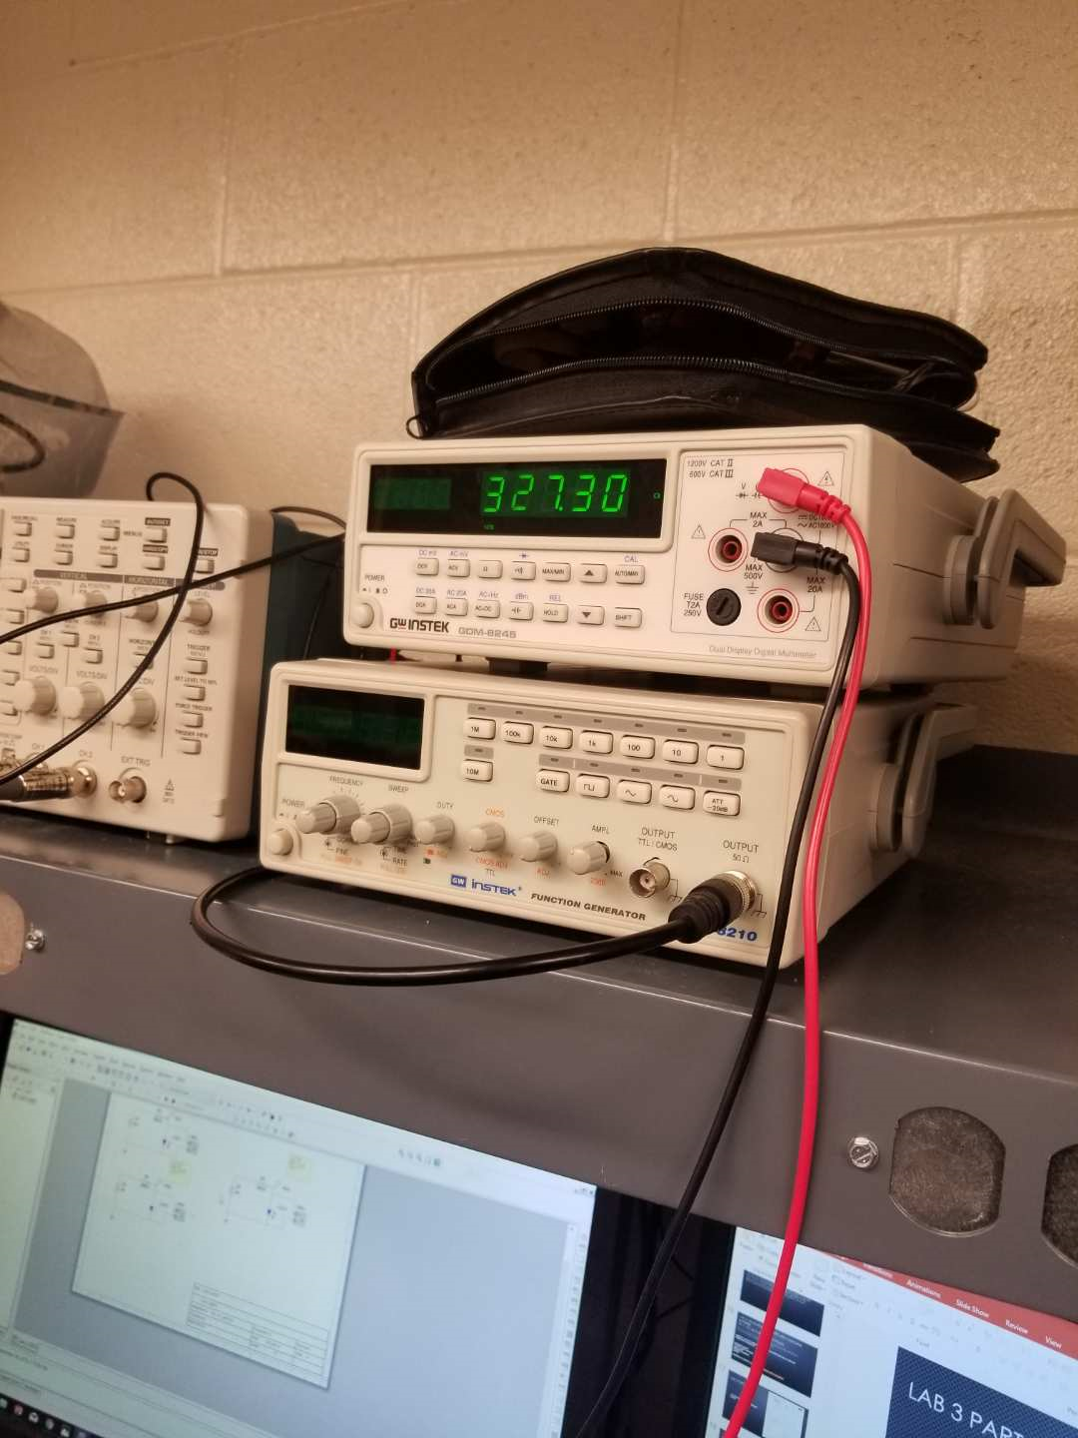
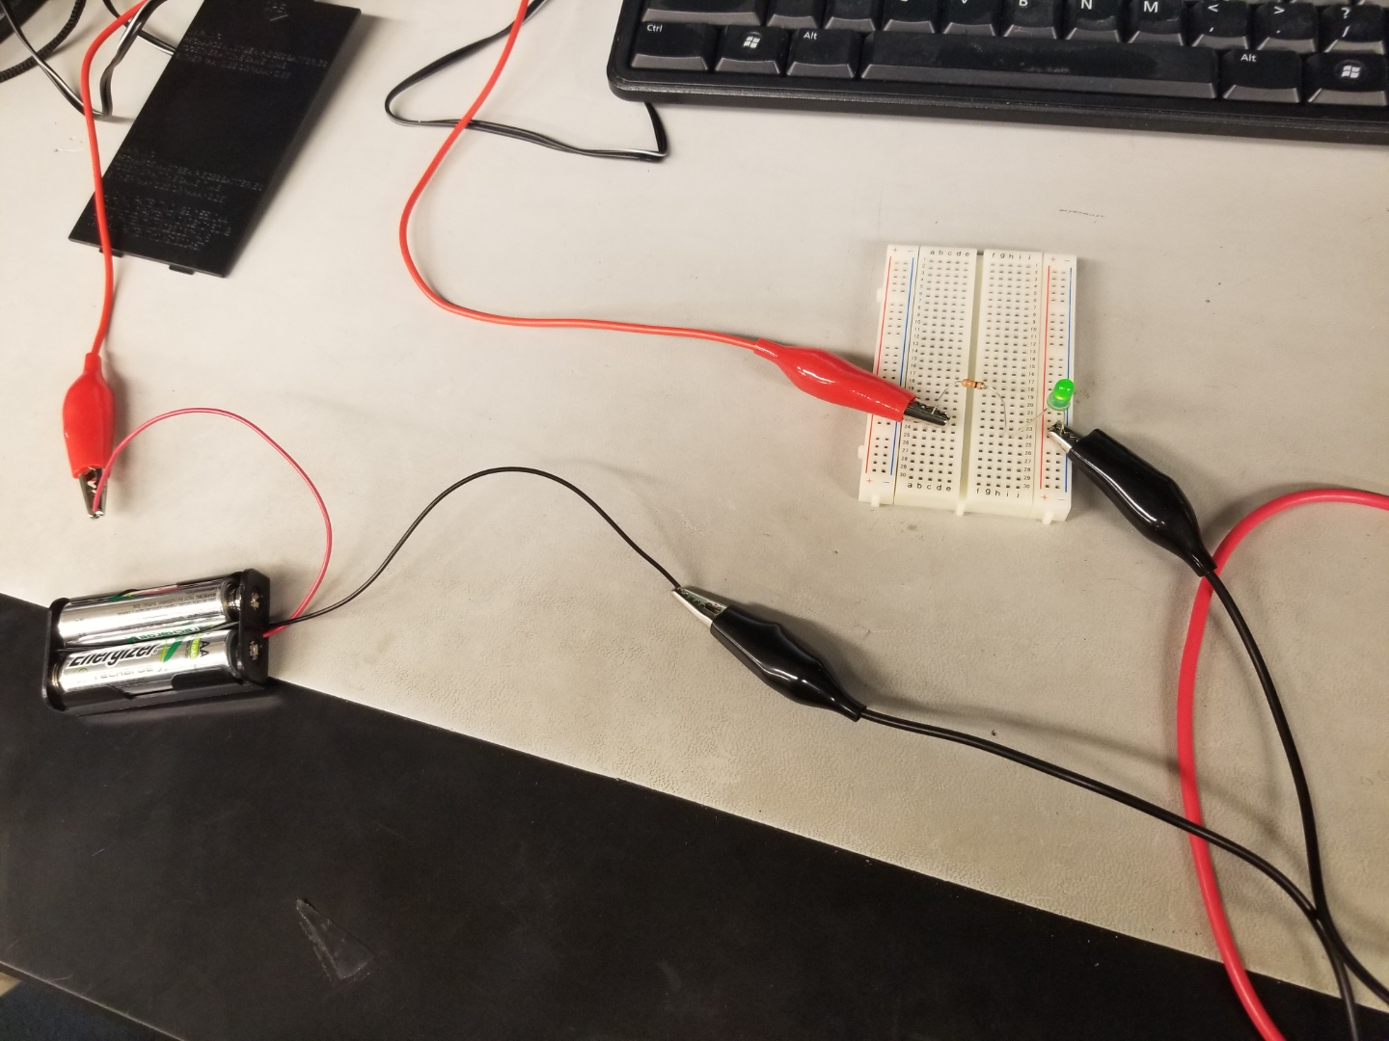
Lab 3 Part five
This is the circuit and how we wired the battery pack up to light the led
This is the resistor reading which is 327.30 ohms

Slide 25
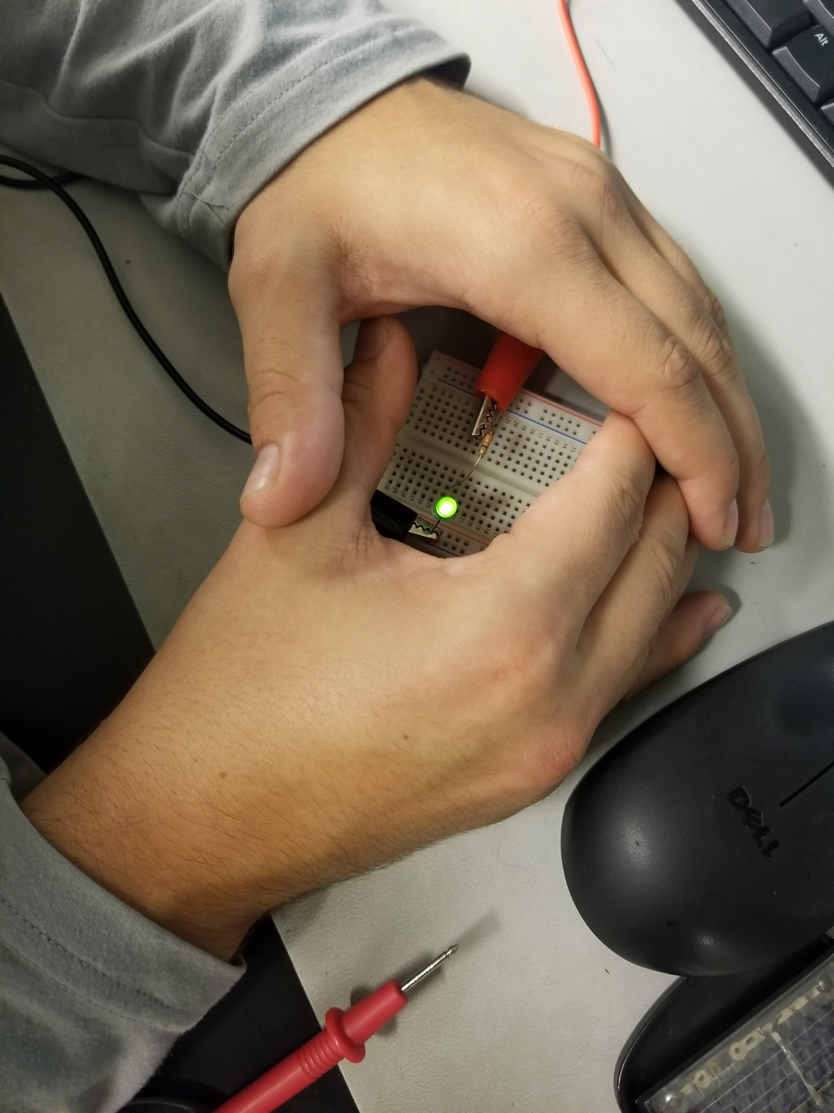
Lab 3 Part six
This is a picture of the LED being lit up by the connection of the batteries of a power source

Slide 26
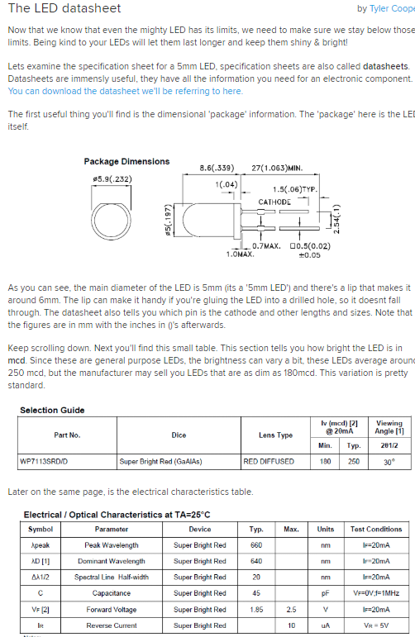
Lab 3 Part seven
This the LED datasheet that is used for this experiment

Slide 27
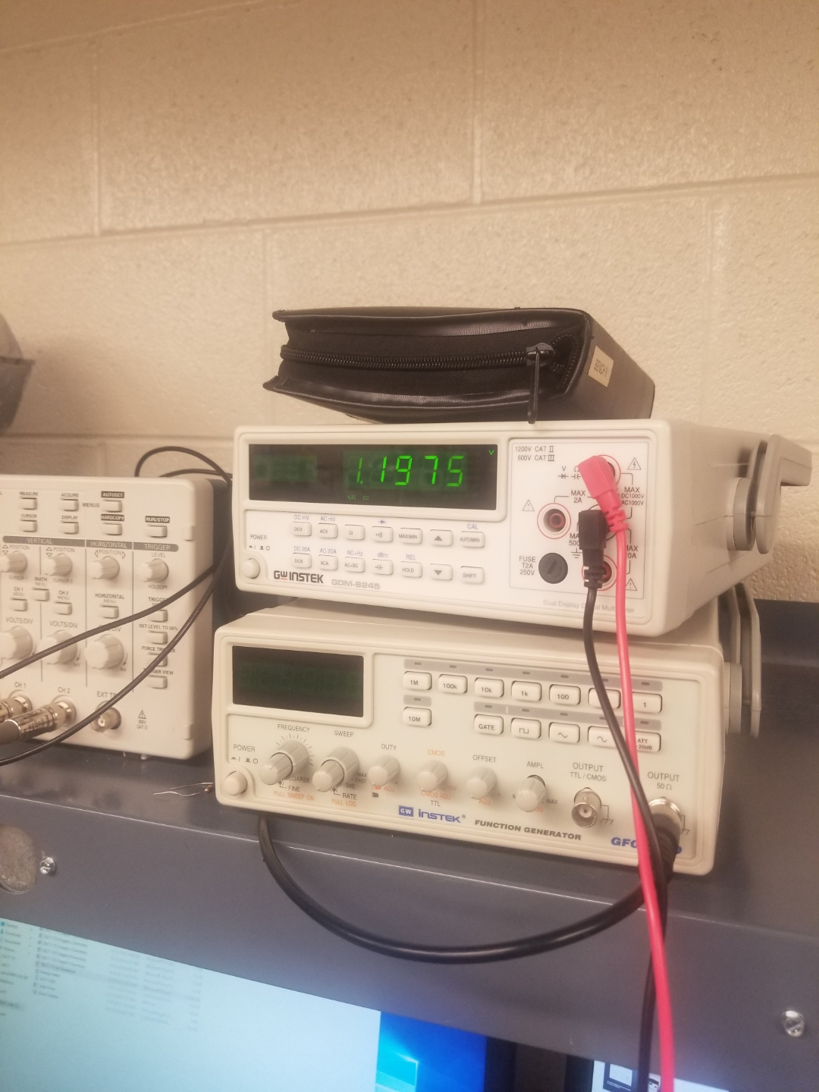
Lab 3 Part Eight
After one week of discharging the batteries they went from 1.2979 Volts down to 1.1975 Volts. So the batteries approximately discharged 1 Volt

Slide 28
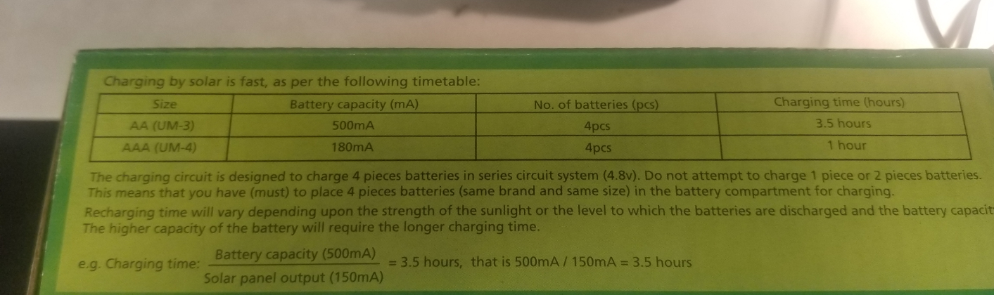
Lab 3 Part nine
After discharging both Energizer AA batteries down 1 volt we are ready to start charging them with the 2 in 1 Folding panel.
Our goal is to charge them back up to the full potential voltage

Slide 29
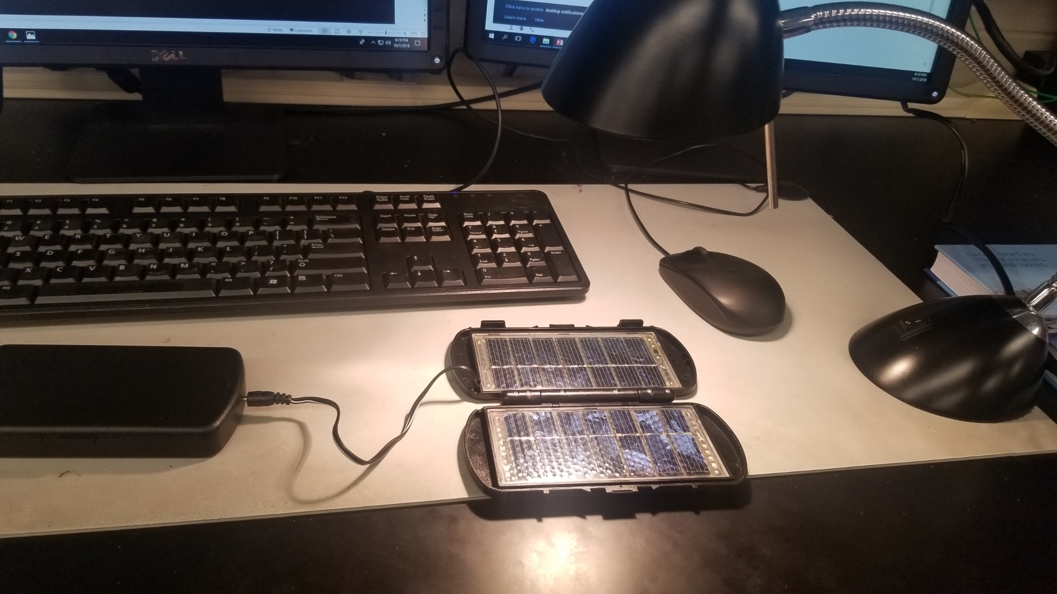
Lab 3 Part ten
This is our setup using the 2 in 1 panel to charge the AA batteries

Slide 30
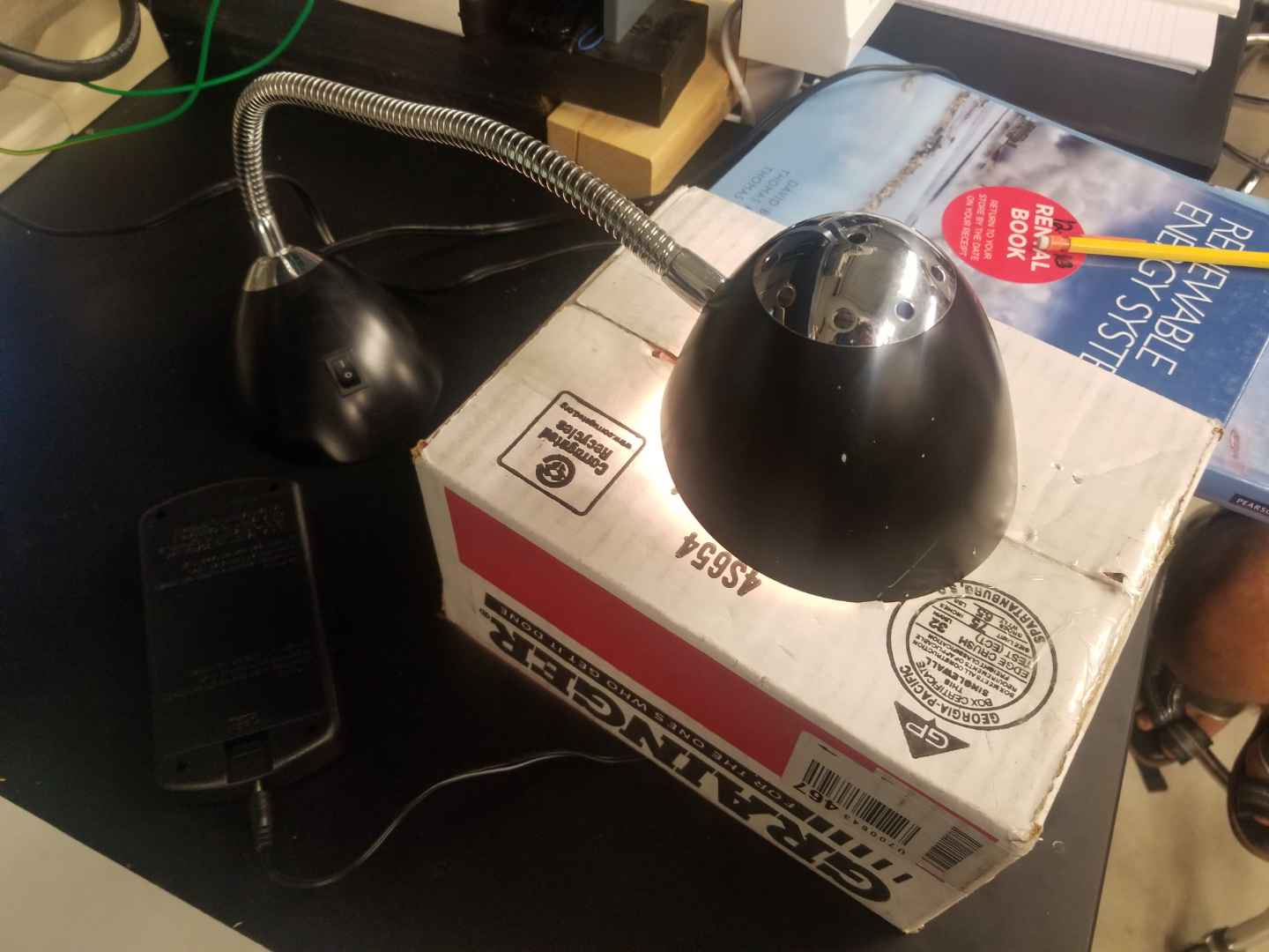
Lab 3 Part Eleven
We decided to take a box and cut a hole the size of the lamp to make sure that the solar panel that is charging the batteries is getting direct light in stead of the miscommunications between the light in the room

Slide 31
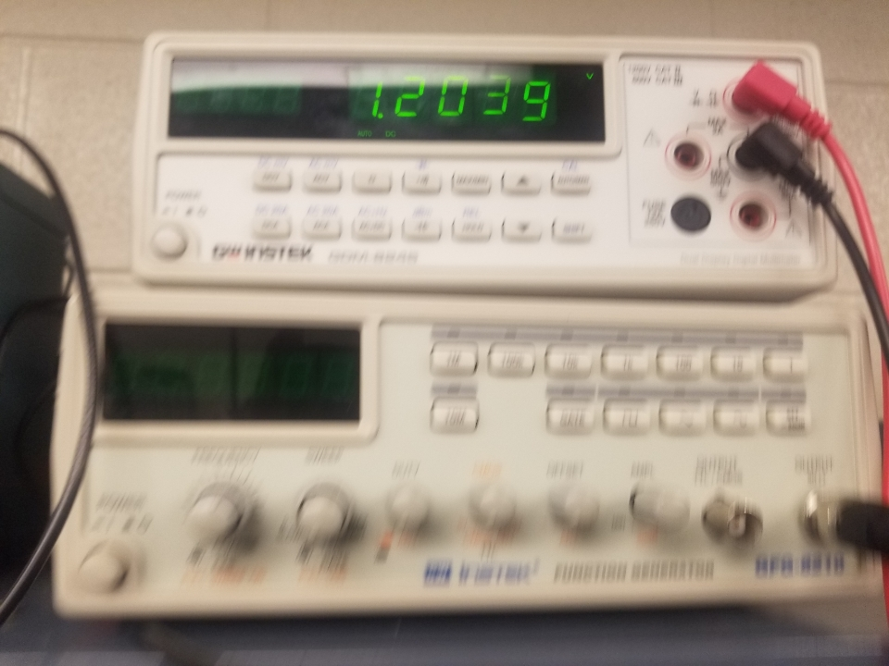
Lab 3 Part Twelve
After an hour and fourty five minutes the batteries charged up to 1.2039 volts using the solar panel and the battery packl

Slide 32
Lab 3 Observations
Discharging the batteries took a couple tries because they were not discharging fast enough. It took about 2 weeks to fully get this lab done. Then after we found a better way to discharge them we then charge the batteries using the 2 in 1 solar panel and charged them back up to about fully charged

Slide 33
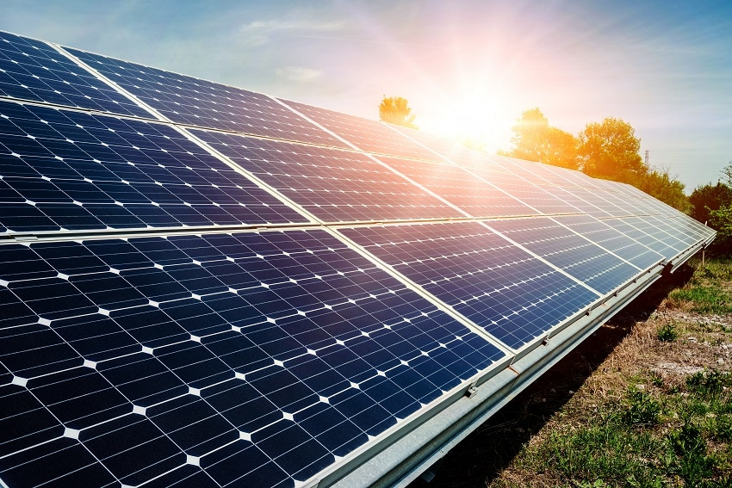
SITE AUDIT for the 100 Watt Solar Panel
BY: Jarred Clark
10/08/18
This site audit is about determining the best spot to place the solar panel to get maximum energy received at all times. This is going to be determined by the evaluating the site for the solar panel, the path of the sun across the sky, the obstacle survey, doing the site survey, and the end result for the site audit.

Slide 34
Table of contents
Evaluating your site for solar energy
Path of the sun across the sky
Obstacle survey
Doing the site survey
End result
Resources

Slide 35
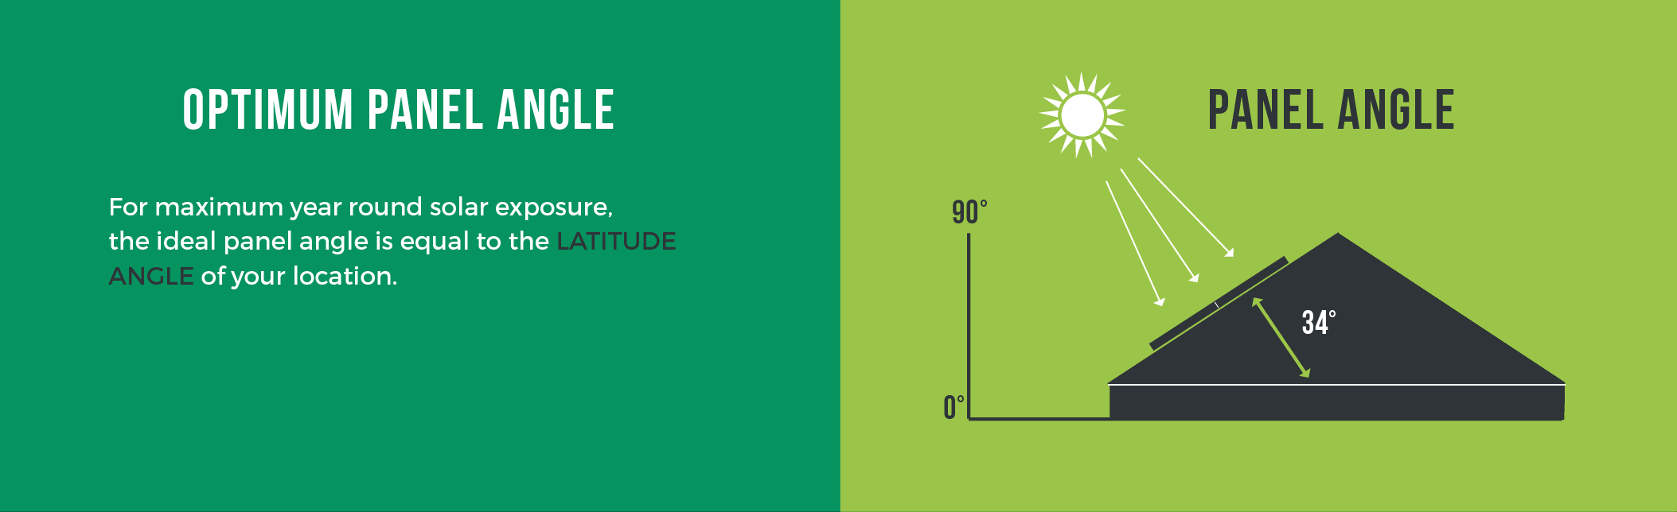
Evaluating your site for solar energy
Questions to be asked that can create a hassle while using the Solar Panel
Does the amount of sunlight hitting the solar panel determine how much energy is produced?
Does the location chosen get enough sun all the way around the area?
Is their any nearby obstacles that block the amount of sunlight that is being received?

Slide 36
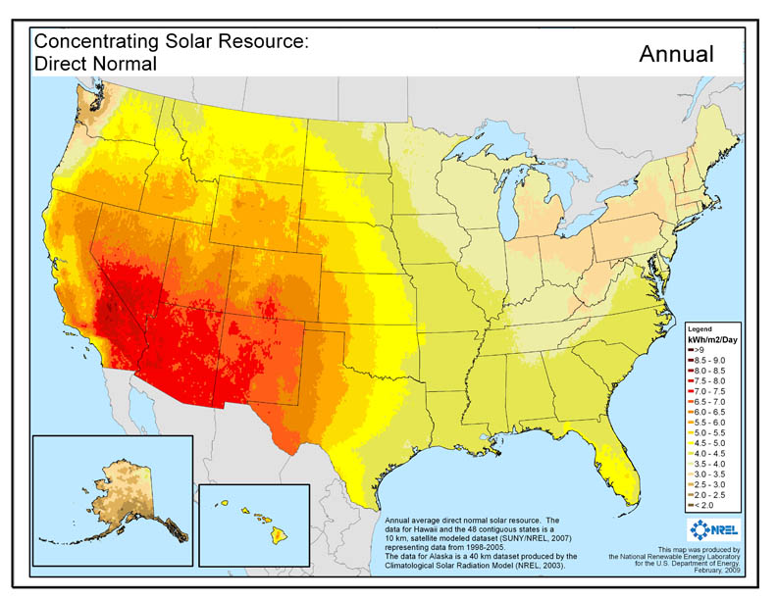
Average Daily radiation per month that the sun gives off
In all of the 50 states in the United States of America according to this chart, all of the states receive enough radiation in order to receive power from solar panels.
From the data received from this chart of the United States, Indiana receives 4 to 5 kWh/m2/day and the northern part receives a little more than the central and the south area.

Slide 37

This some information that was found on the web about the latitude tilt radiation over the past 29 years over each month.
The latitude and longitude of the location that is being used in the chosen location determines the amount of energy that will be received from the solar panel depending on the angle of the sun.

Slide 38
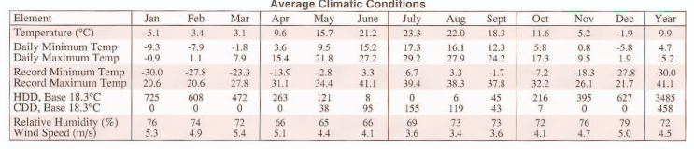
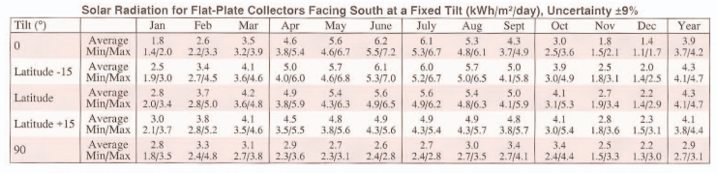
This is a small datasheet where It shows the difference between the climate at multiple times of year. This is a huge factor when it comes to using solar panels.
This is a small datasheet where It shows the difference between the tilt of the solar panel at multiple times of year. This is a huge factor when it comes to using solar panels.

Slide 39

Obstacle survey for the chosen spot for our solar panel
It is important to know all specifications for the chosen spot for our solar panel. We need to observe the best spot with the least amount of obstacles and the greatest amount of sunlight received 24 hours a day.
Latitude and Longitude of chosen location.
Lat- 41.123615 North
Long- -85.098479 West

Slide 40
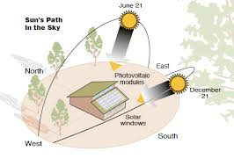
Path of the Sun Across the sky
The path of the sun across the sky changes or varies throughout each year. In order to do an obstacle survey. You want to choose a location where there are no obstacle and the sun hits the solar panel 24 hours a day and 365 days a year. If chose the wrong location you can run into a lot of obstacles into trying to get the max energy from the solar panel.

Slide 41
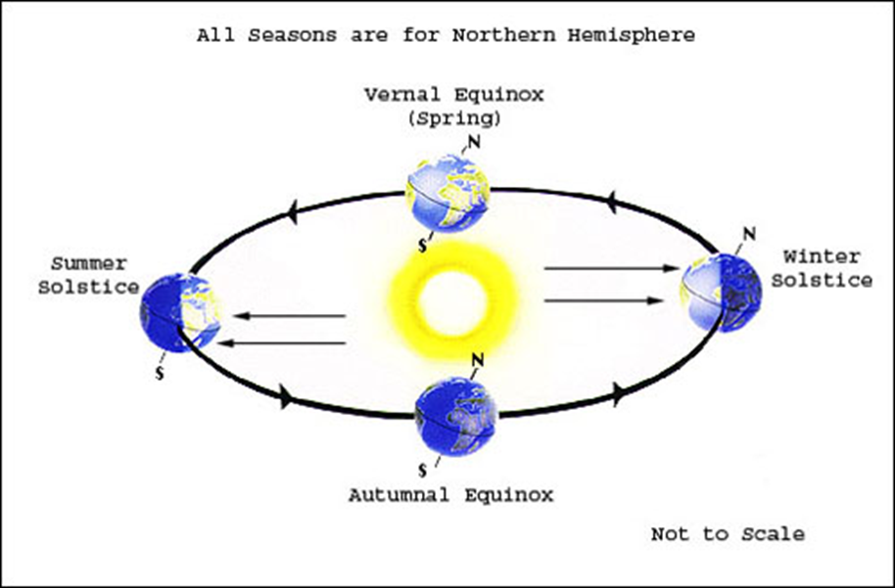
- At the two equinoxes, the sun rises due east and sets due west. At solar noon on the equinoxes, the altitude of the sun is 90 minus the local latitude. The spring equinox occurs on Mar 21st, and the fall equinox on Sept 21st.
- The winter solstice is the shortest day of the year and occurs on Dec 21st. On this day the sun will rise well to the south of east, and will set well to the south of west.
- The summer solstice is the longest day of the year and occurs on June 21st. On this day the sun will rise well to the north of east, and will set well to the north of west.

Slide 42
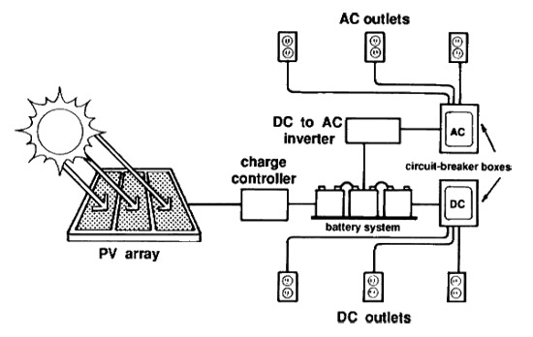
Basic Setup and function of a solar Panel
Also known as how it begins to function
This picture shows the basic setup for a standard solar panel without any modifications. This the diagram that we will use when we setup our solar panel outside the Steel Dynamics Technology Building at Ivy Tech Community College in Fort Wayne, Indiana

Slide 43
Solar Panel Build and Testing Lab for
11-05-18
The purpose of this lab is to design and build and test the 100 watt solar panel and evaluate the different voltages coming out of each specific part.
Equipment needed:
100 Watt Solar Panel
2 12 Volts deep cycle batteries
Battery Connectors
Battery Charger
500 Watt Off-grid Inverter
14 Gauge wires
Mc4 Connectors
Digital Multimeter
2 Lamps powered by the 500 Watt Inverter

Slide 44
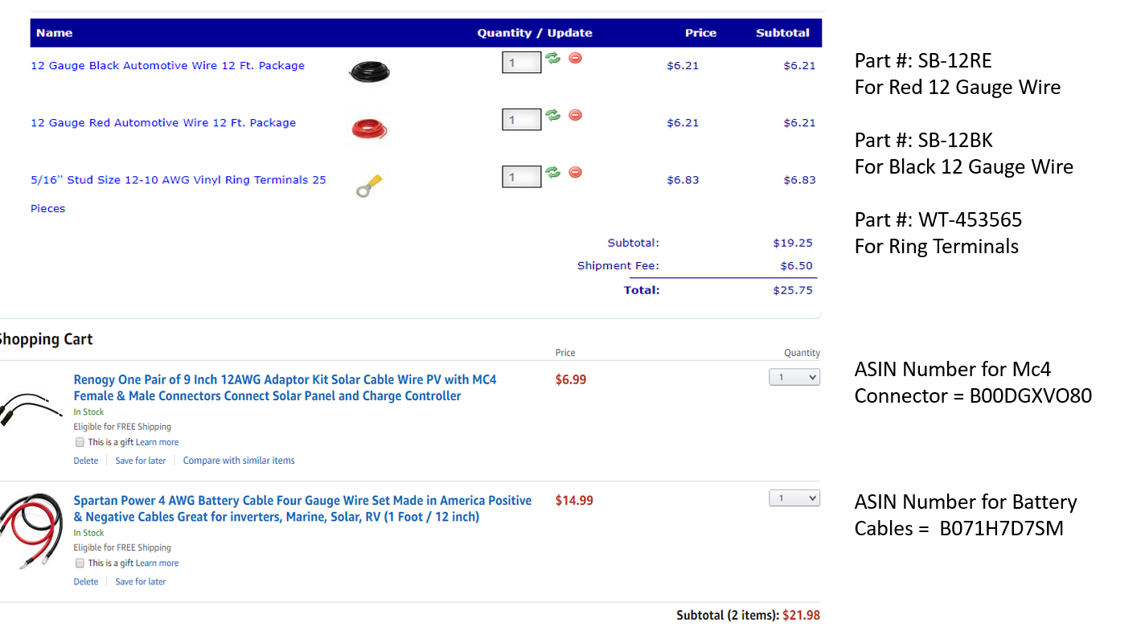
Solar panel Part 2
This is the parts list in order to hook up the solar panel, but their were some minor changes such as the bolts we had to change them from 5/16 to a ¼ bolt.

Slide 45
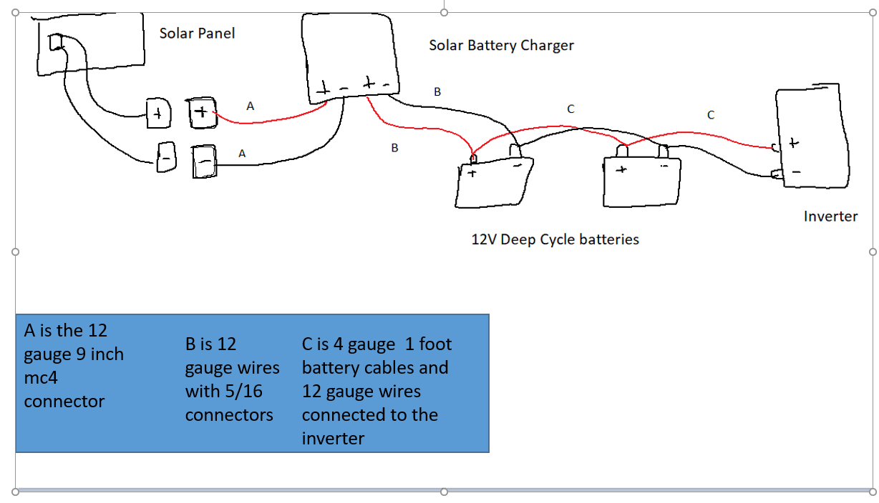
Solar panel Part 3
This is the diagram that I made in order to hook up the 100 Watt Solar Panel, with the minor changes

Slide 46
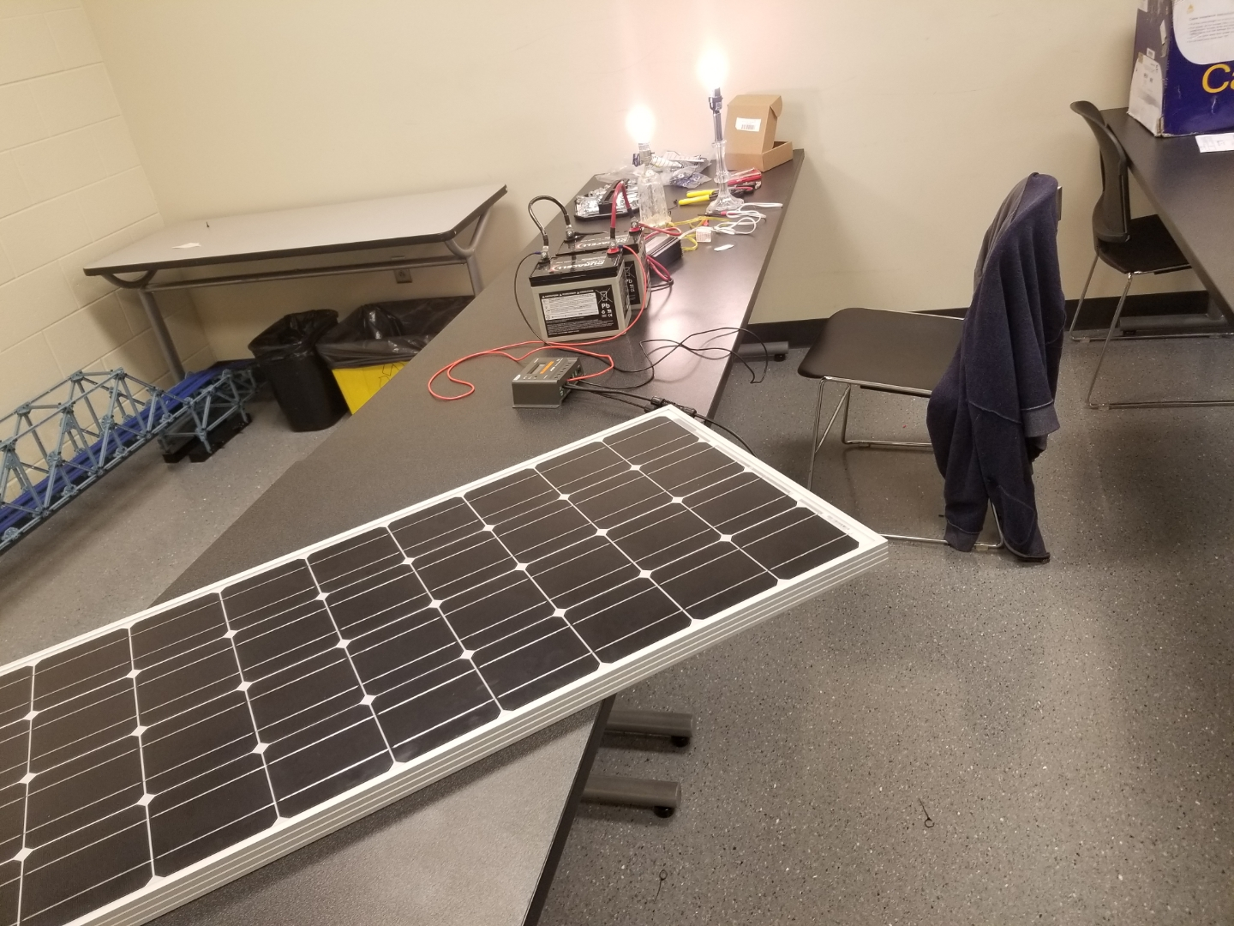
Solar Panel Part 4
This is the complete setup for the 100 Watt Solar Panel

Slide 47
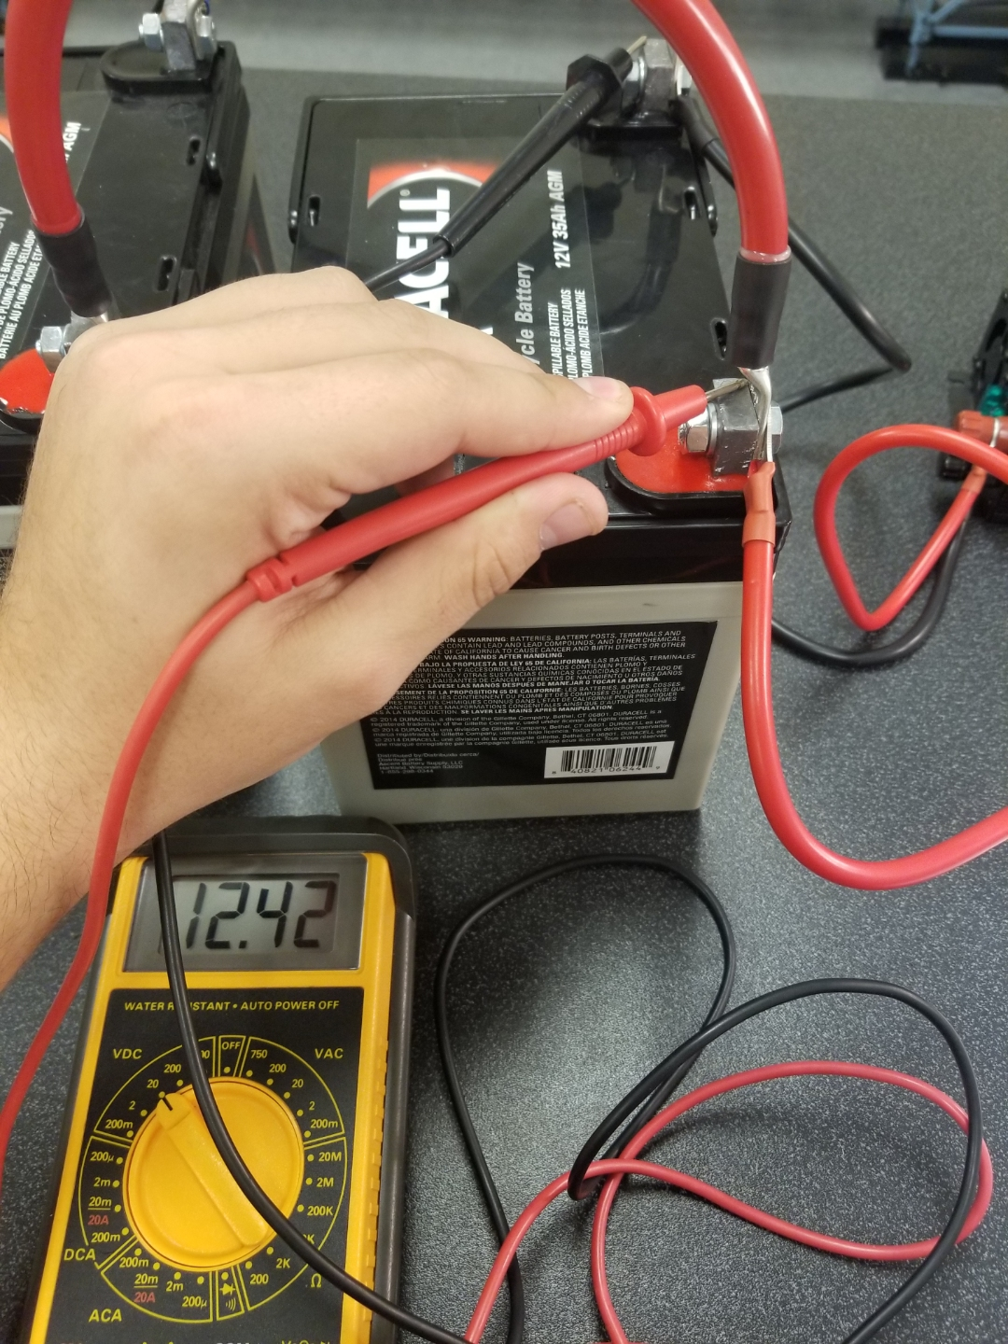
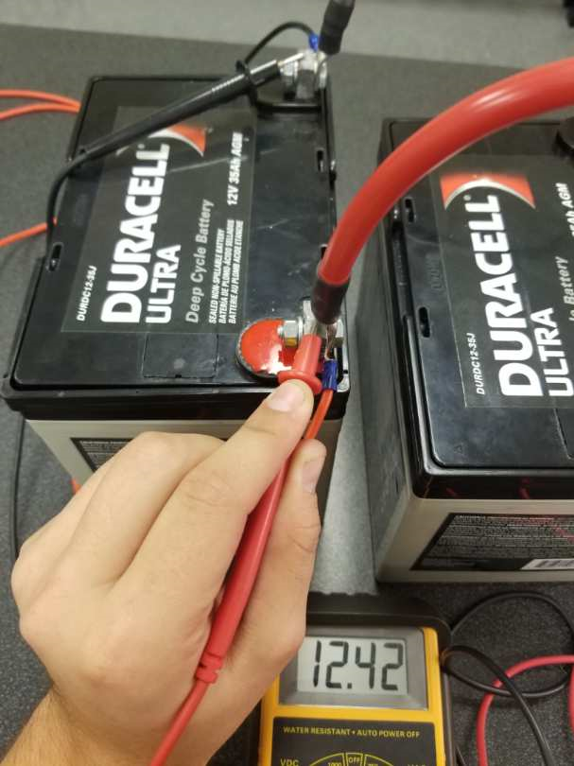
Solar Panel Part 5
This is how I tested the to batteries where both batteries were functioning at 12.42 VDC

Slide 48
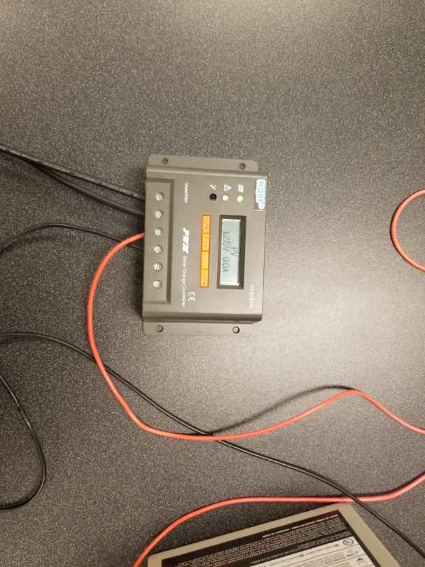
Solar Panel Part 6
This is the battery charger that is being charged by the batteries and the solar panel is producing a voltage of 12.5 Volts. So the solar panel being inside with the light is producing a steady 12.5 volts without any interruptions.

Slide 49
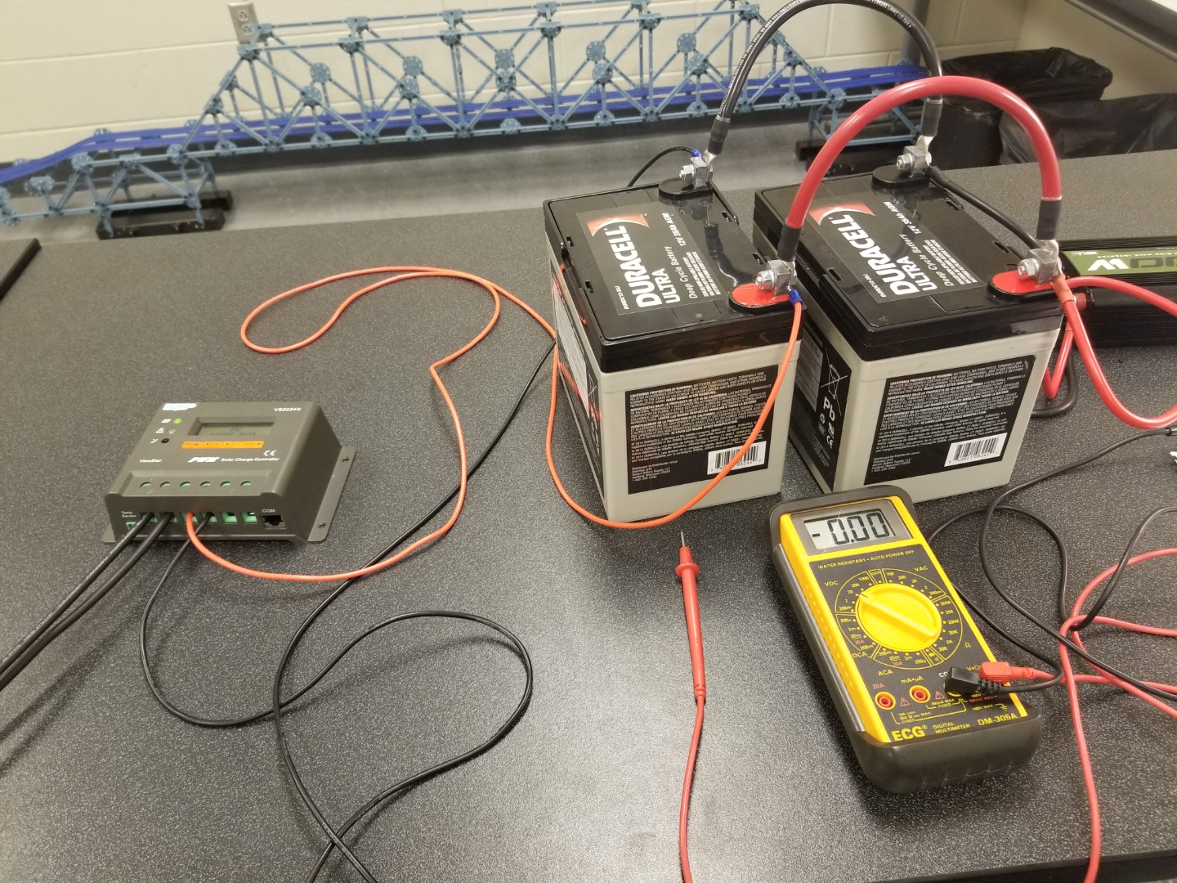
Solar Panel Part 7
This is the setup for the batteries being connected to the Battery Charger

Slide 50
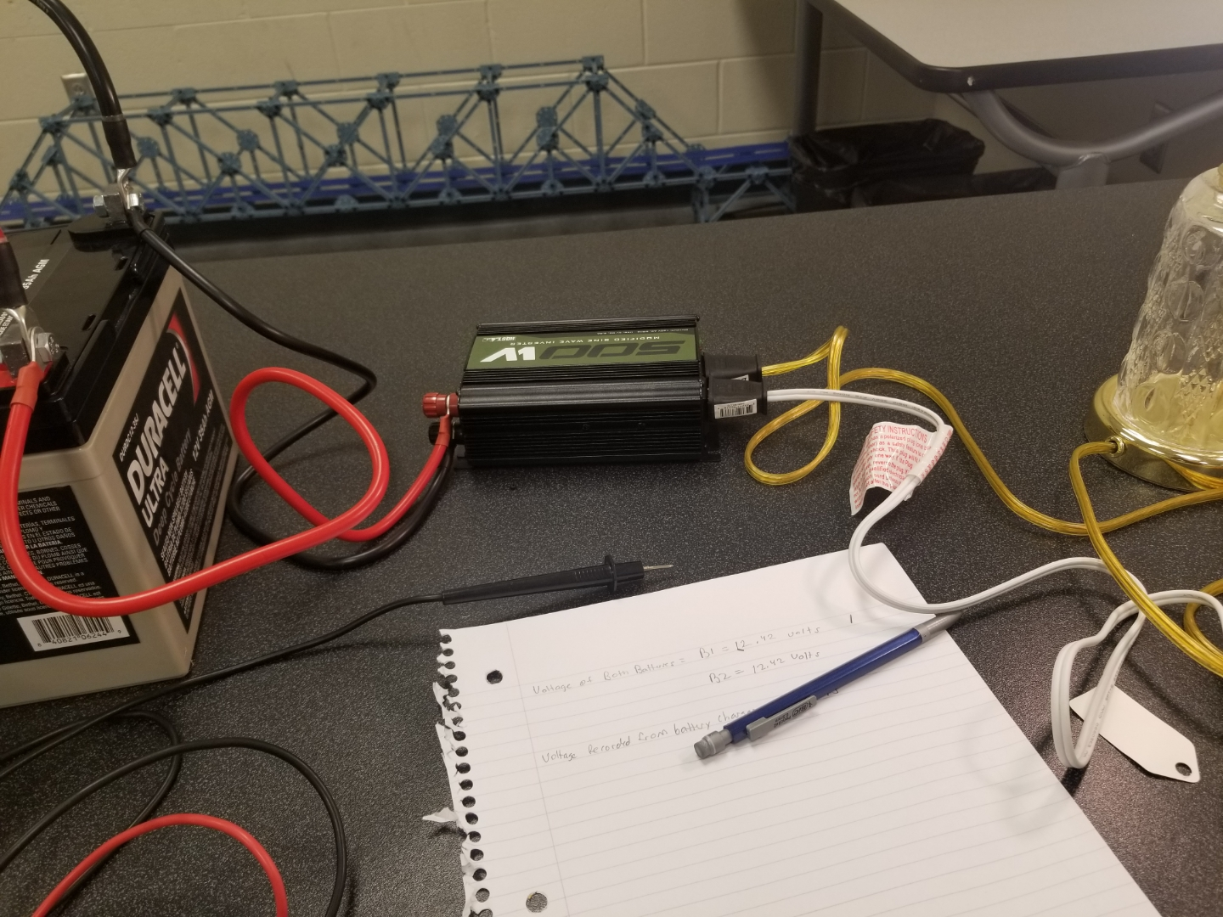
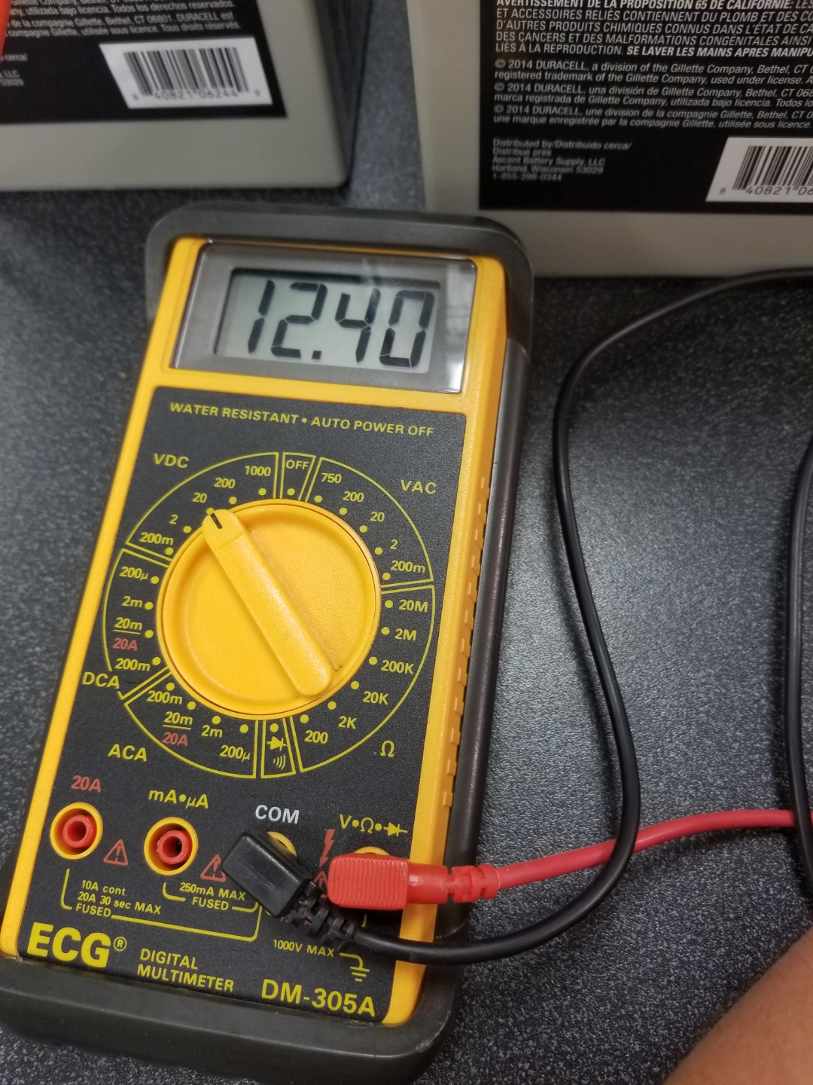
Solar Panel Part 8
This is the setup for the 500 Watt off grid inverter being connected to the 12 volt deep cycle batteries
This is the multimeter reading coming from the inverter which is producing a total of 12.4 Volts

Slide 51
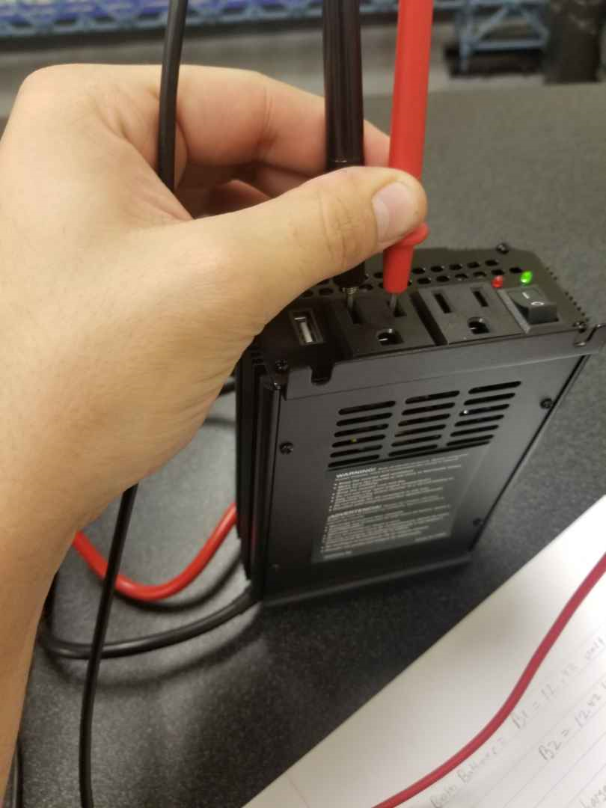
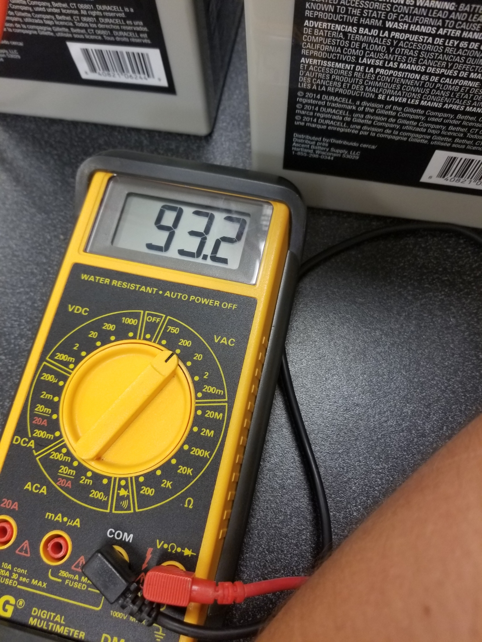
Solar Panel Part 9
This is how I measured the AC voltage coming out of terminal one from the output which is reading approximately 93.2 Volts AC and Terminal two was reading approximately 93.3 Volts AC

Slide 52
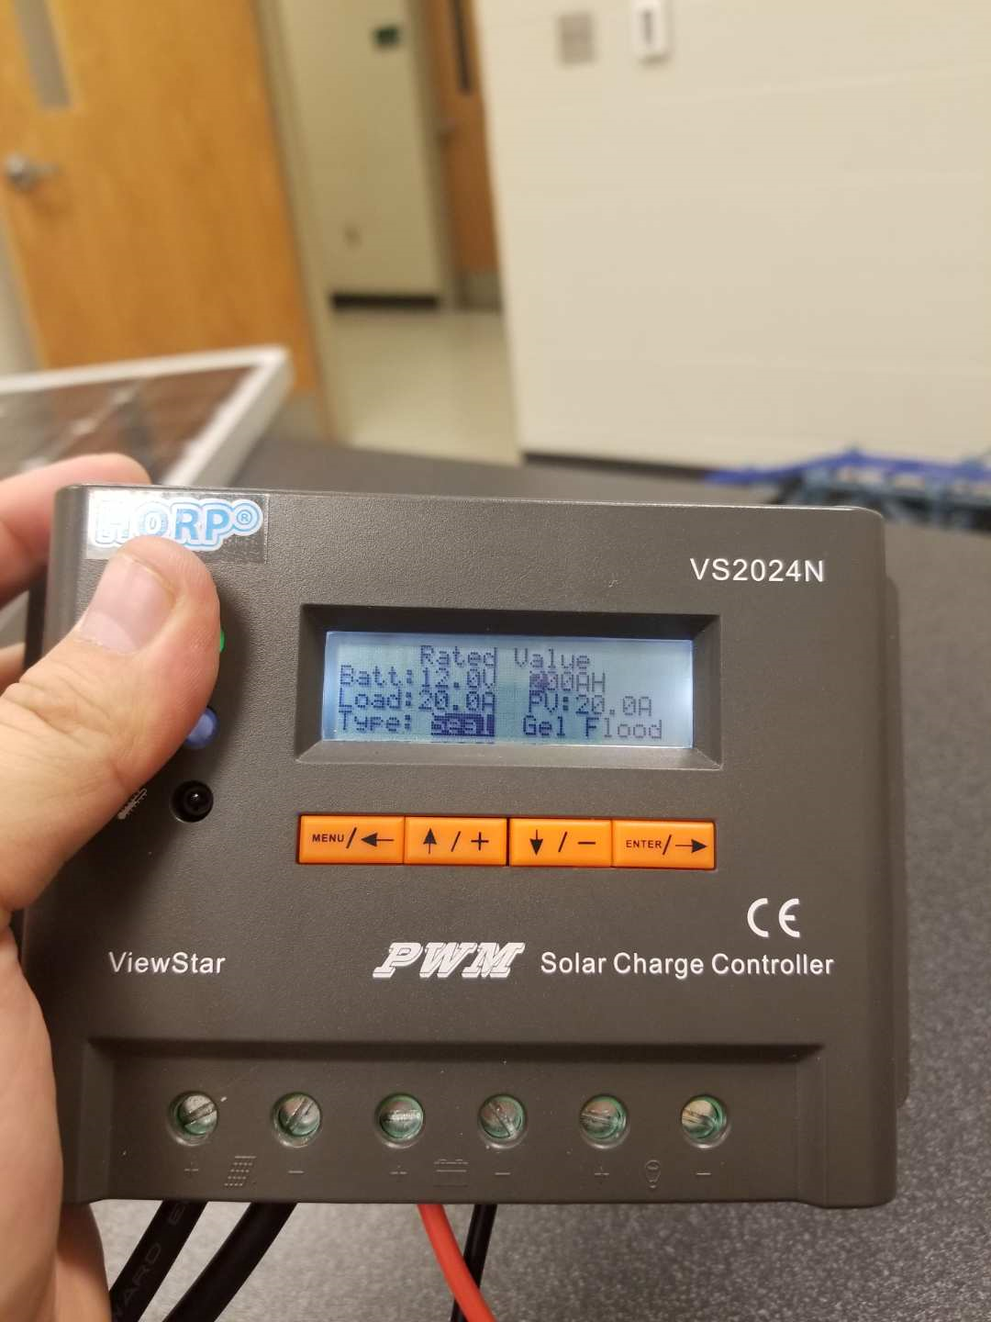
Solar Panel Part 10
This is a picture of the Battery Charger reading with the Battery reading at 12 volts and the load being received is Amps

Slide 53
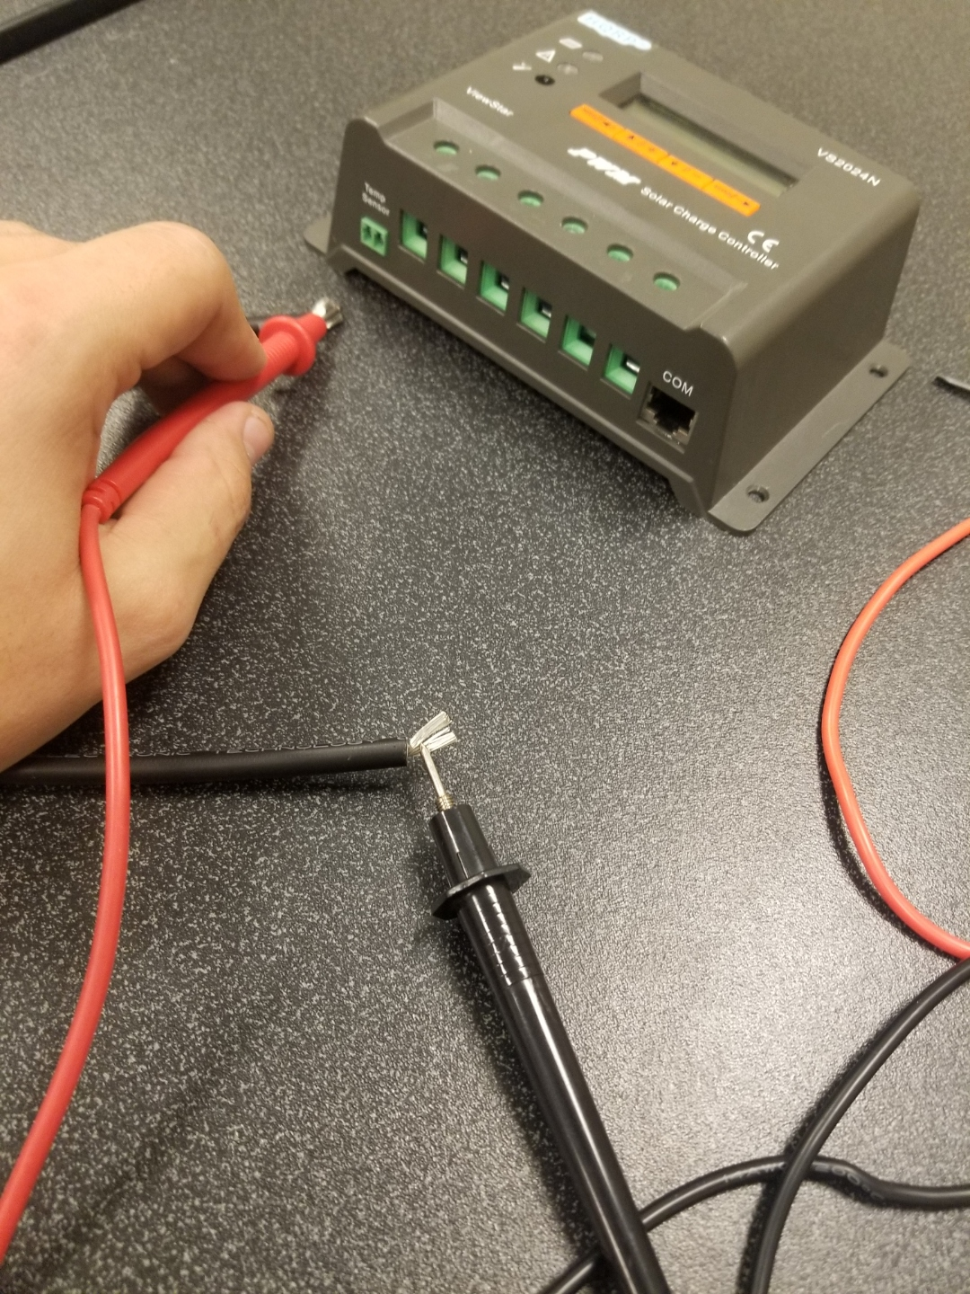
Solar Panel Part 11
This is a picture of me testing the voltage coming from the solar panel with no load present with the voltage being 14.3 Volts

Slide 54
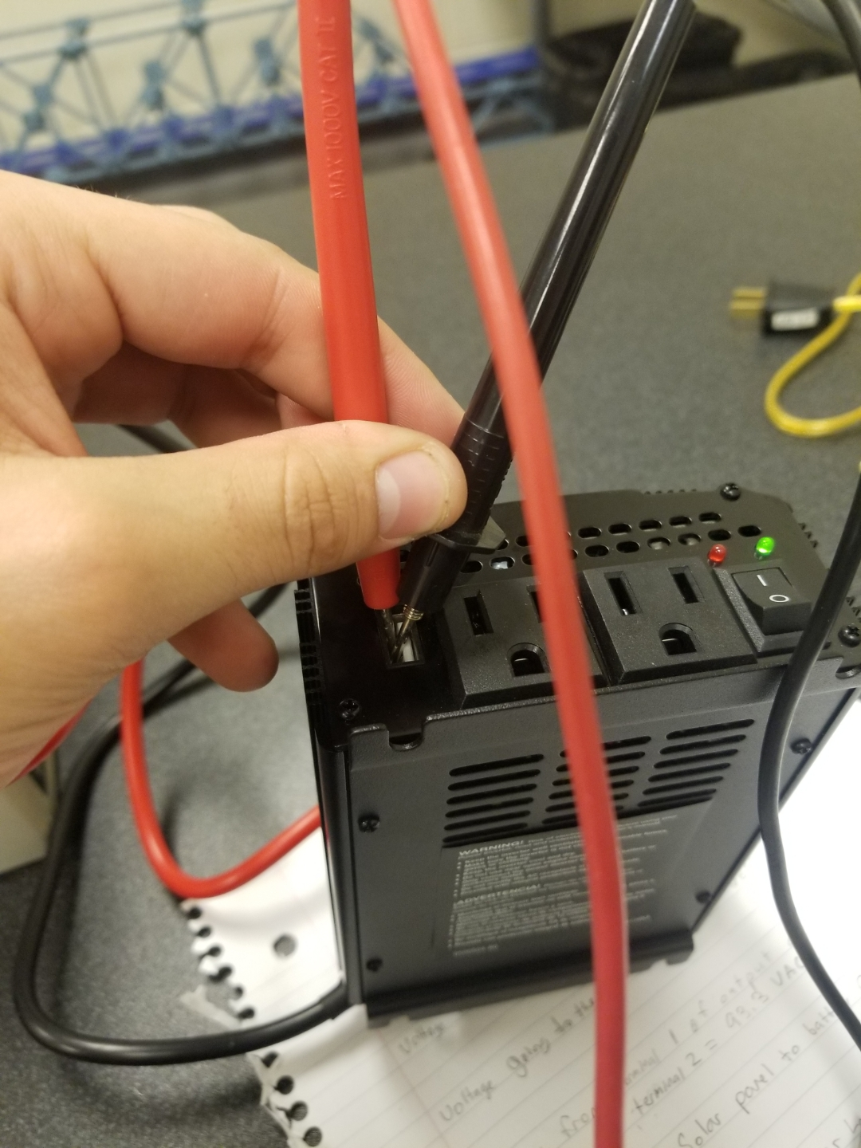
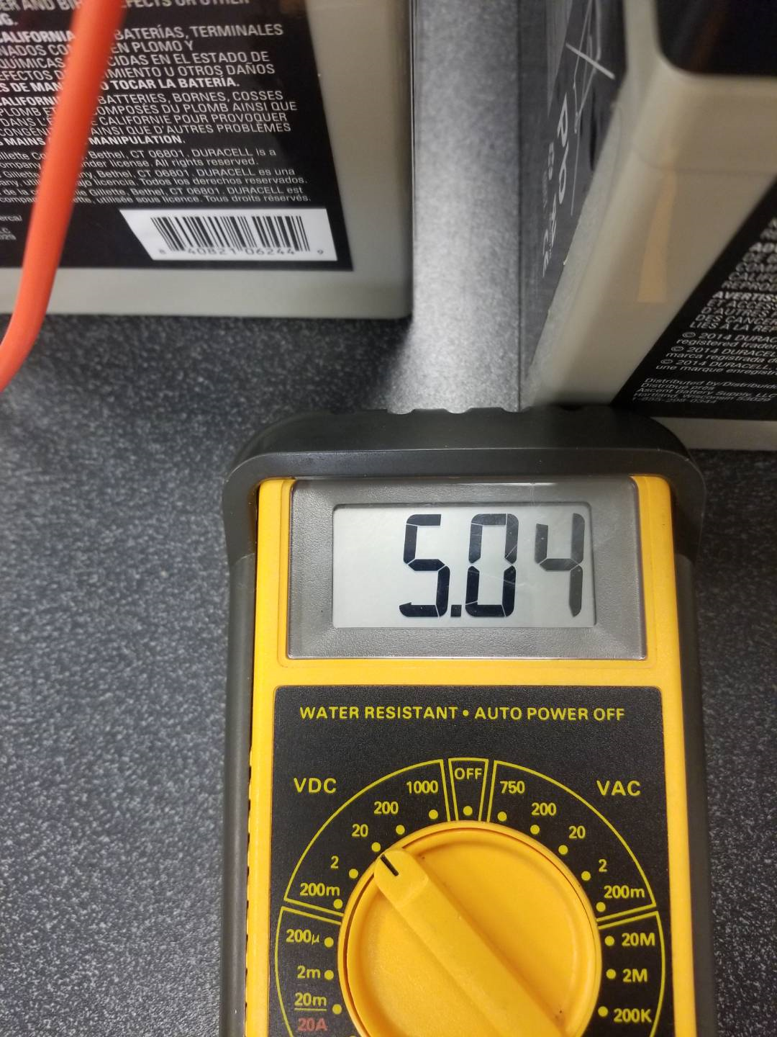
Solar Panel Part 12
This is me testing the voltage coming from the usb port on the inverter which is reading a voltage of 5.04 Volts DC

Slide 55
Solar Panel Lab Observations
From terminal 1, the smaller Lamp was getting an input of 93.2 volts AC and that is enough voltage to power both lamps and terminal 2 was getting 93.3 Volts Ac for the input. The voltage from the solar panel to the battery charger tends to change up and down quite often. When the light in the desired room are turned off then the battery charger drops to 3.5 volts instantly but the Lamps stay lit for quite some time. Covering the solar panel with your hand in multiple spots can cause a voltage drop coming from the output of the solar panel.

Slide 56
Powering googly eyes with a solar power and a power boost 11/26/18 My lab partner was Nathaniel Paulus
The purpose of this lab is to use a 3.7 battery and a solar panel by usng a power boost in order to power up the googly eyes

Slide 57
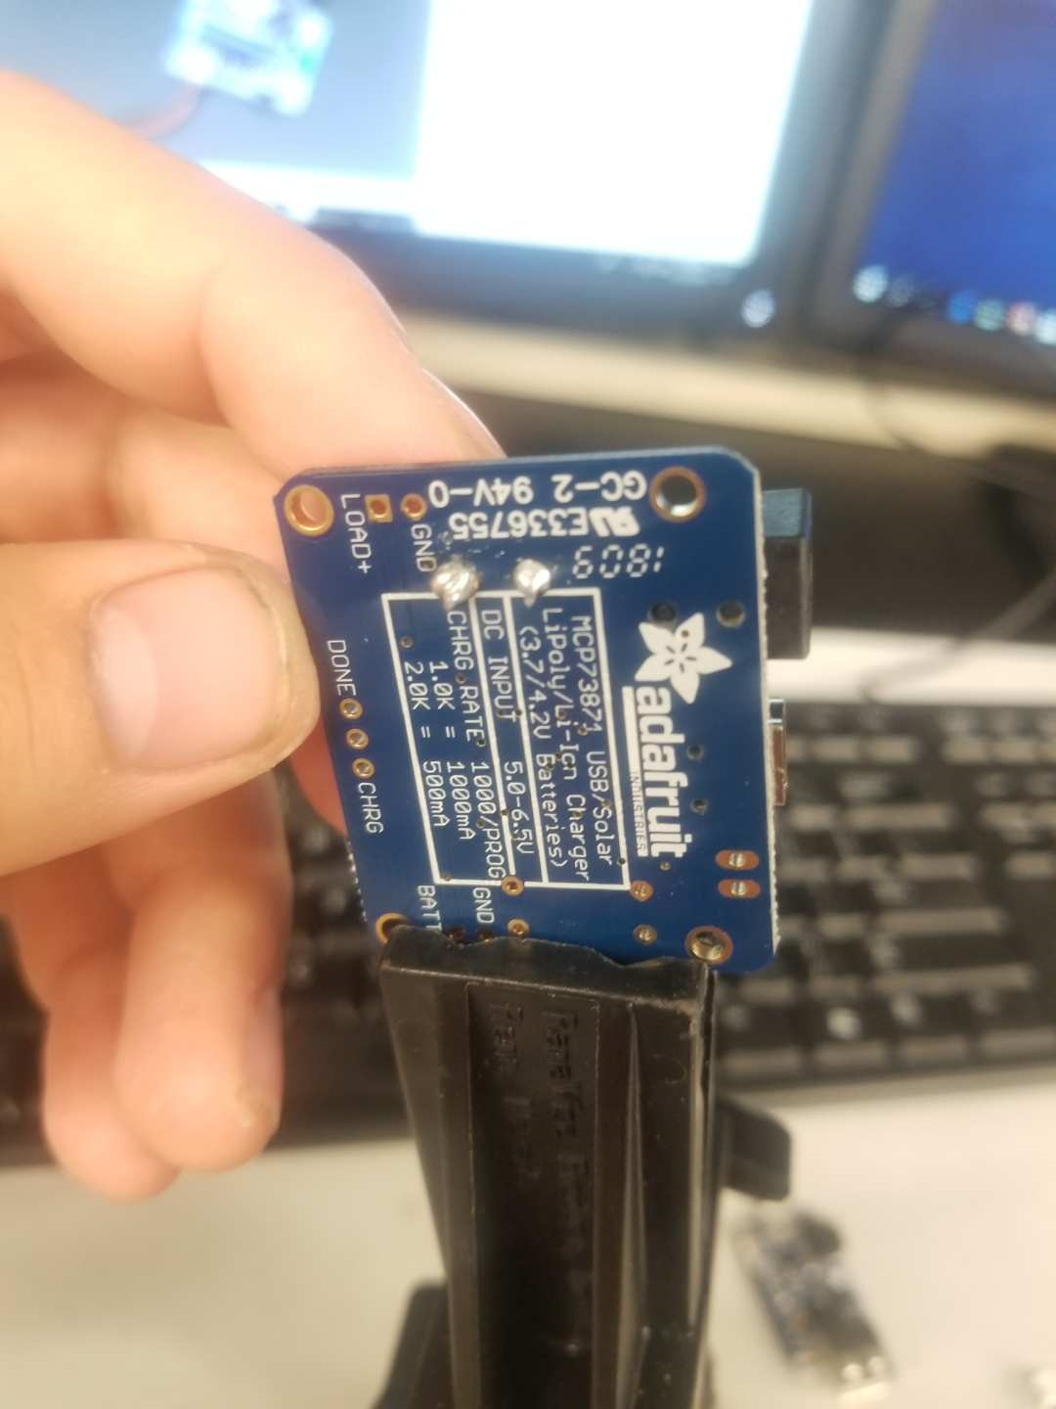

Part 2
This is the picture of the solder joints to the capacitor for the Power Boost

Slide 58


Part 3
This is the whole setup for the Power Source to the googly eyes
This is the battery that is powering up the Power Booster

Slide 59


Part 4
This is the complete set up for the Googly Eyes and the power source.
This is the display for the googly eyes

