Slide 1
Sports Stats in C++
Created and presented to you by: Rachel Herman and Jason block
Professor Ajeet Yadav
Intro to C++
12/11/17

Slide 2
Sport Stat Generator
Started by building a code that had menu option
  Used IF / ELSE IF with in code to take user input to chosen code
Picked 4 sports to have the code generate stats for
  Football, Baseball, Hockey, and Basketball
  Used Player class, as well as Arrays within each sport’s code to call back specific information
Ran into some issues with defining terms, getting algorithms to work, and having patience.
  Eventually got code structure to work for one sport
  Used this structure for the rest of the sports

Slide 3
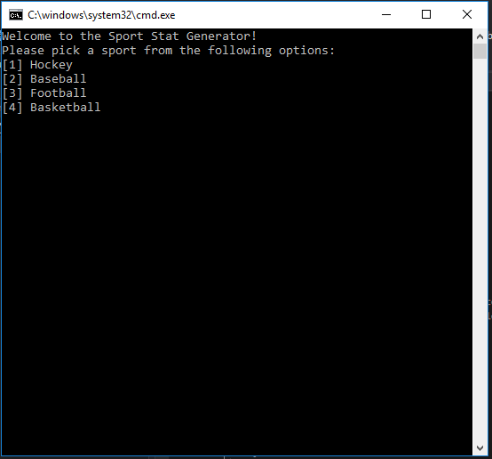
Start by giving the User 4 options

Slide 4
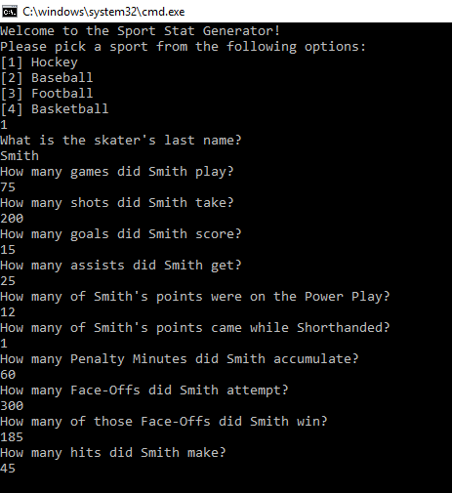

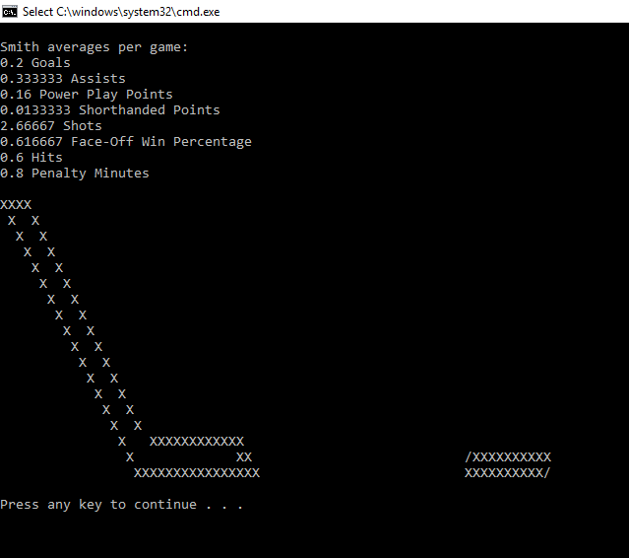
Sport Option 1: Hockey

Slide 5
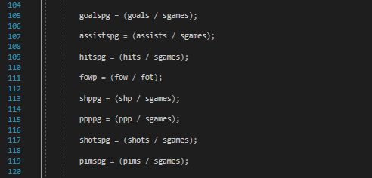
Hockey Stat Calculations:

Slide 6
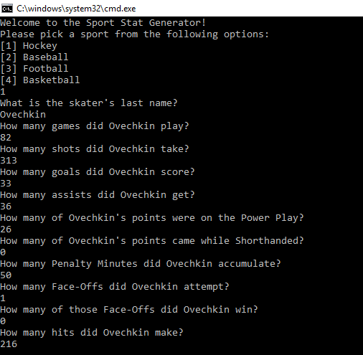
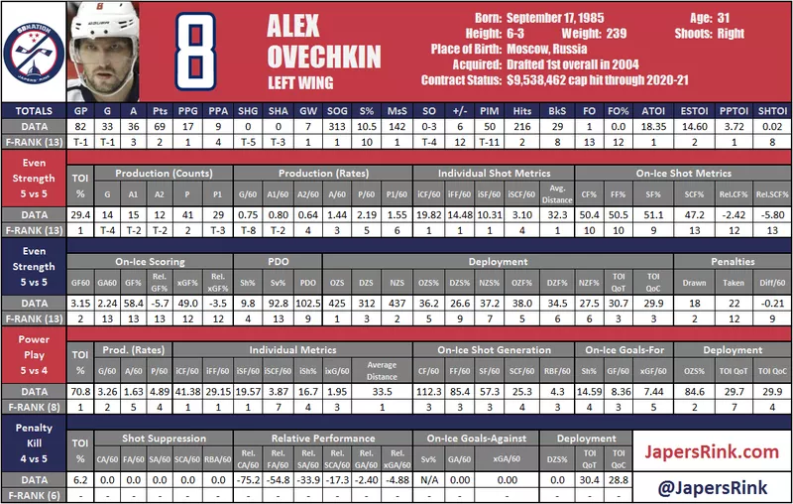
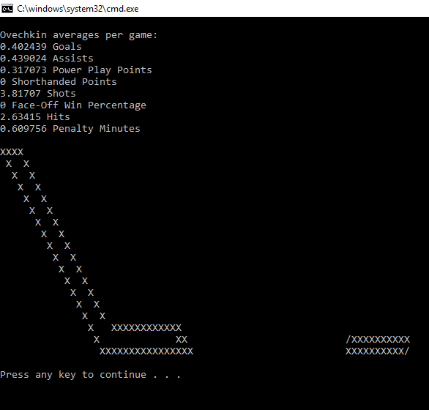
Real Life Hockey Player:
Alexander Ovechkin

Slide 7
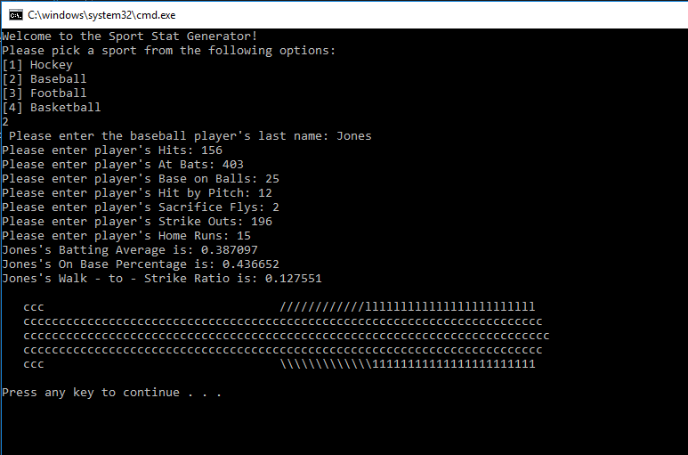

Sport Option 2: Baseball

Slide 8

Baseball Stat Calculations:

Slide 9
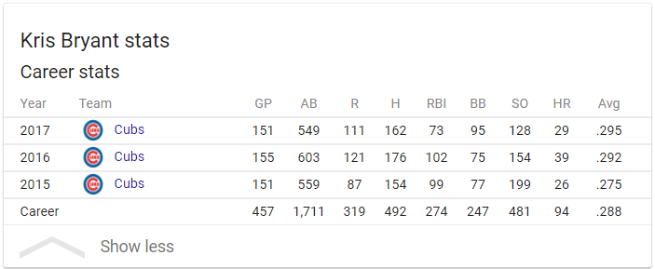
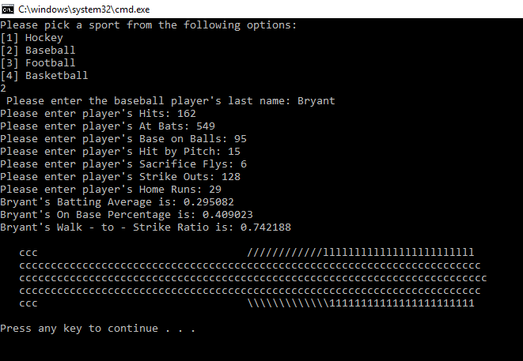
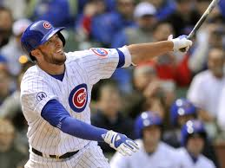
Real Life Baseball Player:
Kris Bryant

Slide 10
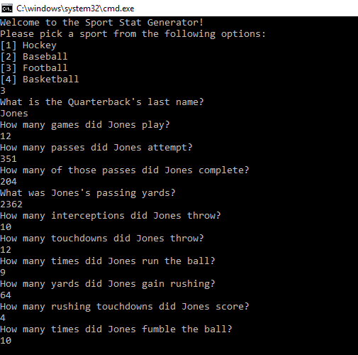

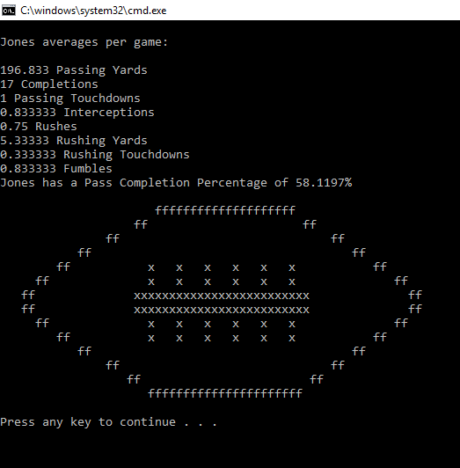
Sport Option 3: Football

Slide 11
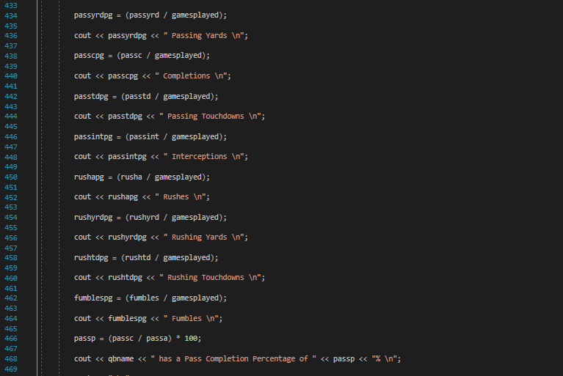
Football Stat Calculations:

Slide 12
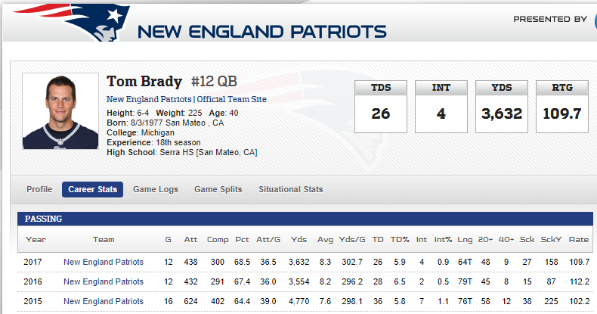
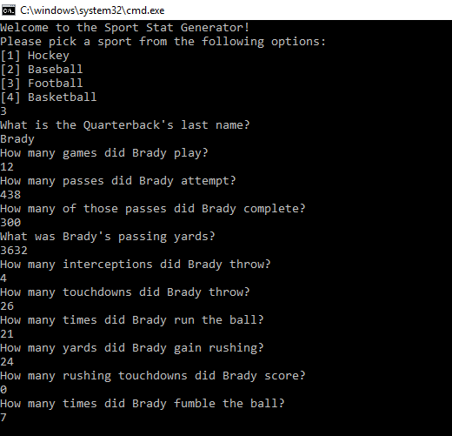
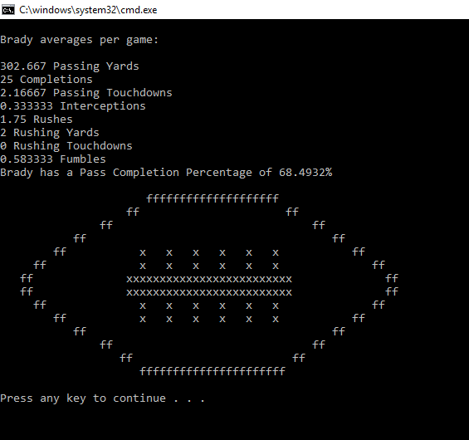
Real Life Football Player:
Tom Brady

Slide 13
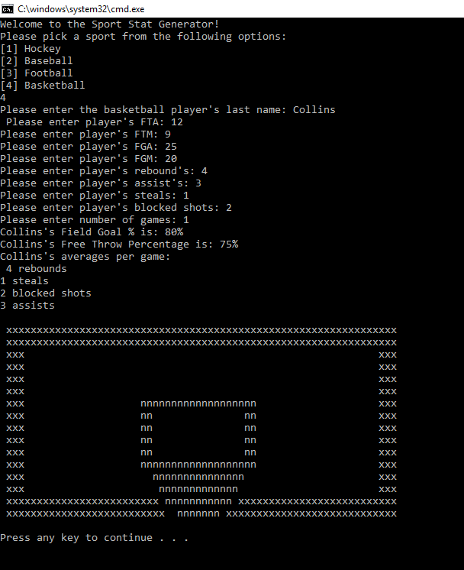

Sport Option 4: Basketball

Slide 14
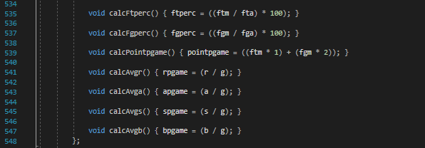
Basketball Stat Calculations:

Slide 15

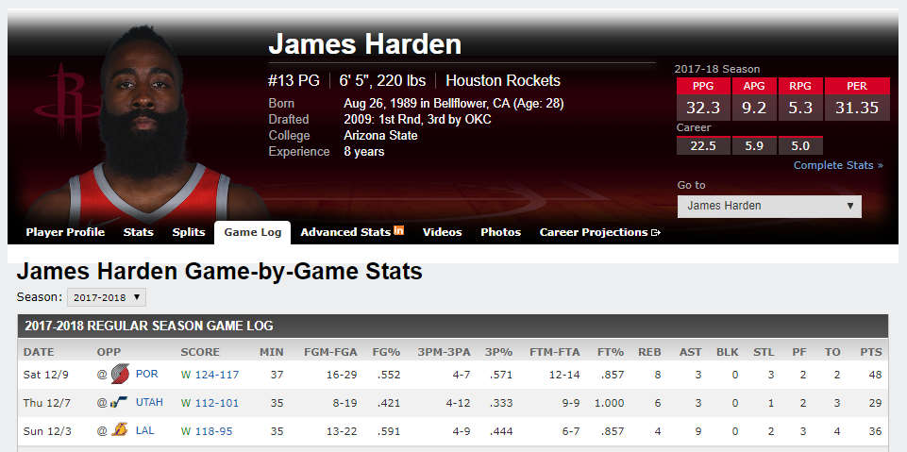
Real Life Basketball Player:
James Harden

Slide 16
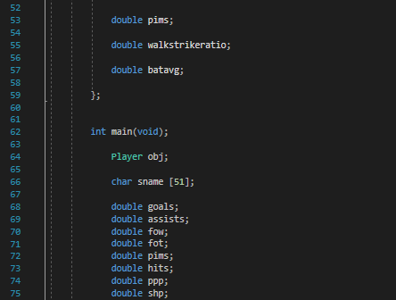
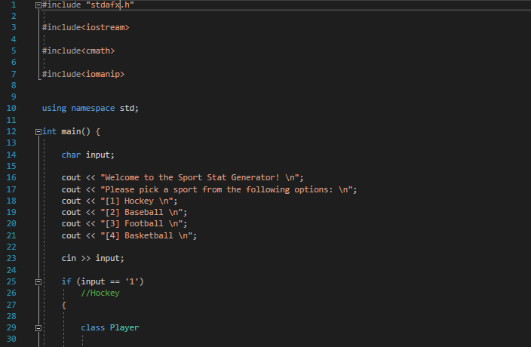
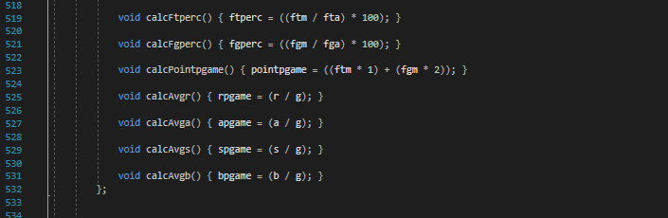
Code structure:

Slide 17
Thank you for your attention!

Slide 18
References:
http://www.athleticscholarshipcorp.com/images/ice_hockey_recruiting_services.jpg
https://www.japersrink.com/2017/6/13/15643182/2016-17-rink-wrap-alex-ovechkin
http://987thecoast.com/wp-content/uploads/2016/05/Baseball.jpg
https://fivethirtyeight.com/features/the-scouts-and-stats-agree-kris-bryant-is-going-to-be-dope/
https://www.google.com/search?q=kris+bryant+stats&oq=kris+bryant+stats&aqs=chrome.0.69i59j0l5.1967j0j1&sourceid=chrome&ie=UTF-8
https://static.pexels.com/photos/4198/field-sport-ball-america.jpg
http://www.nfl.com/player/tombrady/2504211/careerstats
http://boykinsbasketball.com/wp-content/uploads/2016/08/Basketball-Nike.jpg
http://www.espn.com/nba/player/gamelog/_/id/3992/james-harden

