Slide 1
EECT 112 MIDTERM
SHANNON MATUSZNY

Slide 2
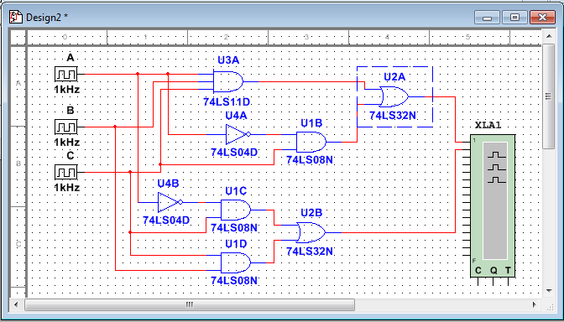
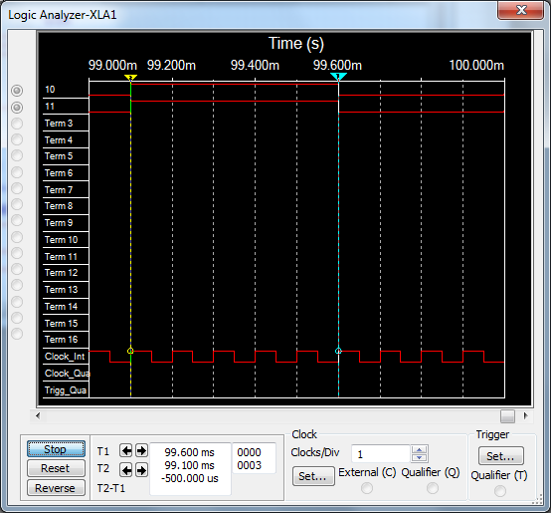
4.1.A
X = ABC + A’C
X = C(AB + A’) 13A
X = C(A’ + B) 15B

Slide 3
4.1.B
Y = (Q + R)(Q’ + R’)
Y = QQ’ + QR’ + RQ’ + RR’ 13B
Y = 0 + QR’ + RQ’ + 0 4
Y = QR’ + Q’R

Slide 4
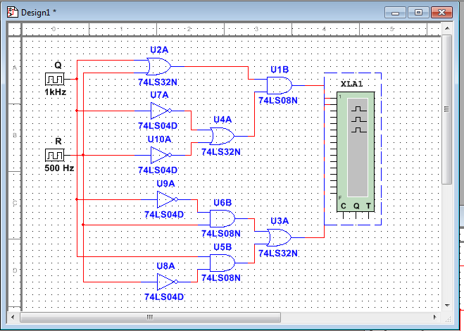
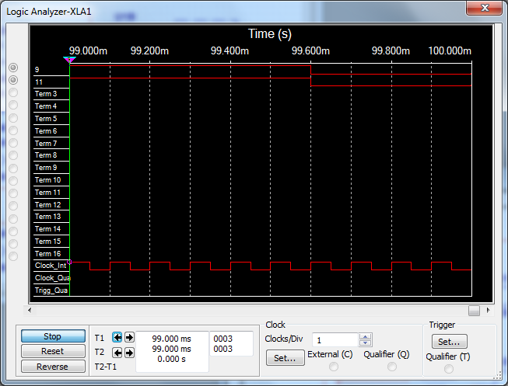
4.1.B CON’T

Slide 5
4.1.C
W = ABC + AB’C + A’
W = AC(B + B’) + A’ 13A
W = AC(1) + A’ 8
W = AC + A’ 2
W = A’ + C 15B

Slide 6
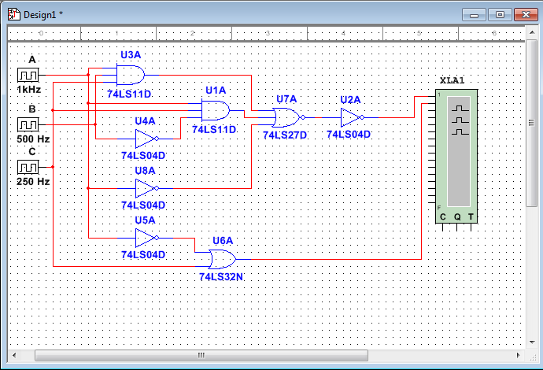
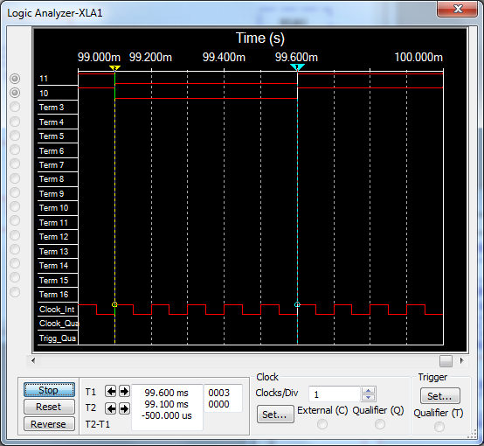
4.1.C CON’T

Slide 7
4.1.D
Q = (RST)’(R + S + T)’
Q = (RST)’(RST)’ DEMORGANS
Q = (RST)’ 3

Slide 8
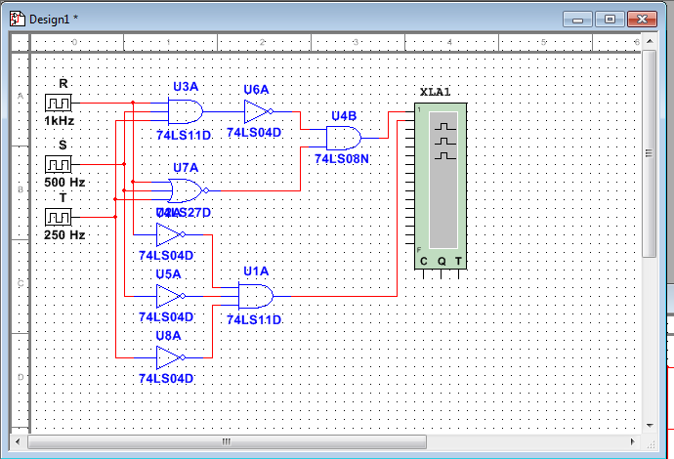
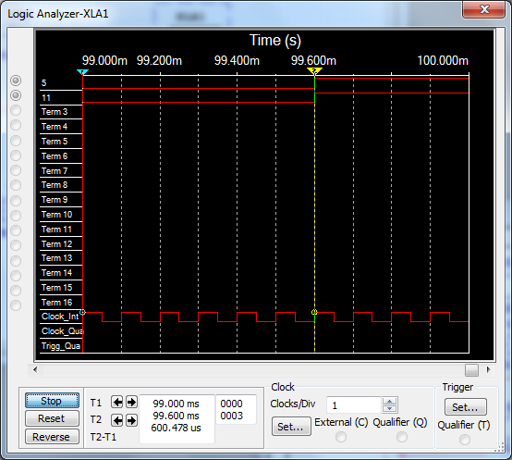
4.1.D CON’T

Slide 9
4.1.E
X = A’B’C’ + A’BC + ABC + AB’C’ + AB’C
X = B’C’(A’ + A) + A’BC + ABC + AB’C 13A
X = B’C’(1) + A’BC + ABC + AB’C 8
X = B’C’ + A’BC + ABC + AB’C 2
X = B’C’ + BC(A’ + A) + AB’C 13A
X = B’C’ + BC(1) + AB’C 8
X = B’C’ + BC + AB’C 2
X = B’(C’ + AC) + BC 13A
X = B’(C’ + A) + BC 15B
X = B’C’ + AB’ + BC 13A

Slide 10
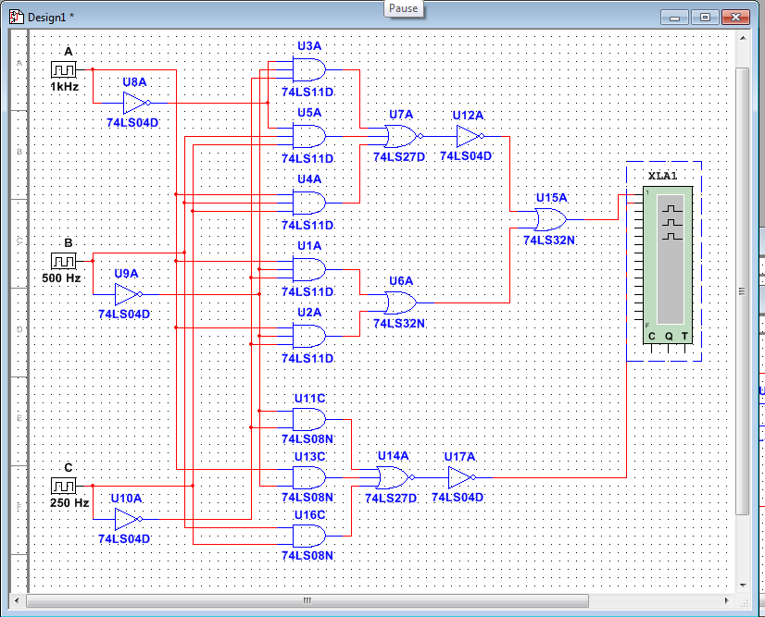
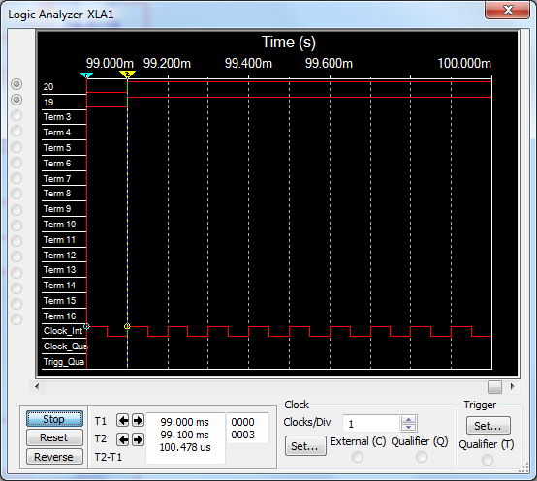
4.1.E CON’T

Slide 11
4.1.F
Z = (B +C’)(B’ + C) + (A’ +B +C’)’
Z = (B +C’)(B’ + C) + AB’C DEMORGANS
Z = BB’ + BC + C’B’ + C’C + AB’C 13B
Z = 0 + BC + B’C’ + 0 + AB’C 4
Z = BC + B’C’ + AB’C 5
Z = BC + B’(C’ + AC) 13A
Z = BC + B’(C’ + A) 15B
Z = BC + B’C’ + AB’ 13A

Slide 12
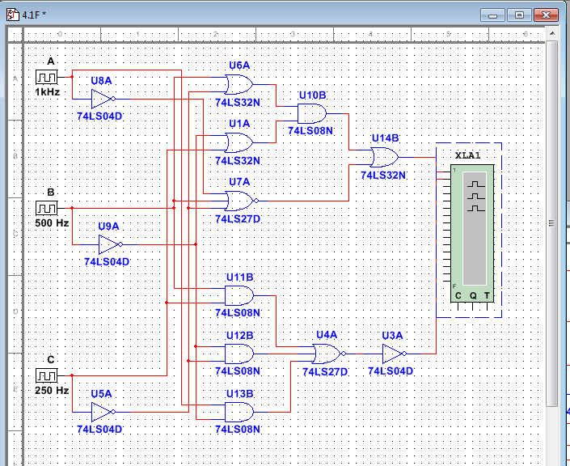
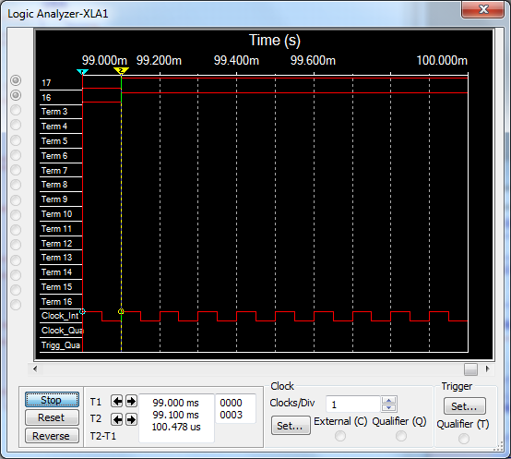
4.1.F CON’T

Slide 13
4.1.G
Y = (C +D)’ + A’CD’ + AB’C’ + A’B’CD + ACD’
Y = C’D’ + A’CD’ + AB’C’ + A’B’CD + ACD’ DEMORGANS
Y = A’C(D’ + B’D) + C’D’ + ACD’ + AB’C’ 13A
Y = A’C(D’ + B’) + C’D’ + ACD’ + AB’C’ 15B
Y = A’CD’ + A’B’C + C’D’ + ACD’ + AB’C’ 13B
Y = CD’(A’ + A) + A’B’C + AB’C’ + C’D’ 13A
Y = CD’(1) + A’B’C + AB’C’ + C’D’ 8
Y = CD’ + A’B’C + AB’C’ + C’D’ 2
Y = D’(C + C’) + A’B’C + AB’C’ 13A
Y = D’(1) + A’B’C + AB’C’ 8
Y = D’ + A’B’C + AB’C’ 2

Slide 14
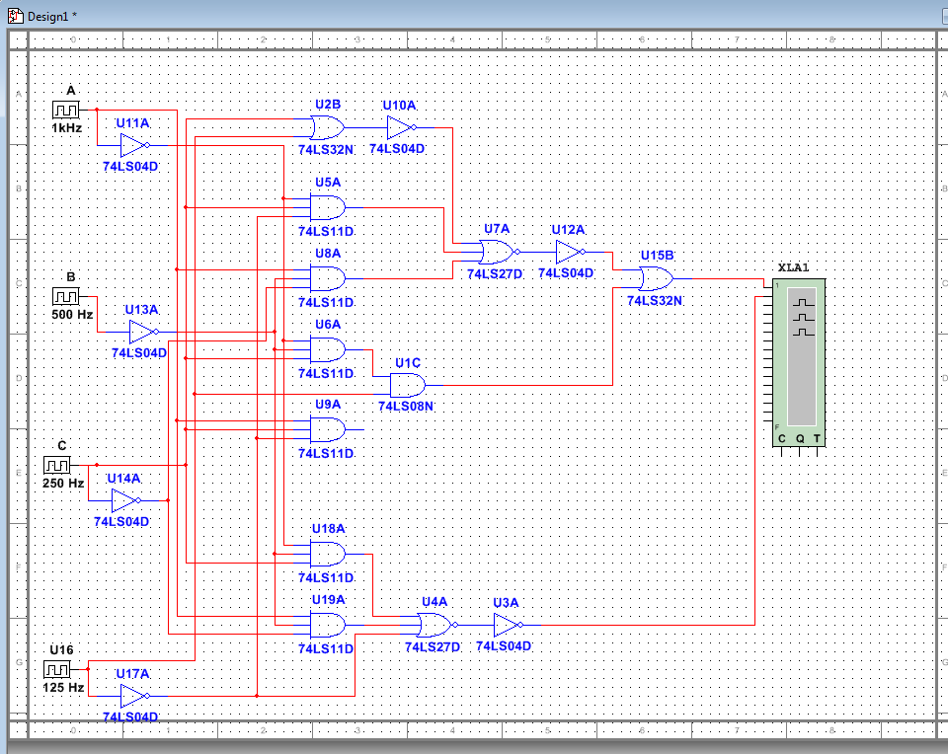
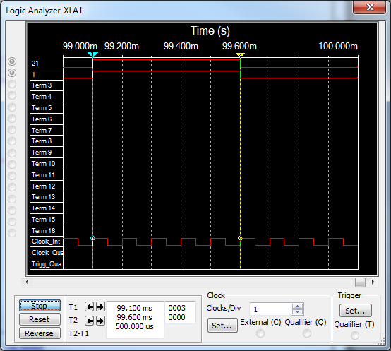
4.1.G CON’T

Slide 15
4.1.H
X = (AB)(C’D)’ + A’BD + B’C’D’
X = AB(C + D’) + A’BD + B’C’D’ DEMORGANS
X = ABC + ABD’ + A’BD + B’C’D 13A

Slide 16
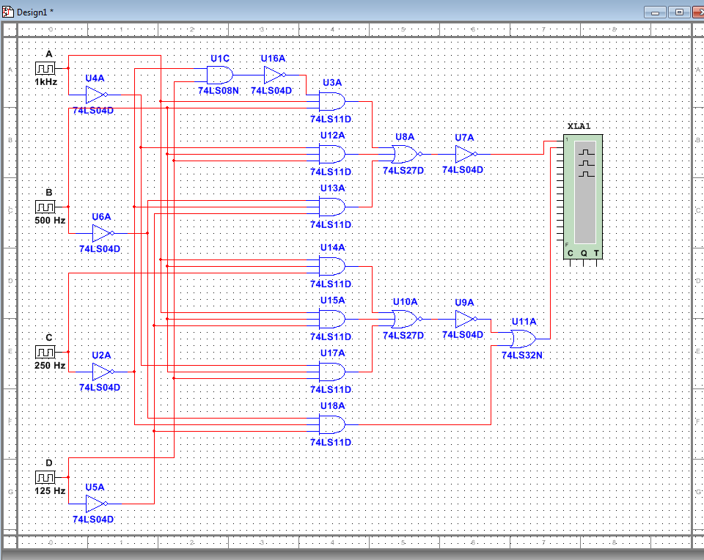
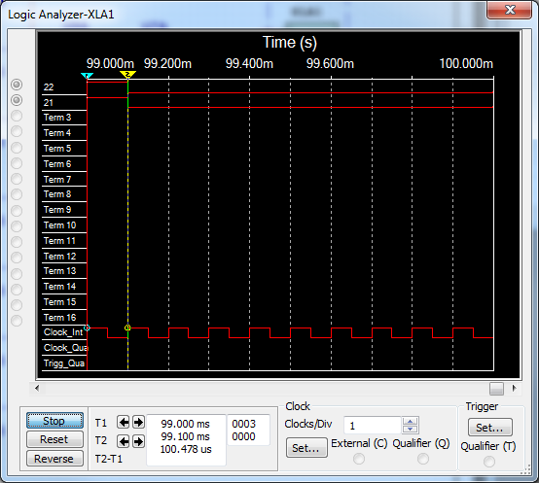
4.1.H CON’T

Slide 17
4.2
X = [(MNQ)’(MN’Q)’(M’NQ)’]’
X = MNQ + MN’Q + M’NQ DEMORGANS
X = MQ(N + N’) + M’NQ 13A
X = MQ(1) + M’NQ 8
X = MQ + M’NQ 2
X = Q(M + M’N) 13A
X = Q(M + N) 15A

Slide 18
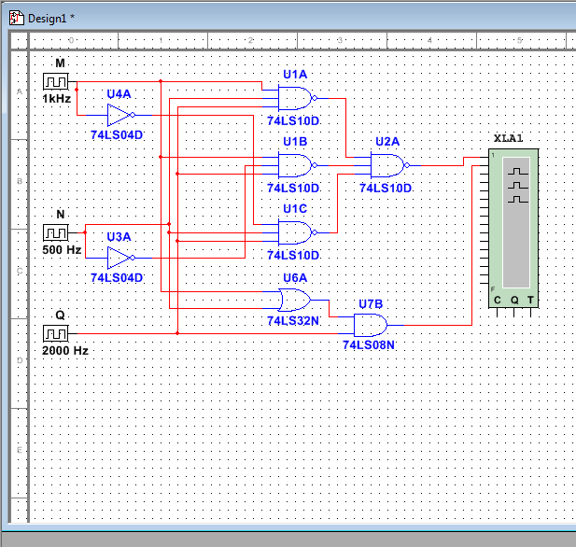
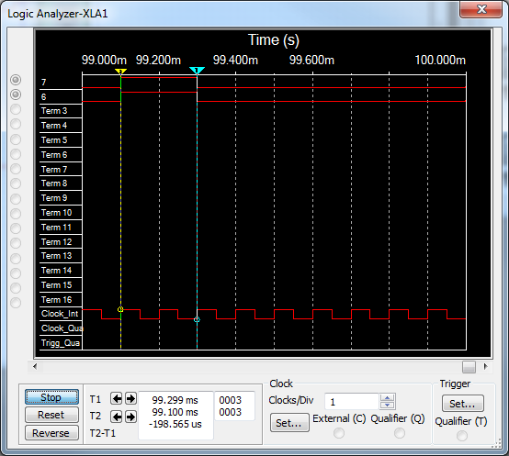
4.2 CON’T

Slide 19
4.3
X = [(M + N + Q)’ + (M + N’ + Q)’ + (M’ + N + Q)’]’
X = MNQ + MN’Q + M’NQ DEMORGANS
X = NQ(M + M’) + MN’Q 13A
X = NQ(1) + MN’Q 8
X = NQ + MN’Q 2
X = Q(N + MN’) 13A
X = Q(N + M) 15A

Slide 20
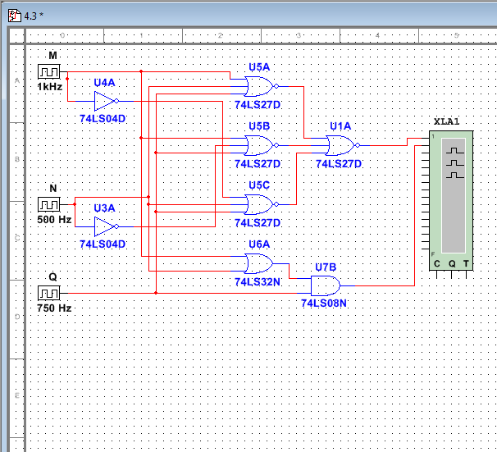
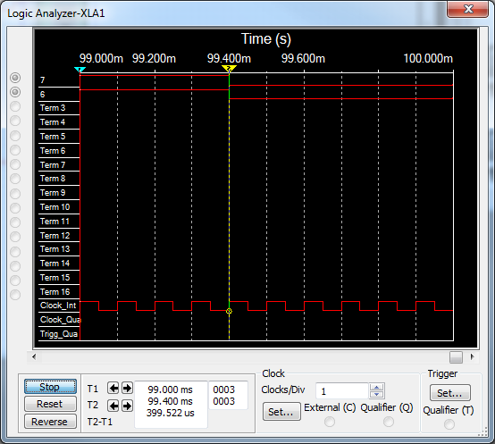
4.3 CON’T

Slide 21
4.4
X = A’B’C’ + A’BC’ + A’BC + AB’C’ + ABC
X = A’C’(B’ + B) + A’BC + AB’C’ + ABC 13A
X = A’C’(1) + A’BC + AB’C’ + ABC 8
X = A’C’ + A’BC + AB’C’ + ABC 2
X = A’C’ + BC(A’ + A’) + AB’C’ 13A
X = A’C’ + BC(1) + AB’C’ 8
X = A’C’ + BC + AB’C’ 2
X = C’(A’ + AB’) + BC 13A
X = C’(A’ + B’) + BC 15B
X = A’C’ + B’C’ + BC 13B

Slide 22
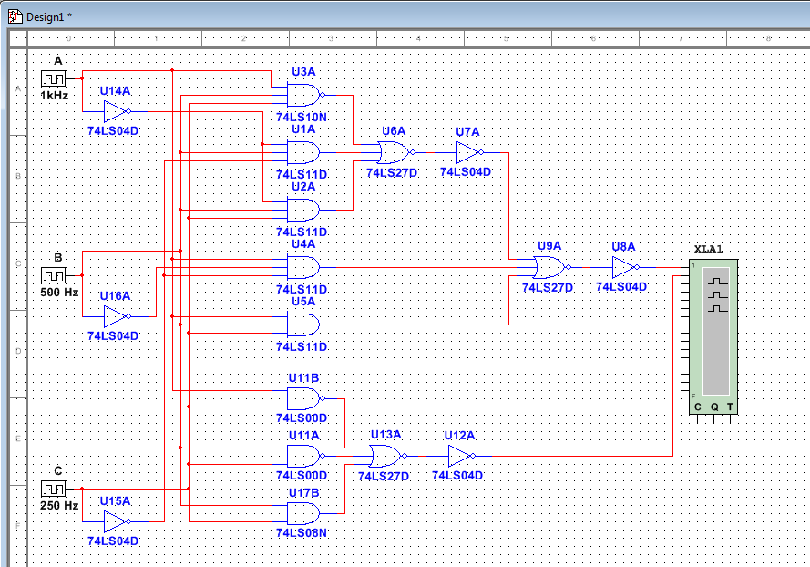
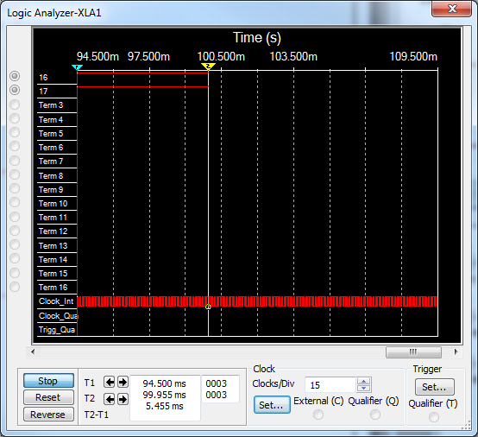
4.4 CON’T

Slide 23
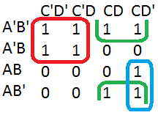
4.11.A
= A’C’ + B’C + ACD’

Slide 24
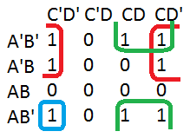
4.11.B
= AB’ + A’D’ + B’C

Slide 25
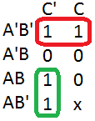
4.11.C
= A’B’ + AC’
“DON’T CARE”
X → 0 FOR SIMPLEST EXPRESSION

Slide 26

4.12
= A’

