Slide 1
EECT 111 – Lab Notebook
Zach Anderson
Circuit Analysis
May 7, 2015

Slide 2




Slide 3
Table of Contents
LAB
Date
SLIDE NUMBER
Lab 1 - Resistor Variability
Lab 2 – Reading and Sorting Resistors
Lab 3 – Series Resistors
Lab 4 – Black Box Design
Lab 5 - Black Box Design 2
Lab 6- non existent
Lab 7 – 4 Parallel Resistor Circuit
Lab 8 – Black Box Design 3
Lab 9 – Series/Parallel Resistors
Lab 10 - Series/Parallel Capacitors
Lab 11 – RC Lab
Lab 12 - Series/Parallel Inductors
Lab 1 –
Lab 2 – 1/29/15
Lab 3 – 1/29/15
Lab 4 – 2/12/15
Lab 5 - 2/19/15
Lab 6- non existent
Lab 7 – 2/26/15
Lab 8 – 2/26/15
Lab 9 –3/19/15
Lab 10 – 4/2/15
Lab 11 – 4/9/15
Lab 12 – 4/23/15
Lab 1 – 4
Lab 2 –11
Lab 3 –17
Lab 4 –24
Lab 5 - 31
Lab 6- non existent
Lab 7 – 40
Lab 8 –48
Lab 9 –54
Lab 10 – 64
Lab 11 –71
Lab 12 –80

Slide 4
Lab 1 – Resistor Variability

Slide 5
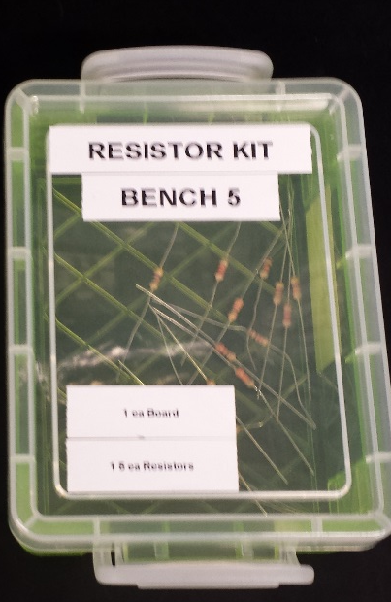
Lab 1 – Resistor Variability
Purpose
Equipment
The purpose of this lab was to learn how resistors vary using 20 resistors with the same color code
Digital Multimeter
Make-GW instek
Model-GDM-8245
SN-CL860237
20 – 1 kΩ resistors

Slide 6
Lab 1 – Resistor Variability
Procedure
In two person groups, we took ten 1k Ohm resistors and measured their actual resistance using an Ohmmeter.
This information was recorded on our provided handouts.
We then took the information gathered back to the classroom where we created an Excel sheet documenting and charting our findings.
.

Slide 7
Lab 1 – Resistor Variability 1/15/15
Resistor Variability |  |  | Tolerance
Sample | Measured Value (kOhm) | Ohm | High | Low | Nominal
1 | 0.979 | 979 | 1050 | 950 | 1000
2 | 0.982 | 982 | 1050 | 950 | 1000
3 | 0.978 | 978 | 1050 | 950 | 1000
4 | 0.979 | 979 | 1050 | 950 | 1000
5 | 0.999 | 999 | 1050 | 950 | 1000
6 | 0.987 | 987 | 1050 | 950 | 1000
7 | 0.987 | 987 | 1050 | 950 | 1000
8 | 0.982 | 982 | 1050 | 950 | 1000
9 | 0.98 | 980 | 1050 | 950 | 1000
10 | 1 | 1000 | 1050 | 950 | 1000
11 | 0.977 | 977 | 1050 | 950 | 1000
12 | 0.985 | 985 | 1050 | 950 | 1000
13 | 0.996 | 996 | 1050 | 950 | 1000
14 | 0.977 | 977 | 1050 | 950 | 1000
15 | 0.983 | 983 | 1050 | 950 | 1000
16 | 0.981 | 981 | 1050 | 950 | 1000
17 | 0.994 | 994 | 1050 | 950 | 1000
18 | 0.979 | 979 | 1050 | 950 | 1000
19 | 0.975 | 975 | 1050 | 950 | 1000
20 | 0.978 | 978 | 1050 | 950 | 1000
21 | 0.98 | 980 | 1050 | 950 | 1000
22 | 0.979 | 979 | 1050 | 950 | 1000
23 | 0.978 | 978 | 1050 | 950 | 1000
24 | 0.977 | 977 | 1050 | 950 | 1000
25 | 0.978 | 978 | 1050 | 950 | 1000
26 | 0.979 | 979 | 1050 | 950 | 1000
27 | 0.977 | 977 | 1050 | 950 | 1000
28 | 0.979 | 979 | 1050 | 950 | 1000
29 | 0.981 | 981 | 1050 | 950 | 1000
30 | 0.983 | 983 | 1050 | 950 | 1000
31 | 0.982 | 982 | 1050 | 950 | 1000
32 | 0.98 | 980 | 1050 | 950 | 1000
33 | 0.981 | 981 | 1050 | 950 | 1000
34 | 0.984 | 984 | 1050 | 950 | 1000
35 | 0.978 | 978 | 1050 | 950 | 1000
36 | 0.98 | 980 | 1050 | 950 | 1000
37 | 0.98 | 980 | 1050 | 950 | 1000
38 | 0.98 | 980 | 1050 | 950 | 1000
39 | 0.981 | 981 | 1050 | 950 | 1000
40 | 0.982 | 982 | 1050 | 950 | 1000
41 | 0.982 | 982 | 1050 | 950 | 1000
42 | 0.98 | 980 | 1050 | 950 | 1000
43 | 0.978 | 978 | 1050 | 950 | 1000
44 | 1.002 | 1002 | 1050 | 950 | 1000
45 | 0.99 | 990 | 1050 | 950 | 1000
46 | 0.978 | 978 | 1050 | 950 | 1000
47 | 0.979 | 979 | 1050 | 950 | 1000
48 | 1.001 | 1001 | 1050 | 950 | 1000
49 | 0.98 | 980 | 1050 | 950 | 1000
50 | 0.99 | 990 | 1050 | 950 | 1000
51 | 0.984 | 984 | 1050 | 950 | 1000
52 | 0.983 | 983 | 1050 | 950 | 1000
53 | 0.984 | 984 | 1050 | 950 | 1000
54 | 0.982 | 982 | 1050 | 950 | 1000
55 | 0.978 | 978 | 1050 | 950 | 1000
56 | 0.983 | 983 | 1050 | 950 | 1000
57 | 0.984 | 984 | 1050 | 950 | 1000
58 | 0.981 | 981 | 1050 | 950 | 1000
59 | 0.981 | 981 | 1050 | 950 | 1000
60 | 0.978 | 978 | 1050 | 950 | 1000
61 | 0.98 | 980 | 1050 | 950 | 1000
62 | 0.984 | 984 | 1050 | 950 | 1000
63 | 0.981 | 981 | 1050 | 950 | 1000
64 | 0.982 | 982 | 1050 | 950 | 1000
65 | 0.984 | 984 | 1050 | 950 | 1000
66 | 0.982 | 982 | 1050 | 950 | 1000
67 | 0.984 | 984 | 1050 | 950 | 1000
68 | 0.98 | 980 | 1050 | 950 | 1000
69 | 0.987 | 987 | 1050 | 950 | 1000
70 | 0.981 | 981 | 1050 | 950 | 1000

Slide 8
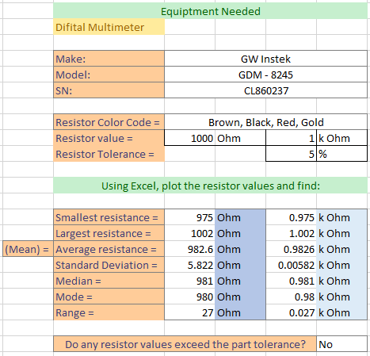
Lab 1 – Resistor Variability
Equipment Needed
Digital Multimeter
Make: | GW Instek
Model: | GDM - 8245
SN: | CL860237
Resistor Color Code = | Brown, Black, Red, Gold
Resistor value = | 1000 | Ohm | 1 | k Ohm
Resistor Tolerance = |  |  | 5 | %
Using Excel, plot the resistor values and find:
Smallest resistance = | 975 | Ohm | 0.975 | k Ohm
Largest resistance = | 1002 | Ohm | 1.002 | k Ohm
Average resistance = | 982.6 | Ohm | 0.9826 | k Ohm
Standard Deviation = | 5.822 | Ohm | 0.00582 | k Ohm
Median = | 981 | Ohm | 0.981 | k Ohm
Mode = | 980 | Ohm | 0.98 | k Ohm
Range = | 27 | Ohm | 0.027 | k Ohm
Do any resistor values exceed the part tolerance? |  |  |  | No

Slide 10
Lab 1 - Conclusion
Summary
We initially measured the values of 5 different 1000 ohm resistors. After passing out the resistors, there were enough for 10 resistors a group. After each group measured their 10 resistors, each group sent their data to each other. A new total of 70 resistor values was plotted. All 70 of the resistor samples were within the part tolerance (50 Ohms). The majority of the samples fell under the nominal value of 1000 ohms. There are only three resistors that equaled 100 or over. The median value came out to be 981 ohms and the mode was 980 ohms. The difference between the high and the low, or the range, was 27 ohms.

Slide 11
Lab 2 – Reading and Sorting Resistors

Slide 12
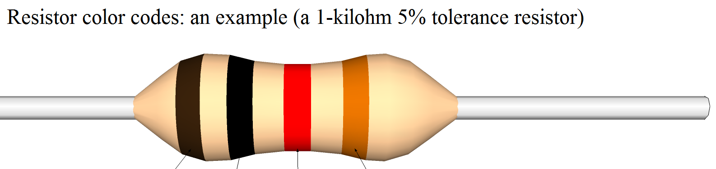
Lab 2 – Reading and Sorting Resistors
Purpose
Equipment
The purpose of this lab was to learn the resistor color code using 15 resistors which must be sorted from smallest to largest value. Build a resistor kit that includes 15 resisters and sort resistors based on color code from smallest to largest and measure the resistance of each resistor and verify sorting.
Digital Multimeter
Make-GW instek
Model-GDM-8245
SN-CL860237
15 –resistors

Slide 13
Lab 2 – Reading and Sorting Resistors
Procedure
We broke up into two person groups and found the 15 resistors described on the provided hand out.
We then used the resistor color code to sort the resistors from smallest to largest.
After sorting the resistors, we used a digital multimeter to verify our sorting.
After measuring the resistors, we also made an Excel sheet showing that all resistors were within tolerance.

Slide 14
Lab 2 – Resistor Color Codes
Zach Anderson Lab 2, 1/29/15, Reading and Sorting Resistors
 | Value | Measured | Tolerance | Min | Max | Within Tolerance | Too High, man | Too Low | Color Code
1 | 100 | 98.2 | 0.05 | 95 | 105 | Yes | No | No | BROWN | BLACK | BROWN | GOLD
2 | 220 | 216.2 | 0.05 | 209 | 231 | Yes | No | No | RED | RED | BROWN | GOLD
3 | 330 | 322 | 0.05 | 313.5 | 346.5 | Yes | No | No | ORANGE | ORANGE | BROWN | GOLD
4 | 470 | 462.6 | 0.05 | 446.5 | 493.5 | Yes | No | No | YELLOW | VIOLET | BROWN | GOLD
5 | 1000 | 983.5 | 0.05 | 950 | 1050 | Yes | No | No | BROWN | BLACK | RED | GOLD
6 | 2200 | 2193 | 0.05 | 2090 | 2310 | Yes | No | No | RED | RED | RED | GOLD
7 | 3300 | 3218 | 0.05 | 3135 | 3465 | Yes | No | No | ORANGE | ORANGE | RED | GOLD
8 | 4700 | 4598 | 0.05 | 4465 | 4935 | Yes | No | No | YELLOW | VIOLET | RED | GOLD
9 | 10000 | 9820 | 0.05 | 9500 | 10500 | Yes | No | No | BROWN | BLACK | ORANGE | GOLD
10 | 22000 | 21560 | 0.05 | 20900 | 23100 | Yes | No | No | RED | RED | ORANGE | GOLD
11 | 33000 | 32900 | 0.05 | 31350 | 34650 | Yes | No | No | ORANGE | ORANGE | ORANGE | GOLD
12 | 47000 | 45660 | 0.05 | 44650 | 49350 | Yes | No | No | YELLOW | VIOLET | ORANGE | GOLD
13 | 100000 | 100150 | 0.05 | 95000 | 105000 | Yes | No | No | BROWN | BLACK | YELLOW | GOLD
14 | 1000000 | 1028000 | 0.05 | 950000 | 1050000 | Yes | No | No | BROWN | BLACK | GREEN | GOLD
15 | 10000000 | 10040000 | 0.05 | 9500000 | 10500000 | Yes | No | No | BROWN | BLACK | BLUE | GOLD
Example | Value | Measured | Tolerance | Min | Max | Within Tolerance | Too High, man | Too Low
16 | 10 | 8 | 0.05 | 9.5 | 10.5 | No | No | Yes
17 | 20 | 25 | 0.05 | 19 | 21 | No | Yes | No

Slide 16
Lab 2 - Conclusion
Summary:
We found that we had correctly sorted all of our resistors.
We also found that all of the sorted resistors had the same tolerance (5%)

Slide 17
Lab 3 – Series Resistors Current and Voltage

Slide 18
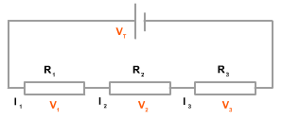
Lab 3- Series Resistors Current and Voltage
Purpose
Equipment
The purpose of this lab was to experiment with the series circuits and verify that the simulation, analysis, and measured test results all agree.
Digital Multimeter
Make-GW instek
Model-GDM-8245
SN-CL860237
3 –resistors
10 kΩ, 2.2kΩ, 4.7kΩ
Elviss II
Make-NI
Model-GDM-8245
SN-CL860264

Slide 19
Lab 3 – Series Resistors Current and Voltage
Procedure
We will be building a simple series circuit using the Elvis II board and three resistors, a 10KΩ, a 2.2KΩ, and a 4.7KΩ.
We will calculate the total resistance of this circuit in Excel, Multisim, and on the Elvis II board in the lab.

Slide 20

Lab 3 – Series Resistors Current and Voltage
 | Measured | Calculated | Simulated
R1 | 97.8E+3 | 10.0E+3 | 10.0E+3 | Ω
R2 | 2.22E+3 | 2.20E+3 | 2.20E+3 | Ω
R3 | 4.61E+3 | 4.70E+3 | 4.70E+3 | Ω
RT | 16.6E+3 | 16.9E+3 | 16.9E+3 | Ω
IT | 542.2E-6 | 532.5E-6 | 532.9E-6 | Amps
V1 | 9.00E+0 | 9.00E+0 | 9.00E+0 | volts
VA | 5.32E+0 | 5.33E+0 | 5.33E+0 | volts
VB | 1.17E+0 | 1.17E+0 | 1.17E+0 | volts
VC | 2.51E+0 | 2.51E+0 | 2.50E+0 | volts
$$R_{T}=R_{1}+R_{2}+R_{3}$$

Slide 21
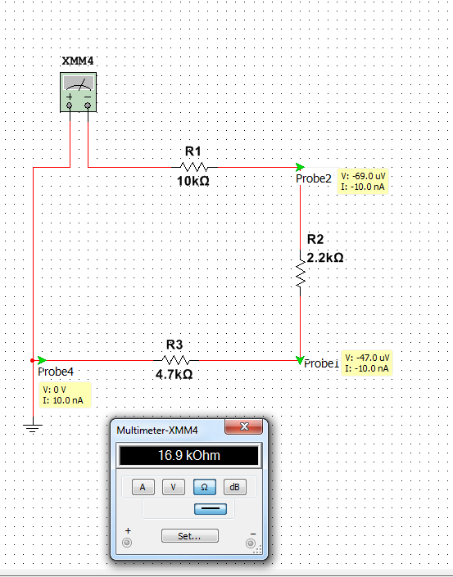
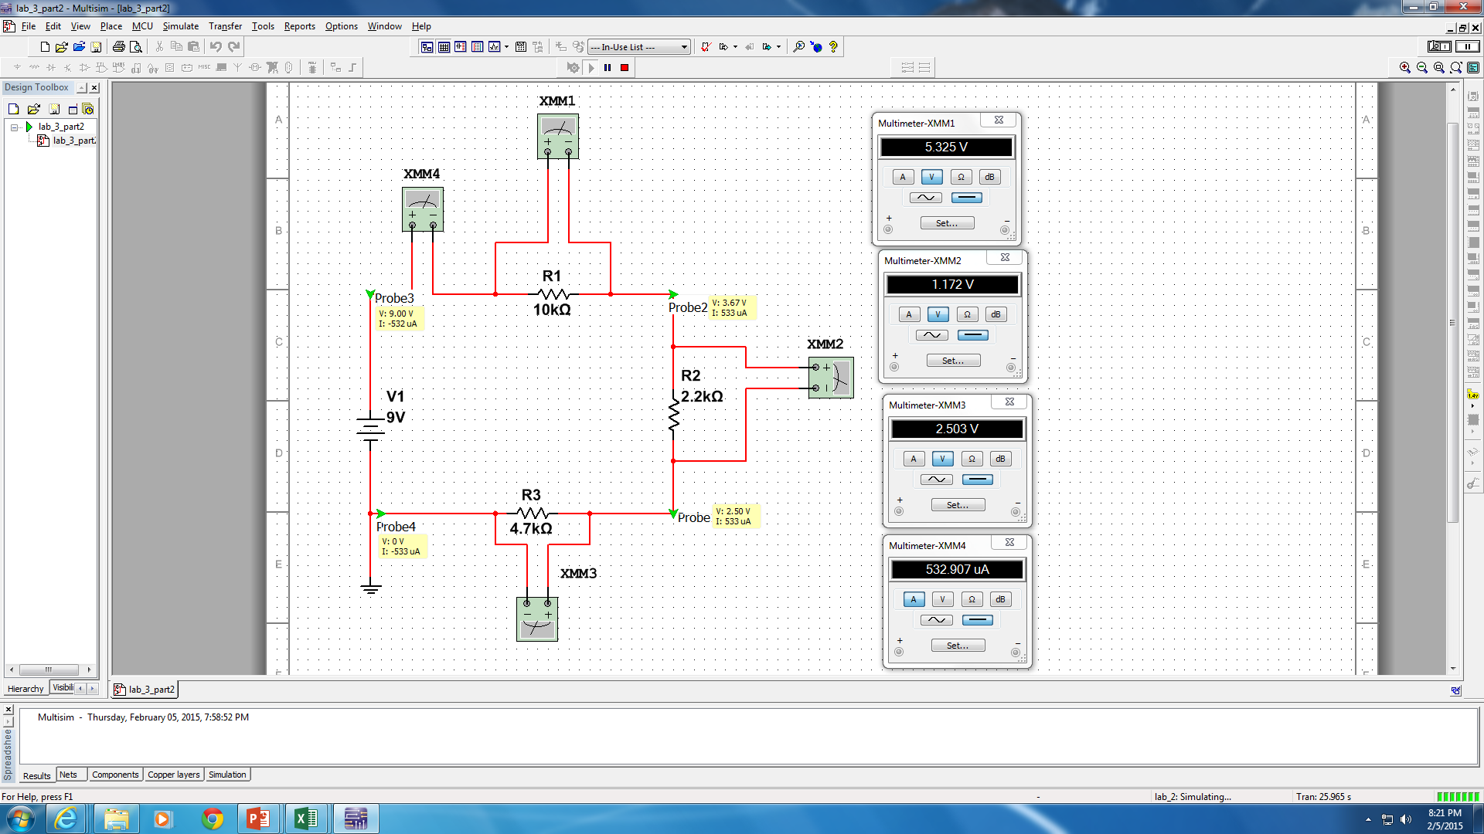
Lab 3 – Multisim Examples

Slide 22
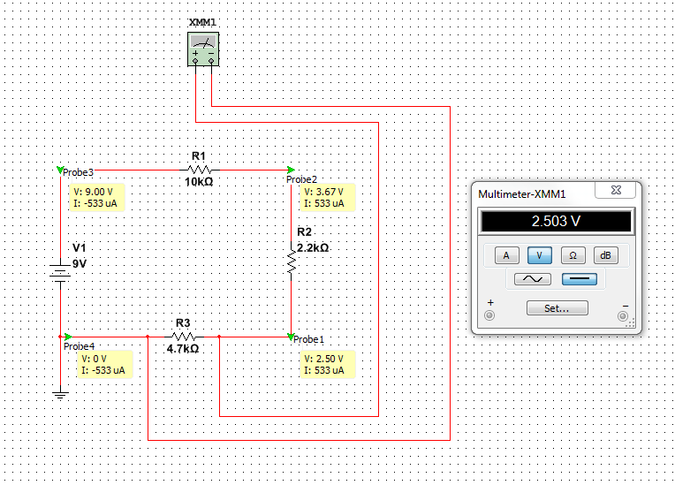
Lab 3 – Multisim Examples

Slide 23
Lab 3 - Conclusion
Summary:
Our results from Excel, Multisim, and in-lab measurements all agreed.

Slide 24
Lab 4 – Black Box Design

Slide 25
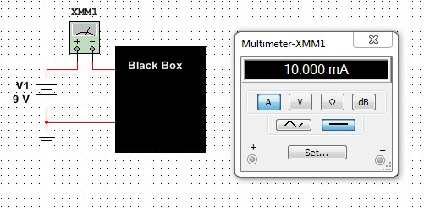
Lab 4- Black Box Design
Purpose
Equipment
The purpose of this lab was to learn about series circuits.
Digital Multimeter
Make-GW instek
Model-GDM-8245
SN-CL860334
3 –resistors
Standard
Elvis II
Make-Nation Instruments
Model-NI ELVIS II
SN-166CF1

Slide 26
Lab 4 – Black Box Design
Procedure
We were given a hand out that contained a picture of a circuit with part of the circuit blacked out. We will use the information that is not blacked out, to figure out what components are blacked out.
We will be doing calculations of this circuit in Excel and Multisim. We will then build the circuit in the lab.

Slide 27
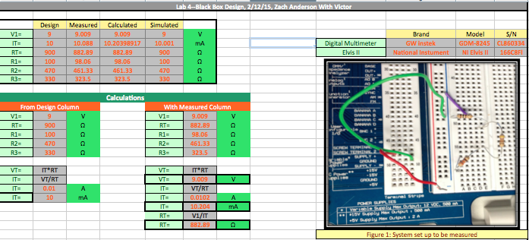
Lab 4 – Black Box Design

Slide 28

Lab 4 – Black Box Design
Equations Used
Series Resistors
$$R_{T}=R_{1}+R_{2}+R_{3}$$
Ohm’s Law
V = IR

Slide 29
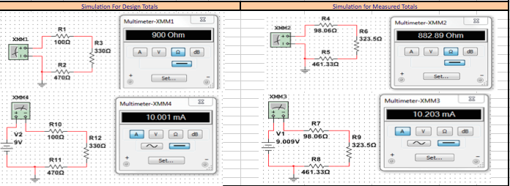
Lab 4 - Multisim

Slide 30
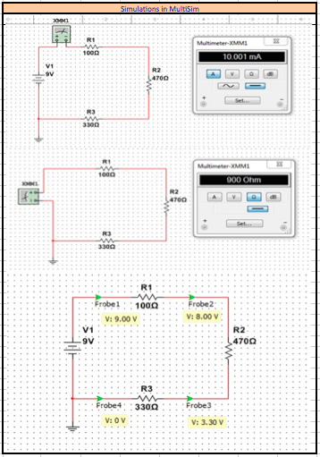

Slide 31
Lab 4 - Conclusion
Summary:
By using what we already knew about the circuit, we were able to figure out what parts of the circuit were covered by the “black box”.

Slide 32
Lab 5 – Black Box Design

Slide 33
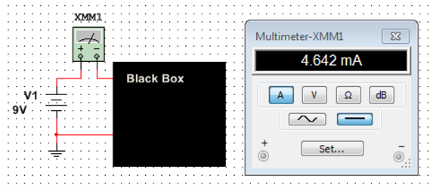
Lab 5- Black Box Design
Purpose
Equipment
The purpose of this lab was to learn about parallel circuits
Digital Multimeter
See slide 24
3 –resistors
Standard
Elviss II
See slide 24

Slide 34
Lab 5 – Black Box Design
Procedure
We will use the information given about the circuit to figure out what components are being hidden under the black box.
We will use Excel & Multisim to calculate and simulate what components may be missing. We will then build the circuit in the lab to verify that we are correct.

Slide 35
Lab 5 – Black Box Design in Parallel
V1= | 9 | V
It= | 4.64E-03 | A
Rt=V/It |  | Ω
Rt= | 1938.819474 | Ω
Choose R1
R2=Rt/(1-(Rt/R1)) |  | Ω
R1= | 4000 | Ω
R2= | 3762.541806 | Ω
 | Design | Measured | Calculated | Simulated | 3 resistors
V1= | 9 | 9.005 | 9 | 9 | 9.004 | V
It= | 4.642 | 4.4288 | 4.642 | 4.642 | 4.6308 | mA
Rt= | 1938.82 | 1932.2 | 1938.819474 | 1939 | 1842.2 | Ω
R1= | 4000 | 3862.4 | 4000 | 4000 | 5592.7 | Ω
R2= | 3762.5438 | 3862.1 | 3762.541806 | 3762.543786 | 6782.1 | Ω
 |  |  |  |  | 4618.9 | Ω

Slide 36
Lab 5 – Black Box Design in Parallel
Equipment Needed
Digital Multimeter
Make: | GW Instek
Model: | GDM - 8245
SN: | CL860237
Resistor Color Code = | Orange, White, Red, Gold
Resistor value = | 3900 | Ohm
Resistor Tolerance = | 5 | %
5% of design Rt= | 96.941 | Ω
Rt - 5%= | 1841.879
3 resistors Rt= | 1842.2
Percent off= | 0.049834435
 | 4.983443538 | %

Slide 37

Lab 5 – Black Box Design
Equations Used
Two Resistors In Parallel
$$RT= \frac{(R_{1}∗R_{2})}{(R_{1}+R_{2})}$$
Ohm’s Law
V = IR

Slide 38
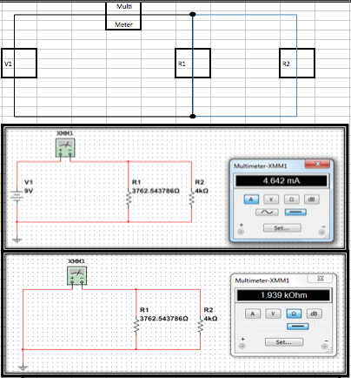
Lab 5 - Multisim

Slide 39
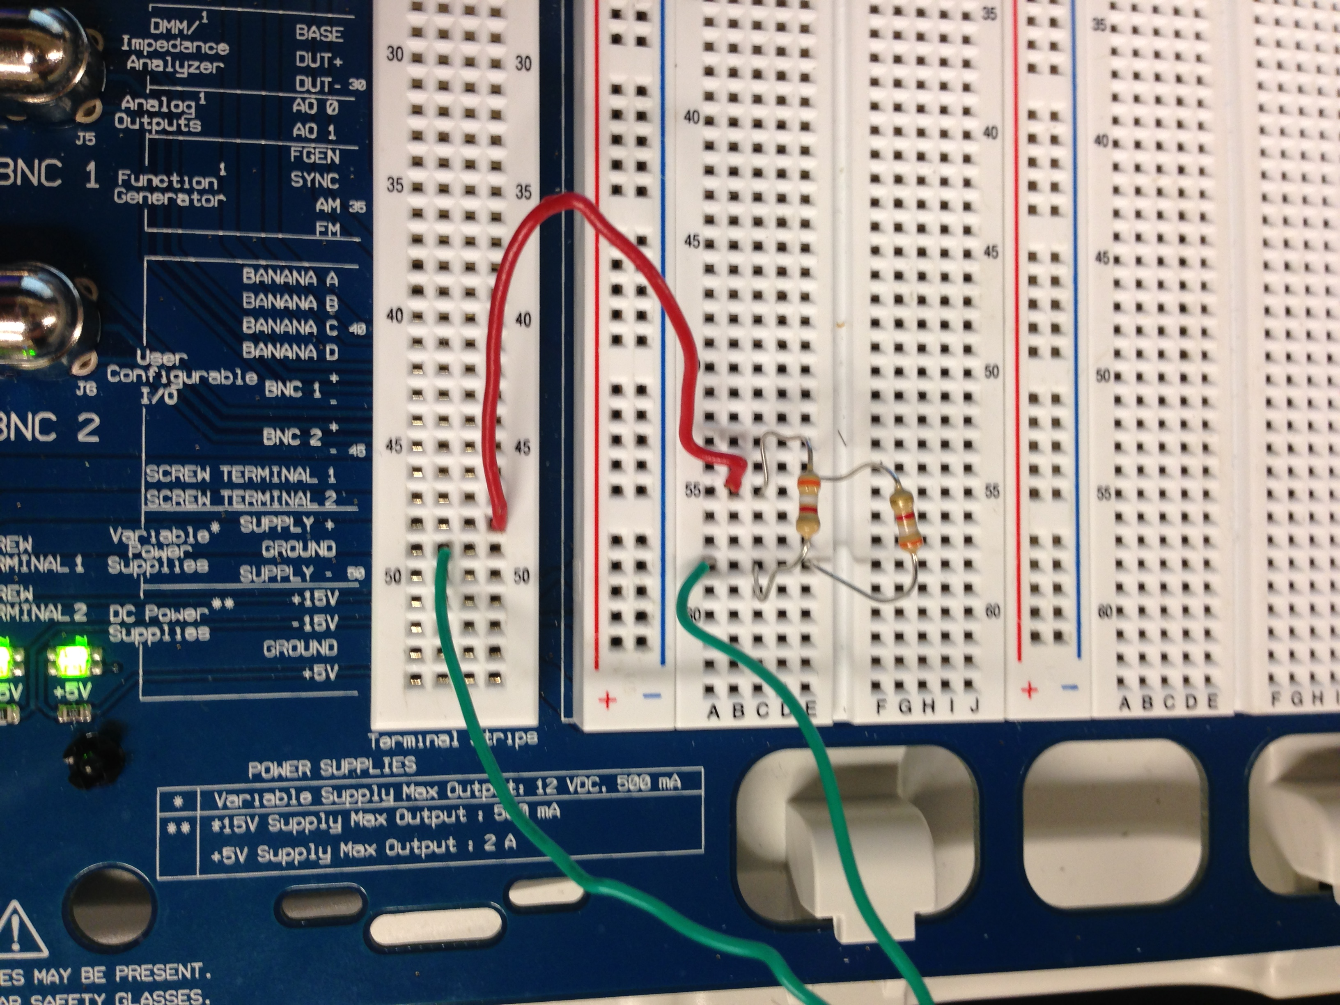
Lab 5 - Visual

Slide 40
Lab 5 - Conclusion
Summary:
Using the information provided about the circuit, we were able to determine what components were hidden under the black box.

Slide 41

Lab 6 – Nothing

Slide 42
Lab 7 – Parallel Resistor Circuit

Slide 43
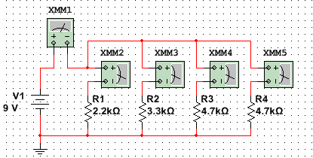
Lab 7- 4 Parallel Resistor Circuit
Purpose
Equipment
The purpose of this lab was to learn about parallel circuits
Digital Multimeter
Make-GW instek
Model-GDM-8245
SN-CL860334
3 –resistors
Standard
Elviss II
Make-Nation Instruments
Model-NI ELVIS II
SN-166CF1

Slide 44
Lab 7 – Parallel Resistor Circuit
Procedure
We will calculate the values of a circuit containing resistors in parallel.
We will calculate the values in Excel, simulate the circuit in Multisim, and measure the actual circuit in the lab.

Slide 45
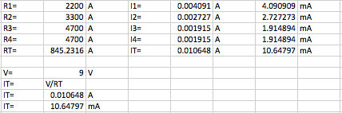
Lab 7 – 4 Parallel Resistor Circuit

Slide 46

Lab Seven – Parallel Resistor Circuit
Equations Used
Parallel
$$R_{T}= \frac{1}{(\frac{1}{R_{1}}+\frac{1}{R_{2}}+\frac{1}{R_{3}})}$$
Ohm’s Law
V = IR

Slide 47
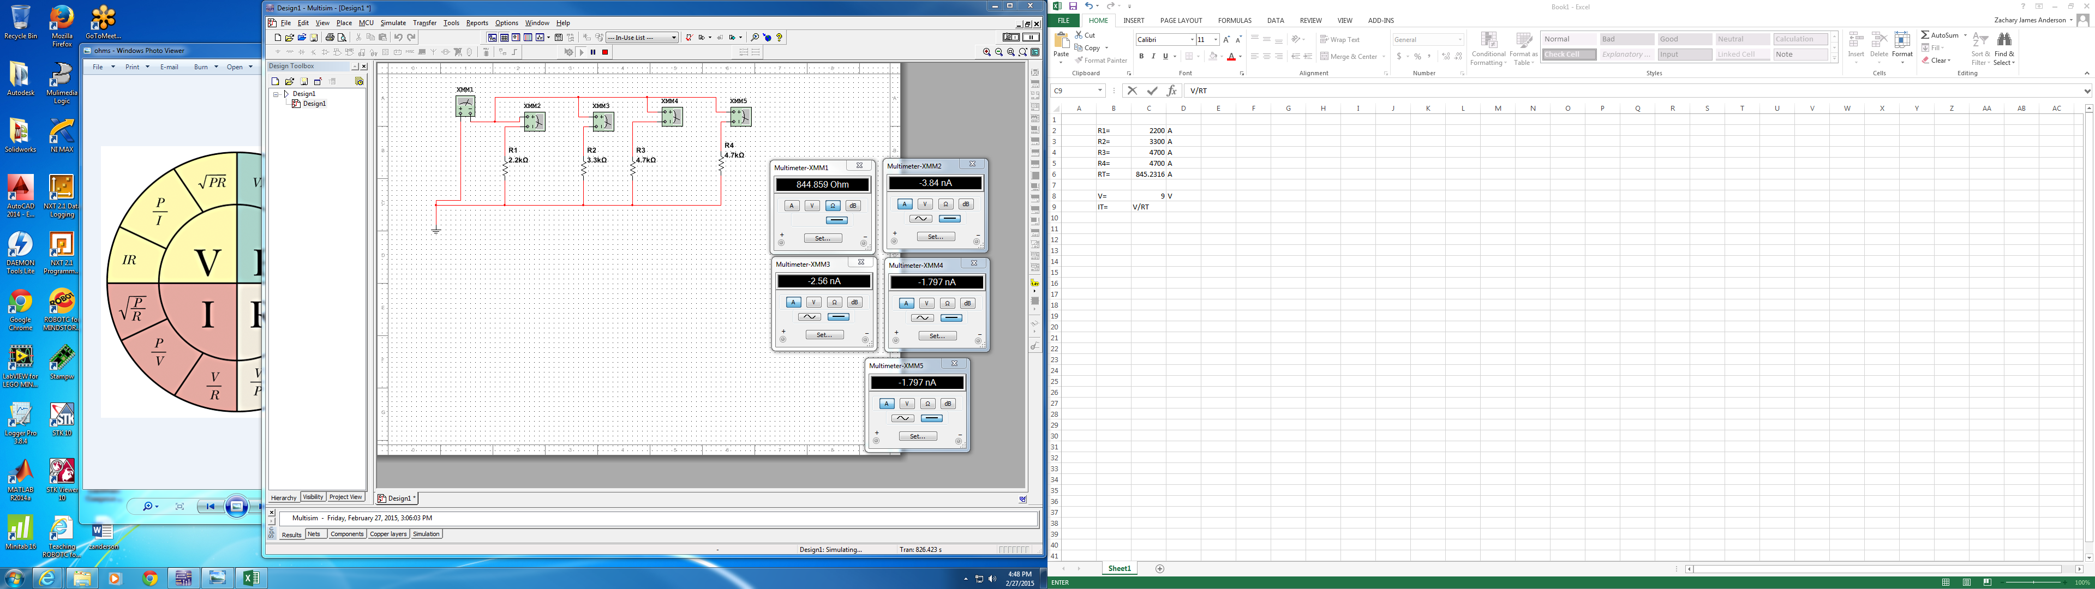
Lab 7 - Multisim

Slide 48
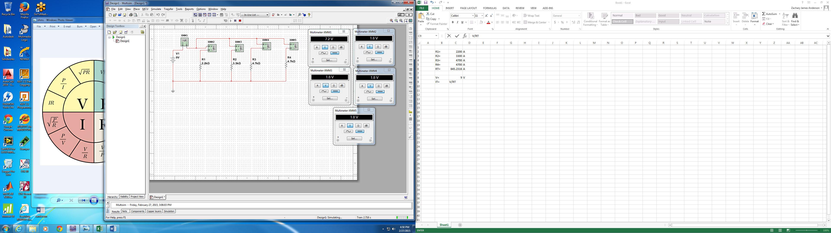
Lab 7 - Multisim

Slide 49
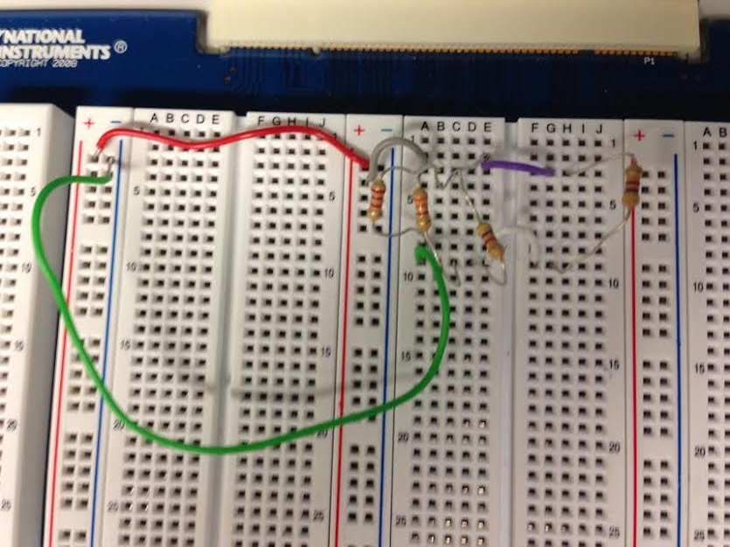
Lab 7 -Visual

Slide 50
Lab 7 - Conclusion
Summary:
We found our calculations in Excel, simulation in Multisim, and measurements done in the lab to all agree.

Slide 51
Lab 8 – Black Box Design 3

Slide 52
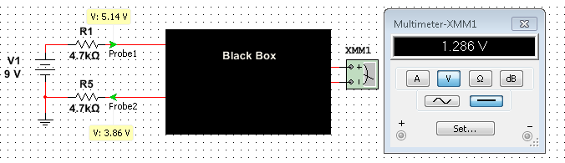
Lab 8- Black Box 3
Purpose
Equipment
The purpose of this lab was to learn about building a circuit that produces exactly 1.3V. We will need to use what we already know about the circuit to determine what components are hidden under the black box.
Digital Multimeter
Make-GW instek
Model-GDM-8245
SN-CL860334
3 –resistors, 1 – 10kohm potentiometer
Standard
Elviss II
Make-Nation Instruments
Model-NI ELVIS II
SN-166CF1

Slide 53
Lab 8 – Black Box 3

Slide 54


Lab Eight – Black Box Design
Equations Used
Parallel
$$R_{T}= \frac{1}{(\frac{1}{R_{1}}+\frac{1}{R_{2}}+\frac{1}{R_{3}})}$$
Series
$$R_{T}=R_{1}+R_{2}+R_{3}$$
Ohm’s Law
V = IR

Slide 55
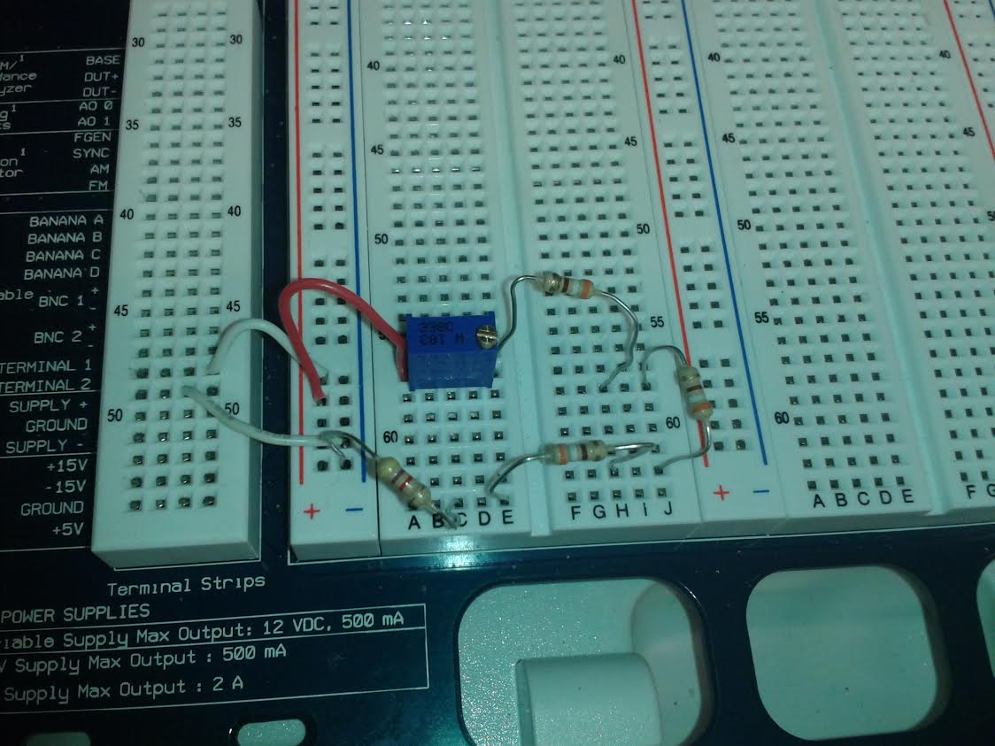
Lab 8 - Visual

Slide 56
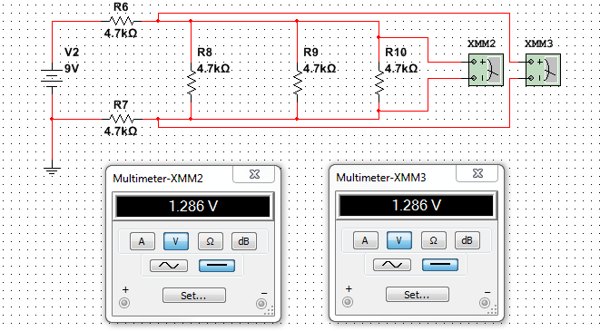
Lab 8 - Multisim

Slide 57
Lab 8 - Conclusion
Summary:
We initially used the wrong resistance in this lab. Through a misunderstanding with our professor, we used the wrong data and needed to re-do this lab
After using the correct information and parts, we found our calculations in Excel, simulation in Multisim, and measurements done in the lab to all agree.

Slide 58
Lab 9 – Series/Parallel Resistors

Slide 59
Lab 9 – Series/Parallel Resistors
Purpose
Equipment
The purpose of this lab was to experiment with the series circuits and verify that the simulation, analysis, and measured test results all agree.
Digital Multimeter
Make-GW instek
Model-GDM-8245
SN-CL860237
8 –resistors
2 x 10 kΩ, 2 x 2.2kΩ, 4.7kΩ
Elviss II
Make-GW instek
Model-GDM-8245
SN-CL860237

Slide 60
Lab 9 – Series/Parallel Resistors
Procedure
We will be analyzing the circuit provided in the Lab 9 hand out. We will be calculating the resistance of the circuit in Excel and simulating the resistance of the circuit in Multisim. We will then build the circuit in the lab and take measurements.

Slide 61


Lab 9 – Series/Parallel Resistors
Equations Used
Parallel
$$R_{T}= \frac{1}{(\frac{1}{R_{1}}+\frac{1}{R_{2}}+\frac{1}{R_{3}})}$$
Series
$$R_{T}=R_{1}+R_{2}+R_{3}$$

Slide 62
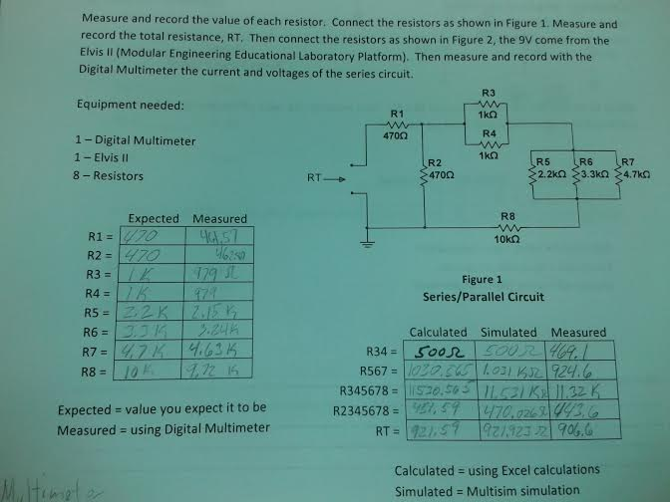
Lab 9 – Series/Parallel Resistors

Slide 63
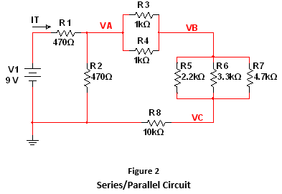
Lab 9 – Series/Parallel Resistors

Slide 64
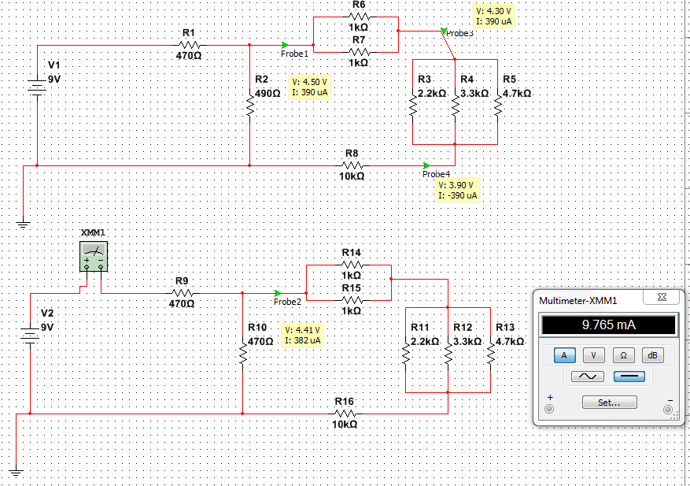
Lab 9 - Multisim

Slide 65
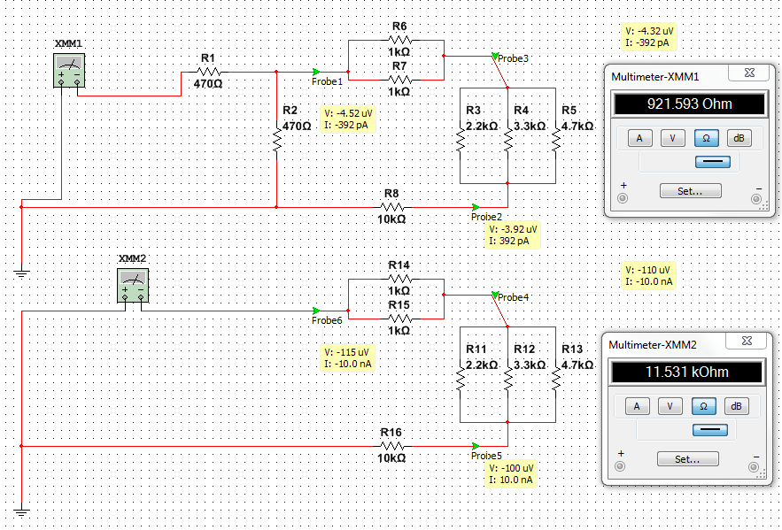
Lab 9 - Multisim

Slide 66
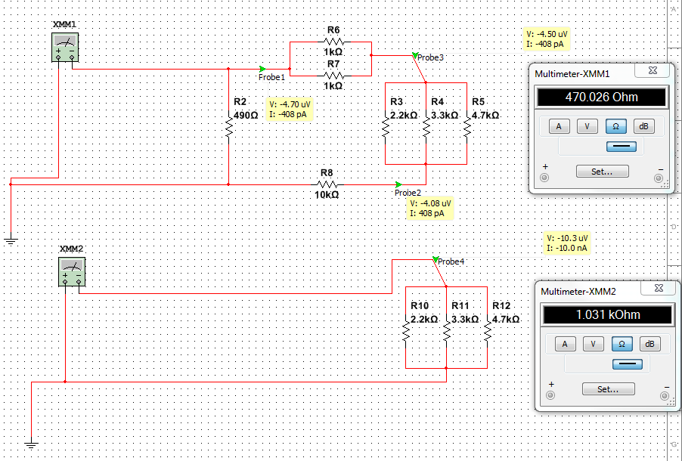
Lab 9 - Multisim

Slide 67
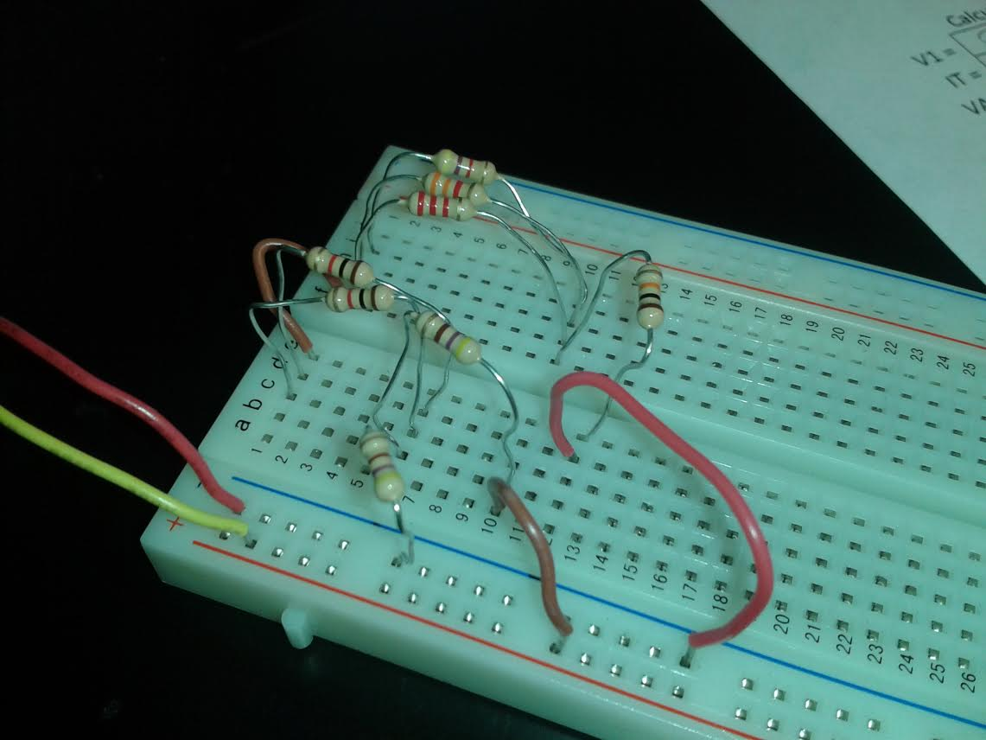
Lab 9 –Series Parallel Resistors

Slide 68
Lab 9 - Conclusion
Summary:
We found our calculations in Excel, simulation in Multisim, and measurements done in the lab to all agree.

Slide 69
Lab 10 – Series/ Parallel Capacitors

Slide 70
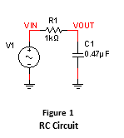
Lab 10 – Series/Parallel Capacitors
Purpose
Equipment
The purpose of this lab was to experiment with series and parallel combinations of capacitors.
LCR meter
Make- GW instek
Model-LCR meter 819
SN-E120997
8 –resistors
2 x 10 kΩ, 2 x 2.2kΩ, 4.7kΩ
Elviss II
Make-GW instek
Model-GDM-8245
SN-CL860237

Slide 71
Lab 10 – Series/ Parallel Capacitors
Procedure:
We will be measuring the capacitance of capacitors using an LCR meter. We will then combine capacitors in series and in parallel. We will use Excel and Multisim to calculate and simulate what the capacitance of a series circuit and a parallel circuit should be, we will then build the circuits in the lab and measure.

Slide 72


Lab 10 – Series/Parallel Capacitors
Equations Used
Parallel
$$C_{T}= C_{1}+C_{2}+C_{3}$$
Series
$$C_{T}= \frac{1}{\frac{1}{C_{1}}+\frac{1}{C_{2}}+\frac{1}{C_{3}}}$$

Slide 73
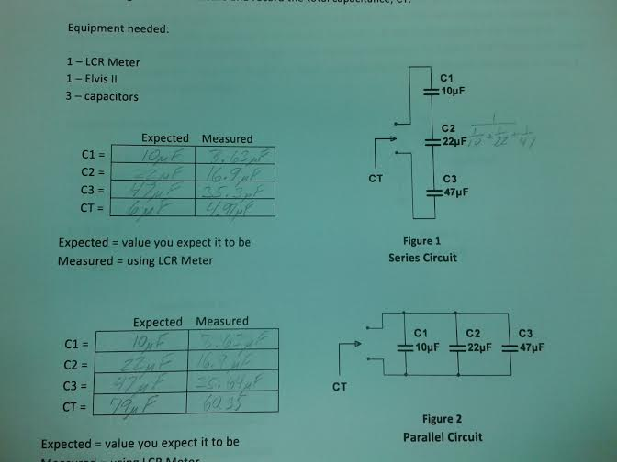
Lab 10 – Series/Parallel Capacitors

Slide 74
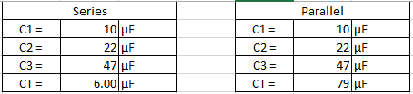
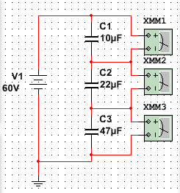
Lab 10 – Series/Parallel Capacitors

Slide 75
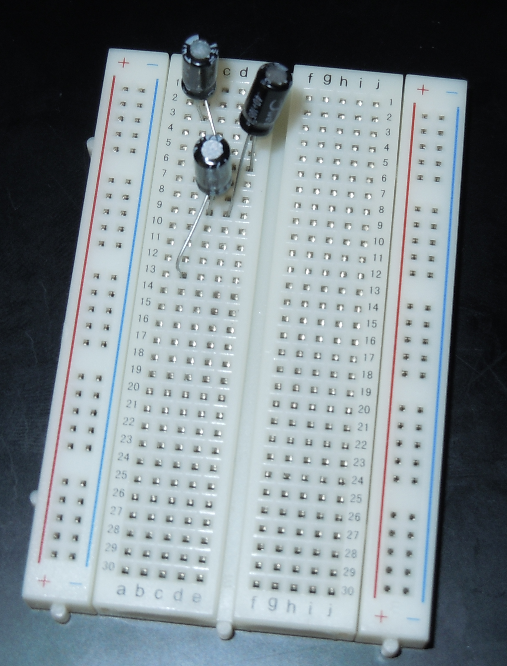
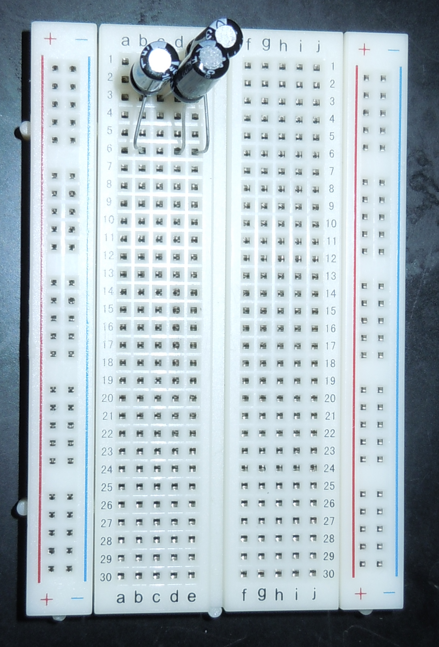
Lab 10 - Visual
Parallel
Series

Slide 76
Lab 10 – Conclusion
Summary:
When we went to the lab to build and measure our circuits, we found that our results matched what we were expecting.
This showed us that our simulations and calculations were done correctly.

Slide 77
Lab 11 – RC Lab

Slide 78
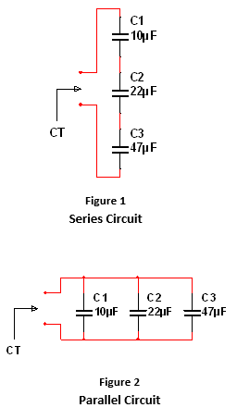
Lab 11 – RC Lab
Equipment
Purpose
Oscilloscope
Function Generator
LCR meter
Make- GW instek
Model-LCR meter 819
SN-E120997
Resistor – 1 kΩ
SN-CL860237
Digital Multimeter
Make-GW instek
Model-GDM-8245
SN-CL860237
LCR meter
Make-
Model-
SN-
3 capacitors
0.47 uF, 1 uF, 2.2 uF
Elviss II
Make-GW instek
Model-GDM-8245
SN-CL860237
The purpose of this lab was to experiment with RC circuits.

Slide 79
Lab 11 – RC Lab
Procedure:
The information we used to carry out this lab was obtained from the book and in class lectures.

Slide 80


Lab 11 – RC Lab
Equations Used
$$X_{C}=\frac{1}{2πfC }$$
$$Z= \sqrt{R^{2}+ {X_{C}}^{2}}$$

Slide 81
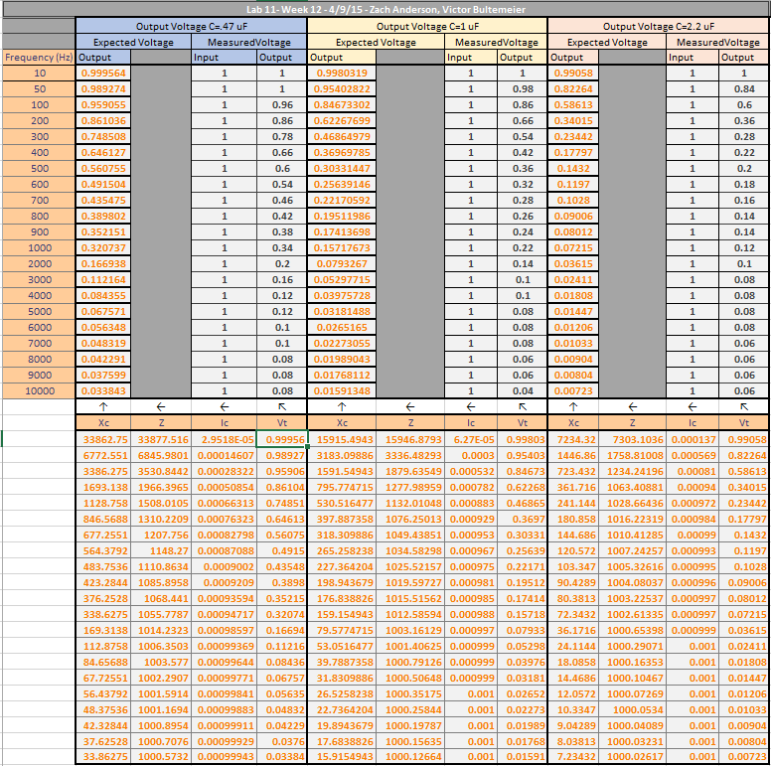

Slide 82
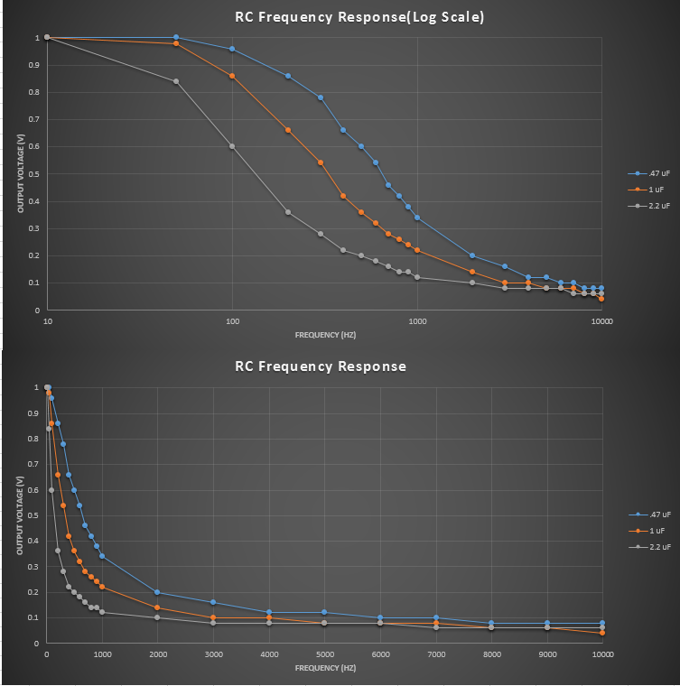

Slide 83
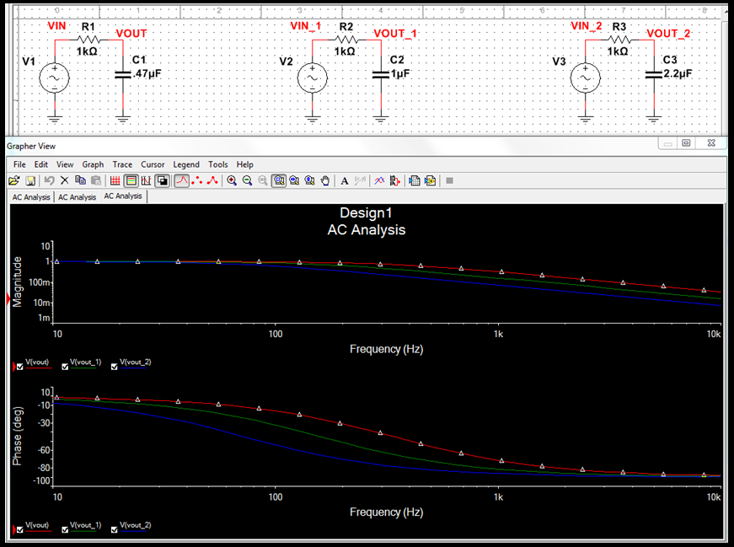
Lab 11 - Multisim

Slide 84
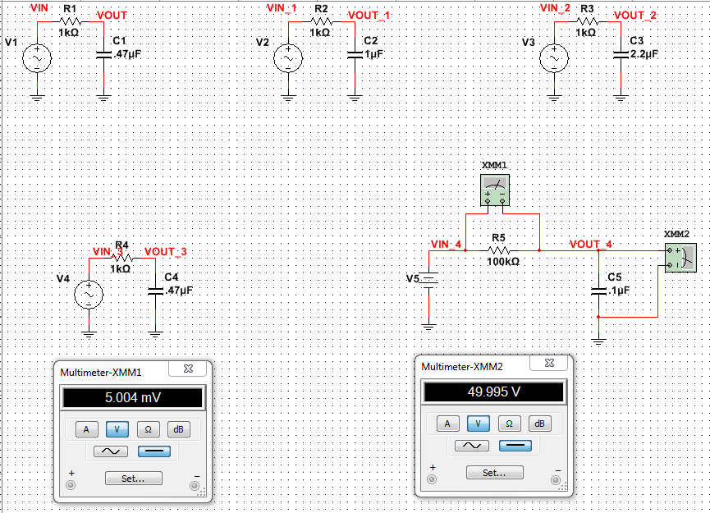
Lab 11 - Multisim

Slide 85
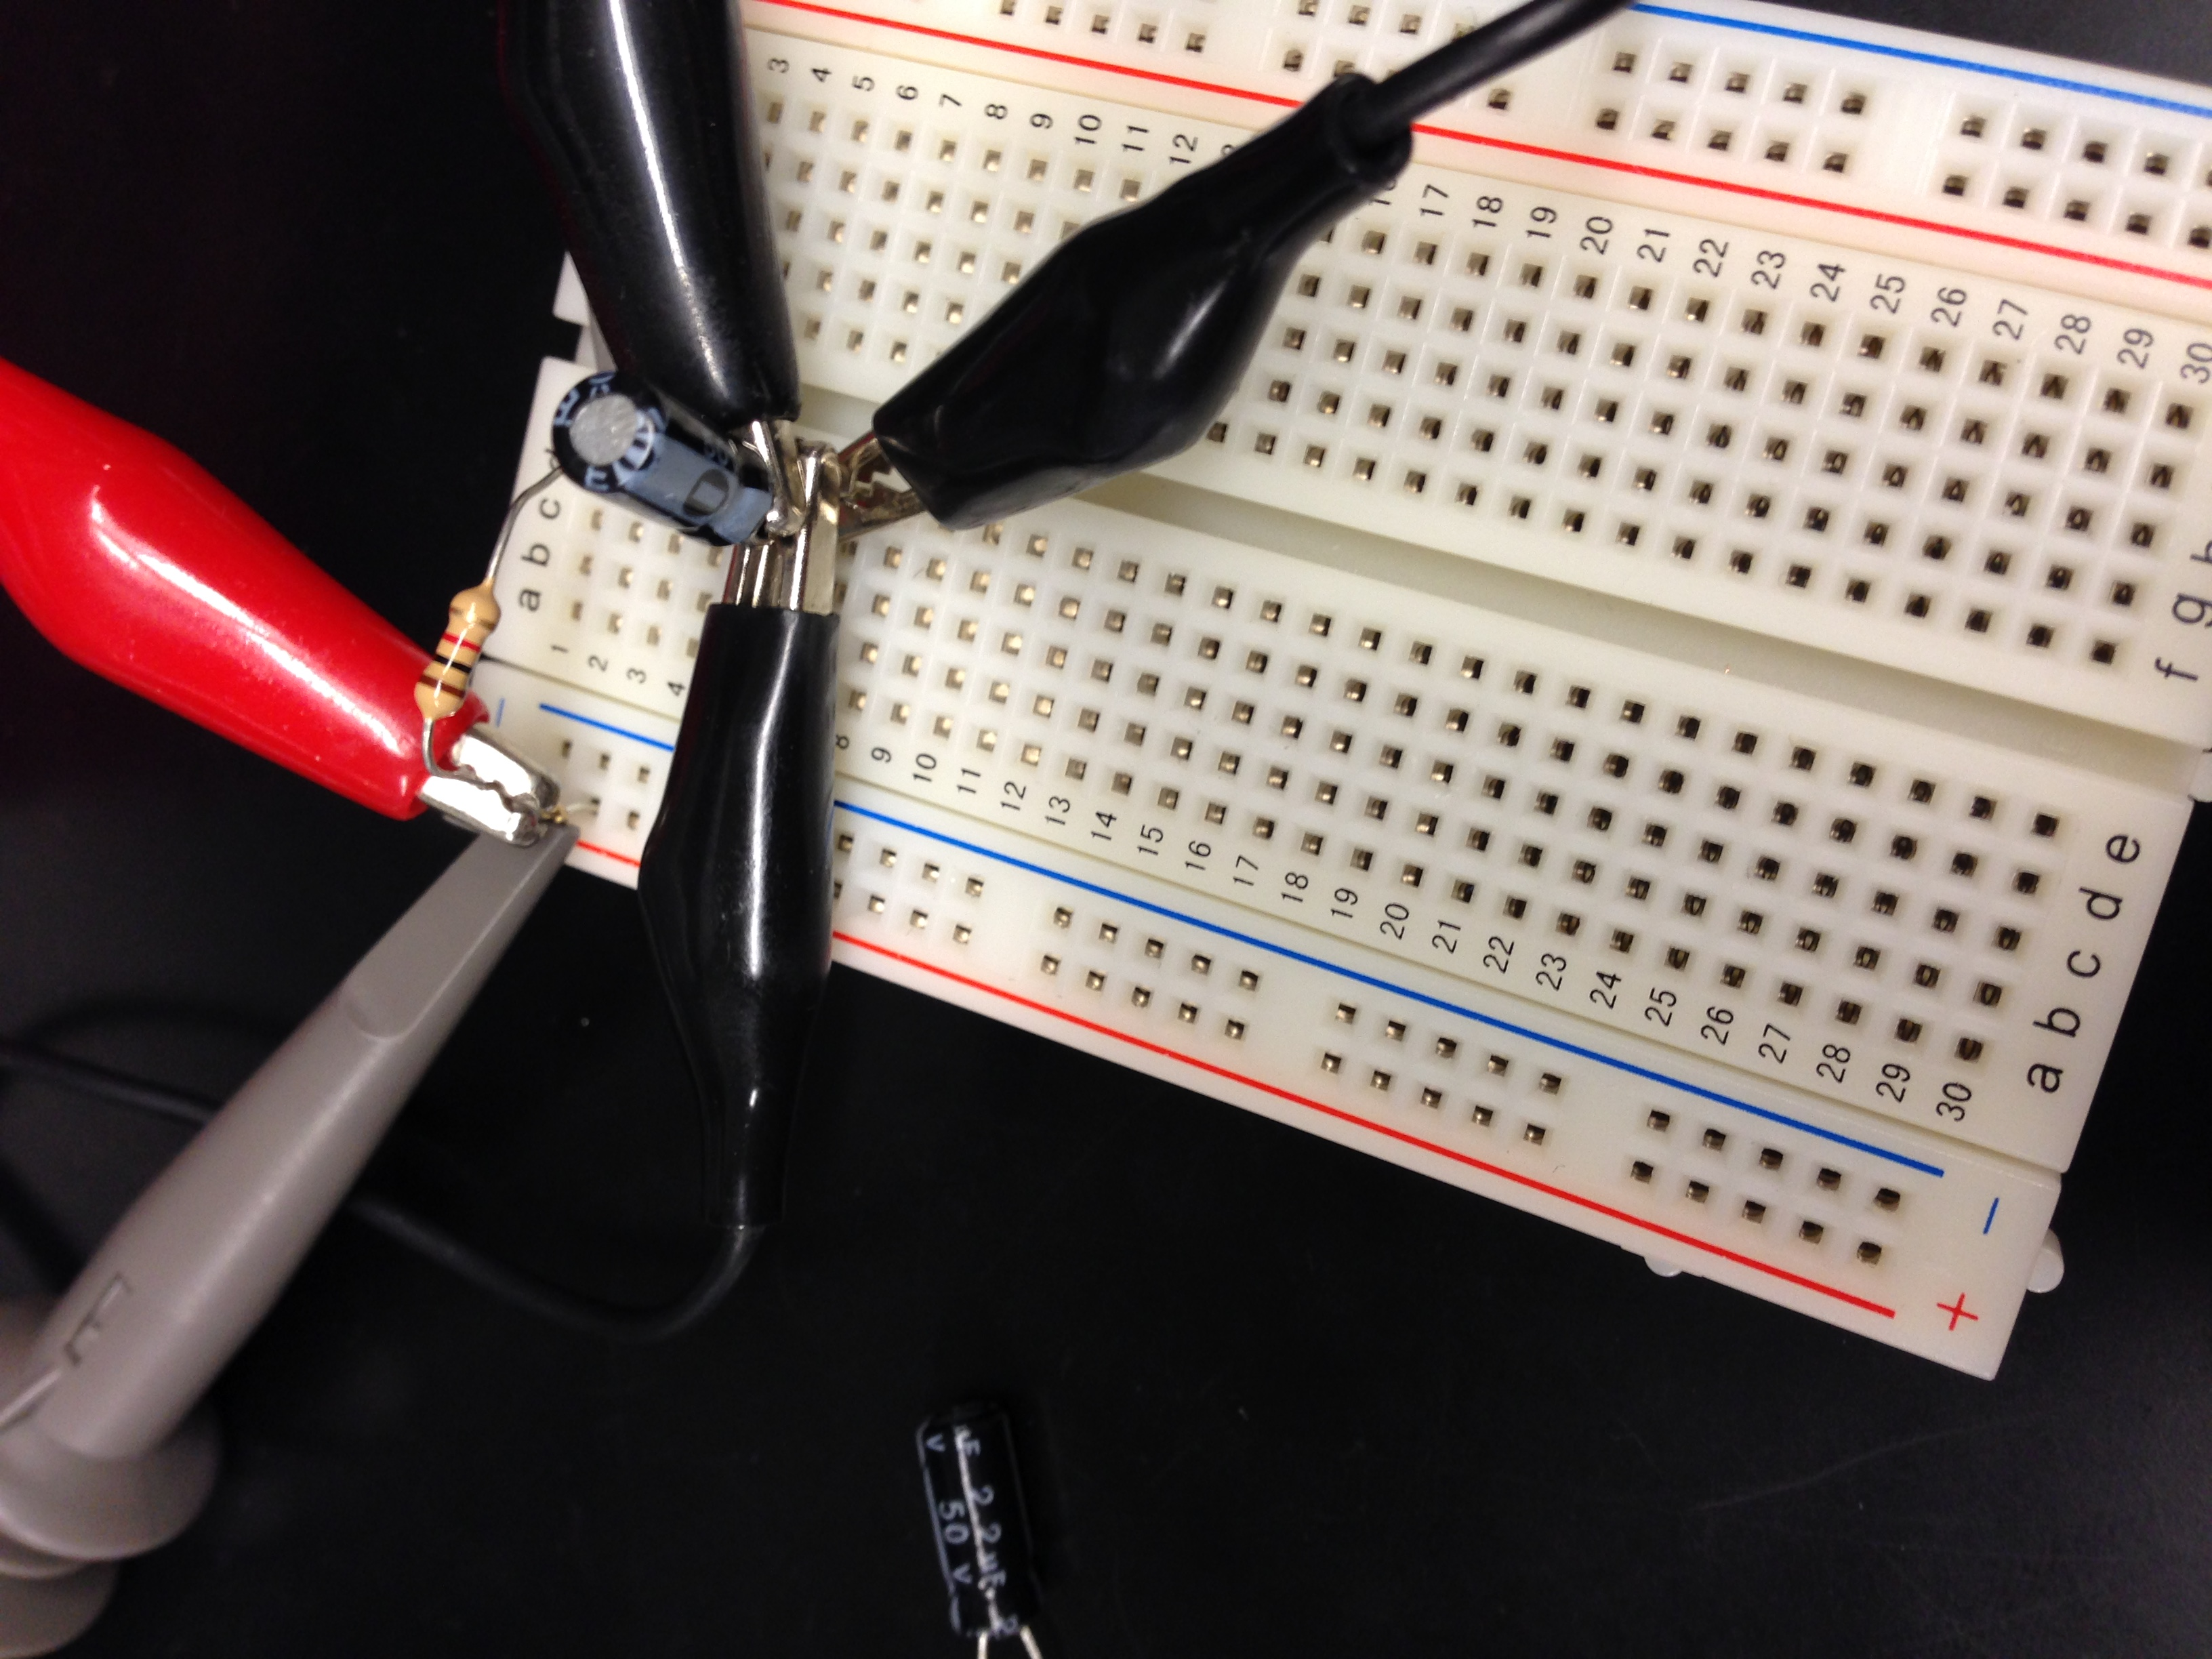
Lab 11 - Visual

Slide 86
Lab 11 - Conclusion
Summary:
We found our calculations in Excel, simulation in Multisim, and measurements done in the lab to all agree.

Slide 87
Lab 12 – Series/ Parallel Inductors

Slide 88
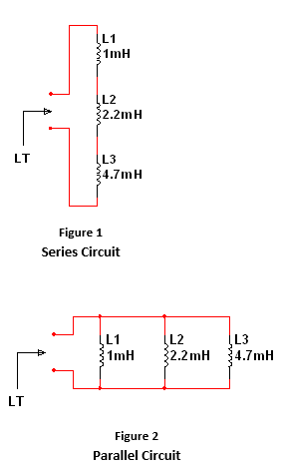
Lab 12 – Series/Parallel Inductors
Purpose
Equipment
The purpose of this lab was to experiment with series and parallel combinations of inductors.
LCR meter
Make- GW instek
Model-LCR meter 819
SN-E120997
3 –inductors
1 mH, 2.2 mH, 4.7 mH
Elviss II
Make-GW instek
Model-GDM-8245
SN-CL860237

Slide 89
Lab 12 – Series/ Parallel Inductors
Procedure
The information needed to conduct this experiment was gathered from the instructor and the book.
We will set up and measure three inductors in a series circuit and in a parallel circuit.
We will calculate what the inductance of both circuits should be in Excel, simulate the circuits in Multisim, and take actual measurements in the lab.

Slide 90


Lab 12 – Series/Parallel Inductors
Equations Used
Series
$$L_{T}= L_{1}+L_{2}+L_{3}$$
Parallel
$$L_{T}= \frac{1}{\frac{1}{L_{1}}+\frac{1}{L_{2}}+\frac{1}{L_{3}}}$$

Slide 91
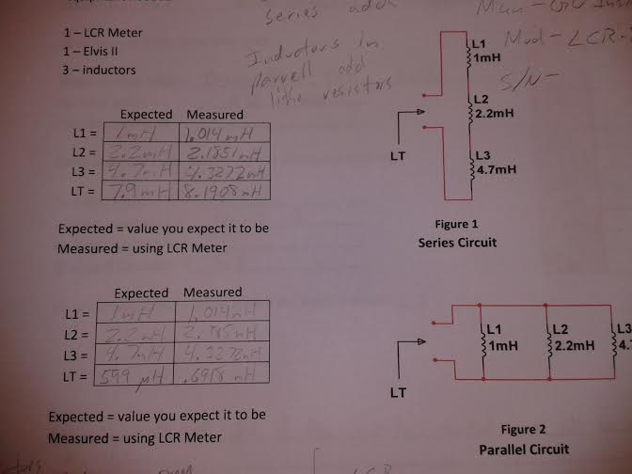
Lab 12 – Series/Parallel Inductors

Slide 92
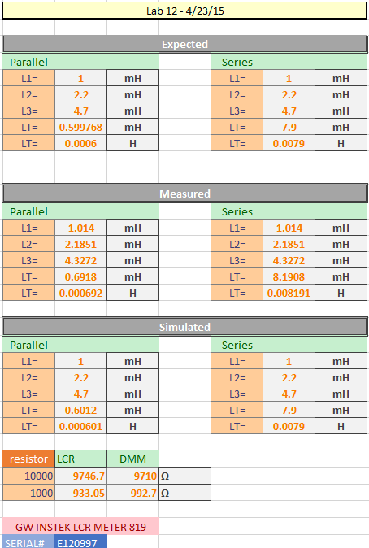
Lab 12 – Series/Parallel Inductors

Slide 93
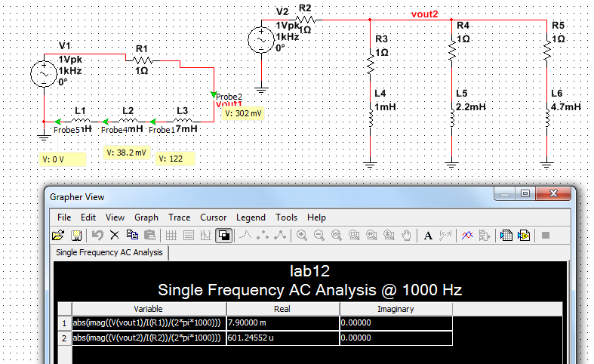
Lab 12 - Multisim

Slide 94
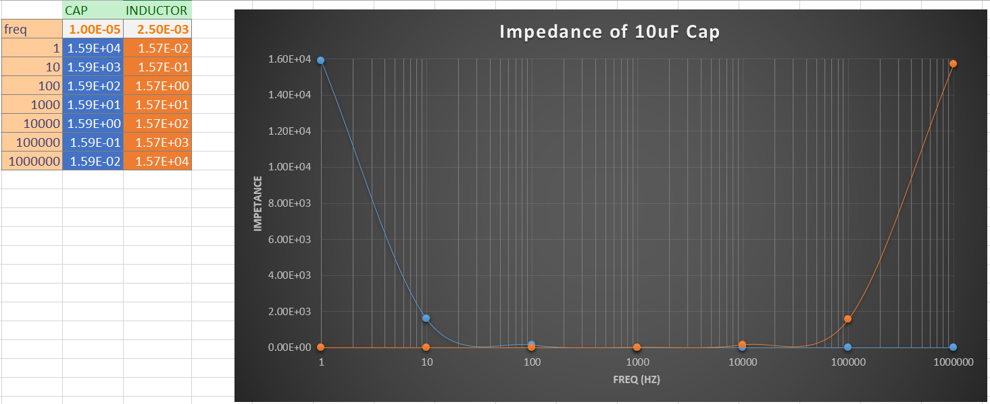
Lab 12 - Measurements

Slide 95
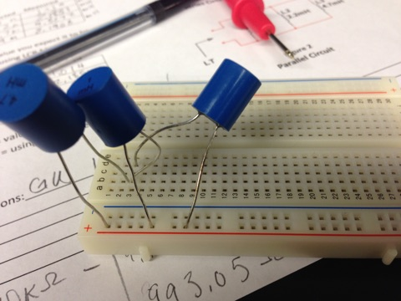
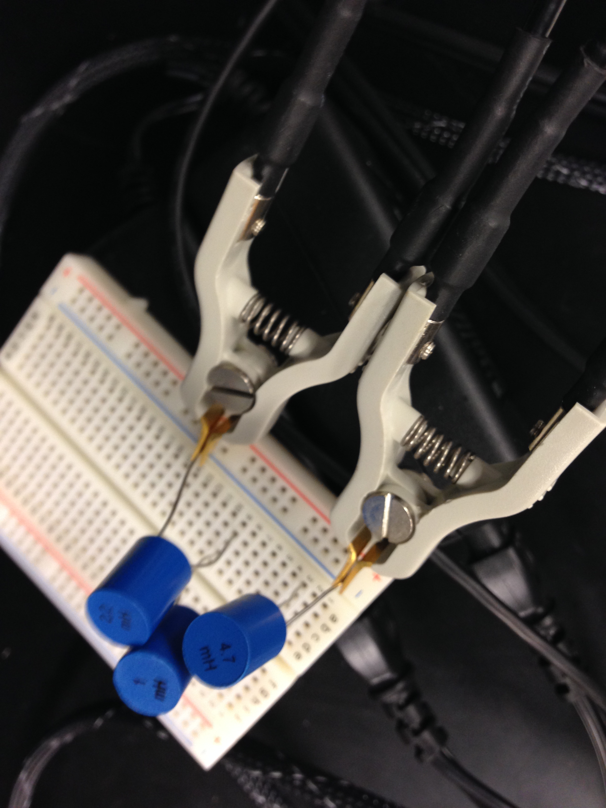
Lab 12 - Visual
Series
Parallel

Slide 96
Lab 12 - Conclusion
Summary:
We calculated and simulated both circuits, then built and measured the circuits in the lab.
Our calculations and simulations were correct.

Slide 97

In conclusion
All in all, taking EECT 111, I was able to expand my knowledge of the intricacies of circuits. I have not only gained a better understanding of approaching, handling, and the math of circuits, but gained a lifelong appreciation for something that will be very useful in the real world. Thank you

