Slide 1
EECT 111-51C
LAB NOTEBOOK

Slide 3
Observation For Lab 1:
The resistors all measured lower than one thousand ohms but fell within the allowed ten percent. The standard deviation was 5.611 ohms.

Slide 5
Observation For Lab 2:
All but two resistors fell within the allowable range. The range is five percent based on the gold band.

Slide 6
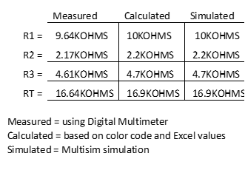
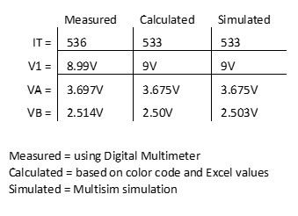
LAB 3

Slide 8
Observation For Lab 3:
The calculated values and the measured values were very close but were not exactly the same. The resistance in a series circuit is additive. The biggest resistance in the series circuit will have the biggest voltage drop.

Slide 10
Observation For Lab 4:
The purpose of lab 4 was to use standard resistors to obtain a total resistance of 900 ohms. Designed two circuits one with two resistors and another with three resistors to obtain a resistance that was close to 900 ohms. Both circuits calculated resistance total was 900 ohms but when measured both circuits fell short of the 900 ohms.

Slide 12
Observation For Lab 6:
The calculated values and the measured values were very close but were not exactly the same. The simulated values match the calculated values. Total resistance is lower than lowest branch resistance.

Slide 14
Observation For Lab 7:
The calculated values and simulated values were the same. Theses values don’t account for circuit tolerances. The measured values were very close but were not exactly the same. Total resistance in parallel circuit is lower than smallest branch resistance. The voltage in each parallel branch is the same.

Slide 16
Observation For Lab 8:
The calculated values and simulated values were the same. Theses values don’t account for circuit tolerances. The measured values were very close but were not exactly the same. Total resistance in parallel circuit is lower than smallest branch resistance. The voltage in each parallel branch is the same. VA is the voltage after the first resistor before the parallel circuit. The series part of the circuit has larger voltage drops because the resistance in the parallel circuit is smaller.

Slide 18
Observation For Lab 10:
Lab 10 total capacitance in a series circuit is calculated like resistance in a parallel circuit. This is done using the reciprocal formula. Total capacitance in a parallel circuit is additive like resistance in a series circuit. The calculated values and the simulated values are higher than the measured values.

Slide 20
Observation For Lab 11:
Lab 11 was lengthy and we measured the voltage in and the voltage out using the scope at different frequencies. Can’t get calculations to work correctly in spreadsheet.

Slide 22
Observation For Lab 12:
Inductors are calculated like resistance for their respective circuits. The inductance is added together in series circuits. The inductance is in a parallel circuit is figured with the reciprocal formula. The measured values were higher and lower than the expected values for the circuit. The simulation values were close to the expected values.

