Slide 1
Traffic Control Light
By: Chad Creager and Matt Fowler
EECT 112, Professor Lou Toth, 2015

Slide 2
Traffic Control Light Created Using Basic Stamp
What we were trying to accomplish.
Materials we used.
Basic Stamp Program Sheet.
MultiSim Schematic
Some issues we ran into.
Videos of Traffic Control Light in Action.

Slide 3
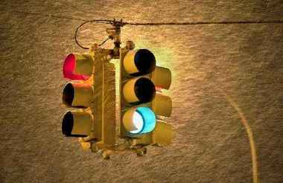
What we were trying to accomplish.
We had to design a traffic control light for a main street and a side street.
The side street light was to remain green for 5 seconds unless a car triggered the switch. Then the light was to remain green for an additional 5 seconds.

Slide 4
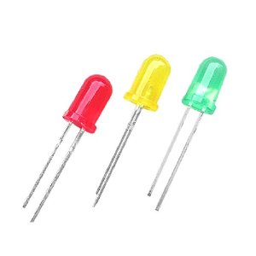
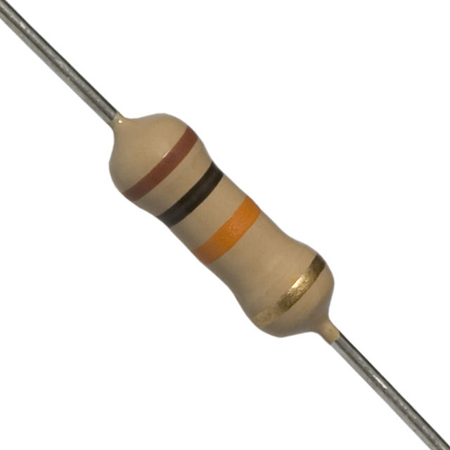
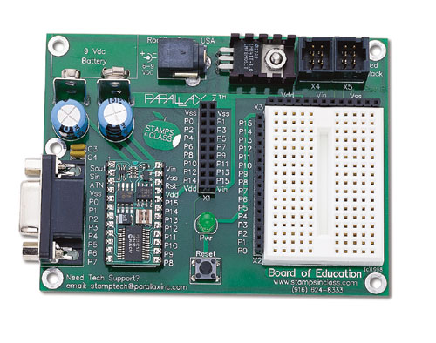
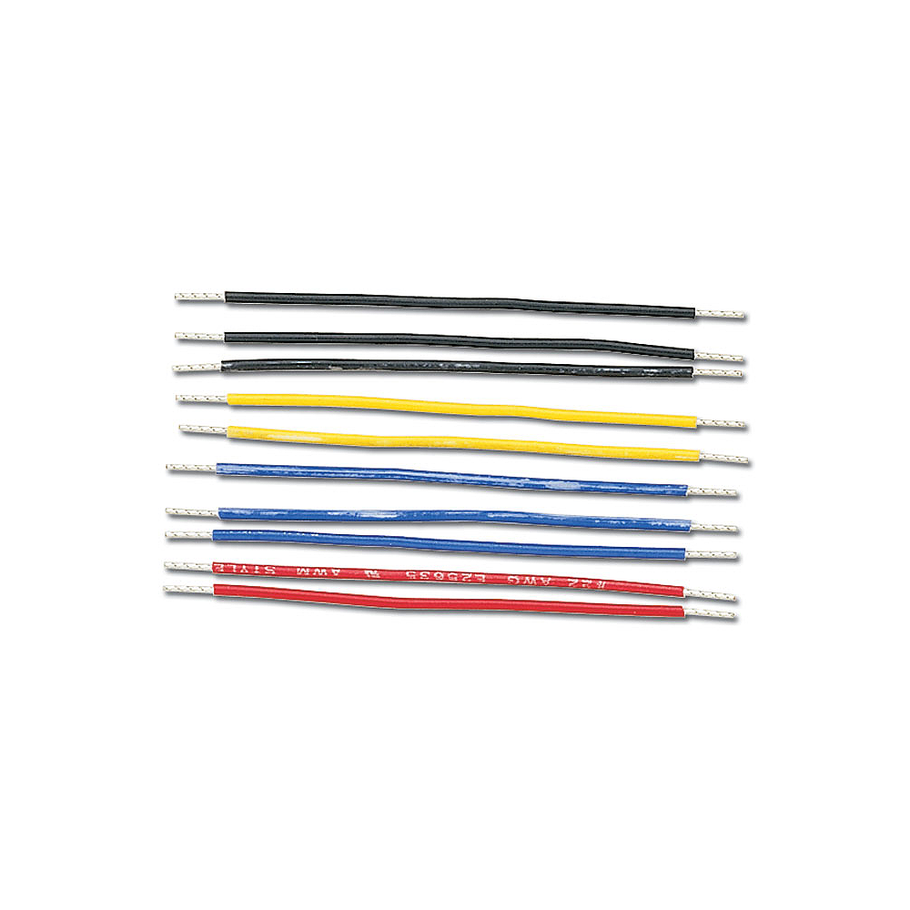
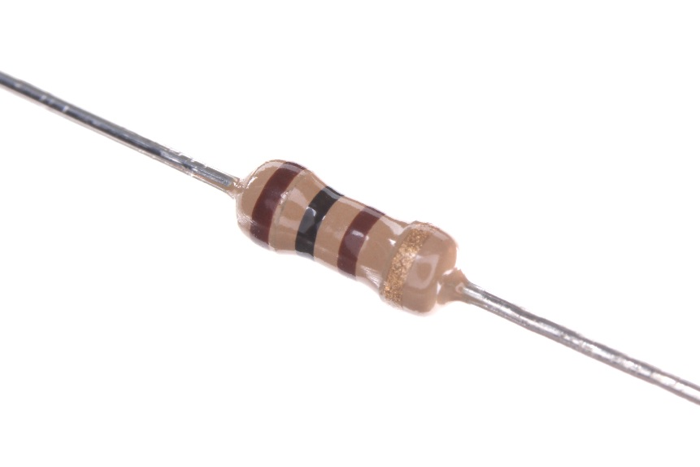
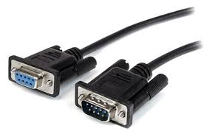
Materials List
Basic Stamp 2
Power Cord
Serial Cable
6 LEDs
100 OHM resistor X 2
10k OHM resistor
Jumper Wires

Slide 5
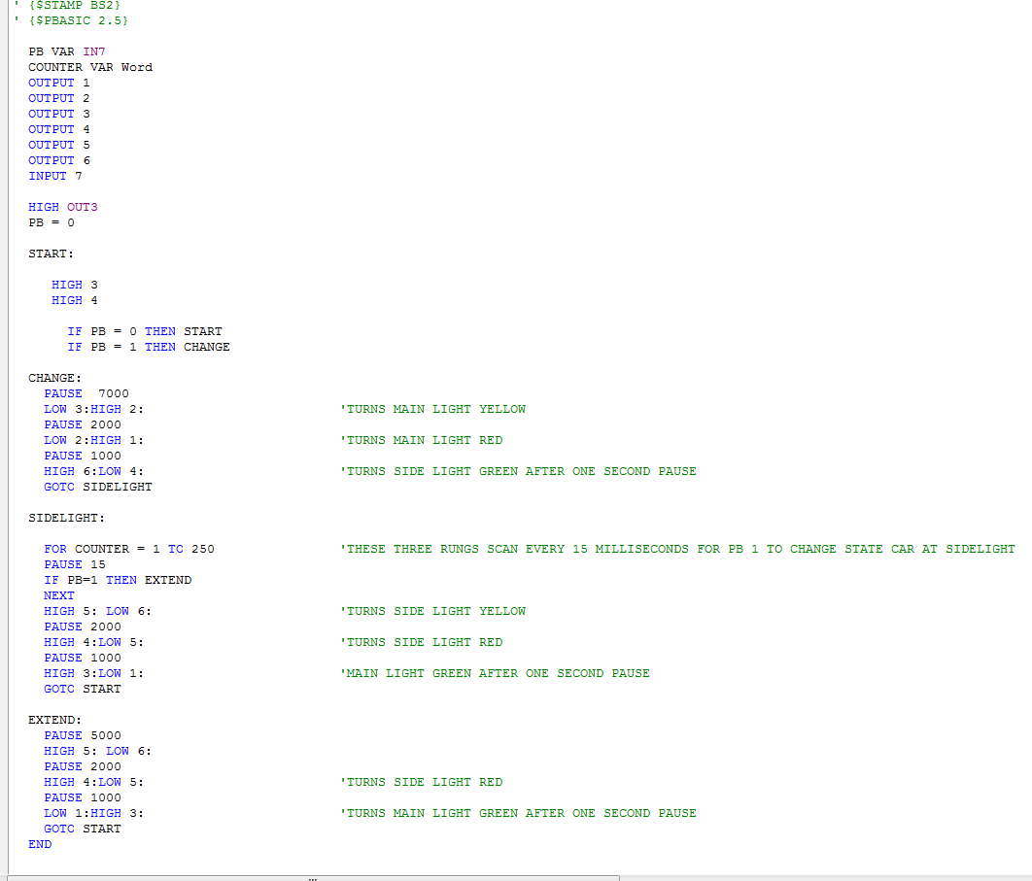
Basic Stamp Programming Code

Slide 6
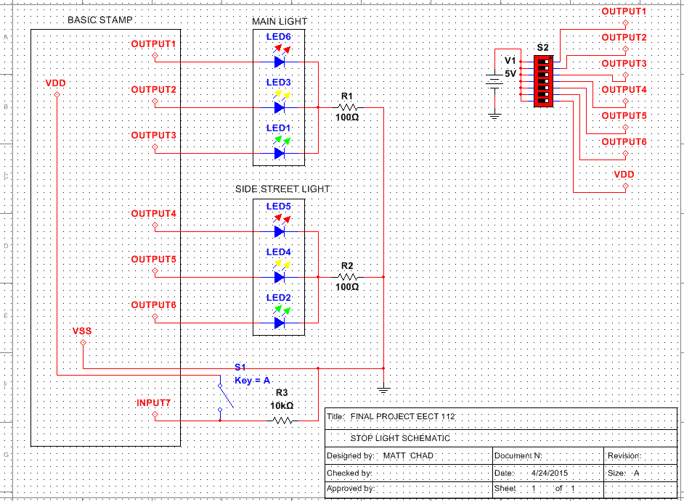
Traffic Control Light MultiSim Schematic

Slide 7
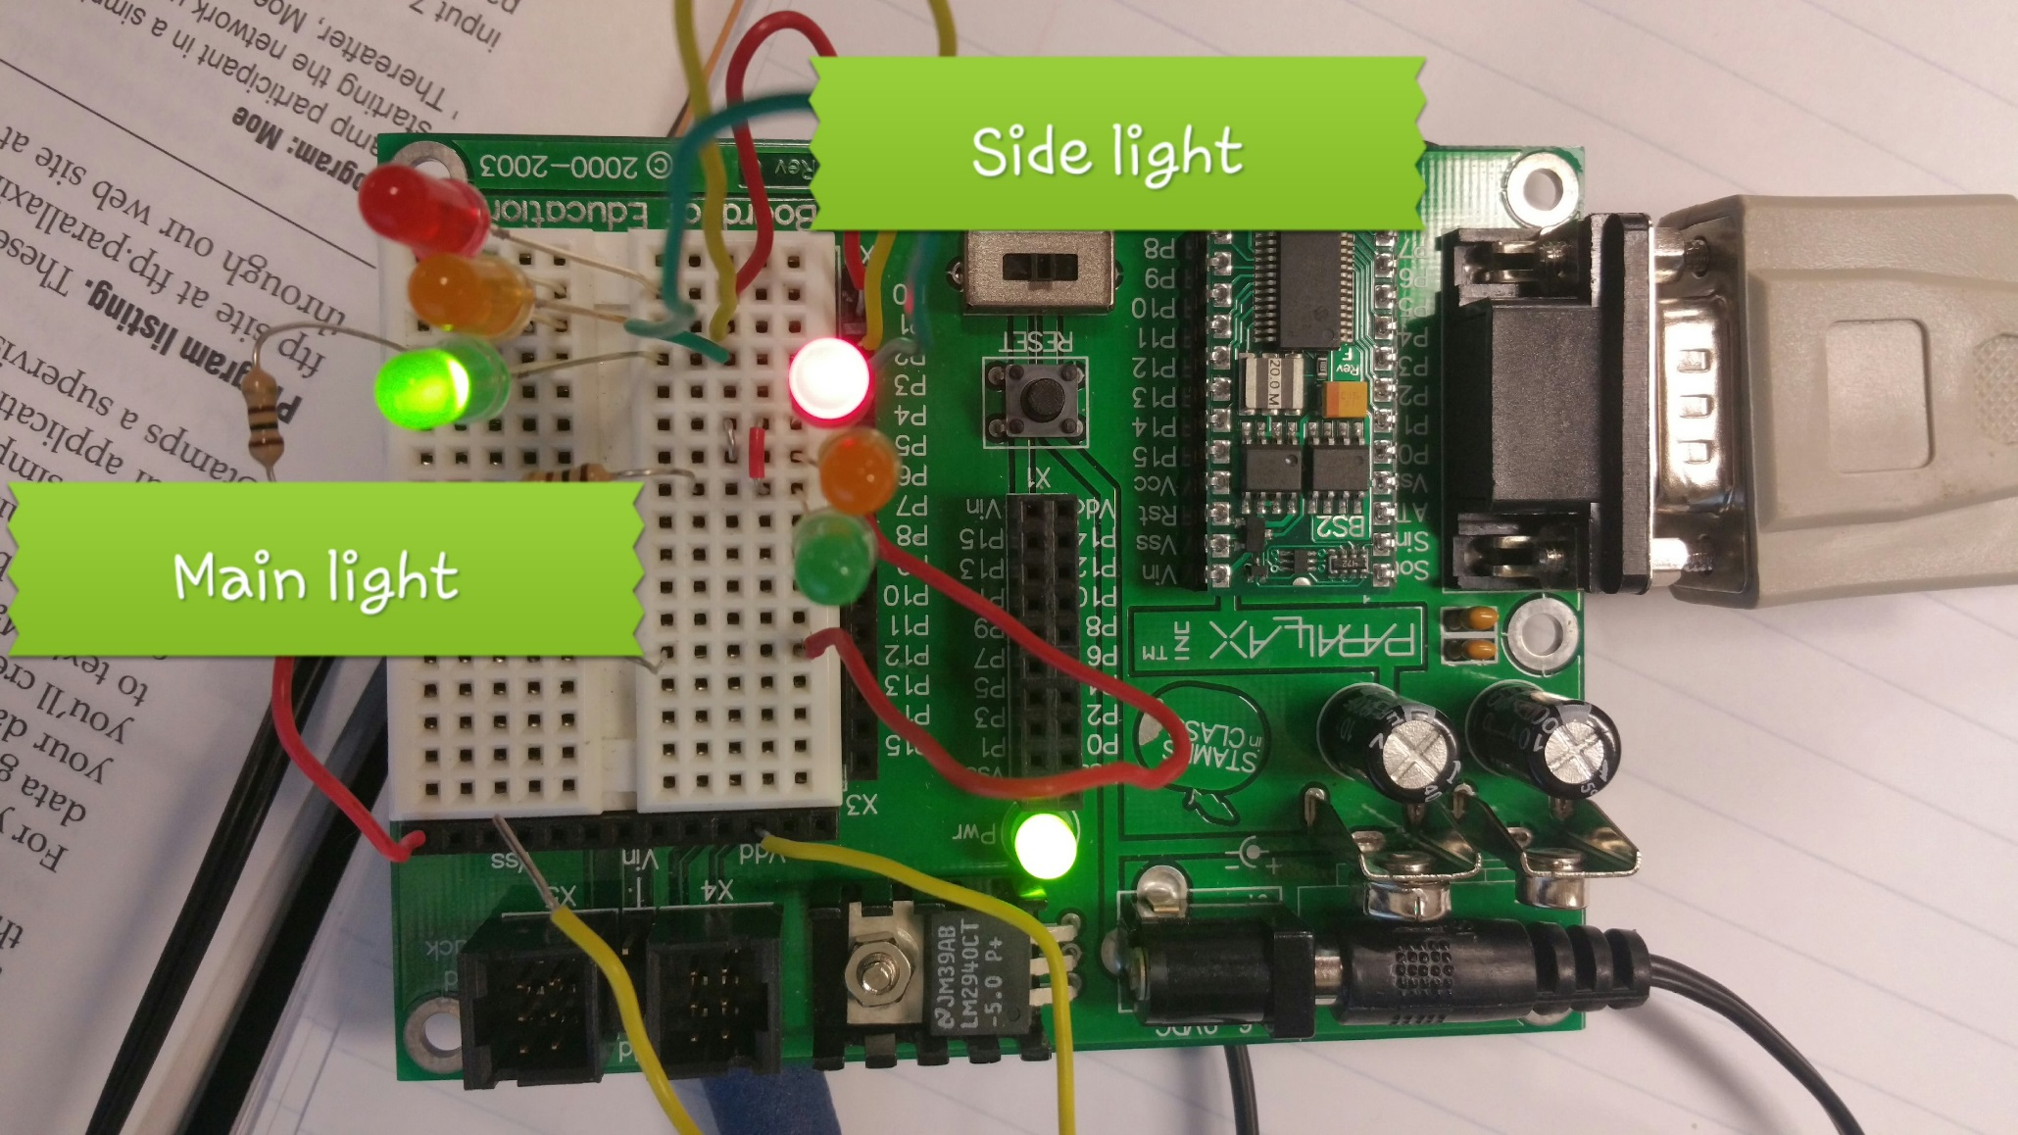
Picture of Traffic Control Light

Slide 8
Issues we ran Into.
Had to hold input on to get the side street light to extend for an additional 4 seconds.
Had red and green lights changing at the same time.

Slide 9
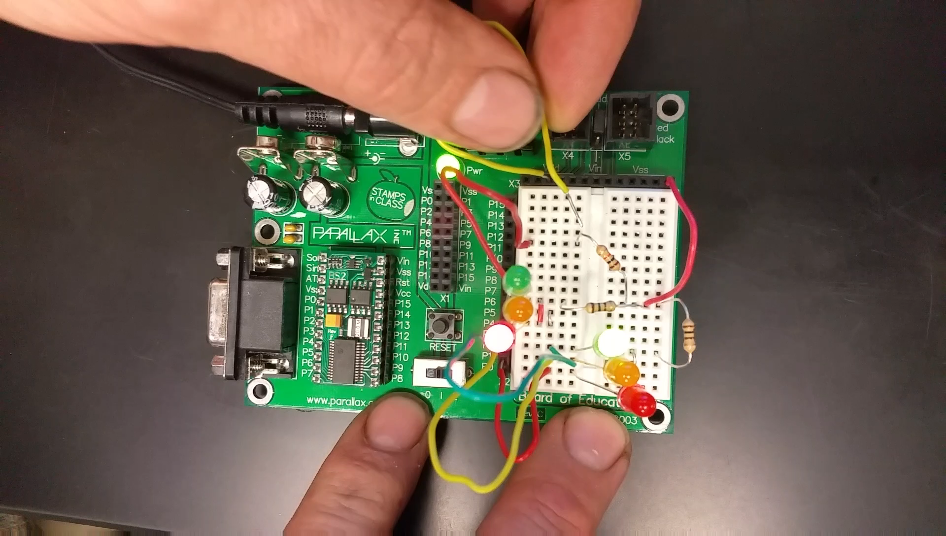
Video of Traffic Control Light
No Car Trigger.

Slide 10
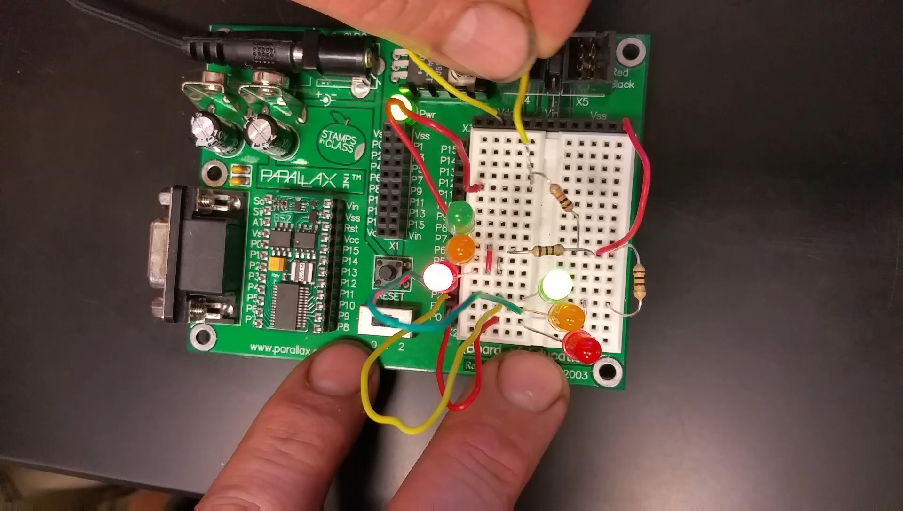
Video of Traffic Control Light With Car Triggering Light.

