Slide 1
LAB NOTEBOOK
EECT 121
Chad Creager

Slide 2
Table of Contents
Lab 1 – DIODES 3
Lab 2 – POWER SUPPLIES 12
Lab 3 – TRANSISTORS 19
Lab 4 – TRANSISTOR CIRCUITS 31
Lab 5 – FLIP FLOPS 41
Lab 6 – SCR 48
Lab 7 – PHOTO DIODE 55

Slide 3
LAB 1:
DIODES

Slide 4
Objective
  Learn how a diode functions.
Equipment and Material
  Bench 7, Elvis S#1677D1F, 74LSO8D,74LS32D, Diode 1N4001, Diode 1N754A, LED, 10K ohm Resistor,
  10 Volt DC Power Supply, Jumper Wires, Digital Multimeter GWInstek.
Research and Information
  http://ivytechengineering.com/stores/diodes/files/1n4007.pdf
javascript:openreq('http://pdf.datasheetcatalog.com/datasheet/GeneralSemiconductor/mXrxxxz.pdf')

Slide 5
Procedures and Results
We hooked up the diode to an adjustable power supply and changed the voltage in steps of 1 volt from 0V to 10V. We measured the voltage drop across the diode and the current thru the diode. The voltage drops increased rapidly until the power supply was adjusted to 4V. The graphs show the curves for each diode.

Slide 6
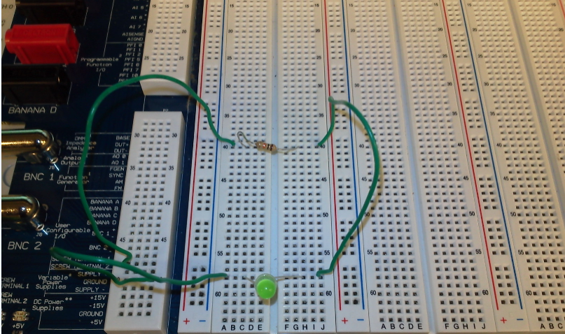

Slide 7
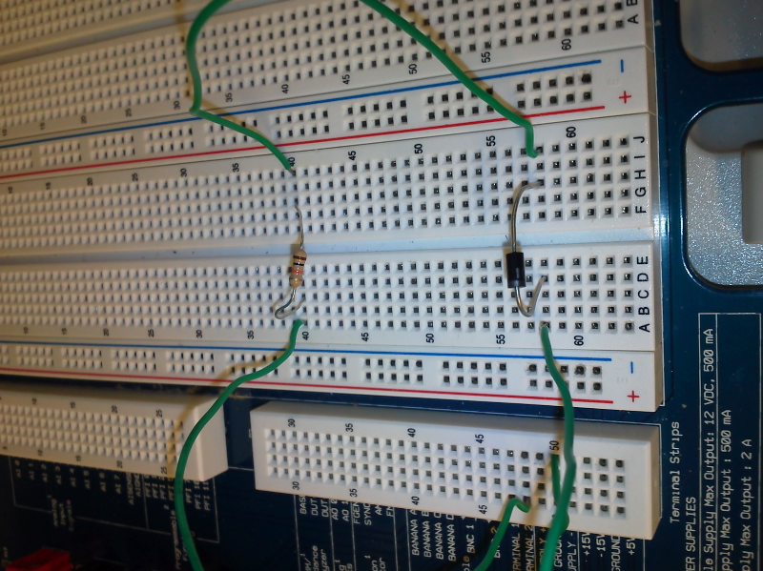

Slide 8
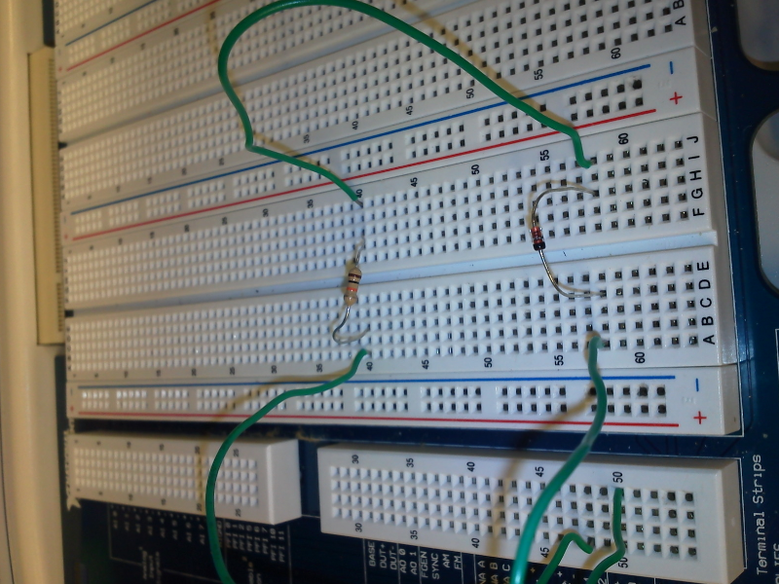

Slide 9
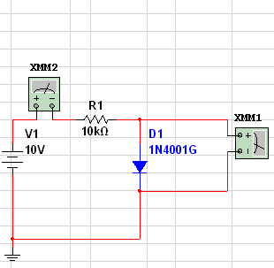
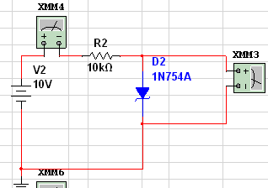
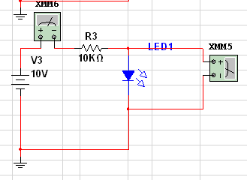
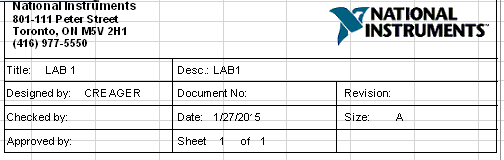

Slide 10
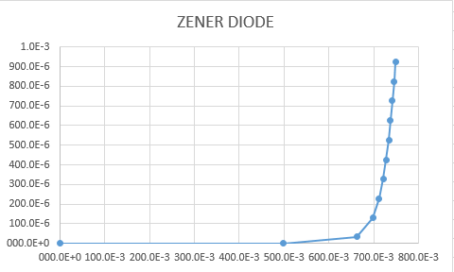
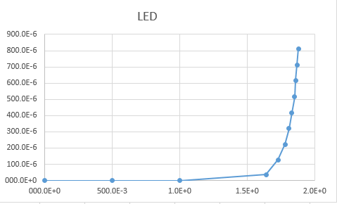
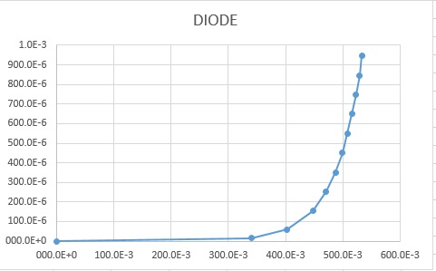
Graphs of Voltage Drops

Slide 11
Summary and Conclusions
The lab results confirmed what we found in Multisim. The voltage drops
vary at different voltages but by looking at the graphs once they start to
increase they increase rapidly.

Slide 12
LAB 2:
POWER
SUPPLIES

Slide 13
Objective
  To test different setups of Power Supplies
Equipment and Material
  Bench 6.
Research and Information

Slide 14
Procedures and Results
Used Multisim to create four different styles of power supplies and used simulations
to show what the sine waves look like on O-scope.

Slide 15
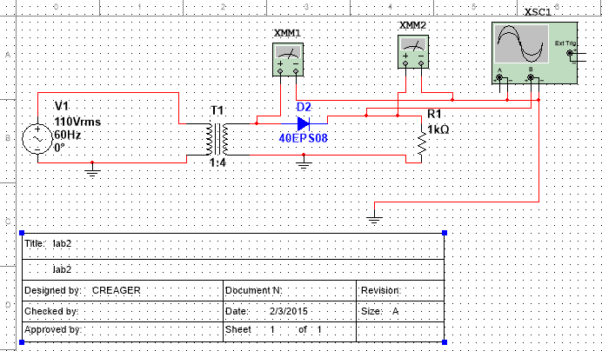
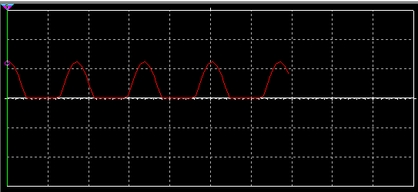
Half wave

Slide 16
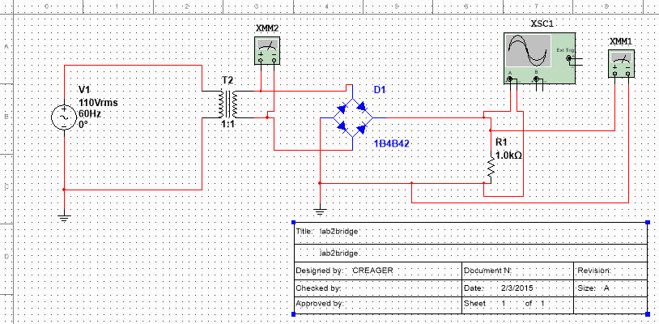
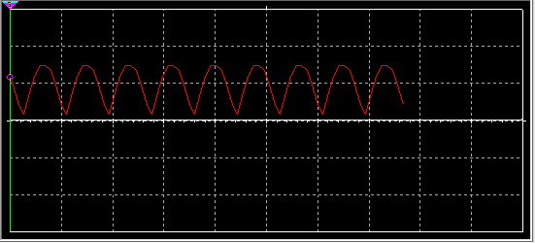
Bridge

Slide 17
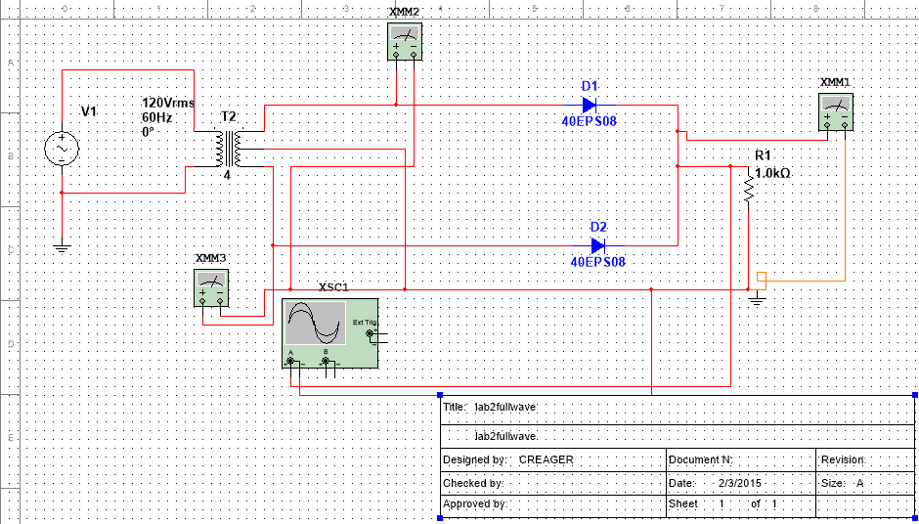
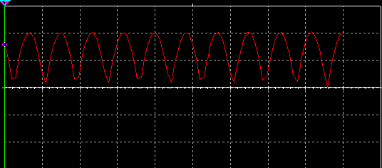
Full wave

Slide 18
Summary and Conclusions
The Multisim shows how the power supplies are different in construction
but are very similar in output. The half wave has a low output that is longer
then the other two. The voltages are all positive on these power supplies.
We didn’t do an actual lab due to the examples needing 120V.

Slide 19
LAB 3:
TRANSISTORS

Slide 20
Objective
  Design a circuit using a transistor and to show the transistor curve by applying different voltages to the transistor
  and thru the transistor.
Equipment and Material
  Bench 6, Elvis S#1677D1B, 2N3904, 2N3906,2 Power Supplies , 100K and 3K Ohm Resistors, Jumper Wires.
Research and Information
  http://ivytechengineering.com/stores/transistors/files/2n3904.pdf
  http://ivytechengineering.com/stores/transistors/files/2n3906.pdf

Slide 21
Procedures and results
Used Multisim to test and create the voltage curves for an npn
transistor and a pnp transistor.

Slide 23
LAB 3 TRANSISTORS
NPN TRANSISTOR
V BB |  | V BE |  | I B |  | V CC |  | V CE |  | I C |  | I E
0 | VOLTS | 000.0E+0 | mV | 0 | uA | 0 | V | 000.0E+0 | V | 000.0E+0 |  | 000.0E+0
0 | VOLTS | 679.0E-3 | mV | 0 | uA | 5 | V | 5.0E+0 | V | 20.0E-9 | mA | 50.0E-9 | mA
0 | VOLTS | 1.0E-3 | mV | 0 | uA | 10 | V | 10.0E+0 | V | 40.0E-9 | mA | 110.0E-9 | mA
0 | VOLTS | 2.0E-3 | mV | 0 | uA | 15 | V | 15.0E+0 | V | 70.0E-9 | mA | 180.0E-9 | mA
0 | VOLTS | 3.0E-3 | mV | 0 | uA | 20 | V | 20.0E+0 | V | 940.0E-9 | mA | 250.0E-9 | mA
0 | VOLTS | 3.0E-3 | mV | 0 | uA | 25 | V | 25.0E+0 | V | 1.2E-6 | mA | 330.0E-9 | mA
0 | VOLTS | 4.0E-3 | mV | 0 | uA | 30 | V | 30.0E+0 | V | 1.4E-6 | mA | 420.0E-9 | mA
1.7 | VOLTS | 556.2E+0 | mV | 11.4 | uA | 0 | V | 15.0E-3 | V | 000.0E+0 | mA | 6.5E-6 | mA
1.7 | VOLTS | 675.1E+0 | mV | 10.2 | uA | 5 | V | 734.0E-3 | V | 1.4E+0 | mA | 1.4E+0 | mA
1.7 | VOLTS | 675.1E+0 | mV | 10.2 | uA | 10 | V | 5.5E+0 | V | 1.5E+0 | mA | 1.5E+0 | mA
1.7 | VOLTS | 675.1E+0 | mV | 10.2 | uA | 15 | V | 10.2E+0 | V | 1.6E+0 | mA | 1.6E+0 | mA
1.7 | VOLTS | 675.1E+0 | mV | 10.2 | uA | 20 | V | 14.9E+0 | V | 1.7E+0 | mA | 1.7E+0 | mA
1.7 | VOLTS | 675.1E+0 | mV | 10.2 | uA | 25 | V | 19.7E+0 | V | 1.8E+0 | mA | 1.8E+0 | mA
1.7 | VOLTS | 675.1E+0 | mV | 10.2 | uA | 30 | V | 24.4E+0 | V | 1.9E+0 | mA | 1.9E+0 | mA
2.7 | VOLTS | 575.2E+0 | mV | 21.2 | uA | 0 | V | 18.0E-3 | V | 000.0E+0 | mA | 15.4E-6 | mA
2.7 | VOLTS | 679.0E+0 | mV | 20.2 | uA | 5 | V | 146.0E-3 | V | 1.6E+0 | mA | 1.6E+0 | mA
2.7 | VOLTS | 695.2E+0 | mV | 20 | uA | 10 | V | 945.0E-3 | V | 3.0E+0 | mA | 3.0E+0 | mA
2.7 | VOLTS | 695.2E+0 | mV | 20 | uA | 15 | V | 5.4E+0 | V | 3.2E+0 | mA | 3.2E+0 | mA
2.7 | VOLTS | 695.2E+0 | mV | 20 | uA | 20 | V | 9.9E+0 | V | 3.4E+0 | mA | 3.4E+0 | mA
2.7 | VOLTS | 695.2E+0 | mV | 20 | uA | 25 | V | 14.3E+0 | V | 3.6E+0 | mA | 3.6E+0 | mA
2.7 | VOLTS | 695.2E+0 | mV | 20 | uA | 30 | V | 18.8E+0 | V | 3.7E+0 | mA | 3.8E+0 | mA
3.7 | VOLTS | 586.5E+0 | mV | 31.1 | uA | 0 | V | 19.0E-3 | V | 000.0E+0 | mA | 15.8E-6 | mA
3.7 | VOLTS | 697.9E+0 | mV | 30 | uA | 5 | V | 127.0E-3 | V | 1.6E+0 | mA | 1.7E+0 | mA
3.7 | VOLTS | 707.1E+0 | mV | 29.9 | uA | 10 | V | 168.0E-3 | V | 3.3E+0 | mA | 3.3E+0 | mA
3.7 | VOLTS | 707.1E+0 | mV | 29.9 | uA | 15 | V | 1.0E+0 | V | 4.7E+0 | mA | 4.7E+0 | mA
3.7 | VOLTS | 707.1E+0 | mV | 29.9 | uA | 20 | V | 5.2E+0 | V | 4.9E+0 | mA | 5.0E+0 | mA
3.7 | VOLTS | 707.1E+0 | mV | 29.9 | uA | 25 | V | 9.4E+0 | V | 5.2E+0 | mA | 5.2E+0 | mA
3.7 | VOLTS | 707.1E+0 | mV | 29.9 | uA | 30 | V | 13.6E+0 | V | 5.5E+0 | mA | 5.5E+0 | mA
4.7 | VOLTS | 594.6E+0 | mV | 41.1 | uA | 0 | V | 20.0E-3 | V | 000.0E+0 | mA | 34.5E-6 | mA
4.7 | VOLTS | 679.9E+0 | mV | 40.2 | uA | 5 | V | 115.0E-3 | V | 1.6E+0 | mA | 1.7E+0 | mA
4.7 | VOLTS | 698.2E+0 | mV | 40 | uA | 10 | V | 148.0E-3 | V | 3.3E+0 | mA | 3.3E+0 | mA
4.7 | VOLTS | 709.2E+0 | mV | 39.9 | uA | 15 | V | 181.0E-3 | V | 4.9E+0 | mA | 5.0E+0 | mA
4.7 | VOLTS | 715.6E+0 | mV | 39.8 | uA | 20 | V | 1.0E+0 | V | 6.3E+0 | mA | 6.4E+0 | mA
4.7 | VOLTS | 715.6E+0 | mV | 39.8 | uA | 25 | V | 5.0E+0 | V | 6.7E+0 | mA | 6.7E+0 | mA
4.7 | VOLTS | 715.6E+0 | mV | 39.8 | uA | 30 | V | 9.0E+0 | V | 7.0E+0 | mA | 7.0E+0 | mA
5.7 | VOLTS | 600.7E+0 | mV | 51 | uA | 0 | V | 20.0E-3 | V | 000.0E+0 | mA | 44.3E-6 | mA

Slide 24
5.7 | VOLTS | 680.3E+0 | mV | 50.2 | uA | 5 | V | 109.0E-3 | V | 1.6E+0 | mA | 1.7E+0 | mA
5.7 | VOLTS | 698.4E+0 | mV | 50 | uA | 10 | V | 136.0E-3 | V | 3.3E+0 | mA | 3.3E+0 | mA
5.7 | VOLTS | 709.4E+0 | mV | 49.9 | uA | 15 | V | 161.0E-3 | V | 5.0E+0 | mA | 5.0E+0 | mA
5.7 | VOLTS | 717.3E+0 | mV | 49.8 | uA | 20 | V | 192.0E-3 | V | 6.6E+0 | mA | 6.7E+0 | mA
5.7 | VOLTS | 722.3E+0 | mV | 49.8 | uA | 25 | V | 1.1E+0 | V | 8.0E+0 | mA | 8.0E+0 | mA
5.7 | VOLTS | 722.3E+0 | mV | 49.8 | uA | 30 | V | 4.9E+0 | V | 8.4E+0 | mA | 8.4E+0 | mA
6.7 | VOLTS | 605.8E+0 | mV | 60.9 | uA | 0 | V | 20.0E-3 | V | 000.0E+0 | mA | 54.1E-6 | mA
6.7 | VOLTS | 680.7E+0 | mV | 60.2 | uA | 5 | V | 102.0E-3 | V | 1.6E+0 | mA | 1.7E+0 | mA
6.7 | VOLTS | 698.7E+0 | mV | 60 | uA | 10 | V | 129.0E-3 | V | 3.3E+0 | mA | 3.4E+0 | mA
6.7 | VOLTS | 709.6E+0 | mV | 59.9 | uA | 15 | V | 149.0E-3 | V | 5.0E+0 | mA | 5.0E+0 | mA
6.7 | VOLTS | 717.5E+0 | mV | 59.8 | uA | 20 | V | 170.0E-3 | V | 6.6E+0 | mA | 6.7E+0 | mA
6.7 | VOLTS | 723.8E+0 | mV | 59.8 | uA | 25 | V | 201.0E-3 | V | 8.3E+0 | mA | 8.3E+0 | mA
6.7 | VOLTS | 727.7E+0 | mV | 59.7 | uA | 30 | V | 1.2E+0 | V | 9.6E+0 | mA | 9.7E+0 | mA
7.7 | VOLTS | 610.1E+0 | mV | 70.9 | uA | 0 | V | 21.0E-3 | V | 000.0E+0 | mA | 64.0E-6 | mA
7.7 | VOLTS | 681.1E+0 | mV | 70.2 | uA | 5 | V | 98.0E-3 | V | 1.6E+0 | mA | 1.7E+0 | mA
7.7 | VOLTS | 699.0E+0 | mV | 70 | uA | 10 | V | 123.0E-3 | V | 3.3E+0 | mA | 3.4E+0 | mA
7.7 | VOLTS | 709.8E+0 | mV | 69.9 | uA | 15 | V | 142.0E-3 | V | 5.0E+0 | mA | 5.0E+0 | mA
7.7 | VOLTS | 717.7E+0 | mV | 69.8 | uA | 20 | V | 159.0E-3 | V | 6.6E+0 | mA | 6.7E+0 | mA
7.7 | VOLTS | 724.0E+0 | mV | 69.8 | uA | 25 | V | 179.0E-3 | V | 8.3E+0 | mA | 8.3E+0 | mA
7.7 | VOLTS | 729.2E+0 | mV | 69.7 | uA | 30 | V | 209.0E-3 | V | 9.9E+0 | mA | 10.0E+0 | mA
8.7 | VOLTS | 613.7E+0 | mV | 80.9 | uA | 0 | V | 21.0E-3 | V | 000.0E+0 | mA | 73.9E-6 | mA
8.7 | VOLTS | 681.5E+0 | mV | 80.2 | uA | 5 | V | 95.0E-3 | V | 1.6E+0 | mA | 1.7E+0 | mA
8.7 | VOLTS | 699.2E+0 | mV | 80 | uA | 10 | V | 118.0E-3 | V | 3.3E+0 | mA | 3.4E+0 | mA
8.7 | VOLTS | 710.0E+0 | mV | 79.9 | uA | 15 | V | 136.0E-3 | V | 5.0E+0 | mA | 5.0E+0 | mA
8.7 | VOLTS | 717.9E+0 | mV | 79.8 | uA | 20 | V | 151.0E-3 | V | 6.6E+0 | mA | 6.7E+0 | mA
8.7 | VOLTS | 724.2E+0 | mV | 79.8 | uA | 25 | V | 168.0E-3 | V | 8.3E+0 | mA | 8.4E+0 | mA
8.7 | VOLTS | 729.4E+0 | mV | 79.7 | uA | 30 | V | 187.0E-3 | V | 9.9E+0 | mA | 10.0E+0 | mA
9.7 | VOLTS | 617.0E+0 | mV | 90.8 | uA | 0 | V | 21.0E-3 | V | 000.0E+0 | mA | 83.8E-6 | mA
9.7 | VOLTS | 681.9E+0 | mV | 90.2 | uA | 5 | V | 91.0E-3 | V | 1.6E+0 | mA | 1.7E+0 | mA
9.7 | VOLTS | 699.5E+0 | mV | 90 | uA | 10 | V | 114.0E-3 | V | 3.3E+0 | mA | 3.4E+0 | mA
9.7 | VOLTS | 710.2E+0 | mV | 89.9 | uA | 15 | V | 130.0E-3 | V | 5.0E+0 | mA | 5.1E+0 | mA
9.7 | VOLTS | 718.1E+0 | mV | 89.8 | uA | 20 | V | 145.0E-3 | V | 6.6E+0 | mA | 6.7E+0 | mA
9.7 | VOLTS | 724.4E+0 | mV | 89.8 | uA | 25 | V | 160.0E-3 | V | 8.3E+0 | mA | 8.4E+0 | mA
9.7 | VOLTS | 729.6E+0 | mV | 89.7 | uA | 30 | V | 175.0E-3 | V | 9.9E+0 | mA | 10.0E+0 | mA
10.7 | VOLTS | 619.9E+0 | mV | 101 | uA | 0 | V | 21.0E-3 | V | 000.0E+0 | mA | 93.7E-6 | mA
10.7 | VOLTS | 682.2E+0 | mV | 100 | uA | 5 | V | 88.0E-3 | V | 1.6E+0 | mA | 1.7E+0 | mA
10.7 | VOLTS | 699.7E+0 | mV | 100 | uA | 10 | V | 111.0E-3 | V | 3.3E+0 | mA | 3.4E+0 | mA
10.7 | VOLTS | 710.4E+0 | mV | 99.9 | uA | 15 | V | 127.0E-3 | V | 5.0E+0 | mA | 5.1E+0 | mA
10.7 | VOLTS | 718.3E+0 | mV | 99.8 | uA | 20 | V | 141.0E-3 | V | 6.6E+0 | mA | 6.7E+0 | mA
10.7 | VOLTS | 724.5E+0 | mV | 99.8 | uA | 25 | V | 153.0E-3 | V | 8.3E+0 | mA | 8.4E+0 | mA
10.7 | VOLTS | 729.7E+0 | mV | 99.7 | uA | 30 | V | 167.0E-3 | V | 9.9E+0 | mA | 10.0E+0 | mA

Slide 26
Voltage |  |  |  |  |  | Current
Vcc | Vbb | Vce |  | Vbe | UNITS | Ib | UNITS | Ic | UNITS | Ie | UNITS
0 | 0 | 0 |  | 0 | V | 0 | A | 0 | A | 0 | A
5 | 0 | 5 |  | 100.48 | nV | 1 | pA | 5.02 | nA | 5.01 | nA
10 | 0 | 10 |  | 200.932 | nV | 2.01 | pA | 10 | nA | 10 | nA
15 | 0 | 15 |  | 301.384 | nV | 3.01 | pA | 15.1 | nA | 15 | nA
20 | 0 | 20 |  | 401.835 | nV | 4.02 | pA | 20.1 | nA | 20 | nA
25 | 0 | 25 |  | 502.287 | nV | 5.02 | pA | 25.1 | nA | 25.1 | nA
30 | 0 | 30 |  | 602.739 | nV | 6.03 | pA | 30.1 | nA | 30.1 | nA
0 | 1.7 | 0.004265 | V | 633.381 | mV | -0.0107 | mA | -0.00142 | mA | 0.00924 | mA
5 | 1.7 | 0.176401 | V | 719.487 | mV | -0.00981 | mA | 1.61 | mA | 1.62 | mA
10 | 1.7 | 3.917 | V | 633.381 | mV | -0.0107 | mA | 2.03 | mA | 2.04 | mA
15 | 1.7 | 7.83 | V | 720.627 | mV | -0.00979 | mA | 2.39 | mA | 2.4 | mA
20 | 1.7 | 11.743 | V | 720.627 | mV | -0.00979 | mA | 2.75 | mA | 2.76 | mA
25 | 1.7 | 15.656 | V | 720.627 | mV | -0.00979 | mA | 3.11 | mA | 3.12 | mA
30 | 1.7 | 19.569 | V | 720.627 | mV | -0.00979 | mA | 3.48 | mA | 3.49 | mA
0 | 2.7 | 0.004549 | mV | 650.645 | mV | -0.0205 | mA | -0.00152 | mA | 0.019 | mA
5 | 2.7 | 0.096986 | mV | 720.992 | mV | -0.0198 | mA | 1.63 | mA | 1.65 | mA
10 | 2.7 | 0.21397 | mV | 738.366 | mV | -0.0196 | mA | 3.26 | mA | 3.28 | mA
15 | 2.7 | 3.371 | mV | 738.688 | mV | -0.0196 | mA | 3.88 | mA | 3.9 | mA
20 | 2.7 | 6.607 | mV | 738.688 | mV | -0.0196 | mA | 4.46 | mA | 4.48 | mA
25 | 2.7 | 9.843 | mV | 738.688 | mV | -0.0196 | mA | 5.05 | mA | 5.07 | mA
30 | 2.7 | 13.079 | mV | 738.688 | mV | -0.0196 | mA | 5.64 | mA | 5.66 | mA
0 | 3.7 | 0.004661 | mV | 661.043 | mV | -0.0304 | mA | -0.00155 | mA | 0.0288 | uA
5 | 3.7 | 0.080387 | mV | 722.043 | mV | -0.0298 | mA | 1.64 | mA | 1.67 | mA
10 | 3.7 | 0.120089 | mV | 739.289 | mV | -0.0296 | mA | 3.29 | mA | 3.32 | mA
15 | 3.7 | 0.313636 | mV | 749.342 | mV | -0.0295 | mA | 4.9 | mA | 4.92 | mA
20 | 3.7 | 3.082 | V | 749.342 | mV | -0.0295 | mA | 5.64 | mA | 5.67 | mA
25 | 3.7 | 5.853 | V | 749.342 | mV | -0.0295 | mA | 6.38 | mA | 6.41 | mA
30 | 3.7 | 8.624 | V | 749.342 | mV | -0.0295 | mA | 7.13 | mA | 7.15 | mA
0 | 4.7 | 0.004722 | mV | 668.512 | mV | -0.0403 | mA | -0.00157 | mA | 38.7 | uA
5 | 4.7 | 0.070891 | mV | 723.019 | mV | -0.0398 | mA | 1.64 | mA | 1.68 | mA
10 | 4.7 | 0.102688 | mV | 739.891 | mV | -0.0396 | mA | 3.3 | mA | 3.34 | mA
15 | 4.7 | 0.136886 | mV | 750.311 | mV | -0.0395 | mA | 4.95 | mA | 4.99 | mA
20 | 4.7 | 0.518694 | mV | 756.949 | mV | -0.0394 | mA | 6.49 | mA | 6.53 | mA
25 | 4.7 | 2.952 | V | 756.949 | mV | -0.0394 | mA | 7.35 | mA | 7.39 | mA
30 | 4.7 | 5.384 | V | 756.949 | mV | -0.0394 | mA | 8.21 | mA | 8.24 | mA

Slide 27
0 | 5.7 | 0.004761 | mV | 674.35 | mV | -0.0503 | mA | -0.00159 | mA | 48.7 | uA
5 | 5.7 | 0.064334 | mV | 723.949 | mV | -0.0498 | mA | 1.65 | mA | 1.69 | mA
10 | 5.7 | 0.092656 | mV | 740.454 | mV | -0.0496 | mA | 3.3 | mA | 3.35 | mA
15 | 5.7 | 0.118489 | mV | 750.761 | mV | -0.0495 | mA | 4.96 | mA | 5.01 | mA
20 | 5.7 | 0.151931 | mV | 758.313 | mV | -0.0494 | mA | 6.62 | mA | 6.67 | mA
25 | 5.7 | 0.745429 | mV | 762.863 | mV | -0.0494 | mA | 8.08 | mA | 8.13 | mA
30 | 5.7 | 2.921 | V | 762.863 | mV | -0.0494 | mA | 9.03 | mA | 9.08 | mA
0 | 6.7 | 0.004789 | mV | 679.149 | mV | -60.2 | mA | -0.0016 | mA | 58.6 | uA
5 | 6.7 | 0.059389 | mV | 724.844 | mV | -59.8 | mA | 1.65 | mA | 1.71 | mA
10 | 6.7 | 0.08565 | mV | 740.999 | mV | -59.6 | mA | 3.3 | mA | 3.36 | mA
15 | 6.7 | 108.031 | mV | 751.181 | mV | -59.5 | mA | 4.96 | mA | 5.02 | mA
20 | 6.7 | 0.131917 | mV | 758.688 | mV | -59.4 | mA | 6.62 | mA | 6.68 | mA
25 | 6.7 | 0.167084 | mV | 764.646 | mV | -59.4 | mA | 8.28 | mA | 8.34 | mA
30 | 6.7 | 0.983473 | mV | 767.712 | mV | -59.3 | mA | 9.67 | mA | 9.73 | mA
0 | 7.7 | 0.00481 | mV | 683.229 | mV | -70.2 | mA | -0.0016 | mA | 68.6 | uA
5 | 7.7 | 0.05546 | mV | 725.711 | mV | -69.7 | mA | 1.65 | mA | 1.72 | mA
10 | 7.7 | 0.080302 | mV | 741.529 | mV | -69.6 | mA | 3.31 | mA | 3.38 | mA
15 | 7.7 | 0.100746 | mV | 751.587 | mV | -69.5 | mA | 4.97 | mA | 5.04 | mA
20 | 7.7 | 0.120901 | mV | 759.036 | mV | -69.4 | mA | 6.63 | mA | 6.7 | mA
25 | 7.7 | 0.144389 | mV | 764.98 | mV | -69.4 | mA | 8.29 | mA | 8.35 | mA
30 | 7.7 | 0.184061 | mV | 769.914 | mV | -69.3 | mA | 9.94 | mA | 10 | mA
0 | 8.7 | 0.004827 | mV | 686.779 | mV | -80.1 | mA | -0.00161 | mA | 78.5 | uA
5 | 8.7 | 0.005223 | mV | 726.551 | mV | -79.7 | mA | 1.65 | mA | 1.73 | mA
10 | 8.7 | 0.076001 | mV | 742.049 | mV | -79.6 | mA | 3.31 | mA | 3.39 | mA
15 | 8.7 | 0.095179 | mV | 751.984 | mV | -79.5 | mA | 4.97 | mA | 5.05 | mA
20 | 8.7 | 0.113308 | mV | 759.371 | mV | -79.4 | mA | 6.63 | mA | 6.71 | mA
25 | 8.7 | 0.13258 | mV | 765.285 | mV | -79.3 | mA | 8.29 | mA | 8.37 | mA
30 | 8.7 | 0.156674 | mV | 770.227 | mV | -79.3 | mA | 9.95 | mA | 10 | mA
0 | 9.7 | 0.004841 | mV | 689.925 | mV | -90.1 | mA | -0.00161 | mA | 88.5 | uA
5 | 9.7 | 0.049502 | mV | 727.369 | mV | -89.7 | mA | 1.65 | mA | 1.74 | mA
10 | 9.7 | 0.07242 | mV | 742.56 | mV | -89.6 | mA | 3.31 | mA | 3.4 | mA
15 | 9.7 | 0.090692 | mV | 752.375 | mV | -89.5 | mA | 4.97 | mA | 5.06 | mA
20 | 9.7 | 0.107531 | mV | 759.7 | mV | -89.4 | mA | 6.63 | mA | 6.72 | mA
25 | 9.7 | 0.124589 | mV | 765.578 | mV | -89.3 | mA | 8.29 | mA | 8.38 | mA
30 | 9.7 | 0.143715 | mV | 770.504 | mV | -89.3 | mA | 9.95 | mA | 10 | mA
0 | 10.7 | 0.004853 | mV | 692.751 | mV | -100 | mA | -0.00161 | mA | 98.5 | uA
5 | 10.7 | 0.04716 | mV | 728.166 | mV | -99.7 | mA | 1.65 | mA | 1.75 | mA
10 | 10.7 | 0.069365 | mV | 743.062 | mV | -99.6 | mA | 3.31 | mA | 3.41 | mA
15 | 10.7 | 0.086945 | mV | 752.761 | mV | -99.5 | mA | 4.97 | mA | 5.07 | mA
20 | 10.7 | 0.102883 | mV | 760.024 | mV | -99.4 | mA | 6.63 | mA | 6.73 | mA
25 | 10.7 | 0.118564 | mV | 765.865 | mV | -99.3 | mA | 8.29 | mA | 8.39 | mA
30 | 10.7 | 0.135192 | mV | 770.77 | mV | -99.3 | mA | 9.95 | mA | 10.1 | mA

Slide 28
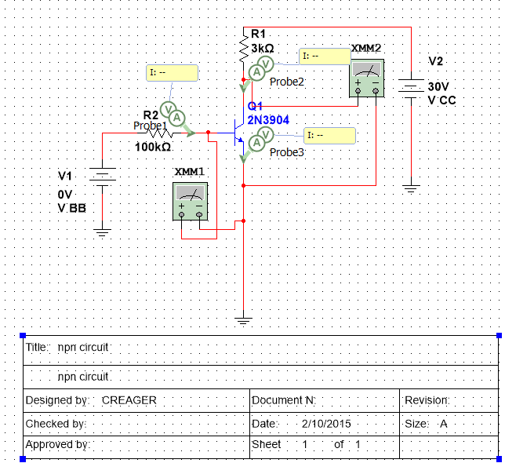

Slide 29
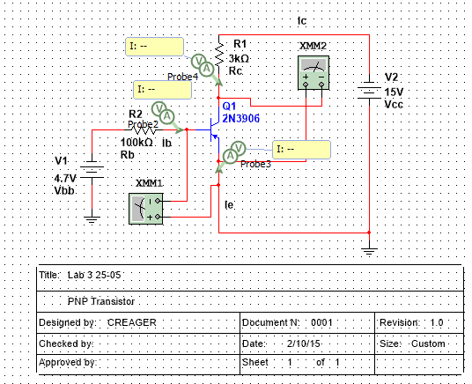

Slide 30
Summary and conclusions
We made a chararistic curve of both NPN and PNP and found that they
function very similar to each other. The lab was very time consuming and
The results matched what was in our text.

Slide 31
LAB 4:
TRANSISTOR
CIRCUITS

Slide 32
Objective
  To learn how a transistor can be used as a voltage divider and how a transistor works in a Swamped Common
  Emitter Circuit.
Equipment and Material
  Bench 6, Elvis S#1677D1F, 4 X 100 Ohm Resistors, 4 X 33K Ohm resistor,2 X 2N3904, 2 X 1µF Capacitor, 2 X 200
  Ohm Resistor, GW Instek Digital Multimeter , 2 X 5 Volt DC Power Supply, Jumper Wires and 1 Variable AC
  Power Supply.
Research and Information
  http://ivytechengineering.com/stores/transistors/files/2n3904.pdf

Slide 33
Procedures and results
Build the circuit and test how the transistor can be used as a voltage divider.
Placed information into excel spreadsheet.
Build the Swamped Common Emitter Circuit and entered results in spreadsheet.

Slide 34
VOLTAGE DIVIDER LAB 4
 | SWITCH CLOSED |  | SWITCH OPEN
 | SIMULATED | MEASURED | SIMULATED | MEASURED
V1= | 5 | 4.94 | 5 | 4.94
V2= | 5 | 4.94 | 5 | 4.94
R1= | 200 | 196 | 200 | 196
R2= | 33000 | 33065 | 33000 | 33065
R3= | 200 | 197 | 200 | 197
PROBE 1 V= | 2.84 | 3.09 | 0.219 | 0
PROBE 2 V= | 5 | 4.94 | 5 | 4.94
PROBE 3 V= | 5 | 4.94 | 5 | 4.94
PROBE 4 V= | 0 | 0 | 0 | 0
PROBE 5 V= | 2.91 | 2.58 | 5 | 4.94
PROBE 6 V= | 2.11 | 2.38 | 0 | 0
PROBE 1 A= | 0.065 | 0.054 | 0 | 0
PROBE 2 A= | 10.5 | 11.7 | 0 | 0
PROBE 3 A= | 10.5 | 11.7 | 0 | 0
PROBE 4 A= | 10.5 | NA | 0 | 0
PROBE 5 A= | 10.5 | 11.7 | 0 | 0
PROBE 6 A= | 10.5 | 11.5 | 0 | 0

Slide 36
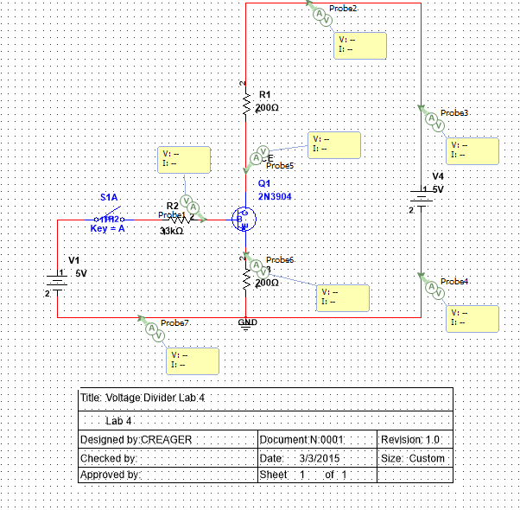

Slide 37
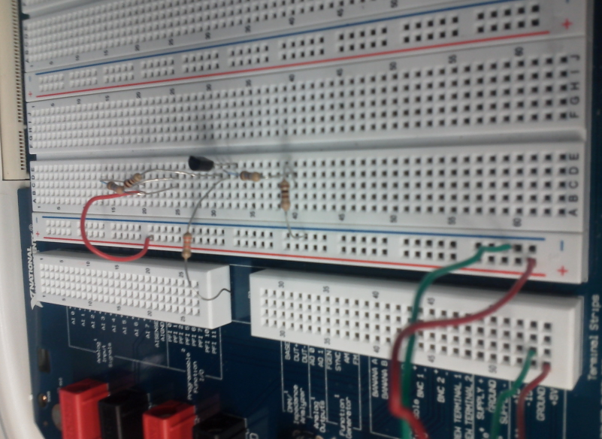

Slide 38
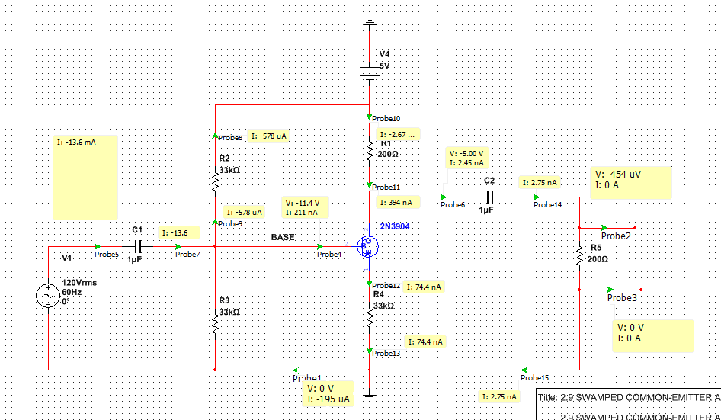
Items Used |  | Voltage Measured |  |  |  | Swamped Common-Emitter
5* 33kOhm resistors |  | 4.1826 | V | LED 1
2* 1uF Capacitors |  | 0 | V | LED 2
1* 2N3904 Transitor |  | 4.9365 | V | R1
Elvis board S/N-1677D3B |  | 4.9365 | V | R2
5V IN |  | 4.973 | V | R3
2* LED's on Elvis |  | 4.188 | V | R4
 |  | 4.183 | V | R5
 |  | 2.237 | V | C1
 |  | 4.1835 | V | C2
 |  | 4.927 | V | Leg (B) | TRANSISTOR
 |  | 4.185 | V | Leg (C)
 |  | 4.187 | V | Leg (E)

Slide 39
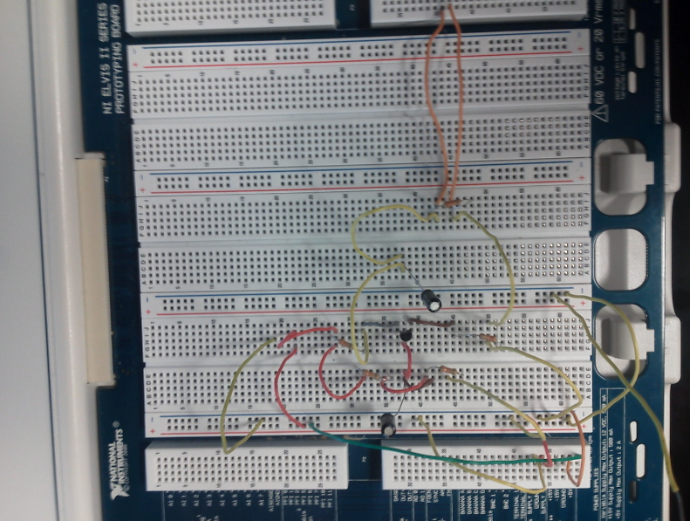

Slide 40
Summary and conclusion
Designed circuit in MultiSim and entered results in excel. Then we recreated
the circuit in lab and tested it. Entered the information in excel and it is fairly close
to what is in the Multisim. It did divide the voltage when tested. The second circuit
we built to see how it works and it worked similar to the Multisim circuit.

Slide 41
LAB 5:
FLIP FLOPS

Slide 42
Objective
  Learn the how to use a transistor to flip flop an output on
Equipment and Material
  Bench 6, Elvis S#1677D1B, 2N3904, 2 X LEDS, 2 X 10K Ohm Resistors, 100 Ohm Resistor, 2 470 Ohm Resistor,
  5 Volt DC Power Supply, Jumper Wires, 2 X 22µF.
Research and Information
  http://ivytechengineering.com/stores/transistors/files/2n3904.pdf

Slide 43
Procedures and results
Design a circuit that will flip flop on an LED and then
Switch to the other LED when switches are opened
And closed in the proper sequence.

Slide 44
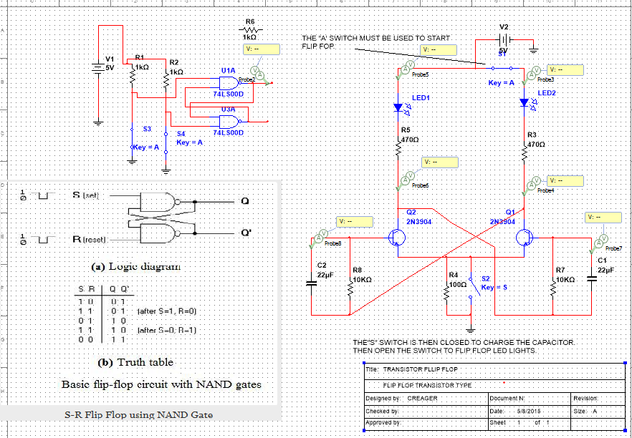

Slide 45
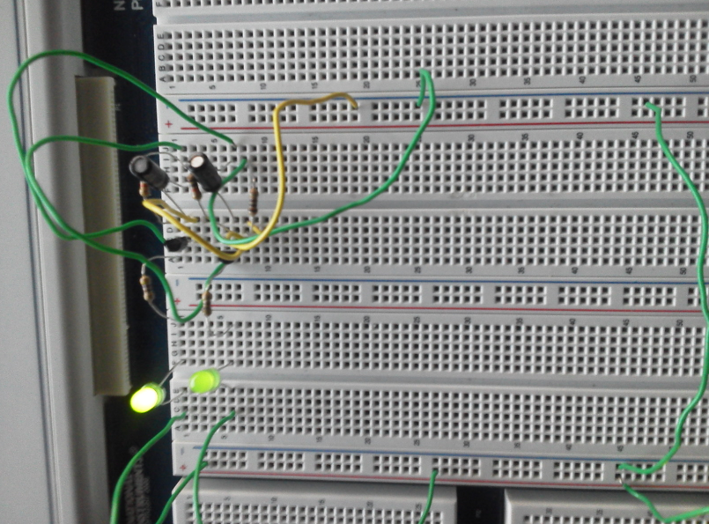
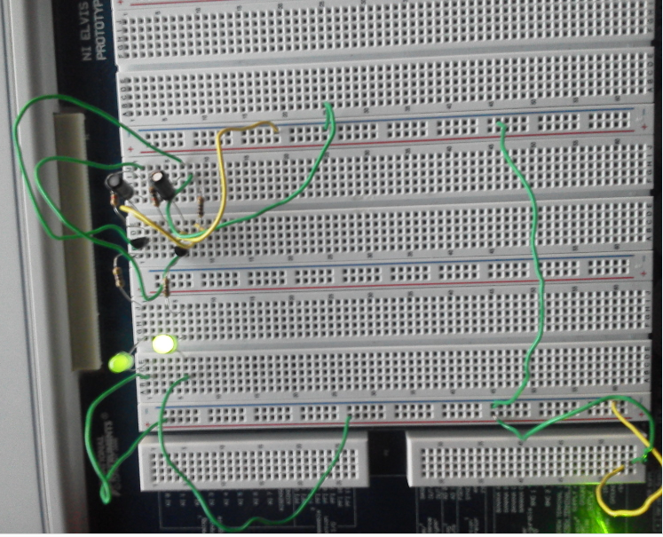

Slide 46
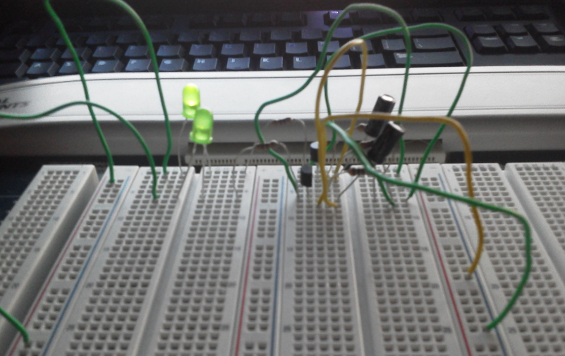

Slide 47
Summary and conclusion
This lab showed how you use transistors to flip flop something on. This is very similar to
how it is done with IC’s in digital circuits. We could get the flip flop to work in one direction
but not in the other direction.

Slide 48
LAB 6:
SCR

Slide 49
Objective
  To create a circuit that uses an SCR acting like a switch in the circuit
Equipment and Material
  Bench 6, 12 V Power Supply, 100 Ohm Resistor, 220 Ohm Resistor, 2N4444, Jumper Wires, Digital Multimeter GWInstek .
Research and Information
  http://www.google.com/url?sa=t&rct=j&q=&esrc=s&source=web&cd=2&cad=rja&uact=8&ved=0CCQQ
  FjAB&url=http%3A%2F%2Fwww.classiccmp.org%2Frtellason%2Ftransdata%2F2n4441.pdf&ei=
  wfJMVbC0EcShyATs2IDQBg&usg=AFQjCNEGicxzZhmaup29ru8s1xQscuGkOQ

Slide 50
Procedures and results
Use an SCR as a switch. We used a meter to test that current was flowing thru the SCR
when voltage was applied. We also used the meter to show that no current was
flowing thru the circuit when voltage was not applied.

Slide 51
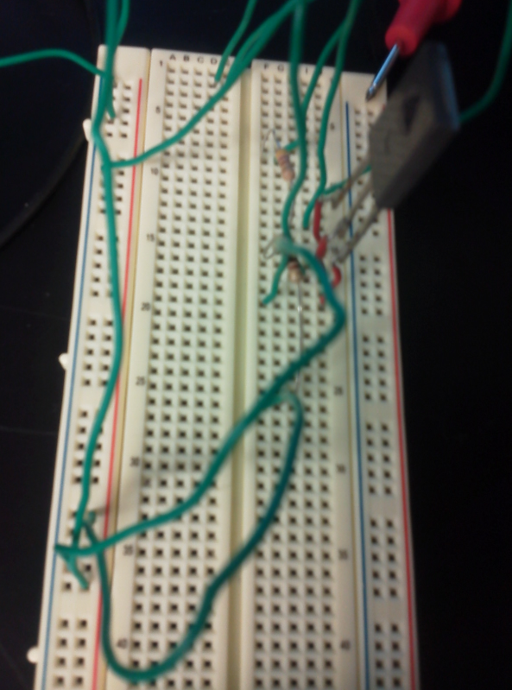
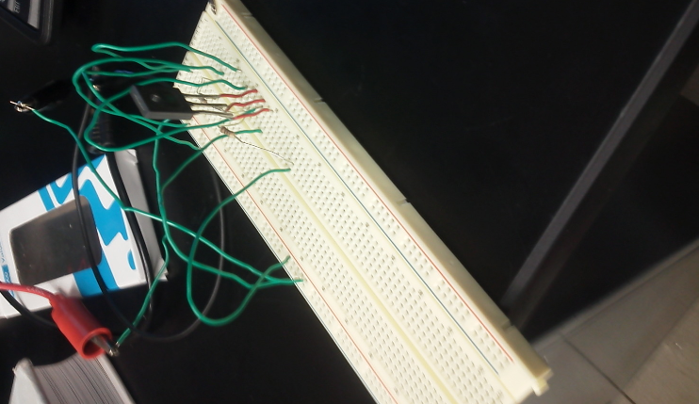

Slide 52
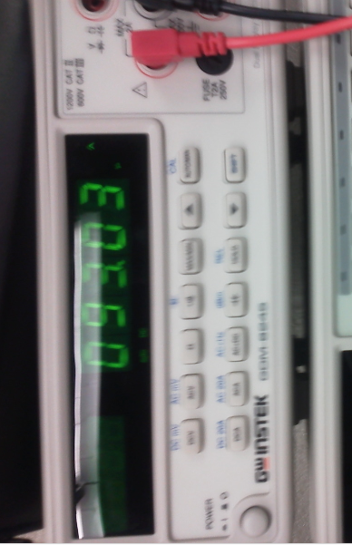
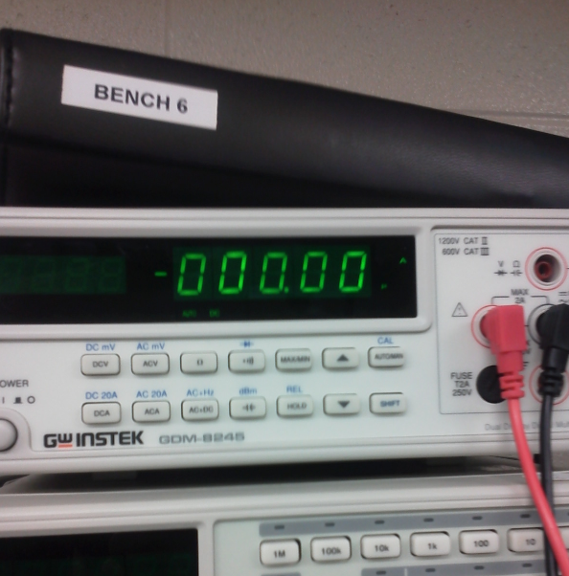

Slide 53
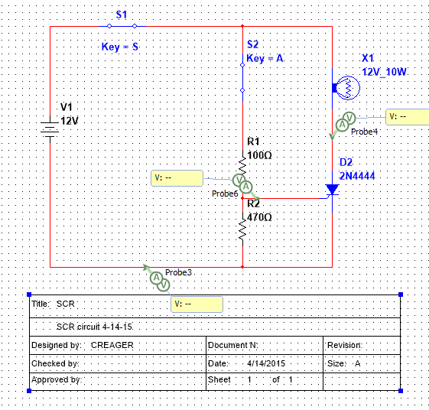

Slide 54
Summary and conclusion
We built the circuit in lab similar to Multisim. We didn’t find the needed light. We
found the SCR in the old parts and we used the multimeter to test if it was opening and
closing.

Slide 55
LAB 7:
PHOTO
DIODE

Slide 56
Objective
  Learn how a photo diode works in a circuit.
Equipment and Material
  Bench 6, 2 X LEDS, 100 ohm resistor, small breadboard, Jumper Wires, photo diode, Digital Multimeter GWInstek .
Research and Information
  Couldn’t find data sheet for photo diode in lab.

Slide 57
Procedures and results
We used one LED to operate the photo diode and used another diode to
Show that the photo diode was opening and closing the circuit.

Slide 58
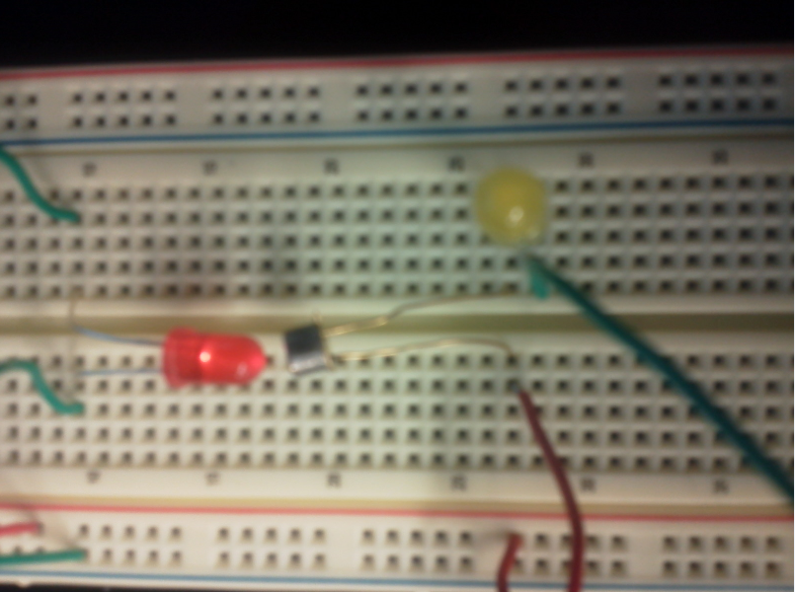
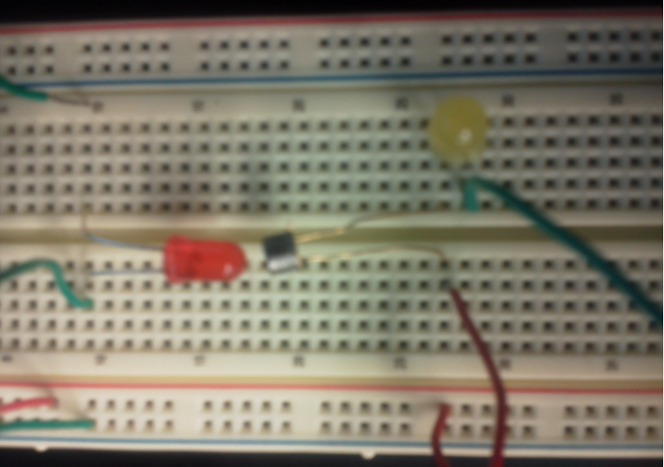

Slide 59
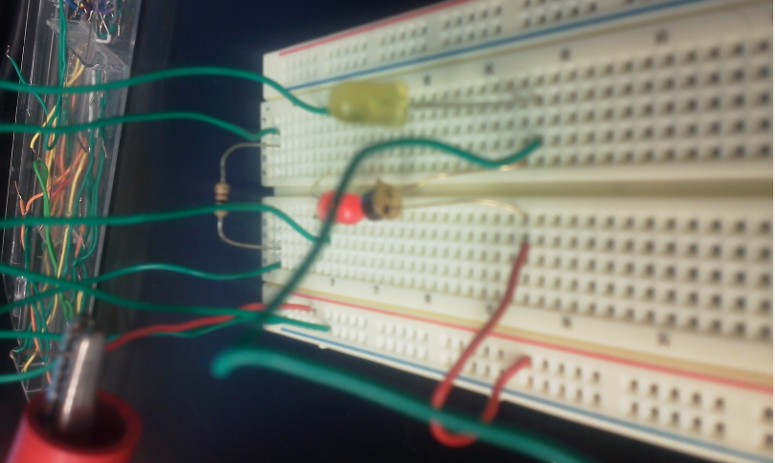

Slide 60
Summary and conclusion
It is hard to tell from the previous pictures that when the LED is pointed directly at
the photo diode the yellow LED is dimly lit. The brightness of the yellow LED varies
with how directly the red LED shines in the photo diode. It is possible that we could
have seen better results but did not know what the rated voltage of the photo diode was
so we used 5V.

