Slide 1
Lab 0
By: Chad Creager
Lab Partner:
Instructor: A Bell
Class: EECT 122
Date: 8/31/15

Slide 2
Objectives:
To test one gate on 74LS08 AND GATE.

Slide 3
Equipment and Parts:
Bench 3
HY1802D Power Supply
GWINSTEK Multi Meter Ser # CL860260
Bread Board
Dip Switches
2- 1KOHM Resistors
1- 74LS08N
1 Green LED
Wires

Slide 4
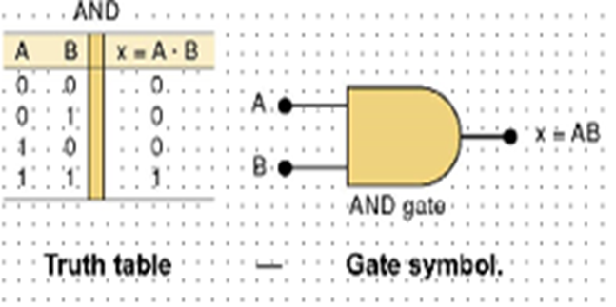
Theories:
X * 1 = X which is Theorem 1
X * 0 = 0 which is Theorem 2
Y * 1 = Y which is Theorem 1
Y * 0 = 0 which is Theorem 2

Slide 5
Data/Lab Results/Simulations/Schematics:
When both switches are open output is low.
When one or the other switch is closed output is low.
When both switches are closed output is high.

Slide 6
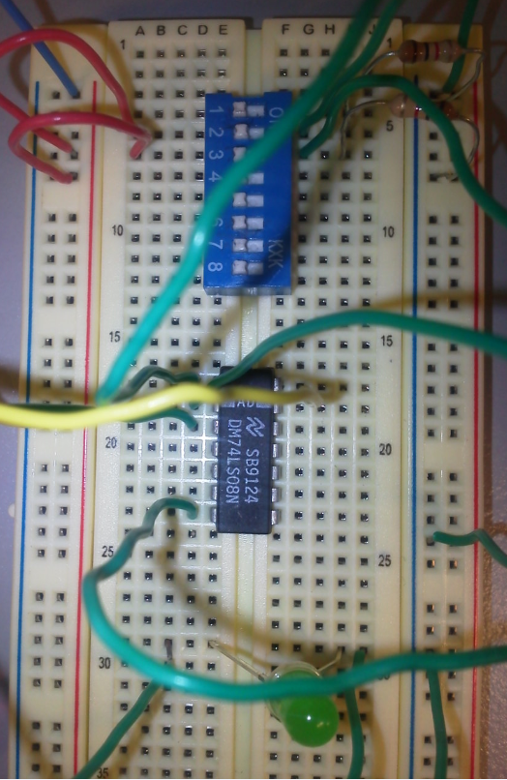
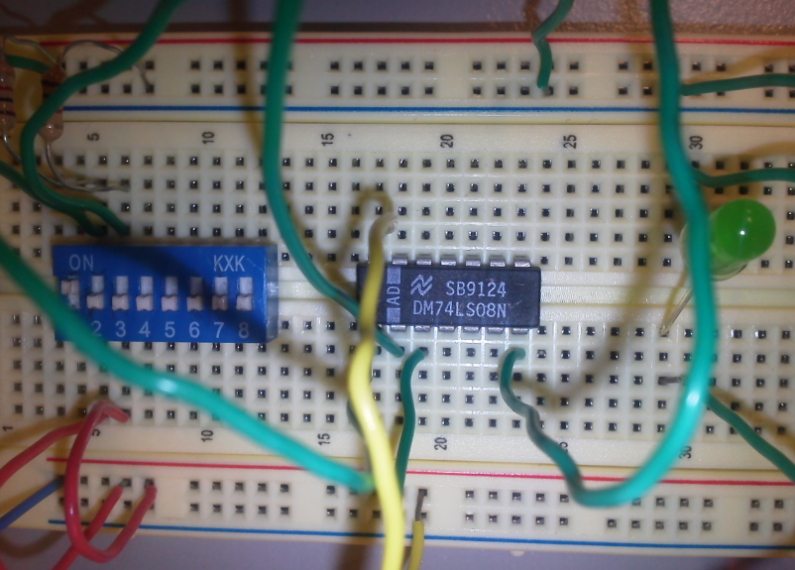
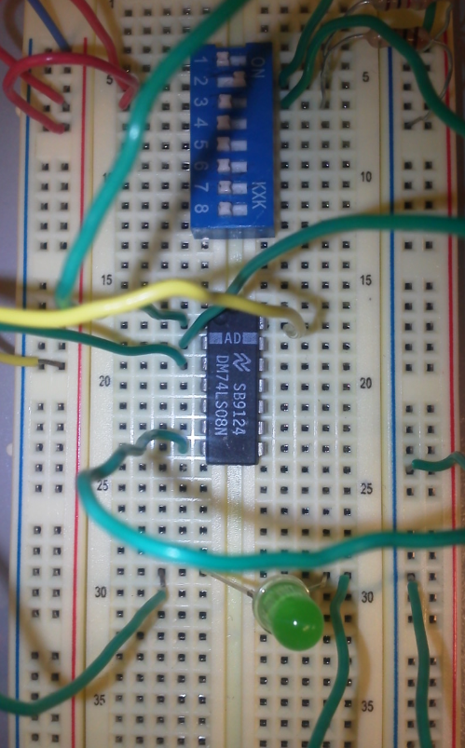

Slide 7
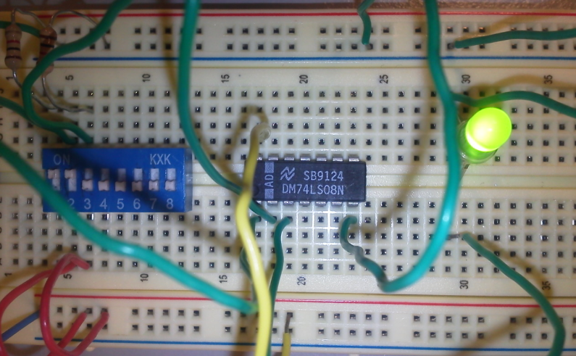
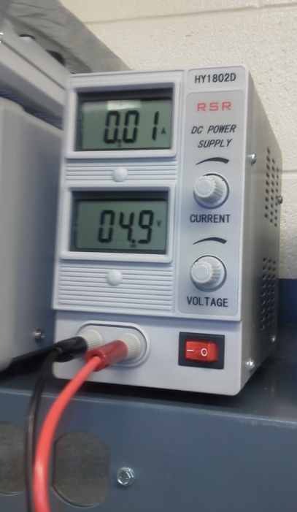

Slide 8
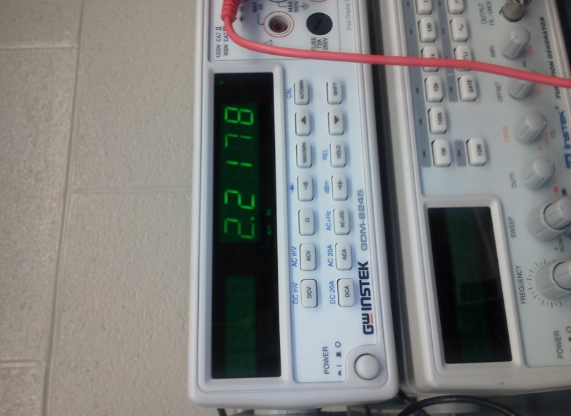
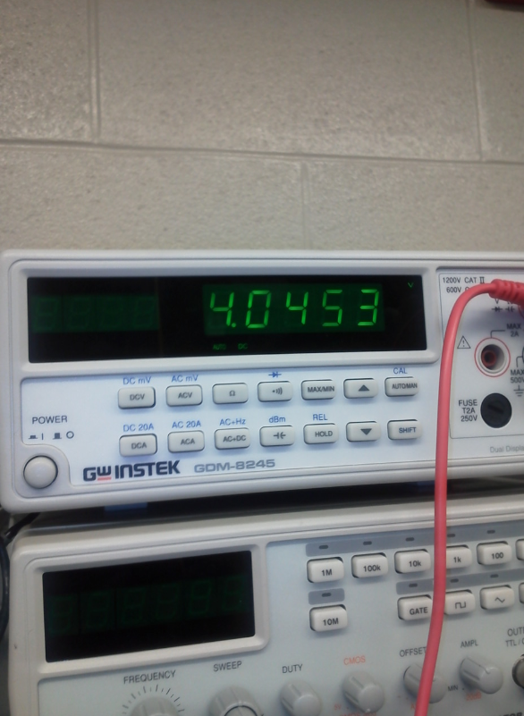

Slide 9
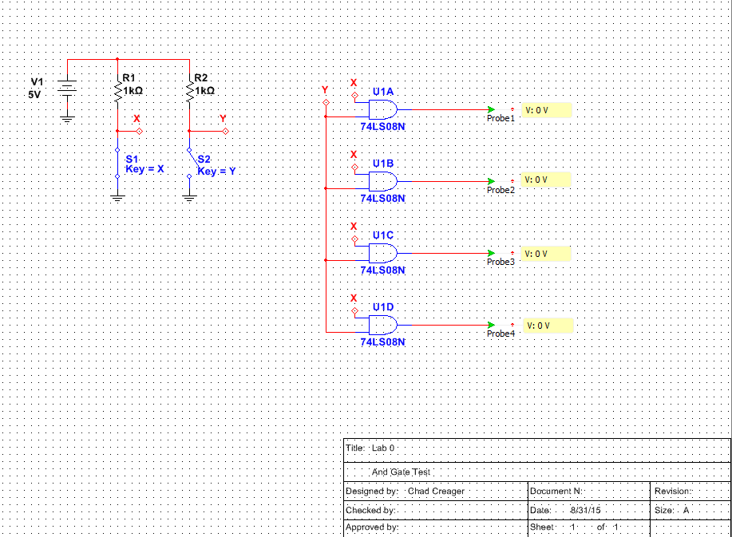
Multisim

Slide 10
Troubleshooting:
Used Multimeter to test all input levels and output levels.
Tested output with a load and without.

Slide 11
Conclusion:
The 74LS08N Gate worked as expected.
The output voltage was higher without a load than it was with a load when the output was high. When the output was low the measured voltage was the same loaded or unloaded.
With output high the voltage was 4.05 V unloaded and 2.22 V loaded
Tested with Vcc at 4.75V and checked High output not loaded and got 3.55V this matches the results on the data sheet.

Slide 12
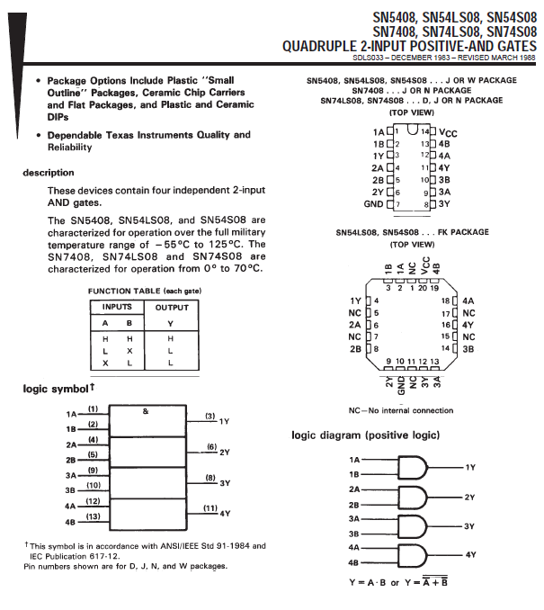
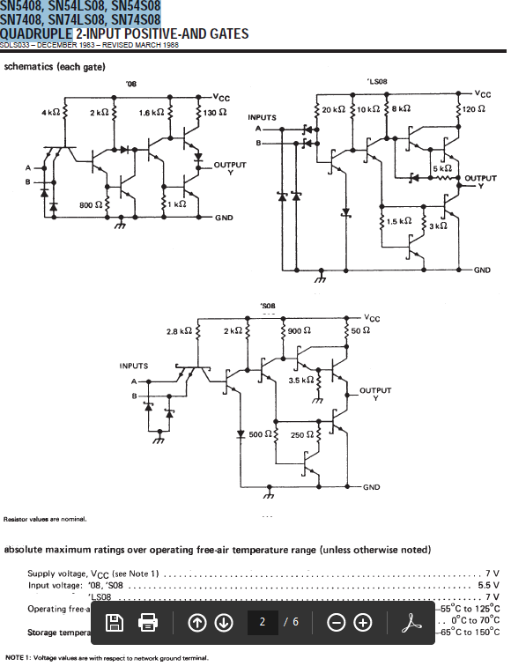
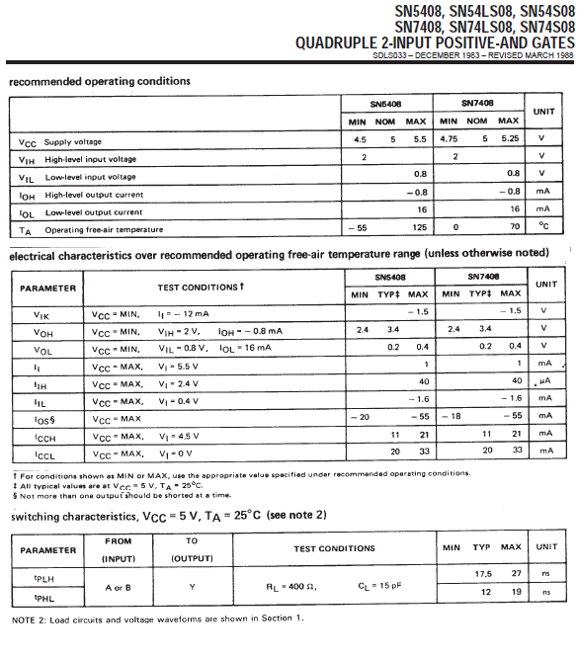
Data Sheets:

Slide 13
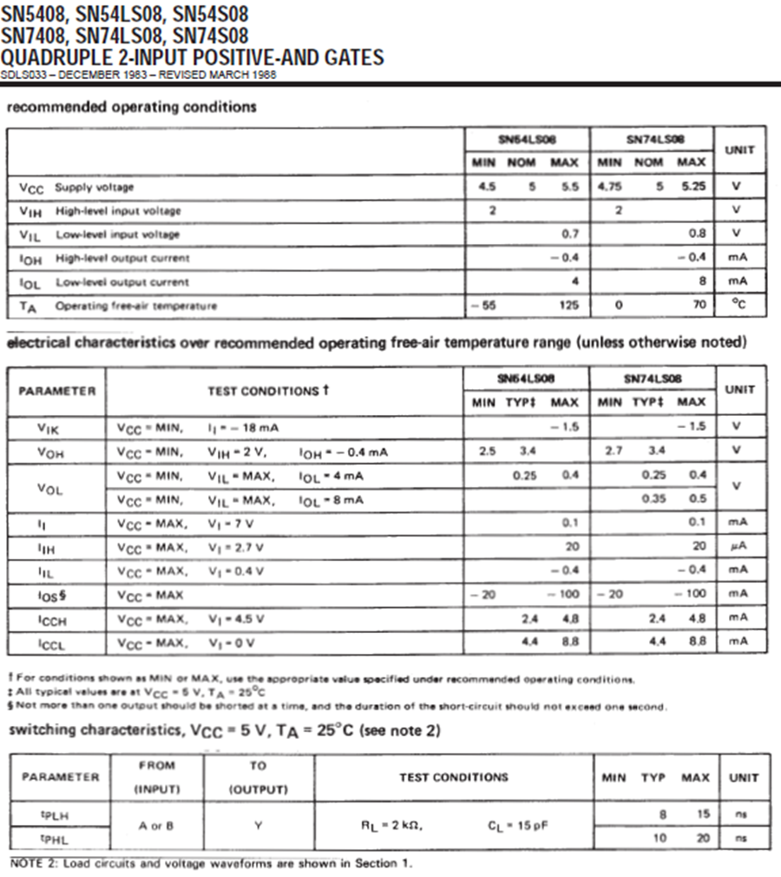
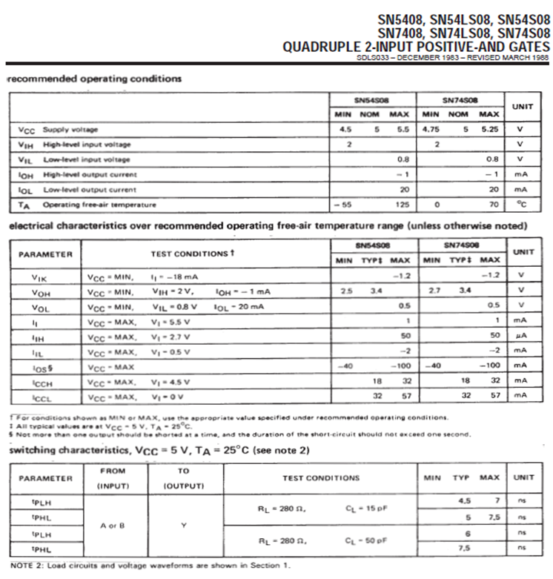
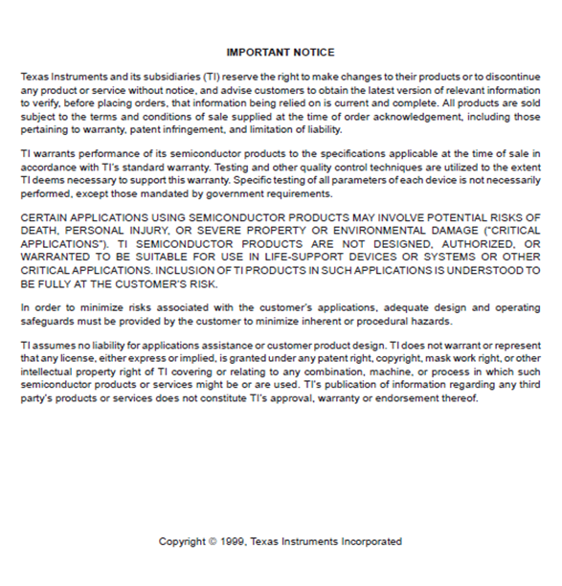

Slide 14
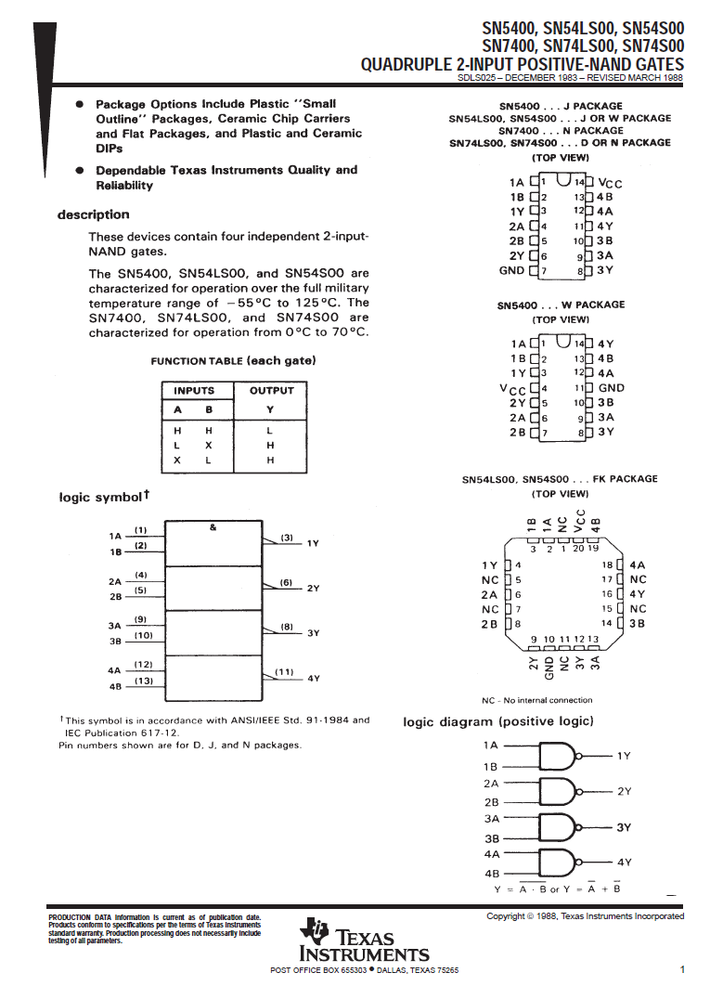
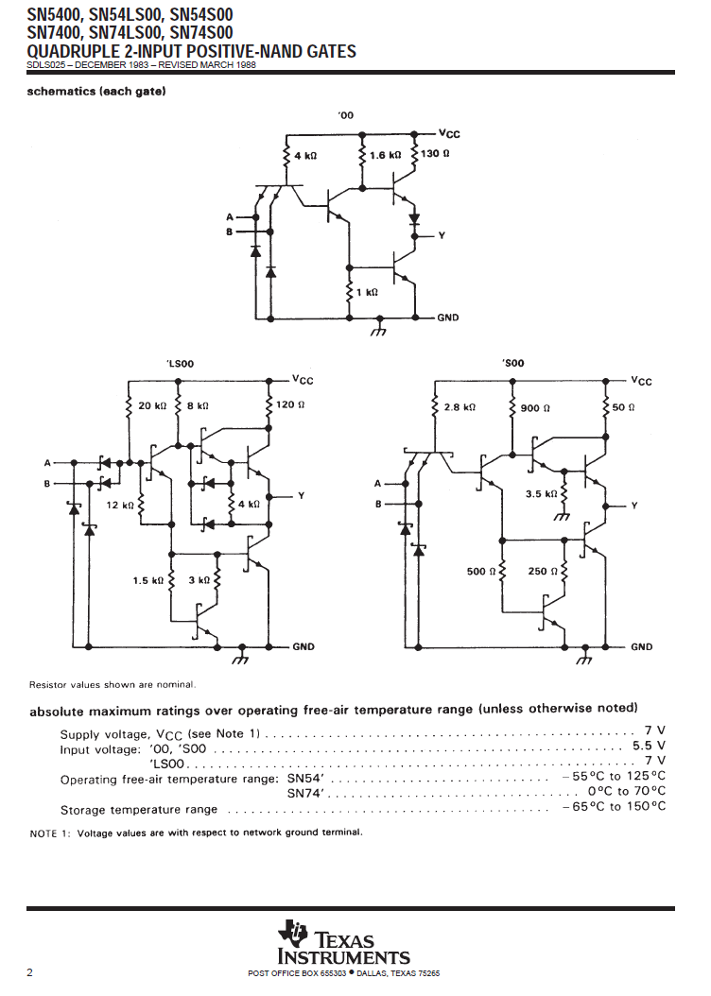

Slide 15
Lab 1
By: Chad Creager
Lab Partner:
Instructor: A Bell
Class: EECT 122
Date: 9/14/15

Slide 16
Objectives:
Design build and test a 3 input “AND” and “OR”

Slide 17
Equipment and Parts:
Bench 3
HY1802D Power Supply
GWINSTEK Multi Meter Ser # CL860260
Bread Board
Dip Switches
3- 1KOHM Resistors
1- 74LS08N and 174LS32
1 Green LED
Wires

Slide 18
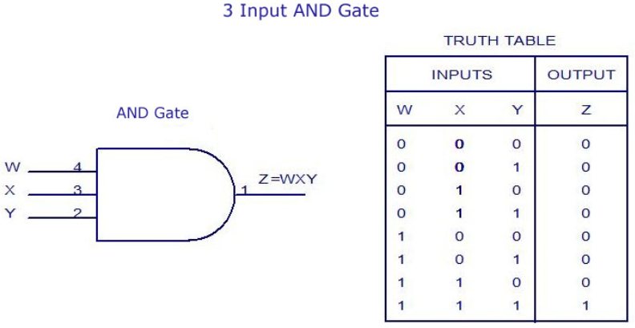
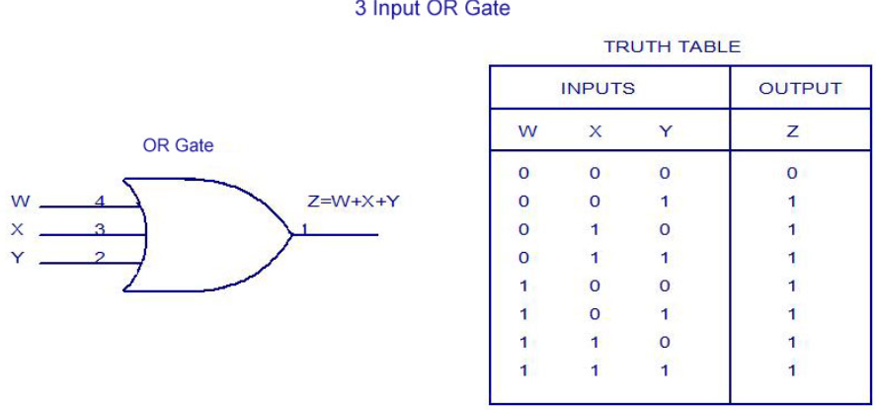
Theories:

Slide 19
Data/Lab Results/Simulations/Schematics:
The And gates had to have all three inputs high to produce a high
The OR gates had to have just one input high to produce a high output

Slide 20
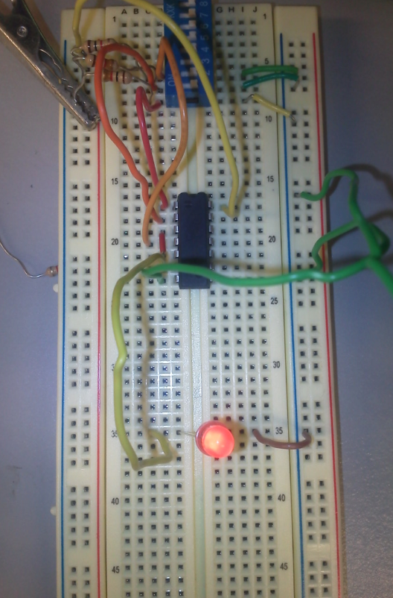
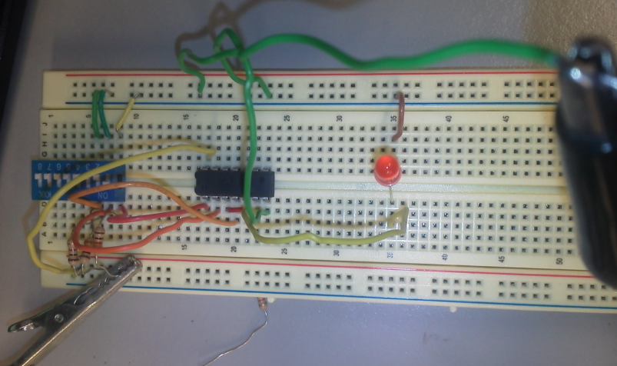
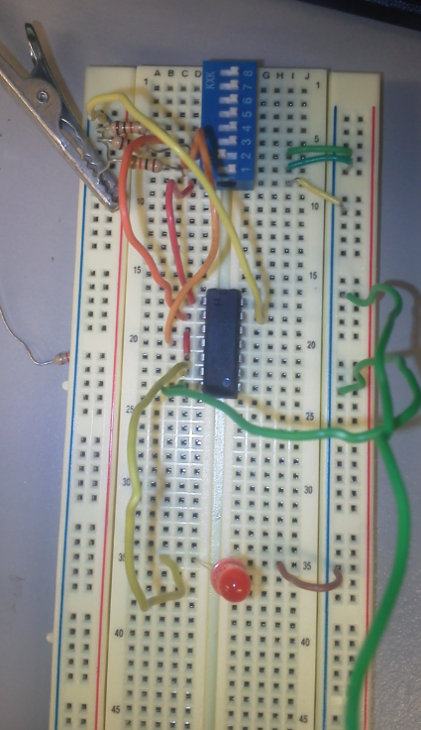

Slide 21
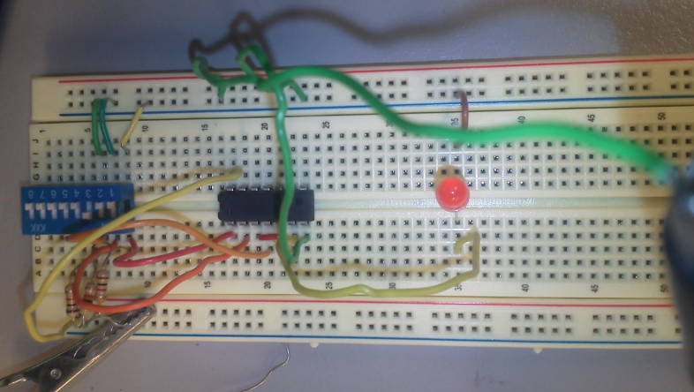
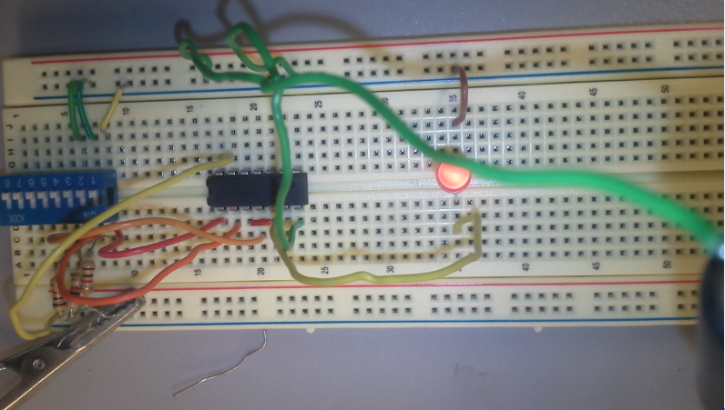
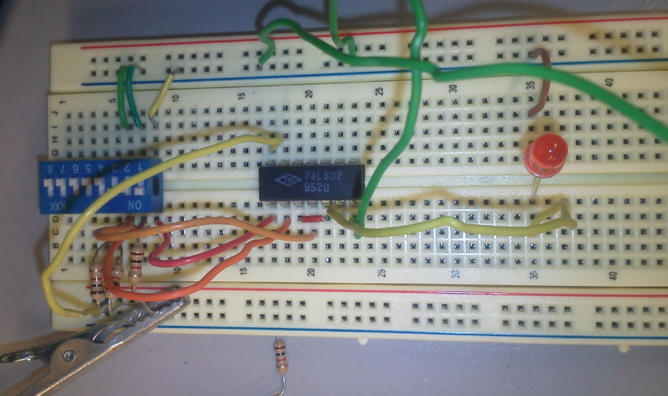

Slide 22
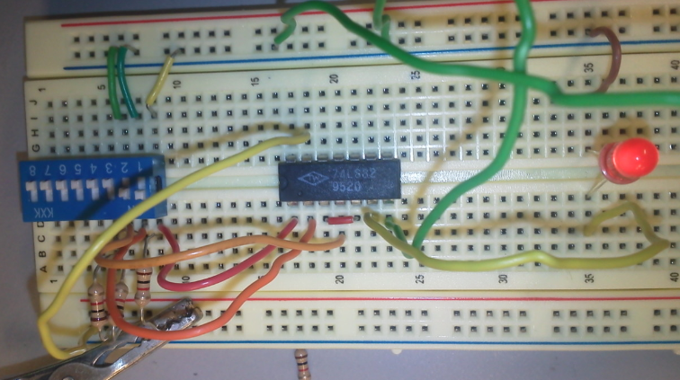
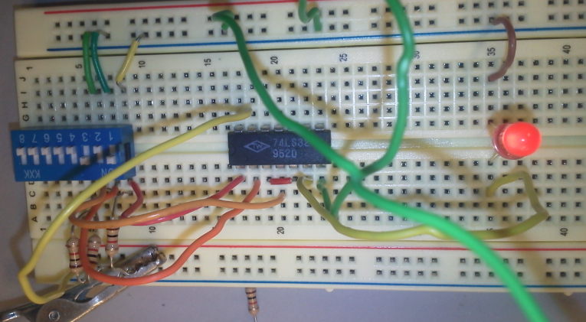
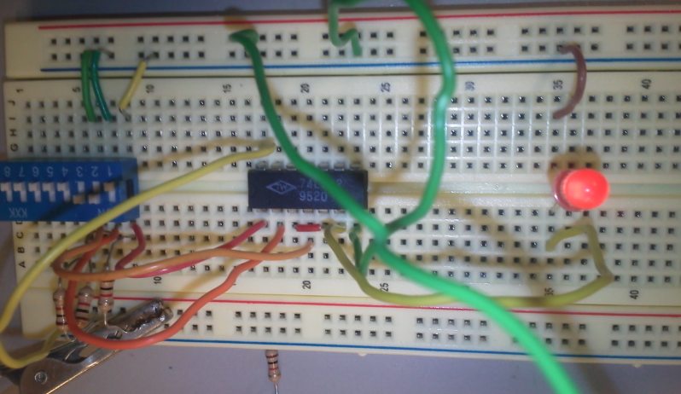

Slide 23
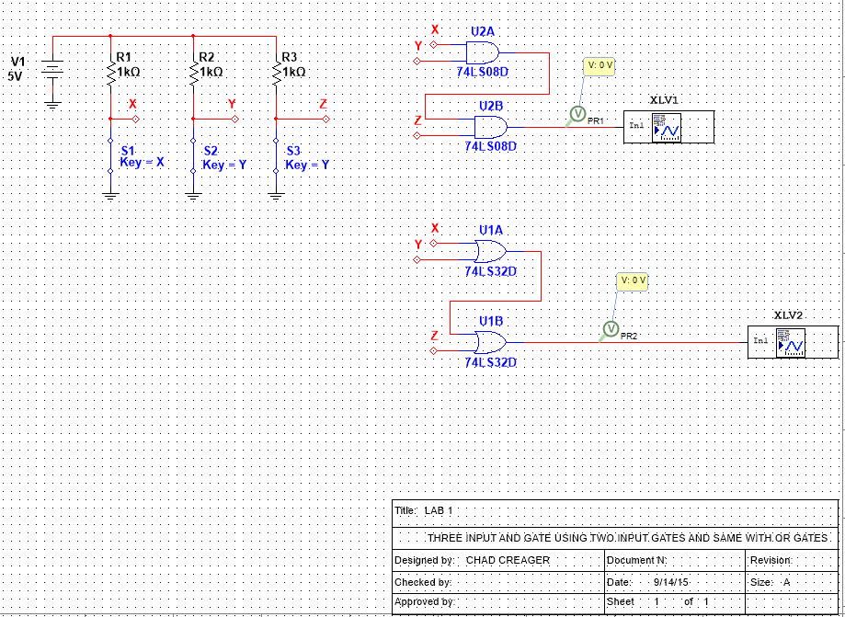
Multisim

Slide 24
Troubleshooting:
Did not have any problems. If problems occurred could use multimeter to test circuit.

Slide 25
Conclusion:
In this lab we used two input gates and wired them to another two input gate
To create a three input gate. They functioned in the same matter

Slide 26
Data Sheets:

Slide 28
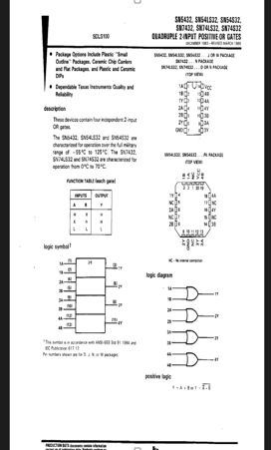
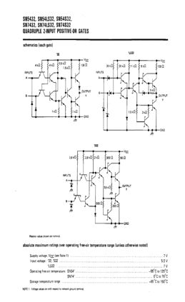
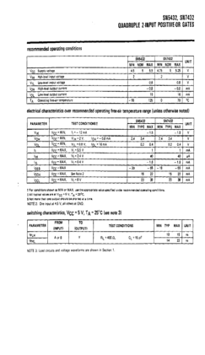

Slide 29
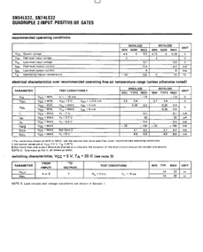
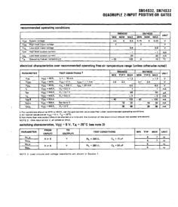

Slide 30
Lab 2
By: Chad Creager
Lab Partner:
Instructor: A Bell
Class: EECT 122
Date: 9/14/15

Slide 31
Objectives:
Design build and test a NAND gate latch

Slide 32
Equipment and Parts:
Bench 3
HY1802D Power Supply
GWINSTEK Multi Meter Ser # CL860260
Bread Board
Dip Switches
2- 1KOHM Resistors
1- 74LS00
Wires
Oscilliscope

Slide 33
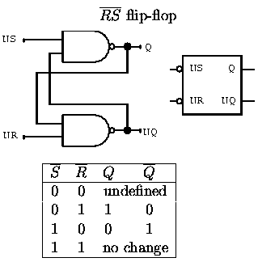
Theories:

Slide 34
Data/Lab Results/Simulations/Schematics:
The simulation does not work well in Multisim.
The real world example works better as long as you do not use the undefined situation.

Slide 35
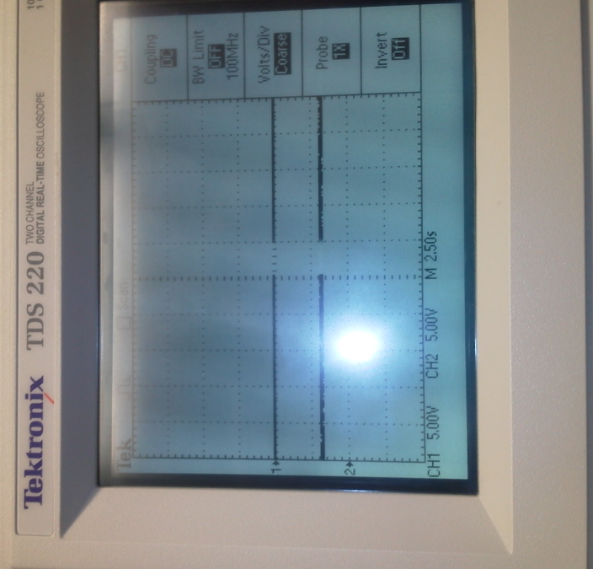
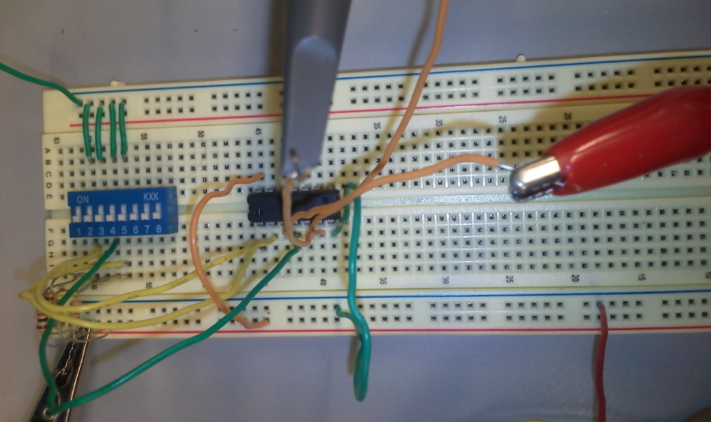

Slide 36
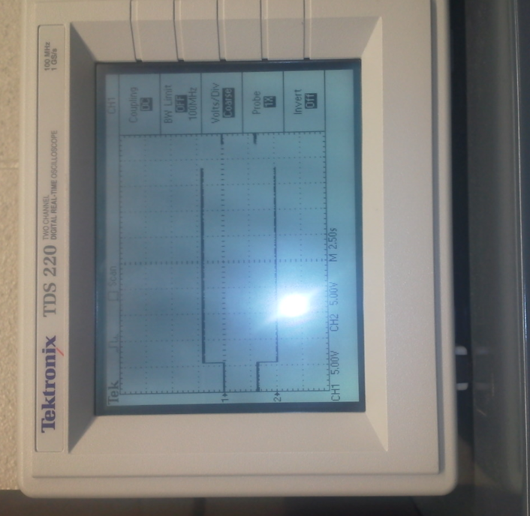
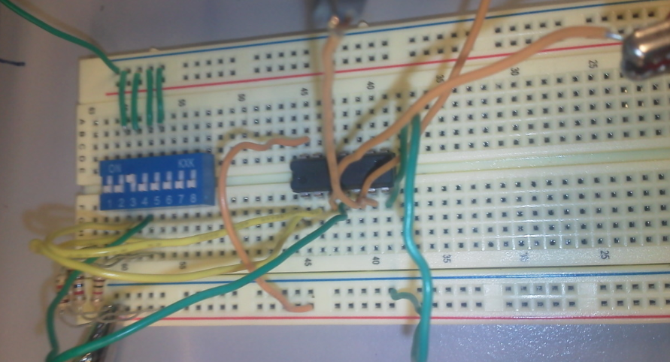

Slide 37
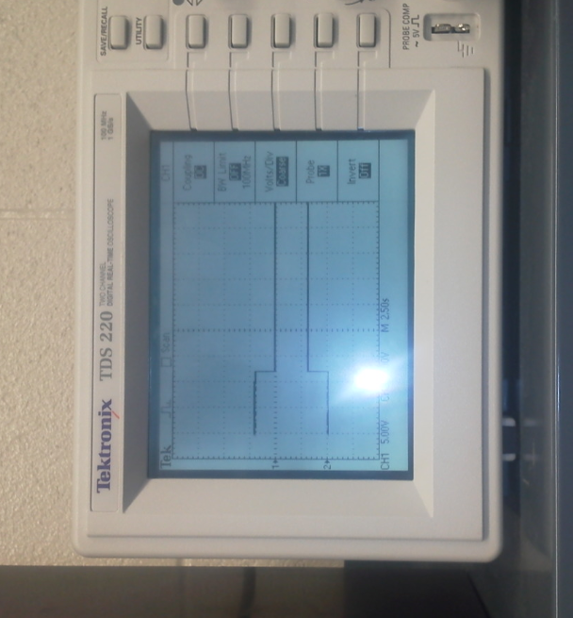
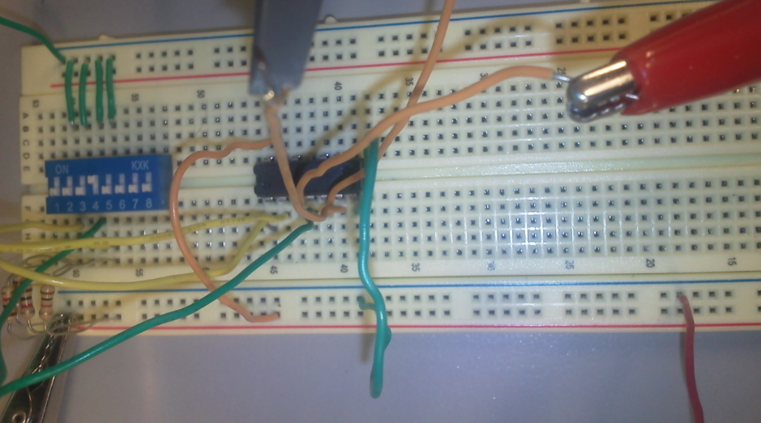

Slide 38
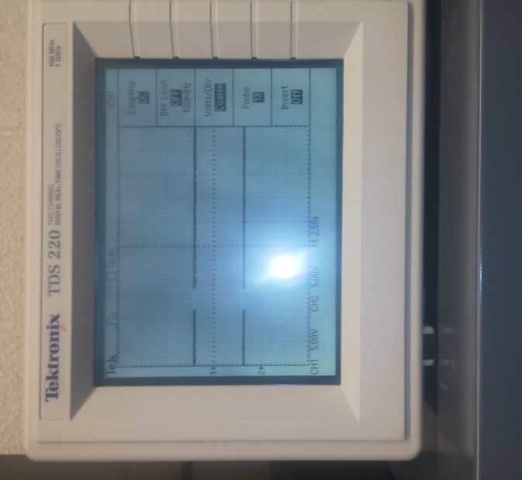
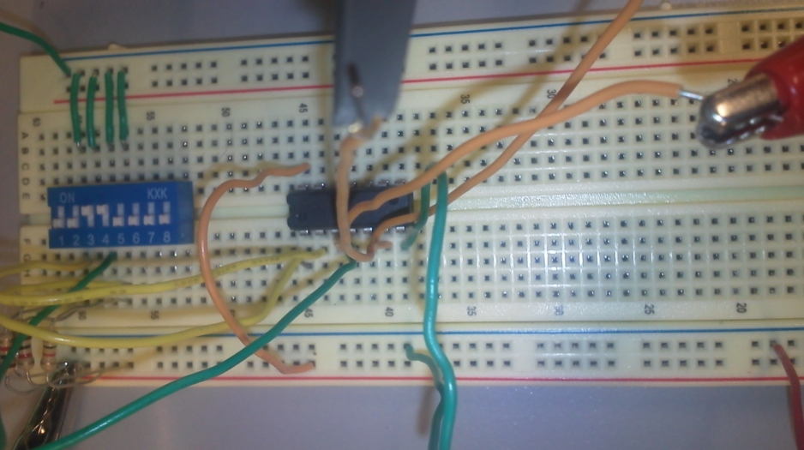

Slide 39
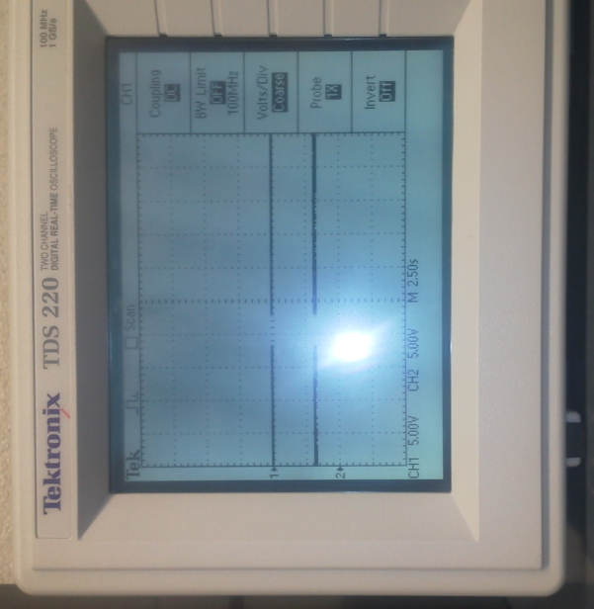
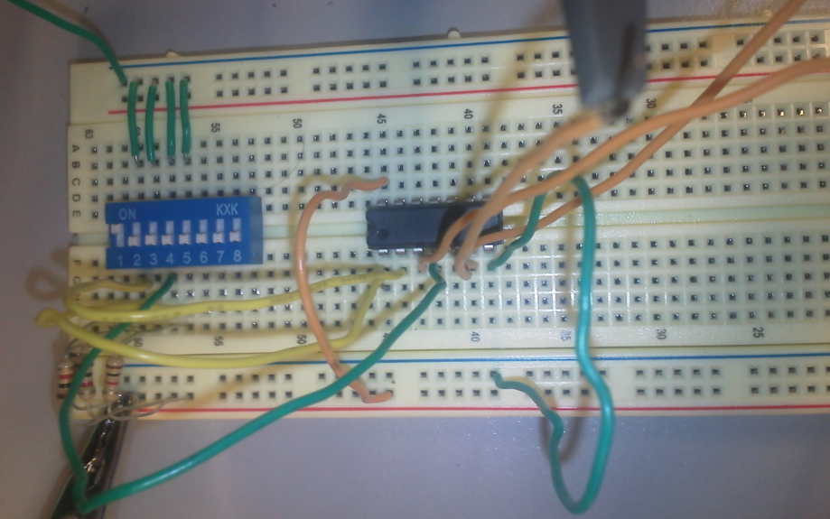

Slide 40
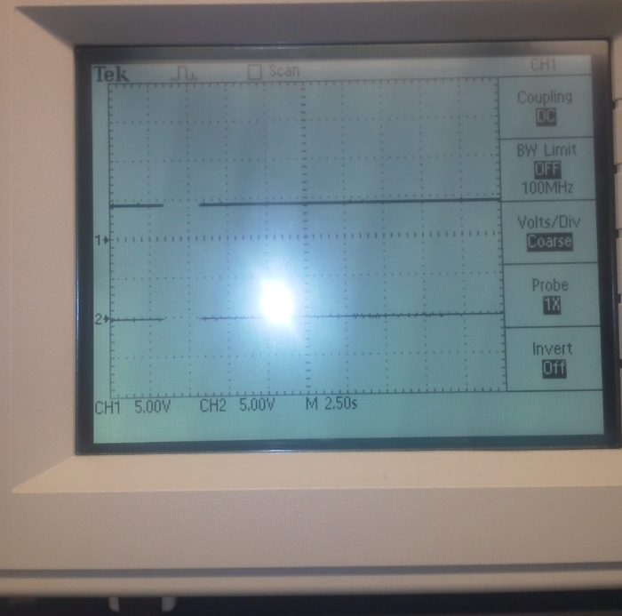
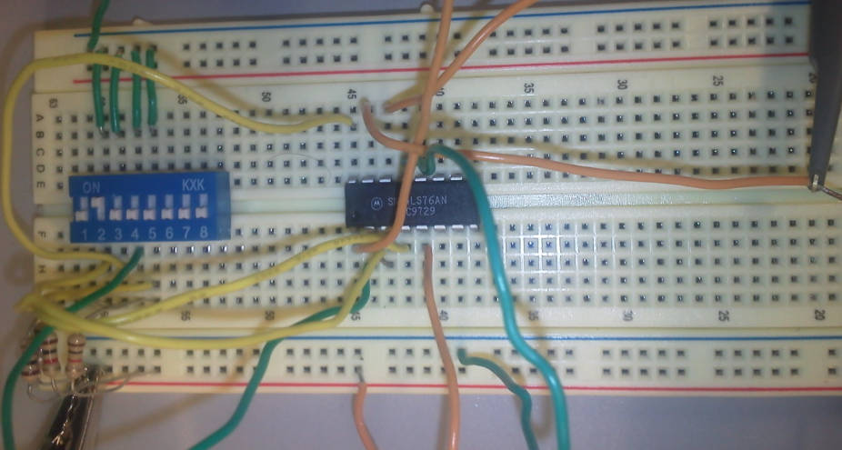

Slide 41
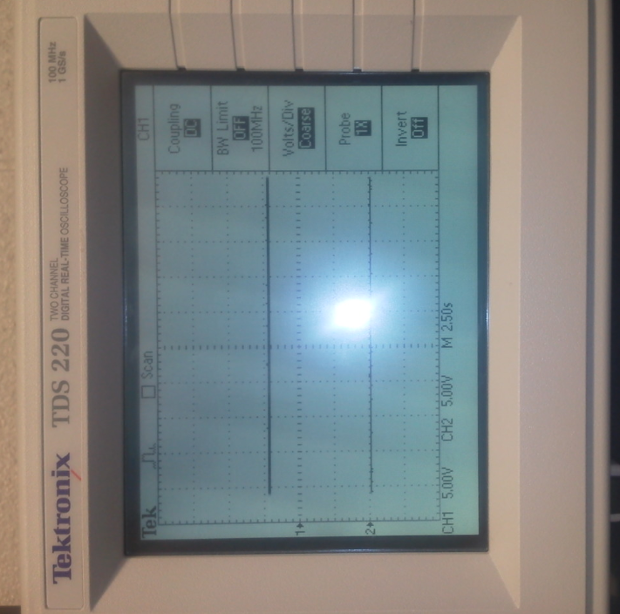
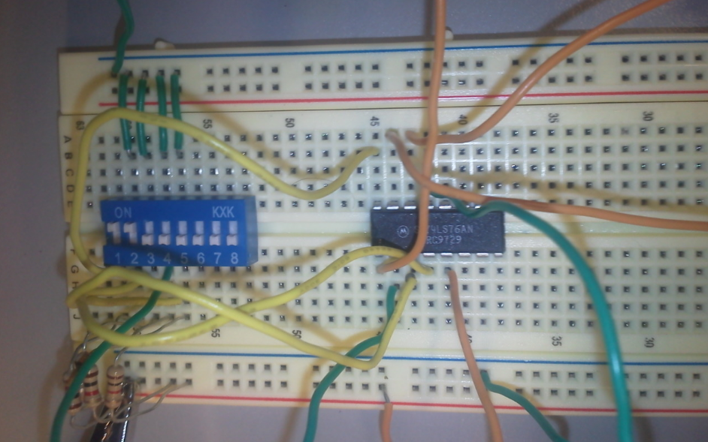

Slide 42
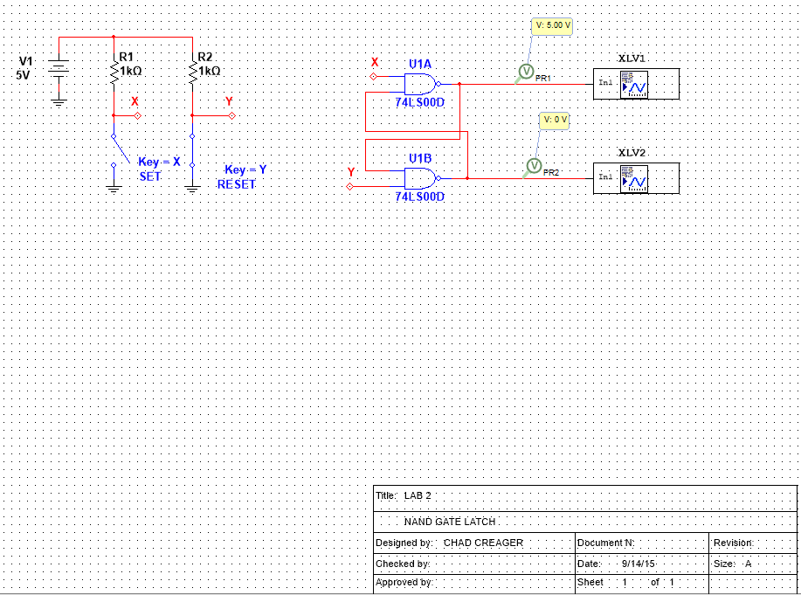
Multisim

Slide 43
Troubleshooting:
The simulation did not work properly even put signal analyzer to try and check circuit.
Used Multimeter to test all input levels and output levels.
Tested output with a load and without.

Slide 44
Conclusion:
The lab shows how a NAND gate works but also shows what happens when you have an undefined state. This is the second semester that have built this circuit and multisim does not operate correctly.

Slide 45

Data Sheets:

Slide 46


Slide 47


Slide 48
Lab 3
By: Chad Creager
Lab Partner:
Instructor: A Bell
Class: EECT 122
Date: 9/14/15

Slide 49
Objectives:
Design, build and test a SR FF

Slide 50
Equipment and Parts:
Bench 3
HY1802D Power Supply
GWINSTEK Multi Meter Ser # CL860260
Bread Board
Dip Switches
2- 1KOHM Resistors
1- 74LS02
Wires

Slide 51

Theories:

Slide 52
Data/Lab Results/Simulations/Schematics:
Sorry Andy no pictures my camera was dead

Slide 53

Multisim

Slide 54
Conclusion:
This lab works.
No picture of lab due to camera being dead.
This is very similar to the nand latch lab.

Slide 55



Data Sheets:

Slide 56




Slide 57
Lab 4
By: Chad Creager
Lab Partner:
Instructor: A Bell
Class: EECT 122
Date: 9/14/15

Slide 58
Objectives:
Design, build and test a D FF

Slide 59
Equipment and Parts:
Bench 3
HY1802D Power Supply
GWINSTEK Multi Meter Ser # CL860260
Bread Board
Dip Switches
3- 1KOHM Resistors
1- 74LS74
Function Generator
Wires

Slide 60
Data/Lab Results/Simulations/Schematics:
No photos due to dead camera.

Slide 61

Multisim

Slide 62
Conclusion:
No photos of this lab.
This lab is very similar to the previous two labs.

Slide 63



Data Sheets:

Slide 64



Slide 65



Slide 66
Lab 5
By: Chad Creager
Lab Partner:
Instructor: A Bell
Class: EECT 122
Date: 9/14/15

Slide 67
Objectives:
Design, build and test a JK FF

Slide 68
Equipment and Parts:
Bench 3
HY1802D Power Supply
GWINSTEK Multi Meter Ser # CL860260
Bread Board
Dip Switches
4- 1KOHM Resistors
1- 74LS76
Function Generator
Wires

Slide 69

Theories:

Slide 70
Data/Lab Results/Simulations/Schematics:
Sorry Andy no photos camera was dead.

Slide 71

Multisim

Slide 72
Conclusion:
This lab is similar to previous lab just uses different type of gates.
No pics due to camera was dead at time of simulation.

Slide 73



Data Sheets:

Slide 74
Lab 6
By: Chad Creager
Lab Partner:
Instructor: A Bell
Class: EECT 122
Date: 9/14/15

Slide 75
Objectives:
Simulated, built and test the 74LS283 2’s complement and 4 bit adder

Slide 76
Equipment and Parts:
Bench 3
HY1802D Power Supply
GWINSTEK Multi Meter Ser # CL860260
Bread Board
Dip Switches
8- 1KOHM Resistors
1-
1 red LED
Wires

Slide 77

Theories:

Slide 78
Data/Lab Results/Simulations/Schematics:
Didn’t run in multisim was working on Lou’s board.

Slide 79




Slide 80
Multisim

Slide 81
Troubleshooting:
Had to change wiring to the led to get orientation correct.
Had to check orientation of wiring when first wired up.

Slide 82
Conclusion:
Created two bit adder in both multisim and real life.
This was a test to keep all the wiring straight.

Slide 83



Data Sheets:

Slide 84



Slide 85
Lab 7
By: Chad Creager
Lab Partner:
Instructor: A Bell
Class: EECT 122
Date: 11/9/15

Slide 86
Objectives:
Design, built and test a 4 counter (synchronous)

Slide 87
Equipment and Parts:
Bench 3
HY1802D Power Supply
GWINSTEK Multi Meter Ser # CL860260
Bread Board
Frequency Generator
1- 74LS73, 74LS47, 74LS08
1 Green LED
Wires

Slide 88
Theories:
The counter is synchronous because it is hooked to the same clock

Slide 89

Data/Lab Results/Simulations/Schematics:

Slide 90




Slide 91

Multisim

Slide 92
Troubleshooting:
No problems but if I would have had problems could have used multimeter to check signals.
Had to rework algebra a couple of time to simplify better.

Slide 93
Conclusion:
This counter worked well.
Was able to use this counter to test other labs.

Slide 94



Data Sheets:

Slide 95




Slide 96




Slide 97




Slide 98



Slide 99
Datasheet for 74LS73 is in Lab11
Datasheet for 74LS08 is in Lab 0

Slide 100
Lab 8
By: Chad Creager
Lab Partner:
Instructor: A Bell
Class: EECT 122
Date: 10/12/15

Slide 101
Objectives:
Design, built and test a Mod 12

Slide 102
Equipment and Parts:
Bench 3
HY1802D Power Supply
GWINSTEK Multi Meter Ser # CL860260
Bread Board
2- 1KOHM Resistors
1- 74LS73, 74LS08, 74LS00
1 Green LED*4
Wires
Frequency Generator

Slide 103
Theories:
That gates can be moved to adjust what the counters count to
Moved gate and made a mod 10 also which is considered a decade counter.

Slide 104
Data/Lab Results/Simulations/Schematics:

Slide 105

Multisim

Slide 106


Slide 107
Troubleshooting:
No problems but if I would have had problems could have used multimeter to check signals.
Had to rework algebra a couple of time to simplify better.

Slide 108
Conclusion:
Add 74LS08 to circuit to change type of counter.
Also made a mod 10 counter by moving chip.

Slide 109
Data Sheets:
Datasheet for 74LS73 is in Lab 11
Datasheet for 74LS08 is in Lab 0
Datasheet for 74LS00 is in Lab 2

Slide 110
Lab 9
By: Chad Creager
Lab Partner:
Instructor: A Bell
Class: EECT 122
Date: 10/19/15

Slide 111
Objectives:
Boolean Reduction – simulation and simplification

Slide 112
Equipment and Parts:
Bench 3
HY1802D Power Supply
GWINSTEK Multi Meter Ser # CL860260
Bread Board
Dip Switches
3- 1KOHM Resistors
1- 74LS08N, 74LS32, 74LS04
1 Green LED
Wires

Slide 113

Theories:

Slide 114
Data/Lab Results/Simulations/Schematics:
Built both circuits simplified and original circuit.

Slide 115



Slide 116

Multisim

Slide 117
Troubleshooting:
No problems but if I would have had problems could have used multimeter to check signals.
Had to rework algebra a couple of time to simplify better.

Slide 118
Conclusion:
With the use of K-maps and algebra I was able to reduce the Boolean equation.
Used algebra first and had to try it a couple of different ways to get the equation simplified.

Slide 119


Data Sheets:

Slide 120



Slide 121




Slide 122




Slide 123




Slide 124




Slide 125




Slide 126

Datasheet for 74LS32 is in Lab 1
Datasheet for 74LS08 is in Lab 0
Datasheet for 74LS00 is in Lab 2

Slide 127
Lab 10
By: Chad Creager
Lab Partner:
Instructor: A Bell
Class: EECT 122
Date: 9/14/15

Slide 128
Objectives:
74185 Model development

Slide 129
Equipment and Parts:
Bench 3
Multisim

Slide 130
Theories:
Use multisim to develop a 74185 IC that is obsolete.

Slide 131

Data/Lab Results/Simulations/Schematics:
Data table for 74185
Example below is a
Modified IC so that
Will display count in Hex
Correctly.

Slide 132

Multisim

Slide 133



Slide 134
Troubleshooting:
Had to check the programming a couple of times.

Slide 135
Conclusion:
Created the 74185 IC in multisim. No way to test IC without putting the logic in programmable IC.

Slide 136
Data Sheets:
This data sheet is located in Lab FF

Slide 137
Lab 11
By: Chad Creager
Lab Partner:
Instructor: A Bell
Class: EECT 122
Date: 10/19/15

Slide 138
Objectives:
Binary to 7 segment display

Slide 139
Equipment and Parts:
Bench 3
HY1802D Power Supply
GWINSTEK Multi Meter Ser # CL860260
Bread Board
Dip Switches
2- 1KOHM Resistors
1- 74LS73
7 segment display
Wires

Slide 140
Theories:
Trying to use IC’s to convert a binary signal to a 7 segment display.
No IC is available to do this in Hexadecimal
It can be done with a programmable IC.

Slide 141
Data/Lab Results/Simulations/Schematics:
When running the circuit it performed exactly like the data sheet said it would.

Slide 142

Multisim

Slide 143


Slide 144
Troubleshooting:
The current IC’s available wouldn’t count in Hexadecimal or display.
Had to change set-up of IC in multisim to accomplish this.

Slide 145
Conclusion:
This lab is a good example of how programmable IC’s can simplify a circuit and also do what you can’t with other IC’s

Slide 146



Data Sheets:

Slide 147



Slide 148
Lab 12
By: Chad Creager
Lab Partner:
Instructor: A Bell
Class: EECT 122
Date: 11/30/15

Slide 149
Objectives:
Xilinx CPLD effort

Slide 150
Equipment and Parts:
Bench 3
Xilinx Lab Kit

Slide 151
Theories:
Using Xilinx to create a circuit.
This eliminates some of the IC chips needed

Slide 152
Data/Lab Results/Simulations/Schematics:
Used Programming software to create a program to simplify the circuit.

Slide 153


Slide 154
Program
Didn’t take a picture of the program and can’t load the program from laptop.

Slide 155
Troubleshooting:
Where to begin? The biggest problem with this lab was that couldn’t download the program to the microproccesser.
I tried this on a couple of occasions and never got it to work.
Tried all port configurations but nothing worked.

Slide 156
Conclusion:
The Xilinx lab was frustrating for a couple of reasons.
The programming was different and sometimes difficult to interpret.
Couldn’t get the program downloaded once I had it figured out.

Slide 157
Data Sheets:
http://www.xilinx.com/support/documentation/data_sheets/ds312.pdf
The Data sheet is massive so just supplied a link

Slide 158
Lab 13
By: Chad Creager
Lab Partner:
Instructor: A Bell
Class: EECT 122
Date: 11/30/15

Slide 159
Objectives:
Arduino Labs

Slide 160
Equipment and Parts:
Bench 3
Arduino Lab Kit

Slide 161
Theories:
Using Arduino’s to create a circuit.
This eliminates some of the IC chips needed

Slide 162
Data/Lab Results/Simulations/Schematics:
Build three individual labs to show how microprocessor simplifies circuit
First lab was using a switch to change LED’s
Second lab was showing temperature to change LED’s
Third lab was making a magic 8-ball that changed when you shake circuit board

Slide 163


PROGRAM

Slide 164




Slide 165


Slide 166



Slide 167


Slide 168
Troubleshooting:
The labs were pretty straightforward the only issue was that the tilt switch wanted to keep falling out on the magic 8-ball.

Slide 169
Conclusion:
The Arduino is one way to make a complicated IC circuit smaller with the use of a microproccessor.

Slide 170


Data Sheets:

Slide 171



Slide 172
Lab 14
By: Chad Creager
Lab Partner:
Instructor: A Bell
Class: EECT 122
Date: 12/7/15

Slide 173
Objectives:
Arduino Labs Part 2

Slide 174
Equipment and Parts:
Bench 3
Arduino Lab Kit

Slide 175
Theories:
Using Arduino’s to create a circuit.
This eliminates some of the IC chips needed

Slide 176
Data/Lab Results/Simulations/Schematics:
Built a circuit and programmed microproccesor so that when a potentiometer
was turned the servo followed suit.

Slide 177



Slide 178


program

Slide 179
Troubleshooting:
When I first assembled circuit the servo would shake.
To correct this problem I had to install capacitors to clean up signals.

Slide 180
Conclusion:
The Arduino is one way to make a complicated IC circuit smaller with the use of a moicroproccessor.

Slide 181
Data Sheets:

Slide 183
Lab FF
By: Chad Creager
Lab Partner:
Instructor: A Bell
Class: EECT 122
Date: 11/2/15

Slide 184
Objectives:
Develop a schematic for Lou’s box

Slide 185
Equipment and Parts:
Bench 3
Multisim
Multimeter

Slide 186
Theories:
This circuit uses many of the Theroms located in the cover of the book

Slide 187
Data/Lab Results/Simulations/Schematics:
Worked on creating a chip and figuring out Lou’s adder.
Did not get whole circuit completed

Slide 188


Slide 189

Multisim

Slide 190


Slide 191


Slide 192


Slide 193


Slide 194


Slide 195


Slide 196


Slide 197
Troubleshooting:
I did not do much troubleshooting since didn’t finish schematic.
One type of testing I had to do was to use a meter to test continuity on Lou’s board to determine where some of the wires went.

Slide 198
Conclusion:
The 74LS185 is obsolete and I think it is so that we don’t have to try and build things like this.
The 74ls185 had to be made using a data sheet.

Slide 199



Data Sheets:

Slide 200




Slide 201




