Slide 1
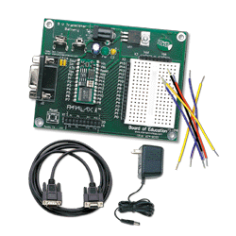

BASIC STAMP II FINAL PROJECT
7 SEMGENT COUNTER
CHARLES SLAGAL

Slide 2
EQUIPMENT USED
BASIC STAMP II
JUMPER WIRES
100 ohm RESISTOR
7 SEGMENT COUNTER
STAMPW PROGRAM (TO WRITE CODE)

Slide 3
BASIC STAMP II
Vss is the ground
Vdd is the power (5 volts)
Connect wires horizontally with no soldering required
Pins are set high and light up certain segments

Slide 4
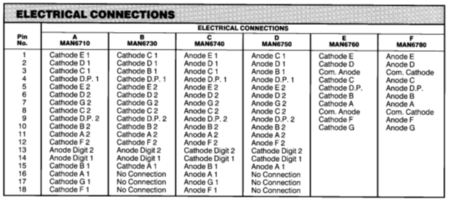
Data Sheet for 7 Segment Counter

Slide 5
COMMON CATHODE
The Cathode, or (-) is supplied
So if any of the input pins to turn on the segments go high, they will complete a circuit from (+) to (-) and light a light.
For example if there is a high signal (+) on pin 10 the G line in the middle will light up.

Slide 6
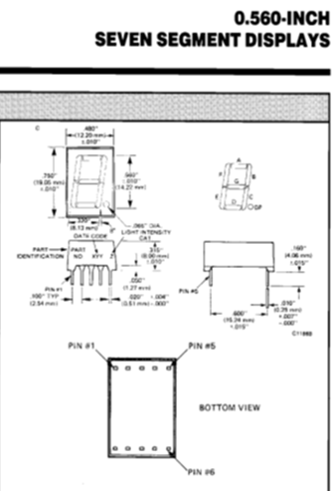

Data Sheet for 7 Segment Counter

Slide 7
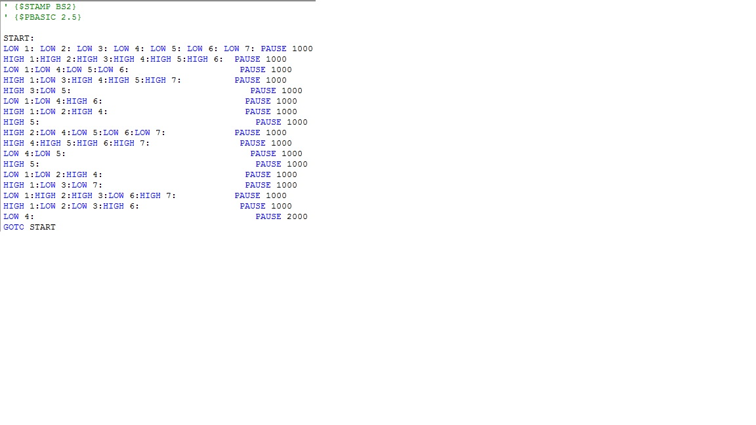
Program used…

Slide 8
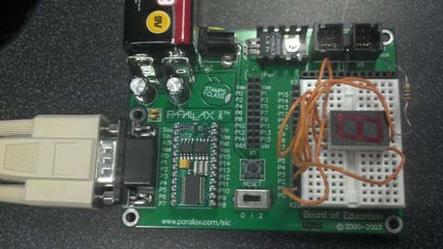
9 VOLT BATTERY
JUMPER WIRES
(CONNECTED HORIZONTALLY)
100 ohm RESISTOR
GROUND Vdd
I/O PINS
100 ohm resistor connected to Common Cathode
7 SEGMENT LED DISPLAY

Slide 9

Video of Project Counting…

