Slide 1
Lab Notebook
EECT 112
Charles Slagal

Slide 2
AND/OR GATES LAB
Shows the basic functions of AND/OR gates
Shows Multisim schematic of AND/OR gates
Shows probe displaying power output of AND/OR gates
Show lab work

Slide 3
Function of AND/OR gates
OR gate is a logic gate that combines many logic outputs into fewer logic outputs. It shows that if either output is a high, the output becomes high.
Example: A(high)+ B(low)=high output X
AND gate is also a logic gate that combines many logic outputs into fewer logic outputs. It shows that if either output is a low, the output becomes low.
Example: A(low)x B(high)=low output X

Slide 4
MULTISIM SCHEMATICS FOR AND/OR GATES
AND GATE
OR GATE

Slide 5
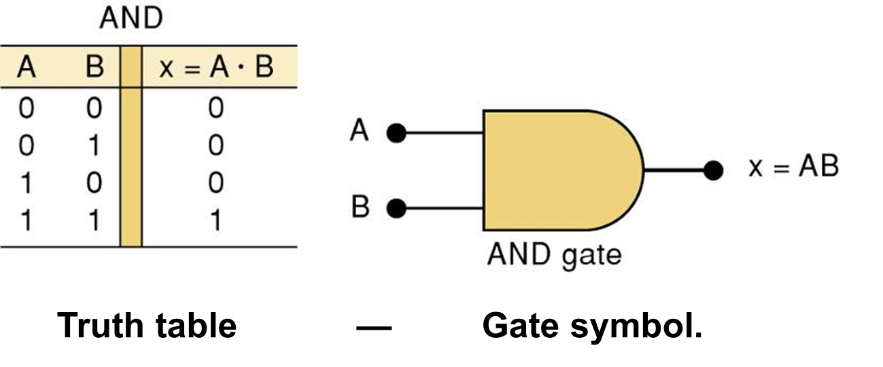
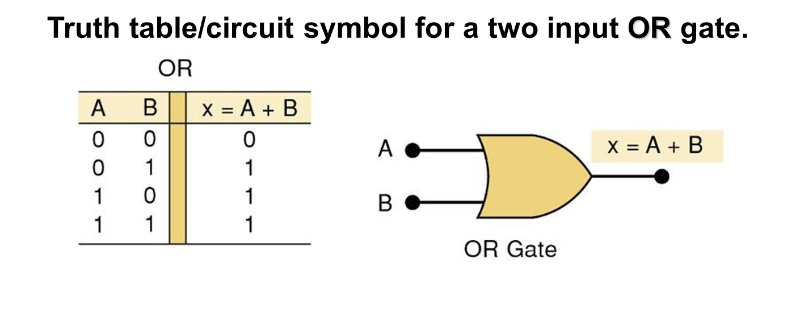

Slide 6
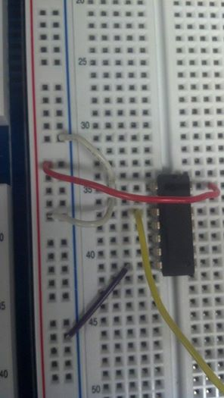
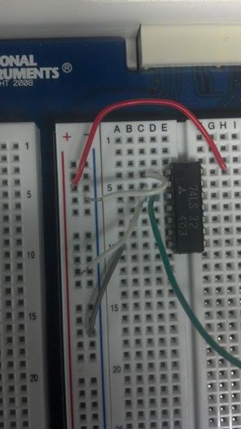
IN THE LAB…
OR GATE
AND GATE

Slide 7
AND/NAND GATES LAB
Show basic function of NAND Gates
Show schematic of NAND Gate with AND gate
Show lab work

Slide 8
NAND GATE FUNCTION
NAND gate is a logic gate that combines more than one logic output into fewer logic outputs. It shows the inverse output of that of the AND gate.
NAND gates may reduce the amount of logic gates needed to be used. (As will be show in the schematic)

Slide 9






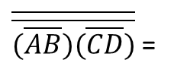
SWITCHES CONTROLLINAND/NAND GATES
MULTISIM SCHEMATIC FOR AND/NAND GATES
$$(\overline{A} + \overline{B})$$
AND/OR GATES ACTING AS NAND GATES
$(\overline{A} + \overline{B})(\overline{C}+\overline{D})$
This shows the amount
of gates used
can be reduced by using
NAND gates.
$$(\overline{C} + \overline{D})$$
$$\overline{AB}$$
$$\overline{\left(\overline{AB})(\overline{CD}\right)}$$
NAND GATES
$\overline{\overline{(\overline{AB})(\overline{CD})}}$ =
$(\overline{A} + \overline{B})(\overline{C}+\overline{D})$
$$\overline{CD}$$

Slide 10
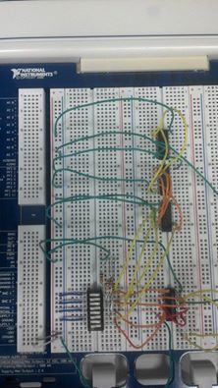
LAB WORK…
SAME OPERATION CAN BE CARRIED OUT WITH ONE CHIP (NAND GATE) AS OPPOSED TO USING THREE CHIPS (AND GATE, OR GATE AND INVERTOR)
AND GATE
OR GATE
INVERTOR
SWITCH BOARD
NAND GATE

Slide 11
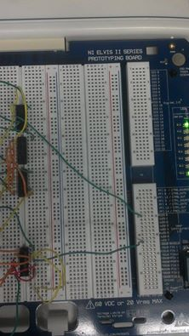
LIGHTS BEING LIT BY BOTH OF THE CONFIGURATIONS

Slide 12
MIDTERM CAR ALARM
We need to create a configuration that allows the alarm to go off when the door is open and the lights are on, but off if the doors are closed, engine is on and lights on.
Show schematic of this configuration
Show lab work

Slide 13
MULTISIM SCHEMATIC

Slide 14
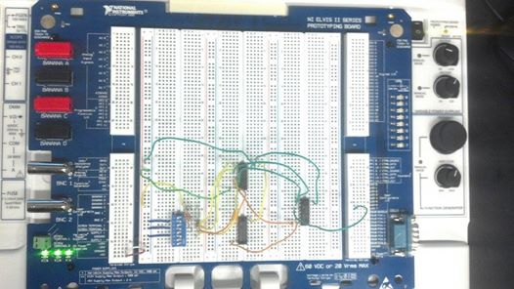
LAB WORK…
SWITCH BOARD
AND GATE
OR GATE
INVERTOR

Slide 15
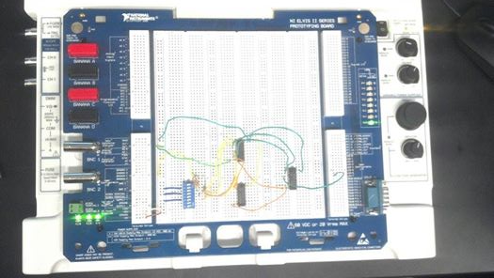
LIGHT ON, SHOWING THE CAR ALARM HAS BEEN SET OFF DUE TO SWITCH BOARD SWITCHING ON LIGHTS AND DOOR AJAR.

Slide 16
DDF Enable/disable

Slide 17
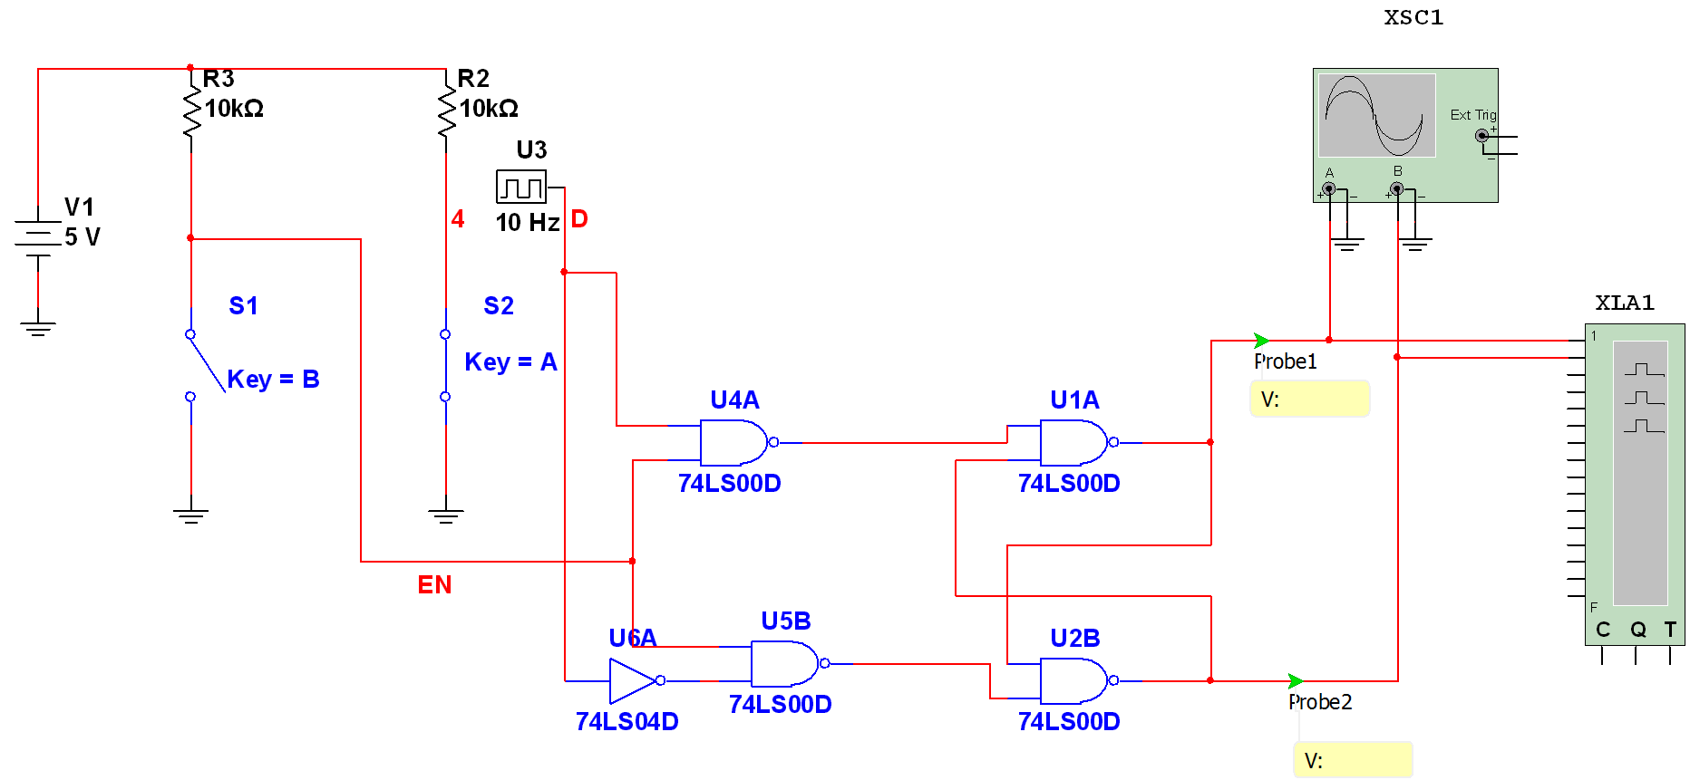
DFF ENABLE/DISABLE

Slide 18
NAND latch

Slide 19
Blinking LED & Temperature Detection Lab
Shows program used

Slide 20
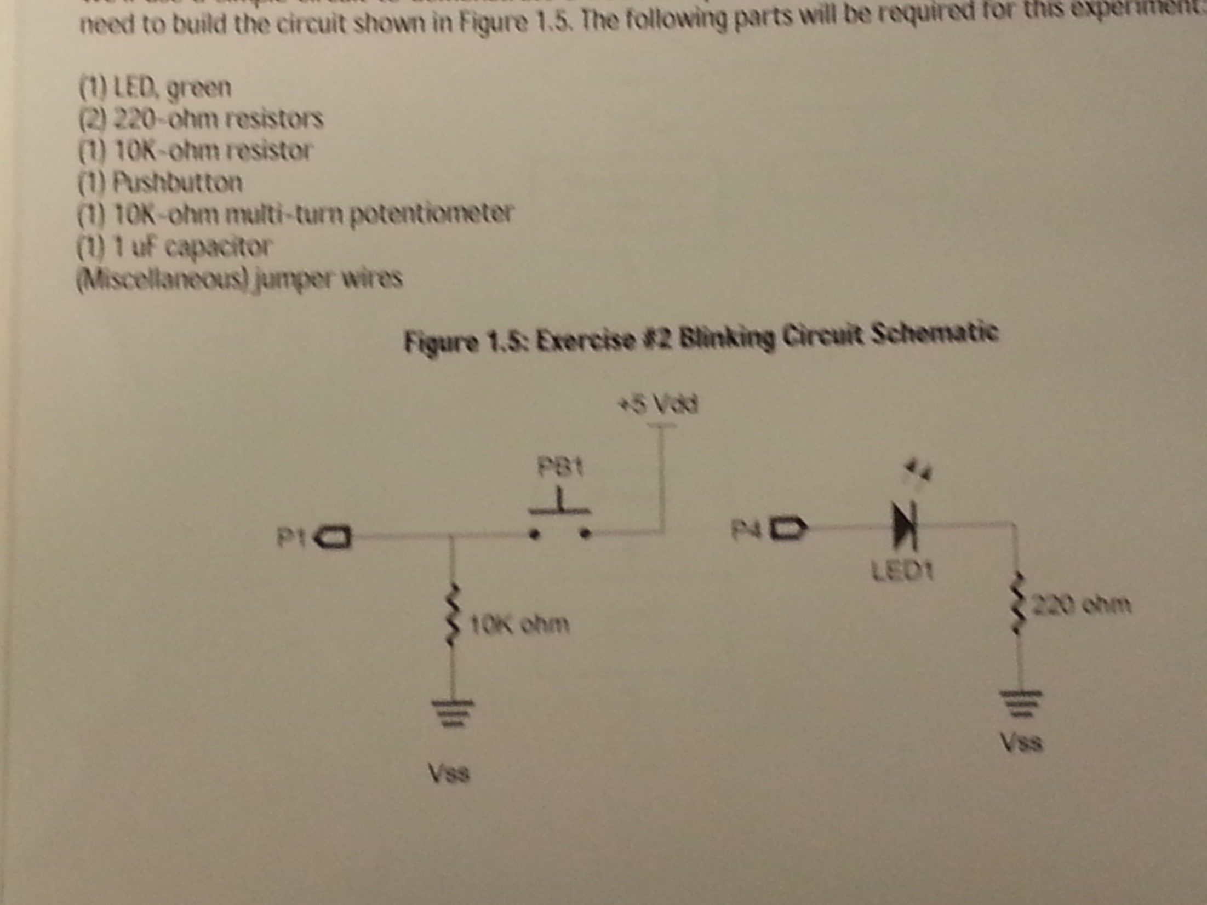
Equipment Used

Slide 21
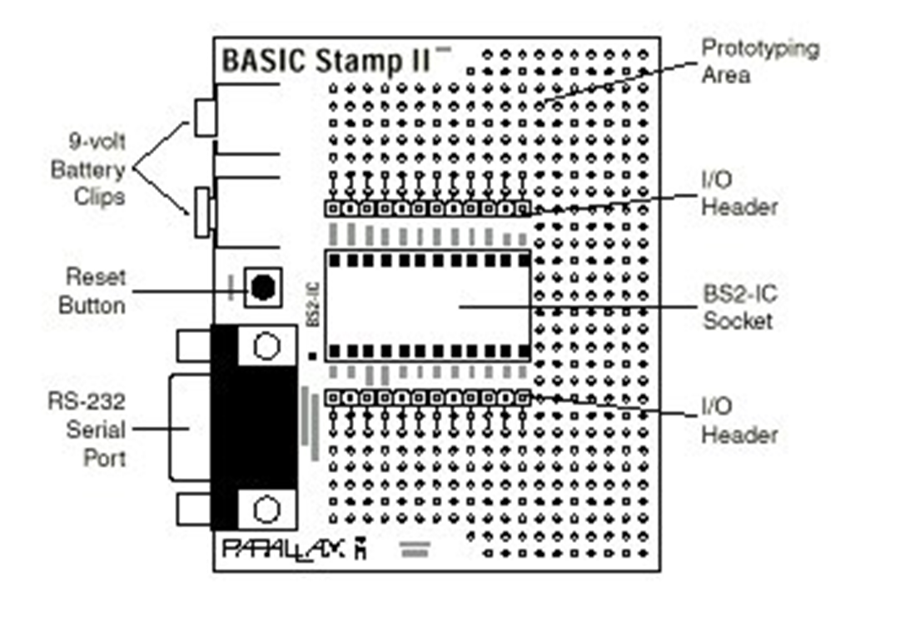

Slide 22
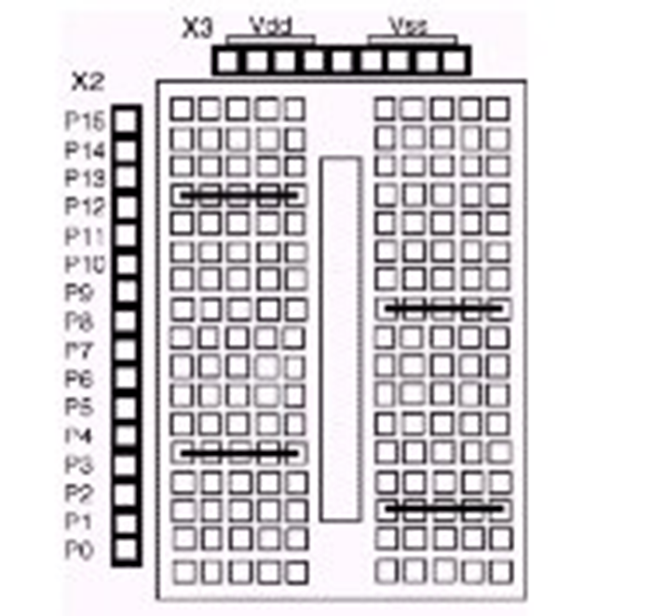
Breadboard connections:
The horizontal black lines show how the
“sockets” are connected underneath the
breadboard. This means you don’t have to
plug two wires into one socket since the
socket to the right or left is connected.
I/O Pin connections are along left
power connections are along the top
“Vdd” is +5 volts
“Vss” is ground

Slide 23

PROGRAM USED…
This is the program that we used to make the LED lights perform the task of lighting the LED five times within ten seconds.

Slide 24
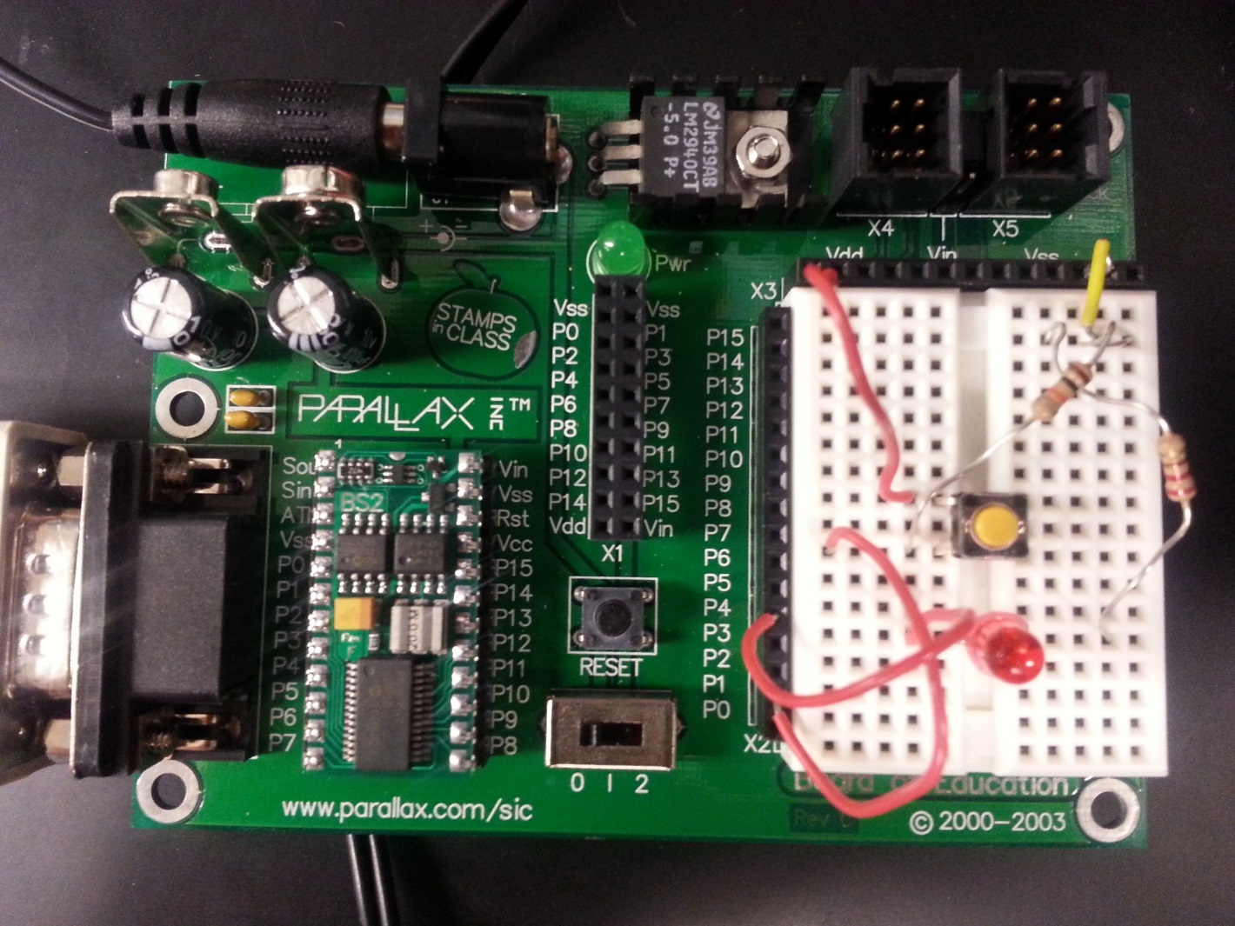
LAB WORK…
RESISTORS
PUSH BUTTON
LED

Slide 25
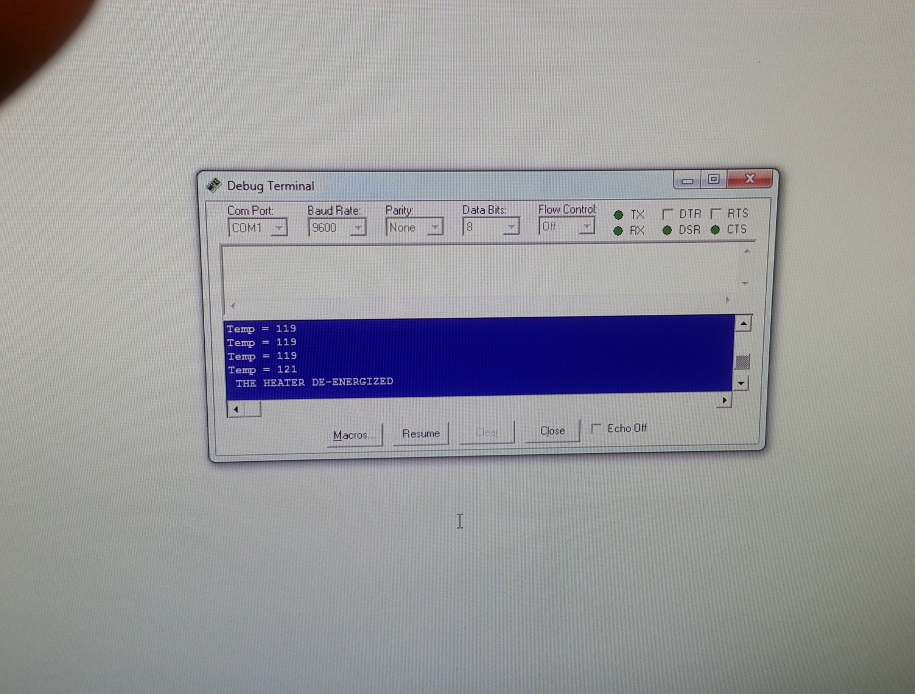
We used the potentiometer to detect when the LED reached certain temperatures. Once the LED reached 120 degrees, the light would turn off.

Slide 26
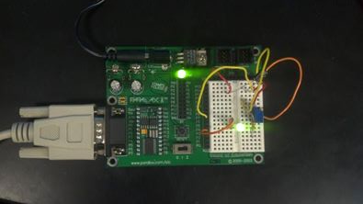
Pot meter- detects the temperature of LED
LED light being lit due to pot meter reading 120°

Slide 27
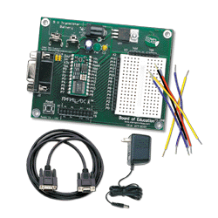
4 DIGIT COUNTER (BASIC STAMP II)
Create a 4 digit counter

Slide 28
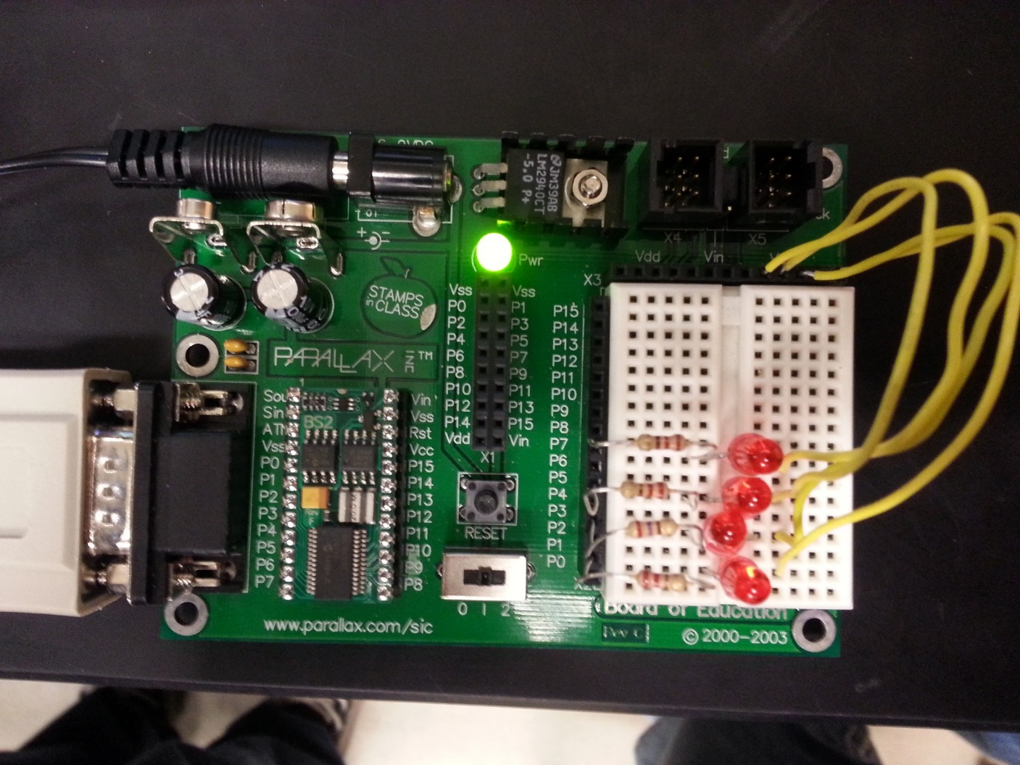
Wiring configuration of 4-Bit digital counter…

