Slide 1
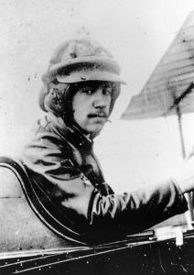
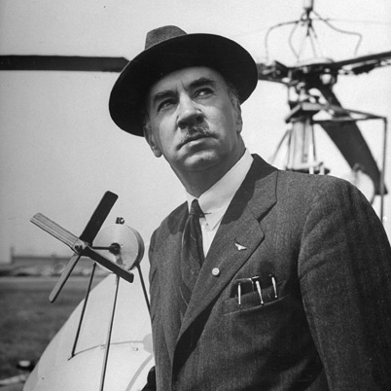
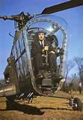
Igor Sikorsky
By: Charles Slagal

Slide 2

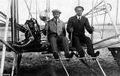
Beggings of Aviation
Orville and Wilbur Wright (Wright Brothers)
Igor has a prophetic dream as a child

Slide 3
Igor’s Start
Igor is born to Ivan and Mariya Sikorsky in 1889
Igor was homeschooled. Taught about the arts. Leonardo Da Vinci
Went to St. Petersburg Naval Academy and later went to the Mechanical College of the Kiev Polytechnic Institute. Later he went to Paris to study Aviation
Wanted to create a machine with vertical flight. Failed.
Changed to fixed winged planes

Slide 4

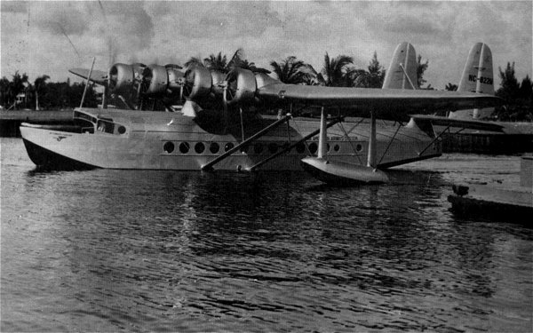
Fixed Winged Airplanes
Wings stay in the same place (fixed).
Design of the wings
Le Grand First four engine airplane

Slide 5
Going Abroad
In 1917 the Russian Revolution led Igor to flee Russia
Went to England. Can’t find work
traveled to France. Finds work. Loses work due to Armistice
Came to America. Can’t find work
Finds other Russian refugees. Manufactures planes
Founded his own company and eventually manufactured the first transatlantic airplane with Charles Lindergh. The S-42

Slide 6
Igor’s Original Passion
More educated and more experienced with Aviation
Louis and Jacques Breguet give Igor inspiration with their helicopter raising just .6 meters off the ground in 1906
Creates the VS-300. America’s first practical helicopter. First with rotor on tail
Makes way for the VS-316. The first production helicopter. Starts the market for helicopters

Slide 7
Igor’s Original Passion (cont’d)
Helicopters can do things airplanes can’t
An estimated 100,000 lives were saved within the first 20 years
Helicopters are capable of carrying huge payloads
The S-64 was one of his first helicopters that were capable of carrying heavy payloads. Maximum of 10 tons
Today the Mil V-12 has the largest lift capacity of about 44 tons

Slide 8
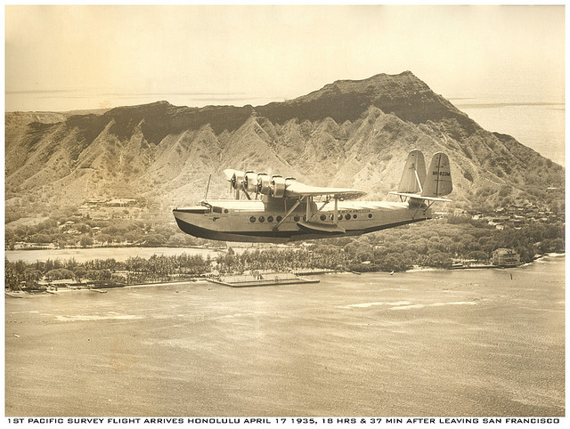
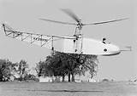
Igor’s Dream Fulfilled
His inventions has and will continue to be beneficial to people
After Igor retired he experiences his dream he had as a boy in Kiev

Slide 9
Works Cited
http://www.biography.com/imported/images/Biography/Images/Profiles/S/Igor-Ivan-Sikorsky-9483585-1-402.jpg
https://ixquick-proxy.com/do/spg/show_picture.pl?l=english&cat=pics&c=pf&q=Igor+sikorsky&h=1056&w=736&th=160&tw=111&fn=6af1623703d53ff01274ef193eb28670.jpg&fs=139 k&el=boss_pics_2,boss_pics_1&tu=http:%2F%2Fts3.mm.bing.net%2Fth%3Fid%3DH.4979959938942170%26pid%3D15.1%26H%3D160%26W%3D111&rl=NONE&u=http:%2F%2Fwww.pinterest.com%2Fpin%2F120330621267218961%2F&udata=494d6798510e48f14b0e25033957676f&rid=NELNSPNMTQTS&oiu=http:%2F%2Fmedia-cache-ak0.pinimg.com%2F736x%2F6a%2Ff1%2F62%2F6af1623703d53ff01274ef193eb28670.jpg
https://ixquick-proxy.com/do/spg/show_picture.pl?l=english&cat=pics&c=pf&q=Kiev+flag&h=583&w=1024&th=91&tw=160&fn=flag_of_kiev_ruminska_by_zalezsky-d36wa50.png&fs=67.5 k&el=boss_pics_2,boss_pics_1&tu=http:%2F%2Fts4.mm.bing.net%2Fth%3Fid%3DH.4583195176337467%26pid%3D15.1%26H%3D91%26W%3D160&rl=NONE&u=http:%2F%2Fzalezsky.deviantart.com%2Fart%2FFlag-of-Kiev-Ruminska-192982356&udata=77b46c5617a0bd36f88374c9026104be&rid=OILNSPNNKRQN&oiu=http:%2F%2Ffc06.deviantart.net%2Ffs71%2Fi%2F2011%2F010%2F1%2F8%2Fflag_of_kiev_ruminska_by_zalezsky-d36wa50.png
https://ixquick-proxy.com/do/spg/show_picture.pl?l=english&cat=pics&c=pf&q=wright+brothers+flying+plane&h=406&w=634&th=102&tw=160&fn=article-2327286-0B2A9DF4000005DC-817_634x406.jpg&fs=53.8 k&el=boss_pics_1&tu=http:%2F%2Fts4.mm.bing.net%2Fth%3Fid%3DH.4993459001754375%26pid%3D15.1%26H%3D102%26W%3D160&rl=NONE&u=http:%2F%2Fwww.dailymail.co.uk%2Fsciencetech%2Farticle-2327286%2FThe-Wright-Brothers-NOT-fly-plane--German-pilot-beat-years-earlier-flying-car-claims-leading-aviation-journal.html&udata=67edd2b8885328f63fa5485d4d1437bb&rid=NDLNSPNNLMLR&oiu=http:%2F%2Fi.dailymail.co.uk%2Fi%2Fpix%2F2013%2F05%2F20%2Farticle-2327286-0B2A9DF4000005DC-817_634x406.jpg
http://www.msacomputer.com/FlyingBoats-old/sikorsky/Sikorsky-S42-c.jpg
https://ixquick-proxy.com/do/spg/show_picture.pl?l=english&cat=pics&c=pf&q=design+of+air+plane+wings&h=564&w=1440&th=62&tw=160&fn=lift.gif&fs=10.8 k&el=boss_pics_2&tu=http:%2F%2Fts4.mm.bing.net%2Fth%3Fid%3DH.4802212744134751%26pid%3D15.1%26H%3D62%26W%3D160&rl=NONE&u=http:%2F%2Fwww.allstar.fiu.edu%2Faero%2Ffltmidfly.htm&udata=7ebdba3851c51475fe65f7df5d005cba&rid=NDLNSPNNMNQR&oiu=http:%2F%2Fwww.allstar.fiu.edu%2Faero%2Fimages%2Flift.gif
http://www.indiandefencereview.com/spotlights/the-helicopter-as-a-combat-platform/
http://farm3.staticflickr.com/2434/3832430893_9827fc81b8_z.jpg

