Slide 1
EECT 101-50C Lab Notebook
ELECTRONIC PROJECTS
Spring 2015
by
Dakota Johnson
Lab Partner:
Vince Erb
Instructor:
Lou Toth
12-16-15

Slide 2
Table of Contents
Lab 1 – Testing Resistors 3-7
Lab 2 – Resistors and Ohm’s Law 8-12
Lab 3 – Resistors and Multisim 13-19
Lab 4 – Test Equipment 1 20-26
Lab 5 – Capacitors and Inductors 27-30
Lab 6 – Learn to Solder 31-35
Lab 7 – Component Identification/First Solder Kit 36-41
Lab 8 – 555 Timer 42-47
Lab 9 – Filters 48-53
Lab 10 – Changing a Square Wave to a Sine Wave 54-58
Lab 11 – Troubleshoot Home Electronics/Testing TTL Chips 59-64
Lab 12 – Lissajous Pattern/Misc Troubleshooting 65-70
Lab 13 – AC to DC Power Supplies/Misc Troubleshooting 71-76
Lab 14 – ESD Precautions/Test LEDs/Misc Troubleshooting 77-82
Lab 15 – Plan, Prepare, Test Solder Kit 83-88
Lab 16 – Final Soldering Kit 89-93

Slide 3
Lab 1 – Testing Resistors

Slide 4
Lab 1 – Testing Resistors
Objective
To test the resistance of different resistors
Equipment and Material
Bench #6
Table Digital Multimeter Model # GwINTEK GDM-8245
Hand-Held Digital Multmeter Model # OTE DT6830
3 Resistors of various color codes
Research and Information
How to use a multimeter: https://www.youtube.com/watch?v=18d-DQPIyE8
Resistor Color Code: https://www.youtube.com/watch?v=kvQBhXo_tF0
How to measure Resistors: https://www.youtube.com/watch?v=HrZZMhWZiFk

Slide 5
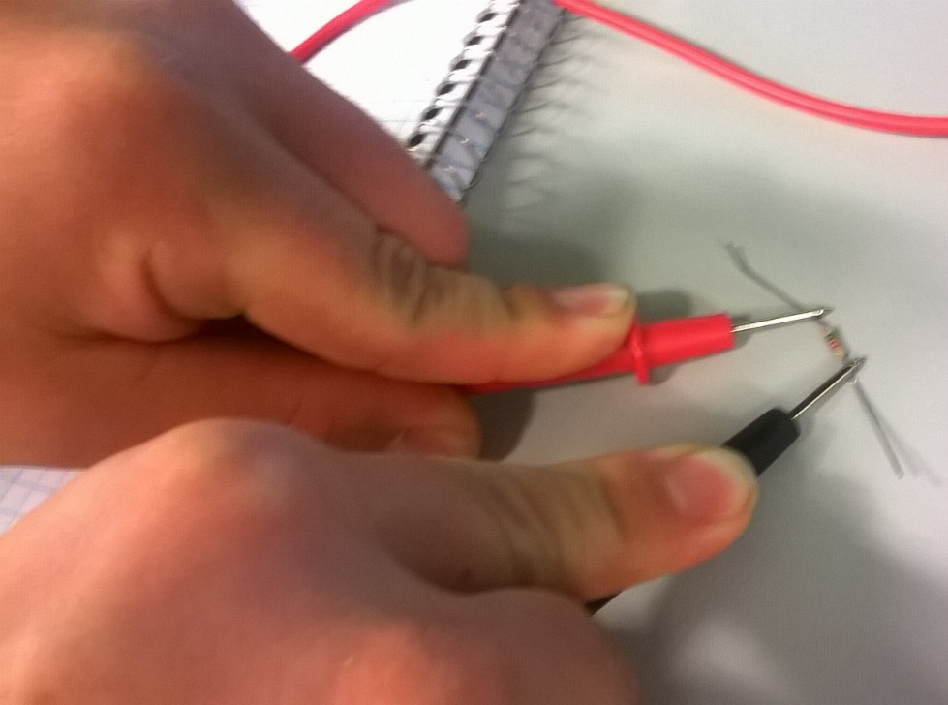
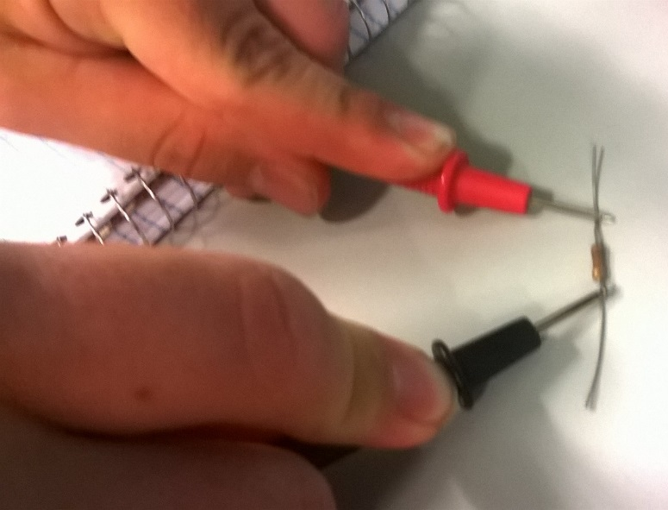
Lab 1 – Testing Resistors
Procedures, Calculations, Results, etc.
Procedure: The multimeter was turned on and the set to measure resistance. The resistance of the resistors was measured by placing the probes of the multimeter on each end of the resistor and reading the resistance.

Slide 6
Lab 1 – Testing Resistors
Resistor Number | Color code | Assumed Number | Assumend Tolerance | Tolerance Low | Measured | Tolerance High
1 | Brown, Black Brown, Gold | 100 | 5% | 95 | 100.5 | 105
2 | Red,Red,Red,Gold | 2200 | 5% | 2090 | 2161 | 2310
3 | Red,Red,Brown, Green | 220 | 0.50% | 218.9 | 5122 | 221.1
 | Green,Brown,Red,Red | 5100 | 2% | 4998 | 5122 | 5202
The third resistor was measured with a hand-held multimeter and the result was 5.11 kohm.

Slide 7
Lab 1 - Soldering
Summary and Conclusions
How to read resistor color codes and how to use multimeters.
Reading the third resistor’s color code was a little difficult because we were not sure which side to start reading from.
I need to practice the resistor color code.

Slide 8
Lab 2 – Resistors and Ohm’s Law

Slide 9
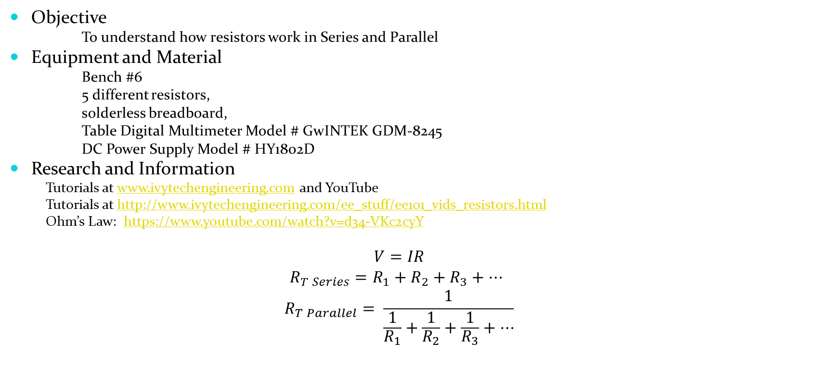
Lab 2 – Resistors and Ohm’s Law
Objective
To understand how resistors work in Series and Parallel
Equipment and Material
Bench #6
5 different resistors,
solderless breadboard,
Table Digital Multimeter Model # GwINTEK GDM-8245
DC Power Supply Model # HY1802D
Research and Information
Tutorials at www.ivytechengineering.com and YouTube
Tutorials at http://www.ivytechengineering.com/ee_stuff/ee101_vids_resistors.html
Ohm’s Law: https://www.youtube.com/watch?v=d34-VKc2cyY
$$V=IR$$
$${R_{T Series}=R_{1}+R_{2}+R_{3}+…}_{ }$$
$$R_{T Parallel}= \frac{1}{\frac{1}{R_{1}}+\frac{1}{R_{2}}+\frac{1}{R_{3}}+…}$$

Slide 10
Lab 2 – Resistors and Ohm’s Law
Procedure:
Five resistor values were given and the resistors were chosen by reading the resistor color codes. The resistors were measured to ensure they were within tolerance. Three resistors were then put in series and the total resistance was measured using the multimeter. Five resistors were put in series and the total resistance was measured. Three resistors were then put in parallel and the total resistance was found. Next five resistors were put in parallel and the total resistance was measured. The DC power supply adjusted to 5V and this was checked by connecting the multimeter to the power supply. The power supply was connected to the bread board. The total current, a single branch current and voltage drops were then measured for each of the four previous circuits using the multimeter. All result were put into Microsoft Excel.

Slide 11
Lab 2 – Resistors and Ohm’s Law
 | EECT 101-50C Lab 2 Series/Parallel Resistors
 |  |  |  |  |  | Circuit 1 - Series, R1-3 |  |  |  |  | Circuit 2 - Series, R1-5
 | Nominal | Measured |  |  |  | Calculated | Measured | Simulated |  |  | Calculated | Measured | Simulated
R1 = | 330 | 324.68 |  |  | Rt = | 2150 | 2123.1 | 2150 |  | Rt = | 9050 | 8854 | 9050
R2 = | 820 | 820 |  |  | It = | 2.3E-3 | 2.249 | 2.326 |  | It = | 552.5E-6 | 507.4E-6 | 552.447
R3 = | 1000 | 977.9 |  |  | VR1= | 767.4E-3 | 0.7534 | 0.767442 |  | VR1= | 182.3E-3 | 0.1806 | 0.182321
R4 = | 2200 | 2154 |  |  | VR2= | 1.9E+0 | 1.9123 | 1.907 |  | VR2= | 453.0E-3 | 0.4587 | 0.45304
R5 = | 4700 | 4577 |  |  | VR3= | 2.3E+0 | 2.3298 | 2.326 |  | VR3= | 552.5E-3 | 0.5588 | 0.552487
V1 = | 5 | 5.006 |  |  |  |  |  |  |  | VR4= | 1.2E+0 | 1.1999 | 1.215
 |  |  |  |  |  |  |  |  |  | VR5= | 2.6E+0 | 2.5896 | 2.597
 |  |  |  |  |  | Circuit 3 - Parallel R1-3 |  |  |  |  | Circuit 4 - Parallel, R1-5
 |  |  |  |  |  | Calculated | Measured | Simulated |  |  | Calculated | Measured | Simulated
 |  |  |  |  | Rt = | 190.48 | 187.99 | 190.483 |  | Rt = | 169.00 | 166.62 | 169.001
 |  |  |  |  | It = | 26.2E-3 | 25.1E-3 | 26.249 |  | It = | 29.6E-3 | 28.2E-3 | 29.586
 |  |  |  |  | IR1= | 0.015152 | 0.0149 | 0.015151 |  | IR1= | 0.015152 | 0.0149 | 0.015151

Slide 12
Lab 2 – Resistors and Ohm’s Law
Summary and Conclusions
We learned how to add resistors in series and parallel.
Make sure that the multimeter is set to measure the desired reading.

Slide 13
Lab 3 – Resistors and Multisim

Slide 14
Lab 3 – Resistors and Multisim
Objective
To use the Multisim computer program to understand how resistors work in Series and Parallel.
Equipment and Material
Bench #6
Multisim 13
Research and Information
Basic Multisim https://www.youtube.com/watch?v=10Rt2p3seV4
Basic Multisim continued https://www.youtube.com/watch?v=2UQPd0pj6uc
How to measure resistance in Multisim https://www.youtube.com/watch?v=3G5V0Hxjkbg
Measuring DC voltage in Multisim https://www.youtube.com/watch?v=8P4oFw6sIzQ
Measuring DC current in Multisim https://www.youtube.com/watch?v=8h2SAZ9gkBA

Slide 15
Lab 3 – Resistors and Multisim
Procedure:
The circuits from Lab 2 were built in multisim and the total resistance, total current, voltage drops, and branch currents were measured in multisim.

Slide 16
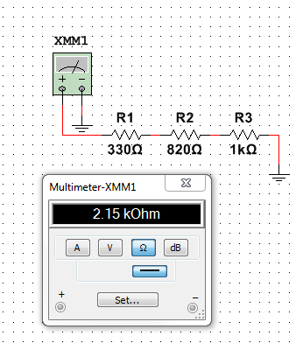
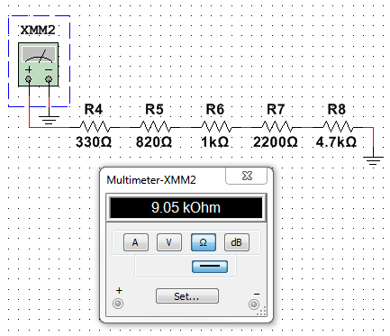
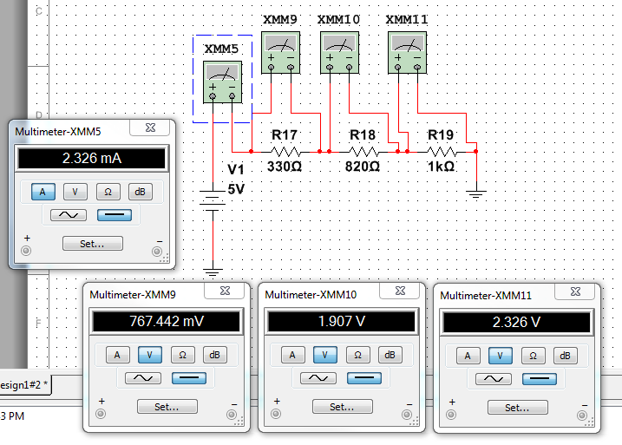
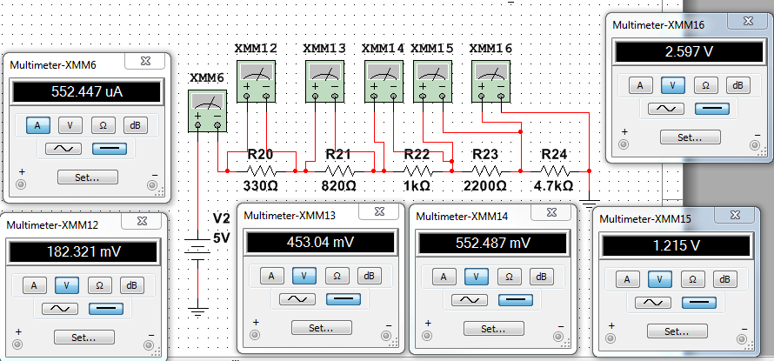
Lab 3 – Resistors and Multisim
Series circuit resistance measurements.
Series circuit total current and voltage drop measurements.

Slide 17
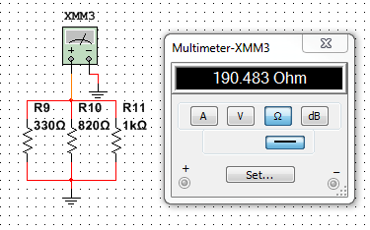
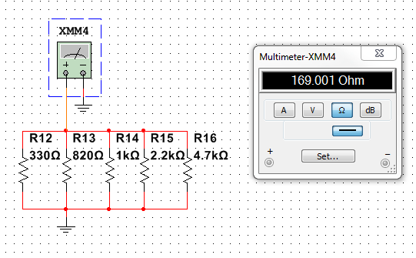
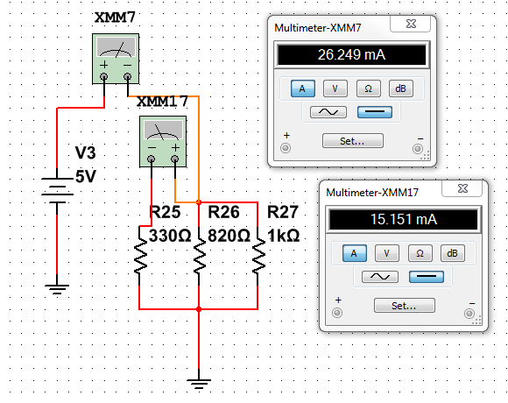
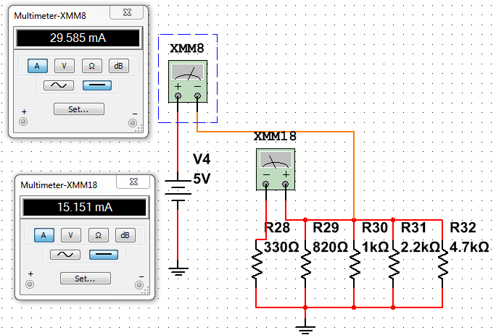
Lab 3 – Resistors and Multisim
Parallel circuit resistance measurements.
Parallel circuit current measurements.

Slide 18
Lab 3 – Resistors and Multisim
 | EECT 101-50C Lab 2 Series/Parallel Resistors
 |  |  |  |  |  | Circuit 1 - Series, R1-3 |  |  |  |  | Circuit 2 - Series, R1-5
 | Nominal | Measured |  |  |  | Calculated | Measured | Simulated |  |  | Calculated | Measured | Simulated
R1 = | 330 | 324.68 |  |  | Rt = | 2150 | 2123.1 | 2150 |  | Rt = | 9050 | 8854 | 9050
R2 = | 820 | 820 |  |  | It = | 2.3E-3 | 2.249 | 2.326 |  | It = | 552.5E-6 | 507.4E-6 | 552.447
R3 = | 1000 | 977.9 |  |  | VR1= | 767.4E-3 | 0.7534 | 0.767442 |  | VR1= | 182.3E-3 | 0.1806 | 0.182321
R4 = | 2200 | 2154 |  |  | VR2= | 1.9E+0 | 1.9123 | 1.907 |  | VR2= | 453.0E-3 | 0.4587 | 0.45304
R5 = | 4700 | 4577 |  |  | VR3= | 2.3E+0 | 2.3298 | 2.326 |  | VR3= | 552.5E-3 | 0.5588 | 0.552487
V1 = | 5 | 5.006 |  |  |  |  |  |  |  | VR4= | 1.2E+0 | 1.1999 | 1.215
 |  |  |  |  |  |  |  |  |  | VR5= | 2.6E+0 | 2.5896 | 2.597
 |  |  |  |  |  | Circuit 3 - Parallel R1-3 |  |  |  |  | Circuit 4 - Parallel, R1-5
 |  |  |  |  |  | Calculated | Measured | Simulated |  |  | Calculated | Measured | Simulated
 |  |  |  |  | Rt = | 190.48 | 187.99 | 190.483 |  | Rt = | 169.00 | 166.62 | 169.001
 |  |  |  |  | It = | 26.2E-3 | 25.1E-3 | 26.249 |  | It = | 29.6E-3 | 28.2E-3 | 29.586
 |  |  |  |  | IR1= | 0.015152 | 0.0149 | 0.015151 |  | IR1= | 0.015152 | 0.0149 | 0.015151

Slide 19
Lab 3 – Resistors and Multisim
Summary and Conclusions
We learned how to use multisim
The simulations agreed with the measured and calculated numbers.

Slide 20
Lab 4 – Test Equipment 1

Slide 21
Lab 4 –Test Equipment 1
Objective
To learn how to use a oscilloscope and function generator
Equipment and Material
Bench #6
DMM Brand: GwInstek Model #: GDM-8245 SN: CL860332
Oscilloscope Brand: Tektronix Model #: TDS220 SN: B083266
Function Generator Brand: GwInstek Model #: GFG-8210 SN: C705245
Research and Information
How to use an oscilloscope https://www.youtube.com/watch?v=dTPHSDoWKU0
How to use an oscilloscope https://www.youtube.com/watch?v=zHEQEnG5GSw
How to use an oscilloscope https://www.youtube.com/watch?v=7nwIIPN9QEY
AC vs. DC https://www.youtube.com/watch?v=8VEg6L2QG5o
Using an oscilloscope with AC https://www.youtube.com/watch?v=g0tBJlOEz00
Oscilloscope trigger levels https://www.youtube.com/watch?v=OFGm-Pel4Hg
How to use a function generator https://www.youtube.com/watch?v=Zink6v6TXk4

Slide 22
Lab 4 –Test Equipment 1
Procedure:
The function generator was set up to provide a 100Hz sine wave with a peak to peak voltage of 1V. An oscilloscope was used to measure the period of the wave, the amplitude of the wave, and the rise time and fall time of the wave. The function generator was then set to provide a 1kHz square with a peak to peak voltage of 5 with a 50% duty cycle. The oscilloscope was used to measure the period, pulse width, amplitude, and rise/fall time of the wave. The duty cycle was then set to 80/20 and the measurements were made again. Finally the function generator was set so that a square wave would pulse high for 100ms in a 1000ms period and the period, pulse width, and amplitude were measured using the oscilloscope.

Slide 23
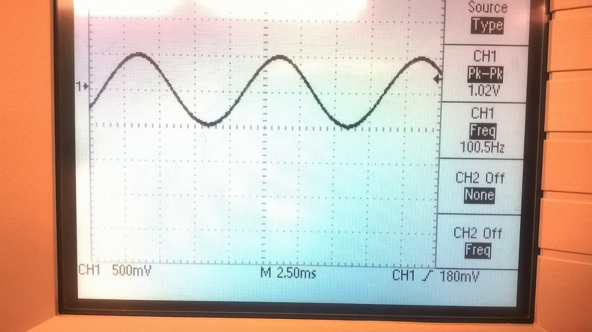
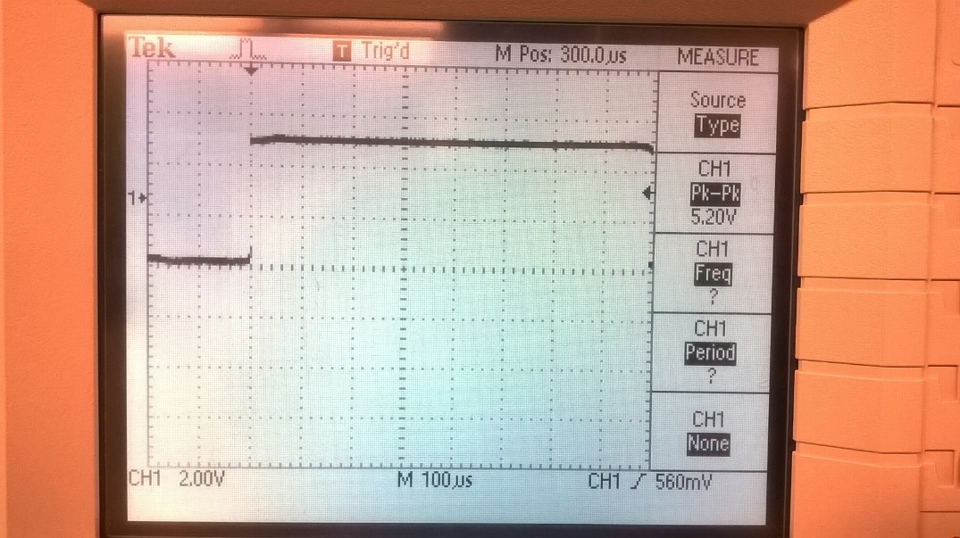
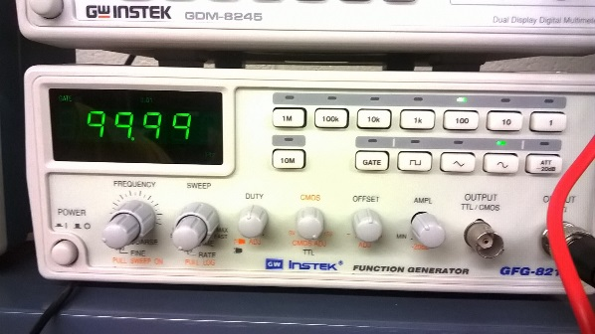
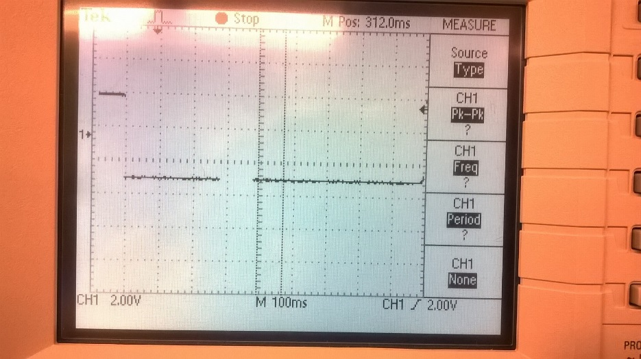
Lab 4 –Test Equipment 1
80/20 duty cycle square wave measurements.
Sine wave measurements.
10/90 duty cycle square wave measurements.

Slide 24
Lab 4 –Test equipment 1
1.a. | Set up the Function Generator to provide a 100Hz sine wave at 1V P-P.
 | Record the settings of the Function Generator.
 | Range was set to 100Hz
 | The wave type was sine
 | The amplitude adjustment was pulled out
 | 100.13Hz was read on the screen
1.b. | Use an Oscilloscope to verify the output of the function generator. Record the settings of the
 | Oscilloscope. |  | (Horiz scale X # of divisions = period. Vert scale X # of div = amplitude)
 | The oscilloscope was set to 500mV per division
 | 2.50ms per division
 | and had a trigger level of 180mV
1.c. | Measure the following: |  |  |  |  |  |  | Units:
 | a. | Period of the sine wave |  |  |  | 9.95 |  | ms
 | b. | Amplitude of the sine wave |  |  |  | 1.02 |  | V
 | c. | Rise time of the sine wave |  |  |  | 3 |  | ms
 | d. | Fall time of the sine wave |  |  |  | 3 |  | ms
 | e.
2.a. | Set up the Function Generator to provide a 1KHz square wave at 5V P-P, 50% duty cycle.
 | Record the settings of the Function Generator.
 | Range was set to 1kHz
 | The wave type was square
 | The amplitude dial was pushed in.
2.b. | Use an Oscilloscope to verify the output of the function generator. Record the settings of the
 | Oscilloscope. |  | (Horiz scale X # of divisions = period. Vert scale X # of div = amplitude)
 | 2.00V
 | M = 250us
 | Trigger 560mV
2.c. | Measure the following: |  |  |  |  |  |  | Units:
 | a. | Period of the square wave |  |  |  | 991 |  | us
 | b. | Pulse width of the square wave |  |  |  | 480 |  | us
 | c. | Amplitude of the square wave |  |  |  | 5.04 |  | V
 | d. | Rise time of the square wave |  |  |  | 36 |  | ns
 | e. | Fall time of the square wave |  |  |  | 36 |  | ns

Slide 25
Lab 4 –Test equipment 1
3.a. | Change the square wave to an 80/20 duty cycle. Record the settings of the Function Generator.
 | The range was set to 1kHz
 | The wave type was square
 | The amplitude dial was pushed in.
 | The reading on the screen was 1.0020kHz
3.b. | Use an Oscilloscope to verify the output of the function generator. Record the settings of the
 | Oscilloscope. |  | (Horiz scale X # of divisions = period. Vert scale X # of div = amplitude)
 | 2.00V
 | M = 100us
 | Trigger 560mV
3.c. | Measure the following: |  |  |  |  |  |  | Units:
 | a. | Period of the square wave |  |  |  | 998 |  | us
 | b. | Pulse width of the square wave |  |  |  | 790 |  | us
 | c. | Amplitude of the square wave |  |  |  | 5.04 |  | V
 | d. | Rise time of the square wave |  |  |  | 38 |  | ns
 | e. | Fall time of the square wave |  |  |  | 38 |  | ns
4.a. | Change the square wave to a one-shot that is high for 10ms and off for the rest of the 1000ms period.
 | Record the settings of the Func Generator.
 | The range was set to 1Hz
 | The wave type was square
 | The amplitude dial was pushed in
 | The reading on the screen was 1.1363Hz
4.b. | Use an Oscilloscope to verify the output of the function generator. Record the settings of the
 | Oscilloscope.
 | 2.00V
 | M =100ms
 | Trigger 2.00V
4.c. | Measure the following: |  |  |  |  |  |  | Units:
 | a. | Period of the square wave |  |  |  | 1 |  | s
 | b. | Pulse width of the square wave |  |  |  | 102 |  | ms
 | c. | Amplitude of the square wave |  |  |  | 4.4 |  | V
 | d. | Rise time of the square wave |  |  |  | N/A |  | N/A
 | e. | Fall time of the square wave |  |  |  | N/A |  | N/A

Slide 26
Lab 4 –Test Equipment 1
Summary and Conclusions
I learned how to use a function generator to generate different kinds of wave including sinusoidal and square waves. I also learned how to change a wave’s duty cycle and amplitude. I learned how to use an oscilloscope to measure the voltage, frequency, period, and rise/fall times of AC voltages. I also learned about the inverse relationship of frequency and period.

Slide 27
Lab 5 – Capacitors and Inductors

Slide 28

Lab 5 –Capacitors and Inductors
Objective
To use an LCR meter to measure inductors and capacitors including custom hand-wound inductors.
Equipment and Material
Bench #6
4 capacitor
3 inductors
3 hand wound inductors
Digital calipers
GW Instek LCR meter model#: LCR-819 SN#: E120998
Research and Information
What is a capacitor https://www.youtube.com/watch?v=X707xxqB1Qc
What is a capacitor https://www.youtube.com/watch?v=gOwJLgjRtw8
What is a capacitor https://www.youtube.com/watch?v=t9Qwx75eg8w
Capacitor explosions https://www.youtube.com/watch?v=3b7mjukhTyQ
What is an inductor https://www.youtube.com/watch?v=WKFnuHfmx00
What is an inductor https://www.youtube.com/watch?v=rqvqIQSBZc8
What is an inductor https://www.youtube.com/watch?v=NgwXkUt3XxQ
What is an inductor https://www.youtube.com/watch?v=VSMGnmQApA0
$$l=μN^{2}\frac{A}{L}$$
Inductance = Permeability x turns squared x (cross-sectional area/ length of wind)

Slide 29
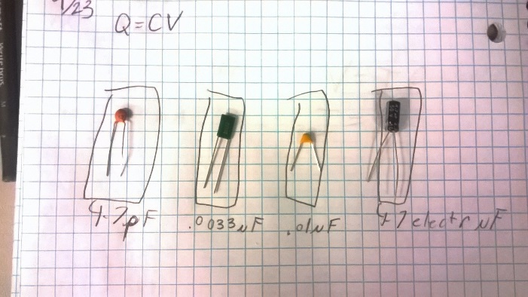
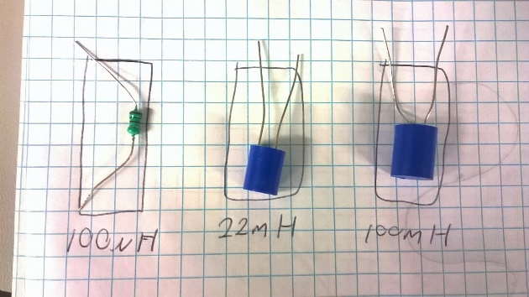
Lab 5 –Capacitors and Inductors
Capacitors
Inductors
Expected: |  | Measured:
4.70 | pF | 4.66 | pF
0.003 | µF | 0.00337 | µF
0.01 | µF | 0.00968 | µF
4.7 | µF | 4.56 | µF
Expected: |  | Measured:
100 | µH | 107.5 | µH
22 | mH | 20.97 | mH
100 | mH | 97.1 | mH
Hand wound Inductors
inductance measured |  | inductance caculated |  | lenth | area | diameter |  | turns | permeability
0.00132 | mH | 1.0E-6 | mH | 0.01016 | 1.81E-05 | 0.0048 |  | 10 | 0.0000057
0.00248 | mH | 2.8E-6 | mH | 0.01279 | 1.89E-05 | 0.0049 |  | 15 | 0.00000855
0.00477 | mH | 9.4E-6 | mH | 0.0157 | 3.36E-05 | 0.00654 |  | 20 | 0.000011

Slide 30
Lab 5 –Capacitors and Inductors
Summary and Conclusions
The capacitances and inductances were able to be measured. The hand wound inductors were built and the calculations and measured were all within tolerance except for the last one. It was thought that the winding was not tight enough and that is why they were so different.

Slide 31
Lab 6 – Learn to Solder

Slide 32
Lab 6 –Learn to Solder
Objective
Practice soldering 11 components on a 1"x1" circuit board (4 resistors-2 sizes; 1 electrolytic capacitor; 1 signal diode; 3 rectifier diodes-2 sizes; 1 inductor; 1 transistor). First mount all components then solder and trim off excess leads.
Equipment and Material
Bench #6
Soldering iron Brand: Weller, Model#: WES51
4 resistors
1 electrolytic capacitor
1 signal diode
3 rectifier diodes
1 inductor
1 transistor
Research and Information
How to solder: https://www.youtube.com/watch?v=oqV2xU1fee8
How to remove solder: https://www.youtube.com/watch?v=-lnRf2biz50
Soldering tutorial: https://www.youtube.com/watch?v=vIT4ra6Mo0s

Slide 33
Lab 6 –Learn to Solder
Procedure:
11 different components were chosen and then soldered onto a 1in X 1in breadboard.

Slide 34
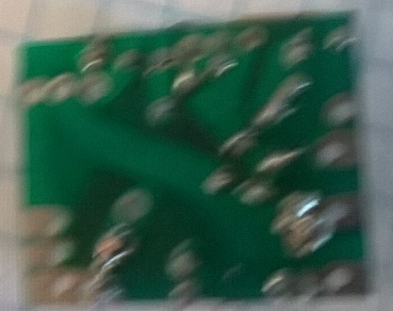
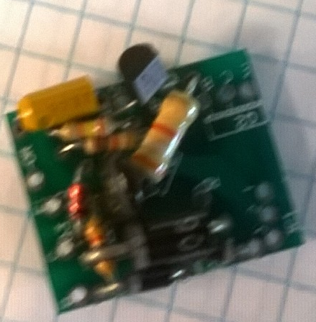
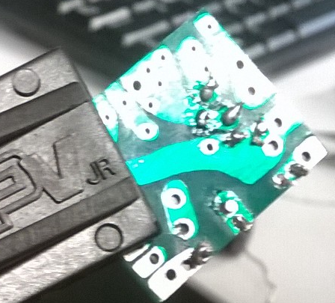
Lab 6 –Learn to Solder
Transistor
capacitor
24k resistor
3.9k resistor
Solder on underside of the board
10k resistor
Signal diode
inductor
1k resistor
Rectifier diodes

Slide 35
Lab 6 –Learn to Solder
Summary and Conclusions
I learned to solder by heating the pad and then placing the solder to melt onto the lead.

Slide 36
Lab 7 – Component Identification/First Solder Kit

Slide 37
Lab 7- Component Identification/First Solder Kit
Objective
Work in teams and open up either the old CD-1 CMOS/TTL boards or the Cadet 2 PB-505 boards to identify all the different components. Document the quantity of each type of component. List the number of transformers and each value resistor; number of diodes, transistors, electrolytic caps, non-electrolytic caps, inductors, potentiometers, ICs.
Each person gets their own flashing LED Vellman kit MK102 to build. Use knowledge and experience from last week's soldering activity to build your kit. Then, compare soldering quality of this week's kit to last week's soldering. Anyone without a working kit will troubleshoot and attempt to fix. Non-working kits from last semester are available to troubleshoot
Equipment and Material
Bench #6
Soldering iron Brand: Weller, Model#: WES51
Tool Kit
CD-1 CMOS/TTL boards
LED Vellman kit MK102
Research and Information
How to solder: https://www.youtube.com/watch?v=oqV2xU1fee8
How to remove solder: https://www.youtube.com/watch?v=-lnRf2biz50
Soldering tutorial: https://www.youtube.com/watch?v=vIT4ra6Mo0s

Slide 38
Lab 7- Component Identification/First Solder Kit
Procedure:
The screws on the face plate of the CD-1 CMOS/TTL board were taken off and the plate removed. The components were then identified. The soldering kit was opened and the parts were identified. The parts were then put onto the board and soldered in place according to the instructions. The circuit was then tested and troubleshot.

Slide 39
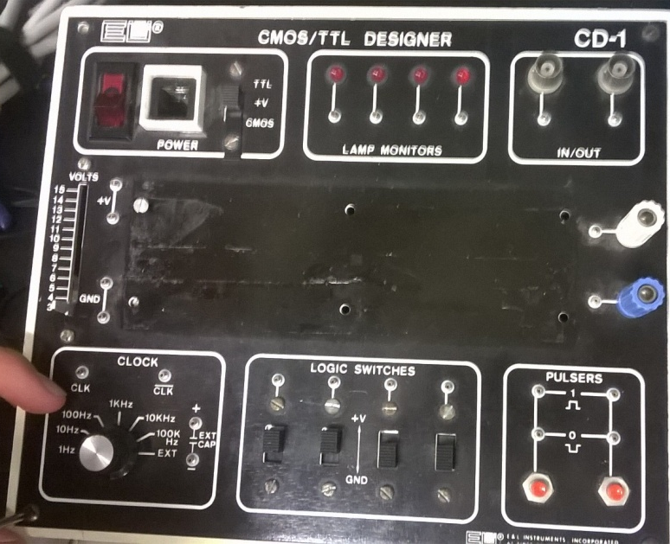
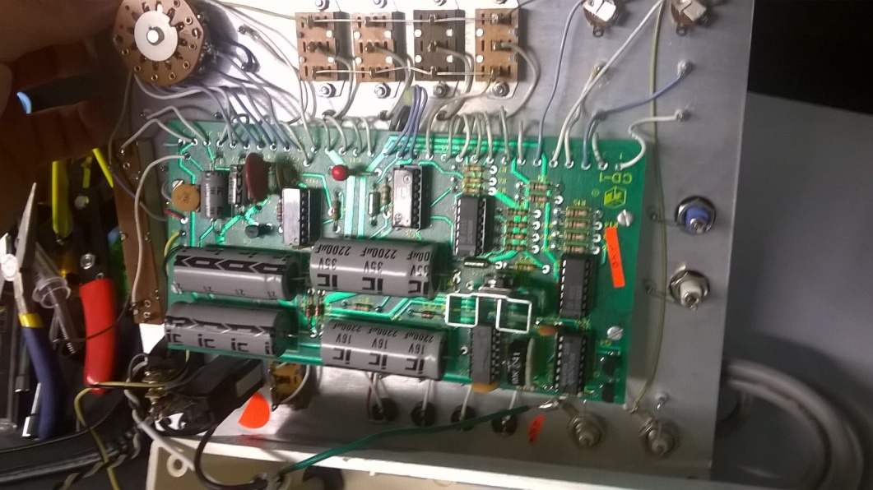
Lab 7- Component Identification/First Solder Kit
Resistors | Ω | Notes
R1 | 470
R2 | 1000
R3 | 1000
R4 | 1000
R5 | 470000
R6 | 470000
R7 | 470000
R8 | 470000
R9 | 150
R10 | 150
R11 | 150
R12 | 150
R13 | 1000
R14 | 1000
R15 | 1000
R16 | 1000
R17 | 4700
R18 | 0.2
R19 | 100000 | Potentiometer
R20 | 1000
R21 | 1000
R22 | 15
Capacitors | uF | Voltage range (V)
C1 | 330 | 10
C2 | 33 | 16
C3 | 3.3 | 50
C4 | 0.33 | 12
C5 | 0.03
C6 | 0.003
C7 | 2200 | 16
C8 | 2200 | 16
C9 | 3500 | 35
C10 | 0.1
C11 | 10 | 25
C12 | 2200 | 16
C13 | 0.003
C14 | 10
C15 | 0.003
C16 | 0.1
C17 | 0.1
Diodes | Part #
CR1 | 1N4003
CR2 | 1N4004
CR3 | 1N4005
CR4 | 1N4003
Integrated Circuits | Part #
IC1 | 7474
IC2 | 723
IC3 | 7406
IC4 | 7406
IC5 | 4049
IC6 | 7414
Face plate
Transformer
2 tap | 115V
Transistors | Part #
Q1 | 8134
Q2 | T1P29
Q3 | 5134
Q4 | 5134
Inside of the Board.

Slide 40
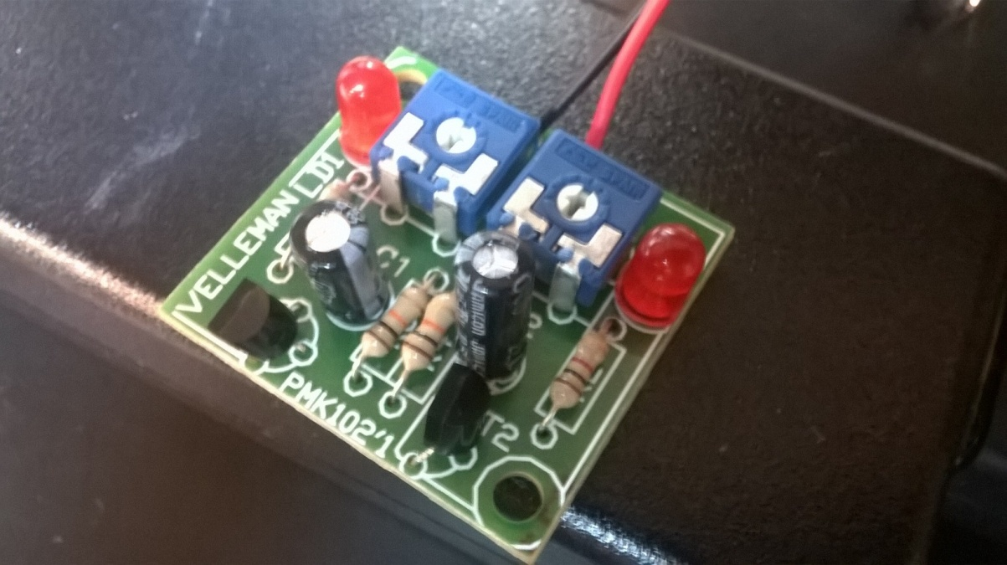
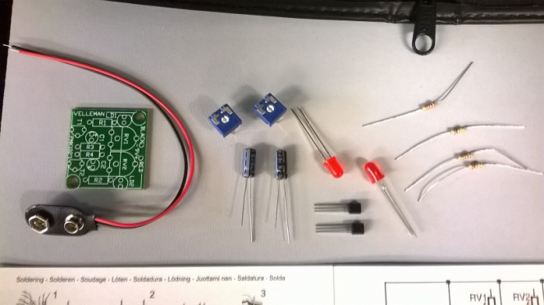
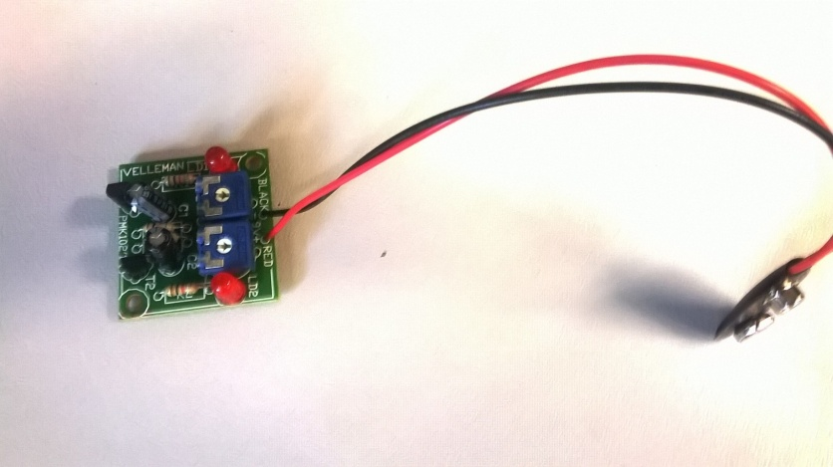
Lab 7- Component Identification/First Solder Kit

Slide 41
Lab 7- Component Identification/First Solder Kit
Summary and Conclusions
The components on the board were all identified. The soldering kit did not function when first put together. The circuit was troubleshot by unsoldering the led that would not light and replacing it with another. When that did not work the potentiometer was removed and replaced. While attempting to test the re-soldered circuit it was discovered that by flexing the board the circuit would work properly, so it was concluded that the board was bad.

Slide 42
Lab 8 – 555 Timer

Slide 43


Lab 8- 555 Timer
Objective
Research all about the 555 Timer chip and two types of LEDs and breadboarded a typical circuit to flash an LED at 0.5Hz, 1Hz, 4Hz. Use worksheet in this folder.
Equipment and Material
Bench #6
GW Instek LCR meter model#: LCR-819 SN#: E120998
Table Digital Multimeter Model # GwINTEK GDM-8245
Oscilloscope Brand: Tektronix Model #: TDS220 SN: B083266
555 Timer
1 capacitor
Various resistors
Research and Information
555 timer data sheet: http://ivytechengineering.com/stores/linear/files/lm555.pdf
Frequency
Duty Cycle

Slide 44
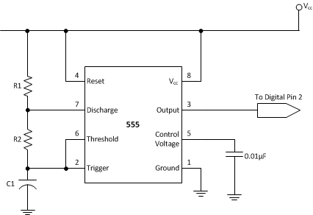
Lab 8- 555 Timer
Procedure:
The circuit was built following the schematic below. The values of the capacitors and resistors were calculated so that the output frequency was correct. The resistors and capacitors measured and the output voltage, frequency, and period were measured.

Slide 45
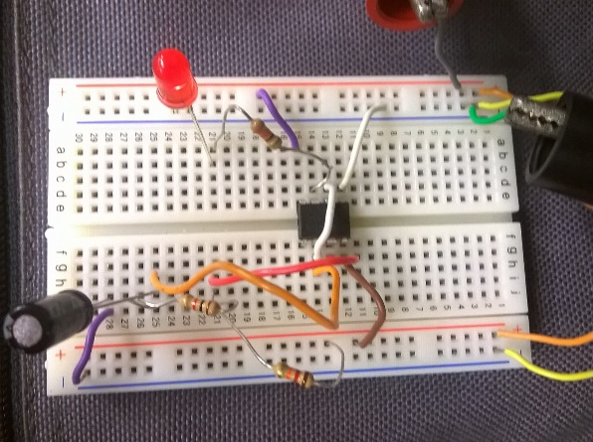
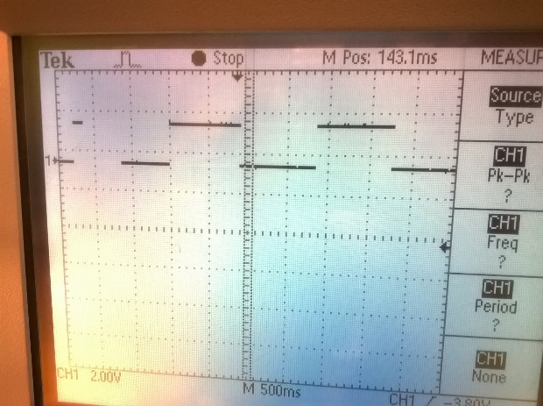
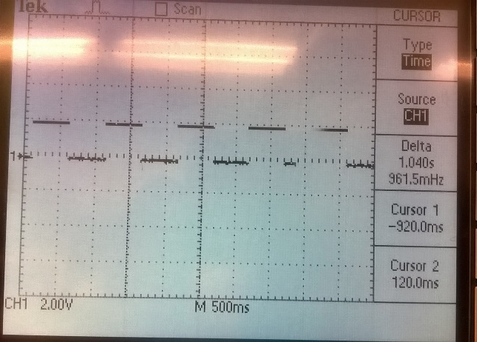
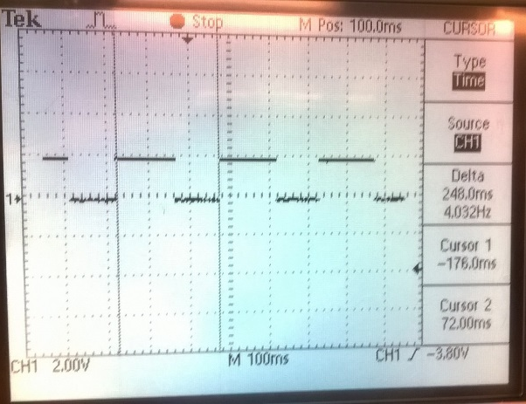
Lab 8- 555 Timer
.5 Hz
1 Hz
4 Hz

Slide 46
Lab 8- 555 Timer
Calculated
 |  | uF |  | Ω |  | Ω
0.5 Hz | C = | 47.0E-6 | Ra = | 7.3E+3 | Rb = | 27000
1 Hz | C = | 47.0E-6 | Ra = | 638.3E+0 | Rb = | 15000
4 Hz | C = | 47.0E-6 | Ra = | 1.1E+3 | Rb = | 3300
LED part # if known: |  | 08L53 |  | Common Anode: | Yes | Common Cathode: | No
 |  | Current limiting resistor used: |  | 330 | ohms
standard values
 |  | uF |  | Ω |  | Ω
0.5 Hz | C = | 47.0E-6 | Ra = | 6.8E+3 | Rb = | 27000
1 Hz | C = | 47.0E-6 | Ra = | 680.0E+0 | Rb = | 15000
4 Hz | C = | 47.0E-6 | Ra = | 1.2E+3 | Rb = | 3300
Vout 1.99 VDC
Record the settings of the Oscilloscope.
0.5 Hz | Vert scale: | 2 | v/div |  | Horiz scale: | 500 | ms/div
1 Hz | Vert scale: | 2 | v/div |  | Horiz scale: | 500 | ms/div
4 Hz | Vert scale: | 2 | v/div |  | Horiz scale: | 100 | ms/div
Measured
 |  | uF |  | Ω |  | Ω
0.5 Hz | C = | 40.1 | Ra = | 6884 | Rb = | 27025
1 Hz | C = | 40.1 | Ra = | 668.1 | Rb = | 14798
4 Hz | C = | 40.1 | Ra = | 1186.2 | Rb = | 3249.7
Measure the output of the 555 Timer on an Oscilloscope to verify each of the frequencies.
Expected |  | Expected |  | Measured |  | Measured
Frequency |  | Period |  | Period |  | Frequency
0.5 Hz |  | 2000 | ms | 1840 | ms | 0.537 | Hz
1 Hz |  | 1000 | ms | 1040 | ms | 0.961 | Hz
4 Hz |  | 250 | ms | 248 | ms | 4.032 | Hz

Slide 47
Lab 8- 555 Timer
Summary and Conclusions
I learned how to find desired frequencies duty cycles using a 555 timer.

Slide 48
Lab 9 – Filters

Slide 49
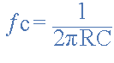

Lab 9- Filters
Objective
Determine the frequency response of a simple RC circiut
Equipment and Material
Bench #6
Table Digital Multimeter Model # GwINTEK GDM-8245
Oscilloscope Brand: Tektronix Model #: TDS220 SN: B083266
Function Generator Brand: GwInstek Model #: GFG-8210 SN: C705245
GwInstek LCR meter model#: LCR-819 SN#: E12099
1 capacitor
1resistors
Research and Information
Low Pass Filters:
https://online.ivytech.edu/webapps/blackboard/execute/content/file?cmd=view&content_id=_29861188_1&course_id=_864283_1

Slide 50
Lab 9- Filters
Procedure:
A resistor and a capacitor were put in series with each other like in the picture below. The Function Generator was adjusted to produce a 1Vpp, 10Hz sine wave and verified using the scope. The oscilloscope probes were attached to both the input and output of the circuit and connect the scope probe grounds to the ground or bottom side of the capacitor. Both Channel 1 & 2 of the oscilloscope were set to measure to Vpp and Frequency. The frequency on the function generator was changed based on the table given and the amplitude of the input and output voltages was measured.

Slide 51
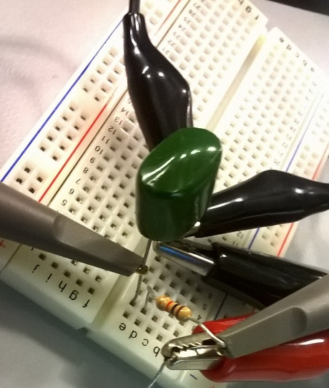
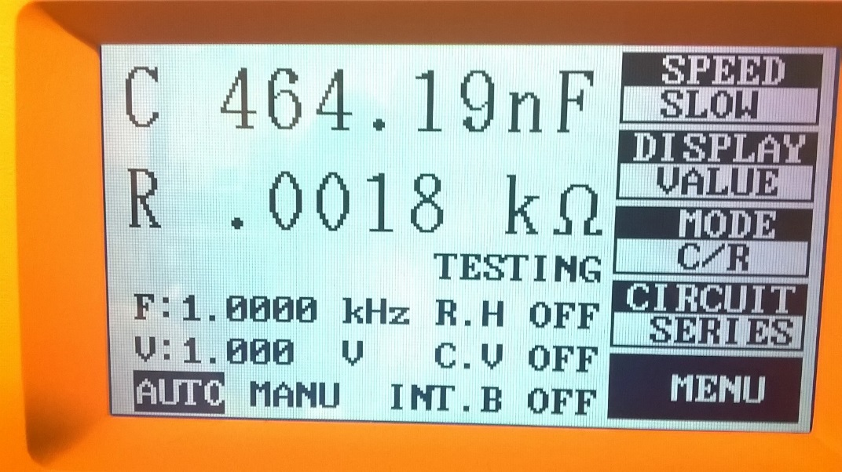
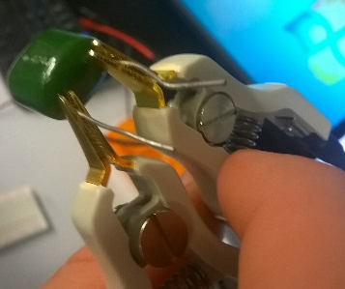
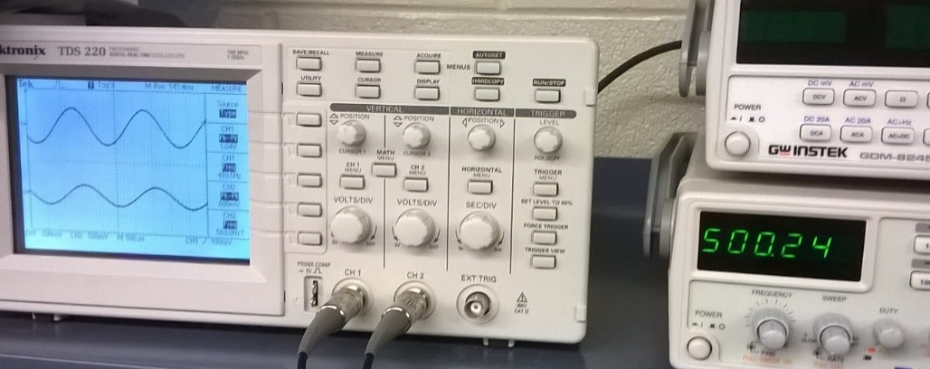
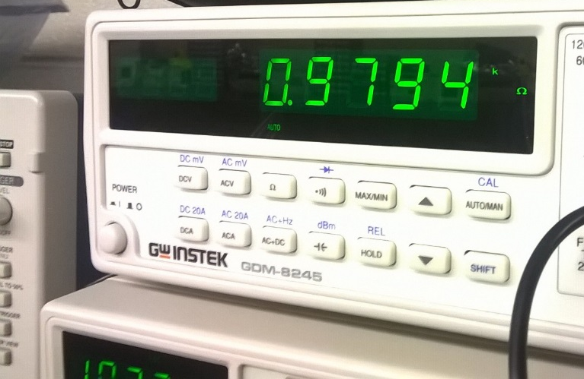
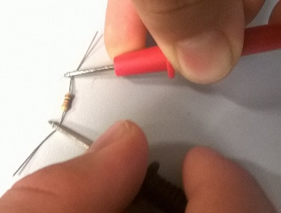
Lab 9- Filters
Testing the capacitor
Circuit Setup
Vin
Testing the resistor
Vout
Frequency response

Slide 52
Lab 9- Filters
-3dB
350 Hz

Slide 53
Lab 9- Filters
Summary and Conclusions
I learned that when capacitors and resistors are put in series with each other they can filter frequencies and depending on which way they are arranged they can either filter high frequencies or low frequencies.

Slide 54
Lab 10 – Changing a Square Wave to a Sine Wave

Slide 55
Lab 10- Changing a Square Wave to a Sine Wave
Objective
Build a circuit using only resistors and capacitors that converts a square wave into a sine wave.
Equipment and Material
Bench #6
Table Digital Multimeter Model # GwINTEK GDM-8245
Oscilloscope Brand: Tektronix Model #: TDS220 SN: B083266
Function Generator Brand: GwInstek Model #: GFG-8210 SN: C705245
GwInstek LCR meter model#: LCR-819 SN#: E12099
4 capacitor
4 resistors
Research and Information
Changing a square wave into a sine https://www.youtube.com/watch?v=IIDp0nfPrts

Slide 56
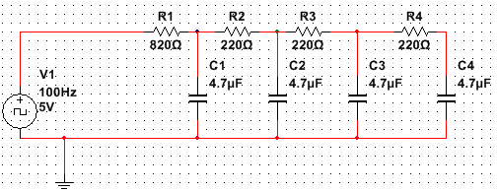
Lab 10- Changing a Square Wave to a Sine Wave
Procedure:
A circuit was built using the schematic below. The function generator was used as the 5V square wave. The input/output voltages were measured along with the frequency.

Slide 57
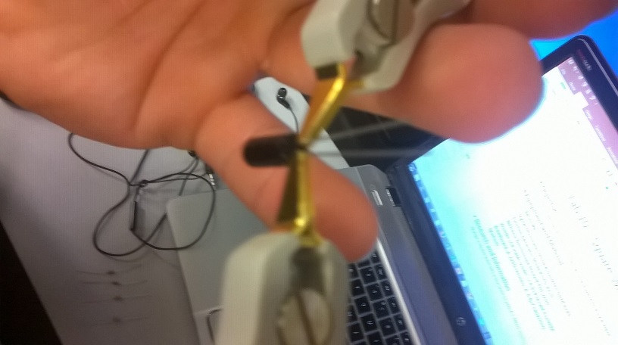
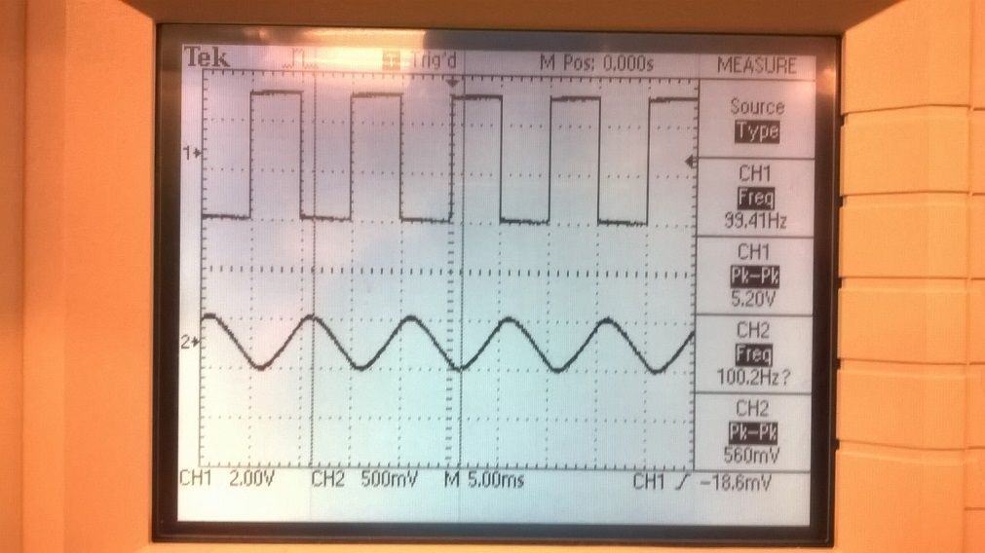
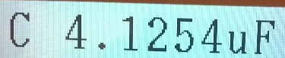
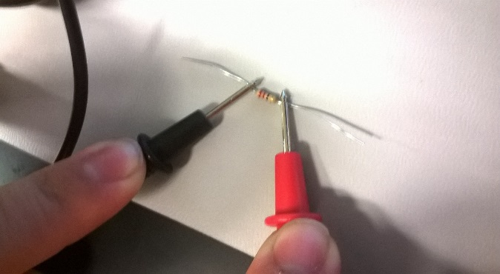
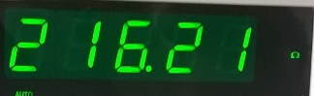
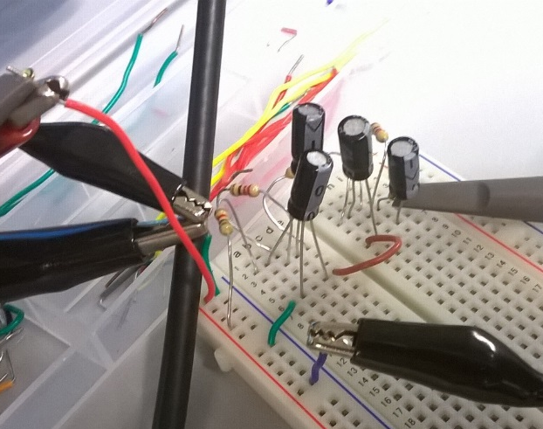
Lab 10- Changing a Square Wave to a Sine Wave
Vin
 | Expected | Measured
 | 4.7 | 4.127 | µF
 | 4.7 | 4.684 | µF
 | 4.7 | 4.683 | µF
 | 4.7 | 4.305 | µF
 | 220 | 216.7 | Ω
 | 220 | 216.1 | Ω
 | 220 | 217.7 | Ω
 | 820 | 818 | Ω
 | 100 | 100.04 | Hz
Vin | 5 | 5.2 | V
Vout | 0.5 | 0.56 | V
Vout
Testing the components
The completed circuit

Slide 58
Lab 10- Changing a Square Wave to a Sine Wave
Summary and Conclusions
The sine wave was able to be created using 4 resistors in series and 4 capacitors in parallel. The wave that was created was stable and well rounded but the voltage level was dropped significantly resulting in a voltage that was only .5V.

Slide 59
Lab 11 – Troubleshooting Home Electronics/Testing TTL Chips

Slide 60
Lab 11-Troubleshoot Home Electronics/Test TTL Chips
Objective
Breadboard a test circuit to test one chip at a time using 74LS00 series TTL chips from untested parts bin.
Troubleshoot and fix home electronics
Equipment and Material
Bench #6
Wire
DC Power Supply Model# HY1802D
Tool kit
Research and Information

Slide 61
Lab 11-Troubleshoot Home Electronics/Test TTL Chips
Procedure:
A circuit was built to test 74LS00 chips. Each gate was tested on the chip to see if it worked.
Procedure:
The Atari was plugged setup to play a game to see if it would work. Once it was hooked up it was discovered that it was not working. The gaming system was then unplugged from the outlet and from the TV and inspected. It was found that the coaxial cable that connects the game to the TV had been severed and was being held together with duck tape. The duck tape and the y-leads were removed so they could be replaced. It was also discovered that the prong in the coaxial cable had been pushed up into the socket. To fix this the socket was disassembled and the prong pushed back out.

Slide 62
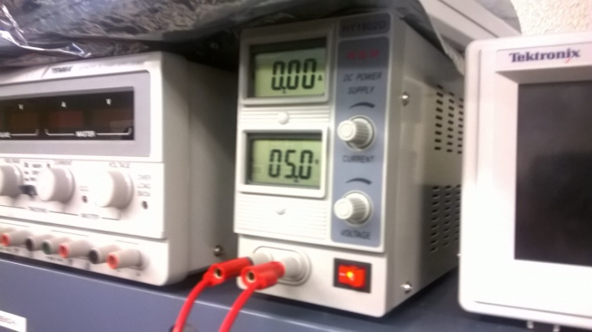
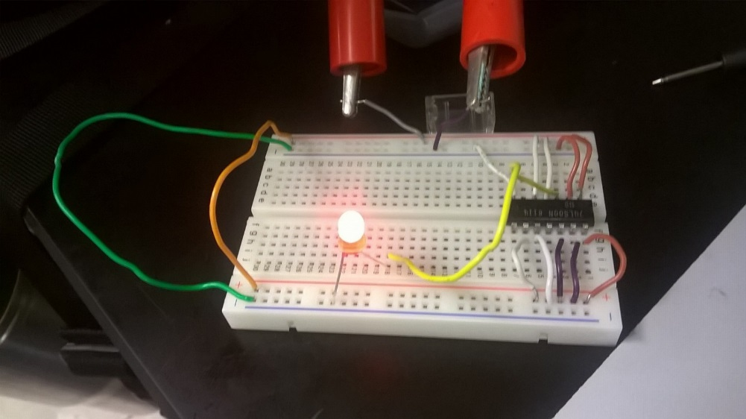
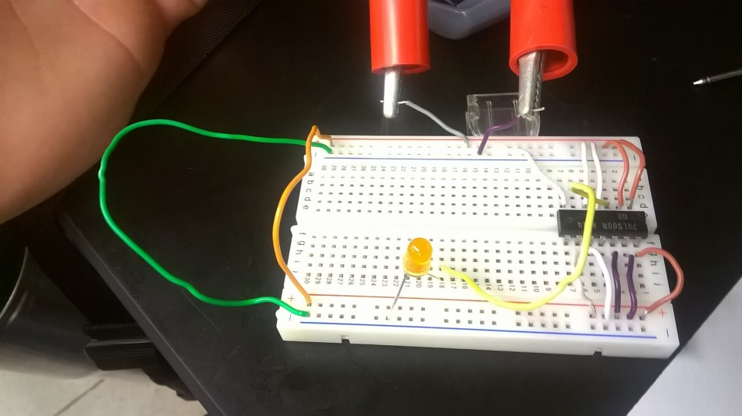
Lab 11-Troubleshoot Home Electronics/Test TTL Chips
Input voltage
Circuit setup
LED on
LED off

Slide 63
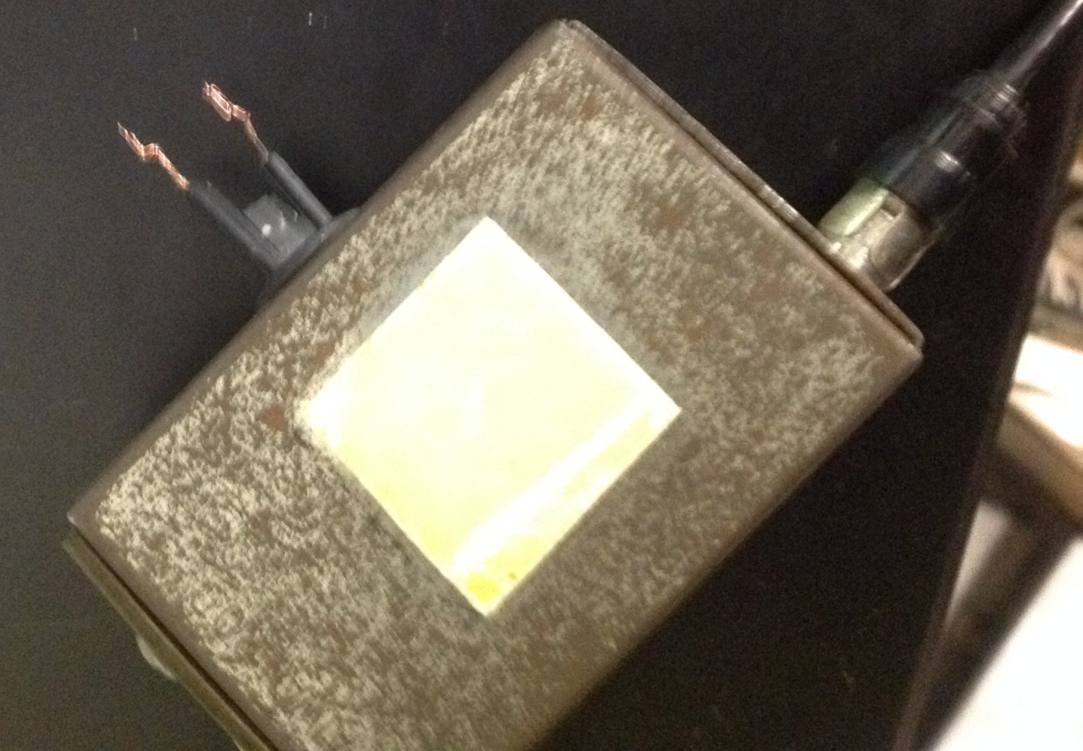
Lab 11-Troubleshoot Home Electronics/Test TTL Chips
The wires once the old Y-leads had been removed.

Slide 64
Lab 11-Troubleshoot Home Electronics/Test TTL Chips
Summary and Conclusions
Once the TTL chips were tested there was a few chips that were found to have had bad gates.
Summary and Conclusions
It was found that the Atari had to have the coaxial leads replaced as well as the center prong on the socket had to be pushed back up.

Slide 65
Lab 12 – Lissajous Patterns/Misc Troubleshooting

Slide 66
Lab 12-Lissajous Pattern/Misc Troubleshooting
Objective
Research a way to display a circle or ellipse on an oscilloscope, then demonstrate in the lab
Troubleshoot and fix home electronics
Equipment and Material
Bench #6
Oscilloscope Brand: Tektronix Model #: TDS220 SN: B083266
Function Generator Brand: GwInstek Model #: GFG-8210 SN: C705245
Soldering iron Brand: Weller, Model#: WES51
Research and Information
http://www.ohmpie.com/lissajous-curves/
http://www.mathcats.com/explore/lissajous/lissajous.html

Slide 67
Lab 12-Lissajous Pattern/Misc Troubleshooting
Procedure:
The coupling of the leads were set one to AC and one to DC. The function generator was turned on and the oscilloscope leads were attached to it. The frequency was adjusted until the oscilloscope had an ellipse appear on the screen. The persistence was adjusted to have a solid shape.
Procedure:
The wires on the coaxial cable were tinned and new Y-leads were placed on the wires. The Y-leads were then attached back onto the socket. The Atari was then hooked back up to see if it would function.

Slide 68
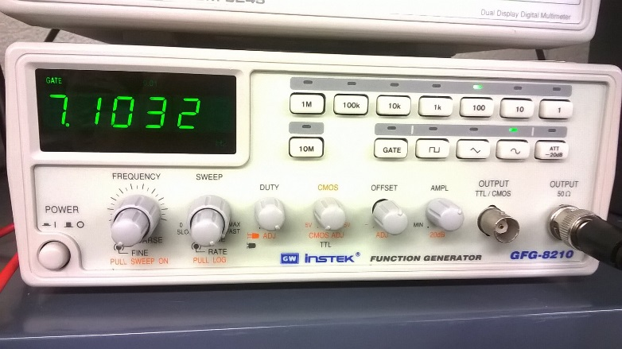
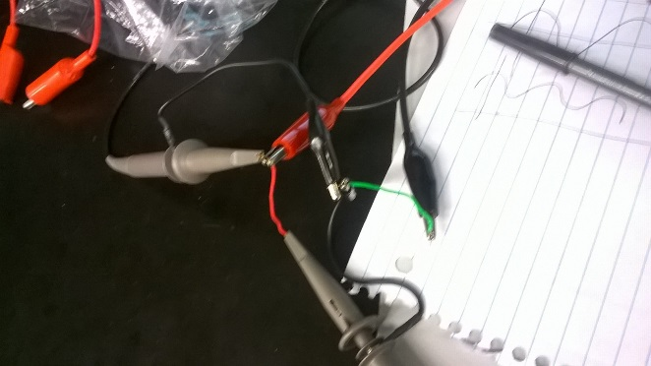


Lab 12-Lissajous Pattern/Misc Troubleshooting
Lead set up
Function generation set up
Without the persistence on
With the persistence set to 5sec

Slide 69




Lab 12-Lissajous Pattern/Misc Troubleshooting
The socket plugged into the back to the TV
The screen once the Atari was turned on
The plug with new Y-Leads.
Complete setup

Slide 70
Lab 12-Lissajous Pattern/Misc Troubleshooting
Summary and Conclusions
I was able to display an ellipse on the oscilloscope using a function generator.
Summary and Conclusions
Once the new Y-leads were replaced and the socket put back together the system worked correctly.

Slide 71
Lab 13 – AC to DC Power Supplies/Misc Troubleshooting

Slide 72
Lab 13-AC to DC Power Supplies/Misc Troubleshooting
Objective
Research how AC is converted to DC for a low voltage power supply. Build and demonstrate in lab. In place of a transformer, use a function generator as the secondary output of the transformer by using a sine wave at 60 Hz. Set the function generator amplitude so that it provides 5VDC at the output of your power supply. Show on the oscilloscope 1) the sine wave on channel 1; and 2) the 5VDC output on channel 2.
Troubleshoot and fix home electronics
Equipment and Material
Bench #6
Oscilloscope Brand: Tektronix Model #: TDS220 SN: B083266
Function Generator Brand: GwInstek Model #: GFG-8210 SN: C705245
Table Digital Multimeter Model # GwINTEK GDM-8245
1N4148 diode
470uF Capacitor
Research and Information
Foundations of Electronics: Circuits & Devices (Conventional Flow Version) by Russell L. Meade Chap 24. pg.715
Amazonhttp://www.shopping.com/amazon/products?sb=1&linkin_id=8075571&ef_id=UrzaswAABPg1qdDv:20151216160638:s

Slide 73

Lab 13-AC to DC Power Supplies/Misc Troubleshooting
Procedure:
The circuit was set up like the schematic at the bottom of the page
Procedure:
The kindle was opened and inspected. The circuit board was removed from the tablet.
Bridge rectifier

Slide 74






Lab 13-AC to DC Power Supplies/Misc Troubleshooting
Circuit and output without a capacitor
Circuit and output with a capacitor
Frequency
Output voltage

Slide 75

Lab 13-AC to DC Power Supplies/Misc Troubleshooting
Location where the USB port should be.
The circuit board once it was removed form the tablet

Slide 76
Lab 13-AC to DC Power Supplies/Misc Troubleshooting
Summary and Conclusions
The circuit worked once a capacitor was placed in the circuit to filter the output down to a DC voltage. It was noted that the input voltage had to be significantly greater (around 8V) in order to produce a DC voltage of 5V. This is due to the fact that not the entire AC voltage is converted to DC voltage, only the Vrms is converted to DC voltage. The Vrms and DC voltage are still not equivalent the DC voltage is greater by a factor of .9.
Summary and Conclusions
Once the tablet was opened up it was discovered that the USB port had come completely off of the circuit board. It was concluded that a new port would have to be ordered before it could be fixed. I researched the part and I was able to find it for relatively cheap on Amazon.

Slide 77
Lab 14 – ESD Precautions/Test LEDs/Misc Troubleshooting

Slide 78
Lab 14-ESD Precautions/Test LEDs/Misc Troubleshooting
Objective
Research ESD (electro-static discharge) and how it can affect electronic devices.
1) Find some of the ways to prevent or minimize ESD for safe handling;
2) Find the approximate voltage generated from basic home items: a) masking tape, b) scotch tape, c) a wool sweater, d) walking across the carpet in the winter time.
Troubleshoot and fix home electronics
Equipment and Material
Bench #6
Research and Information
http://www.esdsystems.com/whitepapers/wp_carpet.html
http://www.teledyne-api.com/manuals/04786B_ESD.pdf
http://literature.rockwellautomation.com/idc/groups/literature/documents/sb/8000-sb001_-en-p.pdf
http://ecmweb.com/content/electrostatic-discharge-causes-effects-and-solutions
http://www.power-eetimes.com/en/what-destroyed-the-hindenburg-can-ruin-your-equipment.html?cmp_id=71&news_id=222907736&page=0
http://www.polyonics.com/EngineeredTapes/tds/Tape_ESD_Brochure_Final.pdf

Slide 79
Lab 14-ESD Precautions/Test LEDs/Misc Troubleshooting
Procedure:
Electrostatic discharge was researched on the internet.
Procedure:
The port was soldered onto the circuit board of the Kindle. And the board was put back together.

Slide 80
Lab 14-ESD Precautions/Test LEDs/Misc Troubleshooting
Electrostatic discharge can effect electronics by frying the components when something that is charged comes near the component and discharges through the circuit instead of the chassis. Some ways of reducing ESD are:
Wearing a static wrist strap when handling electronic equipment, keeping the work area clear of other objects and using static mats.
 | aproximate voltage
Wool | 4000-5000 | V
Scotch tape | 5000 | V
Carpet | 35000 | V
masking tape | 2500 | V

Slide 81


Lab 14-ESD Precautions/Test LEDs/Misc Troubleshooting
USB port in the package that it arrived in
Board put back together

Slide 82
Lab 14-ESD Precautions/Misc Troubleshooting
Summary and Conclusions
Electrostatic discharge is a real problem and if caution is not used you can easily destroy sensitive electrical components.
Summary and Conclusions
Once the tablet was put back together and plugged in it still would not charge. The tablet was reopened and inspected and it was discovered that the leads for the USB port had been soldered together. In order to fix this an attempt was made to desolder the port. In the process of desoldering part of the pad was removed destroying the circuit board.

Slide 83
Lab 15 – Plan, Prepare, Test Solder Kit

Slide 84
Lab 15- Plan, Prepare, Test Solder Kit
Objective
Create an outline/plan for your solder kit next week. Include:
1. step by step to prepare and assemble your kit including testing individual parts before assembly and possible ways to protect against overheating
2. include some steps you would take to troubleshoot your kit if it doesn't work including a) what to check if doesn't power up; b) what to check if partially operational
Test CMOS chips
Test 30 year old custom built power supply with triple fixed outputs +5VDC, +12VDC, and -5VDC built for single board 8080A computer. Check ripple voltage with a scope.
Equipment and Material
Bench #6
Hand held Digital Multimeter Model #OTE Instruments DT-6830
Table Digital Multimeter Model # GwINTEK GDM-8245
GwInstek LCR meter model#: LCR-819 SN#: E12099
Research and Information
Cmos chip http://ivytechengineering.com/stores/cd4000/files/cd4049.pdf
How to test a diode http://www.circuitstoday.com/how-to-test-a-diode

Slide 85
Lab 15- Plan, Prepare, Test Solder Kit
Procedure:
Attach C1 and C2 first then R1 and R2. Attach the 4046 chip next then the zener diode and the 4024 chip. Attach d1,d2 and d3 and r3. solder t1, d5 and LD7. Then D6,D4, R6 and R7. D7, R4 and R5. Then place LD1-7.
Attaching LEDs last should help reduce their exposure to heat. If the circuit is not working check to see if the LEDs or diodes burned up also check to see if the chips were fried.
Procedure:
The chip was put in a circuit and the outputs were tested using a multimeter
Procedure:
The power supply was pugged in and the voltages were measured using the multimeter and the voltage ripple was measured using the oscilloscope for the three different voltages.

Slide 86

Lab 15- Plan, Prepare, Test Solder Kit
 | Expected | Measured
R1 | 100 | 99.2 | KΩ
R2 | 100 | 100.36 | KΩ
R3 | 33 | 32.83 | KΩ
R4 | 1.8 | 1.79 | KΩ
R5 | 1.8 | 1.799 | KΩ
R6 | 3.3 | 3.305 | KΩ
R7 | 2.2 | 2.18 | KΩ
C1 | 100 | 92.2 | nF
C2 | 10 | 8.51 | µF
T1 |  | 301 | hfe
D1 |  | 0.567 | V
D2 |  | 0.569 | V
D3 |  | 0.568 | V
D4 |  | 0.567 | V
D5 |  | 0.567 | V
D6 |  | 0.57 | V
D7 |  | 0.568 | V
D8 |  | 0.694 | V
LD1 |  | works
LD2 |  | works
LD3 |  | works
LD4 |  | works
LD5 |  | works
LD6 |  | works
LD7 |  | works
List of parts tested for electronic dice.
Circuit used to test the CMOS chips

Slide 87



Lab 15- Plan, Prepare, Test Solder Kit
Voltage reading and power supply.
Voltage ripple
voltage |  | ripple
5.019 | V | 0.06 | V | 1.195457 | %
12.034 | V | 0.065 | V | 0.540136 | %
-5.05 |  | 0.06 | V | 1.188119 | %
Inside of the power supply

Slide 88
Lab 15- Plan, Prepare, Test Solder Kit
Summary and Conclusions
The CMOS chips were originally tested using a chip tester but it was not working so a simple circuit was built to test the functionality.
The power supply had the ability to supply +5,-5, and +12 volts with an average ripple of 60mV.

Slide 89
Lab 16 – Final Soldering Kit

Slide 90
Lab 16- Final Soldering Kit
Objective
Solder together the soldering kit form lab 15
Equipment and Material
Bench #6
Soldering iron Brand: Weller, Model#: WES51
Research and Information
how to solder https://www.youtube.com/watch?v=vIT4ra6Mo0s

Slide 91
Lab 16- Final Soldering Kit
Procedure:
The kit was soldered together from the instructions in lab 15.

Slide 92





Lab 16- Final Soldering Kit
All of the components used
Finished product
Output of 2
Output of 3
Output of 6

Slide 93
Lab 16- Final Soldering Kit
Summary and Conclusions
The dice worked once it was plugged in. It was also observed that if a battery that is not fully charged is used the output is sporadic.

