Slide 1
EECT 111-50C
Circuit Analysis
Lab Notebook
By Dakota Johnson
Instructor: Lou Toth
Spring 2015

Slide 2
Table of Contents
Title page Pg. 1
Table of Contents Pg.2
Lab 1 (Resistor Variability) Pg.3
Lab 2 (Reading and Sorting Resistors) Pg.8
Lab 3 ( Series Resistors Current and Voltage) Pg.12
Lab 4 (Black Box Design-Series) Pg.17
Lab 5 (Black Box Design-Parallel) Pg.22
Lab 6 (N/A)
Lab 7 (4 Resistor Parallel Circuit) Pg.29
Lab 8 (Black Box 3 Design) Pg.36
Lab 9 ( Series/Parallel Resistors) Pg.44
Lab 10 (Series/ Parallel Capacitors) Pg.50
Lab 11 (RC Lab) Pg.56
Lab 12 ( Series/Parallel Inductors) Pg.64

Slide 3

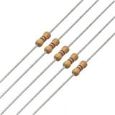
Lab 1
(Resistor Variability)
(1/15/15)
Lab Partners
Josiah Abel
Alex Richards

Slide 4
Lab 1
Objective: To learn how resistor values can vary by using 10 resistors with the same color code.
Procedure: 10 resistors with the color code Brown, Black, Red, Gold were chosen and measured with a multimeter. The data from 6 other groups performing the same experiment were then collected and the information was put into Excel.
Equipment:
Bench 1
10 1k resistors
Digital Multimeter
  Make: GwInstek Model: GDM-8245 SN: CL860259

Slide 5
Lab 1
Data:
Sample | Measured Resistance |  | Low | High | Nominal
1 | 977 | Ω | 950 | 1050 | 1000
2 | 985 | Ω | 950 | 1050 | 1000
3 | 996 | Ω | 950 | 1050 | 1000
4 | 977 | Ω | 950 | 1050 | 1000
5 | 983 | Ω | 950 | 1050 | 1000
6 | 981 | Ω | 950 | 1050 | 1000
7 | 994 | Ω | 950 | 1050 | 1000
8 | 979 | Ω | 950 | 1050 | 1000
9 | 975 | Ω | 950 | 1050 | 1000
10 | 978 | Ω | 950 | 1050 | 1000
11 | 979 | Ω | 950 | 1050 | 1000
12 | 982 | Ω | 950 | 1050 | 1000
13 | 978 | Ω | 950 | 1050 | 1000
14 | 979 | Ω | 950 | 1050 | 1000
15 | 999 | Ω | 950 | 1050 | 1000
16 | 987 | Ω | 950 | 1050 | 1000
17 | 987 | Ω | 950 | 1050 | 1000
18 | 982 | Ω | 950 | 1050 | 1000
19 | 980 | Ω | 950 | 1050 | 1000
20 | 1000 | Ω | 950 | 1050 | 1000
21 | 980 | Ω | 950 | 1050 | 1000
22 | 979 | Ω | 950 | 1050 | 1000
23 | 978 | Ω | 950 | 1050 | 1000
24 | 977 | Ω | 950 | 1050 | 1000
25 | 978 | Ω | 950 | 1050 | 1000
26 | 979 | Ω | 950 | 1050 | 1000
27 | 977 | Ω | 950 | 1050 | 1000
28 | 979 | Ω | 950 | 1050 | 1000
29 | 981 | Ω | 950 | 1050 | 1000
30 | 983 | Ω | 950 | 1050 | 1000
31 | 982 | Ω | 950 | 1050 | 1000
32 | 980 | Ω | 950 | 1050 | 1000
33 | 981 | Ω | 950 | 1050 | 1000
34 | 984 | Ω | 950 | 1050 | 1000
35 | 978 | Ω | 950 | 1050 | 1000
36 | 980 | Ω | 950 | 1050 | 1000
37 | 980 | Ω | 950 | 1050 | 1000
38 | 980 | Ω | 950 | 1050 | 1000
39 | 981 | Ω | 950 | 1050 | 1000
40 | 982 | Ω | 950 | 1050 | 1000
41 | 982 | Ω | 950 | 1050 | 1000
42 | 980 | Ω | 950 | 1050 | 1000
43 | 978 | Ω | 950 | 1050 | 1000
44 | 1002 | Ω | 950 | 1050 | 1000
45 | 990 | Ω | 950 | 1050 | 1000
46 | 978 | Ω | 950 | 1050 | 1000
47 | 979 | Ω | 950 | 1050 | 1000
48 | 1001 | Ω | 950 | 1050 | 1000
49 | 980 | Ω | 950 | 1050 | 1000
50 | 990 | Ω | 950 | 1050 | 1000
51 | 984 | Ω | 950 | 1050 | 1000
52 | 983 | Ω | 950 | 1050 | 1000
53 | 984 | Ω | 950 | 1050 | 1000
54 | 982 | Ω | 950 | 1050 | 1000
55 | 978 | Ω | 950 | 1050 | 1000
56 | 983 | Ω | 950 | 1050 | 1000
57 | 984 | Ω | 950 | 1050 | 1000
58 | 981 | Ω | 950 | 1050 | 1000
59 | 981 | Ω | 950 | 1050 | 1000
60 | 978 | Ω | 950 | 1050 | 1000
61 | 980 | Ω | 950 | 1050 | 1000
62 | 984 | Ω | 950 | 1050 | 1000
63 | 981 | Ω | 950 | 1050 | 1000
64 | 982 | Ω | 950 | 1050 | 1000
65 | 984 | Ω | 950 | 1050 | 1000
66 | 982 | Ω | 950 | 1050 | 1000
67 | 984 | Ω | 950 | 1050 | 1000
68 | 980 | Ω | 950 | 1050 | 1000
69 | 987 | Ω | 950 | 1050 | 1000
70 | 981 | Ω | 950 | 1050 | 1000

Slide 6
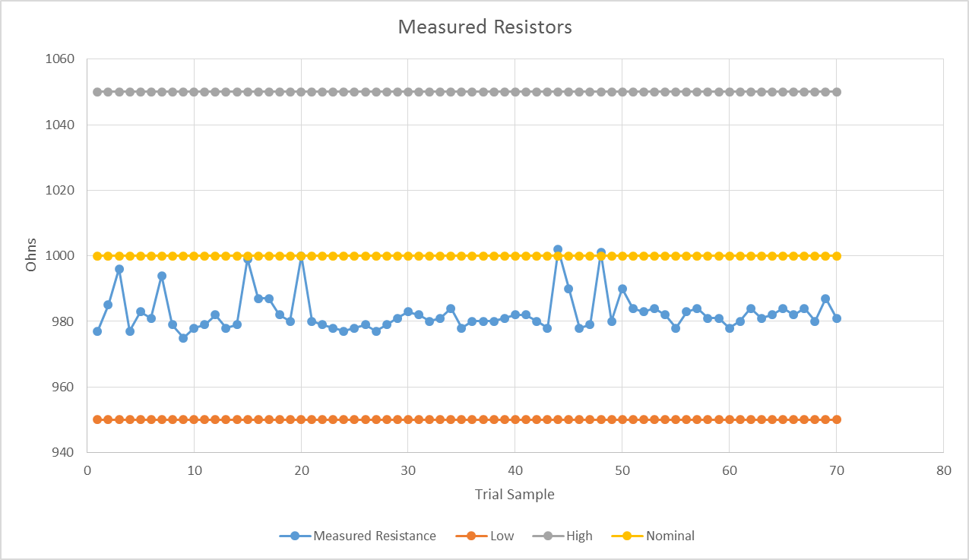
Lab 1
Data:
Minimum | Maximum | Range | Standard Deaviation | Mode | Average | Median
975 | 1002 | 27 | 5.8 | 980 | 982.6 | 981

Slide 7

Lab 1
Equations:
Standard Deviation
Observations: Most of the data was under the nominal value and all of it was with the tolerance level.
Conclusion: It was found that resistors can vary quiet a bit and a resistor should be tested before using it in a circuit to see if the resistance is within tolerance.

Slide 8
Lab 2
(Reading and Sorting Resistors)
(1/29/15)
Lab Partners
Josiah Abel
Cody Fletcher

Slide 9
Lab 2
Objective: To learn the resistor color code using 15 resistor which were sorted from smallest to largest value.
Procedure: 15 resistors were chosen their color codes were recorded and their resistance was measured with a multimeter. The results were then implemented into an excel file.
Equipment:
Bench 6
15 Unique resistors
Digital Multimeter
  Make: GwInstek Model: GDM-8245 SN: CL860332

Slide 10
Lab 2
Data:
Number |  | Color |  | Value | Min | Measured | Max | Tolerance | In Tolerance | Too Low | Too High
 |  |  |  | Ω |  | Ω |  | Ω
1 | Brown | Black | Brown | 100 | 95 | 98.9 | 105 | 0.05 | Yes | No | No
2 | Red | Red | Brown | 220 | 209 | 216.6 | 231 | 0.05 | Yes | No | No
3 | Orange | Orange | Brown | 330 | 313.5 | 325.19 | 346.5 | 0.05 | Yes | No | No
4 | Yellow | Violet | Brown | 470 | 446.5 | 461.9 | 493.5 | 0.05 | Yes | No | No
5 | Brown | Black | Red | 1000 | 950 | 983 | 1050 | 0.05 | Yes | No | No
6 | Red | Red | Red | 2200 | 2090 | 2151 | 2310 | 0.05 | Yes | No | No
7 | Orange | Orange | Red | 3300 | 3135 | 3255 | 3465 | 0.05 | Yes | No | No
8 | Yellow | Violet | Red | 4700 | 4465 | 4633 | 4935 | 0.05 | Yes | No | No
9 | Brown | Black | Orange | 10000 | 9500 | 9788 | 10500 | 0.05 | Yes | No | No
10 | Red | Red | Orange | 22000 | 20900 | 21450 | 23100 | 0.05 | Yes | No | No
11 | Orange | Orange | Orange | 33000 | 31350 | 33310 | 34650 | 0.05 | Yes | No | No
12 | Yellow | Violet | Orange | 47000 | 44650 | 45670 | 49350 | 0.05 | Yes | No | No
13 | Brown | Black | Yellow | 100000 | 95000 | 98850 | 105000 | 0.05 | Yes | No | No
14 | Brown | Black | Green | 1000000 | 950000 | 999000 | 1050000 | 0.05 | Yes | No | No
15 | Brown | Black | Blue | 10000000 | 9500000 | 10060000 | 10500000 | 0.05 | Yes | No | No

Slide 11
Lab 2
Observations: All of the resistors were within 5% tolerance.
Conclusion: The values measured for the resistors matched the color code found on the resistors.

Slide 12

Lab 3
(Series Resistors Current and Voltage)
(1/29/15)
Lab Partners
Josiah Abel
Cody Fletcher

Slide 13
Lab 3
Objective: To experiment with series circuits to see if the simulated, calculated and measured results all agree.
Procedure: 3 resistors were chosen and their individual resistances were measured using a multimeter. The resistors were then placed in series with each other on an Elvis board and their combined total resistance was found using the multimeter. The resistors were then connected to a 9V power supply provided by the Elvis board. The voltage drop was measured at the points VA, VB, and VC the total current was also found for the circuit. A multisim simulation was then made of the circuit and the measurements found in the experiment were found through simulation. Lastly calculations were performed to find the measurements mathematically.
Equipment:
Bench 6
3 Unique resistors
Elvis II
  Make: National Instruments Model NI Elvis II+ SN: 1677D1E
Digital Multimeter
  Make: GwInstek Model: GDM-8245 SN: CL860332

Slide 14
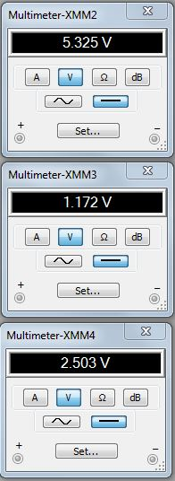
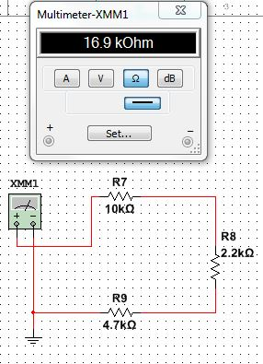
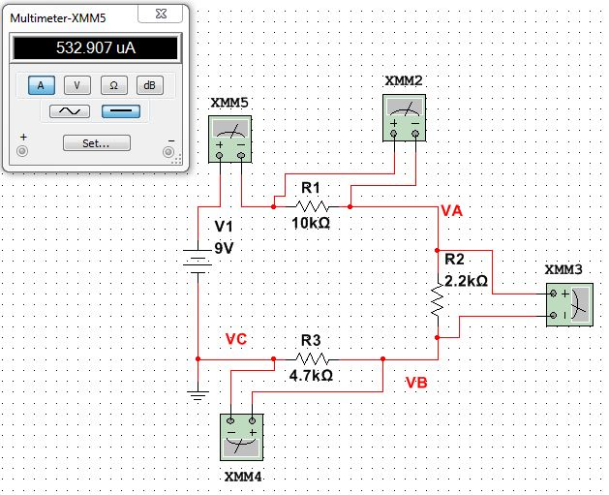
Lab 3
Voltage Drops
Simulations:
Total Current
Total Resistance

Slide 15
Lab 3
Data:
 | Calculated |  | Measured |  | Simulated
IT | 532.5E-6 | A | 541.3E-6 | A | 532.907 | μA
V1 | 9 | V | 9.019 | V | 9 | V
VA | 5.325443787 | V | 5.315 | V | 5.325 | V
VB | 1.171597633 | V | 1.16 | V | 1.172 | V
VC | 2.50295858 | V | 2.529 | V | 2.503 | V
R₁ | 10.0E+3 | Ω | 9.8E+3 | Ω | 1.00E+03 | Ω
R₂ | 2.2E+3 | Ω | 2.2E+3 | Ω | 2.20E+03 | Ω
R₃ | 4.7E+3 | Ω | 4.6E+3 | Ω | 4.70E+03 | Ω
R_{T} | 16.9E+3 | Ω | 16.6E+3 | Ω | 16.9E+3 | Ω
Equations:
Ohm’s Law
Series Resistance
Observations: The calculated measured and simulated measurements were all very close if not the same value.

Slide 16
Lab 3
Conclusion: The three different ways of finding the measurements all agreed with each other. Doing all three approaches to find the measurements is a great way to ensure accuracy in an experiment.

Slide 17
Lab 4
(Black Box Design-Series)
(2/12/15)
Lab Partners
Josiah Abel
Cody Fletcher

Slide 18
Lab 4
Objective: To learn about series circuits.
Procedure: A circuit was to be constructed that contained 3 resistors in series with a 9V source and a total current of 10mA. Ohm’s Law was used to find the total resistance and 3 resistors were chosen that would equal the total resistance when put in series with each other. The resistances of the 3 resistors were measured separately and in series to make sure the calculations were correct. A 9V source was applied and then the total current was measured using a multimeter.
Equipment:
Bench 6
3 Standard resistors
Elvis II
  Make: National Instruments Model NI Elvis II+ SN: 1677D1E
Digital Multimeter
  Make: GwInstek Model: GDM-8245 SN: CL860332

Slide 19
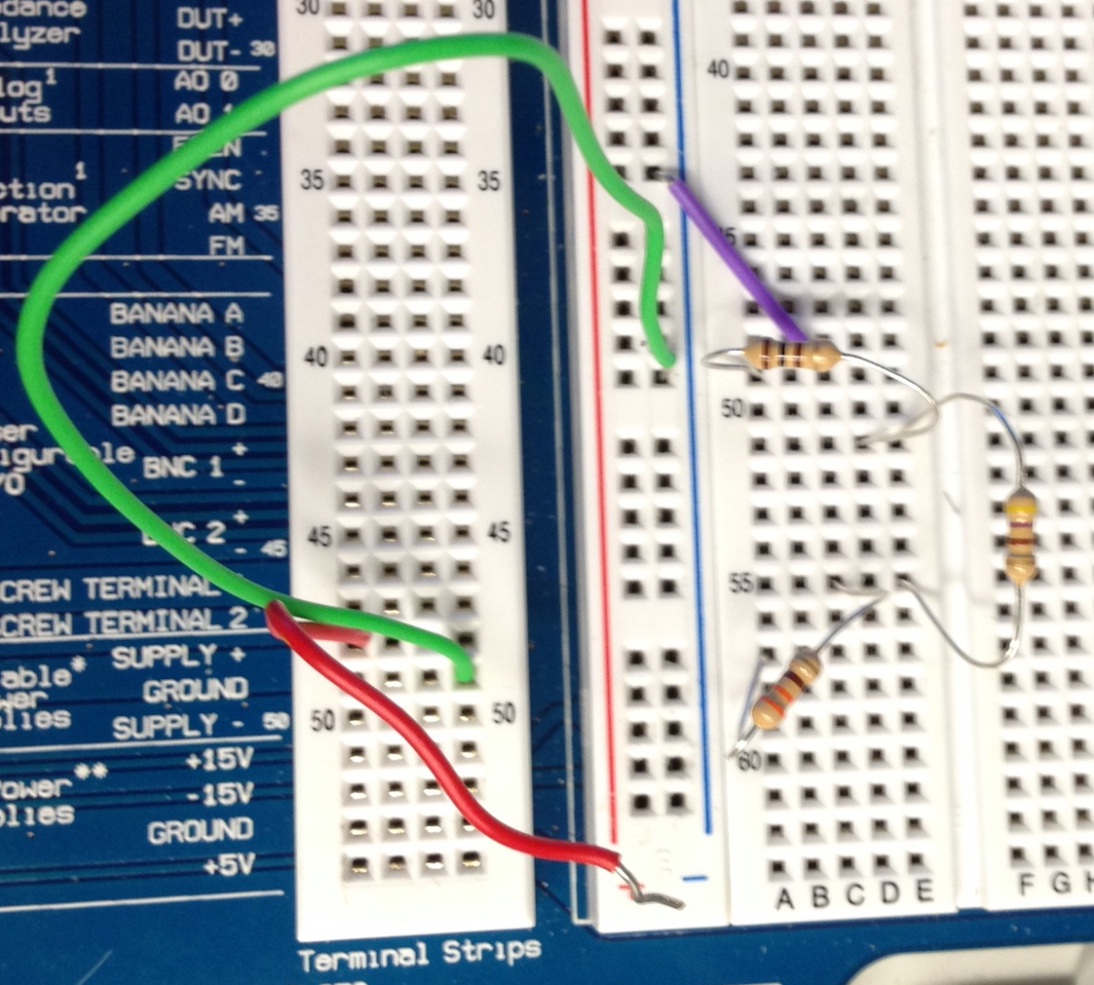
Lab 4
Lab set up:
100Ω Resistor
470Ω Resistor
470Ω Resistor

Slide 20
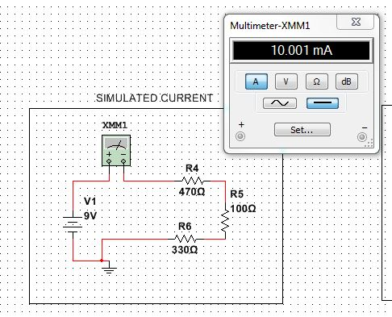
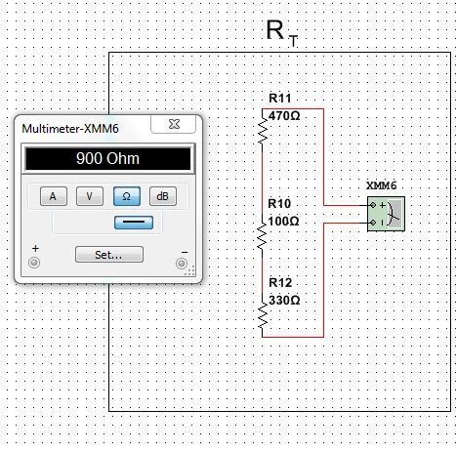
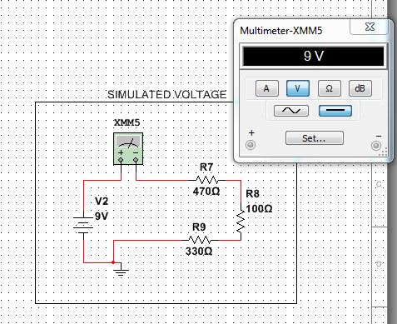
Lab 4
Simulations:
R1
R1
R2
R2
R3
R3

Slide 21
Lab 4
Data:
 | DESIGN | MEASURED | CALCULATED MEASURED | CALCULATED CALC | SIMULATED | UNITS
V1 | 9 | 9.006 | 8.922 | 9.091 | 9 | V
IT | 10 | 10.109 | 10.204 | 10.015 | 10.001 | mA
RT | 900 | 882.57 | 890.889 | 874.328 | 900 | Ω
R1 | 470 | 458.32 |  |  | 470 | Ω
R2 | 100 | 99.92 |  |  | 100 | Ω
R3 | 330 | 324.7 |  |  | 330 | Ω
Equations:
Ohm’s Law
Series Resistance
Observations: The circuit was able to be built and tested with ease once it had been properly grounded.
Conclusion: If a series circuit’s voltage and total current is known the total resistance can be found by using Ohm’s Law. And because resistors add in series the desired 3 resistors were easily found with simple arithmetic.

Slide 22

Lab 5
(Black Box Design-Parallel)
(2/19/15)
Lab Partners
Josiah Abel
Cody Fletcher

Slide 23
Lab 5
Objective: To learn about parallel circuits.
Procedure: A circuit was to be constructed that contained 2 resistors in parallel with a 9V source and a total current of 4.642mA. Ohm’s Law was used to find the total resistance and 2 resistors were chosen that would equal the total resistance when put in parallel with each other. The resistances of the 2 resistors were measured separately and in parallel to make sure the calculations were correct. A 9V source was applied and then the total current was measured using a multimeter. The same steps were done with a 3 resistor parallel circuit.
Equipment:
Bench 6
5 Standard resistors
Elvis II
  Make: National Instruments Model NI Elvis II+ SN: 1677D1E
Digital Multimeter
  Make: GwInstek Model: GDM-8245 SN: CL860332

Slide 24
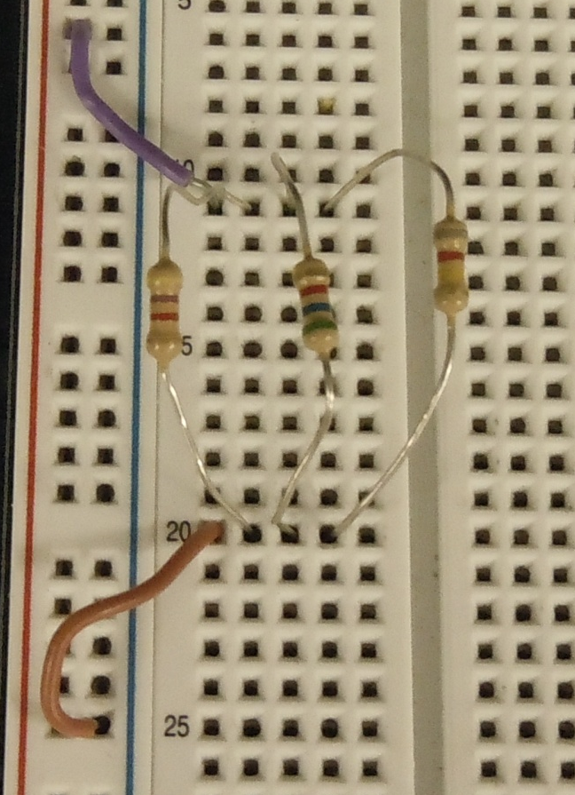
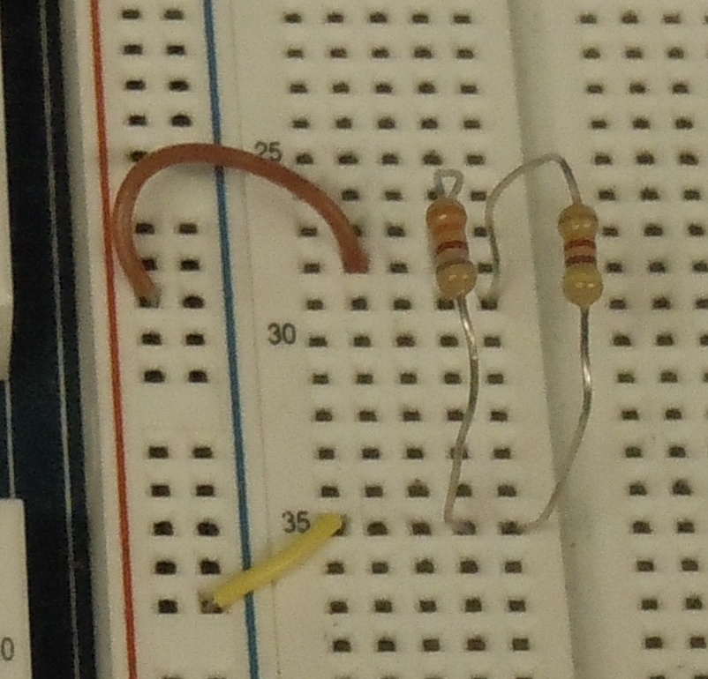
Lab 5
Lab set up:
5.6kΩ Resistor
8.2kΩ Resistor
3.3kΩ Resistor
4.7kΩ Resistor

Slide 25
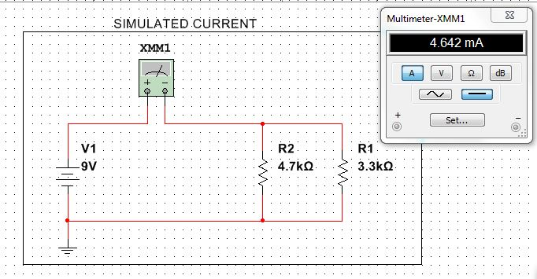
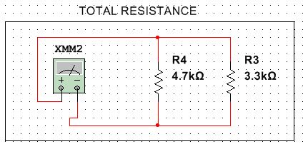
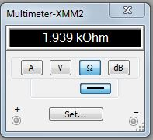
Lab 5
Simulations:
2 Resistor Circuit
R2
R1

Slide 26
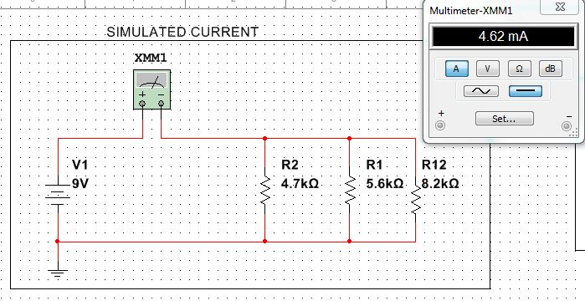
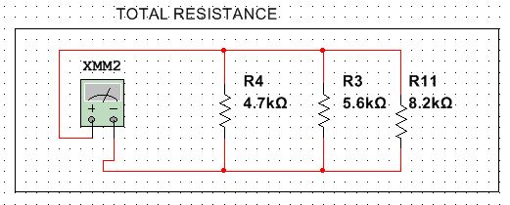
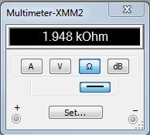
Lab 5
Simulations:
3 Resistor Circuit
R1
R2
R3
R1
R2
R3

Slide 27

Lab 5
Data:
 |  | 2 resistors | 2 resistors | 2 resistors | 3 resistors | 3 resistors | 3 resistors
 |  | design | measured | simulated | design | measured | simulated
Total Voltage | Vt | 9 | 9.007 | 9 | 9 | 9.008 | 9.008 | V
Resistance1 | R1 | 3300 | 3251 | 3300 | 4700 | 4598 | 4700 | Ω
Resistance2 | R2 | 4700 | 4597 | 4700 | 5600 | 5521 | 5600 | Ω
Resistance3 | R3 |  |  |  | 8200 | 8065 | 8200 | Ω
Total Resistance | Rt | 1938.750 | 1904.287 | 1939.000 | 1948.222 | 1913.491 | 1948.000 | Ω
Total Current | It | 4.642E-3 | 4.730E-3 | 4.642E-3 | 4.620E-3 | 4.708E-3 | 4.620E-3 | A
Equations:
Parallel Resistance
Ohm’s Law
Observations: The total resistance in a parallel circuit is less than the smallest value of one of its parts.

Slide 28
Lab 5
Conclusion: If a parallel circuit’s voltage and total current is known the total resistance can be found by using Ohm’s Law. Total resistance in a parallel circuit with two resistors is easy to find because it is just the total resistance divided by two.

Slide 29
Lab 7
(4 Resistor Parallel Circuit)
(2/26/15)
Lab Partners
Josiah Abel
Cody Fletcher

Slide 30
Lab 7
Objective: To measure the total resistance total current and all of the branch currents in a 4 resistor parallel circuit.
Procedure: 4 resistors were measured with a multimeter then placed in a parallel circuit on an Elvis board. The total resistance was then measured. The circuit was hooked up to a 9V source and the total current and branch currents were measured with a multimeter.
Equipment:
Bench 6
4 Standard resistors
Elvis II
  Make: National Instruments Model NI Elvis II+ SN: 1677D1E
Digital Multimeter
  Make: GwInstek Model: GDM-8245 SN: CL860332

Slide 31
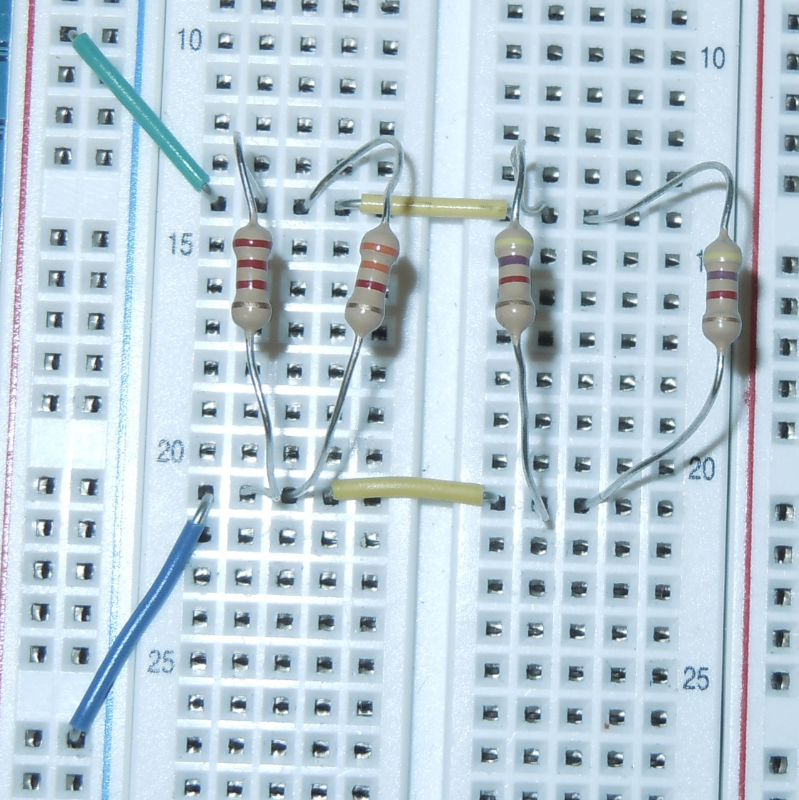
Lab 7
Lab set up:
2.2kΩ Resistor
4.7kΩ Resistor
3.3kΩ Resistor

Slide 32
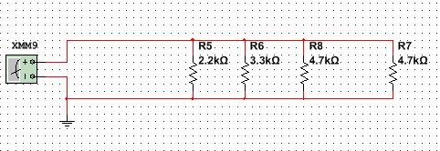
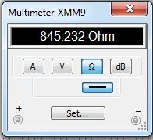
Lab 7
Simulations:
Total Resistance
R4
R1
R2
R3

Slide 33
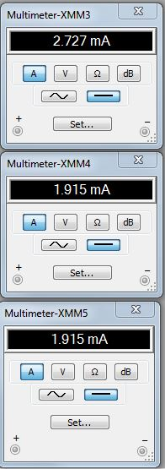
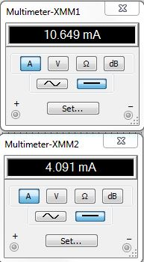
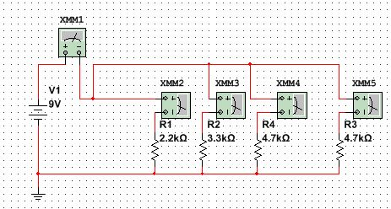
Lab 7
Simulations:
Total Current
Total Current and Branch Currents
Branch Current
Branch Currents

Slide 34
Lab 7
Data:
LAB 7
 |  | Design | Measured | Calculated | Simulated
V | V1 | 9 | 9.003 |  | 9
k Ω | R 1 | 2.2 | 2.151 |  | 2.2
k Ω | R 2 | 3.3 | 3.255 |  | 3.3
k Ω | R 3 | 4.7 | 4.623 |  | 4.7
k Ω | R 4 | 4.7 | 4.634 |  | 4.7
k Ω | RT |  | 0.8299 | 0.8304 | .845
mA | I 1 |  | 3.992 | 4.1855 | 4.091
mA | I 2 |  | 2.679 | 2.7659 | 2.727
mA | I 3 |  | 1.845 | 1.9474 | 1.915
mA | I 4 |  | 1.8996 | 1.9428 | 1.915
mA | IT |  | 10.667 | 10.8483 | 10.649
Equations:
Parallel Resistance
Ohm’s Law

Slide 35
Lab 7
Observations: Current is not constant in a parallel resistor circuit and differs depending on the size of the resistor on the branch.
Conclusion: The total current and branch currents were successfully measured.

Slide 36
Lab 8
(Black Box 3 Design)
(2/26/15)
Lab Partners
Josiah Abel
Cody Fletcher

Slide 37
Lab 8
Objective: To build a circuit that produces exactly 1.3V
Procedure: A circuit with 2 known resistors,3 unknown resistors, 2 known nodal voltages, and a known input voltage was presented and the resistor values had to be found that would equal the difference between the two nodal voltages. In order to do this the total current had to be found and once that was found the total resistance could be found using Ohm’s law. The two known resistor values were subtracted from the total to get the total of the unknown resistors. Once the total unknown resistor value was found the number was divided by 3 to find the values of the three resistors in a parallel circuit. The circuit was then built and the nodal voltages were tested to see if the circuit was correct. Once the circuit was found to be correct a 10kohm potentiometer replaced with one of the known resistors and then the nodal voltages were adjusted to be the exact numbers desired.

Slide 38
Lab 8
Equipment:
Bench 6
5 Standard resistors
Elvis II
  Make: National Instruments Model NI Elvis II+ SN: 1677D1E
Digital Multimeter
  Make: GwInstek Model: GDM-8245 SN: CL860332

Slide 39
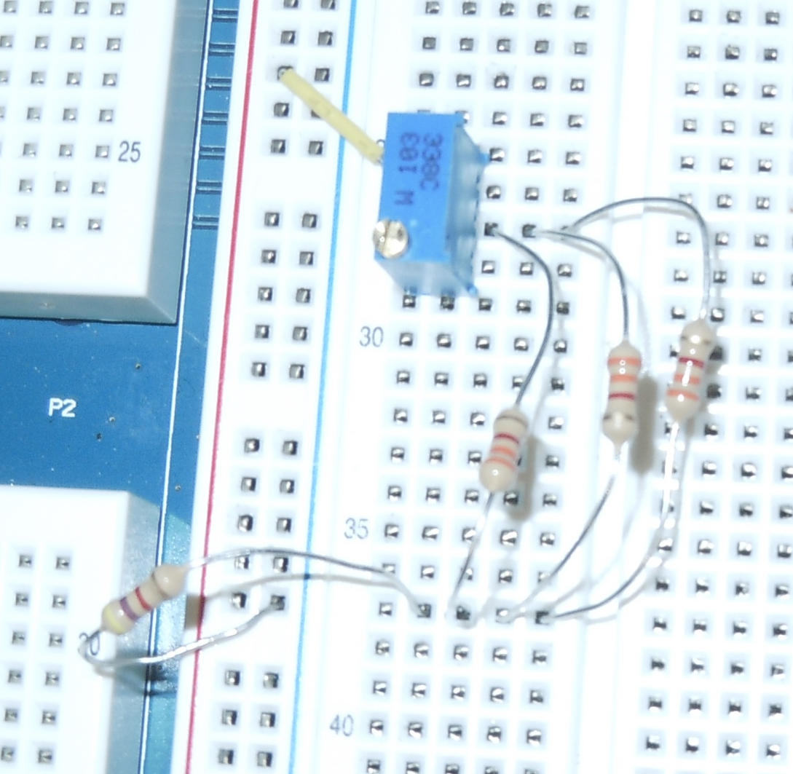
Lab 8
Lab set up:
10k Potentiometer
4.7kΩ Resistor

Slide 40
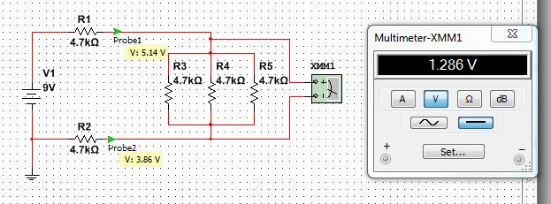
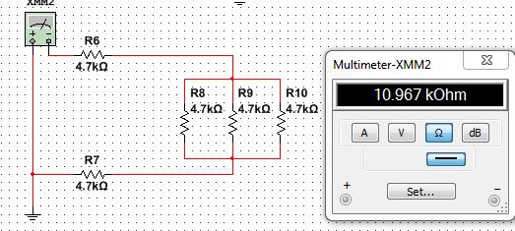
Lab 8
Simulations:
VA
VB
VA-VB
R1
Total Resistance
R3
R2
R4
R5

Slide 41
Lab 8
Data:
LAB 8
 |  | Design | Measured | Adjustment | Calculated | Simulated
k Ω | R 1 | 4.7 | 4.702 | 4.64 | 4.7 | 4.7
k Ω | R 2 | 4.7 | 4.62 | 4.62 | 4.7 | 4.7
k Ω | R 3 | 4.7 | 4.732 | 4.732 | 4.7 | 4.7
k Ω | R 4 | 4.7 | 4.631 | 4.631 | 4.7 | 4.7
k Ω | R 5 | 4.7 | 4.6 | 4.6 | 4.7 | 4.7
k Ω | R T | 10.967 | 10.86867 | 10.80667 | 10.966667 | 10.96667
k Ω | R BlackBox | 1.5667 | 1.553
k Ω | R 1 Adj | 0.2736 | 4.64
mA | IT | 0.8207 |  | 0.837446 | 0.8206687
V | V 1 | 9 | 9.05 | 9.05 | 9 | 9
V | VA | 5.14 | 5.169 |  | 5.1428571 | 5.14
V | V B | 3.86 | 3.8648 |  | 3.8571429 | 3.86
V | V A-V B | 1.286 | 1.3042 |  | 1.2857143 | 1.286
V | (V A-V B) Adj |  | 1.2861 | 1.303

Slide 42
Lab 8
Equations:
Parallel Resistance
Kirchhoff’s Voltage Law
Ohm’s Law
Observations: The simplest way to incorporate the three unknown resistors was in a parallel circuit.
Conclusion: With only knowing a few detail a circuit can be design to meet required specifications.

Slide 43
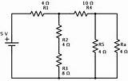
Lab 9
(Series/Parallel Resistors)
(3/26/15)
Lab Partners
Josiah Abel
Cody Fletcher

Slide 44
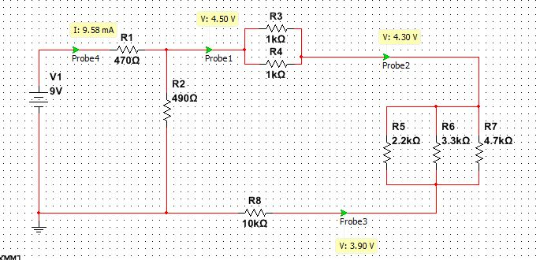
Lab 9
Objective: Experiment with series/parallel circuits and verify that the simulation, calculations and measured results agree.
Procedure: The values of each of the resistors was measured using the multimeter. The resistors were then put into a circuit designed like in the figure below. The resistances of the parallel components of the circuit R34,R567, R345678, and R2345678 were then measured. The total resistance of the circuit was then measured. The circuit was then connected to a 9V source and the total current of the circuit was measured along with the nodal voltages VA,VB, and VC. The resistor R2 was then replaced with a potentiometer and was adjusted so that the nodal voltage was exactly 4.5V.

Slide 45
Lab 9
Equipment:
Bench 6
8 Standard resistors
10K Potentiometer
Solder less Breadboard
Variable power supply
Digital Multimeter
  Make: GwInstek Model: GDM-8245 SN: CL860332

Slide 46
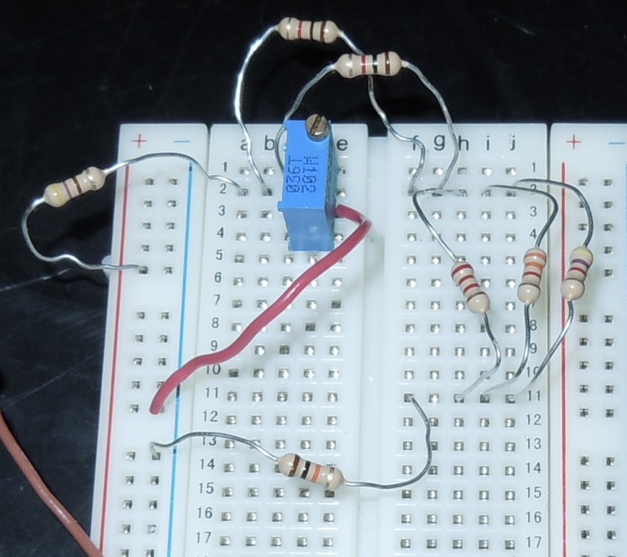
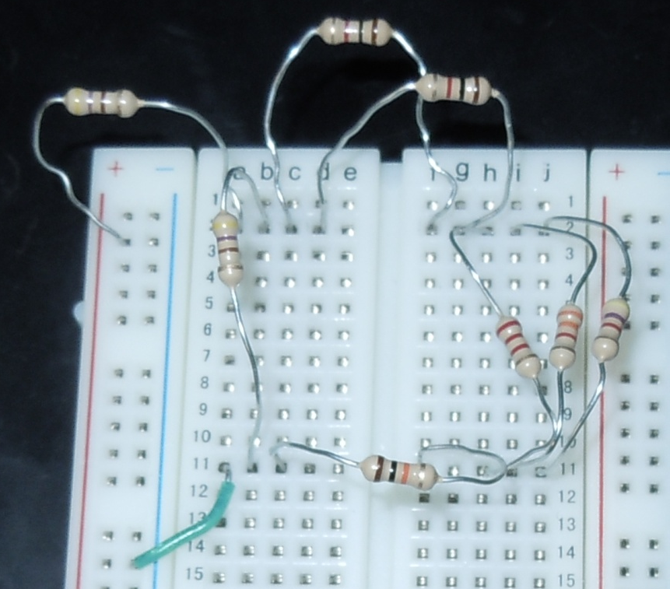
Lab 9
Lab set up:
1kΩ Resistor
10k Potentiometer
470Ω Resistor
2.2kΩ Resistor
10kΩ Resistor
3.3kΩ Resistor
4.7kΩ Resistor

Slide 47
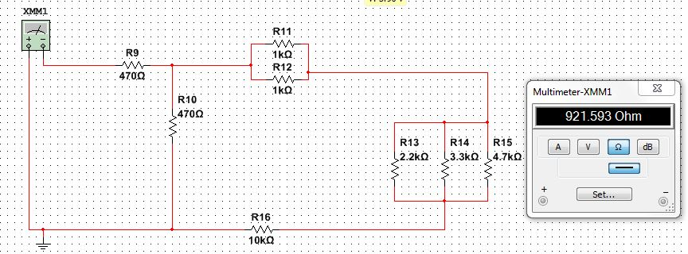

Lab 9
Simulations:
R1
Total Resistance
R2
R6
R4
R5
R7
R8
IT
VA
VB
VC

Slide 48
Lab 9
Data:
 |  | simulated in Ω | Measured | Calculated
V1 | V |  | 9.002 | 9
IT | mA |  | 9.856 | 9.768
VA | V |  | 4.36 | 4.473
VB | V |  | 4.172 | 4.279
VC | V |  | 3.778 | 3.879
I345678 | mA |  |  | 0.38794481
Vadj= | V | 4.5
Vs= | V | 9
Resistor | simulated in Ω | Measured in Ω | Calculated in Ω
R1 | 470 | 463.64 | 470
R2 | 470 | 455.5 | 470
R3 | 1000 | 981 | 1000
R4 | 1000 | 983.5 | 1000
R5 | 2200 | 2163 | 2200
R6 | 3300 | 3248 | 3300
R7 | 4700 | 4643 | 4700
R8 | 10000 | 9575 | 10000
R34 |  |  | 500.00
R567 |  |  | 1030.56
R345678 |  |  | 11530.56
R2345678 |  |  | 451.59
RT |  |  | 921.59
Steps | Calculation
V*(R99/(R1+R99)
R99=4.5R2
R99=R2llR
(R99/(A3+R99))*9=4.5 | R99 | = | 470
470=R2llE13
470=1/((1/R2)+(1/E13)
470=E13R2/(E13+R2)
470*(E13+R2)=E13R2
470*E13+470R2=E13R2 | 5419365.449 | + | 470 | xR2 | = | 11530.56 | xR2
 |  |  | 5419365.449 | = |  | 11060.56 | xR2
 | R2 ADJ | = | 489.9718554

Slide 49
Lab 9
Equations:
Parallel Resistance
Ohm’s Law
Series Resistance
Observations: Once the equivalent resistance is found for a parallel resistors the equivalent resistance can then be added with other resistors in either series or parallel.
Conclusion: The simulation, calculations and measured values all agreed.

Slide 50
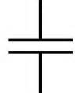
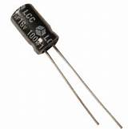
Lab 10
(Series/Parallel Capacitors)
(4/2/15)
Lab Partners
Josiah Abel
Cody Fletcher

Slide 51
Lab 10
Objective: To experiment with capacitors in series and parallel capacitors.
Procedure: The capacitance of each of the capacitors were measured individually with the LCR meter. The capacitors were then put into a series circuit and the total capacitance was measured. Finally the capacitors were put into a parallel circuit and the total capacitance was measured.
Equipment:
Bench 6
3 Capacitors
Variable Power Supply
Solder less Breadboard
LCR Meter
  Make: GwInstek Model: LLR METER, LCR-819 SN: E120998

Slide 52
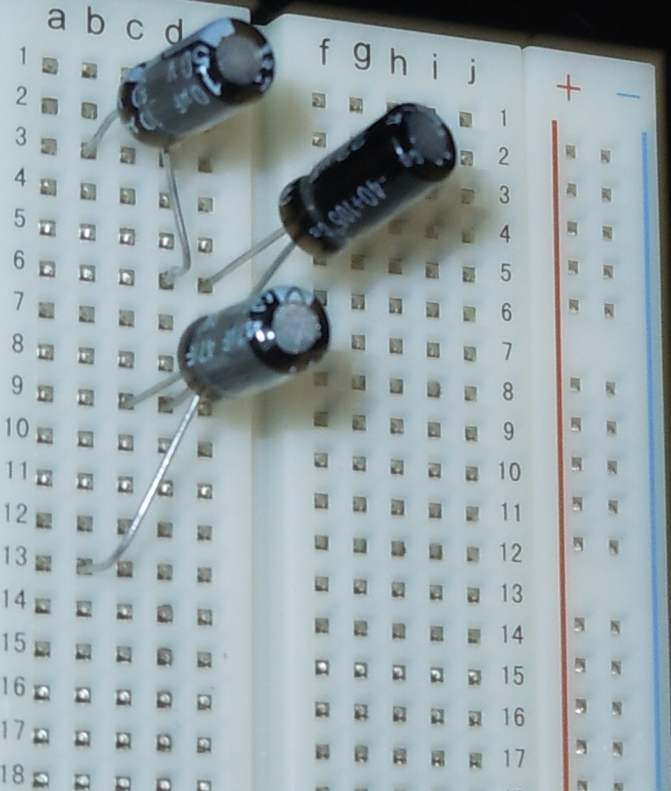
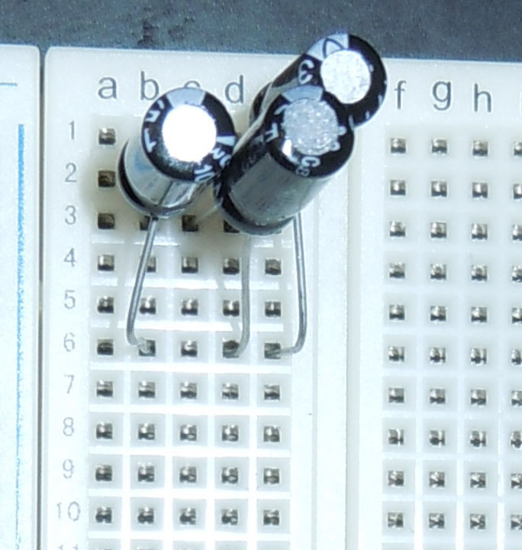
Lab 10
Lab set up:
10μF Capacitor
22μF Capacitor
47μF Capacitor

Slide 53
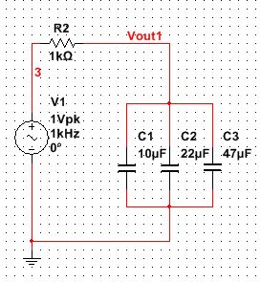
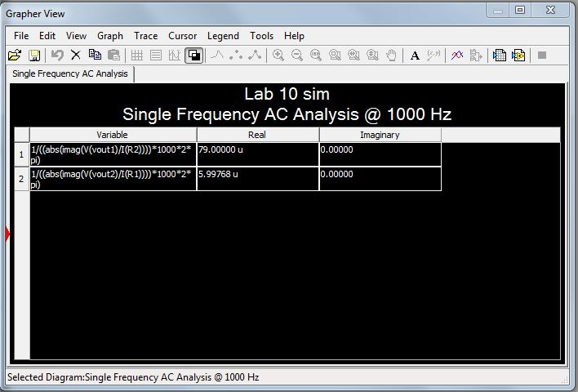
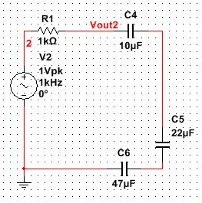
Lab 10
Simulations:

Slide 54

Lab 10
Data:
Series
 | Calculated | Measured | Simulated
 | μF | μF | μF
C1 | 10 | 9.16 | 10
C2 | 22 | 19.51 | 22
C3 | 47 | 38.8 | 47
CT | 5.9976798 | 5.37 | 5.99768
Parallel
 | Calculated | Measured | Simulated
 | μF | μF | μF
C1 | 10 | 9.16 | 10
C2 | 22 | 19.51 | 22
C3 | 47 | 38.8 | 47
CT | 79 | 67.501 | 79
Equations:
Parallel Capacitance
Series Capacitance

Slide 55
Lab 10
Observations: When capacitors are put in series their total capacitance is calculated like resistors in parallel. When capacitors are put in parallel their total capacitance is calculated like resistors in series. The 47 micro Henry capacitor was quiet a bit lower than the expected value. A reason for this might be that the capacitor is starting to go bad.
Conclusion: It was found that the simulation, calculations and measured values all agreed.

Slide 56
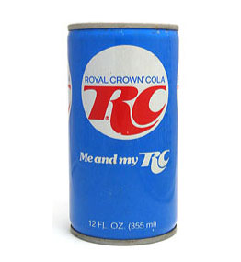
Lab 11
(RC Lab)
(4/9/15)
Lab Partners
Josiah Abel
Cody Fletcher

Slide 57
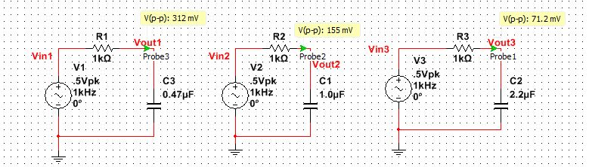
Lab 11
Objective: To experiment with a resistor and a capacitor in a series circuit with each other.
Procedure: The resistor value was measured using the multimeter and the capacitor values were measured using the LCR meter. The resistor and capacitor were put in a circuit like in the picture below with the AC power source being the function generator. The oscilloscope was hooked up to the function generator and the function generator’s amplitude was dialed in so that it was 1V peak to peak. The other lead of the oscilloscope was hooked up to the circuit between the resistor and capacitor. The voltage at the point between the resistor and capacitor was then measured at a range of frequencies. This process was done for all three capacitors.

Slide 58
Lab 11
Equipment:
Bench 6
1 Resistor
3 Capacitors
Variable Power Supply
Solder less Breadboard
Function Generator
  Make: GwInstek Model: Function Generator, GFG-8210 SN; E120998
Oscilloscope
  Make: Tektronix Model: TDS220 SN: B083266
Digital Multimeter
  Make: GwInstek Model: GDM-8245 SN: CL860332
LCR Meter
  Make: GwInstek Model: LLR METER, LCR-819 SN: E120998

Slide 59
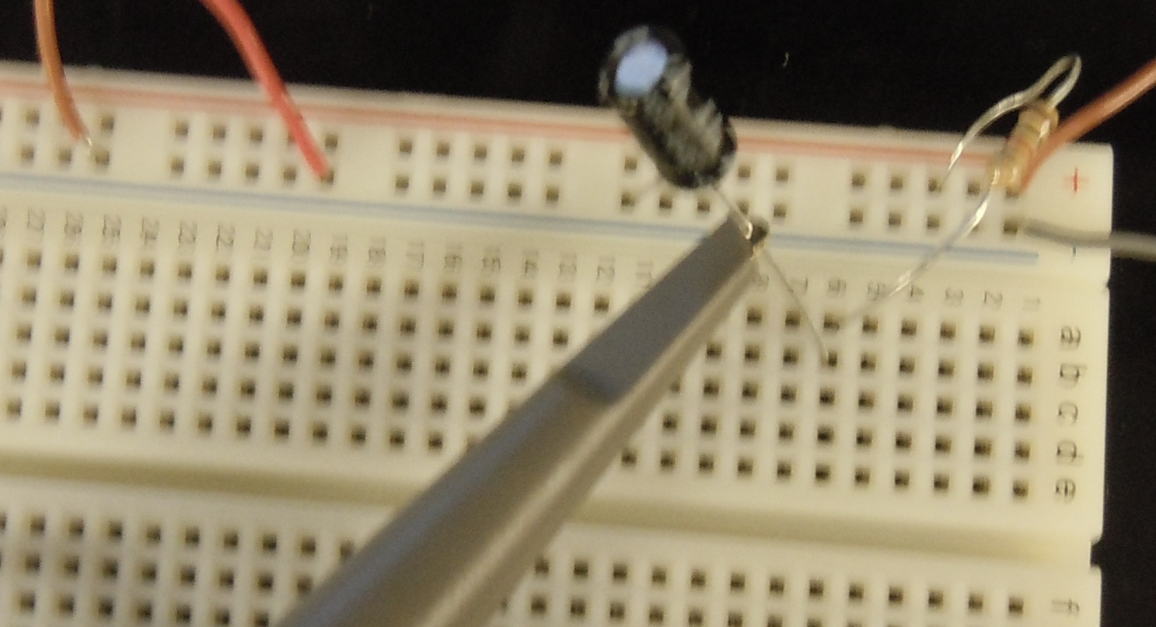
Lab 11
Lab set up:
.47μF Capacitor
1kΩ Resistor

Slide 60
Lab 11
Simulations:

Slide 61
Lab 11
Data:
 | .47uf |  |  |  | 1.00uf |  |  |  | 2.2uf
 | expected | measured |  | Simulated | expected | measured |  | Simulated | expected | measured |  | Simulated
Frequency Hz | output voltage V | input voltage V | output voltage V | output voltage V | output voltage V | input voltage V | output voltage V | output voltage V | output voltage V | input voltage V | output voltage V | output voltage V
10 | 0.99956 | 1.00 | 1.0200 | 0.9996 | 0.99803 | 1.00 | 1.0200 | 0.998 | 0.99058 | 1.00 | 1.0000 | 0.991
50 | 0.98927 | 1.00 | 0.9800 | 0.9893 | 0.95403 | 1.00 | 0.9400 | 0.954 | 0.82264 | 0.98 | 0.8200 | 0.823
100 | 0.95906 | 1.00 | 0.9400 | 0.9591 | 0.84673 | 1.00 | 0.8600 | 0.847 | 0.58613 | 1.00 | 0.6200 | 0.586
200 | 0.86104 | 1.00 | 0.8600 | 0.8610 | 0.62268 | 1.00 | 0.6600 | 0.623 | 0.34015 | 1.01 | 0.3600 | 0.340
300 | 0.74851 | 1.02 | 0.7280 | 0.7485 | 0.46865 | 1.00 | 0.4640 | 0.469 | 0.23442 | 1.00 | 0.2400 | 0.234
400 | 0.64613 | 1.00 | 0.6120 | 0.6461 | 0.36970 | 1.00 | 0.3680 | 0.370 | 0.17797 | 1.00 | 0.1840 | 0.178
500 | 0.56075 | 1.00 | 0.5280 | 0.5608 | 0.30331 | 1.00 | 0.3040 | 0.303 | 0.14320 | 1.00 | 0.1500 | 0.143
600 | 0.49150 | 1.00 | 0.4640 | 0.4915 | 0.25639 | 1.00 | 0.2600 | 0.256 | 0.11970 | 1.00 | 0.1260 | 0.120
700 | 0.43548 | 1.00 | 0.4160 | 0.4355 | 0.22171 | 1.00 | 0.2240 | 0.222 | 0.10280 | 1.00 | 0.1100 | 0.103
800 | 0.38980 | 1.00 | 0.3640 | 0.3898 | 0.19512 | 1.00 | 0.2080 | 0.195 | 0.09006 | 1.00 | 0.1000 | 0.090
900 | 0.35215 | 1.00 | 0.3360 | 0.3522 | 0.17414 | 1.00 | 0.1760 | 0.174 | 0.08012 | 1.00 | 0.0856 | 0.080
1000 | 0.32074 | 1.00 | 0.3000 | 0.3207 | 0.15718 | 1.00 | 0.1580 | 0.157 | 0.07215 | 1.00 | 0.0780 | 0.072
2000 | 0.16694 | 1.00 | 0.1600 | 0.1669 | 0.07933 | 1.00 | 0.0848 | 0.079 | 0.03615 | 1.02 | 0.0424 | 0.036
3000 | 0.11216 | 1.02 | 0.1080 | 0.1122 | 0.05298 | 1.00 | 0.0568 | 0.053 | 0.02411 | 1.00 | 0.0320 | 0.024
4000 | 0.08436 | 1.02 | 0.0840 | 0.0844 | 0.03976 | 1.00 | 0.0440 | 0.040 | 0.01808 | 1.02 | 0.0236 | 0.018
5000 | 0.06757 | 1.00 | 0.0678 | 0.0676 | 0.03181 | 1.00 | 0.0398 | 0.032 | 0.01447 | 1.00 | 0.0208 | 0.014
6000 | 0.05635 | 1.01 | 0.0552 | 0.0563 | 0.02652 | 1.02 | 0.0320 | 0.027 | 0.01206 | 1.00 | 0.0160 | 0.012
7000 | 0.04832 | 1.00 | 0.0520 | 0.0483 | 0.02273 | 1.00 | 0.0316 | 0.023 | 0.01033 | 1.00 | 0.0142 | 0.010
8000 | 0.04229 | 1.00 | 0.0496 | 0.0423 | 0.01989 | 1.00 | 0.0260 | 0.020 | 0.00904 | 1.00 | 0.0120 | 0.009
9000 | 0.03760 | 1.02 | 0.0480 | 0.0376 | 0.01768 | 1.00 | 0.0228 | 0.018 | 0.00804 | 1.00 | 0.0130 | 0.008
10000 | 0.03384 | 1.02 | 0.0388 | 0.0338 | 0.01591 | 1.00 | 0.0190 | 0.016 | 0.00723 | 1.00 | 0.0108 | 0.007

Slide 62
Lab 11
Data:

Slide 63



Lab 11
Equations:
Capacitive Reactance
Total Impedance
Ohm’s Law
Observations: The output voltage did not observe a linear behavior.
Conclusion: It was found that the simulation, calculations and measured values all agreed.

Slide 64
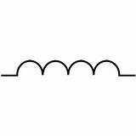
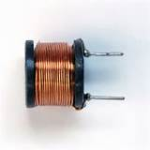
Lab 12
(Series/Parallel Inductors)
(4/23/15)
Lab Partners
Josiah Abel
Cody Fletcher

Slide 65
Lab 12
Objective: To experiment with inductors in series circuit and parallel circuits.
Procedure: The individual inductances of the inductors were measured with the LCR meter. The inductors were then put in a series circuit and the total inductance was measured with the LCR meter. Finally the inductors were put in a parallel circuit and the total inductance was measured with the LCR meter.
Equipment:
Bench 6
3 Inductors
Solder less Breadboard
LCR Meter
  Make: GwInstek Model: LLR METER, LCR-819 SN: E120998

Slide 66
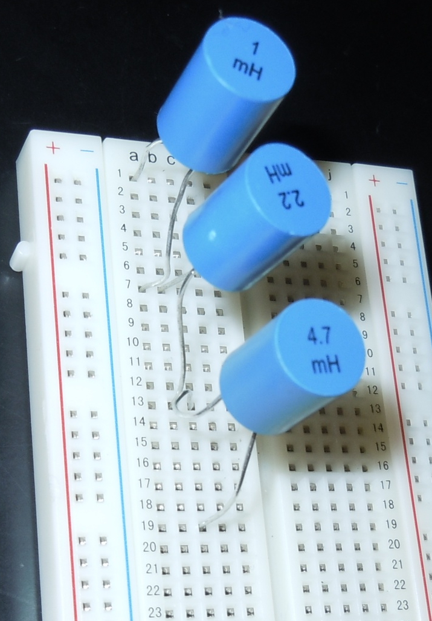
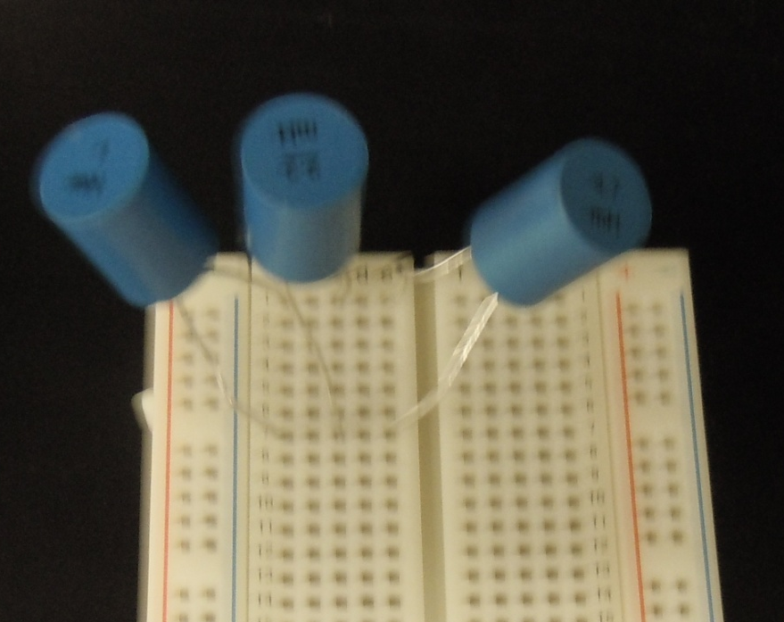
Lab 12
Lab set up:
1mH Inductor
2.2mH Inductor
4.7mH Inductor

Slide 67
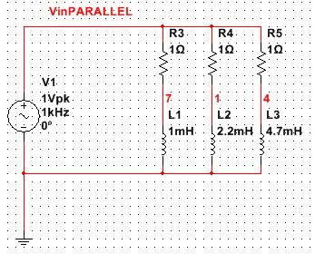
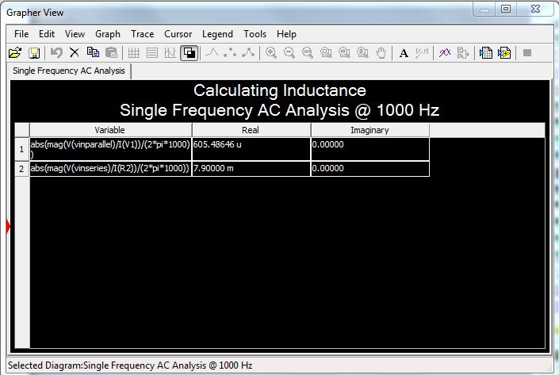
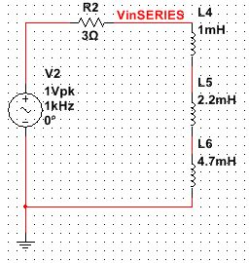
Lab 12
Simulations:

Slide 68
Lab 12
Data:
Inductors in Series Expected |  |  | Inductors in Series Measured |  |  | Inductors in Series Simulated
Inductors |  | Units | Inductors |  | Units | Inductors |  | Units
L1 | 1 | mH | L1 | 1.0038 | mH | L1 | 1 | mH
L2 | 2.2 | mH | L2 | 2.198 | mH | L2 | 2.2 | mH
L3 | 4.7 | mH | L3 | 4.35 | mH | L3 | 4.7 | mH
LT | 7.9 | mH | LT | 7.37776 | mH | LT | 7.9E+0 | mH
Inductors in Parallel Expected |  |  | Inductors in Parallel Measured |  |  | Inductors in Parallel Simulated
Inductors |  | Units | Inductors |  | Units | Inductors |  | Units
L1 | 1 | mH | L1 | 1.0038 | mH | L1 | 1 | mH
L2 | 2.2 | mH | L2 | 2.198 | mH | L2 | 2.2 | mH
L3 | 4.7 | mH | L3 | 4.35 | mH | L3 | 4.7 | mH
LT | 599.8E-3 | mH | LT | 559.1E-3 | mH | LT | 605.5E-3 | mH

Slide 69

Lab 12
Equations:
Series Inductance
Parallel Inductance
Observations: Inductors add just like resistors do in series and parallel circuits.
Conclusion: It was found that the simulation, calculations and measured values all agreed.

