Slide 1
EECT112
LAB NOTEBOOK
Fall 2014
Instructor: Louis Toth
Partner: Josiah Abel
By
Dakota Johnson

Slide 2
Table of Content
Lab Number Slide Number
Lab 1( And/Or Gates) 3-5
Lab 2(Nand Alternative) 6-10
Lab 3(Car Alarm) 11-13
Lab 4(Binary Counter) 14-16
Lab 5(LED Flasher) 17-21
Lab 6(Temp Sensor/Heater) 22-26

Slide 3
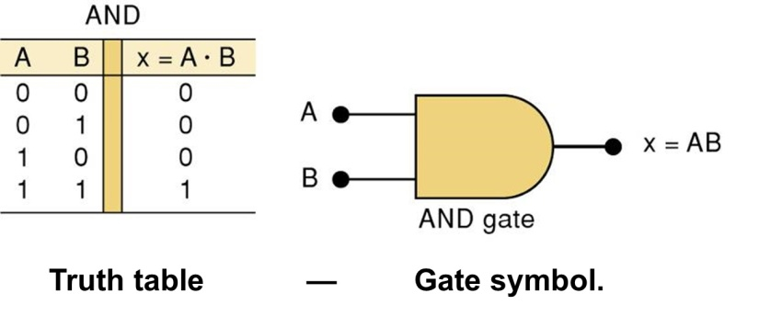
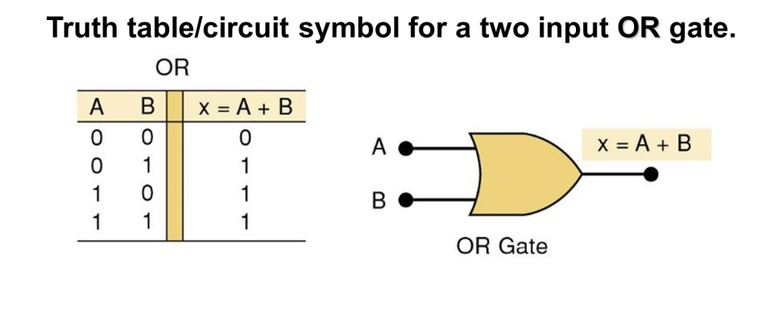
Lab 1
And/Or Gates
Equipment:
Breadboard
Brand: NI ELVIS II+
SN: 14C6E29
Digital Multimeter
Brand: GWINSTEK
GDM: 3245
SN: CL860334
-AND Gate
Chip: 74LS08D
OR Gate
Chip: 74LS32D
-Miscellaneous Wire
Objective: To show the functions of AND and OR gates.
Background: An And Gate sends an output when all inputs are sending a signal. An Or Gate sends an output when just one input sends a signal.

Slide 4
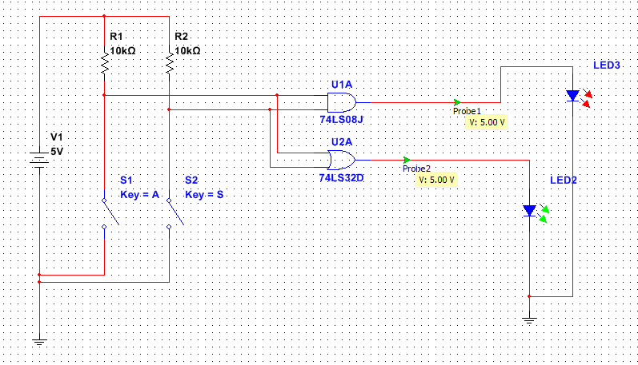
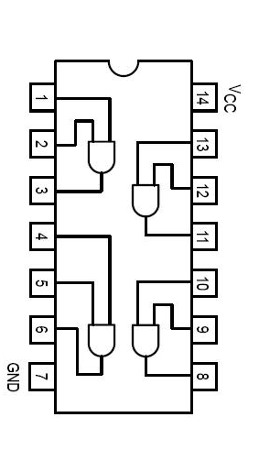
Lab 1
And/Or Gates
Schematics:
Multisim
Schematics for the chips
Resistors
Or Gate
And Gate
Individual gates
Power to the chip
Gate inputs
Gate output
Ground for the chip
Switches
LED Lights

Slide 5
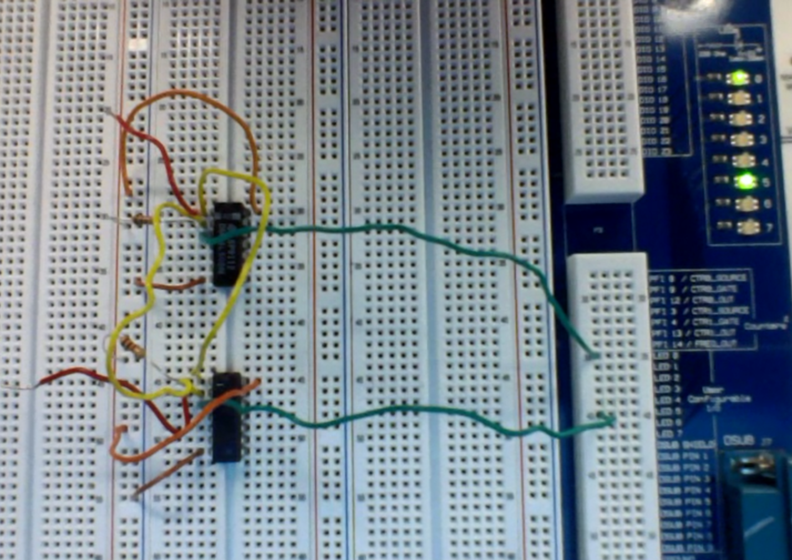
Lab 1
And/Or Gates
Lab Work:
Resistors
And Gate
LED Lights
Switches
The voltage of the circuit was taken using an oscilloscope. The voltage when the LEDs were on was 3.22 V and when they were off it was .16 V.
Or Gate

Slide 6
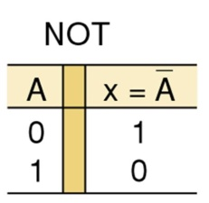
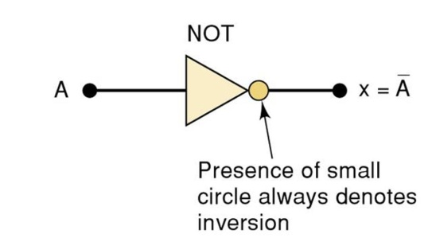
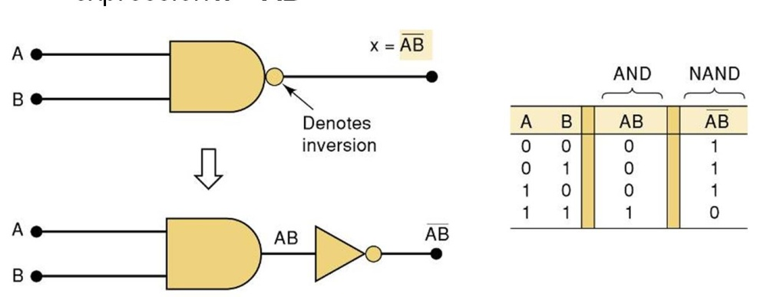
Lab 2
Nand Alternative
Equipment:
Breadboard
Brand: NI ELVIS II+
SN: 1677D1E
Digital Multimeter
Brand: GWINSTEK
GDM: 8245
SN: CL860332
-AND Gate
Chip: 74LS08D
OR Gate
Chip: 74LS32D
-NOT Gate
Chip: 74LS04D
-NAND Gate
Chip: 74LS00D
-Miscellaneous Wire
Objective: To show how a logic circuit can be reduced to a single kind of gate.
Background: Not gates work by inverting whatever signal is going into it. Nand gates behave like the inverse of an And gate so a Nand gate will send an output when one or both of the signals have a logic state of 0 and will not send a signal when both of the signals are a logic state of 1. Nand gates also have a universal property. This means that you can build a circuit using only Nand gates.
NAND

Slide 7
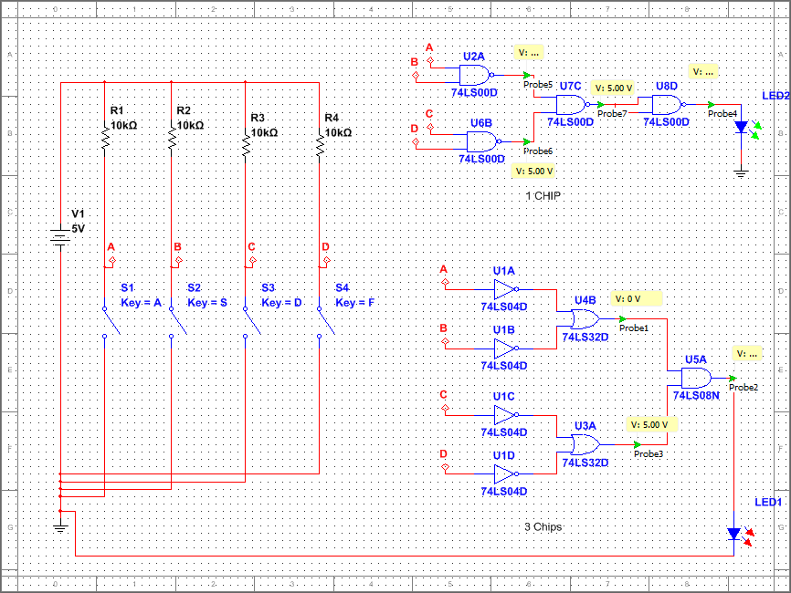
Lab 2
Nand Alternative
Schematics:
Multisim
Nand Gates
Resistors
Switches
LED Lights
Not Gates
Or Gates
And Gate

Slide 8
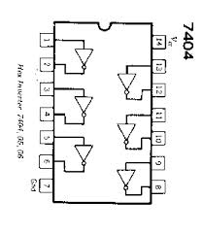
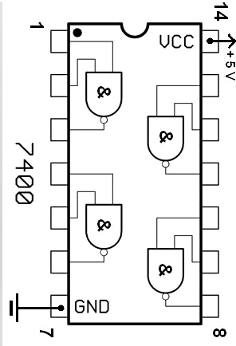
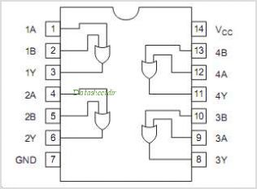
Lab 2
Nand Alternative
Schematics:
Schematics for the chips
Individual Nand gate
Power to the chip
Gate input
Individual Not gate
Gate inputs
Power to the chip
Gate output
Power to the chip
Gate output
Individual Or gate
Gate inputs
Ground for the chip
Ground for the chip
Gate output
Ground for the chip

Slide 9
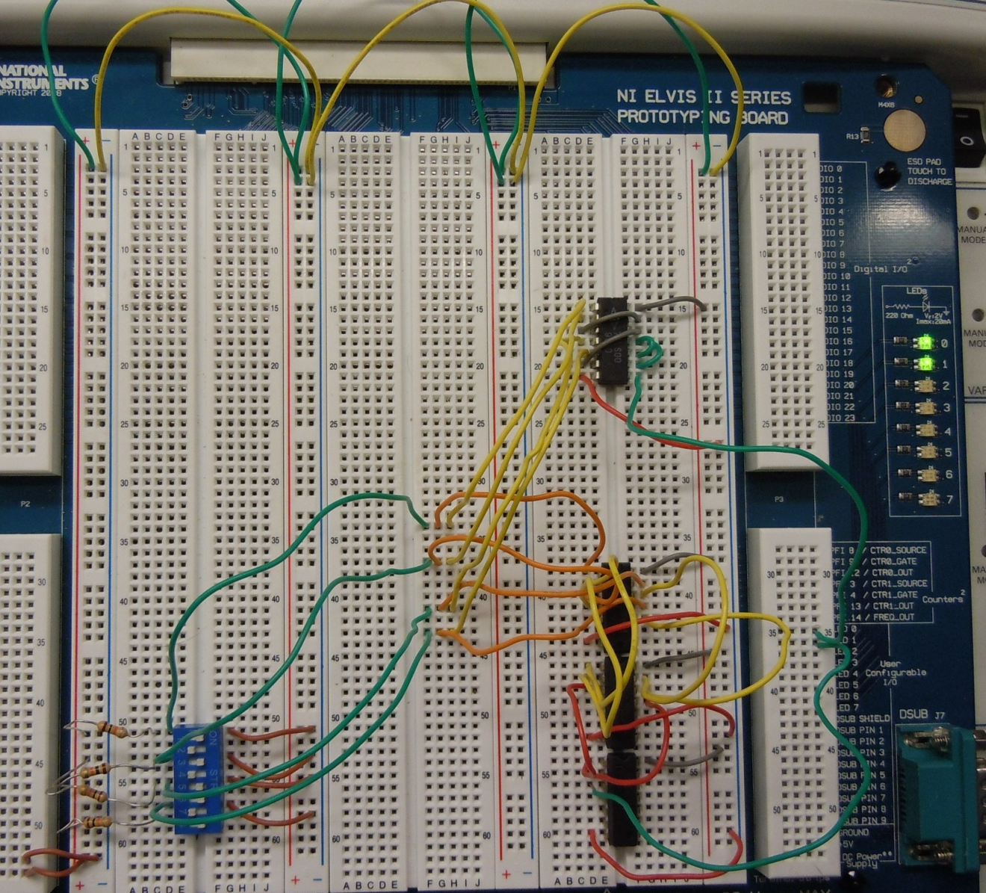
Lab 2
Nand Alternative
Lab Work:
Nand Gates
LED Lights
Not Gates
Switches
Or Gates
And Gate
Resistors

Slide 10
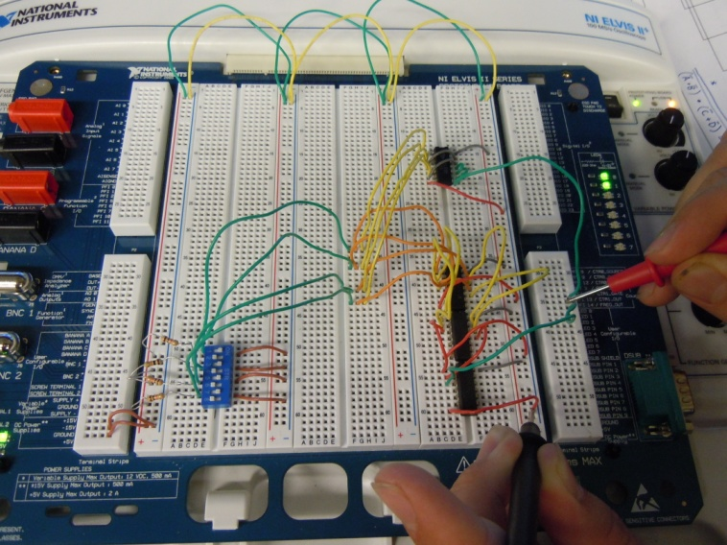
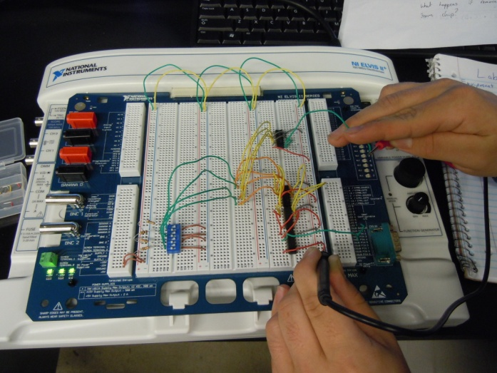
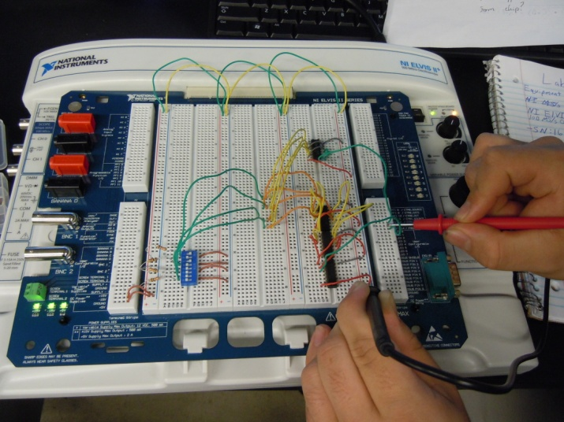
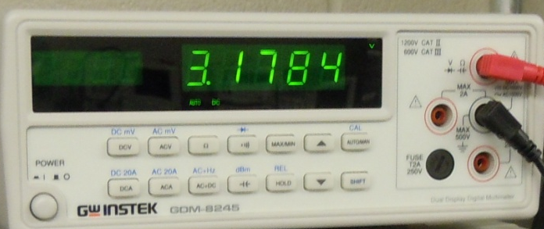
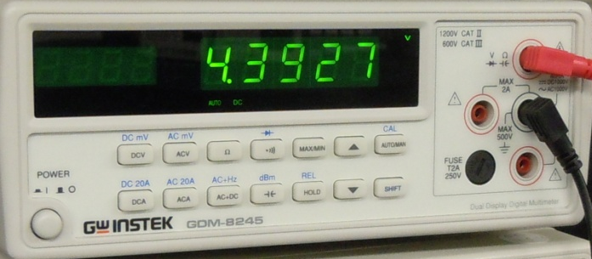
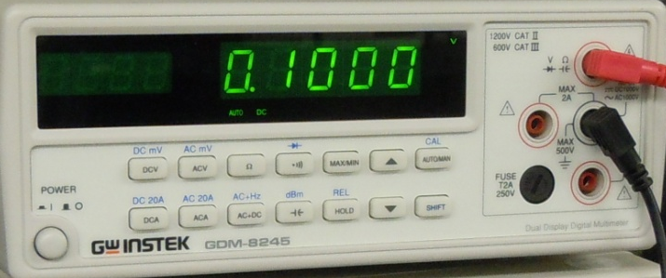
Lab 2
Nand Alternative
Lab Work:
Using an oscilloscope the voltage was taken when the LEDs were on (left picture), when the LEDs were off (center picture), and when the prongs were placed directly on the wires (right picture).

Slide 11
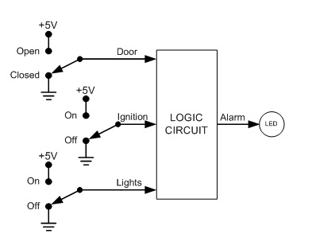
Lab 3
(Mid Term)
Car Alarm
Equipment:
Breadboard
Brand: NI ELVIS II+
SN: 14C6E29
-AND Gate
Chip: 74LS08D
OR Gate
Chip: 74LS32D
-Miscellaneous Wire
Objective: To build a functioning logic circuit given the inputs and desired outputs.
Background: The diagram below was given. The desired outputs were when the door was open and the ignition was on, when the door was open and the lights were on, and when the ignition was off and the lights were on.

Slide 12
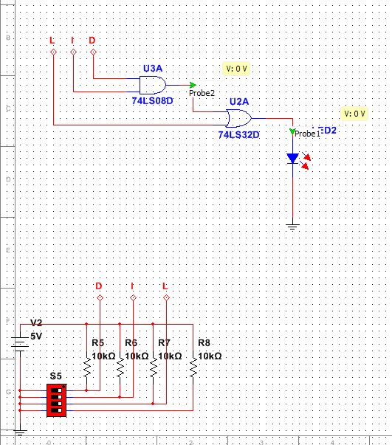
Lab 3
(Mid Term)
Car Alarm
Schematics:
Multisim
Truth Table
Ignition Input
L | D | I | X
0 | 0 | 0 | 0
0 | 0 | 1 | 0
0 | 1 | 0 | 0
0 | 1 | 1 | 1
1 | 0 | 0 | 1
1 | 0 | 1 | 0
1 | 1 | 0 | 1
1 | 1 | 1 | 1
Light Input
LED representing car alarm
Door Input
And Gate
Or Gate
Equation found from truth table*
Switches
Resistors
X = (ID)+L
* There was a mistake made when finding this equation. Because of this the circuit built gives off false positives.

Slide 13
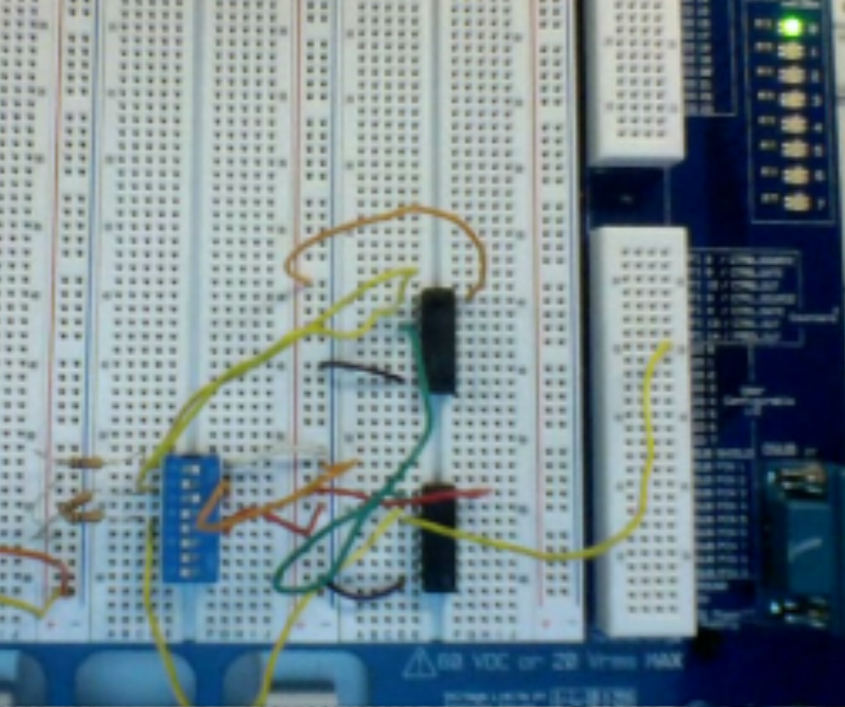
Lab 3
(Mid Term)
Car Alarm
Lab Work:
LED representing car alarm
And Gate
Door Input
Switches
Ignition Input
Resistors
Light Input
Or Gate

Slide 14
Lab 4
Binary Counter
Equipment
Breadboard
Brand: NI ELVIS II+
SN: 1677D3B
-BCD to 7 Segment Decoder
Chip: 74LS48D
4 Bit Ripple Counter
Chip: 74LS93D
Tektronix TDS 220 Two Channel Digital Real-Time Oscilloscope
    SN:B068379
-Man 74-7 Segment display
-Miscellaneous Wire
Objective: To have a 7 segment display count from 0 to F in hexadecimal.
Background: A clock when used with a flip flop latch can be used to store information and count.

Slide 15
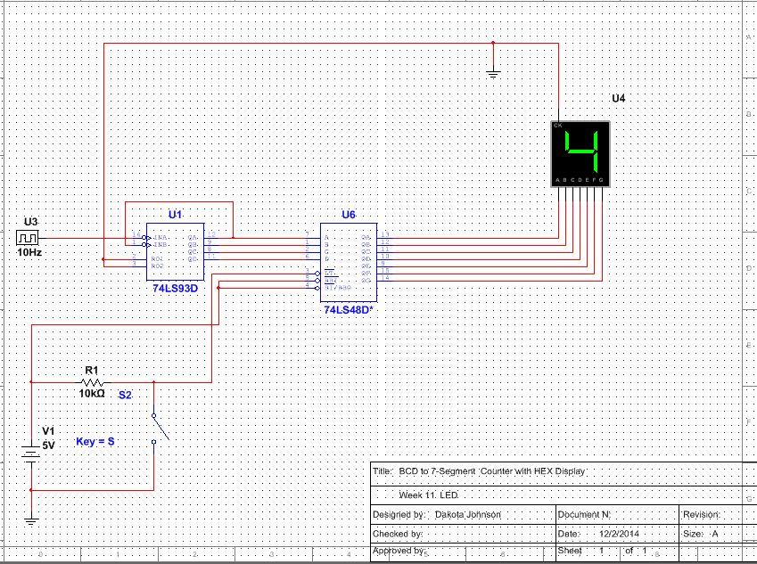
Lab 4
Binary Counter
Schematics:
Multisim
7 Segment Display
4-Bit Ripple Counter
BCD to 7 Segment Decoder
Clock

Slide 16
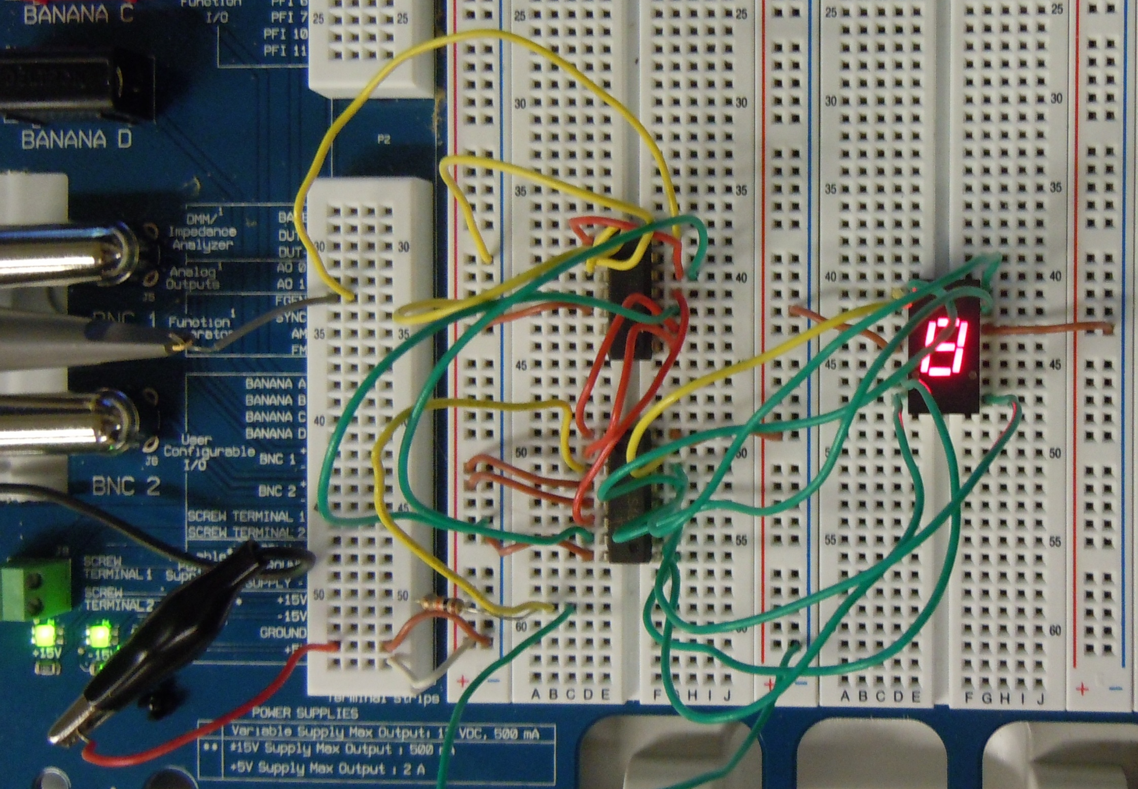
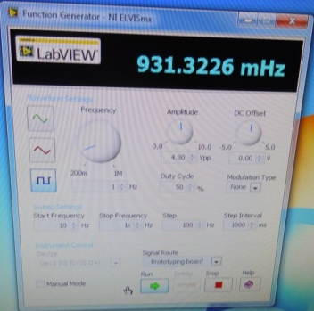
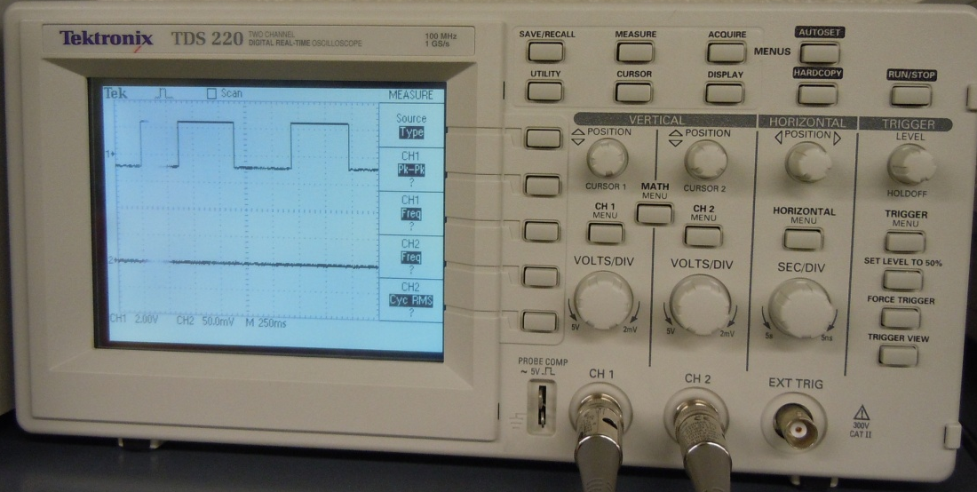
Lab 4
Binary Counter
Lab Work:
4-Bit Ripple Counter
7 Segment Display
Clock
An oscilloscope was attached to the circuit so that the waves of the clock could be observed.
BCD to 7 Segment Decoder

Slide 17
Lab 5
LED Flasher(Basic Stamp 1)
Equipment
-LED Light
-220 ohm resistor
-10k ohm resistor
-Basic Stamp
-Basic Stamp Program
-Miscellaneous Wire
Objective: To program a chip to flash an LED light
Background: The basic stamp program allows you to program a chip to do different functions.

Slide 18
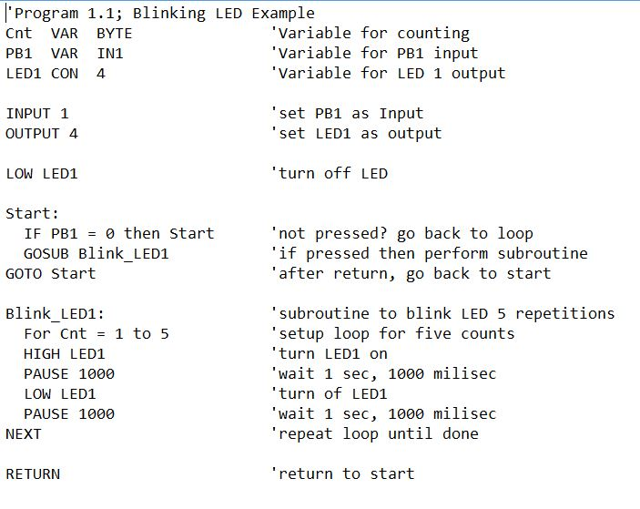
Lab 5
LED Flasher(Basic Stamp 1)
Schematics:
Program
Defining Variables and Constants
Defining Inputs and Outputs
Initial Conditions
Comments about what the program is doing
Main Program
Sub-routine

Slide 19
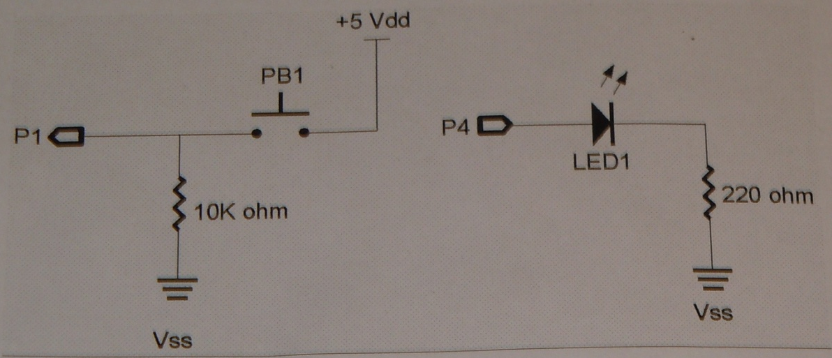
Lab 5
LED Flasher(Basic Stamp 1)
Schematics:
Hardware
LED Light
Switch
Resistors

Slide 20
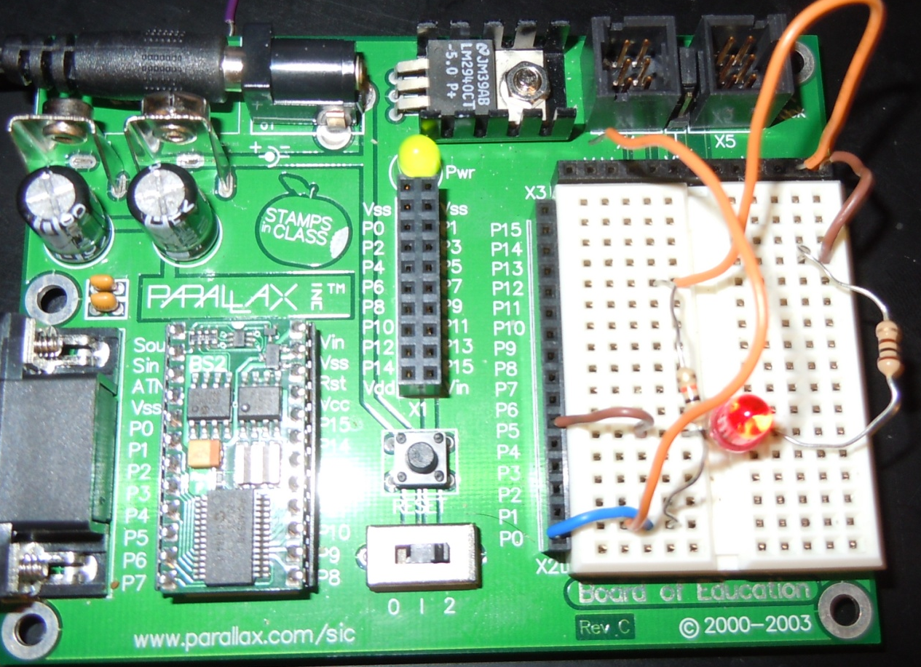
Lab 5
LED Flasher(Basic Stamp 1)
Lab Work:
Switch
LED Light
Programmable Chip
220 ohm resistor
10k ohm resistor

Slide 21
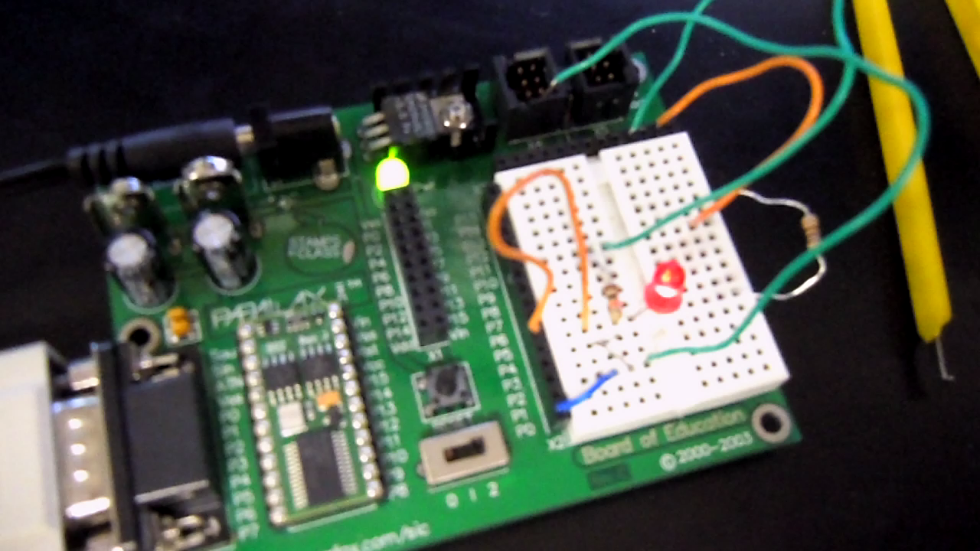
Lab 5
LED Flasher(Basic Stamp 1)
Lab Work:

Slide 22
Lab 6
Temp Sensor/Heater (Basic Stamp 2)
Equipment
-LED Light
-220 ohm resistor
-10k ohm resistor
-10K ohm Multi-turn Potentiometer
-1uF Capacitor
-Basic Stamp
-Basic Stamp Program
-Miscellaneous Wire
Objective: To show how analog data can be used in a digital circuit.
Background: Digital data comes in two states on or off. Analog data can come in varying degrees of states. There are multiple was to get analog data into a digital circuit in this experiment we will be using a resistor/capacitor network for the analog data and the input will be the time it take for the capacitor to discharge.

Slide 23
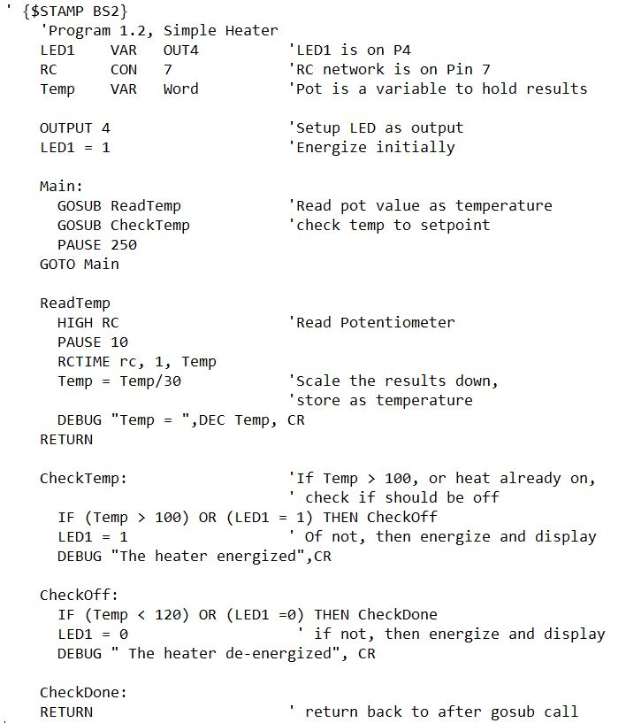
Lab 6
Temp Sensor/Heater (Basic Stamp 2)
Schematics:
Program
Defining Variables and Constants
Defining Inputs and Outputs
Main Program
Comments about what the program is doing
Sub-routines

Slide 24
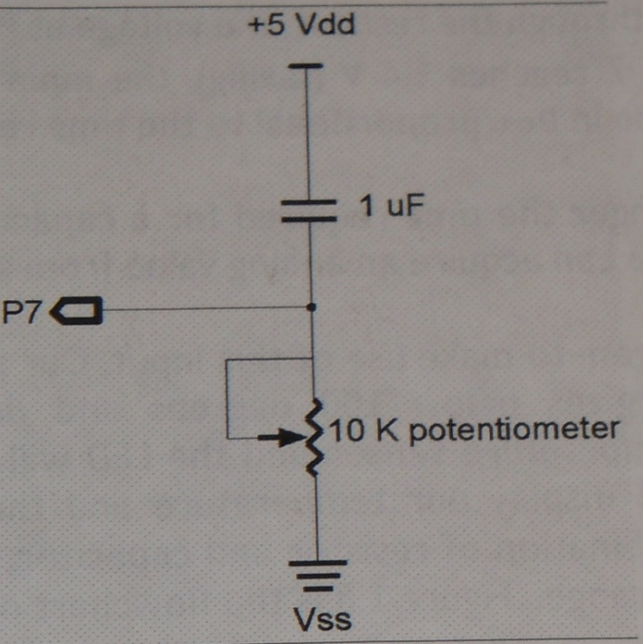
Lab 6
Temp Sensor/Heater (Basic Stamp 2)
Schematics:
Hardware
LED Light
Switch
Capacitor
Resistors
Potentiometer

Slide 25
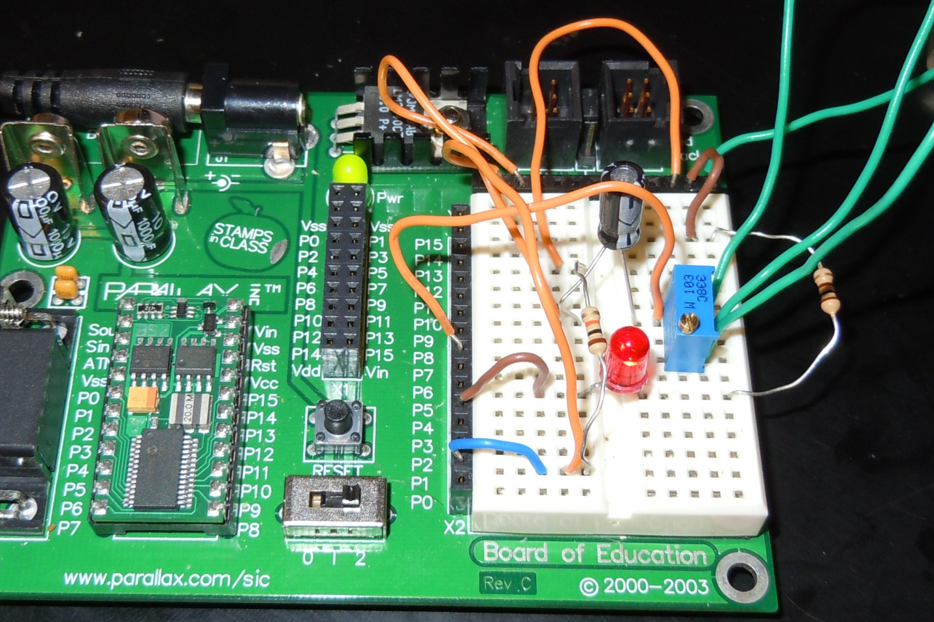
Lab 6
Temp Sensor/Heater (Basic Stamp 2)
Lab Work:
Switch
Capacitor
Programmable Chip
220 ohm resistor
Potentiometer
10k ohm resistor
LED Light

Slide 26
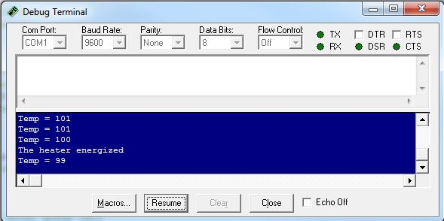
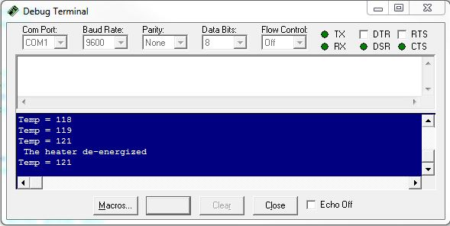
Lab 6
Temp Sensor/Heater (Basic Stamp 2)
Lab Work:
The debug screen saying that the heater energized at 100.
The debug screen saying that the heater de-energized at 121.

