Slide 1
Lab 1: Switching Diode
By: Dakota Johnson
Lab Partner: Josiah Abel
Instructor: Andy Bell
Bench Number: 6
Class: EECT 121-50C
Date: 12/15/2015

Slide 2
Objectives:
To Observe some characteristics of a 1N4148 Switching Diode.
Equipment and Parts:
    Digital Multi Meter Brand: GwInstek Model #: GDM-8245 SN: CL860332
    Function Generator Brand: GwInstek Model #: GFG-8210 SN: C705245
    DC Power Supply Model# HY1802D
    Oscilloscope Brand: Tektronix Model #: TDS220 SN: B083266
    Parts//
    1N4148 Switching Diode
    1kΩ resistor
    Miscellaneous wires
    1kΩ Variable Resistor (Potentiometer)

Slide 3
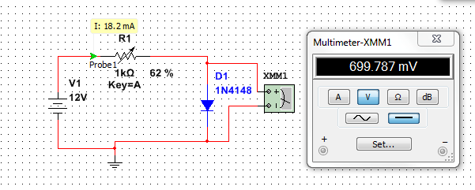
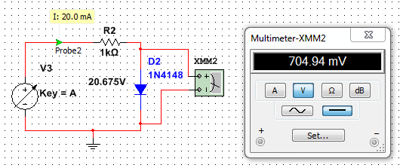
Data/Lab Results/Simulations/Schematics:
The First part of the lab simulation A variable resistor was used to adjust the forward current entering the diode. So that the voltage drop across the diode could be measured.
The second part of the Lab simulation involved a fixed resistance while adjusting the voltage to achieve a similar voltage drop at max forward current.

Slide 4
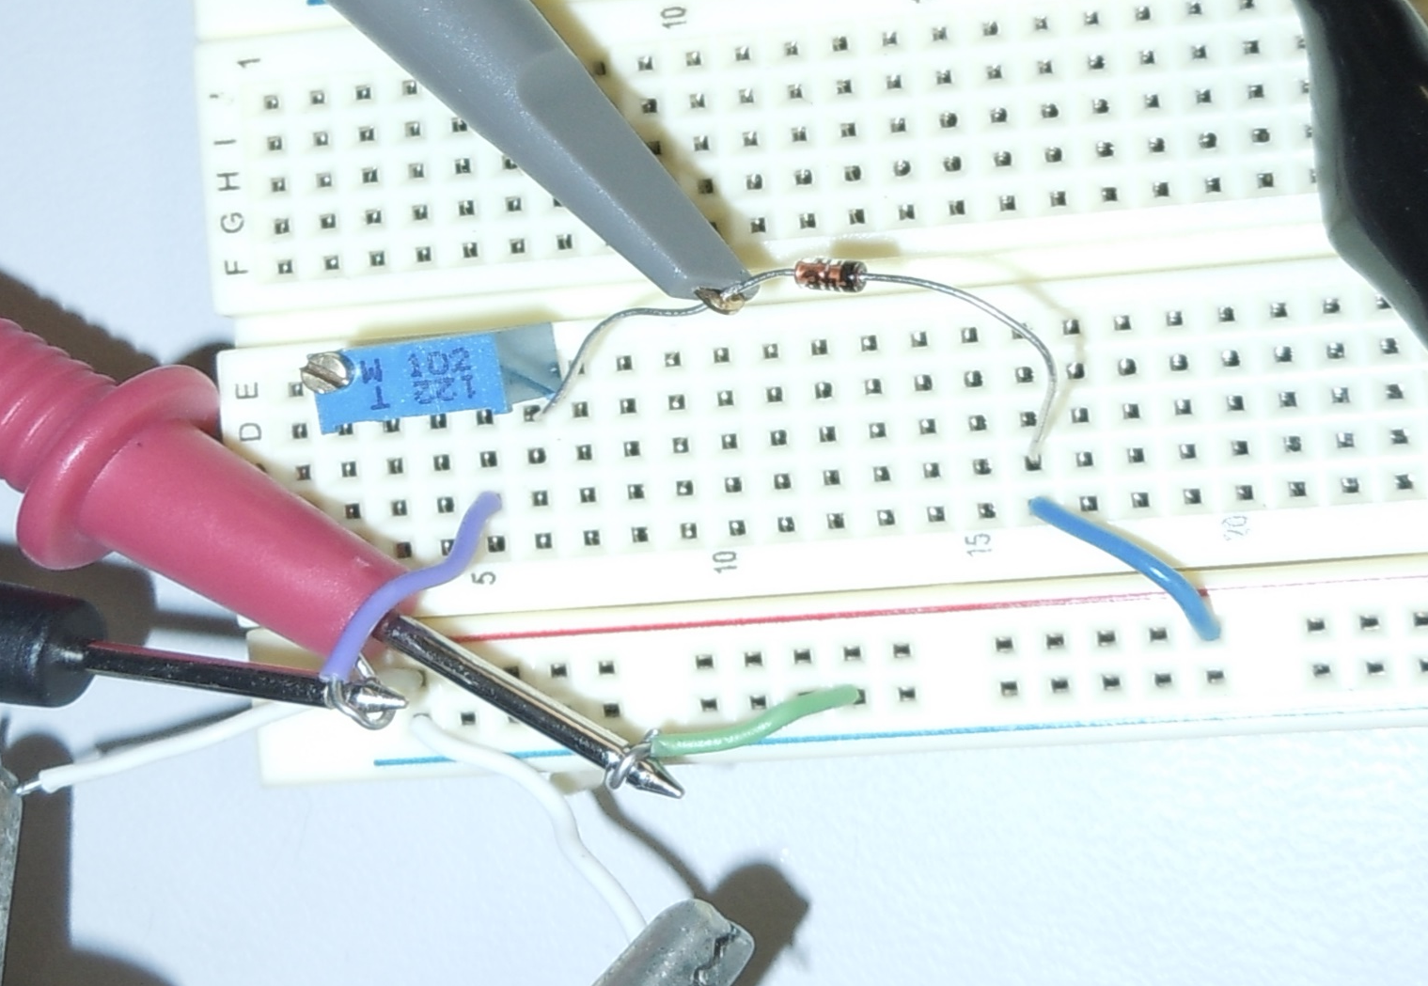
Data/Lab Results/Simulations/Schematics:
First Part
Voltage
1kohm Potentiometer
1N4148 Switching Diode
Forward Current

Slide 5
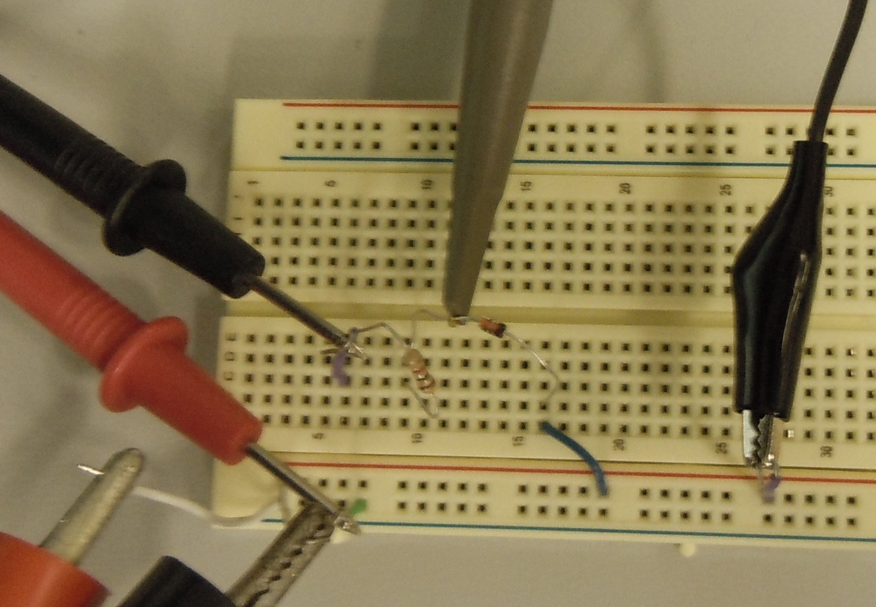
Data/Lab Results/Simulations/Schematics:
Second Part
Voltage
1kohm Resistor
1N4148 Switching Diode
Forward Current

Slide 6
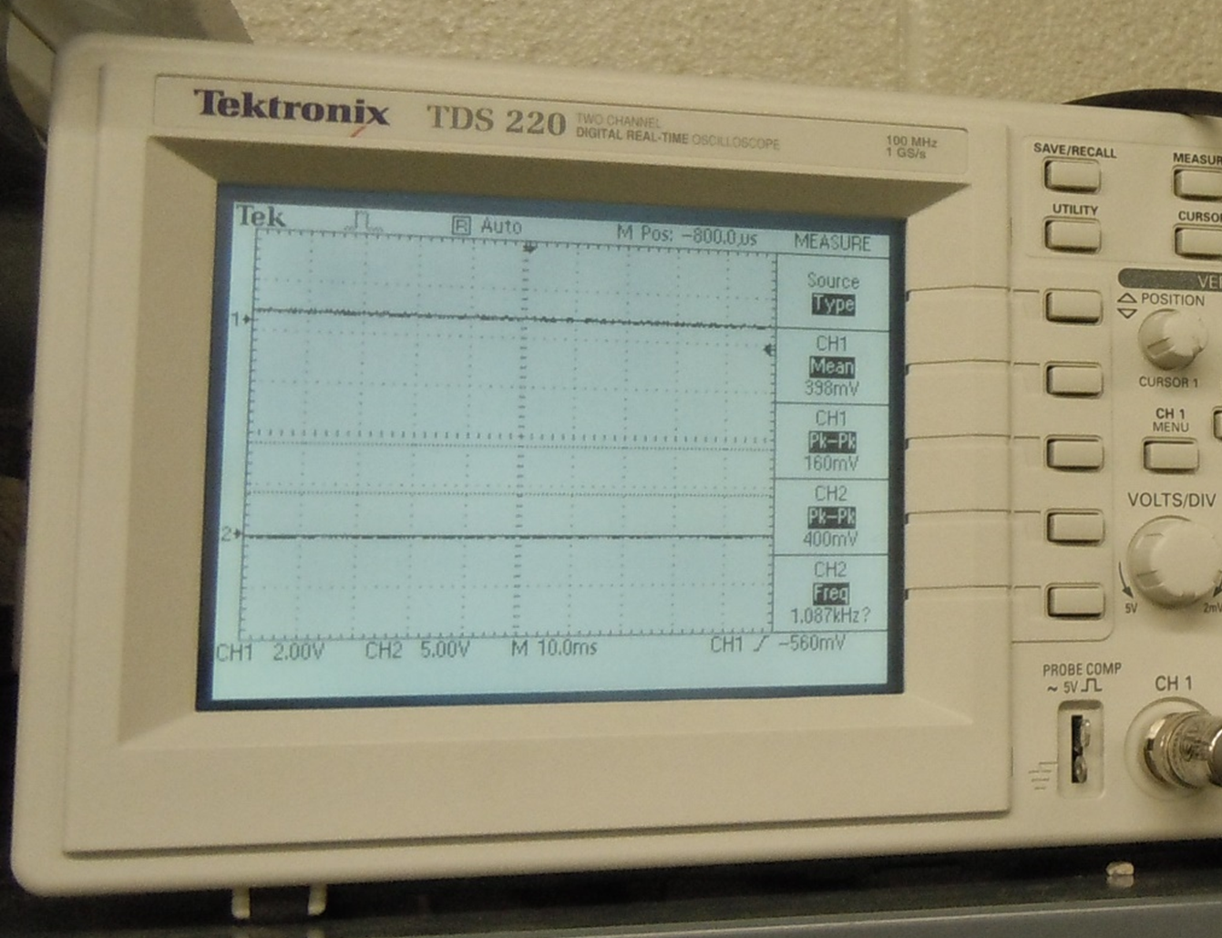
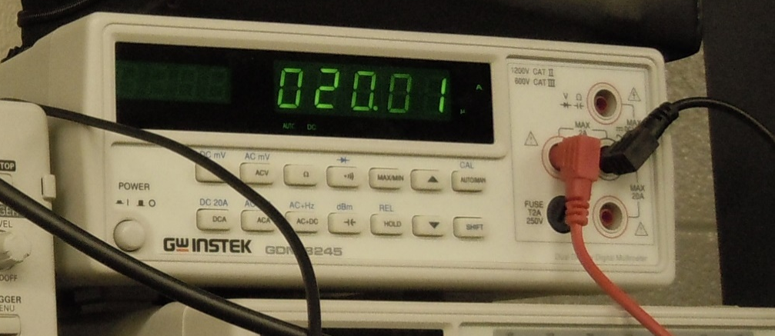
Data/Lab Results/Simulations/Schematics:
A.
B.
A. The Oscilloscope display, where the voltage readings were obtained.
B. The Digital Multimeter, where the forward current readings were obtained.

Slide 7
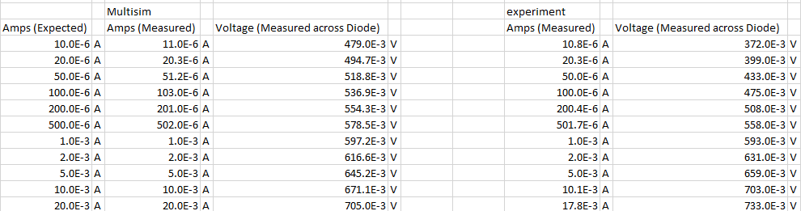
Lab Results:

Slide 8
Troubleshooting:
  There was some difficulty properly adjusting the Variable Power Supply the desired levels.
  The lab itself was designed by another group and was improperly explained.

Slide 9
Conclusion:
The Switching Diode’s Characteristics were measured in the Lab and compared to that of the datasheet and found to be similar.

Slide 10
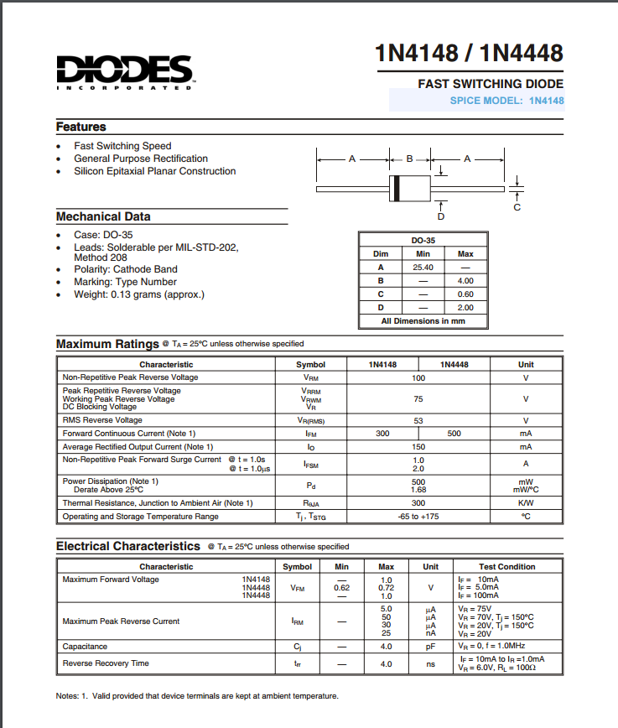
Data Sheet:
1N4148 Switching Diode

