Slide 1
Lab 12
Band Reject Filter Using an OP Amp
By: Dakota Johnson
Lab Partner: Josiah Abel
Instructor: Andy Bell
Bench Number: 6
Class: EECT 121-50C
Date: 12/15/2015

Slide 2
Objectives:
Simulate a band reject filter that attenuates a frequency of1kHz with multisim
Equipment and Parts:
    Oscilloscope Brand: Tektronix Model #: TDS220 SN: B083266
    Digital Multi Meter Brand: GwInstek Model #: GDM-8245 SN: CL860332
    Function Generator Brand: GwInstek Model #: GFG-8210 SN: C705245
    GW Instek LCR meter model#: LCR-819 SN#: E120998
    DC Power Supply Model# HY1802D

Slide 3
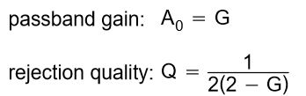
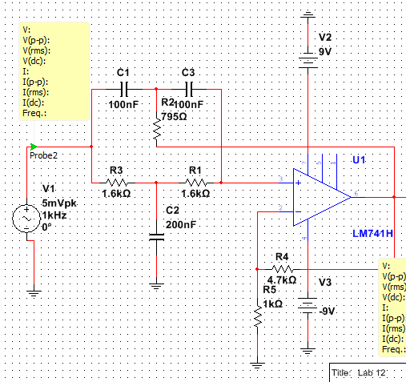

Data/Lab Results/Simulations/Schematics:
Circuit Type:
Active Twin-T
Equation for gain and reject quality
Equation used to find R
fc | 1000 | Hz
A₀ | 1
G | 1
Q | 0.5
C | 100.0E-9 | F
2C | 200.0E-9 | F
R1 | 1.6E+3 | Ω
R/2 | 795.8E+0 | Ω
Table of values for the simulation
Multisim Schematics of the circuit.

Slide 4
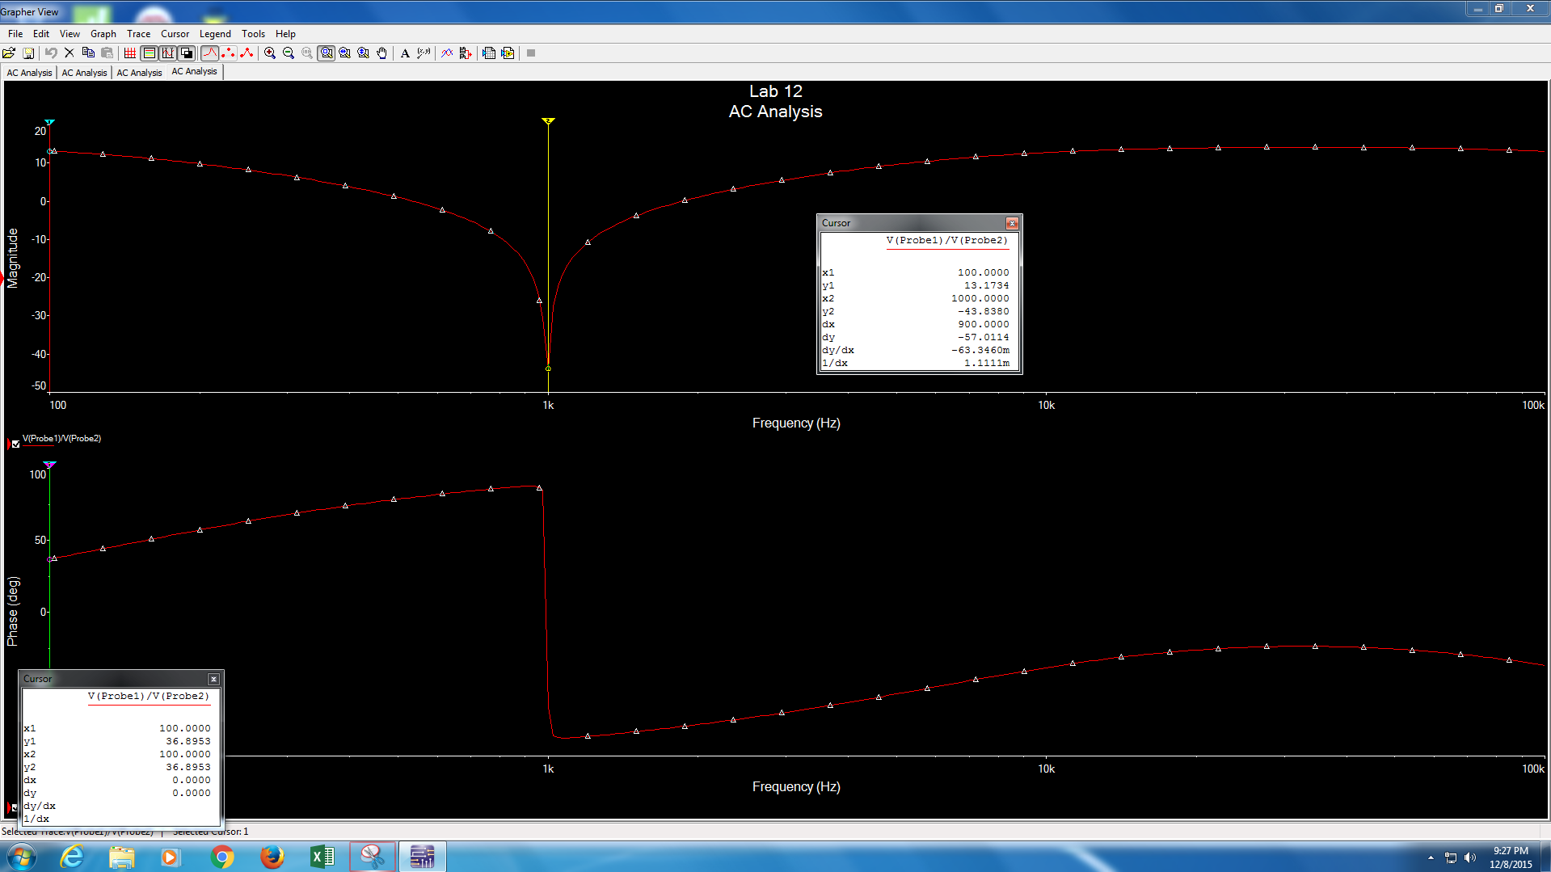
Data from the diagram x2 is in Hz
Frequency Response and phase shift diagrams for the band reject filter

Slide 5
Troubleshooting:
  The circuit was not working. To solve this, the schematic that was used to build circuit was consulted. It was discovered that the resistors R4 and R5 had not been put in. Once these resistors were placed in the circuit it worked as expected.

Slide 6
Conclusion:
A band reject filter that attenuates a 1kHz frequency was built.

