Slide 1
Lab 3: Full And Half-Wave Bridge
By: Dakota Johnson
Lab Partner: Josiah Abel
Instructor: Andy Bell
Bench Number: 6
Class: EECT 121-50C
Date: 12/15/2015

Slide 2
Objectives:
To become familiar with a common functionality of a diode in circuits as a rectifier or filter. A rectifier circuit takes an AC waveform and begins the process of converting it to DC.
To simulate a full wave and half wave rectifier and observe any differences.

Slide 3
    Equipment:
    Oscilloscope Brand: Tektronix Model #: TDS220 SN: B083266
    Digital Multi Meter Brand: GwInstek Model #: GDM-8245 SN: CL860332
    Function Generator Brand: GwInstek Model #: GFG-8210 SN: C705245
    DC Power Supply Model# HY1802D
    Parts:
    Miscellaneous Wires
    1 1N4148 Switching Diode
    Step Down Power Transformer 12.6 VCT 1A, 16P112-1
    1 10kohm resistor

Slide 4
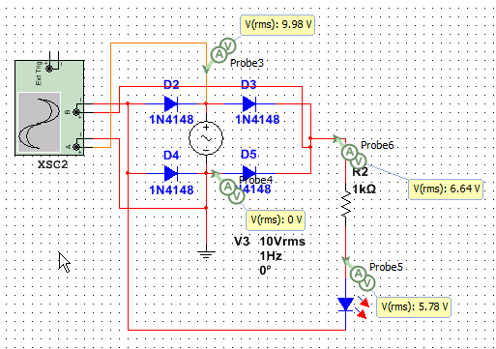
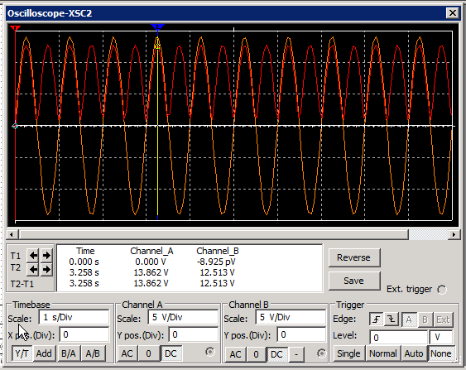
Simulations/Schematics:
Full-bridge rectifier circuit: the Resulting waveform emulates a AC waveform however the benefit is that it inverts the AC negative voltage. This creates a positive voltage AC waveform where there used to be a negative. It becomes fully positive. This is where it gets the name “Full-Bridge”.

Slide 5
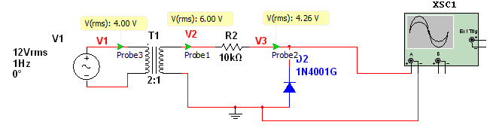
Simulations/Schematics:
Half-bridge rectifier circuit: the Resulting waveform emulates a AC waveform however the benefit is that it converts the AC negative voltage into zero volts. This leaves behind only the positive half of the AC waveform. This is where it gets the name “Half-Bridge”.

Slide 6
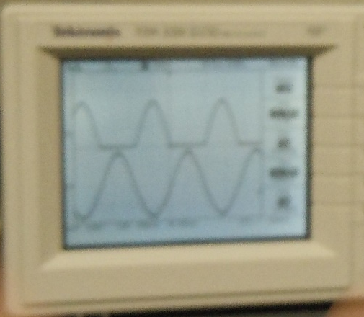
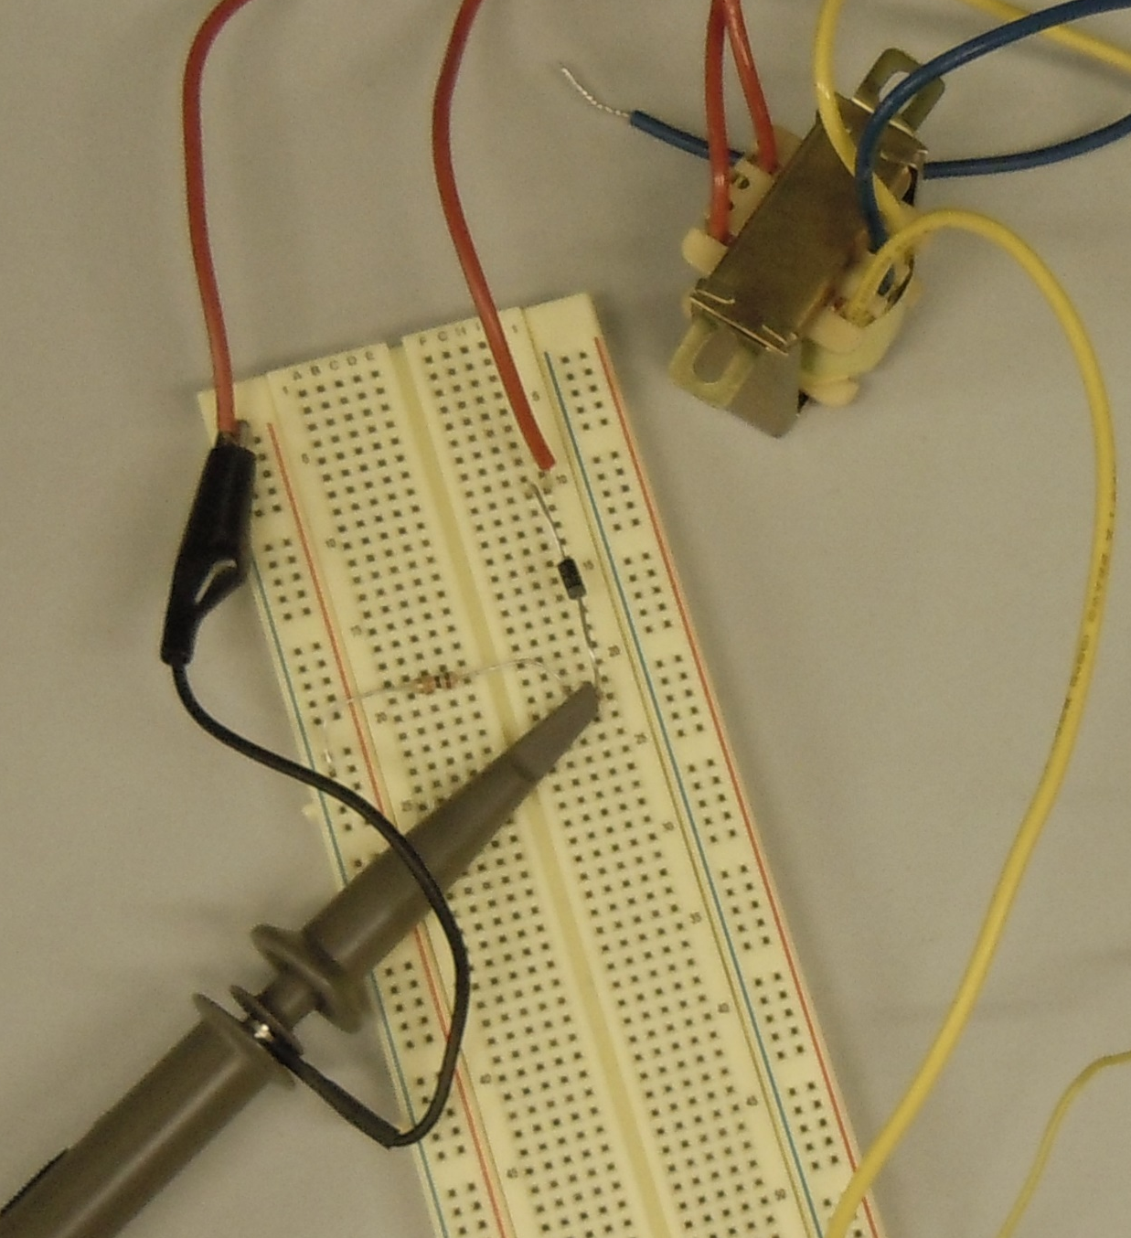
Data/Lab Results:
A.
B.
Transformer 16P112-1
1N4148 Diode
100kΩ Resistor
Half-Wave Circuit Waveform, below it is the AC waveform.
Half-Wave Circuit Setup

Slide 7
Troubleshooting:
  There was some difficulty properly adjusting the oscilloscope to read the half bridge circuit.
  The 1N4148 was not working properly and it was discovered that the transformer wasn’t adjusted properly at first and was outputting too high of a voltage

Slide 8
Conclusion:
The Full-wave Circuit would be easier to convert to DC then the Half-Wave because the waveform is more consistent.
The resulting outputs from the bridges are still course and will need more smoothing before a proper DC voltage could be acquired from the circuits.
If the switching diodes are oriented properly they can be used to rectify an AC signal.

Slide 9
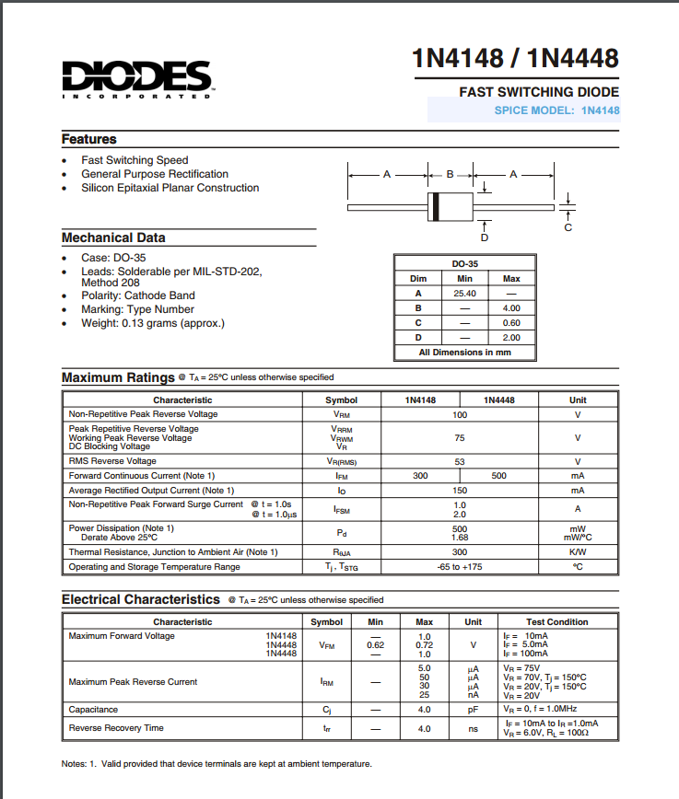
Data Sheets:
1N4148 Switching Diode

