Slide 1
Lab 7 N-Type JFET Switch
By: Dakota Johnson
Lab Partner: Josiah Abel
Instructor: Andy Bell
Bench Number: 6
Class: EECT 121-50C
Date: 12/15/2015

Slide 2
Objectives:
To turn on an LED with an N-Type JFET transistor.
Equipment and Parts:
DC Power Supply Model# HY1802D
Digital Multi Meter Brand: GwInstek Model #: GDM-8245 SN: CL860332
LED
4.7kΩ Resistor
2N5457 N-Type JFET Transistor

Slide 3
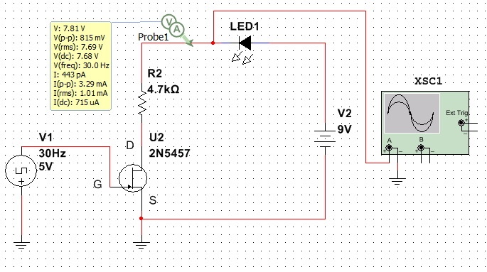
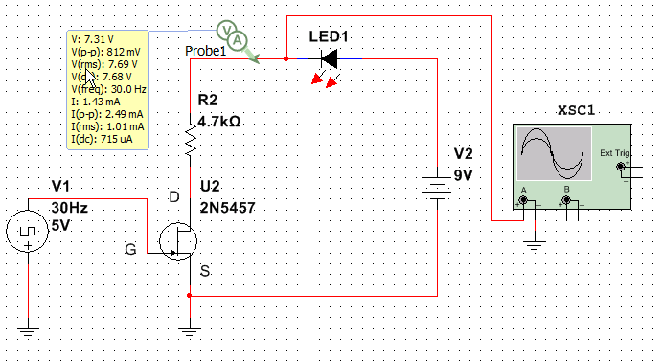
Data/Lab Results/Simulations/Schematics:
.model 2N5457DHJ NJF(Vto=-1.372 Beta=1.125m Lambda=2.3m
+ Vtotc=-2.5m Is=181.3f Isr=1.747p N=1 Nr=2 Xti=3 Alpha=2.543u
+ Vk=152.2 Cgd=4p M=.3114 Pb=.5 Fc=.5 Cgs=4.627p Kf=10.45E-18
+ Betatce=-.5 Rd=1 Rs=1 Af=1)
Model of 2N5457 used in the simulations
Multisim Schematics of the circuit.
Simulation of the circuit with the LED off.
Type | Current |  | Voltage Drop
08LX330 HV12 | 1.354 | mA | 3.582 | V
08L803 | 2.792 | mA | 1.945 | V
08L1043 | 3.049 | mA | 1.688 | V
08L93SRC | 2.999 | mA | 1.738 | V
08L32 | 2.818 | mA | 1.934 | V
08LX330 HV5 | 2.34 | mA | 2.491 | V
08LX330 HV5 | 2.844 | mA | 1.905 | V
08l53 | 2.899 | mA | 1.843 | V
Simulation of the circuit with the LED on.
Table of LEDs measured in lab

Slide 4
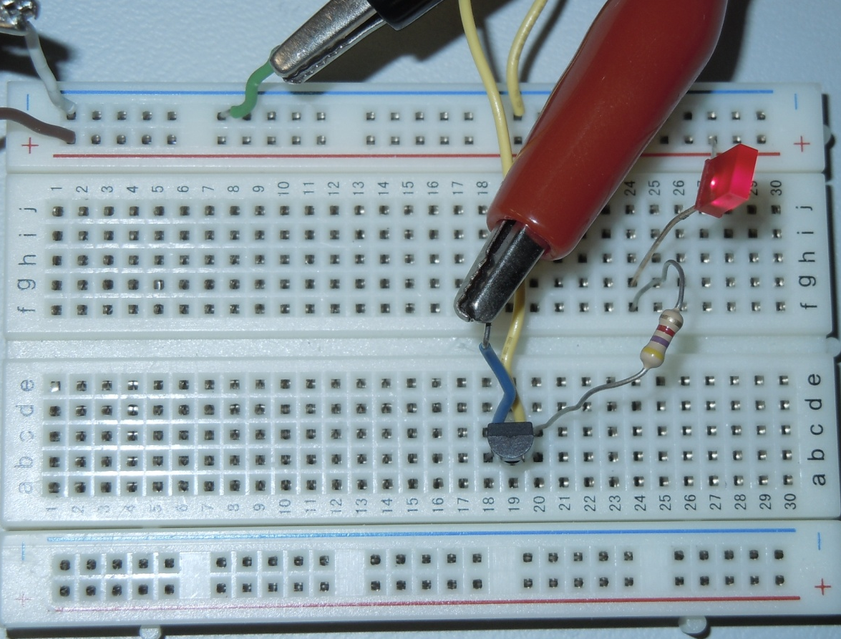

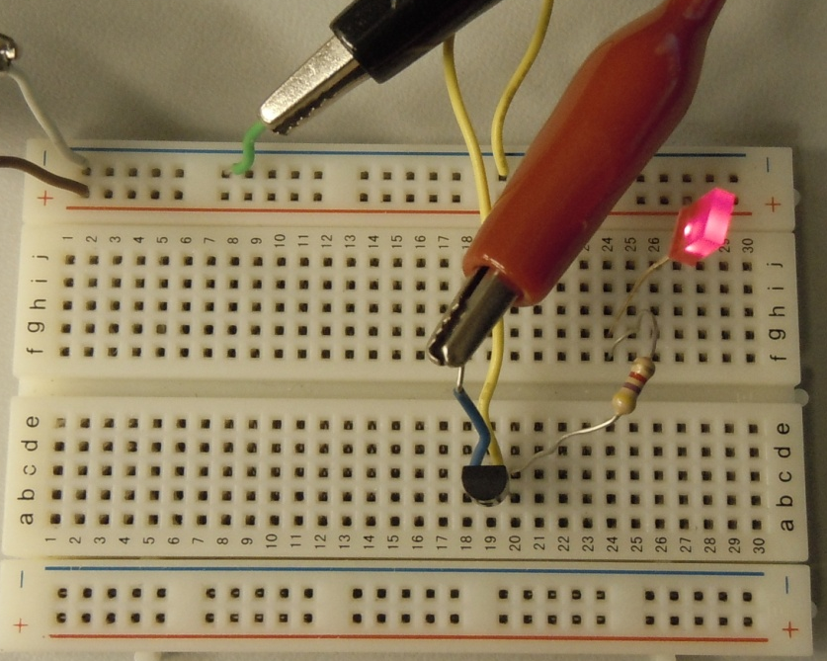
LED
4.7kΩ Resistor
2N5457 N-Type JFET Transistor
Circuit with LED off
Circuit with LED on

Slide 5
Troubleshooting:
The LED in the simulation was not functioning properly. It was found that the transistor could not generate a current strong enough to turn on the LED. To solve this, LEDs from the lab were measured and the current threshold of the LED on the simulation was changed to the measured currents for the LEDs. Once this was done the circuit worked properly.

Slide 6
Conclusion:
JFET transistors can be used as a voltage controlled switch.

Slide 7
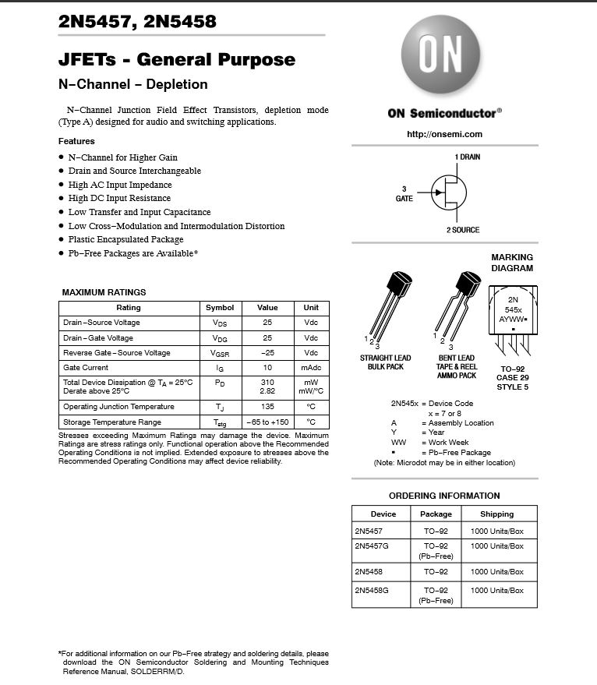
Data Sheets:
2N5457 N-Type Transistor

