Slide 1
Lab 9 Low Pass Filter Using an OP Amp
By: Dakota Johnson
Lab Partner: Josiah Abel
Instructor: Andy Bell
Bench Number: 6
Class: EECT 121-50C
Date: 12/15/2015

Slide 2
Objectives:
Simulate a low pass filter that attenuates frequencies above 1kHz with multisim
Equipment and Parts:
Multisim 13

Slide 3
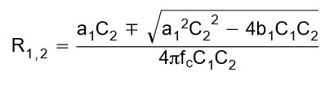
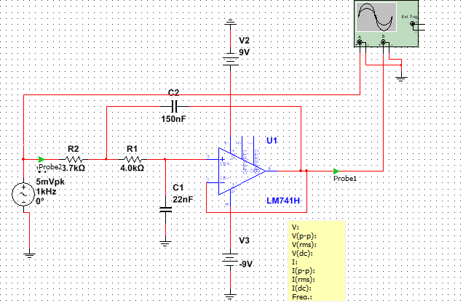
Data/Lab Results/Simulations/Schematics:
Circuit Type:
Sallen-Key
Butterworth
Equation used to find R1 and R2
fc | 1000 | Hz
A₀ | 1
a1 | 1.065
b1 | 1.9305
C1 | 22.0E-9 | F
C2 | 149.8E-9 | F
R1 | 3.9E+3 | Ω
R2 | 3.9E+3 | Ω
Table of values for the simulation
Multisim Schematics of the circuit.

Slide 4
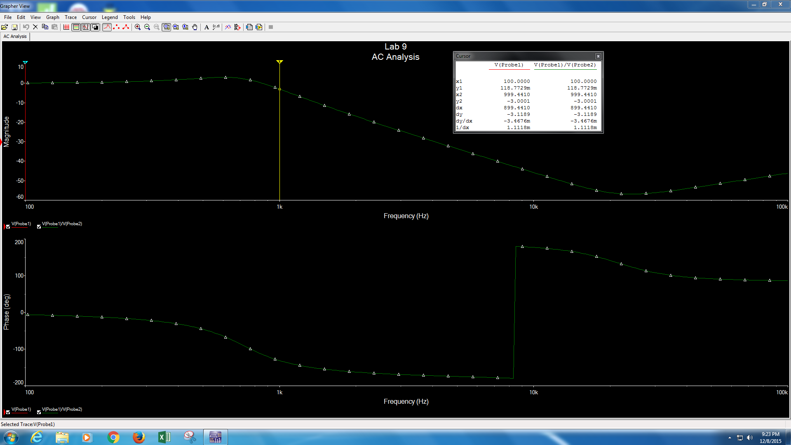
Data/Lab Results/Simulations/Schematics:
Data from the diagram x2 is in Hz and y2 is in dB.
Frequency Response and phase shift diagrams for the low pass filter

Slide 5
Troubleshooting:
The capacitor that was put in the schematic at first was 22μF instead of 22nF. To fix this mistake the calculations were reviewed and it was discovered that the wrong capacitor was placed. Once the capacitor was replaced with the right one the circuit worked correctly.

Slide 6
Conclusion:
A low pass filter that attenuates frequencies above 1kHz was built.

