Slide 1
Lab 0
By: Dakota Johnson
Lab Partner: Josiah Abel
Instructor: Andy Bell
Bench Number: 6
Class: EECT 122-20C
Date: 1/21/2015

Slide 2
Objectives:
To Test the process of creating a circuit in Multisim 13.0 and building that same circuit in the electronics laboratory.
To demonstrate a reduction of a circuit found on page 132 of the Digital Systems Principles and Applications textbook.
Equipment and Parts:
Equipment | Model/Part Number | Serial Number
NI Elvis II+, Breadboard | 19857OA-02L | 1677D1E

Slide 3
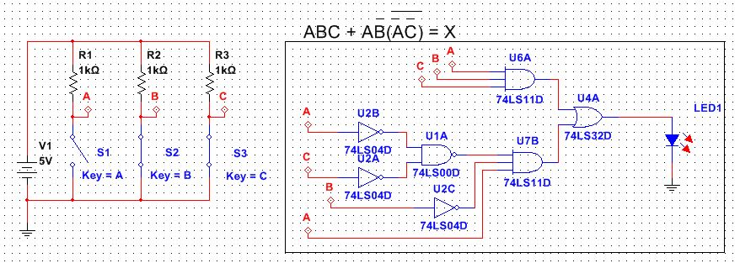
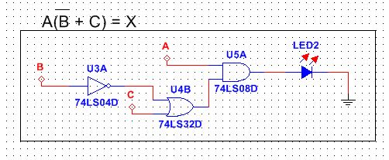
Data/Lab Results/Simulations/Schematics:
A.
Circuit A. Reduces to equivalent Circuit B.
B.

Slide 4
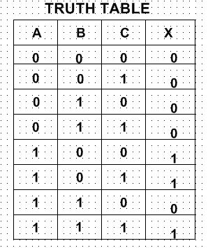
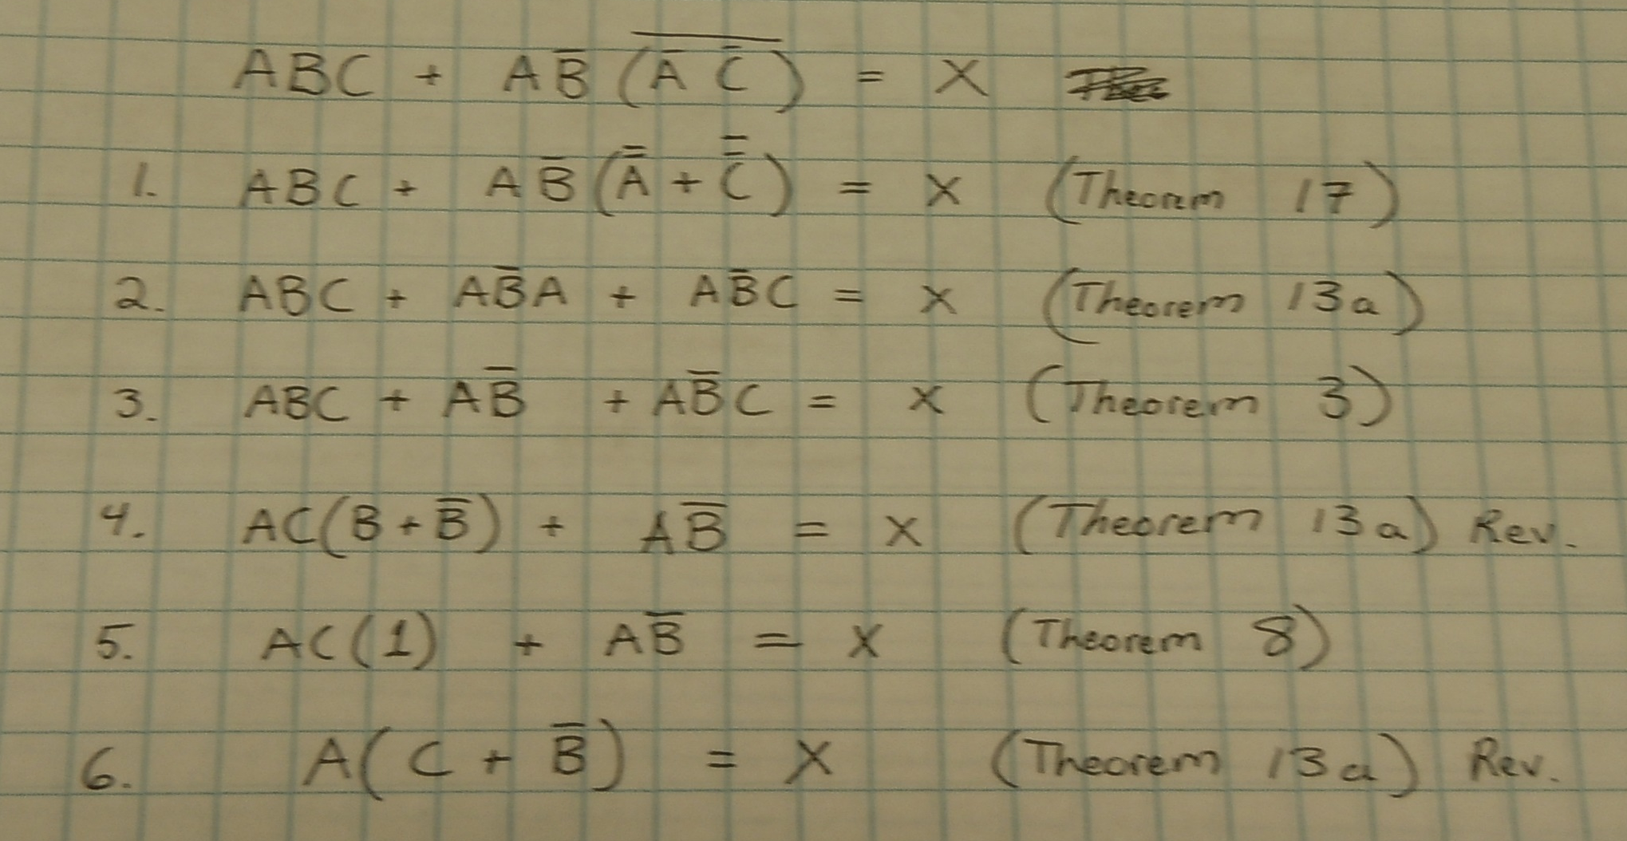
Boolean Reduction of original Expression
Using Boolean algebra theorems.

Slide 5
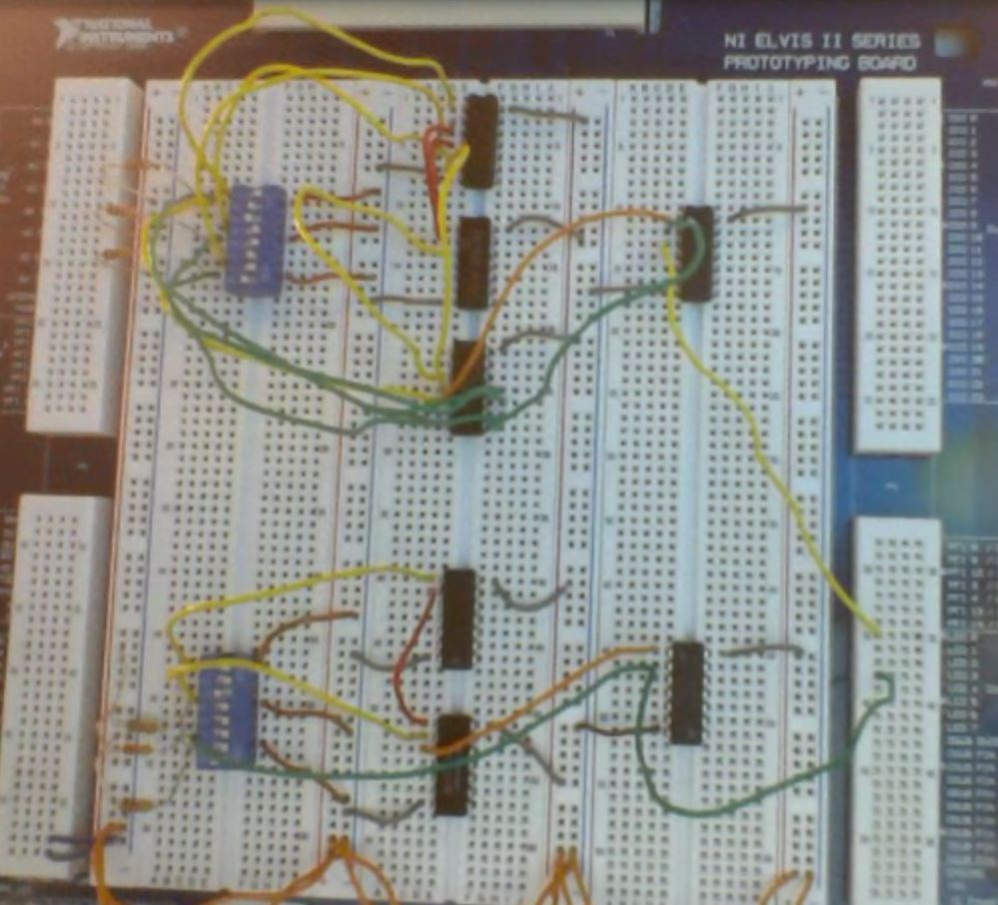
CIRCUIT A, Original circuit
8-Input Dipswitch
74LS11 Chip
74LS00 Chip
1kΩ Resistors
74LS32 Chip
74LS04 Chip

Slide 6
CIRCUIT B, Reduced circuit
74LS04 Chip
8-Input Dipswitch
74LS32 Chip
1kΩ Resistors
74LS08 Chip

Slide 7
Troubleshooting:
We had a little bit of difficulty as a class determining exactly how the Lab Report Template should be constructed. After much discussion about what was absolutely necessary in a lab report, the template was created and uploaded to BlackBoard.

Slide 8
Conclusion:
Using Boolean Algebra it became possible to reduce the design of complex circuit and create an simplified equivalent Circuit which produces the same outputs for the same inputs.

Slide 9
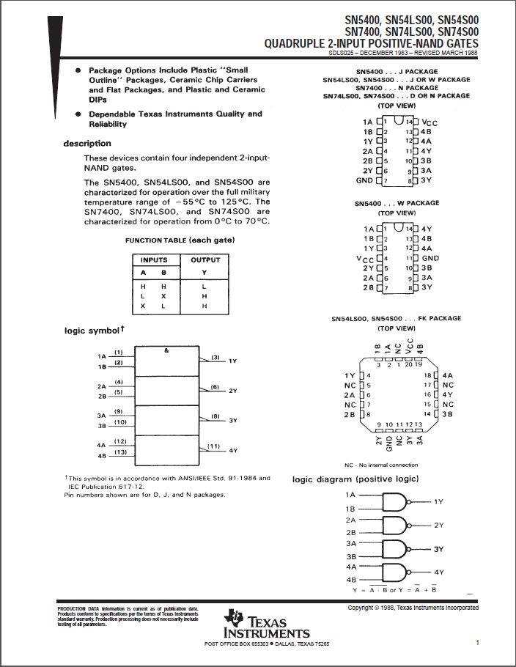
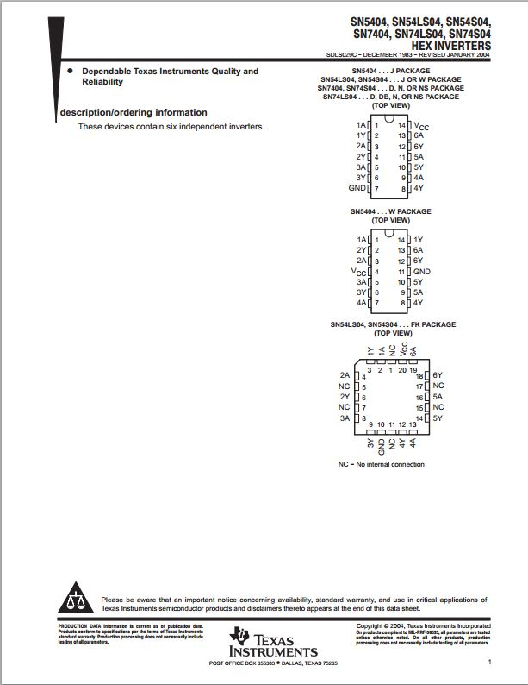
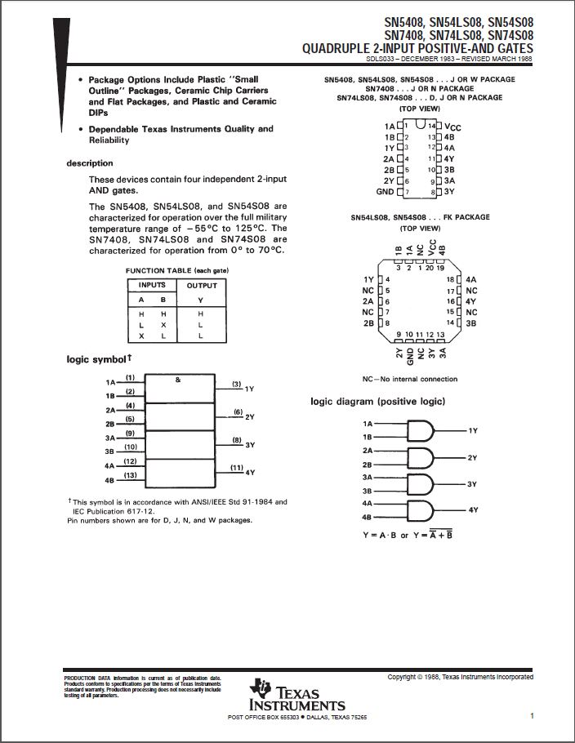
Data Sheets:
74LS00
74LS04
74LS08

Slide 10
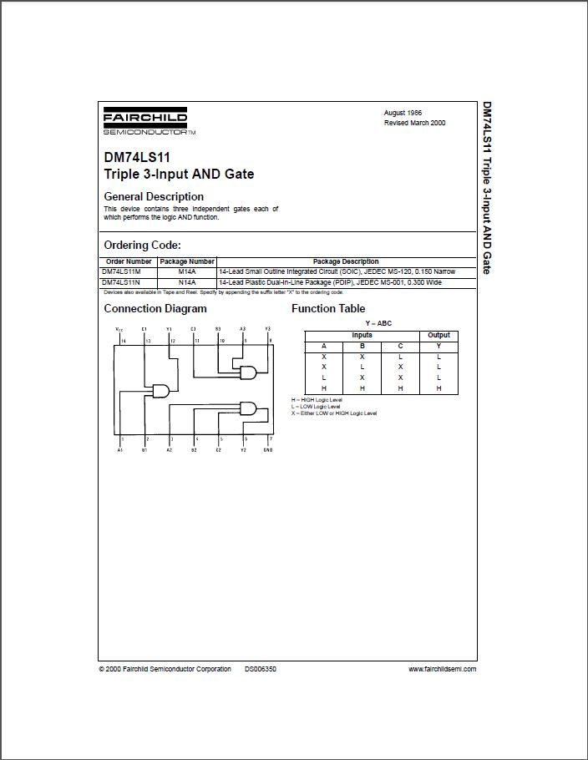
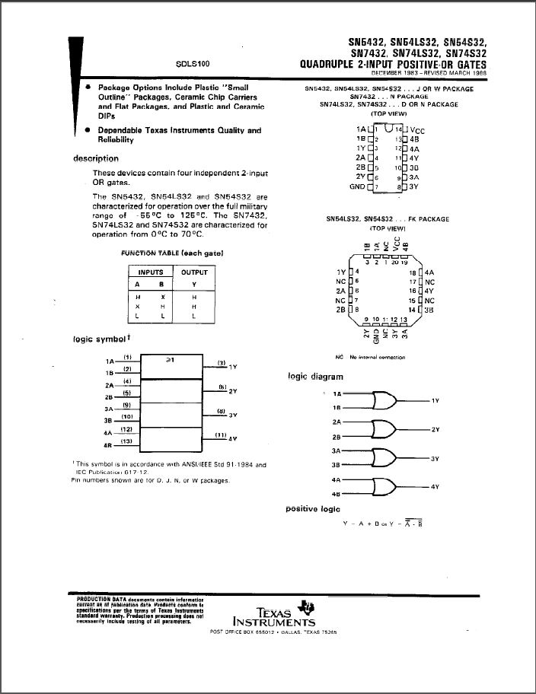
Data Sheets Continued:
74LS11
74LS32

