Slide 1
Lab 1
By: Dakota Johnson
Lab Partner: Josiah Abel
Instructor: Andy Bell
Bench Number: 6
Class: EECT 122-20C
Date: 1/28/2015

Slide 2
Objectives:
To see if the lab template is sufficient for the class’ purpose.
To Verify all possible combinations of Circuit 1 involving 3 inputs and one output using AND gates.
To Verify all possible combinations of Circuit 2 involving 3 inputs and one output using OR gates.
Equipment and Parts:

Slide 3
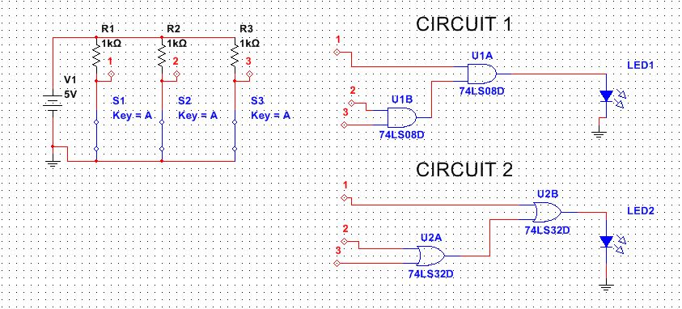
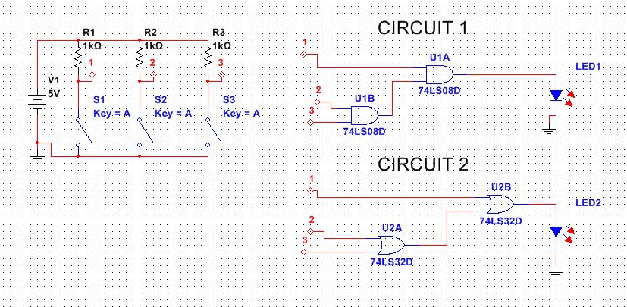
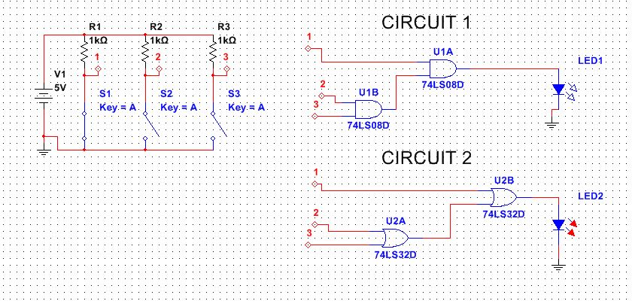
Data/Lab Results/Simulations/Schematics:
Three of the eight tested states for each circuit.
Both Circuit LEDs off
Both Circuit LEDs on
Circuit 1 LED off
Circuit 2 LED on

Slide 4
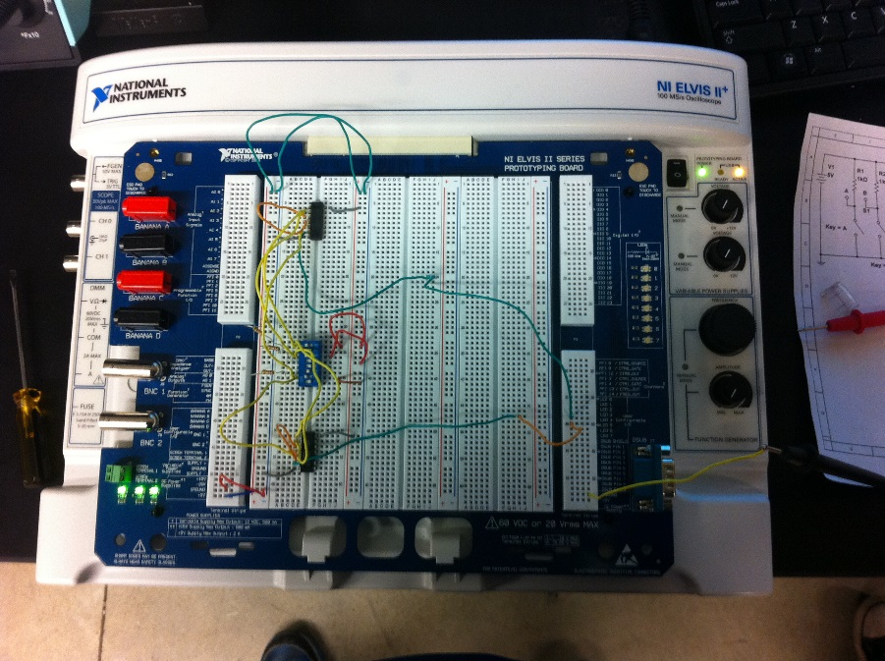
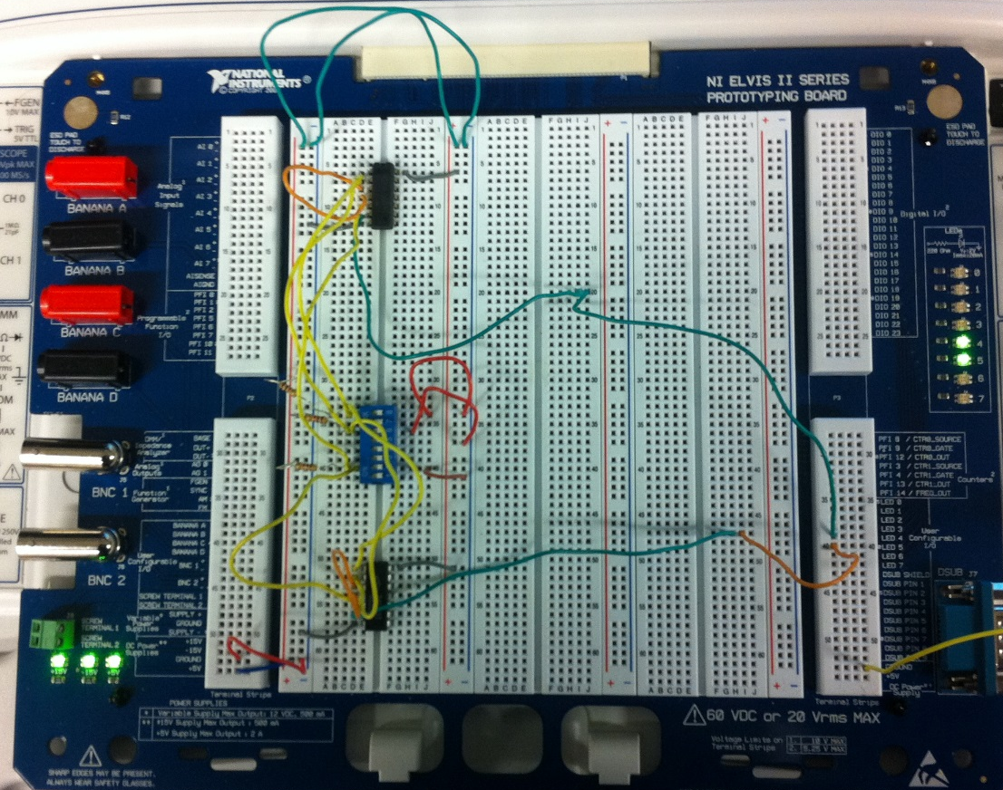
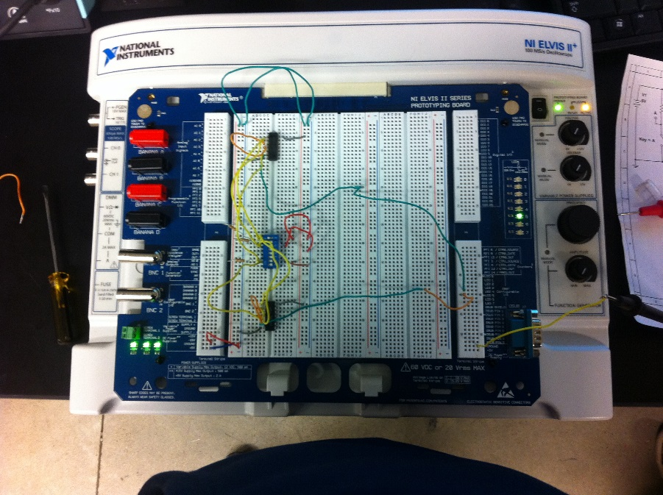
Data/Lab Results/Simulations/Schematics:
Circuit 1
Both Circuit LEDs off
Both Circuit LEDs on
Circuit 1 LED off
Circuit 2 LED on
Circuit 2

Slide 5
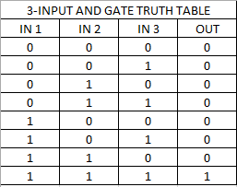
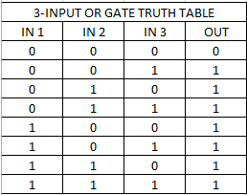
Data/Lab Results/Simulations/Schematics:
The truth tables indicate all of the possible tested inputs for each logic circuit and the resulting outputs.
In the 3-INPUT AND circuit the only combination of inputs which resulted in a lit LED was when all three inputs were engaged.
In the 3-INPUT OR circuit the only combination of inputs that resulted in an unlit LED was when all three inputs were disengaged.

Slide 6
Troubleshooting:
We had difficulty discovering exactly why our initial setup did not function adequately. Both of the LEDs remained lit even when all of the switches were closed.
Eventually we found that our dipswitch was not wired to ground like it was supposed to be causing continuing power to flow through each circuit.

Slide 7
Conclusion:
The Circuits that were built in the lab showed that the Multisim simulation was accurate and the truth tables were accurate.
The lab results and simulation demonstrated a similar relationship.

Slide 8
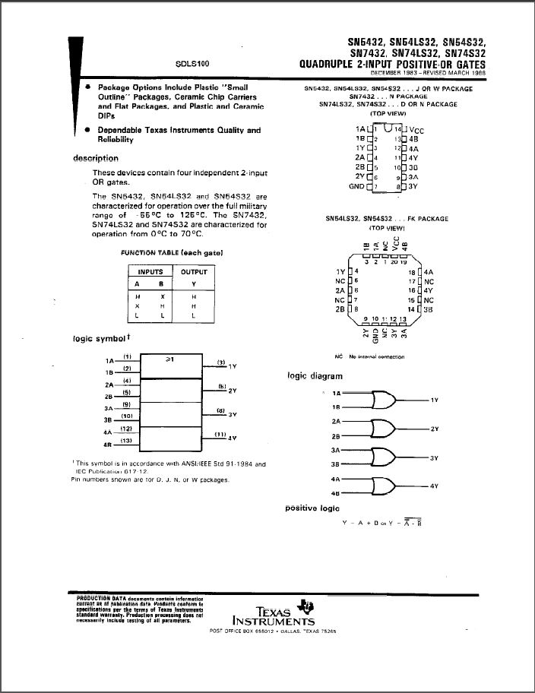
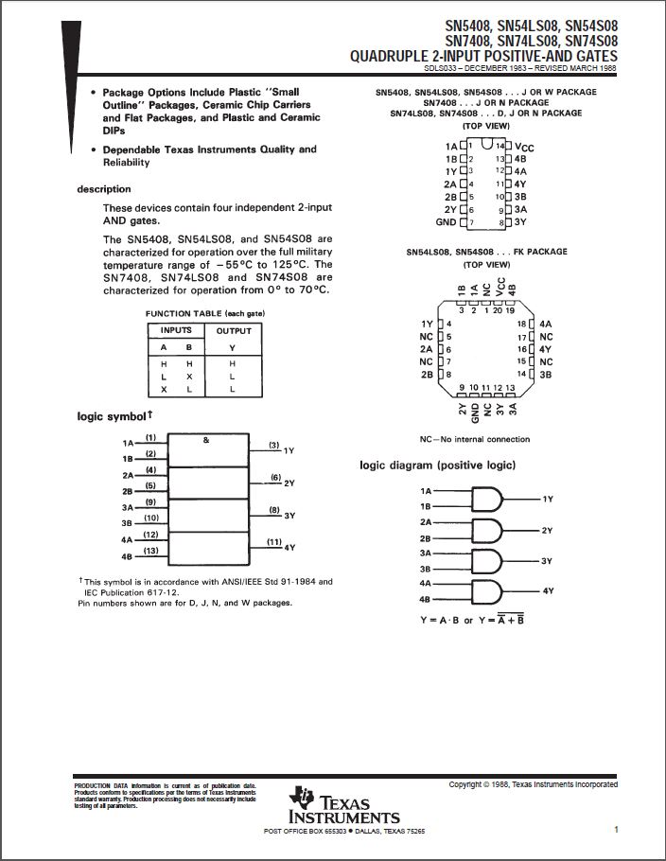
Data Sheets:
74LS32
74LS08

