Slide 1
Lab 10
By: Dakota Johnson
Lab Partner: Josiah Abel
Instructor: Andy Bell
Bench Number: 6
Class: EECT 122-20C
Date: 3/18/2015

Slide 2
Objectives:
To build a MOD-12 counter circuit and test the total propagation delay of the circuit.
Equipment and Parts:
Equipment | Model/Part Number | Serial Number
NI Elvis II+ | 19857OA-02L | 1677D1E
Digital Multimeter | GW INSTEK GDM-8245 | CL860332
Tektronix TDs 220 2-Channel Ocilloscope | TDS220 | B083266
Function Generator | GW INSTEK GFG -8210 | C705245
Part | Amount
330 Resistors | 4
74LS08D Chip | 1
74LS112D Chip | 2
74LS04D Chip | 1
74LS00D Chip | 1
LED 08LX330HV5 | 4
Miscellaneous Wires | ------------

Slide 3
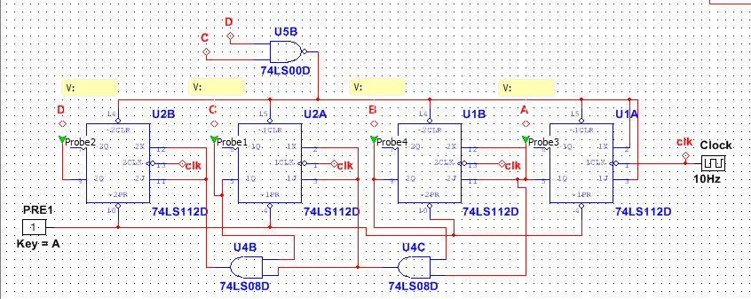
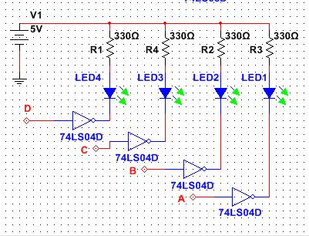
Data/Lab Results/Simulations/Schematics:
State Transition Diagram
1111
0000
0001
1110
0010
1101
0011
1100
0100
1011
0101
1010
0110
Temporary State
1001
0111
1000

Slide 4
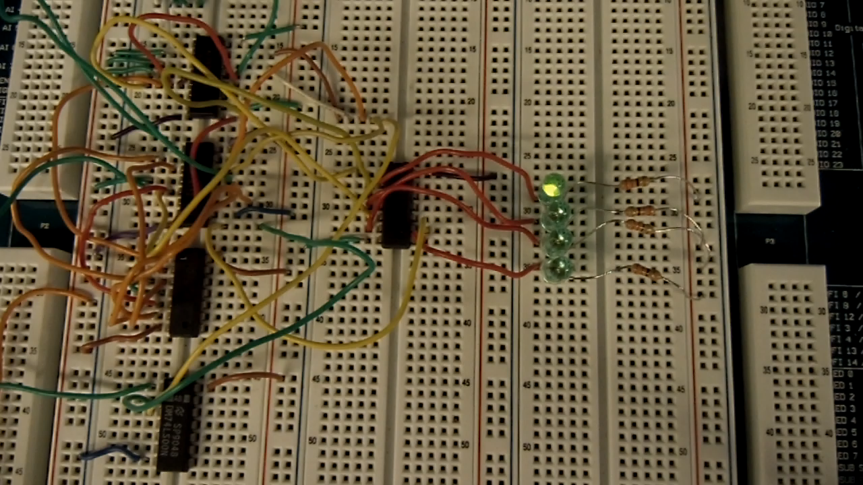
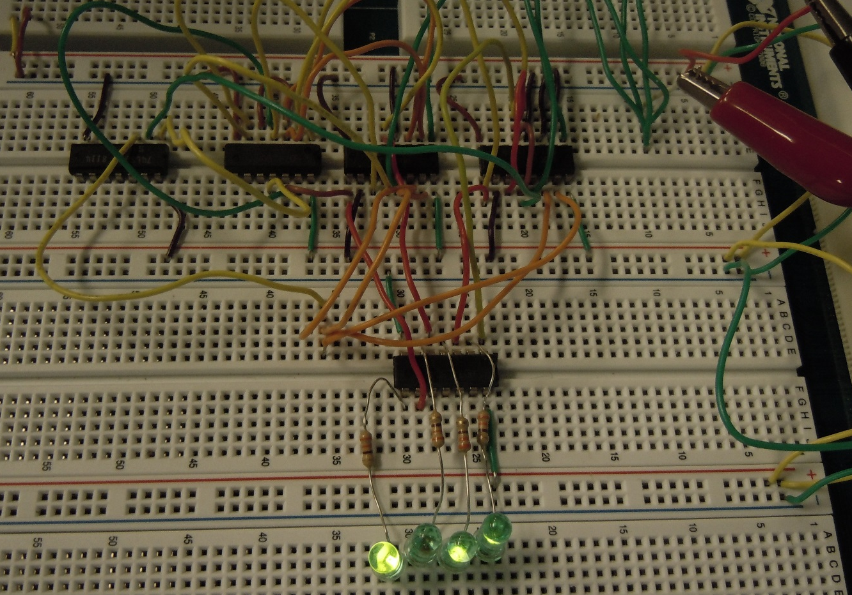
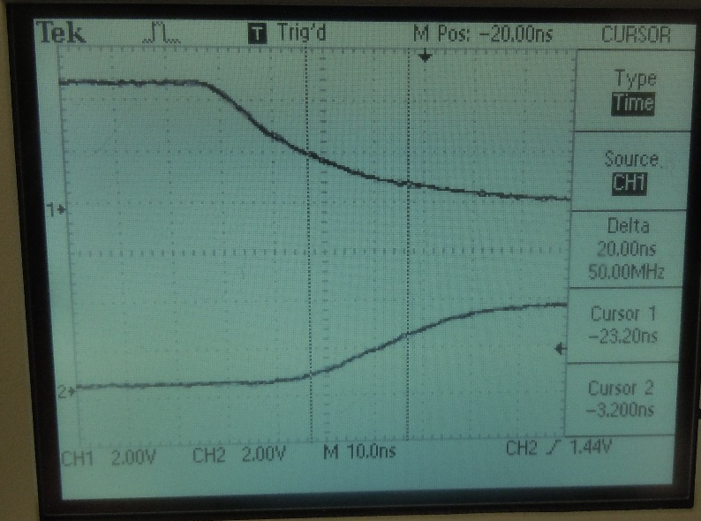
74LS08
74LS112
74LS00
74LS04
330 Resistors
Output Voltages
 | High Voltage | Low Voltage
 | (V) | (V)
MSB | 3.84 | 0.1
3rd Bit | 3.84 | 0.113
2nd Bit | 3.84 | 0.109
LSB | 3.85 | 0.113
Clock Frequency
Frequency
(kHz)
1.08
Total Propagation Delay
Time
(ns)
20

Slide 5
Troubleshooting:
  One major problem was that the counter would count to 12 instead of 11.
    The problem was found to be in the initial design. The original schematic was for a MOD-13 not a MOD-12. The schematic was rebuilt and simulated and the changes were implemented into the physical design. Once this was done the problem was resolved.

Slide 6
Conclusion:
The Circuit was successfully built and the total propagation delay was found to be 20ns.

Slide 7
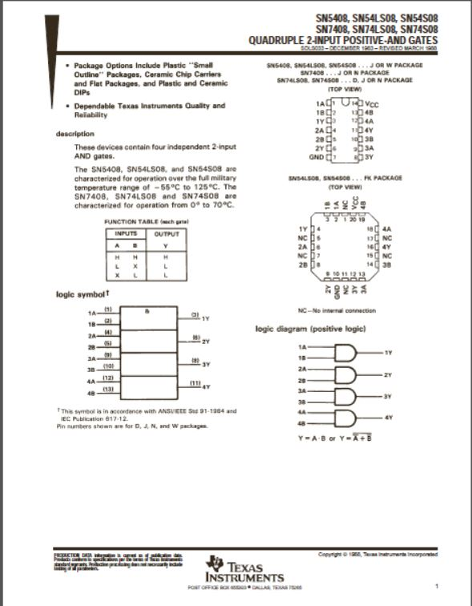
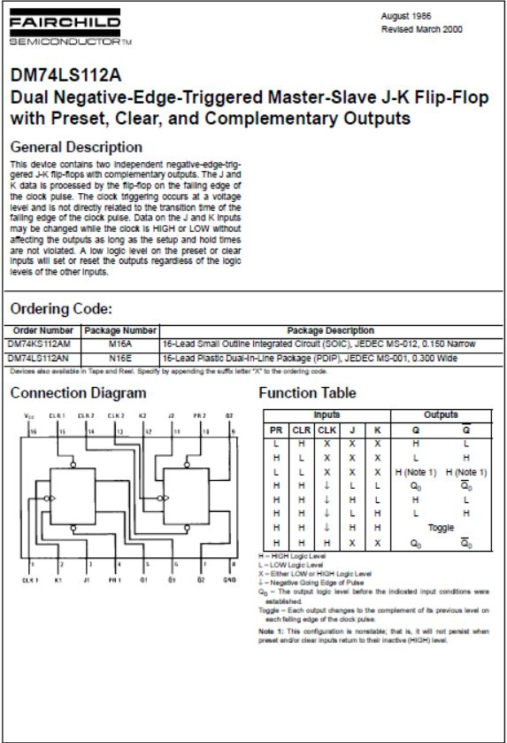
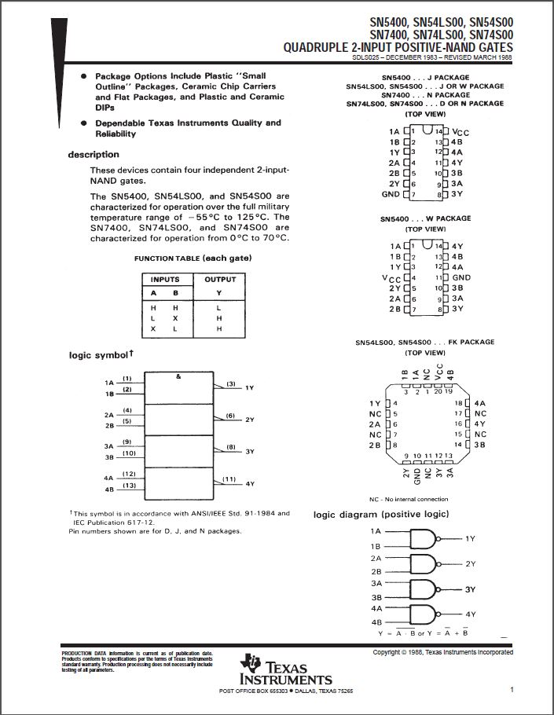
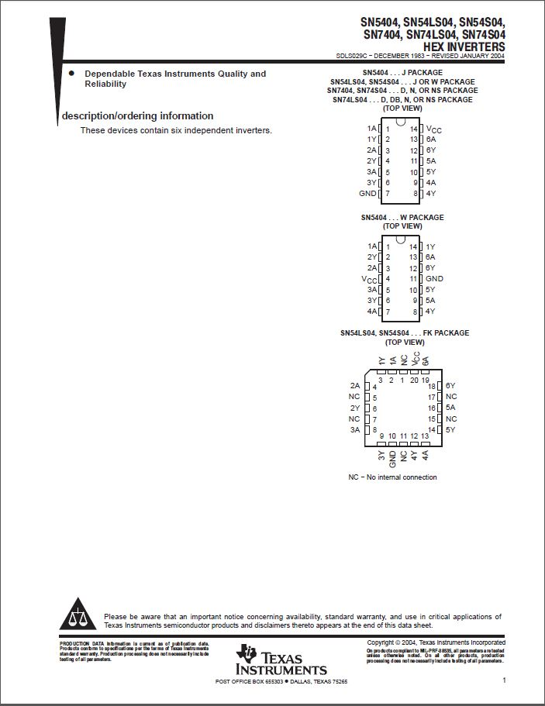
Data Sheets:
74LS08
74LS112
74LS04
74LS00

