Slide 1
Lab 11
By: Dakota Johnson
Lab Partner: Josiah Abel
Instructor: Andy Bell
Bench Number: 6
Class: EECT 122-20C
Date: 4/14/2015

Slide 2
Objectives:
To find the input voltage required to send the output high (VIH) and the input voltage required to send the output low (VIL) in both TTL and CMOS parts.
Equipment and Parts:
Equipment | Model/Part Number | Serial Number
NI Elvis II+ | 19857OA-02L | 1677D1E
Digital Multimeter | GW INSTEK GDM-8245 | CL860332
Tektronix TDs 220 2-Channel Oscilloscope | TDS220 | B083266
Part | Amount
1k Resistors | 2
CMOS 4011 | 1
74LS00D Chip | 1
Miscellaneous Wires | ------------

Slide 3
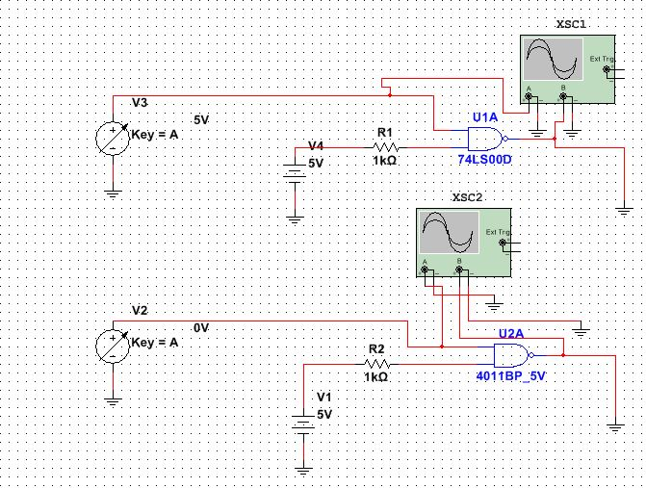
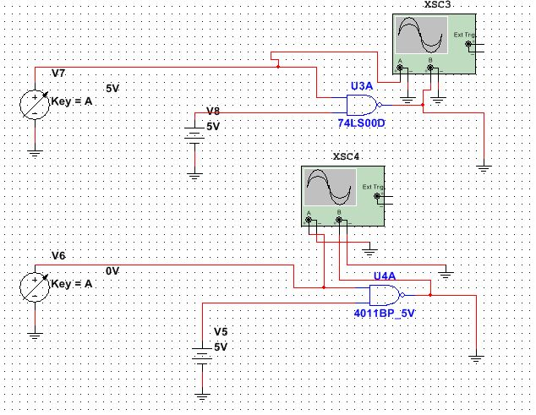
Data/Lab Results/Simulations/Schematics:
TTL 74LS00 Chip
CMOS 4011 Chip
Set up with 1k Resistors
Set up without 1k Resistors

Slide 4
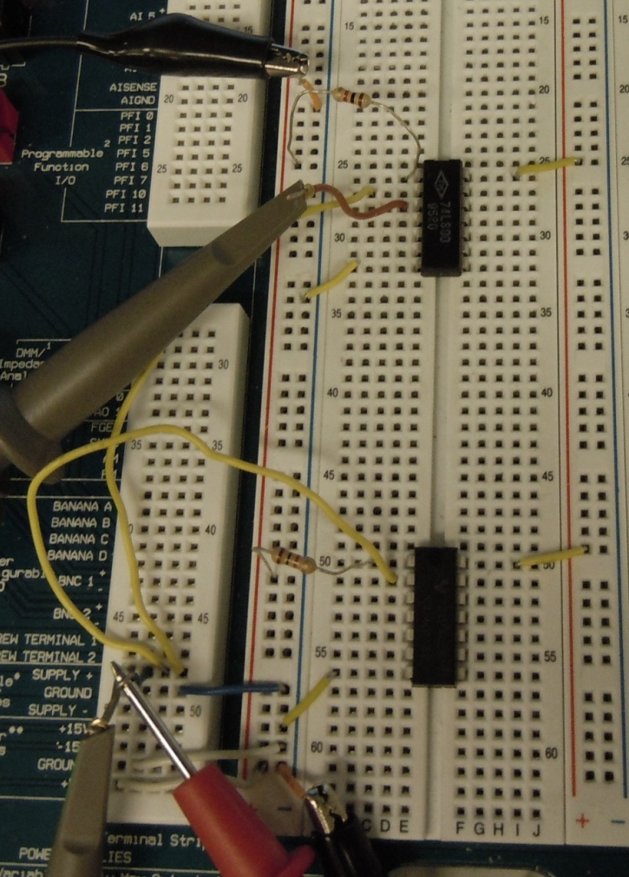
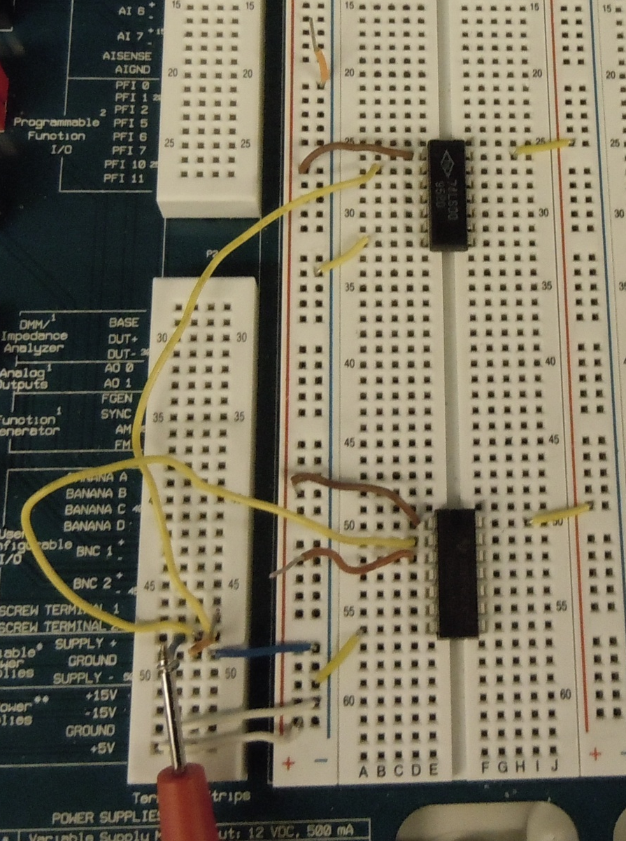
TTL 74LS00 Chip
CMOS 4011 Chip
Set up with 1k Resistors
Set up without 1k Resistors

Slide 5
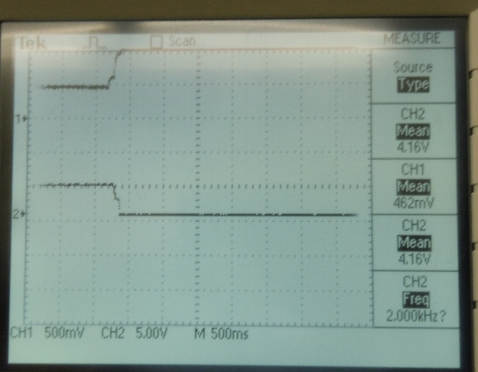
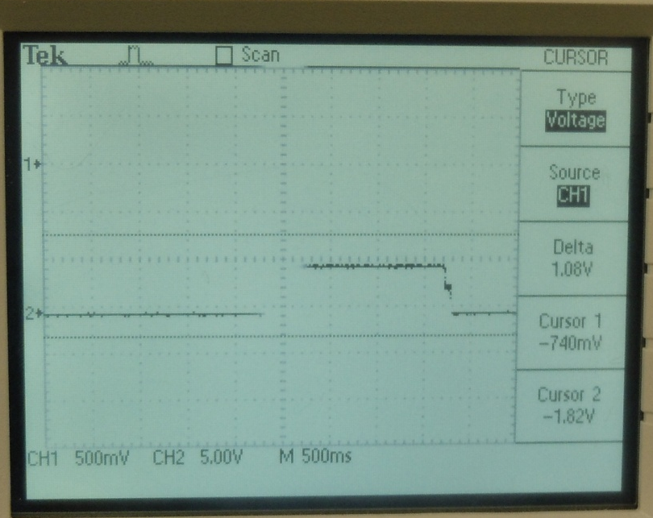
Output going low as a result of a high input voltage.
Output going High as a result of a low input voltage.
TTL Test with Resistor |  |  |  | TTL Test without Resistor |  |  |  | CMOS Test with Resistor |  |  |  | CMOS Test without Resistor
 | (V) | (V) |  |  | (V) | (V) |  |  | (V) | (V) |  |  | (V) | (V)
Trial | V_{IL} | V_{IH} |  | Trial | V_{IL} | V_{IH} |  | Trial | V_{IL} | V_{IH} |  | Trial | V_{IL} | V_{IH}
1 | 0.8348 | 1.131 |  | 1 | 0.7949 | 1.157 |  | 1 | 2.43 | 2.4992 |  | 1 | 2.3486 | 2.6107
2 | 0.8077 | 1.1169 |  | 2 | 0.7133 | 1.0776 |  | 2 | 2.3212 | 2.4857 |  | 2 | 2.2805 | 2.4997
3 | 0.8215 | 1.1034 |  | 3 | 0.7949 | 1.0777 |  | 3 | 2.416 | 2.5572 |  | 3 | 2.4303 | 2.5275
Average | 0.821333 | 1.1171 |  | Average | 0.7677 | 1.1041 |  | Average | 2.389067 | 2.514033 |  | Average | 2.353133 | 2.545967
Average TTL |  |  | Average CMOS
(V) | (V) |  | (V) | (V)
V_{IL} | V_{IH} |  | V_{IL} | V_{IH}
0.794517 | 1.1106 |  | 2.3711 | 2.53

Slide 6
Troubleshooting:
Our major obstacle was to determine how to build the set up with both a constant power supply and a variable power supply in the lab.
  This was accomplished by using the constant and variable power supplies on the NI Elvis II+.

Slide 7
Conclusion:
The average VIH when there were resistors in the circuit was 1.11V for the TTL and 2.53V for CMOS. The average VIL when there were resistors in the circuit was 0.79V for TTL and 2.37V for CMOS.

Slide 8
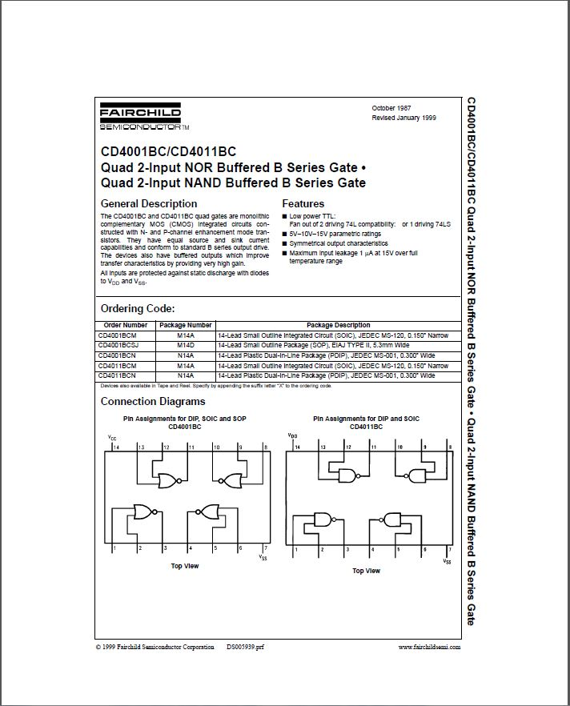
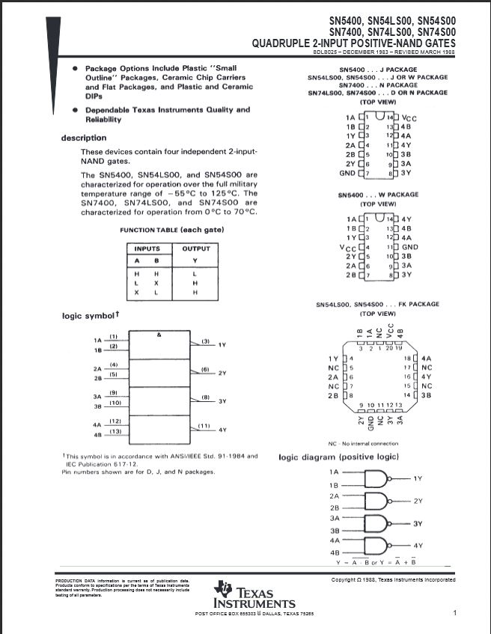
Data Sheets:
CD 4011
74LS00

