Slide 1
Lab 12
By: Dakota Johnson
Lab Partner: Josiah Abel
Instructor: Andy Bell
Bench Number: 6
Class: EECT 122-20C
Date: 4/1/2015

Slide 2
Objectives:
The first objective of this experiment was to build a clock using ICs. The second objective was to find a way to split one clock input into three separate clock outputs. The final objective was to build and test a 3-8 decoder circuit.
Equipment and Parts:
Equipment | Model/Part Number | Serial Number
Solderless Bread board | Jameco Value Pro | ---------------------
Digital Multimeter | GW INSTEK GDM-8245 | CL860332
Tektronix TDs 220 2-Channel Ocilloscope | TDS220 | B083266
TENIMA Frequency Counter | 72-4095 | 7021023
Variable Power Supply RSR | 369987 | HY802D
Part | Amount
LM55CM Timer Chip | 1
74LS112D Chip | 2
74LS138D Chip | 1
74LS08D Chip | 1
.01 μF Capacitor | 1
1 μF Capacitor | 1
12k Resistor | 2
27K Resistor | 2
330 Resistor | 8
08LX330HV5 LED | 8
Miscellaneous Wires | ------------

Slide 3
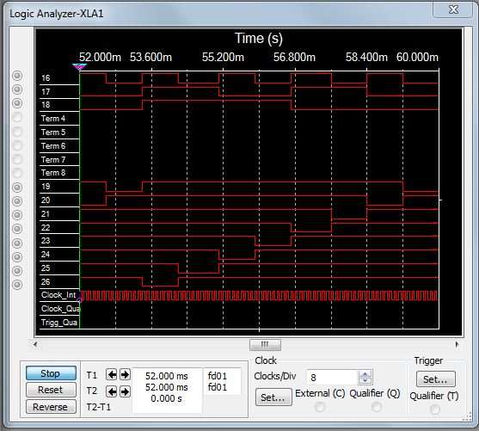
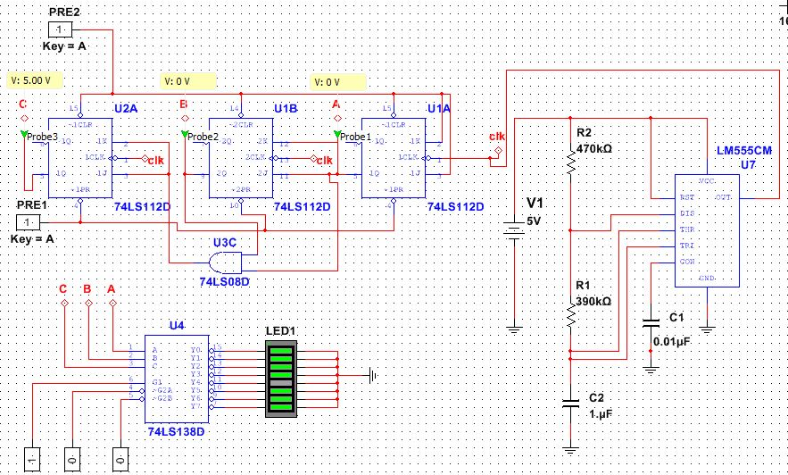
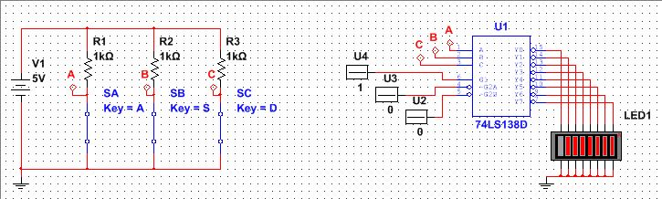
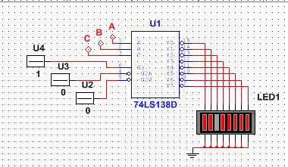


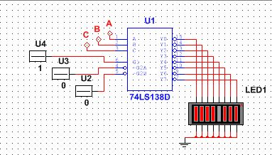

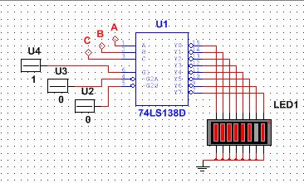

Data/Lab Results/Simulations/Schematics:
Clock 3 output
Clock 1 output
Clock 2 output
555 Timer
Logic analyzer results showing the different states of the LEDs.
0
1
2
3
Decimal representation of LEDs.
4
5
6
7

Slide 4
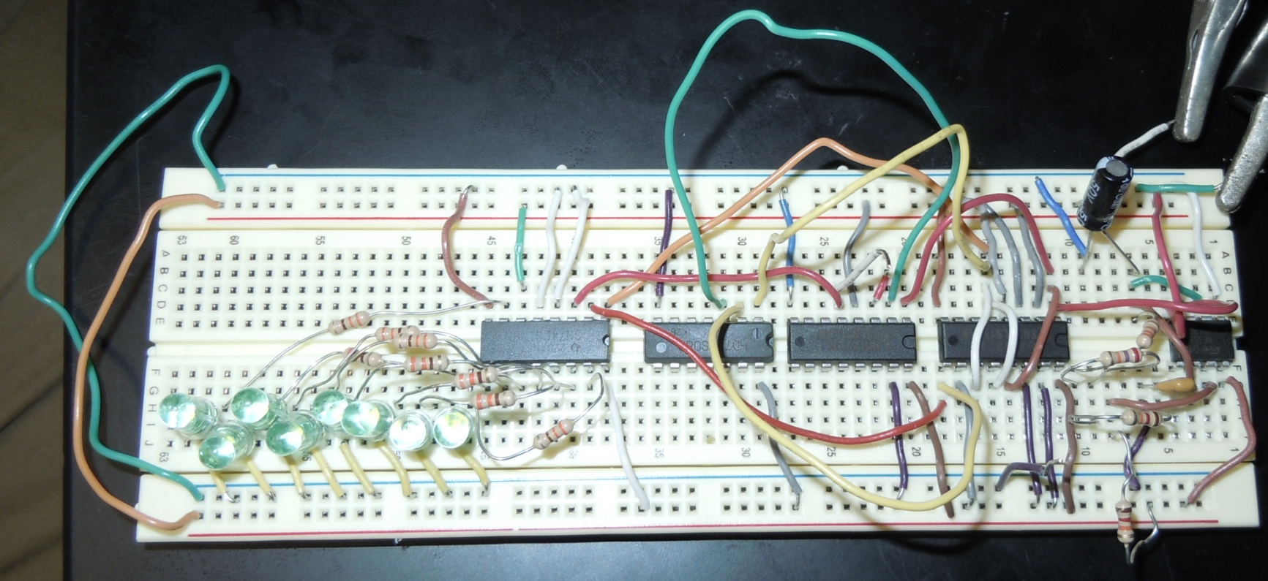
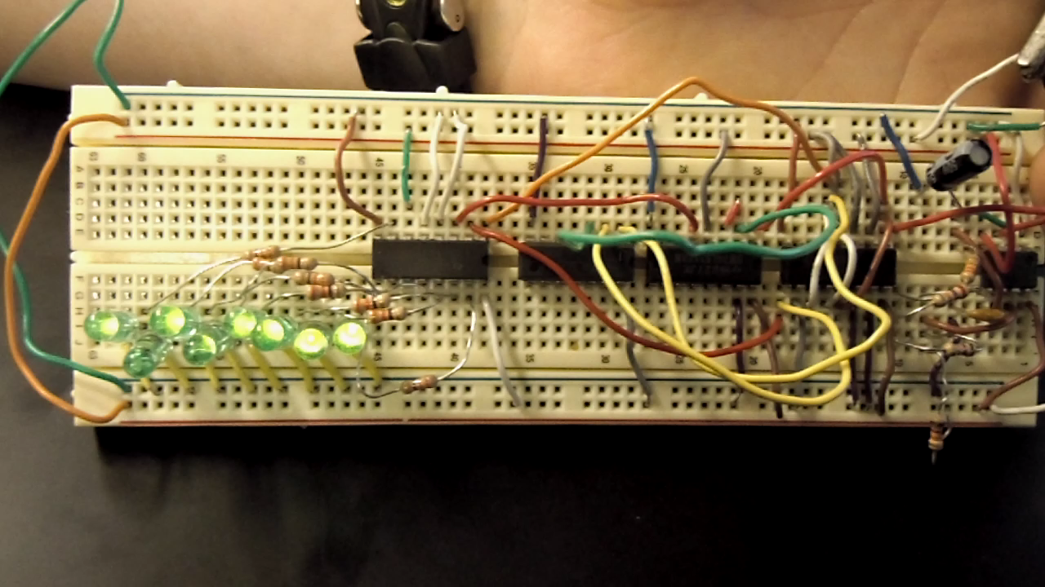
1 μF Capacitor
74LS08D
27k Resistor
74LS138D
555 Timer
330 Resistors
.01 μF Capacitor
74LS112D
12k Resistor

Slide 5
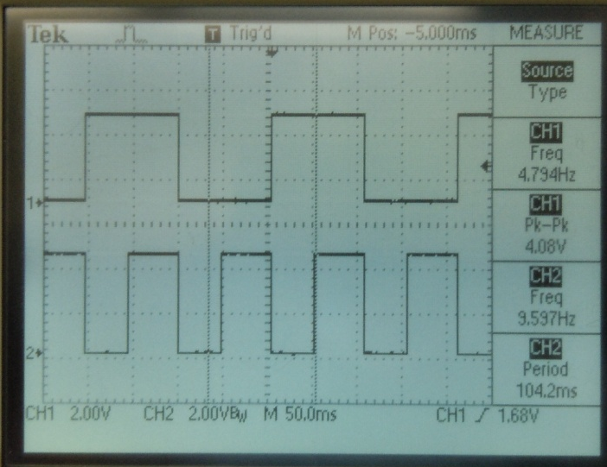
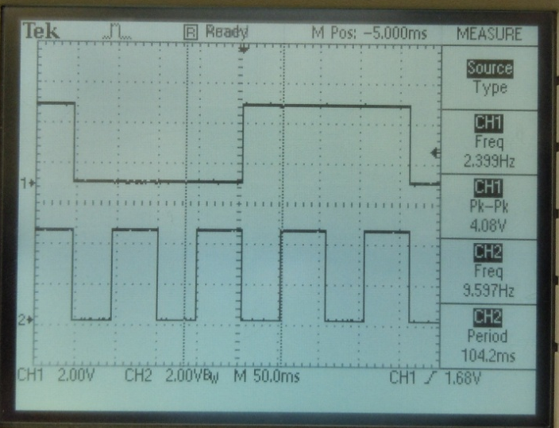
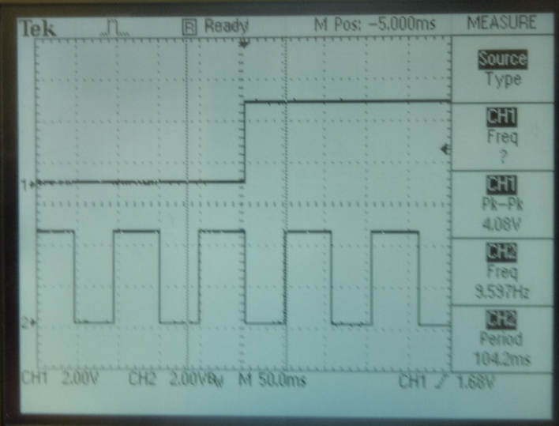
Clock 1 Output
Clock 2 Output
Clock 3 Output
Timer
State of Output (Decimal) | Voltage (V) |  |  |  |  |  |  |  | Voltage Level
0 |  | 3.451 | 3.449 | 3.4428 | 3.447 | 3.458 | 3.447 | 3.455 | High
 | 0.1164 |  |  |  |  |  |  |  | Low
1 | 3.506 |  | 3.349 | 3.443 | 3.448 | 3.448 | 3.447 | 3.456 | High
 |  | 0.1142 |  |  |  |  |  |  | Low
2 | 3.51 | 3.451 |  | 3.443 | 3.448 | 3.451 | 3.447 | 3.457 | High
 |  |  | 0.1121 |  |  |  |  |  | Low
3 | 3.5105 | 3.451 | 3.459 |  | 3.439 | 3.45 | 3.448 | 3.458 | High
 |  |  |  | 0.1145 |  |  |  |  | Low
4 | 3.511 | 3.451 | 3.452 | 3.425 |  | 3.452 | 3.449 | 3.458 | High
 |  |  |  |  | 0.1064 |  |  |  | Low
5 | 3.511 | 3.452 | 3.449 | 3.444 | 3.447 |  | 3.445 | 3.459 | High
 |  |  |  |  |  | 0.1086 |  |  | Low
6 | 3.511 | 3.452 | 3.451 | 3.445 | 3.445 | 3.449 |  | 3.46 | High
 |  |  |  |  |  |  | 0.1042 |  | Low
7 | 3.511 | 3.451 | 3.451 | 3.444 | 3.448 | 3.451 | 3.447 |  | High
 |  |  |  |  |  |  |  | 0.1012 | Low
Frequency (Hz)
Input Clock | 9.588
Output Clock 1 | 4.794
Output Clock 2 | 2.399
Output Clock 3 | 1.2

Slide 6
Troubleshooting:
  One challenge that had to be overcome was how to split one clock input into three.
    This obstacle was overcome by designing a MOD 8 counter.
  Another challenge was finding a way to get the desired frequency of 10Hz from the 555 timer.
    The challenge was meet by building a 555 timer circuit in multisim and altering the amount of resistance in the circuit until the desired frequency was achieved.

Slide 7
Conclusion:
A clock was able to be built using a 555 timer and various resistors and capacitors. It was found that a clock input could be split into three output clocks by using a MOD 8 system. The voltage measurements showed that the 3-8 decoder built in the experiment operates in the manner described in the part’s data sheet.

Slide 8
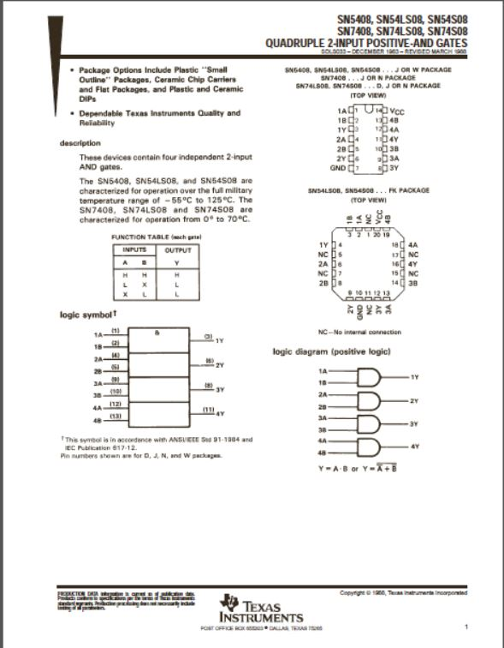
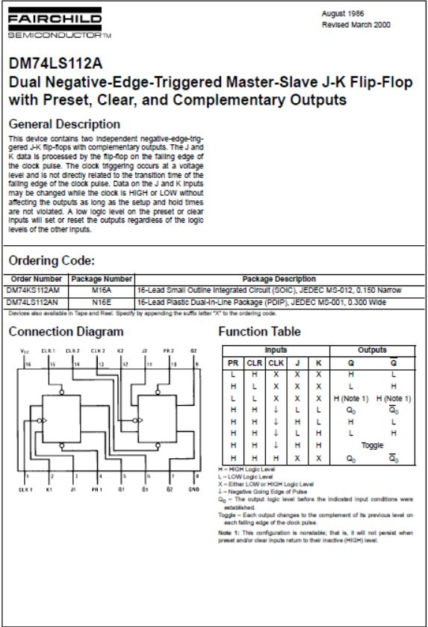
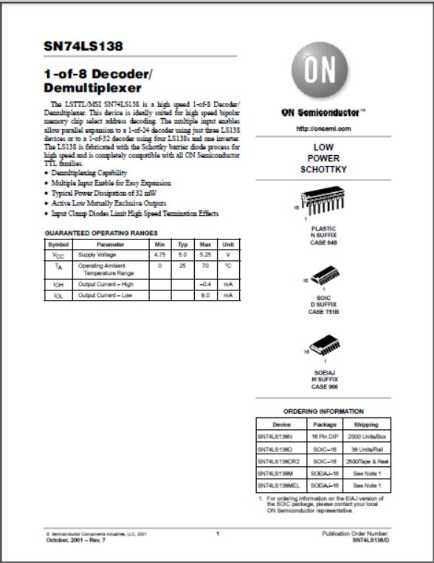
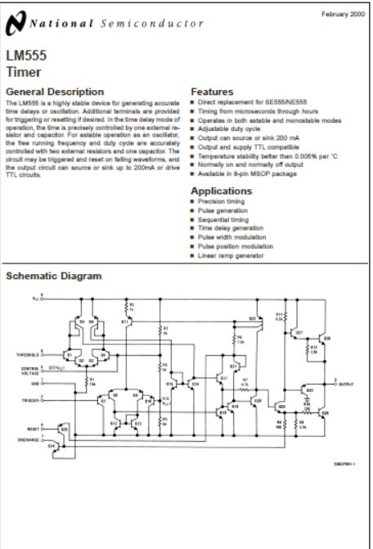
Data Sheets:
74LS08
74LS112
74LS138
LM555

