Slide 1
Lab 13
By: Dakota Johnson
Lab Partner: Josiah Abel
Instructor: Andy Bell
Bench Number: 6
Class: EECT 122-20C
Date: 4/1/2015

Slide 2
Objectives:
To build a decade counter circuit and then convert the outputs so they can be observed on a 7-segment display.
Equipment and Parts:
Equipment | Model/Part Number | Serial Number
Solderless Bread board | Jameco Value Pro | ---------------------
Digital Multimeter | GW INSTEK GDM-8245 | CL860332
TENIMA Frequency Counter | 72-4095 | 7021023
Variable Power Supply RSR | 369987 | HY802D
Part | Amount
390K Resistor | 1
470K Resistor | 1
1K Resistor | 8
1 μF Capacitor | 1
.01μF Capacitor | 1
LM555CM Chip | 1
74LS90D Chip | 1
74LS47D Chip | 1
7-Segment Display | 1
Miscellaneous Wires | ------------

Slide 3
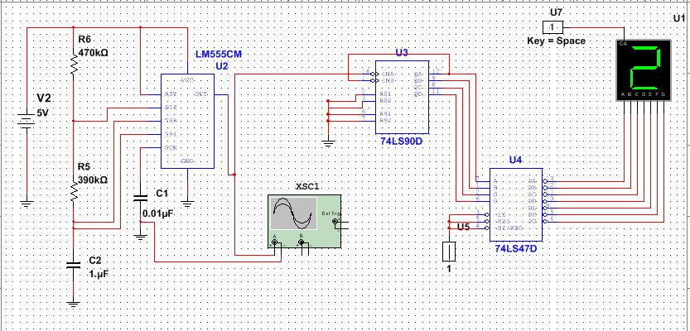
Data/Lab Results/Simulations/Schematics:

Slide 4
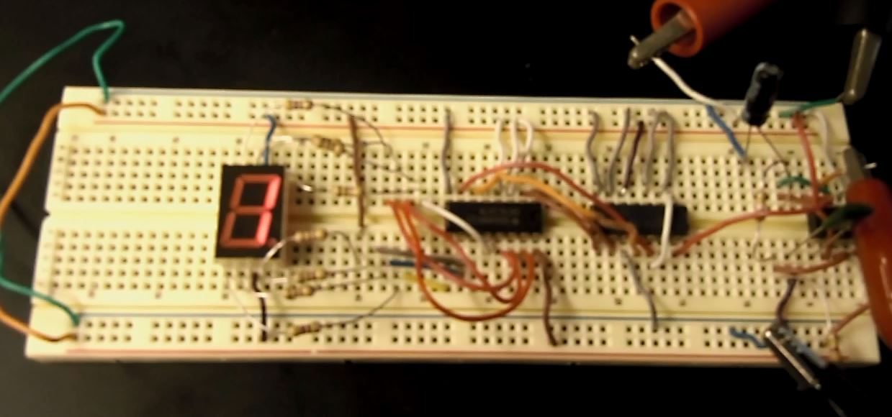
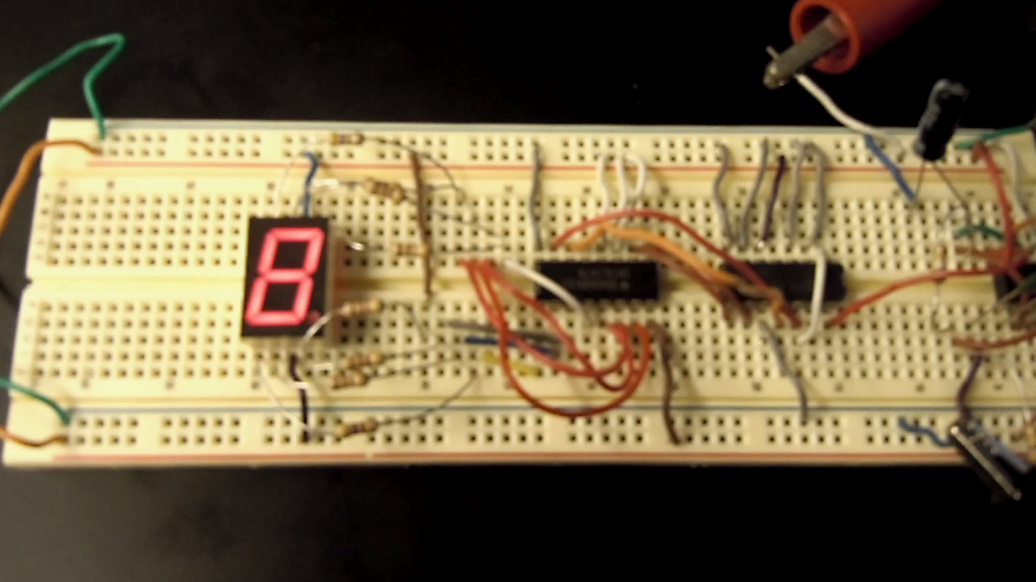
1k Resistors
74LS47D
74LS90D
1 μF Capacitor
390k Resistor
7-Segment Display
555 Timer
.01 μF Capacitor
470k Resistor

Slide 5
Troubleshooting:
One problem that was found was that the clock’s frequency was too high and the numbers on the display could not be distinguished.
The frequency was decreased by increasing the resistor values leading into the 555 timer. Once this was done the all of the numbers were clearly observed.

Slide 6
Conclusion:
The decade counter operated correctly and the numbers 0-9 were easily discernible on the 7-segment display.

Slide 7
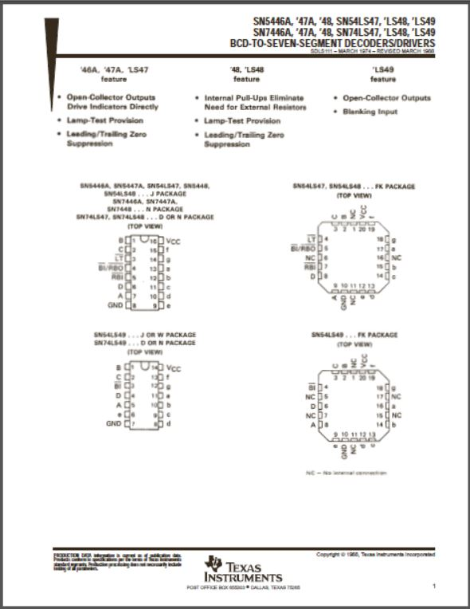
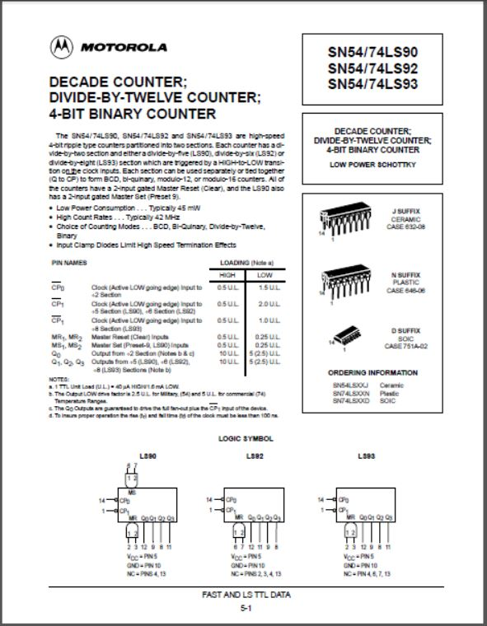
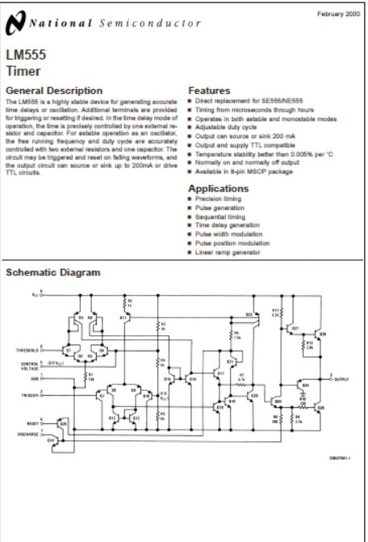
Data Sheets:
74LS47
74LS90
LM555

