Slide 1
Lab 5
By: Dakota Johnson
Lab Partner: Josiah Abel
Instructor: Andy Bell
Bench Number: 6
Class: EECT 122-20C
Date: 2/11/2015

Slide 2
Objectives:
To test all of the states of a JK flip-flop circuit.
Equipment and Parts:
Equipment | Model/Part Number | Serial Number
NI Elvis II+ | 19857OA-02L | 1677D1E
Digital Multimeter | GW INSTEK GDM-8245 | CL860332
Tektronix TDs 220 2-Channel Oscilloscope | TDS220 | B083266
Function Generator | GW INSTEK GFG -8210 | C705245
Part | Amount
1k Resistors | 3
74LS73D Chip | 1
8 input dip switch | 1
Miscellaneous Wires | ------------

Slide 3
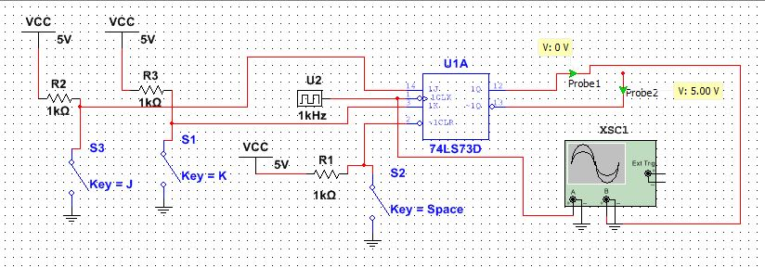
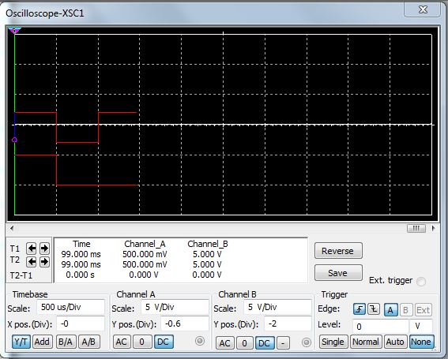
Data/Lab Results/Simulations/Schematics:
The simulation showing the clock on the top and the Q output on the bottom switching from a high to a low. Demonstrates that the JK flip flop is triggered on the negative edge.

Slide 4
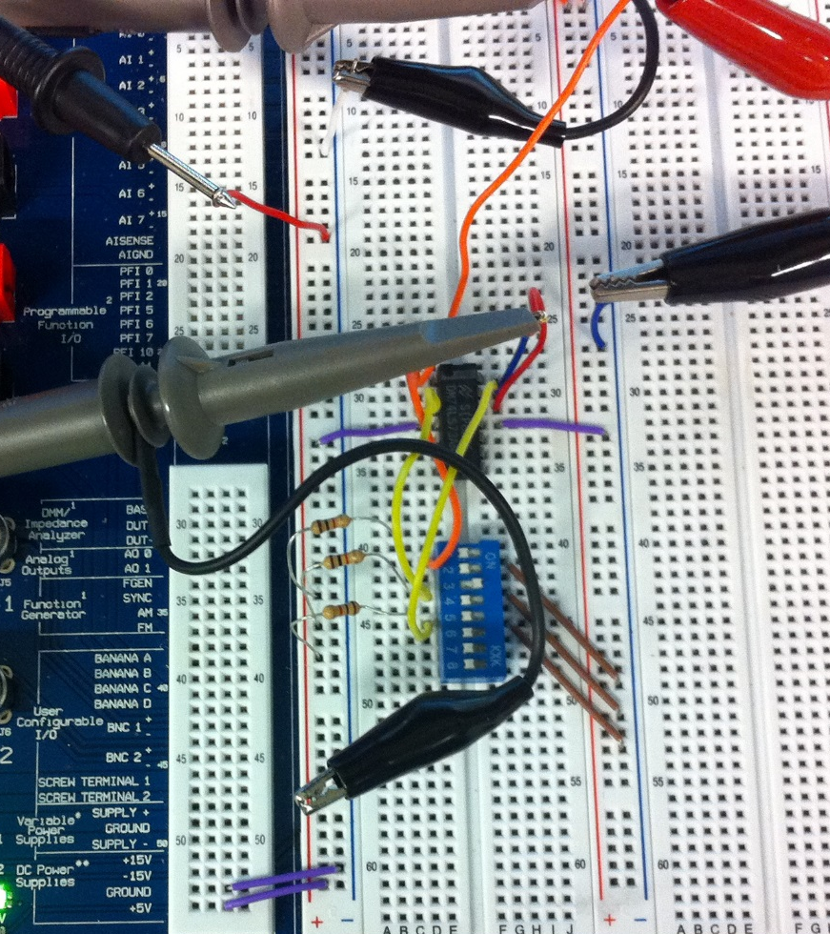
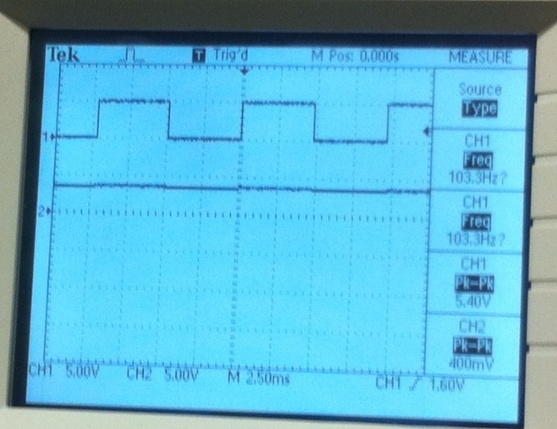
74LS73
1k Resistors
An Oscilloscope showing the clock on the top and the Q output on the bottom.
Test Number | Clear | J | K | Clock | Q | Q' | Notes
 | Logic Level | Logic Level | Logic Level | Position | Volts | Volts
1 | 0 | X | X | X | 0.0872 | 3.8
2 | 1 | 0 | 0 |  | 3.83 | 0.0742
3 | 1 | 1 | 0 |  | 3.79 | 0.0776
4 | 1 | 0 | 1 |  | 0.0813 | 3.79
5 | 1 | 1 | 1 |  | 1.94 | 1.94 | Toggle

Slide 5
Troubleshooting:
  One challenge was getting the oscilloscope to read correctly.
    The challenge was overcome with the assistance of another student. It was found out that the trigger level on the scope was not set correctly so the waves could not be distinguished.

Slide 6
Conclusion:
All states were measured and found to be consistent truth table in the data sheet.

Slide 7
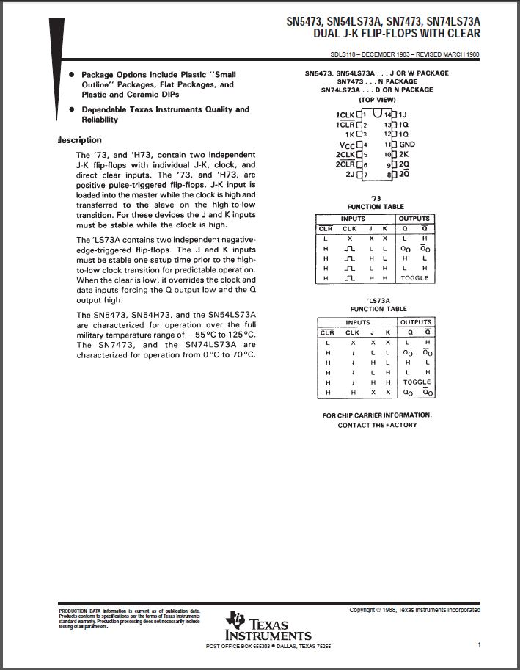
Data Sheets:
74LS73

