Slide 1
Lab 7
By: Dakota Johnson
Lab Partner: Josiah Abel
Instructor: Andy Bell
Bench Number: 6
Class: EECT 122-20C
Date:3/25/2015

Slide 2
Objectives:
To build a 4-bit binary adder.
Equipment and Parts:
Equipment | Model/Part Number | Serial Number
NI Elvis II+ | 19857OA-02L | 1677D1E
Digital Multimeter | GW INSTEK GDM-8245 | CL860332
Part | Amount
330 Resistors | 5
10k Resistors | 8
74LS283D Chip | 1
8 input dip switch | 2
LED 08LX330HV5 | 5
Miscellaneous Wires | ------------

Slide 3
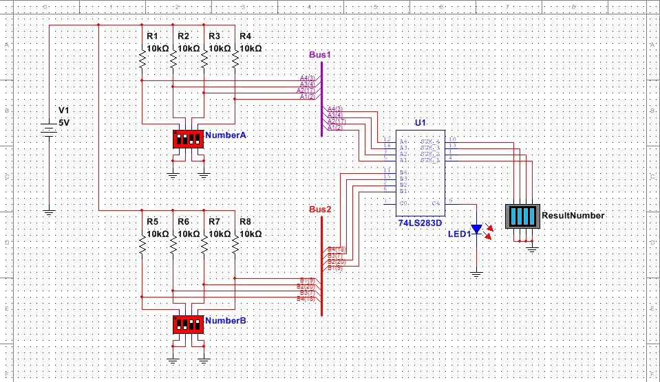
Data/Lab Results/Simulations/Schematics:

Slide 4
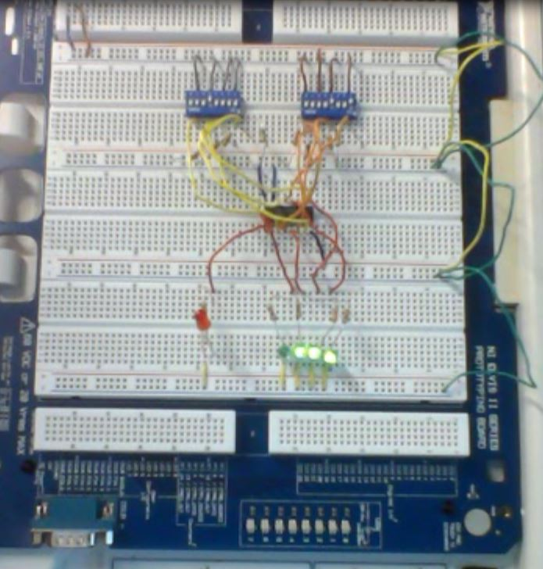
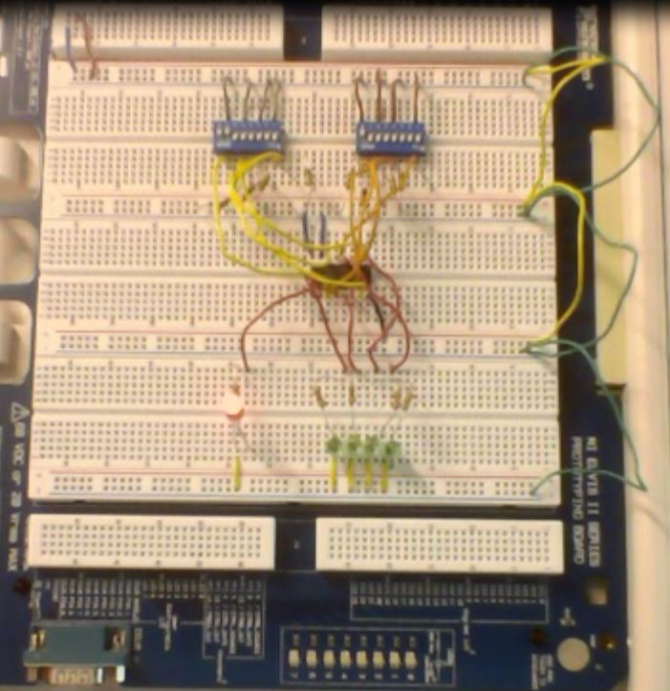
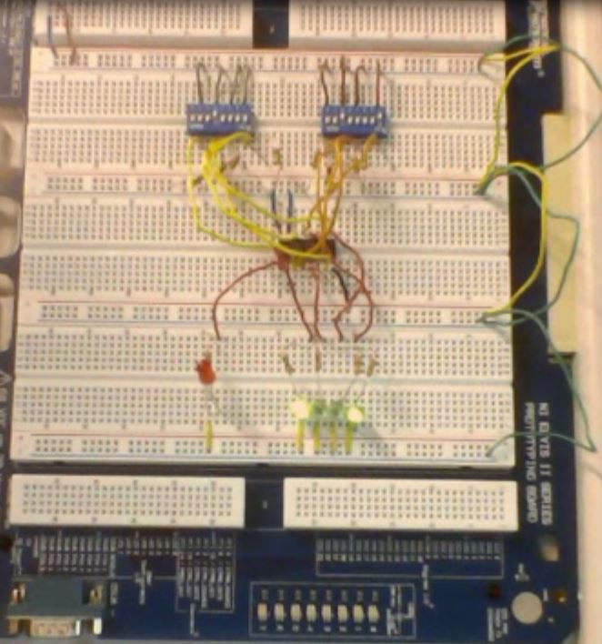
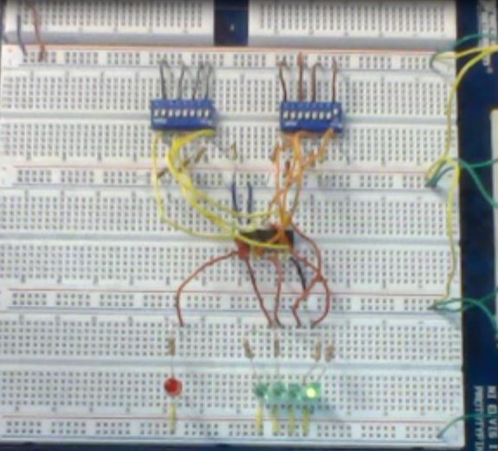
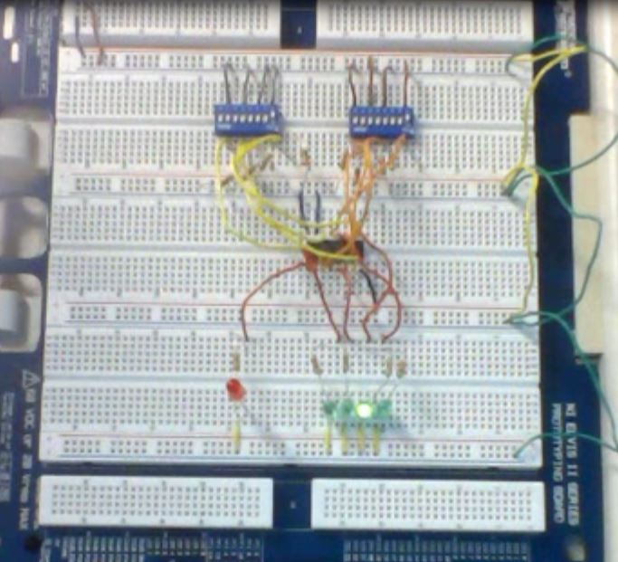
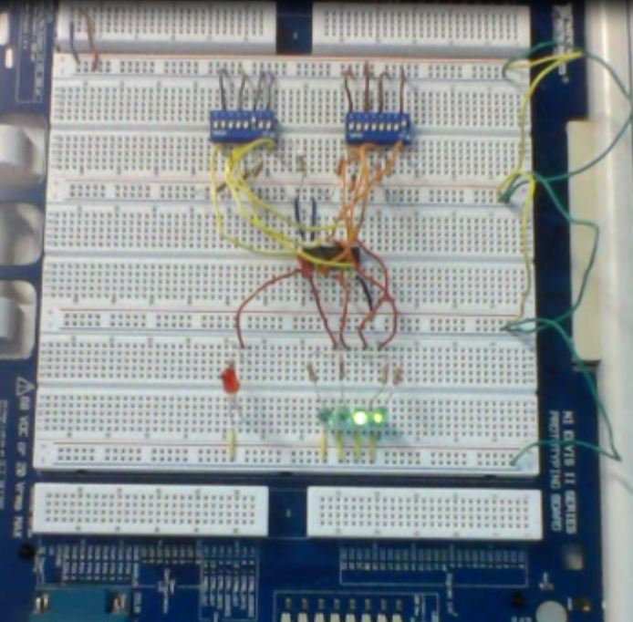
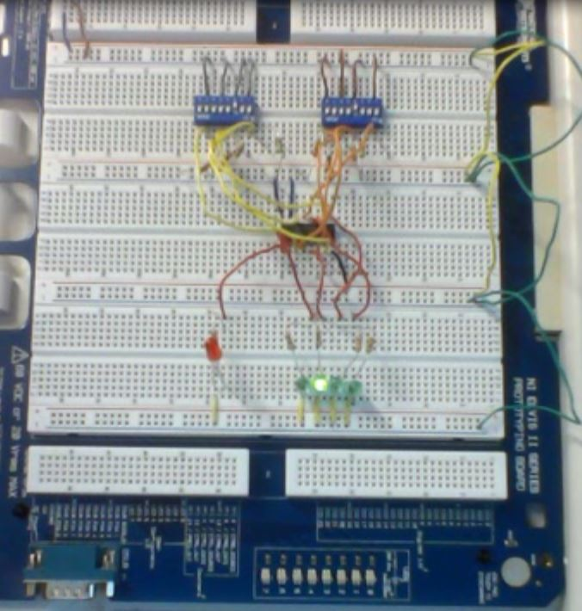
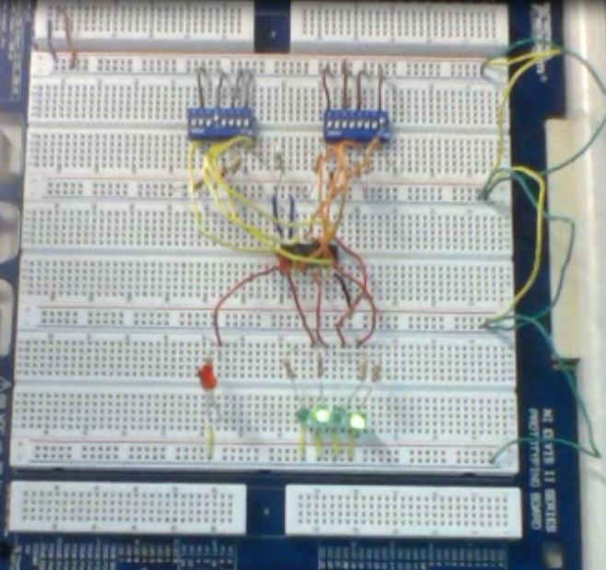
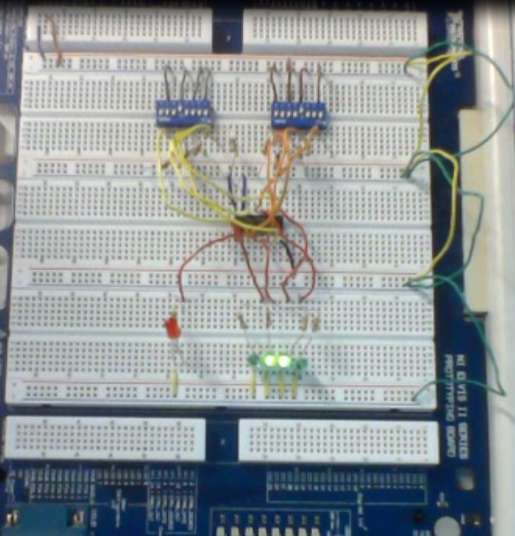
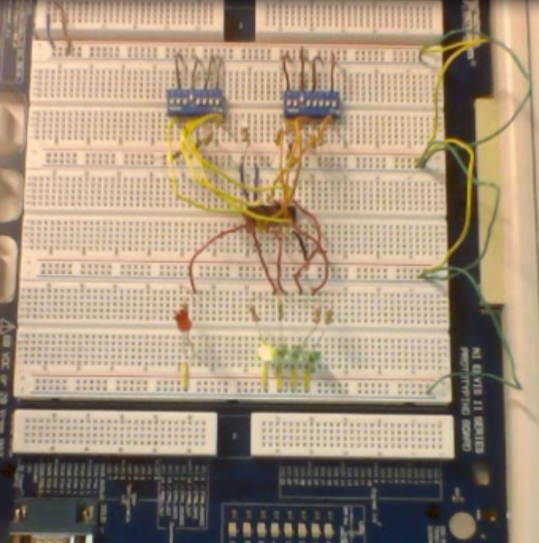
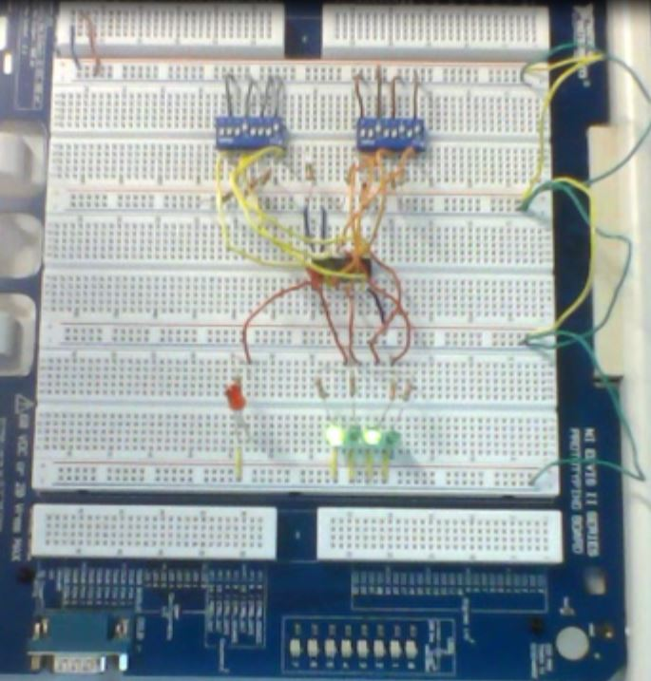
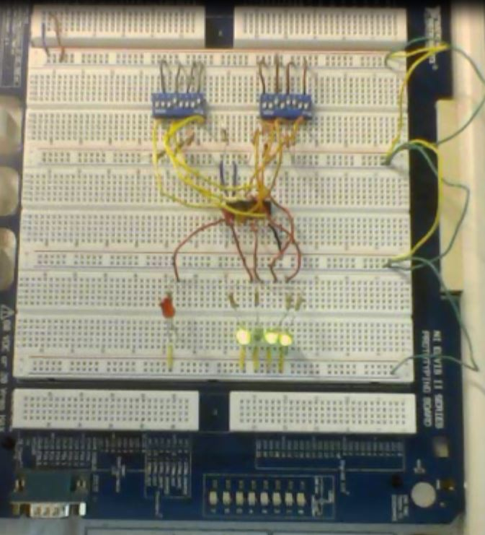
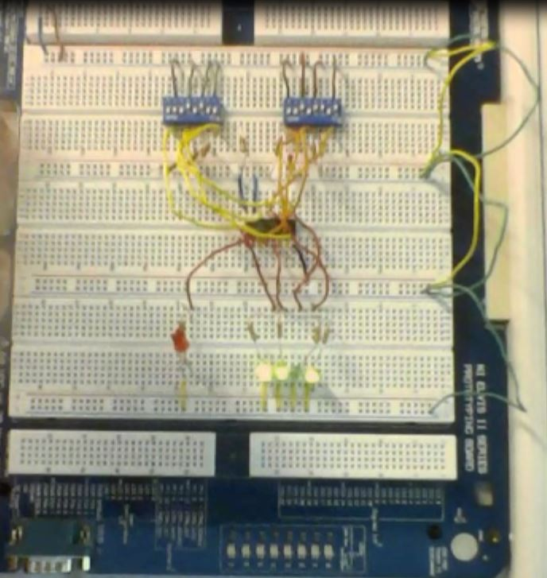
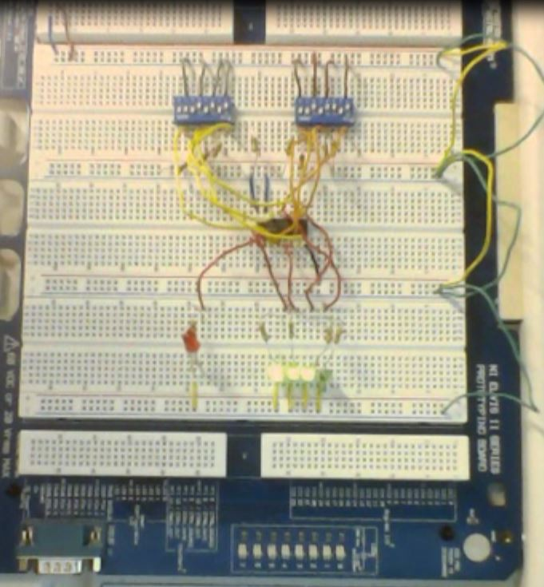
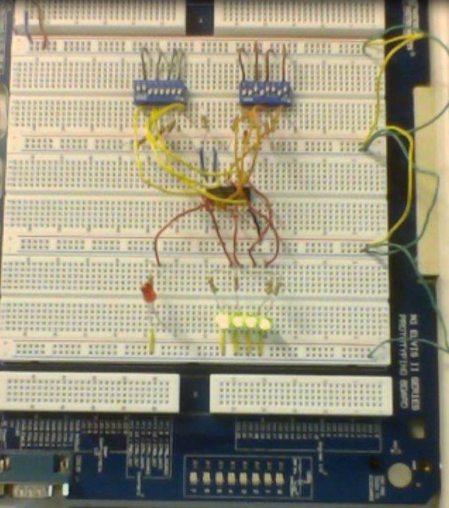
74LS283
LED representation of the numbers 0-16.
330 Resistors
0
 |  |  | Voltages (V) |  | Carry Bit
Sum = | 0 |  | LSB | 0.1113 | Off
A = | 0 |  | 2nd | 0.1149
B = | 0 |  | 3rd | 0.1125
 |  |  | MSB | 0.1098
Sum = | 1 |  | LSB | 3.2247 | Off
A = | 1 |  | 2nd | 0.1132
B = | 0 |  | 3rd | 0.1111
 |  |  | MSB | 0.1088
Sum = | 2 |  | LSB | 0.1102 | Off
A = | 1 |  | 2nd | 3.2319
B = | 1 |  | 3rd | 0.1107
 |  |  | MSB | 0.1085
Sum = | 3 |  | LSB | 3.2262 | Off
A = | 2 |  | 2nd | 3.228
B = | 1 |  | 3rd | 0.1105
 |  |  | MSB | 0.1083
Sum = | 4 |  | LSB | 0.1117 | Off
A = | 2 |  | 2nd | 0.1156
B = | 2 |  | 3rd | 3.2278
 |  |  | MSB | 0.1089
Sum = | 5 |  | LSB | 3.2254 | Off
A = | 2 |  | 2nd | 0.111
B = | 3 |  | 3rd | 3.227
 |  |  | MSB | 0.1082
Sum = | 6 |  | LSB | 0.1108 | Off
A = | 3 |  | 2nd | 3.2291
B = | 3 |  | 3rd | 3.2275
 |  |  | MSB | 0.108
Sum = | 7 |  | LSB | 3.2242 | Off
A = | 4 |  | 2nd | 3.2293
B = | 3 |  | 3rd | 3.2244
 |  |  | MSB | 0.1075
Sum = | 8 |  | LSB | 0.1111 | Off
A = | 4 |  | 2nd | 0.1165
B = | 4 |  | 3rd | 0.1133
 |  |  | MSB | 3.2191
 |  |  | Voltages (V) |  | Carry Bit
Sum = | 9 |  | LSB | 3.228 | Off
A = | 5 |  | 2nd | 0.115
B = | 4 |  | 3rd | 0.112
 |  |  | MSB | 3.2163
Sum = | 10 |  | LSB | 0.1098 | Off
A = | 5 |  | 2nd | 3.2344
B = | 5 |  | 3rd | 0.1115
 |  |  | MSB | 3.2183
Sum = | 11 |  | LSB | 3.2304 | Off
A = | 6 |  | 2nd | 3.2303
B = | 5 |  | 3rd | 0.1113
 |  |  | MSB | 3.2171
Sum = | 12 |  | LSB | 0.1117 | Off
A = | 6 |  | 2nd | 0.1167
B = | 6 |  | 3rd | 3.2242
 |  |  | MSB | 3.2167
Sum = | 13 |  | LSB | 3.2256 | Off
A = | 7 |  | 2nd | 0.1155
B = | 6 |  | 3rd | 3.2236
 |  |  | MSB | 3.2161
Sum = | 14 |  | LSB | 0.111 | Off
A = | 7 |  | 2nd | 3.2298
B = | 7 |  | 3rd | 3.224
 |  |  | MSB | 3.2163
Sum = | 15 |  | LSB | 3.2242 | Off
A = | 8 |  | 2nd | 3.229
B = | 7 |  | 3rd | 3.223
 |  |  | MSB | 3.223
Sum = | 16 |  | LSB | 0.1102 | On
A = | 8 |  | 2nd | 0.1147
B = | 8 |  | 3rd | 0.113
 |  |  | MSB | 0.1094
10k Resistors
1
2
3
4
5
6
7
8
9
10
11
12
13
14
15
16

Slide 5
Troubleshooting:
  We had one LED that would stay light on without any inputs to turn it on.
    The issue was resolved by consulting the schematic and closely review the connections in the circuit. It was found that a wire had been misplaced causing the LED to always stay light.

Slide 6
Conclusion:
The circuit was successfully built.

Slide 7
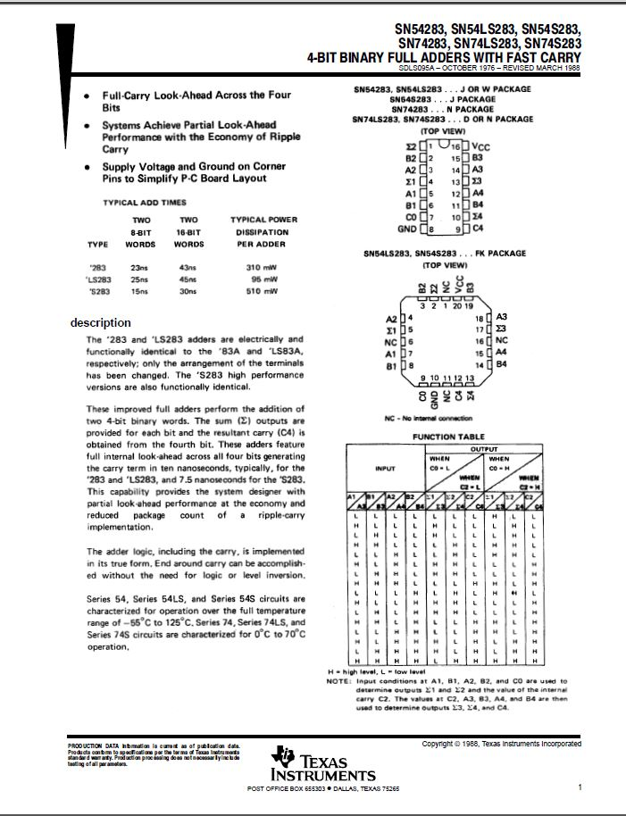
Data Sheets:
74LS283

