Slide 1
Lab 9
By: Dakota Johnson
Lab Partner: Josiah Abel
Instructor: Andy Bell
Bench Number: 6
Class: EECT 122-20C
Date: 3/18/2015

Slide 2
Objectives:
To build a synchronous counting circuit and find its total propagation delay.
Equipment and Parts:
Equipment | Model/Part Number | Serial Number
NI Elvis II+ | 19857OA-02L | 1677D1E
Digital Multimeter | GW INSTEK GDM-8245 | CL860332
Tektronix TDs 220 2-Channel Ocilloscope | TDS220 | B083266
Function Generator | GW INSTEK GFG -8210 | C705245
Part | Amount
330 Resistors | 4
74LS08D Chip | 1
74LS112D Chip | 2
74LS04D Chip | 1
LED 08LX330HV5 | 4
Miscellaneous Wires | ------------

Slide 3
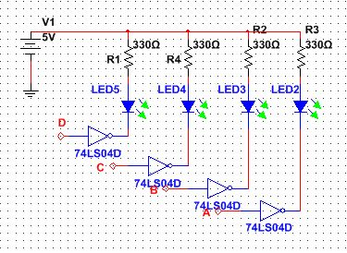
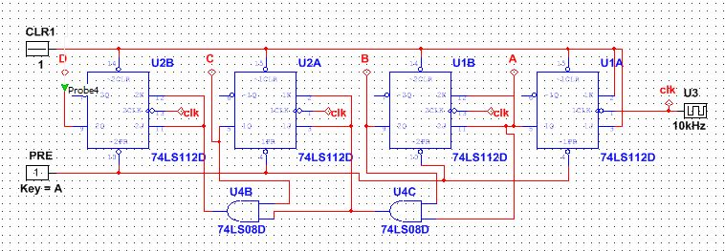
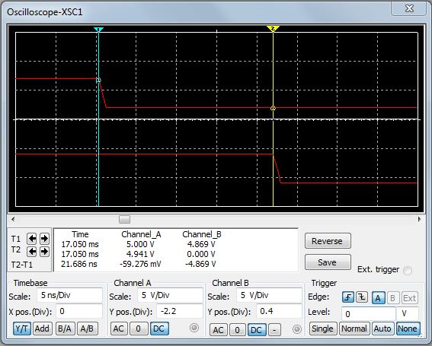
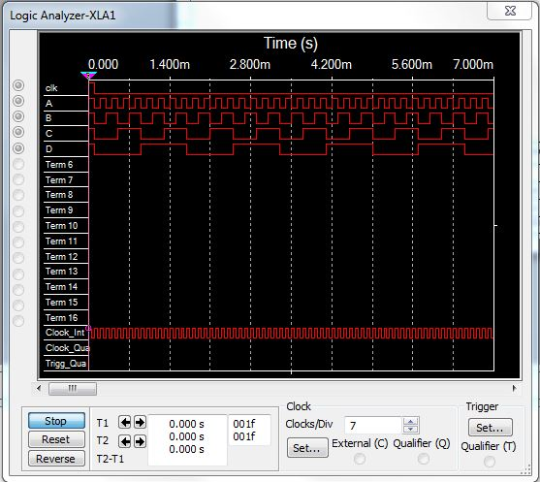
Data/Lab Results/Simulations/Schematics:
Simulation showing the timing of the outputs with respect to the clock.
Simulation of total propagation delay.

Slide 4
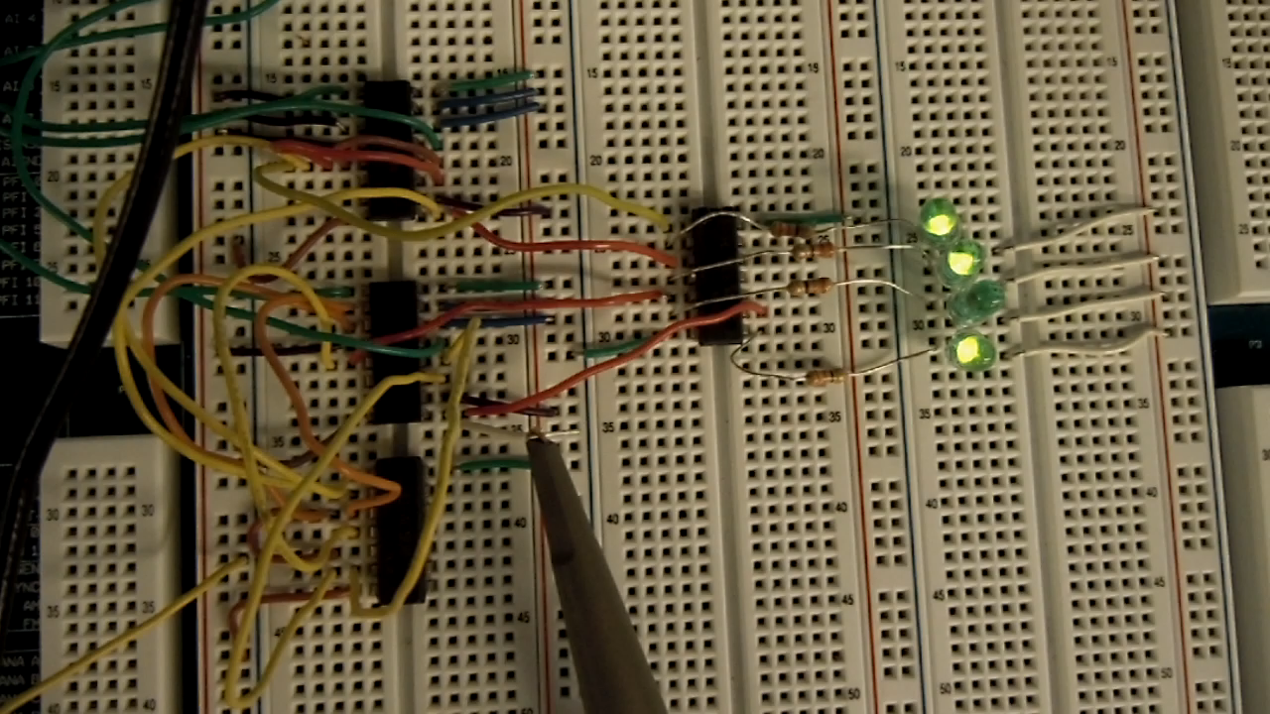

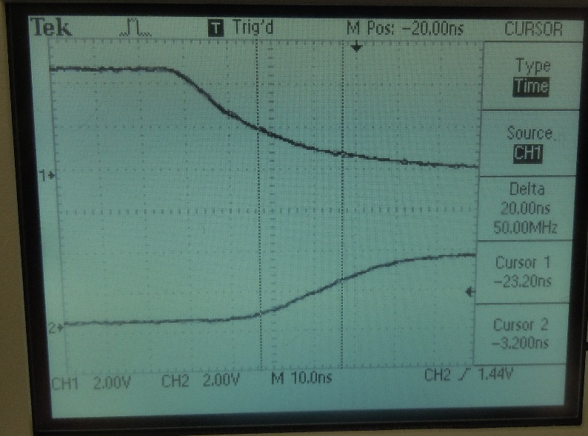
74LS112
74LS04
330 Resistors
74LS08
Output Voltages
 | High Voltage | Low Voltage
 | (V) | (V)
MSB | 3.84 | 0.1
3rd Bit | 3.84 | 0.1
2nd Bit | 3.84 | 0.1
LSB | 3.84 | 0.11
Clock Frequency
Frequency
(kHz)
1.08
Total Propagation Delay
Time
(ns)
20

Slide 5
Troubleshooting:
The lab ran smoothly without any problems.

Slide 6
Conclusion:
The circuit was constructed and the propagation delay was found to be 20ns.

Slide 7
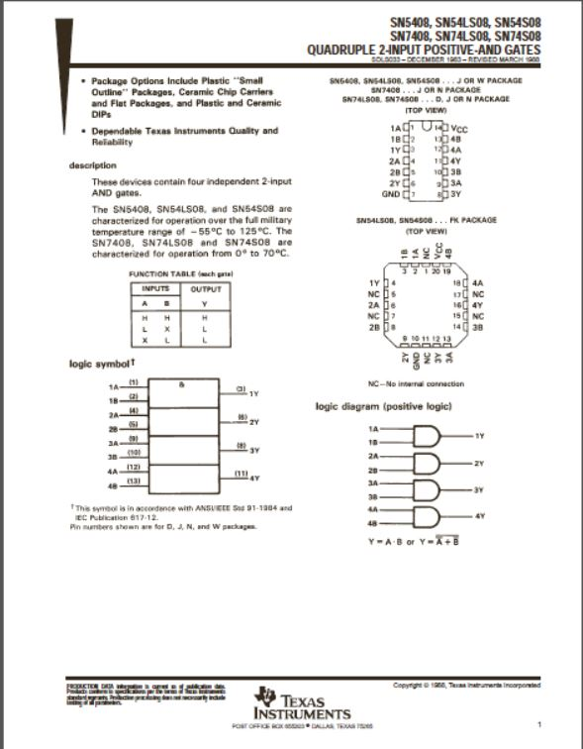
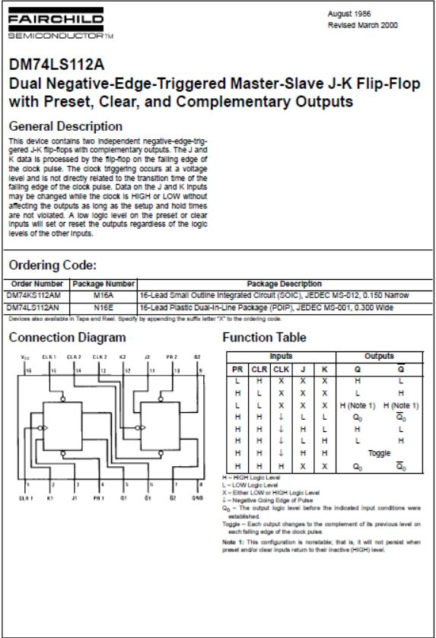
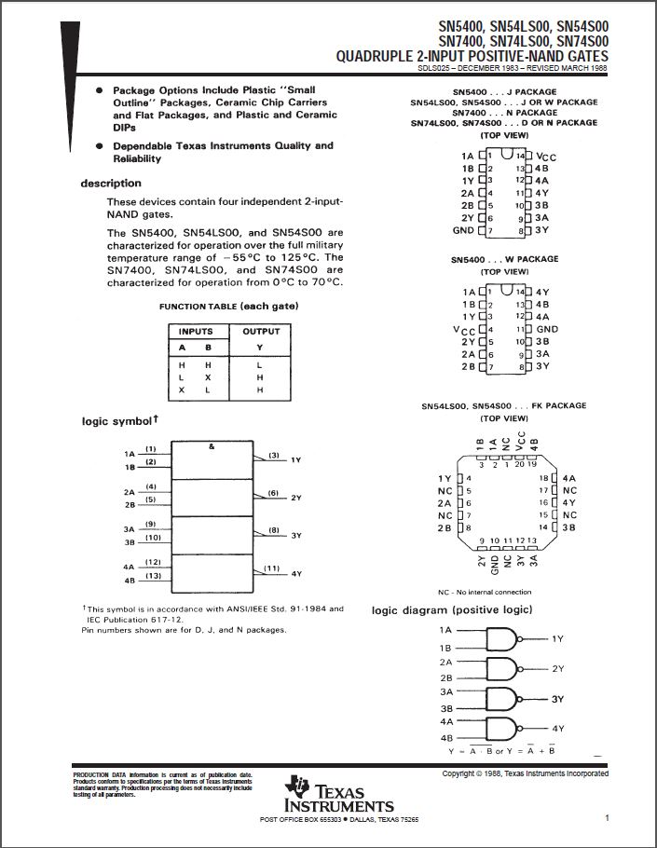
Data Sheets:
74LS08
74LS112
74LS04

