Slide 1
Lab Notebook
By: Dakota Johnson
Lab Partners: Alex Hipskind, Adam Beauchot
Instructor: Andy Bell
Class: EECT 211-50C
Date: 5/3/2016

Slide 2
Table of Contents
Equipment- pg. 1
Review - pg.2-9
Lab1: Diodes- pg.10-12
Lab2: Full wave & Half Wave Rectifier- pg.13-15
Lab3: LED- pg.16-17
Lab4: ±9V & ±3V Power Supplies- pg.18-23
Lab5: BJT LED Switch- pg.24-26
Lab6: BJT Transistor Amplifier- pg.27-31
Lab7: JFET LED Switch- pg.32-34
Lab8: JFET Transistor Amplifier pg.35-37
Lab9: Filters pg.38-44

Slide 3
Equipment
Bench 5:
LCR Meter Brand: GwINSTEK Model: LCR-819 SN: EN181541
Function Generator Brand: GwINSTEK Model: GFG-8210 SN:C705271
Multimeter Brand: GwINSTEK Model:GDM-8245 SN:CL860336
Oscilloscope Brand: Tekronix Model: TDS 220 SN:B083300
DC Power Supply Brand: RSR Model: HY1802D SN: 369986
Multi Channel DC Power Supply Brand: TENIMA Model 72-6615 SN: 0201430
Bench 6:
LCR Meter Brand: GwINSTEK Model: LCR-819 SN: E120998
Function Generator Brand: GwINSTEK Model: GFG-8210 SN:C705245
Multimeter Brand: GwINSTEK Model:GDM-8245 SN:CL860332
Oscilloscope Brand: Tekronix Model: TDS 220 SN:B083266
DC Power Supply Brand: RSR Model: HY1802D SN: 369987
Multi Channel DC Power Supply Brand: TENIMA Model 72-6615 SN:0201443

Slide 4
Review:

Slide 5
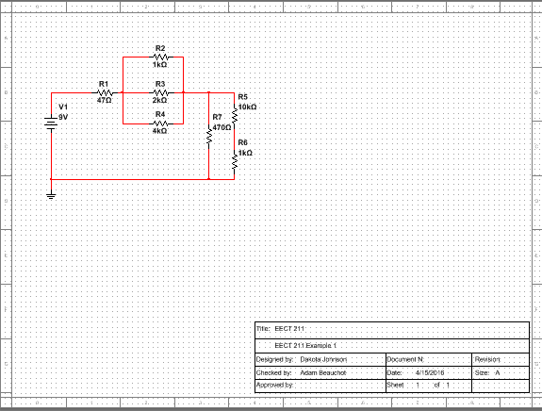
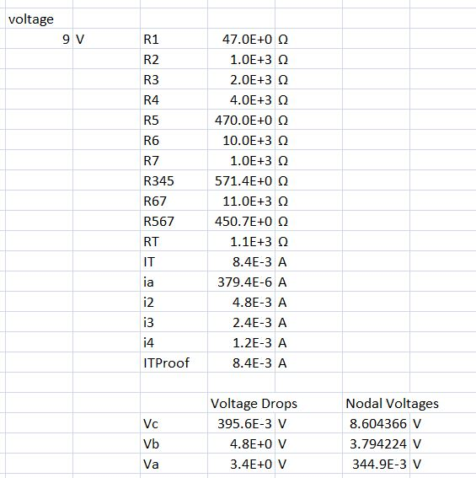
Lab Results:
Objectives:
  To review basic concepts like how resistors add in series and parallel circuits, capacitive and inductive reactance and how to make a bode plot.
  Finding the nodal voltages at different points in the circuit.

Slide 6
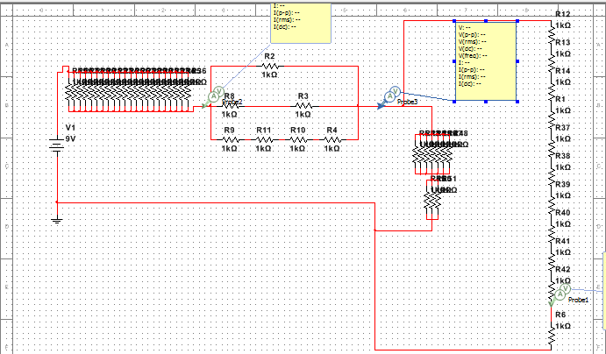
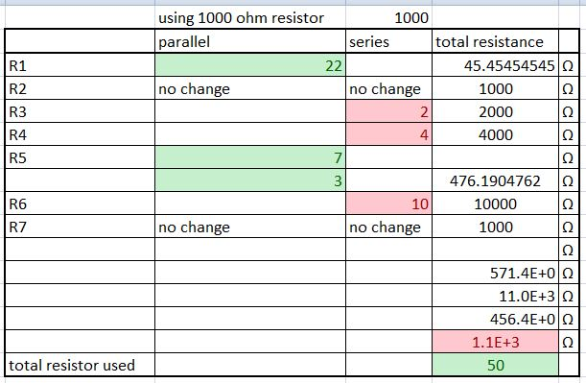
Lab Results:
  Making a circuit with only one kind of resistor.

Slide 7
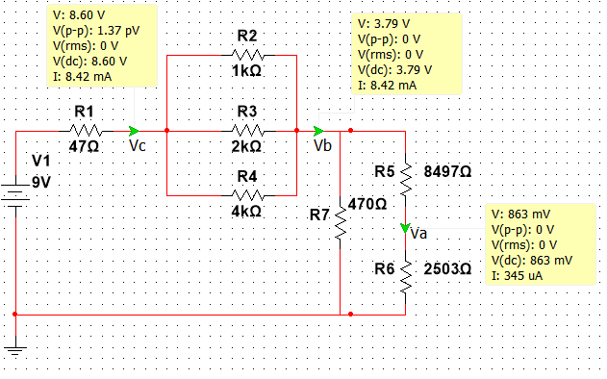
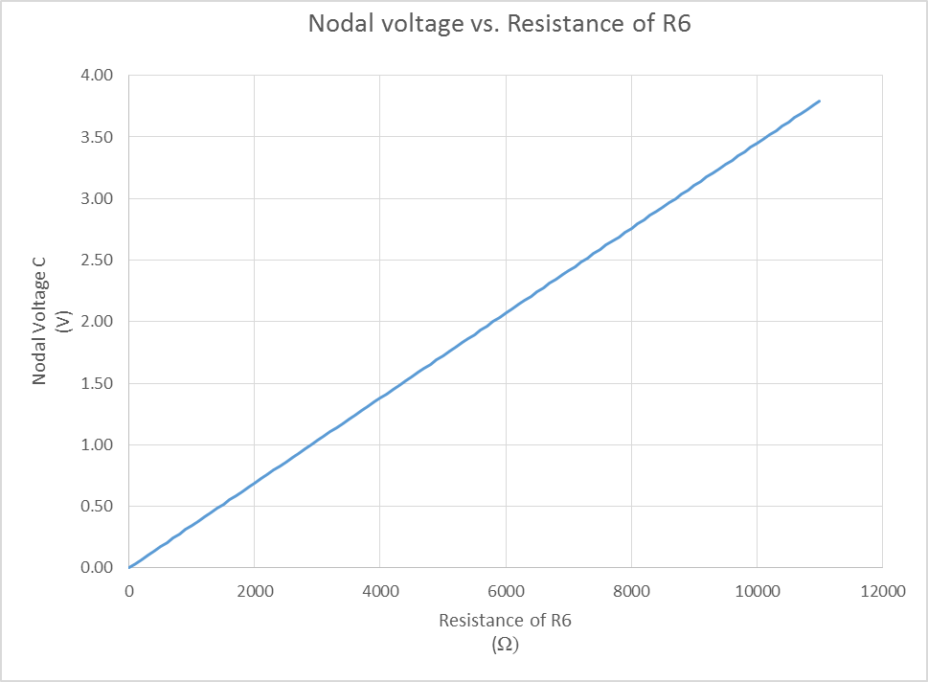
Lab Results:
 |  |  | voltage
 |  |  | 9 | V
 | R1 | 47.0E+0 | Ω |  | R1 | 47.0E+0 | Ω
 | R2 | 1.0E+3 | Ω |  | R2 | 1.0E+3 | Ω
 | R3 | 2.0E+3 | Ω |  | R3 | 2.0E+3 | Ω
 | R4 | 4.0E+3 | Ω |  | R4 | 4.0E+3 | Ω
 | R5 | 470.0E+0 | Ω |  | R5 | 470.0E+0 | Ω
 | R6 | 10.0E+3 | Ω |  | R6 | 3.4E+3 | Ω
 | R7 | 1.0E+3 | Ω |  | R7 | 1.0E+3 | Ω
 | R345 | 571.4E+0 | Ω |  | R345 | 571.4E+0 | Ω
 | R67 | 11.0E+3 | Ω |  | R67 | 4.4E+3 | Ω
 | R567 | 450.7E+0 | Ω |  | R567 | 424.6E+0 | Ω
 | RT | 1.1E+3 | Ω |  | RT | 1.0E+3 | Ω
 | IT | 8.4E-3 | A |  | IT | 8.6E-3 | A
 | ia | 379.4E-6 | A |  | ia | 1.1E-3 | A
 | i2 | 4.8E-3 | A |  | i2 | 4.8E-3 | A
 | i3 | 2.4E-3 | A |  | i3 | 2.4E-3 | A
 | i4 | 1.2E-3 | A |  | i4 | 1.2E-3 | A
 | ITProof | 8.4E-3 | A |  | ITProof | 8.4E-3 | A
 | Voltage Drops |  | Nodal Voltages |  | Voltage Drops |  | Nodal Voltages
Vc | 395.6E-3 | V | 8.604366 | V | 405.5E-3 | V | 8.6E+0 | V
Vb | 4.8E+0 | V | 3.8E+0 | V | 4.9E+0 | V | 3.7E+0 | V
Va | 3.4E+0 | V | 344.9E-3 | V | 2.8E+0 | V | 832.7E-3 | V
  Changing the nodal voltage at one point in the circuit without changing any of the other nodal voltages.
  Graph used to show the change in voltage due to a change in resistance.

Slide 8
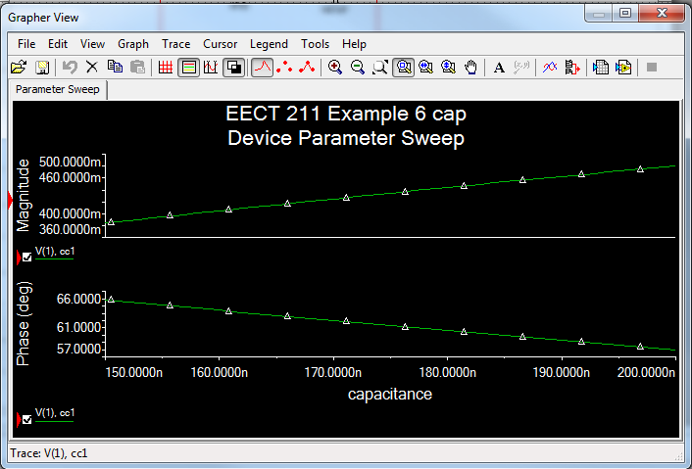
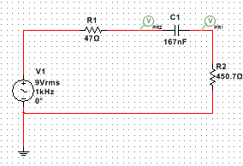
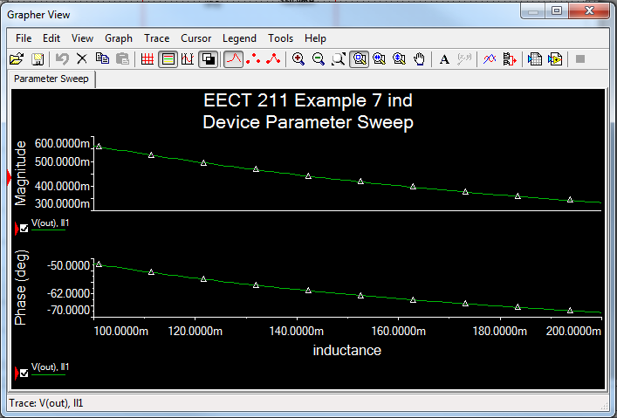
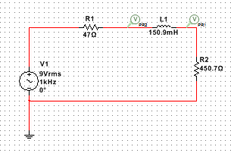
Lab Results:
  Circuit used to measure capacitive reactance
  Graph showing how capacitive reactance is related to capacitance.
  Graph showing how inductive reactance is related to inductance.
  Circuit used to measure inductive reactance

Slide 9
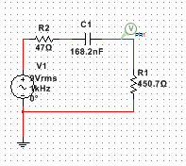
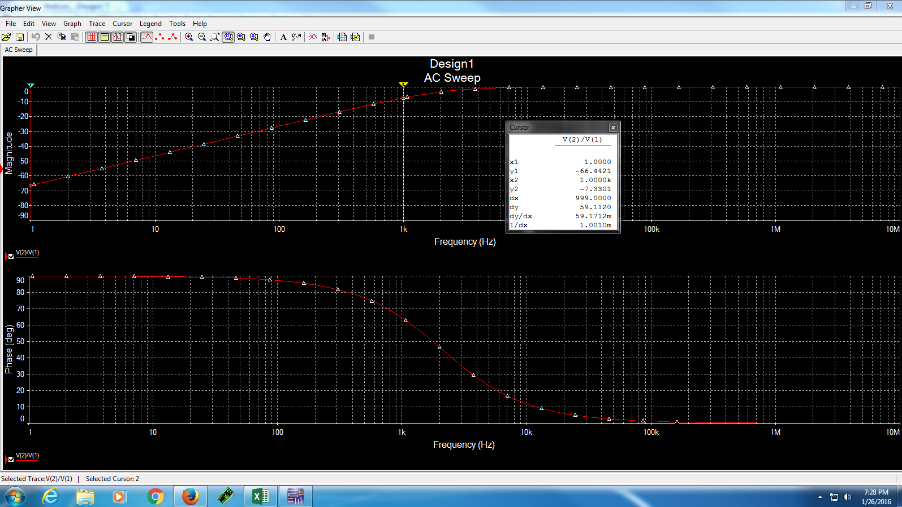
Lab Results:
  Circuit used to do a bode plot
  Frequency response for the circuit.
Conclusion:
How resistors add in series and parallel, capacitive and inductive reactance, and the steps to do a bode plot were all reviewed.

Slide 10
Lab 1:
Diodes

Slide 11
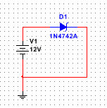
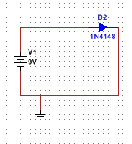
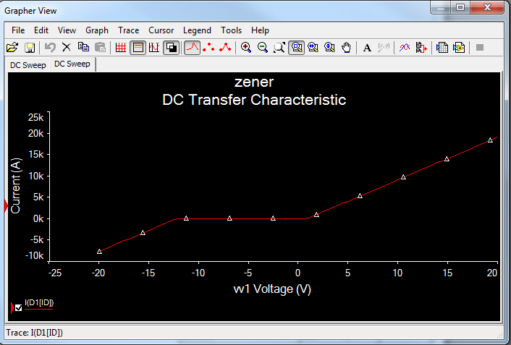
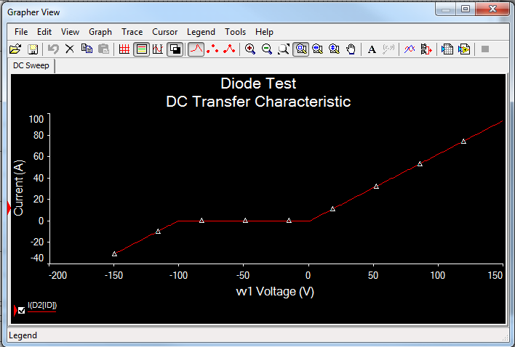
Lab Results:
Objectives:
Test the characteristic curves of diodes.

Slide 12
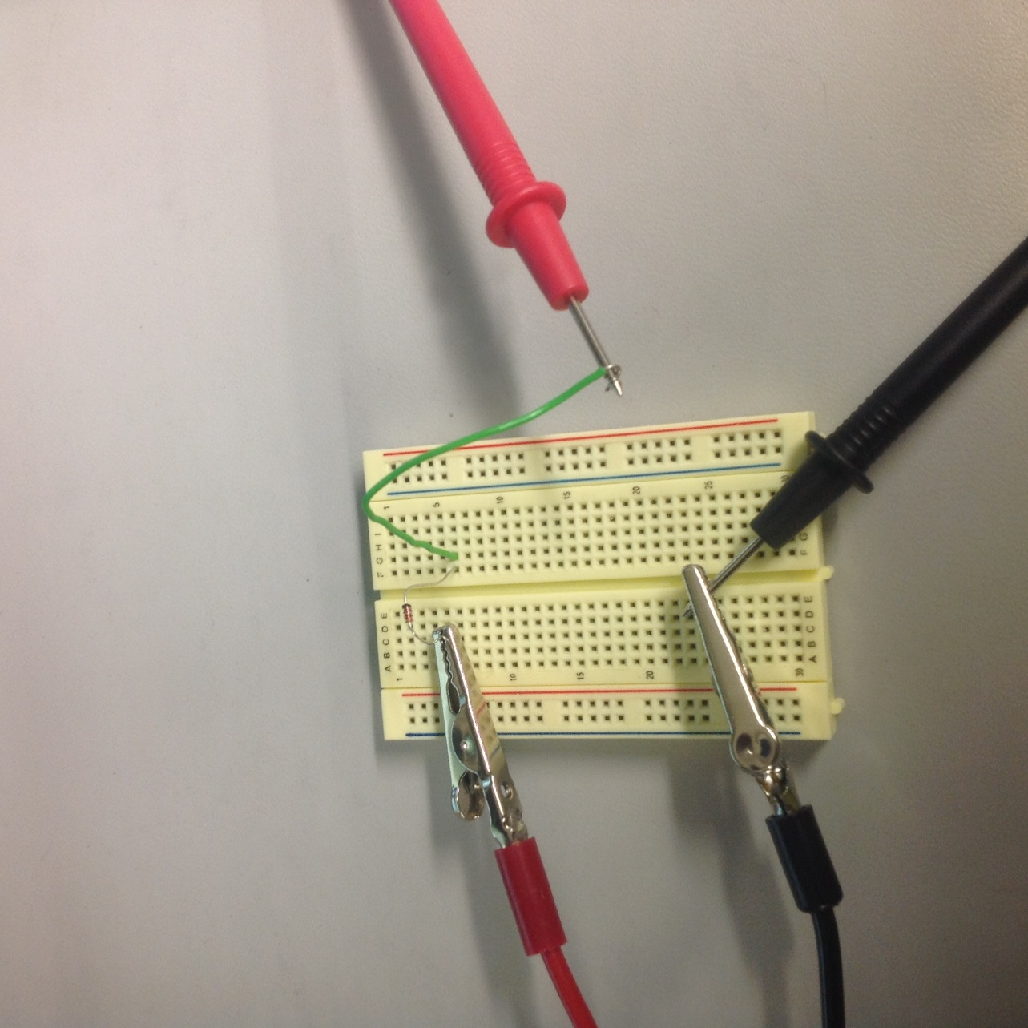
Lab Results:
1N4148
Vin | A
-1 | 0
-0.5 | 0
0 | 0
0.5 | 0.000043
1 | 0.0273
1.5 | 0.35
2 | 0.801
1N4742
Vin | A
-1 | 0
-0.5 | 0
0 | 0
0.5 | 0.0000011
1 | 0.000343
1.5 | 0.436
2 | 0.804
  Data collected for the zener diode.
  Data collected for the switching diode.
  Circuit setup
Conclusion:
  The diodes characteristics were tested.

Slide 13
Lab 2:
Full Wave and Half Wave Rectifiers

Slide 14
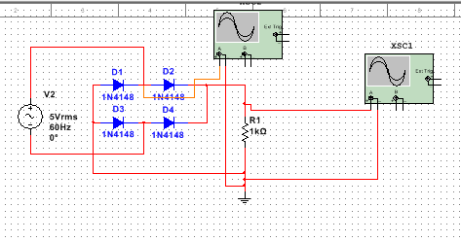
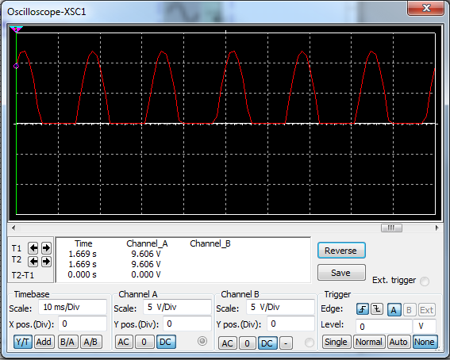
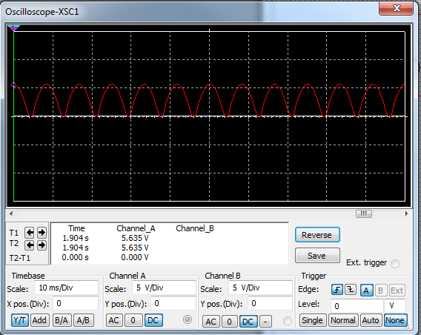
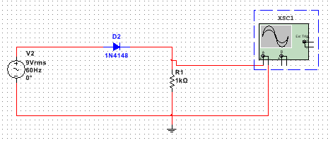
Equipment Used:
Objectives:
Build full wave and half wave rectifier circuits
Bench 5
Oscilloscope
Function Generator
Lab Results:
Simulation of the half wave rectifier.
Simulation of the full wave rectifier.

Slide 15
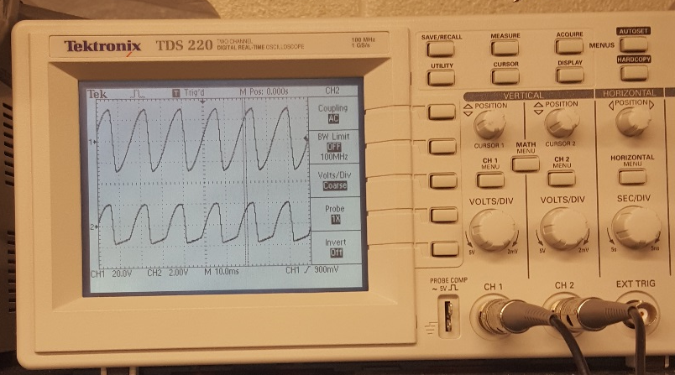
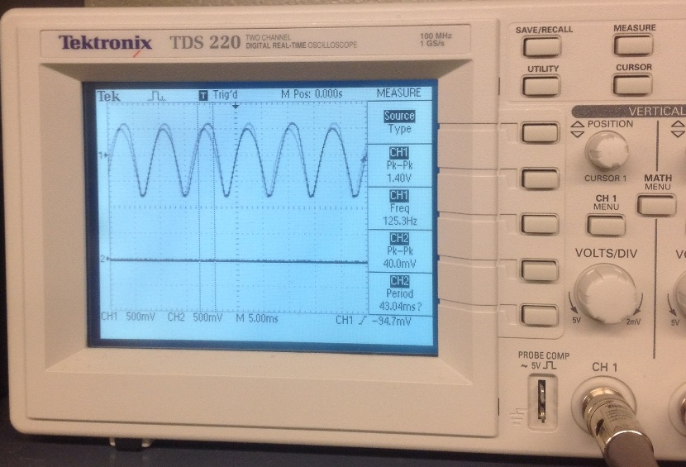
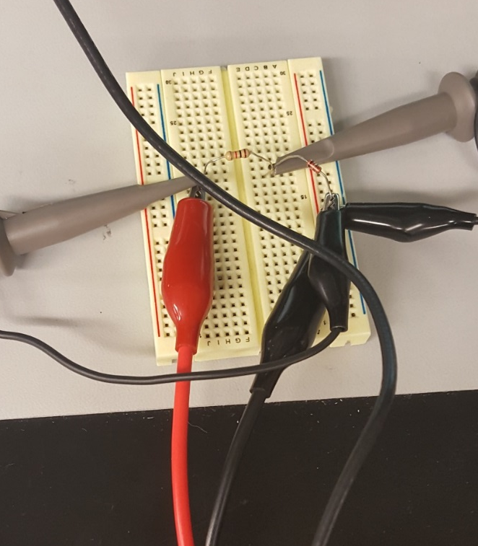
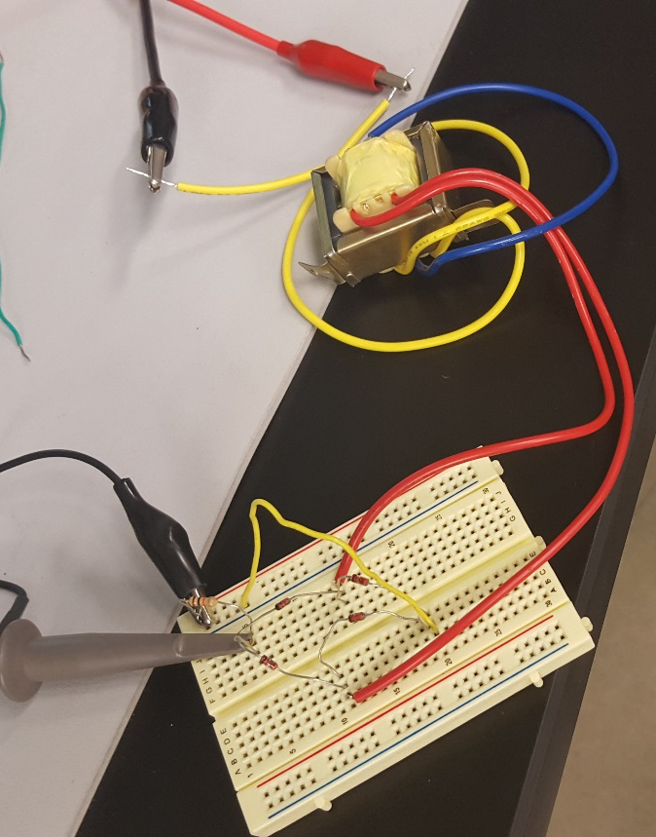
Lab Results:
1kΩ
Transformer
Oscilloscope reading for the half wave rectifier with the input on top and output on bottom
Output wave form for the full wave rectifier.
1N4148
1kΩ
Half wave rectifier design
Conclusion:
Full wave rectifier design
1N4148
A transformer had to be used in order to get the full wave rectifier to work. Once this was implemented both circuits worked fine.

Slide 16
Lab 3:
LEDs

Slide 17
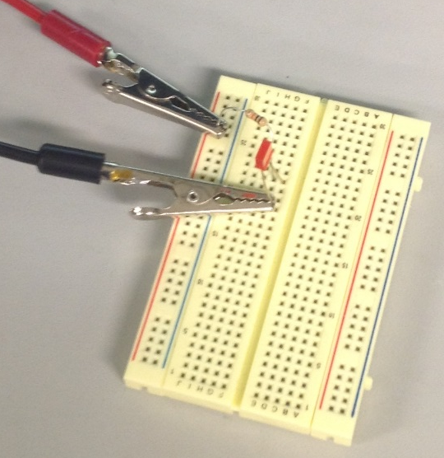
Equipment Used:
Objectives:
Find the voltage drops of various LEDs
Bench 5
Mulitmeter
Lab Results:
Vdc= | 8.982 | V
R | 10000 | Ω
LED Serial | Resistor Drop |  | Current |  | led Drop
08L53 | 7.195 | V | 719.5E-6 | A | 1.787 | V
08L32 | 7.31 | V | 731.0E-6 | A | 1.672 | V
08L93SRC | 7.331 | V | 733.1E-6 | A | 1.651 | V
08L803 | 7.134 | V | 713.4E-6 | A | 1.848 | V
08LX330 HV5 | 6.974 | V | 697.4E-6 | A | 2.008 | V
08L1043 | 7.344 | V | 734.4E-6 | A | 1.638 | V
08LX330 HV12 | 7.086 |  | 708.6E-6 | A | 1.896 | V
Circuit setup for the lab.
Conclusion:
Math done to find the voltage drops
The voltage drops for the LEDs were found.

Slide 18
Lab 4:
±9 Volt & ±3 Volt Power Supplies

Slide 19
Equipment Used:
Objectives:
Simulate a ±9 volt power supply and a ±3 volt power supply that has the following qualities:
  Have a maximum output voltage ripple of 100mV
  Have an output current of 100mA for the ±9 volt supply and 275mA for the ±3 volt supply
  Maximum cost of $25.00
Bench 5
Mulitmeter
Ocsilloscope

Slide 20
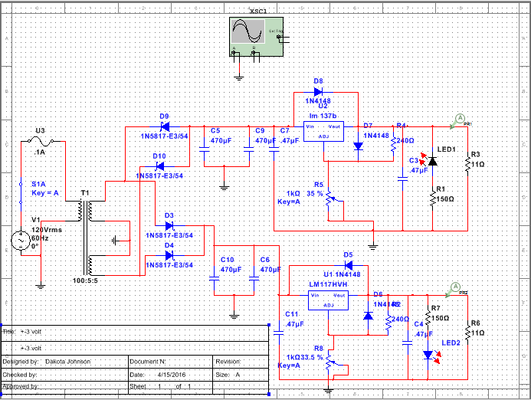
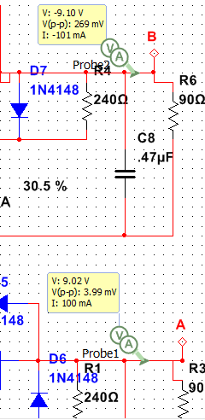
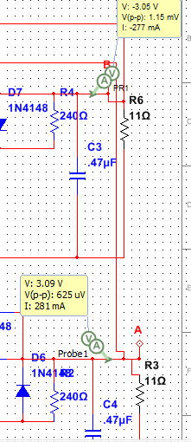
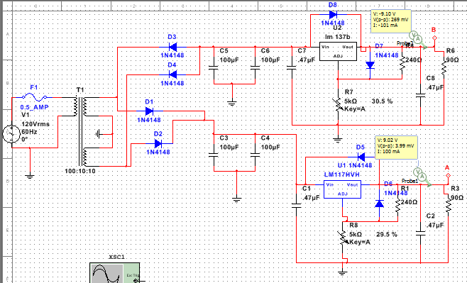
Lab Results:
±9 volt power supply design
±3 volt power supply design

Slide 21
Lab Results:
Express Part # | Part decription | Quantity | Unit Price | Sub Total
Power Transformers 6.3 VCT 1A | 16P16.3-1 | 1 | $9.95 | $9.95
111N4148 | Switching Diode | 8 | $0.06 | $0.48
14ER050.47U | Electrolytic Radial Lead Capacitors - .47 uf 50V | 4 | $0.15 | $0.60
14ER025470U | Electrolytic Radial Lead Capacitors - 470 uf 25V | 4 | $0.30 | $1.20
13005240 | Carbon Film Resistors 5% 1/4 W - Value 240 | 2 | $0.06 | $0.12
18PMD1K | Potentiometer Panel PC mount | 2 | $1.05 | $2.10
2000MYT1/2 | Slow Blow Fuses Economy Type 1/2 Amp | 1 | $0.50 | $0.50
2001LINL | In-Line Holder For 1-1- 4 x 1- 4 Fuses | 1 | $0.55 | $0.55
10317-T | Volt. Regulator Adjustable 1A | 1 | $0.35 | $0.35
10337-T | Volt. Regulator Adjustable 1A | 1 | $0.75 | $0.75
17SWTOGWR | SPST Toggle Switch with lead wires | 1 | $0.95 | $0.95
Total
$17.55
Bill of materials for the ±3 volt power supply

Slide 22
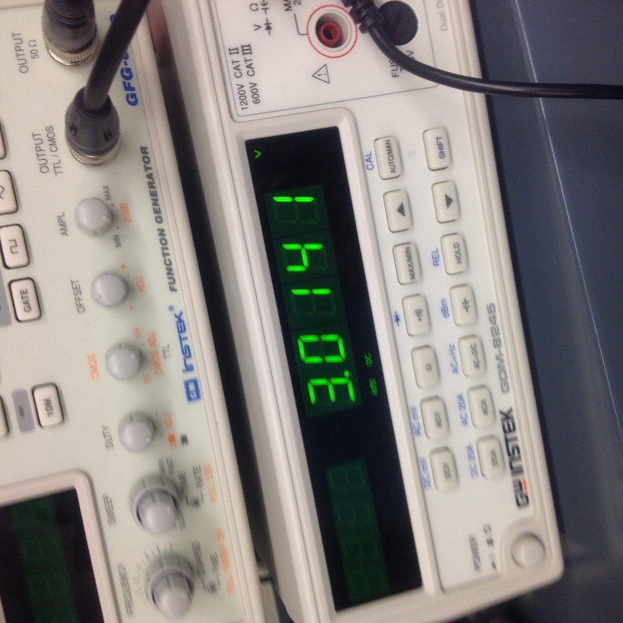
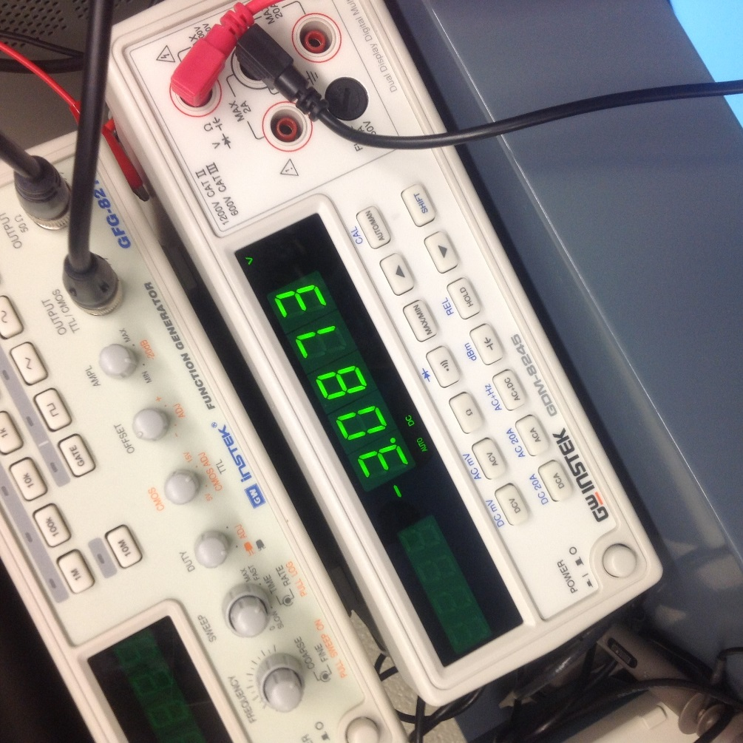
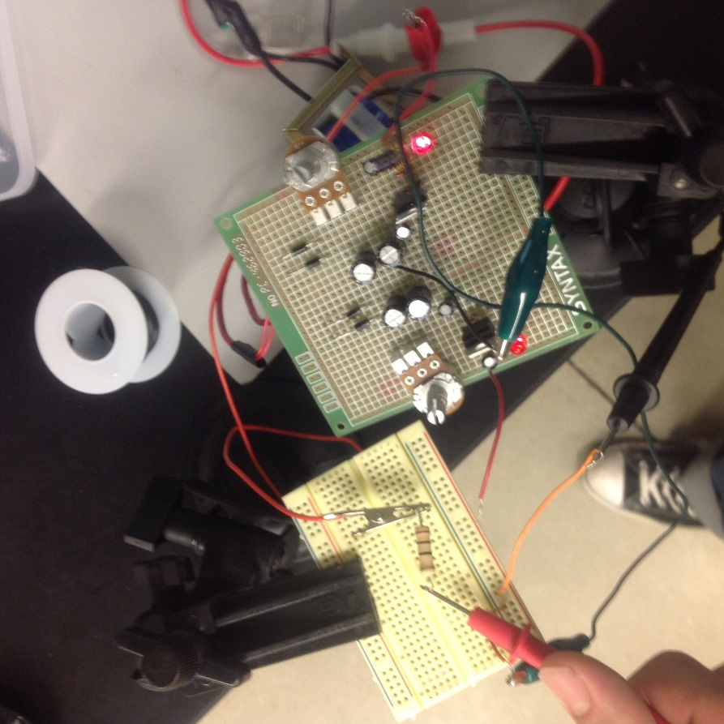
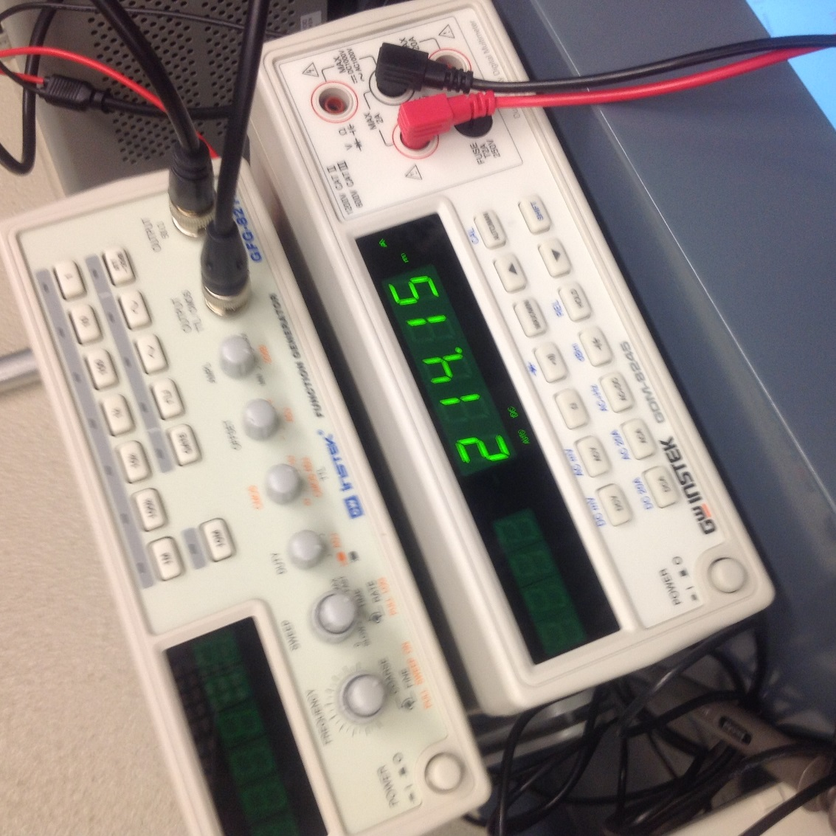
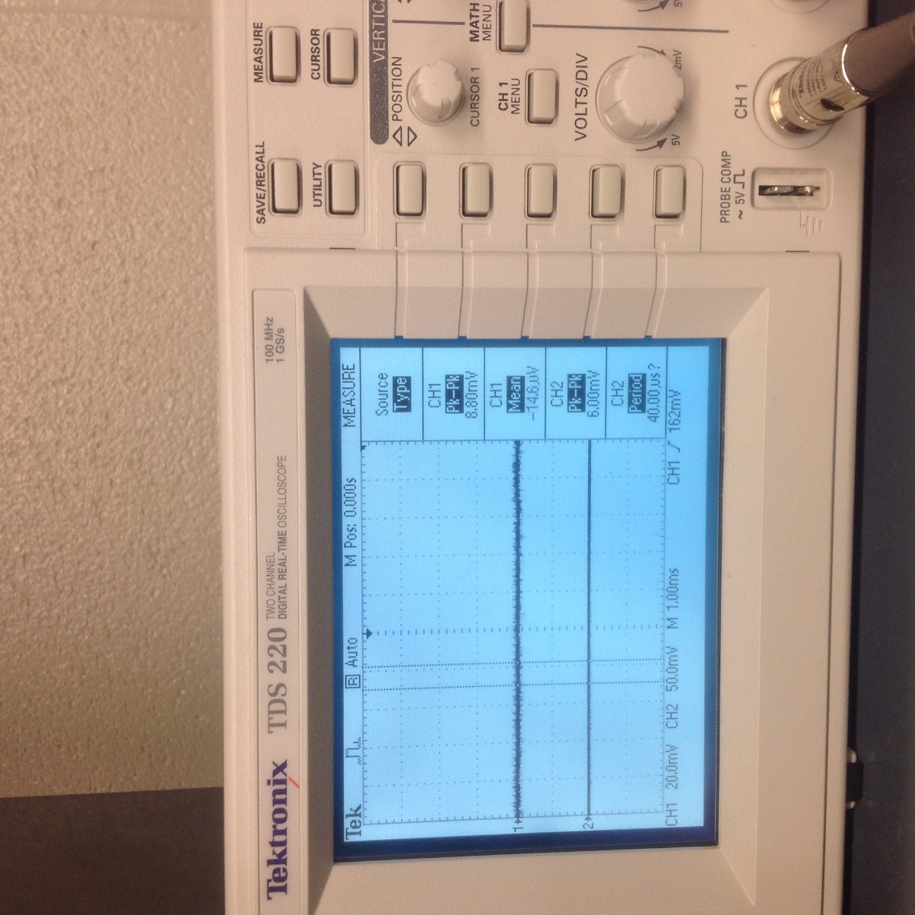
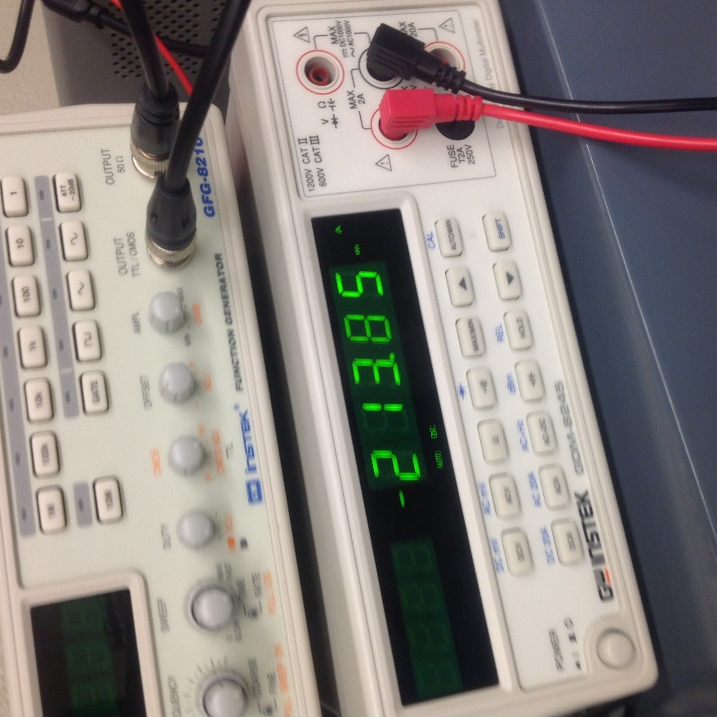
Lab Results:
Voltage measured for the +3 volt side.
Voltage measured for the -3 volt side.
Circuit setup for testing the power supply.
Current measured for the +3 volt side.
A voltage ripple of 8mV was measured using the oscilloscope.
Current measured for the -3 volt side.

Slide 23
Conclusion:
The power supply was successfully made. The voltages and the ripple voltage were both within the desired range. However the currents were both a little bit lower than what was desired.

Slide 24
Lab 5:
BJT LED Switch

Slide 25
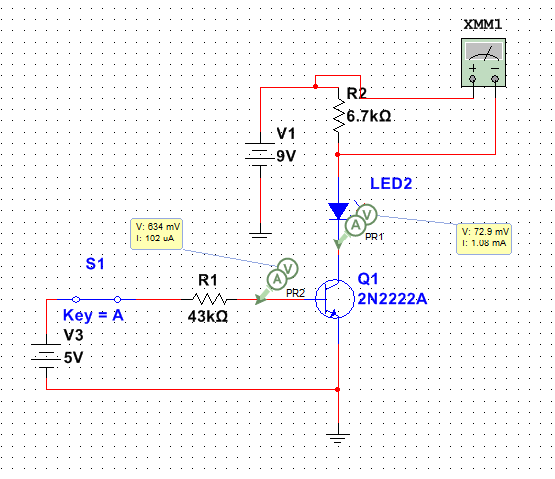
Equipment Used:
Objectives:
Build circuit that can turn on and off an LED using a BJT transistor.
Bench 5
Mulitmeter
Function Generator
Lab Results:
Math/Mutisim
Vb= | 5.0E+0 | V | β= | 10.0E+0
Ib | 100.0E-6 | A
Vbe= | 700.0E-3 | V
 |  |  | V Drop
Rb= | 43.0E+3 | Ω | 4.366 | V
Vc= | 9.0E+0 | Ω
Ic= | 1.0E-3 | A
Vdiode= | 2.0E+0 | V
Vce= | 300.0E-3 | V
 |  |  | V Drop
Rc | 6.7E+3 | Ω | 7.253 | V
Multisim and Excel sheet used to design the circuit.

Slide 26
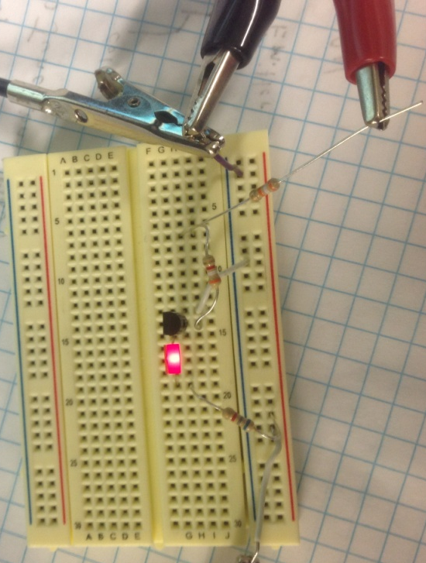

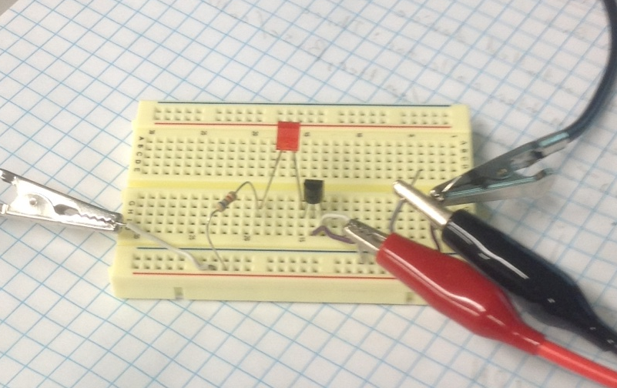
Lab Results:
Measured
Vb= | 5.4E+0 | V | β= | 9.2E+0
Ib | 49.4E-6 | A
Vbe= | 700.0E-3 | V
 |  |  | V Drop
Rb_{T}= | 42.4E+3 | Ω | 4.25 | V
Rb₁= | 3.8E+3 | Ω | 0.393 | V
Rb₂= | 38.6E+3 | Ω | 3.9 | V
Vc= | 9.0E+0 | V
Ic= | 456.0E-6 | A
Vdiode= | 1.6E+0 | V
Vce= | 300.0E-3 | V
 |  |  | V Drop
Rc | 6.9E+3 | Ω | 7.28 | V
Rb2
Two resistors put in series for Rb in order to get the proper resistance.
2N2222
Rb1
LED
Circuit with LED on.
Measured values for the actual parts used.
Rc
Conclusion:
A BJT can be used a current controlled switch.
Circuit with LED off

Slide 27
Lab 6:
BJT Transistor Amplifier

Slide 28
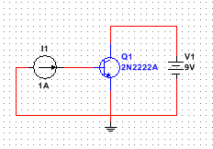
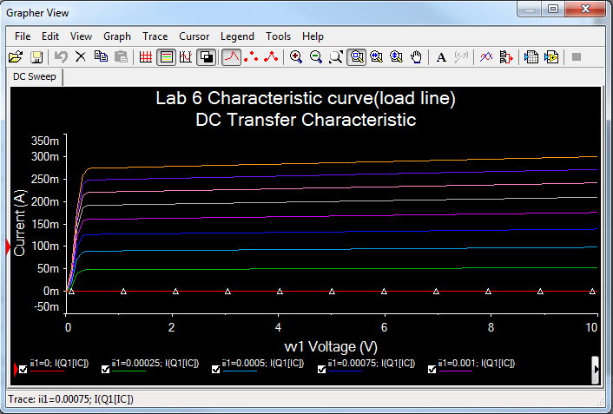
Equipment Used:
Objectives:
Build circuit using a BJT transistor that amplifies an input signal by 20dB.
Bench 5
Oscilliscope
Function Generator
Lab Results:
The first step that was done in order to build the circuit was to make a load line for the transistor.
Circuit used to generate the transfer curve.
Transfer curve that was exported to excel with the load line.
Transfer curve simulated by multisim

Slide 29
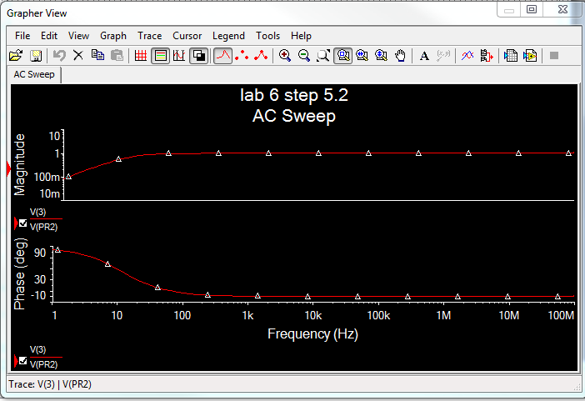
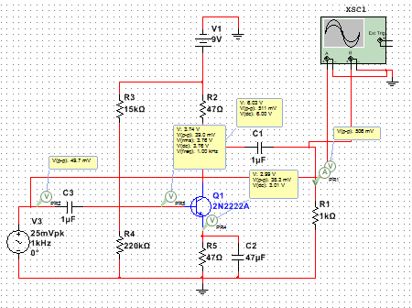
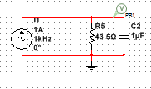
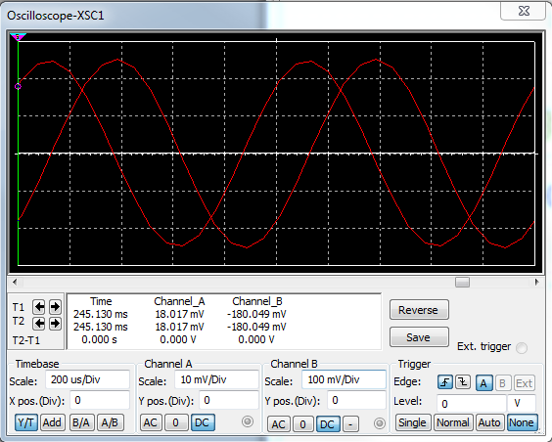
Lab Results:
math
Vin | 0.01 | Vpp
vout | 0.1 | Vpp
Beta= | 10
Vce= | 0.3 | V
Vbe= | 0.7 | V
Vdcin= | 9 | V
Vcc
Freq= | 1000 | hz
Rl= | 1000 | Ω
Ib= | 0.00025 | I
Ic= | 0.1 | I
Rc= | 43.5 | Ω
Re= | 43.5 | Ω
Ie | 0.10025 | I
Ve= | 4.360875 | V
Vbb= | 5.060875 | V
R1= | 15.8E+3 | Ω
R2= | 202.4E+3 | Ω
dt= | 0.000284 | sec
T= | 0.001 | sec
phase shift= | 102.24 | degrees
Circuit and simulation used to determine the value emitter capacitor.
Final circuit design and oscilloscope readings showing a gain of 10.
Calculations used to determine various values.

Slide 30
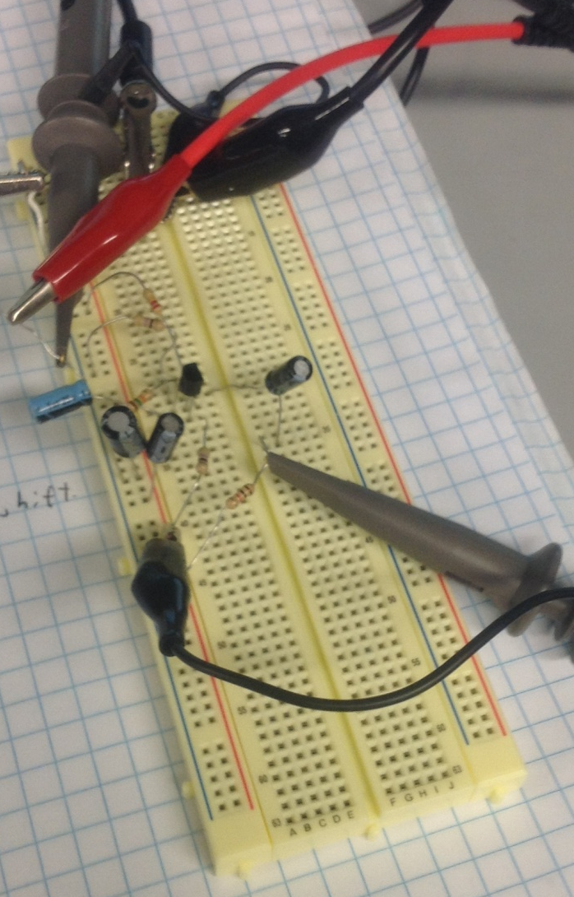
Lab Results:
measured
Vin | 49.6 | Vpp
vout | 496 | Vpp
Beta= | 10
Vce= |  | V
Vbe= |  | V
Vdcin= | 9 | V
Vcc= | 6.31 | V
Freq= | 1007 | hz
Rl= | 979 | Ω
Ib= |  | I
Ic= |  | I
Rc= | 46.25 | Ω
Re= | 46.4 | Ω
Ie |  | I
Ve= | 2.701 | V
Vbb= | 3.358 | V
R1= | 14800 | Ω
R2= | 224390 | Ω
C1= | 0.000000836 | F
C2₁= | 37.7E-6 | F
C2₂= | 20.2E-6 | F
C2_{T}= | 57.9E-6 | F
C3= | 0.0000022 | F
dt= | 0.0003 | sec
T= | 0.000984 | sec
phase shift= | 109.7560976 | degrees
2N2222
R2
C1
Rc
Two Capacitors were put in parallel with each other for C2 because the single 47uF capacitor measured a value less that what it was supposed to.
* C3 is not part of the circuit and is used to filter the input signal so the oscilloscope can be read with more accuracy.
*C3
Rl
R1
C21
C22
Re
Measured values for the actual parts used.

Slide 31
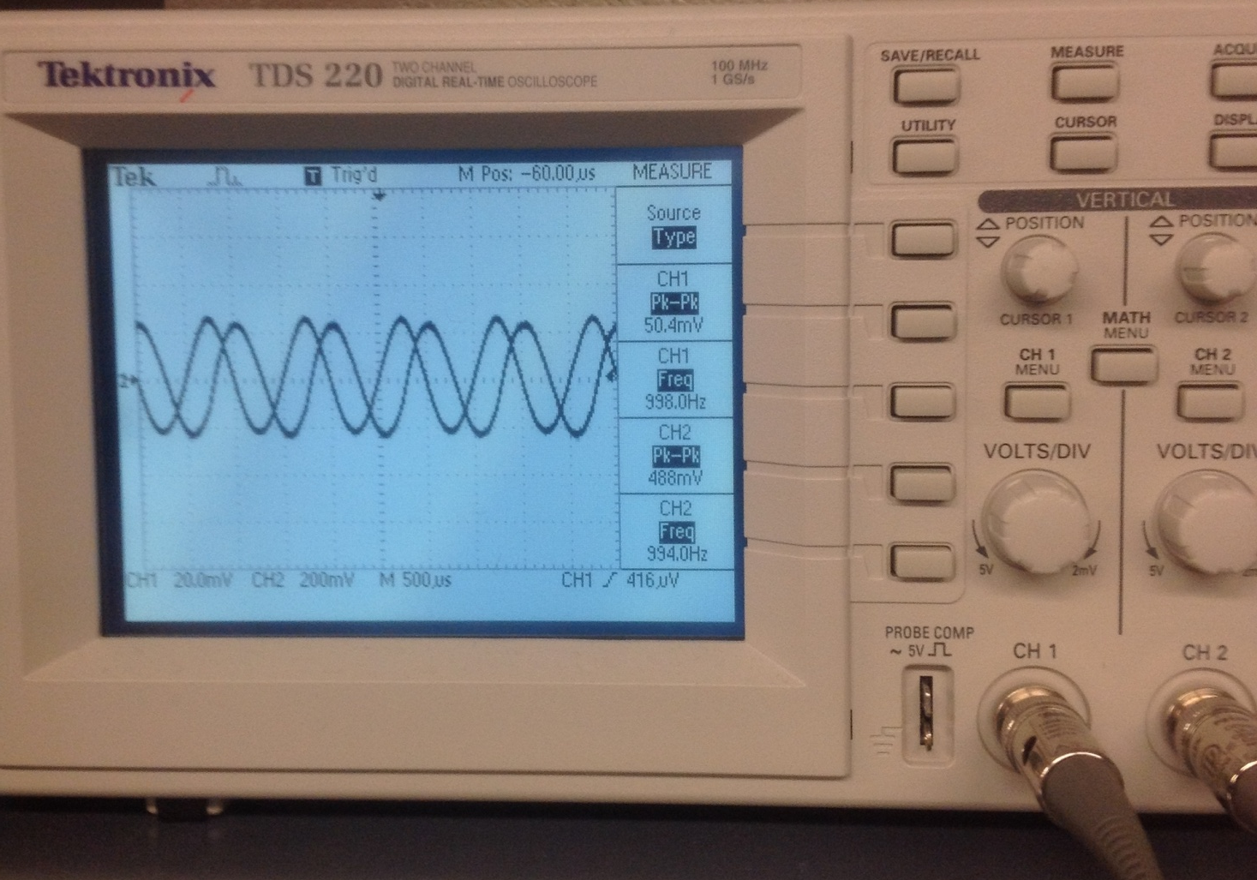
Lab Results:
Oscilloscope read out showing the input and output waves.
Conclusion:
An amplifier with a gain of 10 which is controlled by current was built.

Slide 32
Lab 7:
JFET LED Switch

Slide 33
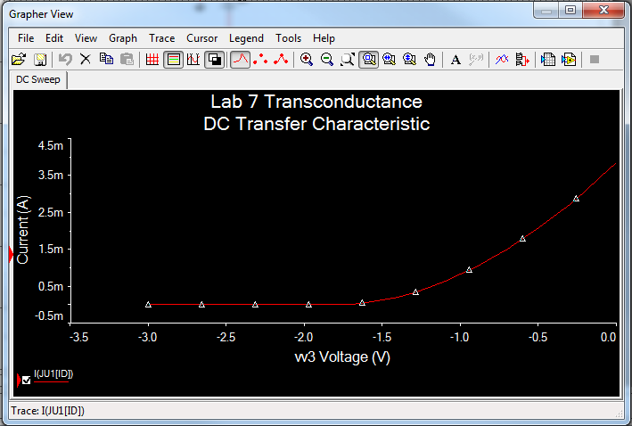
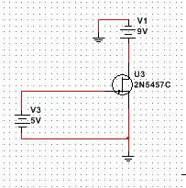
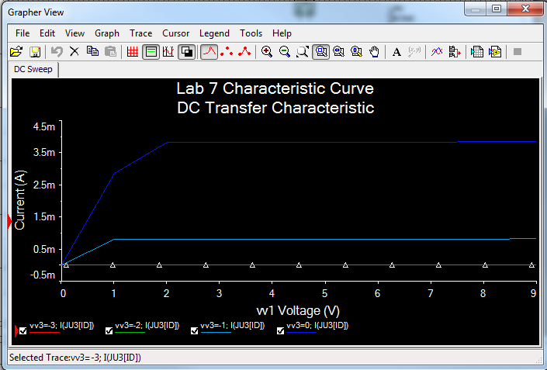
Equipment Used:
Objectives:
Build circuit that can turn on and off an LED using a JFET transistor.
Bench 6
Oscilloscope
Function Generator
Lab Results:
A 2N5457 did not exist in the multisim data base so one had to be created. I looked online and found a few spice models for the part at: http://www.diyaudio.com/forums/solid-state/230743-pspice-2n5457.html
I then ran simulations for the model and compared the models transconductance and charteristic curves to the curves found in the data sheet for the part.
Circuit used to test the spice models

Slide 34



Lab Results:
Circuit with the LED on.
Circuit with the LED off.
Schematic used to build circuit.
Conclusion:
A JFET can be used a voltage controlled switch.

Slide 35
Lab 8:
JFET Transistor Amplifier

Slide 36


Equipment Used:
Objectives:
Build circuit using a JFET transistor that amplifies an input signal by 20dB.
Bench 6
Oscilloscope
Function Generator
Lab Results:
Schematic used to build circuit.
Oscilloscope output showing the input and output waves

Slide 37
Conclusion:
An amplifier with a gain of 10 which is controlled by current was built.

Slide 38
Lab 9:
Filters

Slide 39


Equipment Used:
Objectives:
Build filter circuits using op amps. The filters that will be designed are a low pass, high pass, band pass, and notch filters
Bench 5
Oscilloscope
Function Generator
Multichannel DC power suply
Lab Results:
Low Pass
A0= | 1
a1= | 1.3617
b1= | 0.618 |  | 37.3E-18
C1= | 22.0E-9 |  | F
C2= | 29.3E-9 | 30.0E-9 | F
R1= | 5.7E+3 |  | Ω
R2= | 4.2E+3 |  | Ω
Fc= | 1000 |  | Hz
Simulation showing the frequency response of the circuit.
Math used to simulate a low pass filter with a corner frequency of 1kHz.
Circuit design for a low pass filter.

Slide 40







Lab Results:
C1
C2
R2
LM741
R1
Oscilloscope readings showing the output voltage (bottom wave) decreasing when the frequency is increased.
Low pass filter circuit

Slide 41



Lab Results:
High Pass
A0= | 1
a1= | 1.3617
b1= | 0.618
C1= | 22.0E-9 | F
C2= | 22.0E-9 | F
R1= | 10.6E+3 | Ω
R2= | 8.0E+3 | Ω
Fc= | 1000 | Hz
Simulation showing the frequency response of the circuit.
Math used to simulate a high pass filter with a corner frequency of 1kHz.
Circuit design for a high pass filter.
R2
C1
LM741
C2
R1

Slide 42




Lab Results:
Oscilloscope readings showing the output voltage (bottom wave) decreasing when the frequency is decreased.

Slide 43


Lab Results:
Band Pass
Am= | -2
B= | 50.0E+0
a1= | 1.3617
b1= | 0.618
Q= | 20
C1= | 100.0E-9 | F
R1= | 15.9E+3 | Ω
R2= | 63.7E+3 | Ω
R3= | 39.9E+0 | Ω
Fc= | 1000 | Hz
Math used to simulate a band pass filter with a mid-frequency of 1kHz.
Circuit design for a band pass filter.
Simulation showing the frequency response of the circuit and the band width.

Slide 44


Lab Results:
Notch Filter
A0= | 3.01
G= | 3.01
a1= | 1.3617
b1= | 0.618
Q= | 100
C1= | 100.0E-9 | F
R= | 1.6E+3 | Ω
R/2= | 795.8E+0 | Ω
R1= | 63.7E+3 | Ω
R2= | 128.0E+3 | Hz
Fc= | 1000 | Hz
Math used to simulate a notch filter with a mid-frequency of 1kHz.
Simulation showing the frequency response of the circuit.
Circuit design for a notch filter.
Conclusion:
All of the filters were successfully simulated and the high pass and low pass filters were built. The op amp is a very versatile part.

