Slide 1
Lab Notebook Dakota Johnson METC143

Slide 2
Miller Indices
Date of testing:8/28 /13
Procedure:
1. Two silicon disks were broken with a hammer.
Observations: The specimen labeled 111 broke into triangles. The specimen labeled 100 broke into rectangles
Pg.1

Slide 3
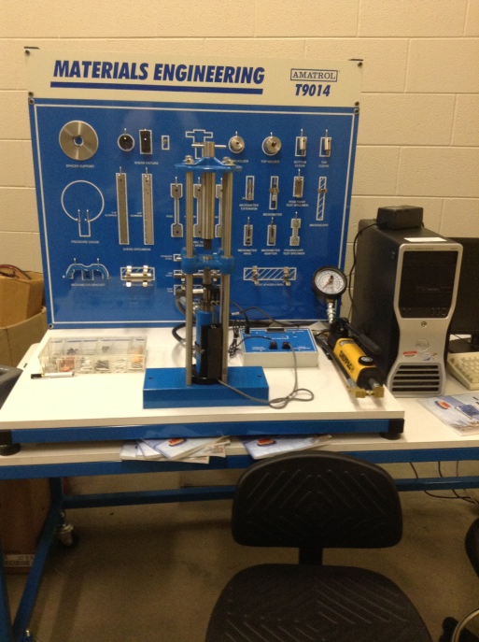
T9014
Date of testing: 9/11/13
Procedure:
1. The T9014 was looked over and the manuals were read.
Observations: Everything was in its place. Everything worked properly.
Pg.2

Slide 4
Fatigue Test
Date of testing: 9/25/13
Procedure:
The computer and testing equipment were removed from storage.
A new plug was placed onto the computer power cord.
The equipment was plugged in and connection cables were attached to the computer and test equipment.
Observations: No data was collected from this test. The incompletion of this test is believed to be due to mechanical failure on the part of the motor.
Pg.3

Slide 5
T9014 Tensile Test
Date of testing: 10/9/13
Procedure:
Aluminum and Steel specimens were tested.
The specimens were placed in the tester.
The pump had pressure built up in it and then released.
Step three was repeated until rupture.
Observations: The steel broke at a higher force than the aluminum.
Pg.4

Slide 6

T9014 Rockwell
Date of testing: 10/9/13
Procedure:
Copper, aluminum, and steel was tested.
Observations: Copper and aluminum had the same diameter circle. Steel had a smaller circle.
Copper-81
Aluminum-102
Pg.5

Slide 7
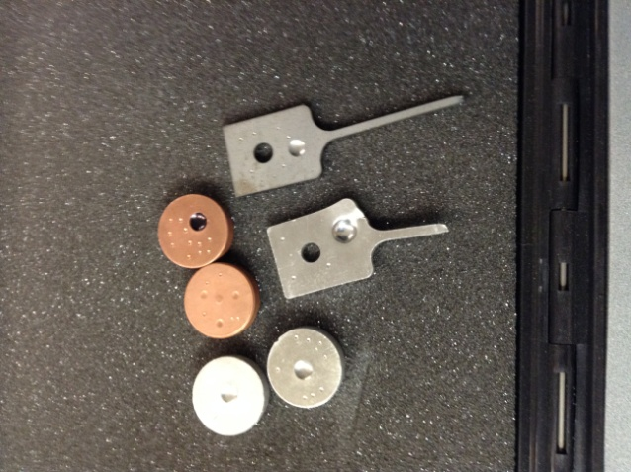
Brinnell Hardness Test
Dates of testing: 10/16/13
Procedure:
1.Copper, aluminum, and steel were tested.
Observations: Copper had the largest diameter circle. Aluminum’s was slightly smaller. Steel had the smallest diameter circle.
Pg.6

Slide 8
Brinnell Hardness Test
Observations: The following is data from the experiment
Data | Steel Flat | Aluminum Round | Aluminum Flat | Copper 1 | Copper 2 | Aluminum Flat 2 | Copper 3 | Steel Flat 2 | Aluminum Round 2 | Units
D= | 10 | 10 | 10 | 10 | 10 | 10 | 10 | 10 | 10 | mm
d= | 5.67 | 6.1 | 6.54 | 6.81 | 6.69 | outside measureable range | 6.44 | 5.69 | 6.1 | mm
F= | 3000 | 3000 | 3000 | 3000 | 3000 | 3000 | 3000 | 3000 | 3000 | mm
HB= | 108.34 | 91.99 | 78.43 | 71.34 | 74.39 | No Measure | 81.27 | 107.49 | 91.99 | Brinnell Hardness
Pg.7

Slide 9
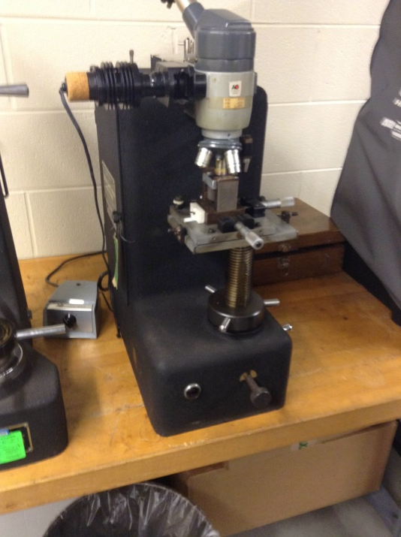
Vickers Hardness Test
Dates of testing: 10/16/13
Procedure:
1.The Vickers sample was put into the Vickers tester.
2.The Vickers sample had a load applied.
3. The sample was examined under a microscope
Observations: The Vickers test is a very unobtrusive way to do a hardness test.
Pg.8

Slide 10
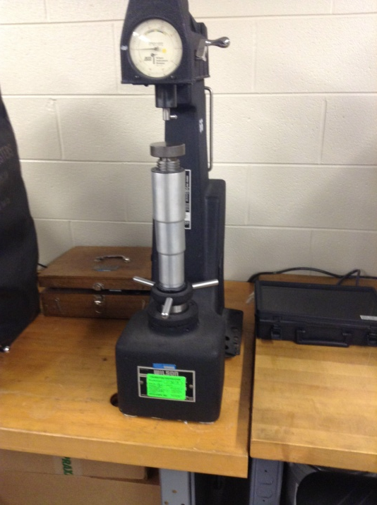
Mechanical Rockwell Hardness Test
Dates of testing: 10/16/13
Procedure:
1. A B scale at 100kg with a 1/16”diamond cone bit was conducted
2. An E scale test with an 1/8” ball was conducted.
Observations:
E scale: Copper-90
Aluminum-79
Steel-70
B scale: Steel- 68,70
Copper- 41,44
Aluminum-23
The scale of these test is the Rockwell E scale and Rockwell B scale respectively.
Pg.9

Slide 11
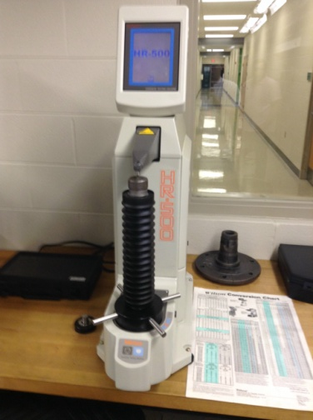
Automated Rockwell Hardness Test
Dates of testing: 10/16/13
Procedure: An A scale test at 150kg with a diamond Braille tip was conducted.
2. An E scale at 100kg with an 1/8”ball was conducted.
Observations:
A scale: Flat steel-47
Copper-35
Aluminum-31,41
E scale: Aluminum-88
Copper-88.4
Aluminum flat-70
Steel flat-99
The scale of these test is the Rockwell A scale and Rockwell E scale respectively.
Pg.10

Slide 12
Tensile Testing and Heat Treatment
Dates of testing: 11/13/13, 11/20/13, 12/4/13
Procedure:
Six steel specimens were chosen for testing.
The six specimens were measured and indented so each specimen would be measured from the same place each time.
3. Two specimens were set aside as a control group and the other four were put in a furnace for 30 minutes at 1550 degrees Fahrenheit
After the time was up the four specimens were quenched in an oil bath and then laid out for the rest of the night to cool down.
The four specimens were then heat treated again. Two were put in a furnace at 750 degrees Fahrenheit and two were put in a furnace at 650 degrees Fahrenheit.
The specimens stayed in the furnaces for 60 minutes then were removed from the furnaces and allowed air cool.
Each sample was then tensile tested with a Dillon LW tensile tester.
A specimen was attached to a micrometer.
Nuts were placed on each end of the specimen as a safety precaution and then placed into the tensile tester.
Pg.11

Slide 13
Tensile Testing and Heat Treatment
Procedure:
The test was begun by placing approximately 1500lbs of force on the specimen.
Next the micrometer scale was moved to .002 inches.
The tester then increased the distance by .002 inch increments. At each interval the force was read off of a force gauge to the nearest hundreds place and recorded. This interval was held until the micrometer read .030 inches.
At .030 inches the interval was increased to .005 inch increments. At each interval the force was read off of a force gauge to the nearest hundreds place and recorded. This interval was held until the micrometer read .050 inches.
At .050 inches the interval was increased to .010 inch increments. At each interval the force was read off of a force gauge to the nearest hundreds place and recorded. This interval was held until the specimen ruptured or until the force gauge read 12,000lbs.
A Rockwell A test was performed on all specimens.
Pg.12

Slide 14
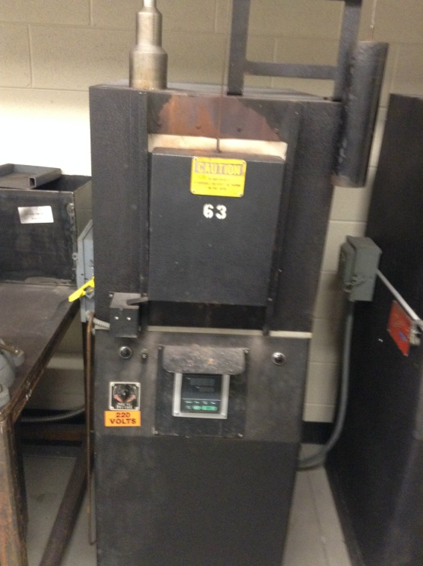
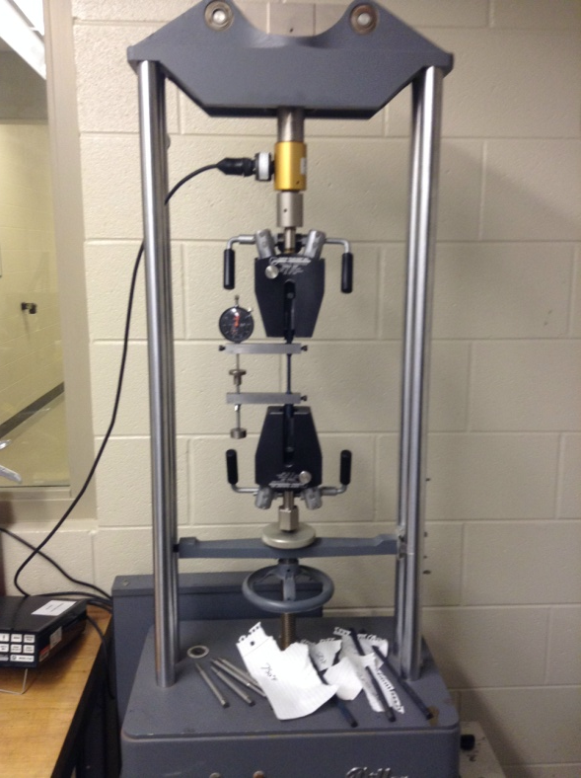
Tensile Testing and Heat Treatment
Observations: The samples that had been heat treated took more force to break than those that did not have heat treatment. Also those specimens that were heat treated at a lower temperature required more force to break. In fact those low temperature treated metal required forces that were immeasurable on our equipment. The flowing graphs are stress strain curves of the samples from this experiment.
Pg.13

Slide 15
Deflection | Force | Strain | Stress | Area | Initial Length
0.002 | 1400 | 0.001 | 28571 | 0.049 | 2.125
0.004 | 1900 | 0.002 | 38776
0.006 | 2200 | 0.003 | 44898
0.008 | 2500 | 0.004 | 51020
0.01 | 2700 | 0.005 | 55102
0.012 | 2900 | 0.006 | 59184
0.014 | 3000 | 0.007 | 61224
0.016 | 3100 | 0.008 | 63265
0.018 | 3200 | 0.008 | 65306
0.02 | 3000 | 0.009 | 61224
0.022 | 3000 | 0.010 | 61224
0.024 | 3000 | 0.011 | 61224
0.026 | 3000 | 0.012 | 61224
0.028 | 3400 | 0.013 | 69388
0.03 | 3400 | 0.014 | 69388
0.035 | 3500 | 0.016 | 71429
0.04 | 3500 | 0.019 | 71429
0.045 | 3500 | 0.021 | 71429
0.05 | 3500 | 0.024 | 71429
0.06 | 3500 | 0.028 | 71429
0.07 | 3500 | 0.033 | 71429
0.08 | 3500 | 0.038 | 71429
0.09 | 3500 | 0.042 | 71429
0.1 | 3400 | 0.047 | 69388
0.11 | 3400 | 0.052 | 69388
0.12 | 3300 | 0.056 | 67347
0.13 | 3300 | 0.061 | 67347
0.14 | 3300 | 0.066 | 67347
0.15 | 3200 | 0.071 | 65306
0.16 | 3200 | 0.075 | 65306
0.17 | 3100 | 0.080 | 63265
0.18 | 3000 | 0.085 | 61224
0.19 | 2800 | 0.089 | 57143
0.2 | 2600 | 0.094 | 53061
0.21 | 2500 | 0.099 | 51020
0.22 | 2370 | 0.104 | 48367 | Fracture
Tensile Testing and Heat Treatment
Specimen#1- Steel 4140 No Heat Treatment
Above: A stress strain curve for specimen #1.
The y axis units are in psi.
Left: The data collected from specimen #1.
Pg.14

Slide 16
Deflection | Force | strain | Stress | Area | Initial Length
0.002 | 1500 | 0.001 | 30612.2 | 0.049 | 2.125
0.004 | 2200 | 0.002 | 44898
0.006 | 4000 | 0.003 | 81632.7
0.008 | 4500 | 0.004 | 91836.7
0.01 | 4700 | 0.005 | 95918.4
0.012 | 5000 | 0.006 | 102041
0.014 | 5000 | 0.007 | 102041
0.016 | 5100 | 0.008 | 104082
0.018 | 5200 | 0.008 | 106122
0.02 | 5300 | 0.009 | 108163
0.022 | 5400 | 0.010 | 110204
0.024 | 5500 | 0.011 | 112245
0.026 | 5500 | 0.012 | 112245
0.028 | 5500 | 0.013 | 112245
0.03 | 5500 | 0.014 | 112245
0.035 | 5500 | 0.016 | 112245
0.04 | 5600 | 0.019 | 114286
0.045 | 5700 | 0.021 | 116327
0.05 | 5600 | 0.024 | 114286
0.06 | 5600 | 0.028 | 114286
0.07 | 5600 | 0.033 | 114286
0.08 | 5600 | 0.038 | 114286
0.09 | 5600 | 0.042 | 114286
0.1 | 5600 | 0.047 | 114286
0.11 | 5500 | 0.052 | 112245
0.12 | 5500 | 0.056 | 112245
0.13 | 5500 | 0.061 | 112245
0.14 | 5400 | 0.066 | 110204
0.15 | 5400 | 0.071 | 110204
0.16 | 5400 | 0.075 | 110204
0.17 | 5300 | 0.080 | 108163
0.18 | 5300 | 0.085 | 108163
Tensile Testing and Heat Treatment
Specimen#2- Steel 4140 No Heat Treatment
Above: A stress strain curve for specimen #2.
The y axis units are in psi.
Left: The data collected from specimen #2.
More data on next page
Pg.15

Slide 17
Deflection | Force | strain | Stress | Area | Initial Length
 |  |  |  | 0.049 | 2.125
0.19 | 5300 | 0.089 | 108163
0.2 | 5300 | 0.094 | 108163
0.21 | 5300 | 0.099 | 108163
0.22 | 5300 | 0.104 | 108163
0.24 | 5300 | 0.113 | 108163
0.25 | 5300 | 0.118 | 108163
0.26 | 5300 | 0.122 | 108163
0.27 | 5300 | 0.127 | 108163
0.28 | 5200 | 0.132 | 106122
0.29 | 5200 | 0.136 | 106122
0.3 | 5100 | 0.141 | 104082
0.31 | 5100 | 0.146 | 104082
0.32 | 5000 | 0.151 | 102041
0.33 | 5000 | 0.155 | 102041
0.34 | 4900 | 0.160 | 100000
0.35 | 4900 | 0.165 | 100000
0.36 | 4800 | 0.169 | 97959.2
0.37 | 4800 | 0.174 | 97959.2
0.38 | 4700 | 0.179 | 95918.4
0.39 | 4700 | 0.184 | 95918.4
0.4 | 4600 | 0.188 | 93877.6
0.41 | 4600 | 0.193 | 93877.6
0.42 | 4575 | 0.198 | 93367.3
0.43 | 4550 | 0.202 | 92857.1 | Fracture
Tensile Testing and Heat Treatment
Specimen#2- Steel 4140 No Heat Treatment
Above: A stress strain curve for specimen #2.
The y axis units are in psi.
Left: The data collected from specimen #2.
Pg.16

Slide 18
Deflection | Force | Strain | Stress | Area | Initial Length
0.002 | 1400 | 0.00097 | 28571.4 | 0.049 | 2.0625
0.004 | 4800 | 0.00194 | 97959.2
0.006 | 5700 | 0.00291 | 116327
0.008 | 6500 | 0.00388 | 132653
0.01 | 7500 | 0.00485 | 153061
0.012 | 8400 | 0.00582 | 171429
0.014 | 9400 | 0.00679 | 191837
0.016 | 10700 | 0.00776 | 218367
0.018 | 10700 | 0.00873 | 218367
0.02 | 10800 | 0.0097 | 220408
0.022 | 10900 | 0.01067 | 222449
0.024 | 11000 | 0.01164 | 224490
0.026 | 11200 | 0.01261 | 228571
0.028 | 11300 | 0.01358 | 230612
0.03 | 11600 | 0.01455 | 236735
0.035 | 11700 | 0.01697 | 238776
0.04 | 11800 | 0.01939 | 240816
0.045 | 11600 | 0.02182 | 236735
0.048 | 11700 | 0.02327 | 238776
0.05
0.052 |  |  | Steel did not fracture it topped out at 12000
0.054
Tensile Testing and Heat Treatment
Specimen#3- Steel 4140 Heat Treatment to 650F
Above: A stress strain curve for specimen #3.
The y axis units are in psi.
Left: The data collected from specimen #3.
More data on next page
Pg.17

Slide 19
Specimen #3 Steel 4140- heat treated to 650 |  |  |  | total length
Initial heat of 1550 degree F for 30 minutes |  |  |  | 10"
no noticable change in length
Hardness-73.7
Tensile Testing and Heat Treatment
Specimen#3- Steel 4140 Heat Treatment to 650F
Above: A stress strain curve for specimen #3.
The y axis units are in psi.
Left: The data collected from specimen #3.
Pg.18

Slide 20
Deflection | Force | Strain | Stress | Area | Initial Length
0.002 | 1400 | 0.00097 | 28571.4 | 0.049 | 2.0625
0.004 | 4300 | 0.00194 | 87755.1
0.006 | 5500 | 0.00291 | 112245
0.008 | 6600 | 0.00388 | 134694
0.01 | 7300 | 0.00485 | 148980
0.012 | 8000 | 0.00582 | 163265
0.014 | 8900 | 0.00679 | 181633
0.016 | 9500 | 0.00776 | 193878
0.018 | 10200 | 0.00873 | 208163
0.02 | 10200 | 0.0097 | 208163
0.022 | 10300 | 0.01067 | 210204
0.024 | 10400 | 0.01164 | 212245
0.026 | 10500 | 0.01261 | 214286
0.028 | 10600 | 0.01358 | 216327
0.03 | 10700 | 0.01455 | 218367
0.035 | 10800 | 0.01697 | 220408
0.04 | 10900 | 0.01939 | 222449
0.045 | 11000 | 0.02182 | 224490
0.05 | 11000 | 0.02424 | 224490
0.06 | 11200 | 0.02909 | 228571
0.07 | 11200 | 0.03394 | 228571
0.08 | 10700 | 0.03879 | 218367
0.09 | 10300 | 0.04364 | 210204
0.1 | 9900 | 0.04848 | 202041
0.11 | 9500 | 0.05333 | 193878
0.12 | 9000 | 0.05818 | 183673
0.13 | 8600 | 0.06303 | 175510 | fracture
Tensile Testing and Heat Treatment
Specimen#4- Steel 4140 Heat Treatment to 750F
Above: A stress strain curve for specimen #4.
The y axis units are in psi.
Left: The data collected from specimen #4.
More data on next page
Pg.19

Slide 21
Specimen #4 Steel-4140-750 heat treatment
 |  | hardness = 72.3
Tensile Testing and Heat Treatment
Specimen#4- Steel 4140 Heat Treatment to 750F
Above: A stress strain curve for specimen #4.
The y axis units are in psi.
Left: The data collected from specimen #4.
Pg.20

Slide 22
deflection | Force | strain | stress | area | initail length
0.002 | 1500 | 0.040816 | 727.2727 | 0.049 | 2.0625
0.004 | 2500 | 0.081633 | 1212.121
0.006 | 3800 | 0.122449 | 1842.424
0.008 | 4800 | 0.163265 | 2327.273
0.01 | 5700 | 0.204082 | 2763.636
0.012 | 6400 | 0.244898 | 3103.03
0.014 | 7100 | 0.285714 | 3442.424
0.016 | 8400 | 0.326531 | 4072.727
0.018 | 9100 | 0.367347 | 4412.121
0.02 | 10400 | 0.408163 | 5042.424
0.022 | 10800 | 0.44898 | 5236.364
0.024 | 10800 | 0.489796 | 5236.364
0.026 | 10800 | 0.530612 | 5236.364
0.028 | 10800 | 0.571429 | 5236.364
0.03 | 10900 | 0.612245 | 5284.848
0.035 | 11300 | 0.714286 | 5478.788
0.04 | 11500 | 0.816327 | 5575.758
0.042 | 11500 | 0.857143 | 5575.758
0.044 | 11600 | 0.897959 | 5624.242
0.046 | 11700 | 0.938776 | 5672.727
0.048 | 11800 | 0.979592 | 5721.212
0.05 | 11800 | 1.020408 | 5721.212
0.09 |  |  | steel did not fracture
Tensile Testing and Heat Treatment
Specimen#5- Steel 4140 Heat Treatment to 650F
Above: A stress strain curve for specimen #5.
The y axis units are in psi.
Left: The data collected from specimen #5.
More data on next page
Pg.21

Slide 23
steel 4140 #650 heat treated 30min 1550 degree austenazation
changed length to 2.125
hardness-73.9 60kg diamond tip rockwell A
Tensile Testing and Heat Treatment
Specimen#5- Steel 4140 Heat Treatment to 650F
Above: A stress strain curve for specimen #5.
The y axis units are in psi.
Left: The data collected from specimen #5.
Pg.22

Slide 24
deflection | force | strain | stress | area | Initial length
0.002 | 1700 | 0.00097 | 34693.88 | 0.049 | 2.0625
0.004 | 4200 | 0.001939 | 85714.29
0.006 | 5500 | 0.002909 | 112244.9
0.008 | 6500 | 0.003879 | 132653.1
0.01 | 7300 | 0.004848 | 148979.6
0.012 | 8400 | 0.005818 | 171428.6
0.014 | 9700 | 0.006788 | 197959.2
0.016 | 10300 | 0.007758 | 210204.1
0.018 | 10400 | 0.008727 | 212244.9
10400 | 10400 | 5042.424 | 212244.9
0.022 | 10400 | 0.010667 | 212244.9
0.024 | 10600 | 0.011636 | 216326.5
0.026 | 10600 | 0.012606 | 216326.5
0.028 | 10800 | 0.013576 | 220408.2
0.03 | 10700 | 0.014545 | 218367.3
0.035 | 10900 | 0.01697 | 222449
0.04 | 11000 | 0.019394 | 224489.8
0.045 | 11000 | 0.021818 | 224489.8
0.05 | 11100 | 0.024242 | 226530.6
0.06 | 11200 | 0.029091 | 228571.4
0.07 | 11200 | 0.033939 | 228571.4
0.08 | 10700 | 0.038788 | 218367.3
0.09 | 10600 | 0.043636 | 216326.5
0.1 | 10200 | 0.048485 | 208163.3
0.11 | 9800 | 0.053333 | 200000
0.12 | 9500 | 0.058182 | 193877.6
0.13 | 9000 | 0.06303 | 183673.5
0.14 | 8600 | 0.067879 | 175510.2
0.15 | 8000 | 0.072727 | 163265.3
Tensile Testing and Heat Treatment
Specimen#6- Steel 4140 Heat Treatment to 750F
Above: A stress strain curve for specimen #6.
The y axis units are in psi.
Left: The data collected from specimen #6.
Pg.23

Slide 25
steel 4140- #750 heat treated 30 minutes
hardness testing 72 | 2.1875
Tensile Testing and Heat Treatment
Specimen#6- Steel 4140 Heat Treatment to 750F
Above: A stress strain curve for specimen #6.
The y axis units are in psi.
Left: The data collected from specimen #6.
Pg.24

Slide 26
Dynamic Cantilever
Dates of testing: 12/4/13, 12/11/1388
Procedure:
A scale was set up on a board.
The materials was clamped down to the table
The materials were pushed down and let go.
The materials were filmed for 5 oscillations.
The material then had a clip put on the end. The material then was pushed and let go again.
The clips were then add one at a time until there were 5 clips.
The videos were then reviewed and the frequency was found.
Observations: The following data is from this experiment
Pg.25

Slide 27
# clips added |  | #Oscillations | #frames | Frequency=osc x fps/Frames=Hz |  |  | frames per second=
example |  |  |  |  |  |  | 60
0 |  | 5 | 180 | 1.666666667
1 |  | 5 | 120 | 2.5
2 |  | 5 | 120 | 2.5
3 |  | 5 | 180 | 1.666666667
4 |  | 5 | 300 | 1
5 |  | 5 | 300 | 1
Dynamic Cantilever
Pg.26

