Slide 1
EECT 111 – Introduction to Circuit Analysis Lab Notebook
Everett Barry, Jr.
Spring Semester
May 7, 2015

Slide 2
EECT 111 – Introduction to Circuit Analysis Lab Notebook
Interactive Table of Contents
Topics | Page Number
Lab 1 | 3-4
Lab 2 | 5-6
Lab 3 | 7-8
Lab 4 | 9-10
Lab 5 | 11-12
Lab 7 | 13-14
Lab 8 | 15-16
Lab 9 | 17-18
Lab 10 | 19-20
Lab 11 | 21-23
Lab 12 | 24-25
Closing Statements | 26
2

Slide 3
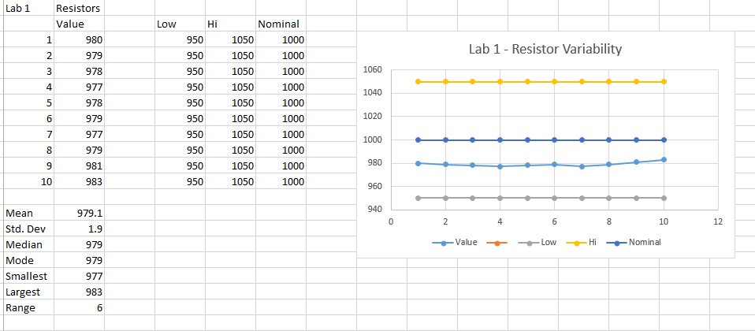
Lab 1 – Resistor Variability
The purpose of this lab was to learn how resistors vary using 10 resistors with the same color code.
Resistor color code: Brown, Black, Red, Gold
Resistor value: 1,000 ohms
Resistor tolerance: 5%
Results
Smallest resistance: 977 ohms Average Resistance: 979.1 ohms
Largest Resistance: 983 ohms Standard Deviation: 1.9 ohms
None of the resistors exceeded the part tolerance.

Slide 4
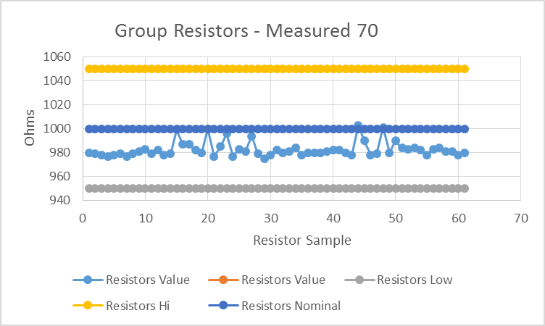
Lab 1 – Resistor Variability
The complete set of resistor values for the entire class with 70 resistors.
Smallest resistance: 977 ohms
Largest resistance: 1003 ohms
Average Resistance: 979.1 ohms
Standard Deviation: 5.9 ohms
Only two resistors exceeded the part tolerance.

Slide 5
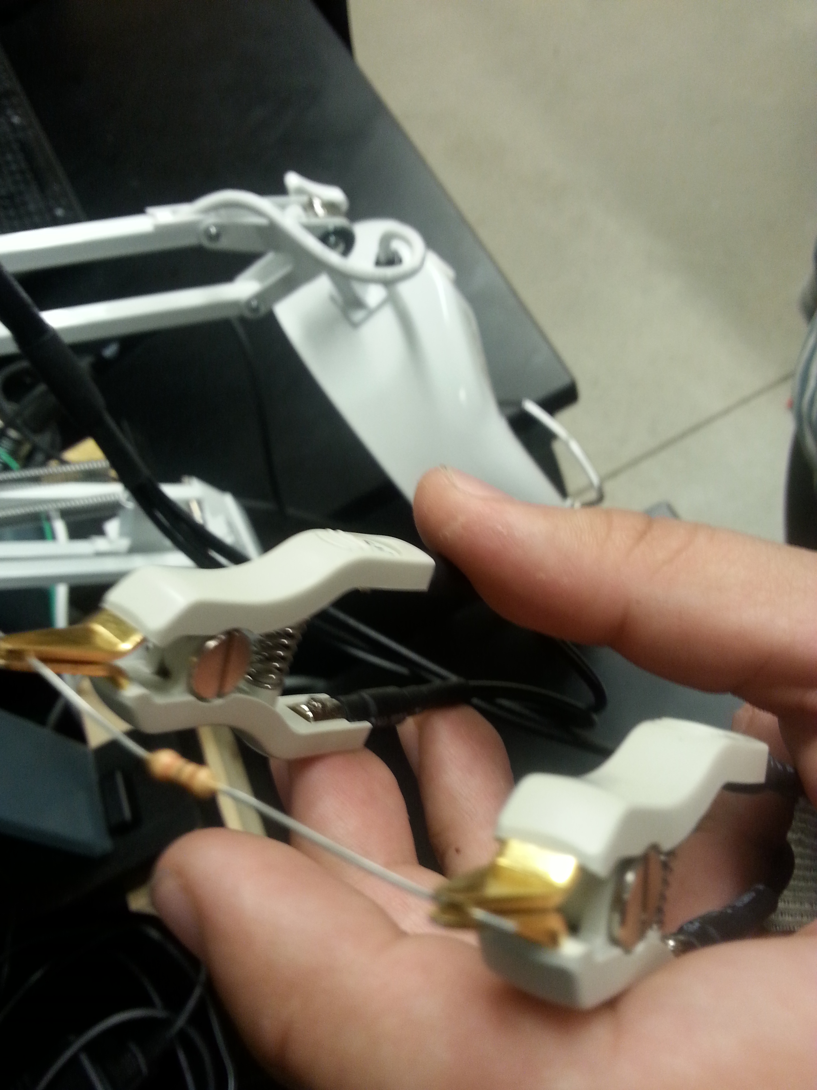
Lab 2 Reading and Sorting Resistors
The purpose of this lab is to learn the resistor color code using 15 resistors which must be sorted from smallest to largest value. Build a resistor kit that included 15 resistors based on color code from smallest to largest and measure the resistance of each resistor and verify sorting.

Slide 6
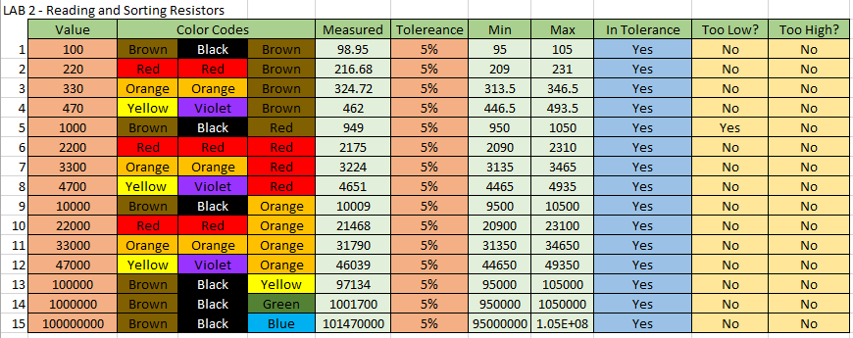
Lab 2 Reading and Sorting Resistors
Results: Every resistor was not exact but close enough to the expected value. The 1M ohm and 10M ohm resistor was measured over the expected value, but yet was still in tolerance range.

Slide 7
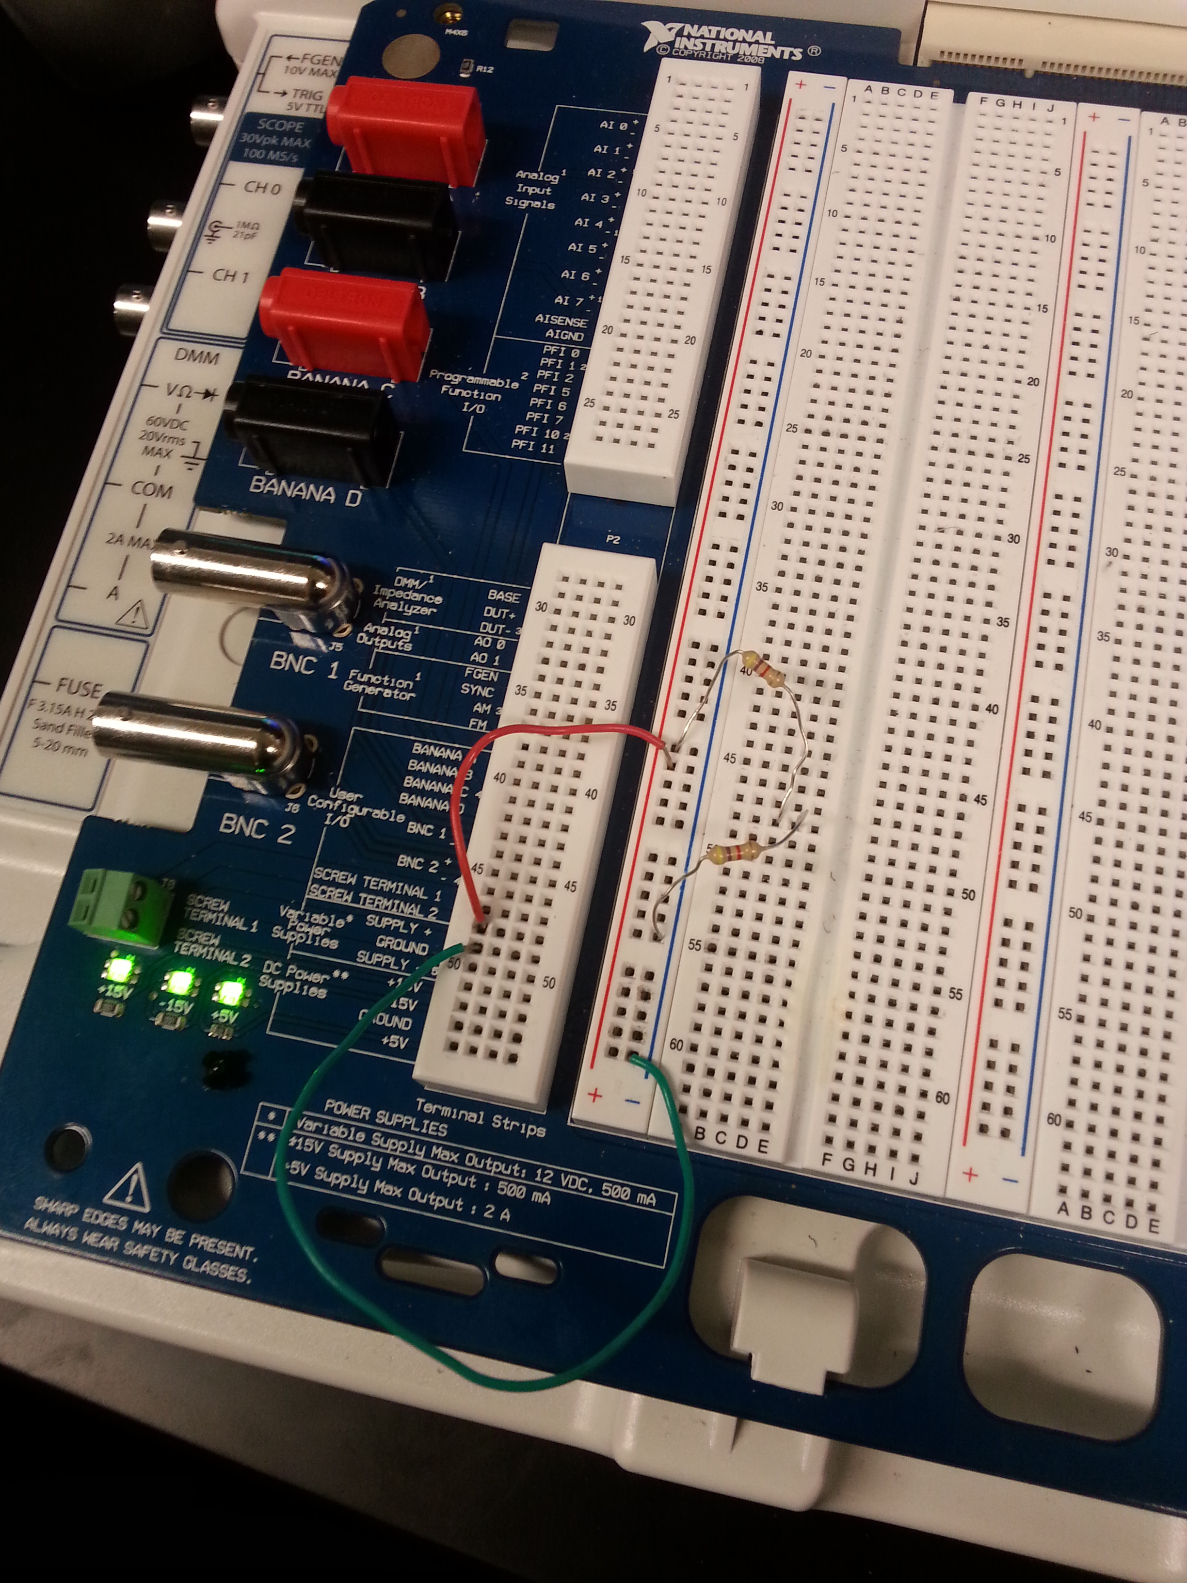
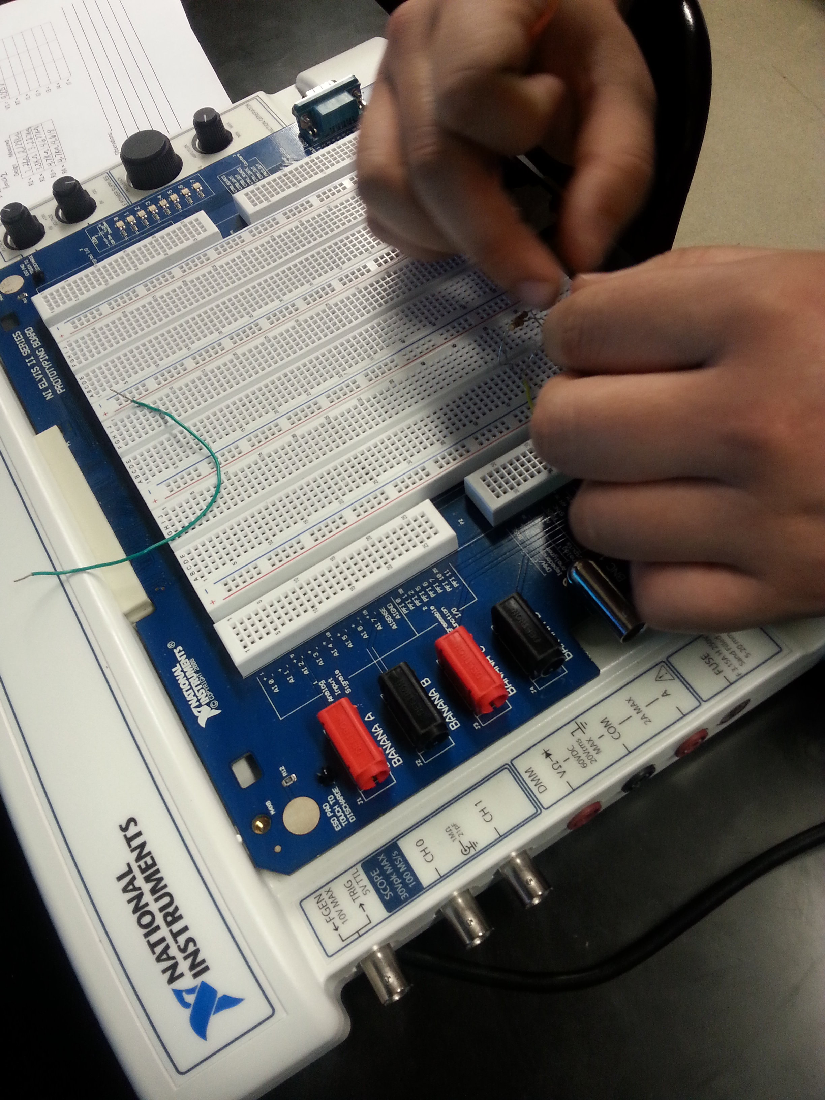
Lab 3 – Series Resistors Current and Voltage
The purpose of this Lab is to experiment with series and verify that the simulation, analysis calculation and measured test results all agree.

Slide 8

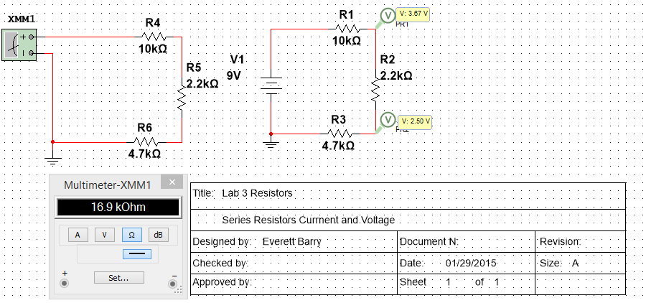
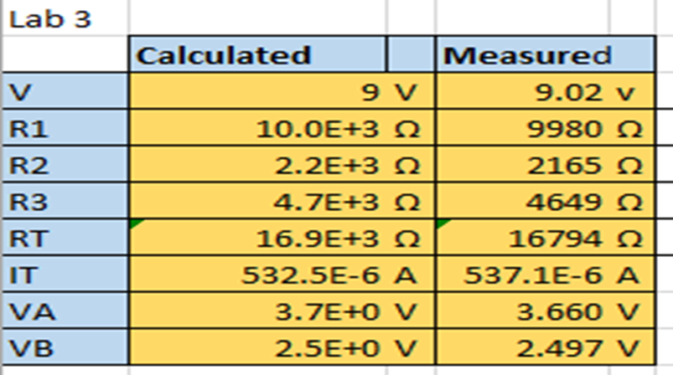
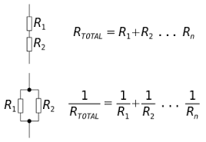
Lab 3 – Series Resistors Current and Voltage
Lab 3 Results:

Slide 9
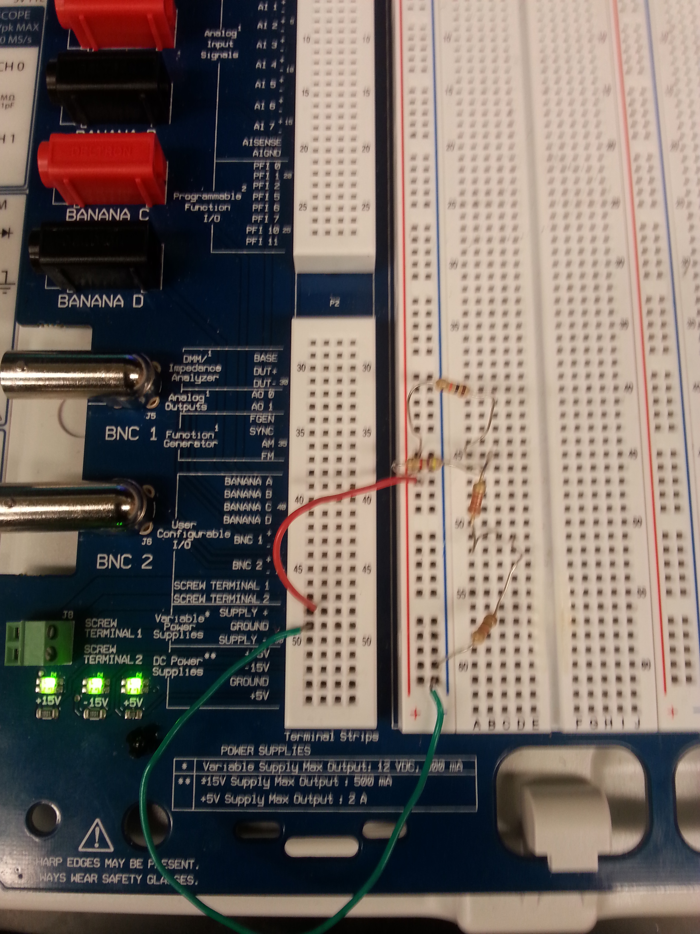
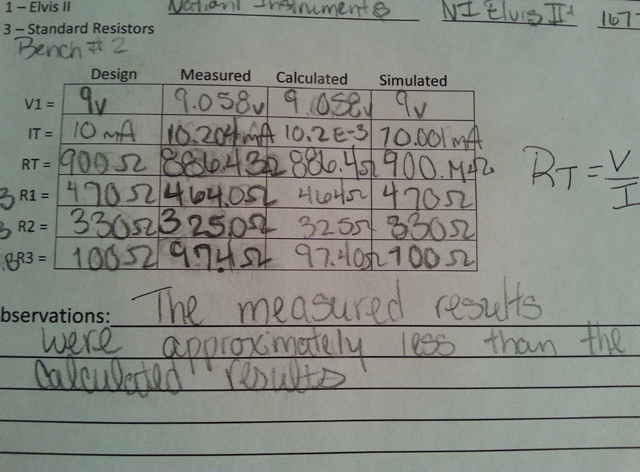
Lab 4 – Black Box Design
The purpose of this lab is to learn about series circuits. The voltage applied to a Black Box is 9V and the measured current draw is 10 mA. Design a 3 resistor series circuit that meets the voltage and current requirements using “standard” resistor value.

Slide 10
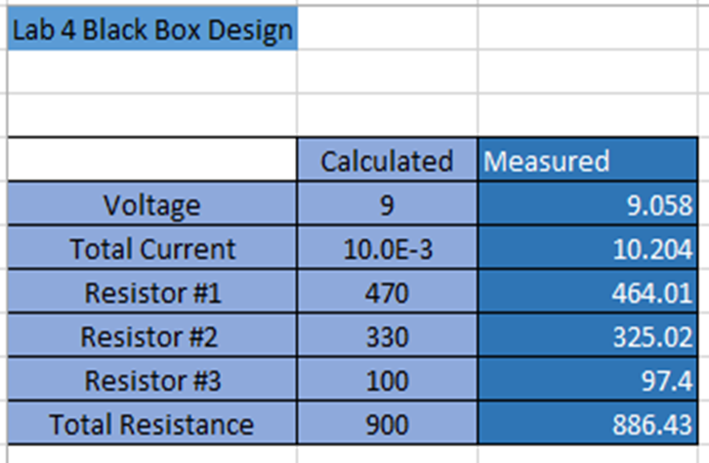
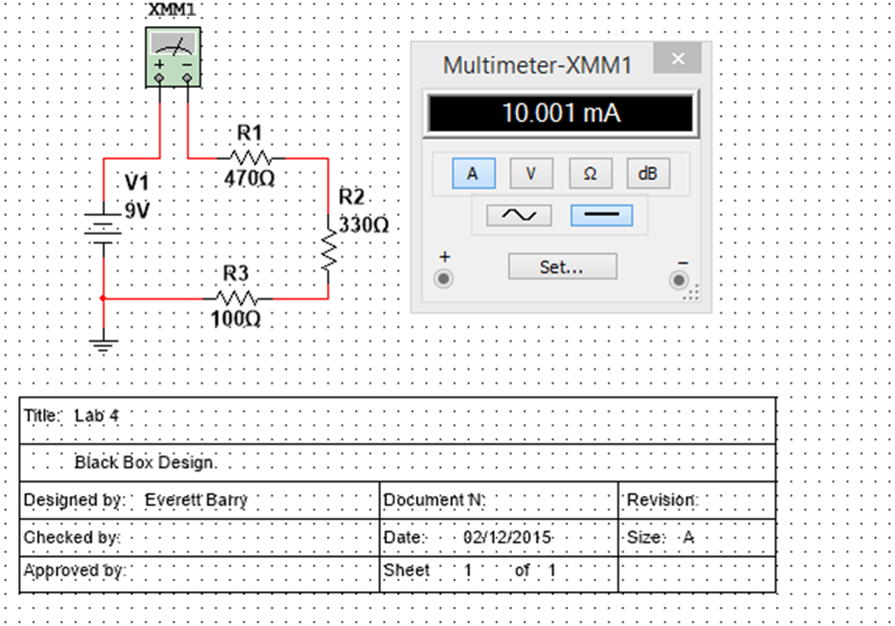
Lab 4 – Black Box Design
Lab 4 Results:

Slide 11
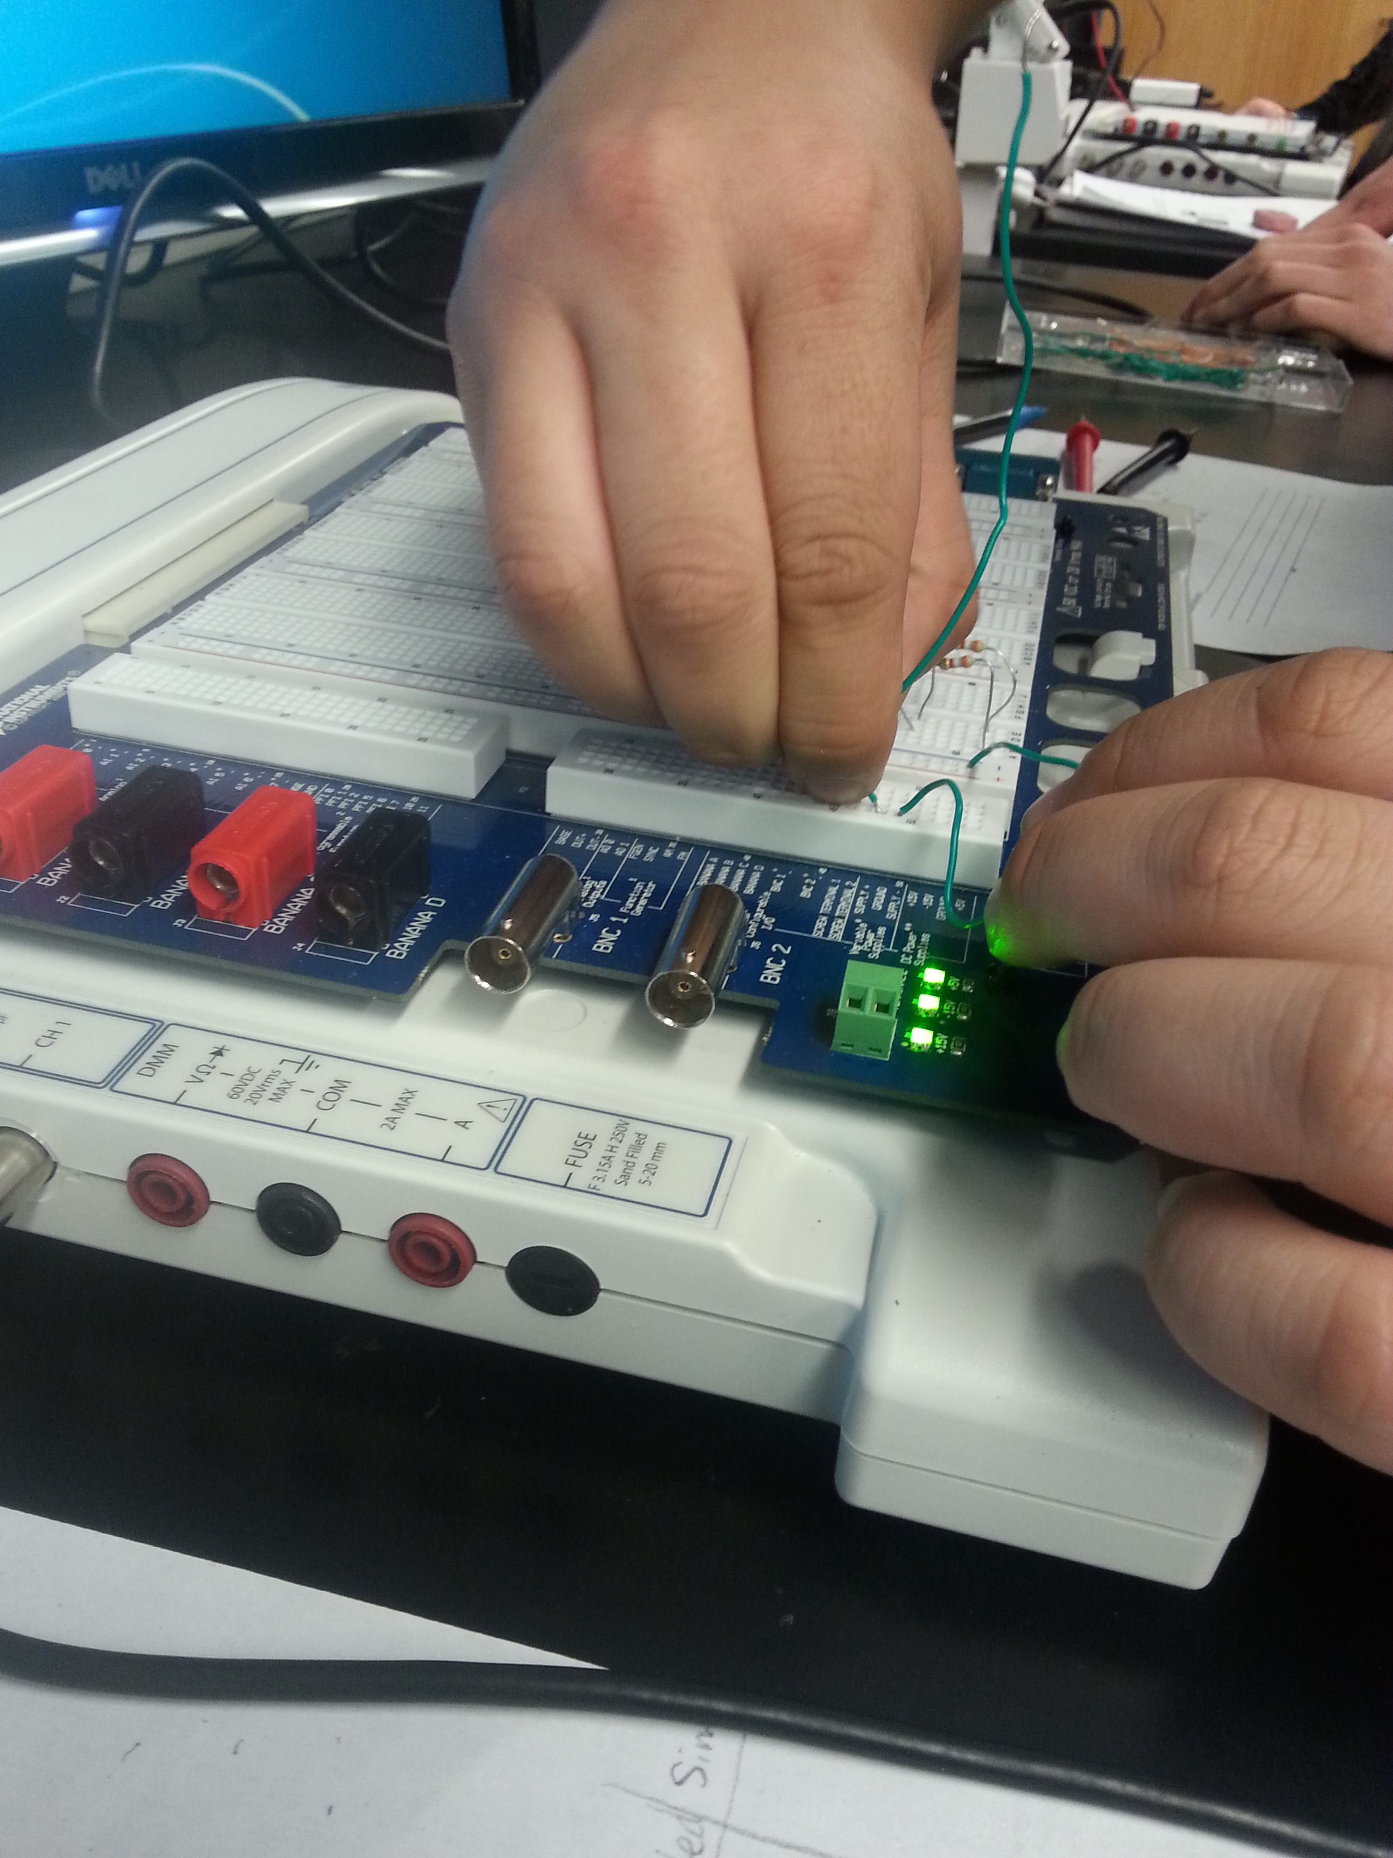
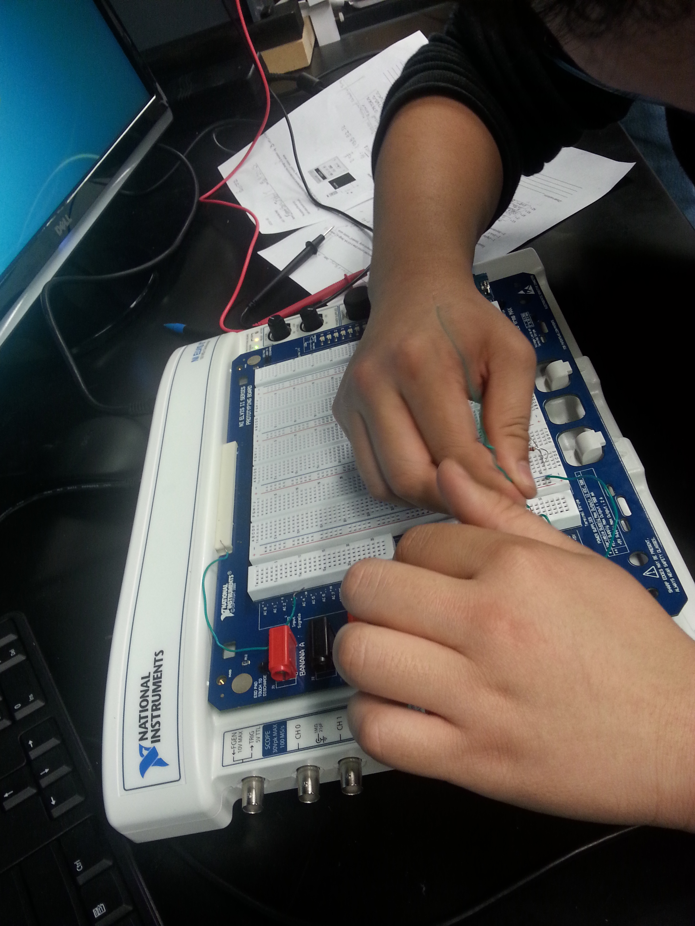
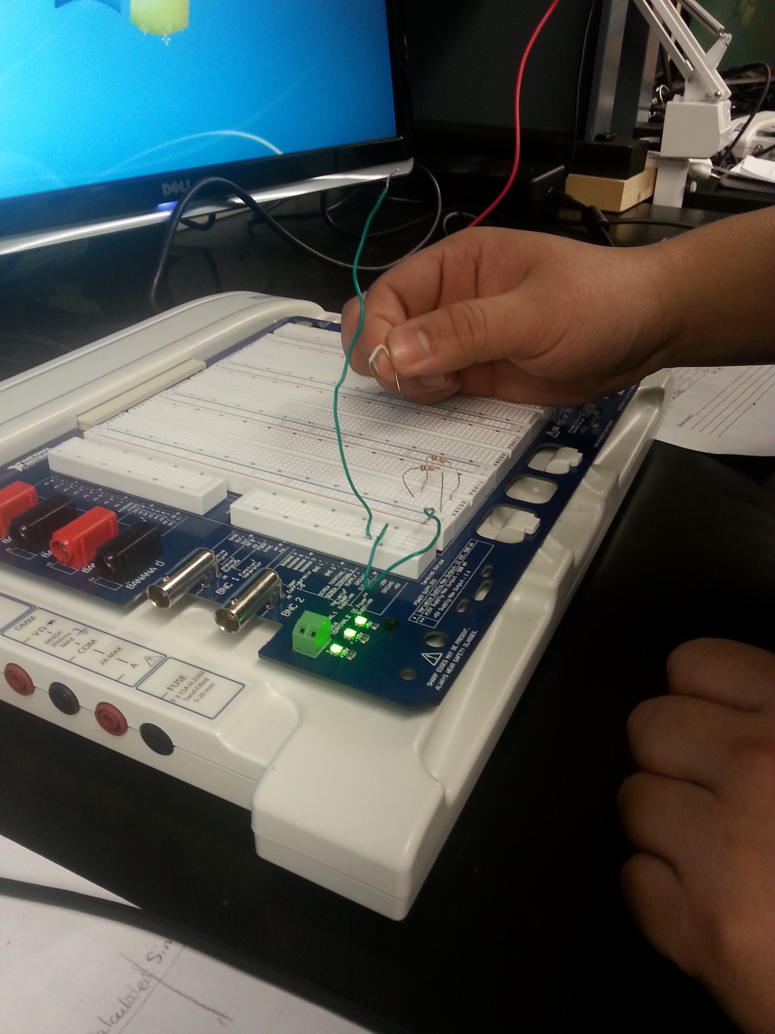
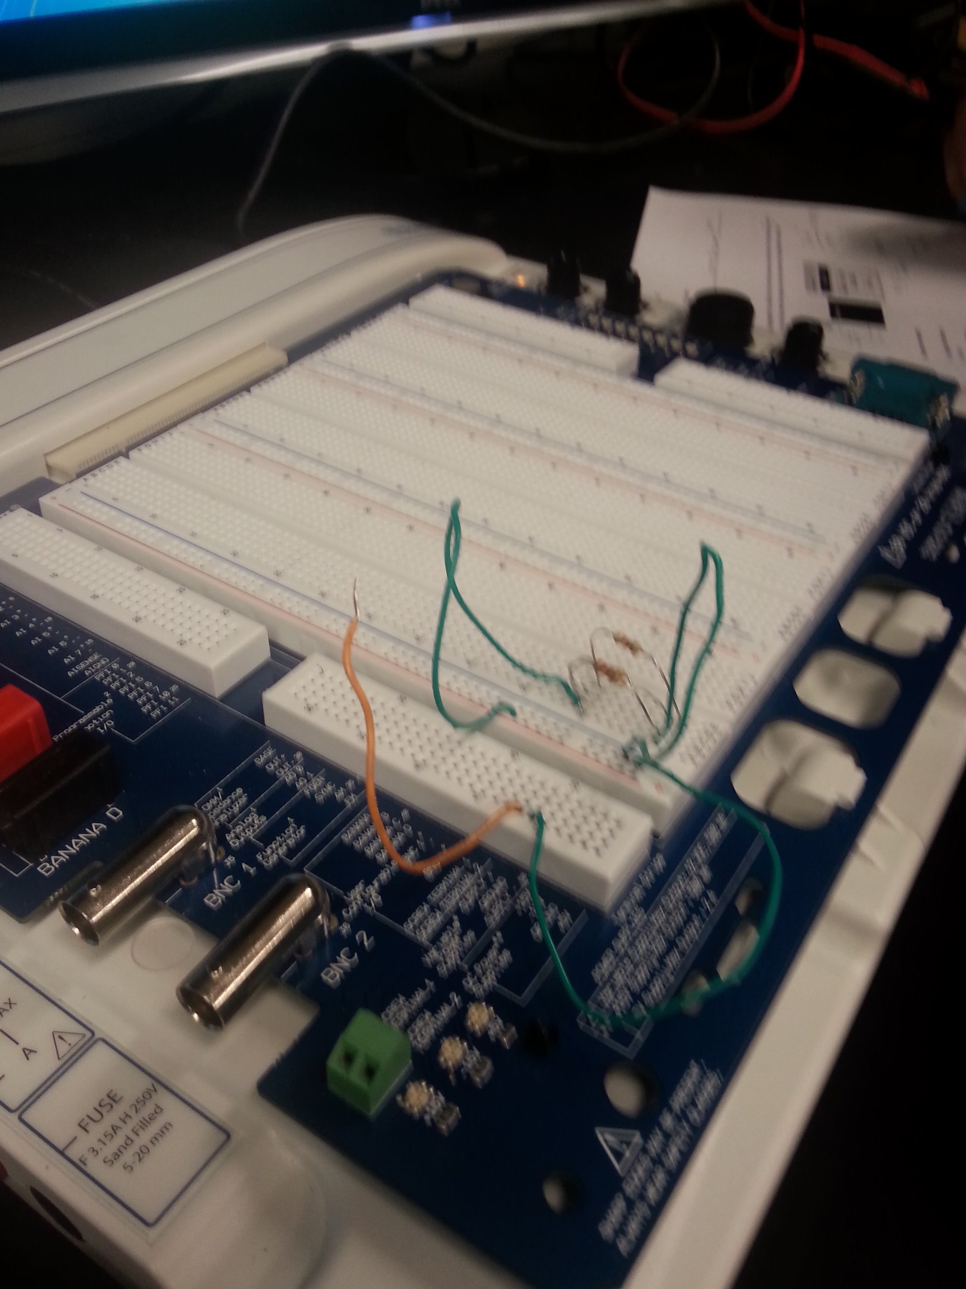
Lab 5 – Black Box Design 2
The purpose of this lab is to learn about parallel circuits. The voltage applied to a Black Box is 9 volts and the measures current dram is 4.6 mA. Design a 2 and 3 resistor parallel circuit that meets the voltage requirements using “standard values.

Slide 12

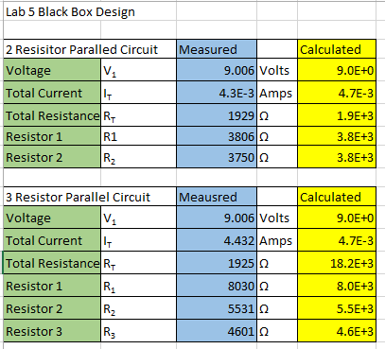
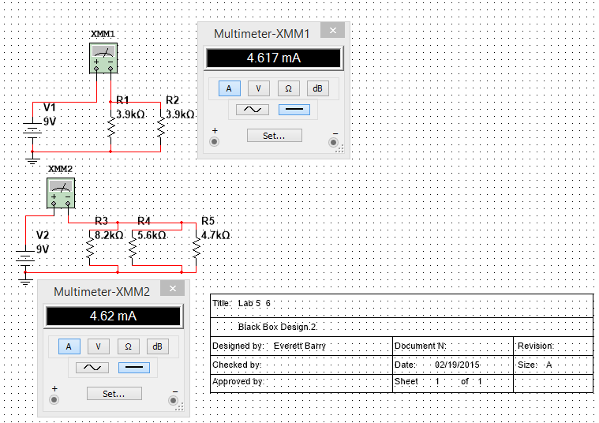
Lab 5 – Black Box Design 2
Lab 5 Results:

Slide 13
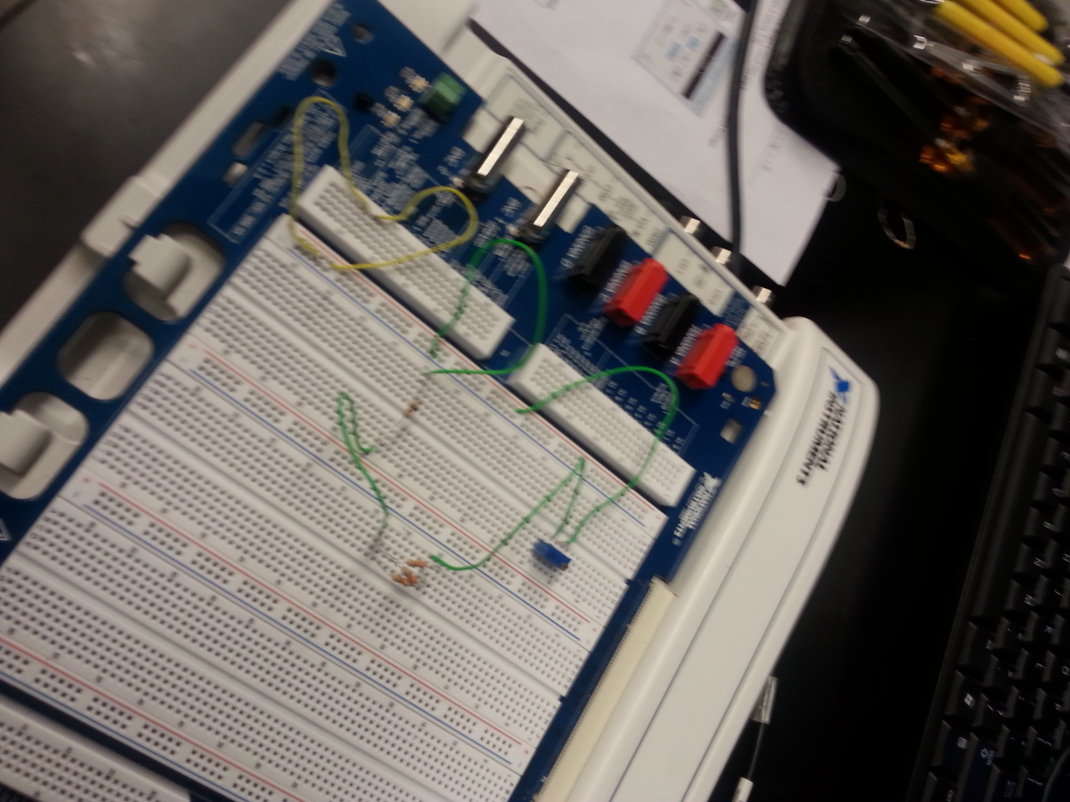
Lab 7 – Resistor Parallel Circuit
The purpose of this Lab is to learn about parallel circuits. The voltage applied to 4 parallel resistors x is 9 volts. Measure all the resistor values, total current and all the branch currents.

Slide 14
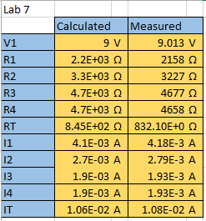
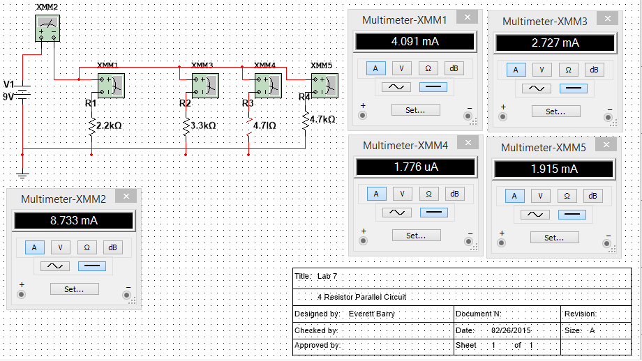
Lab 7 – Resistor Parallel Circuit
Lab 7 Results:

Slide 15
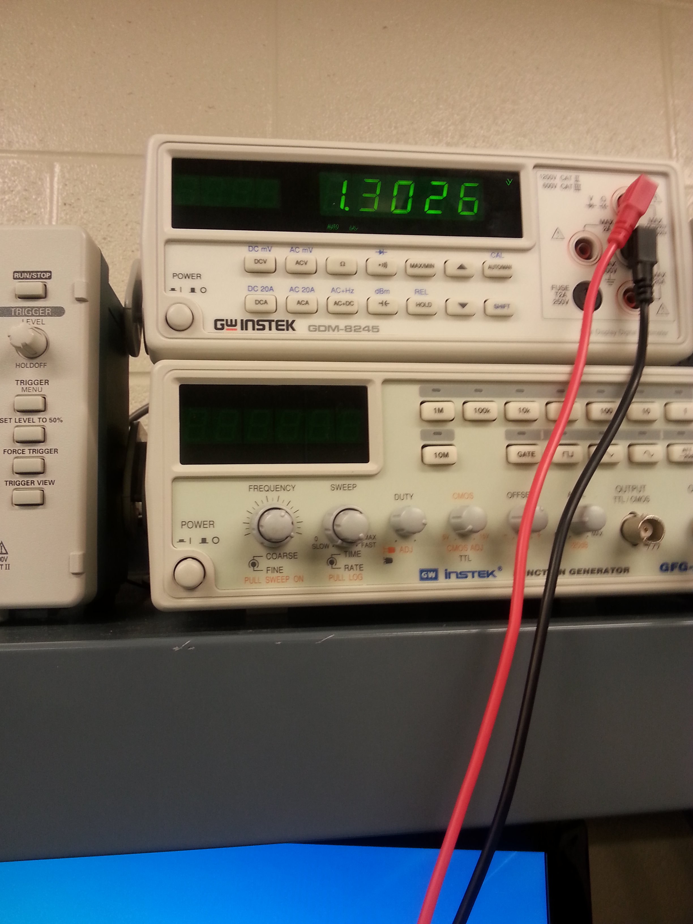
Lab 8 – Black Box 3 Design
The purpose of this lab is to learn about building a circuit the produces exactly 1.3 volts. Using at least 3 equal resistors (in the Black Box) design a circuit that produces an output voltage of 1.3 V. Then adjust R1 so that the output voltage is exactly 1.3 volts.

Slide 16
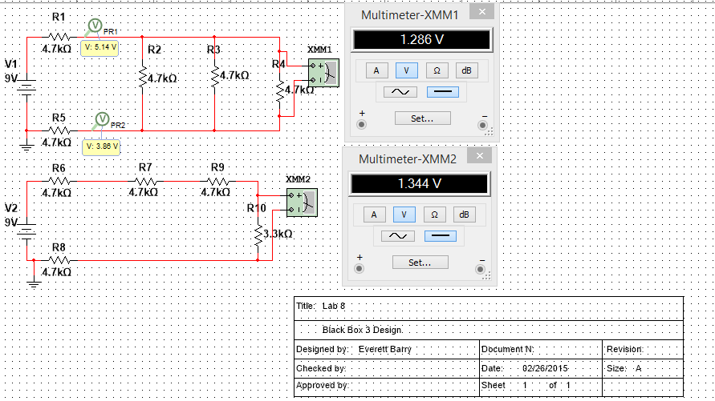
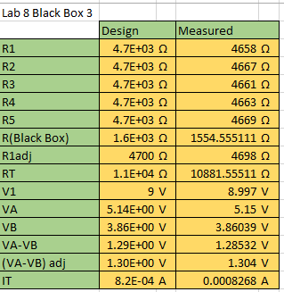
Lab 8 – Black Box 3 Design
Lab 8 Results:

Slide 17
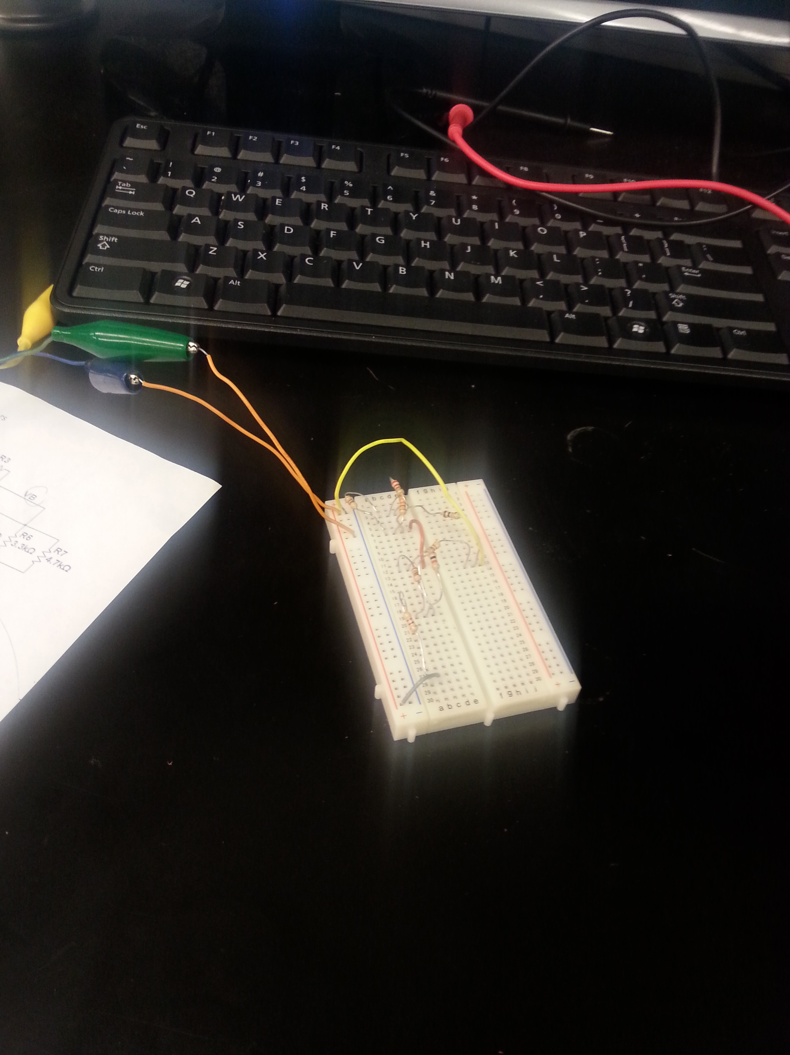
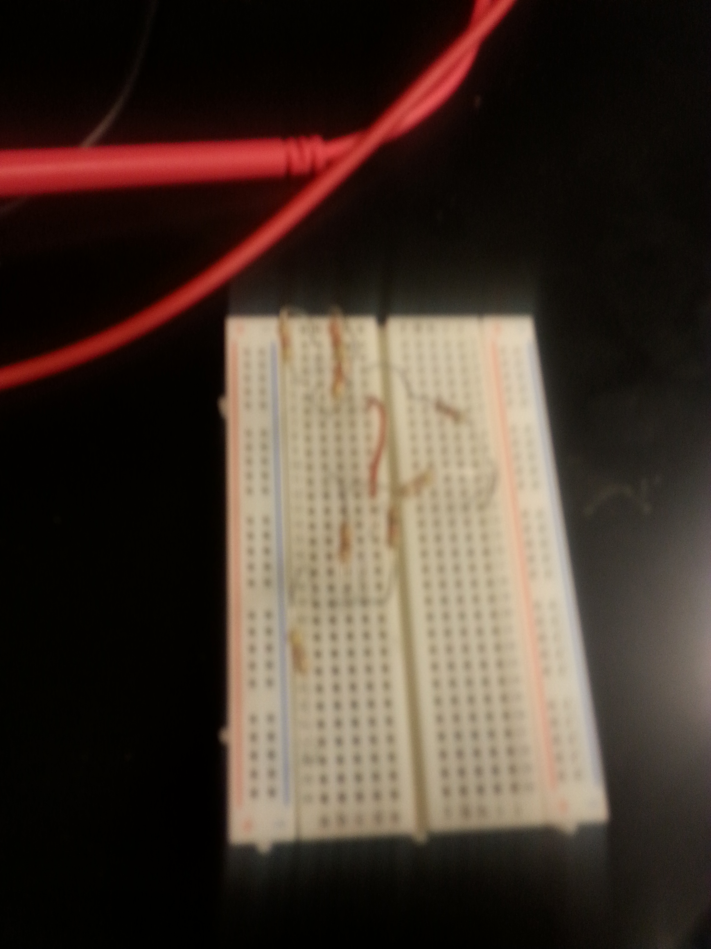
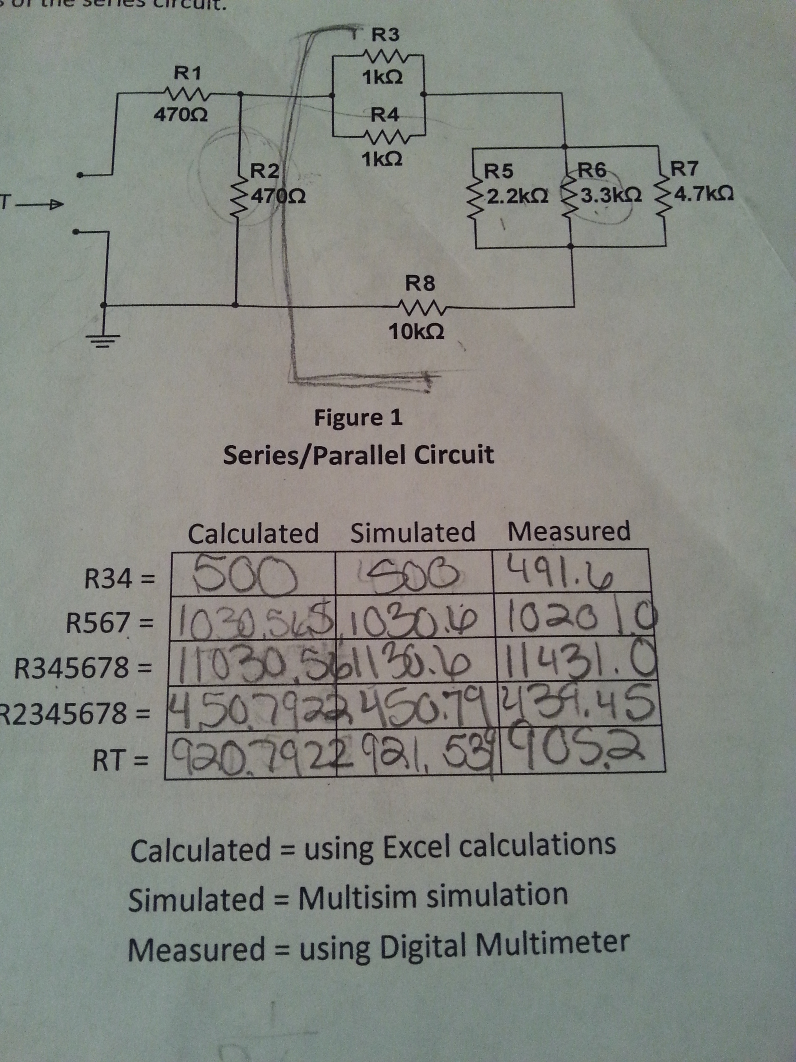
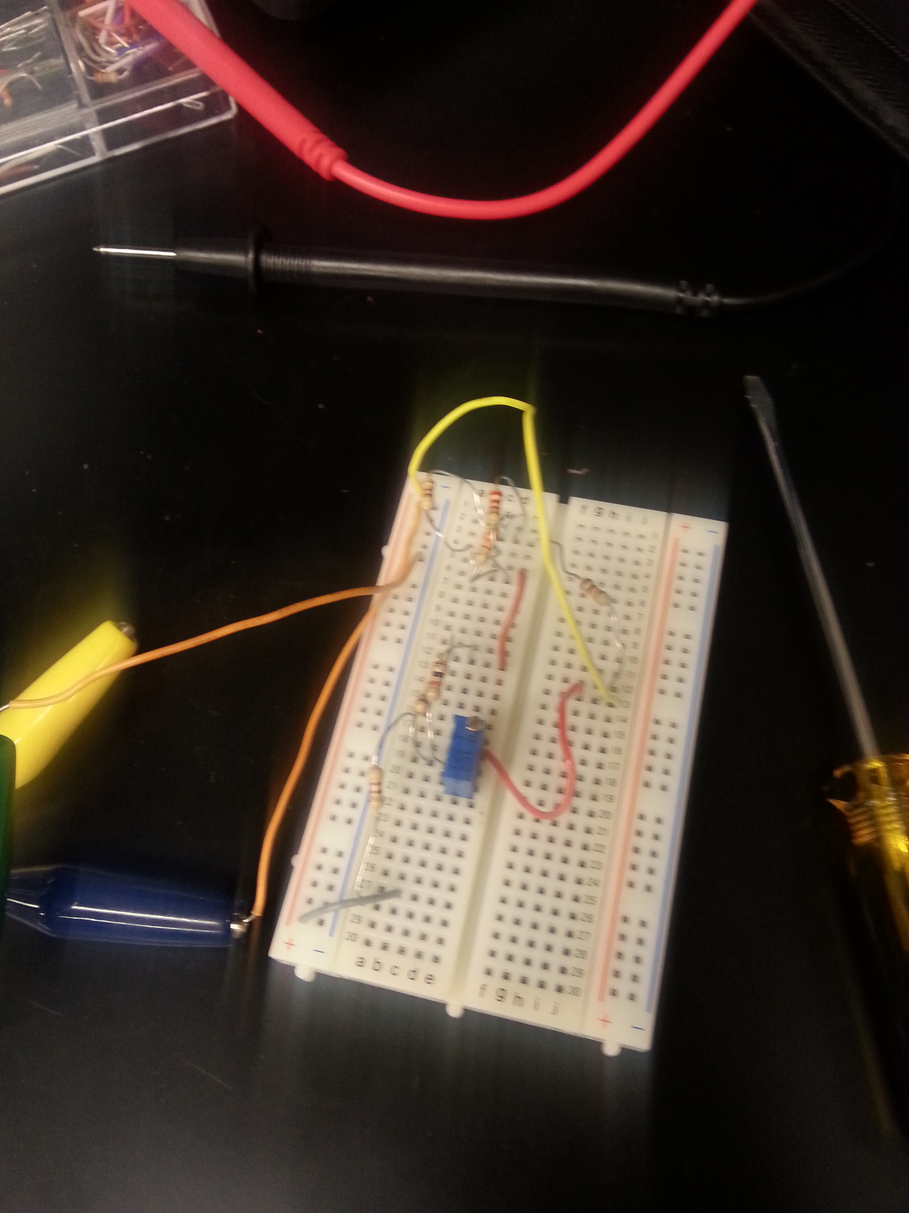
Lab 9 Series and Parallel Resistors
The Purpose of this Lab is to experiment with series circuits and verify that the simulation, analysis (calculations) and test all agree.
From the resistor kit select 8 resistors: 2 each 470 ohm, 2 each 1k ohm, and 1 each of the 2.2k ohm, 3.3k ohm, 10k ohm. Measure and record the value of each resistor. Connect the resistors as shown. Measure and record the total resistance, RT. Then connect the resistors as shown in Figure 2, the 9V come from the Elvis II. Then measure and record with the Digital Multimeter the current and voltages of the series circuit.

Slide 18
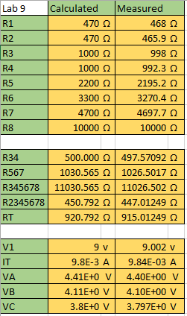
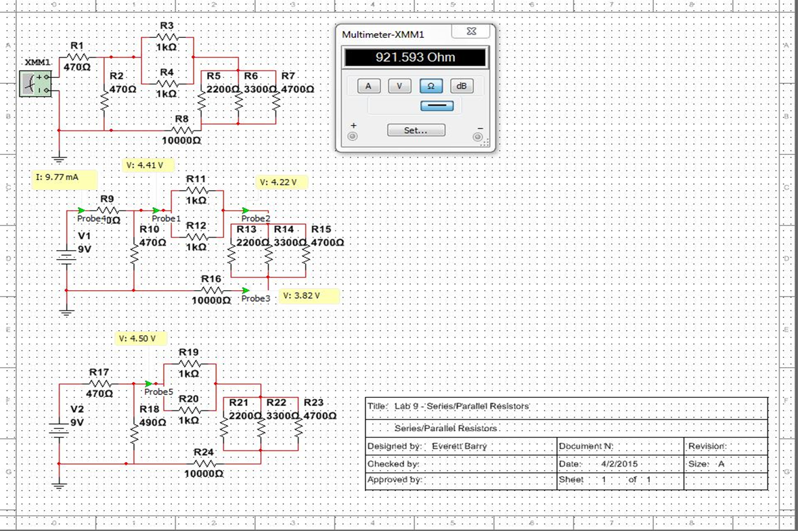
Lab 9 Series and Parallel Resistors
Lab 9 Results:

Slide 19
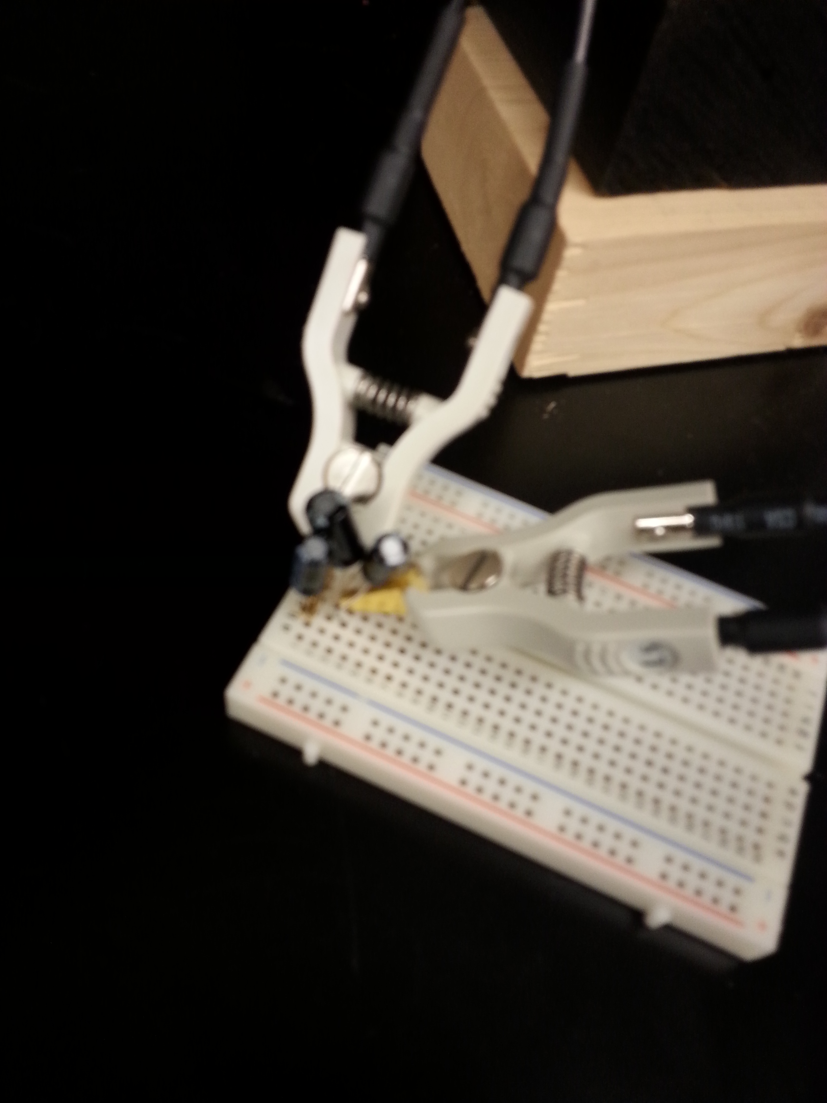
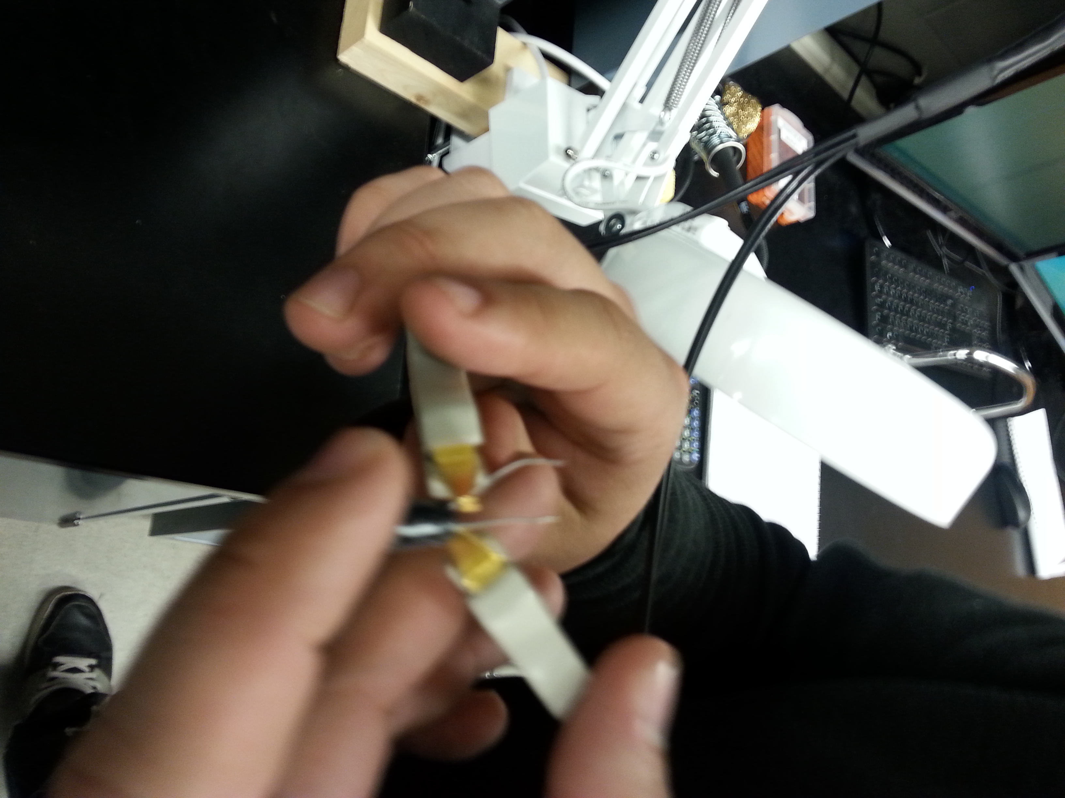
Lab 10 – Series and Parallel Capacitors
The purpose of this lab is to experiment with series circuits and parallel combinations of capacitors. Measure and record the capacitance of each capacitor using the LCR meter. Connect the capacitors as shown in Figure 1 and Figure 2. Measure and record the total capacitance.

Slide 20
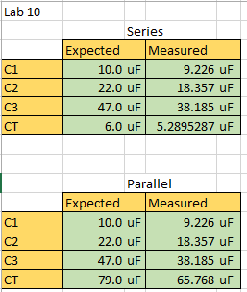
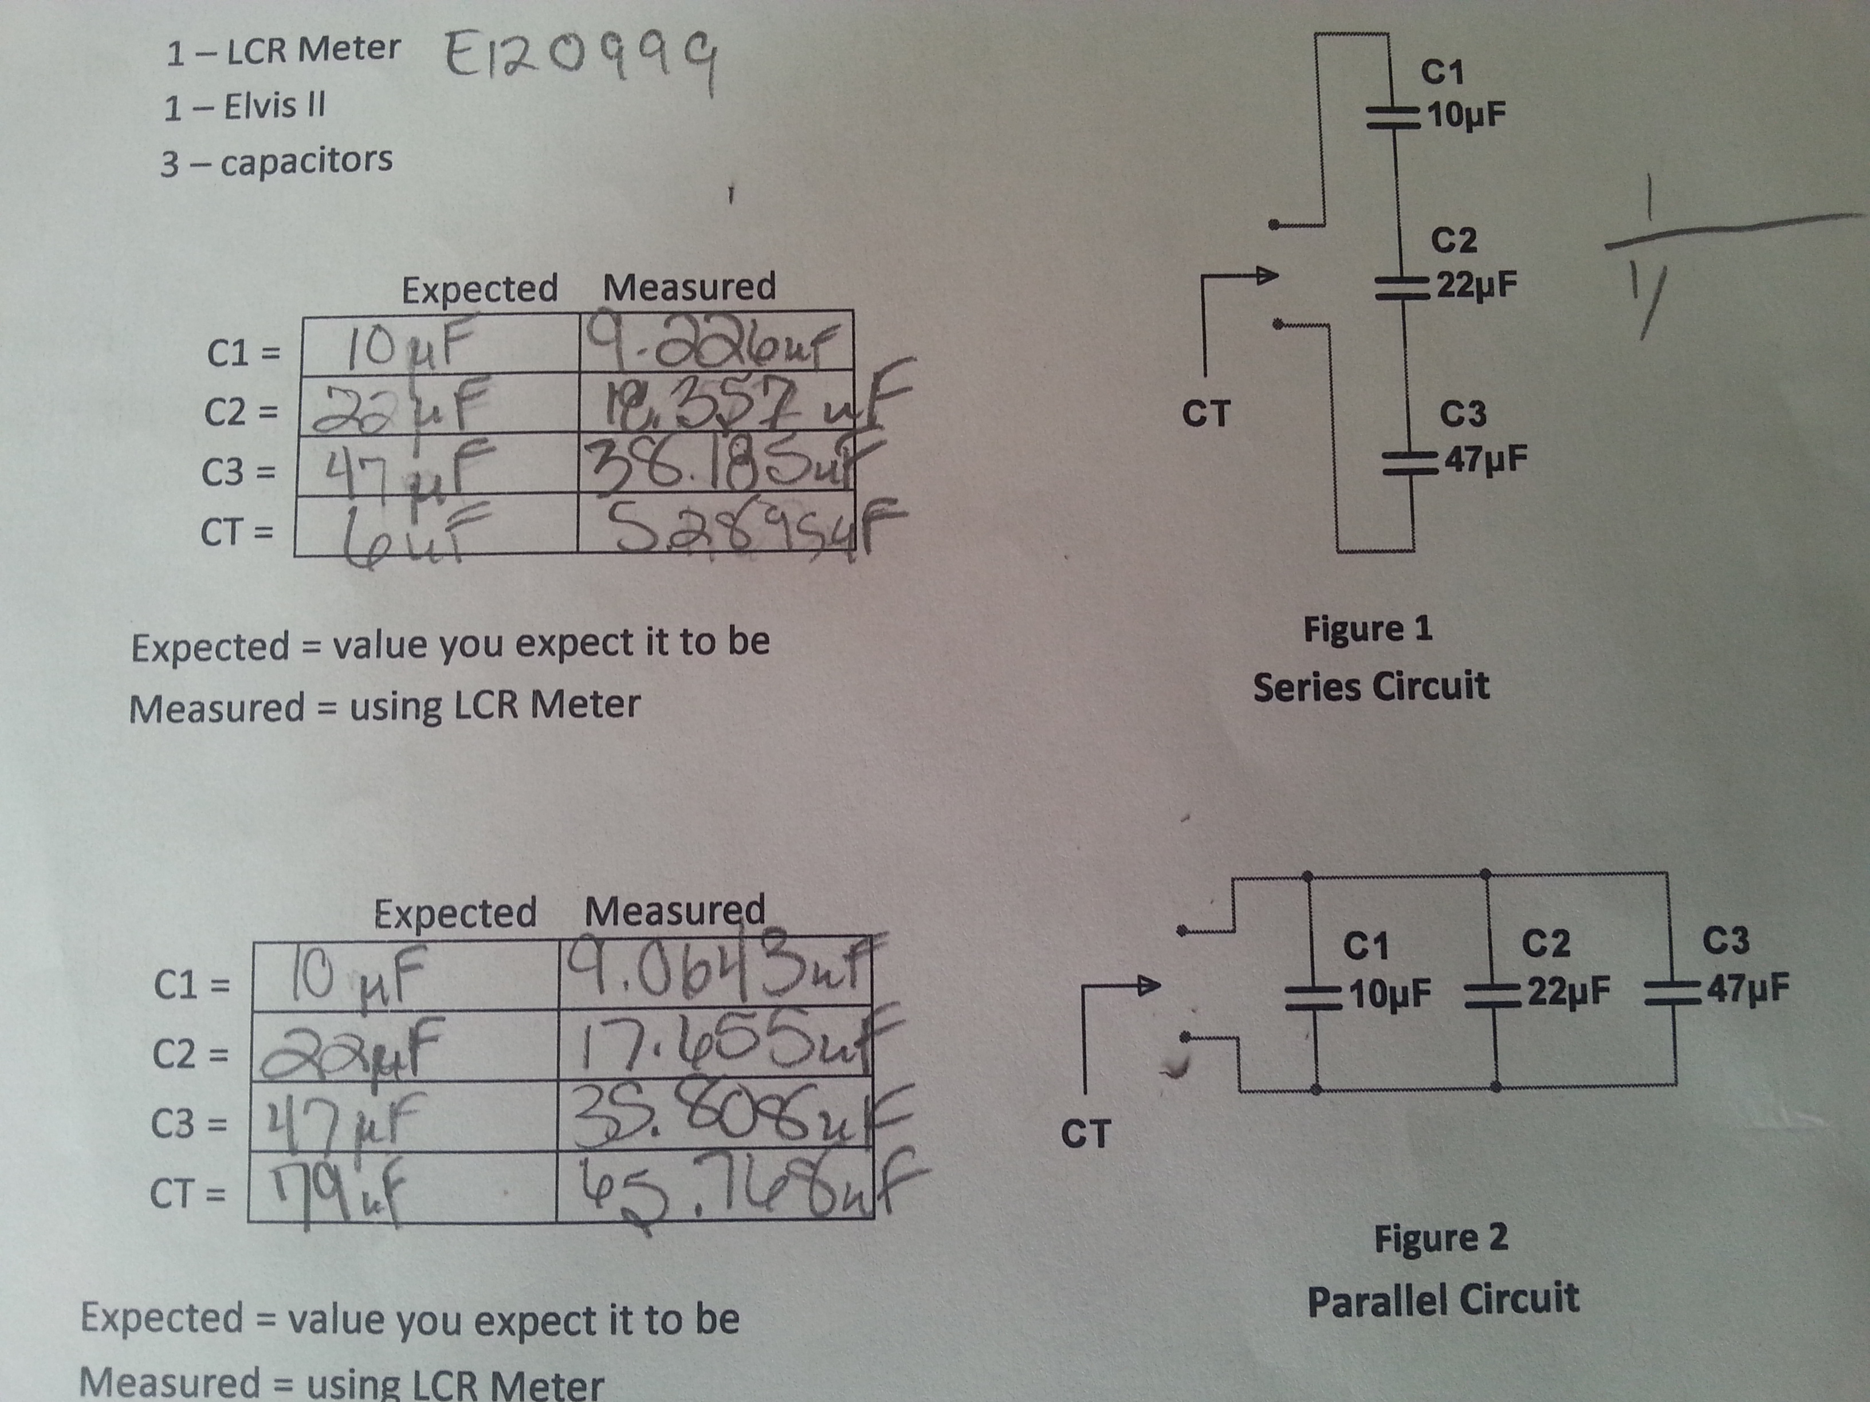
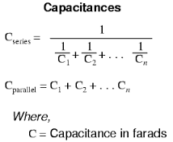
Lab 10 – Series and Parallel Capacitors
Lab 10 Results:
Conclusion: The measurement of a single capacitance was always significantly low compared to the expected value.

Slide 21
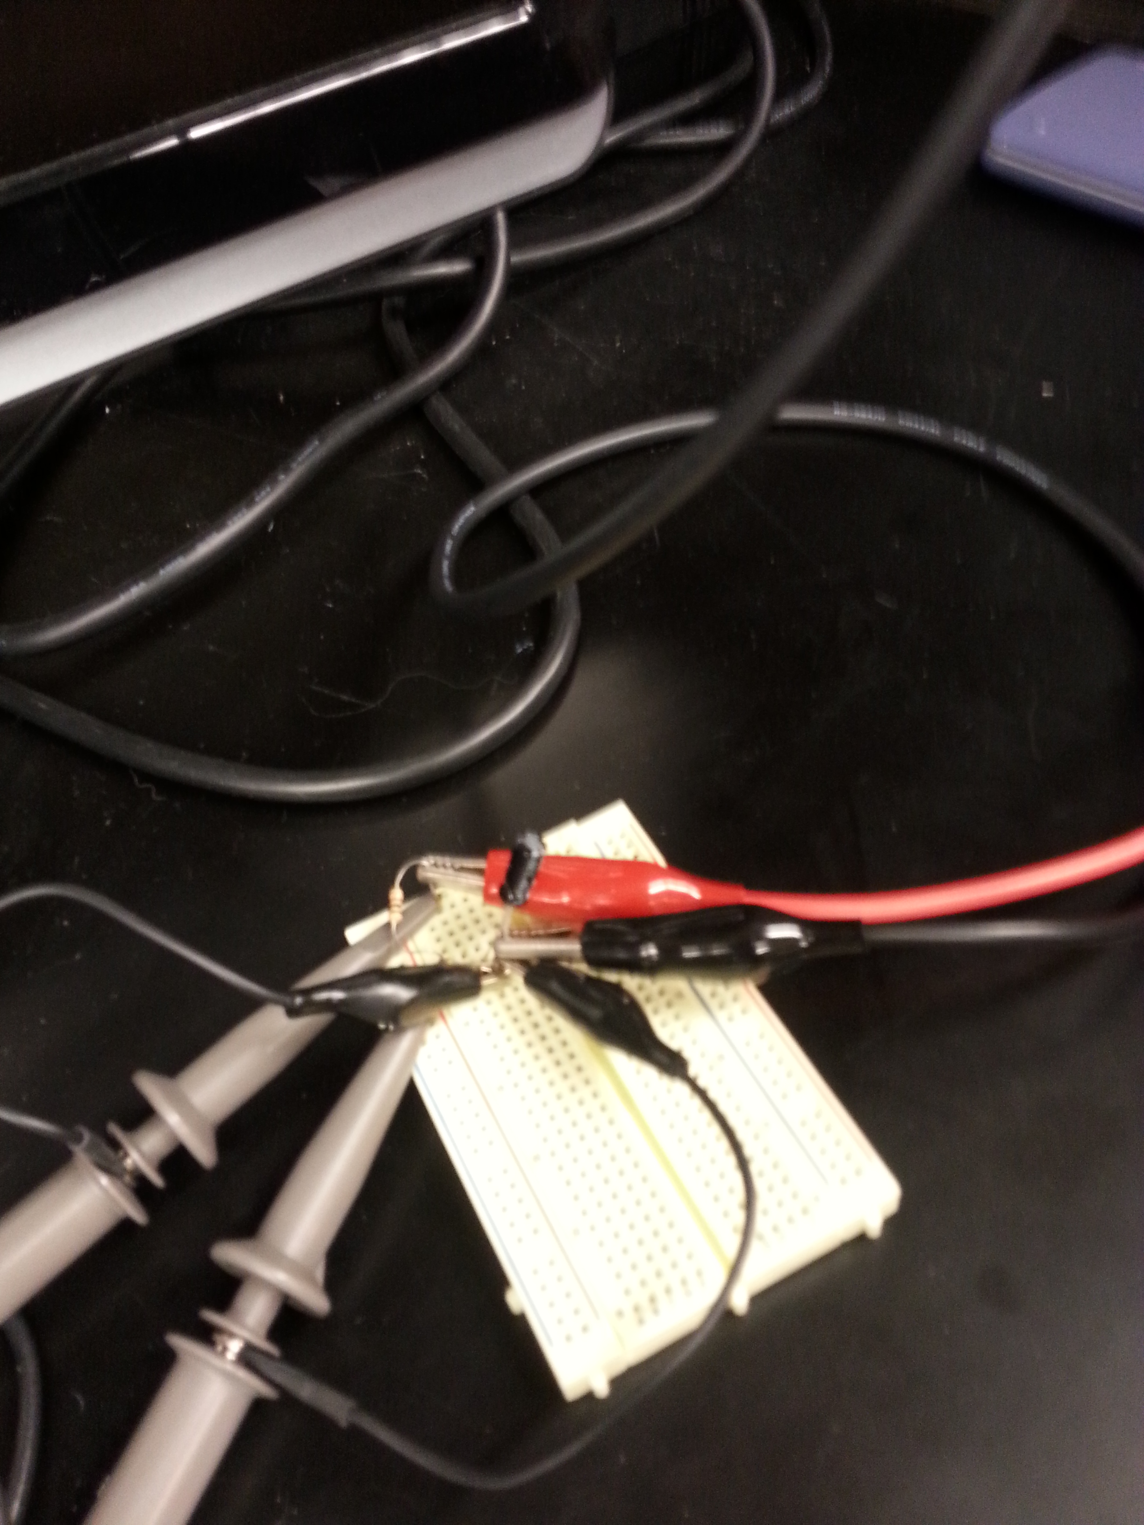
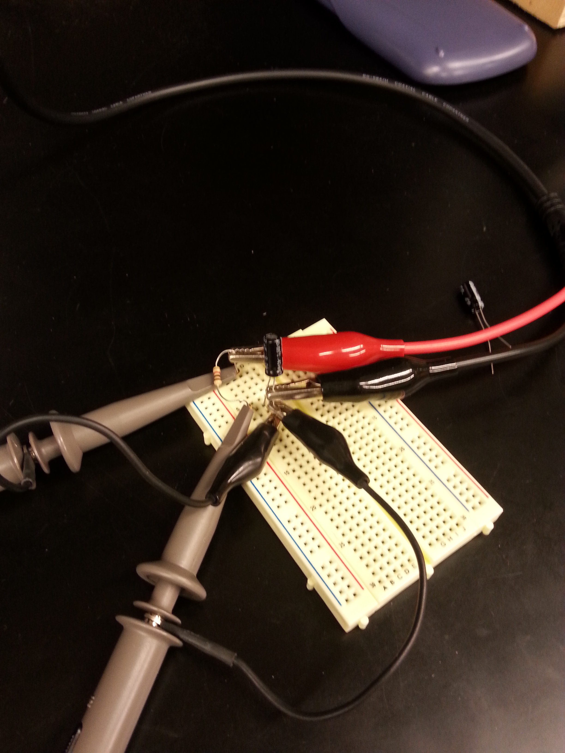
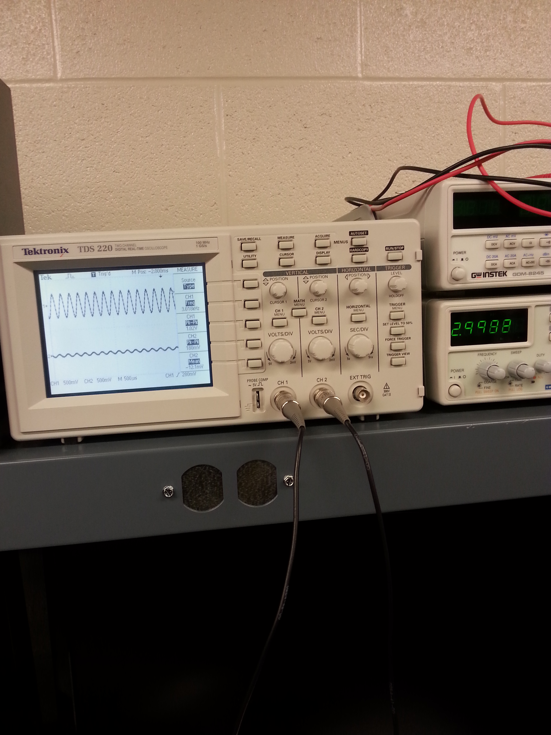
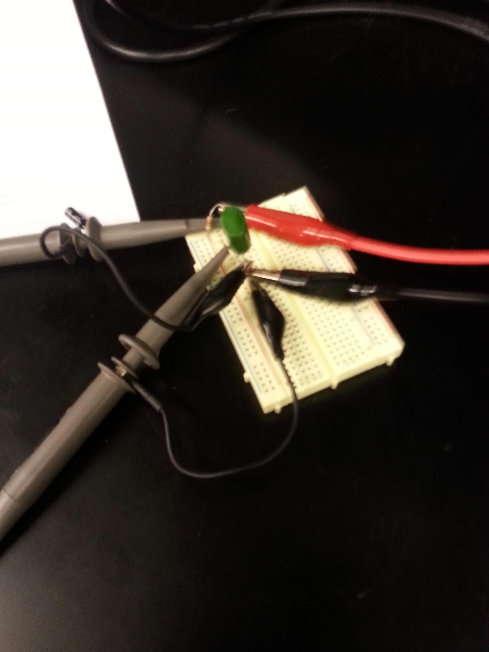
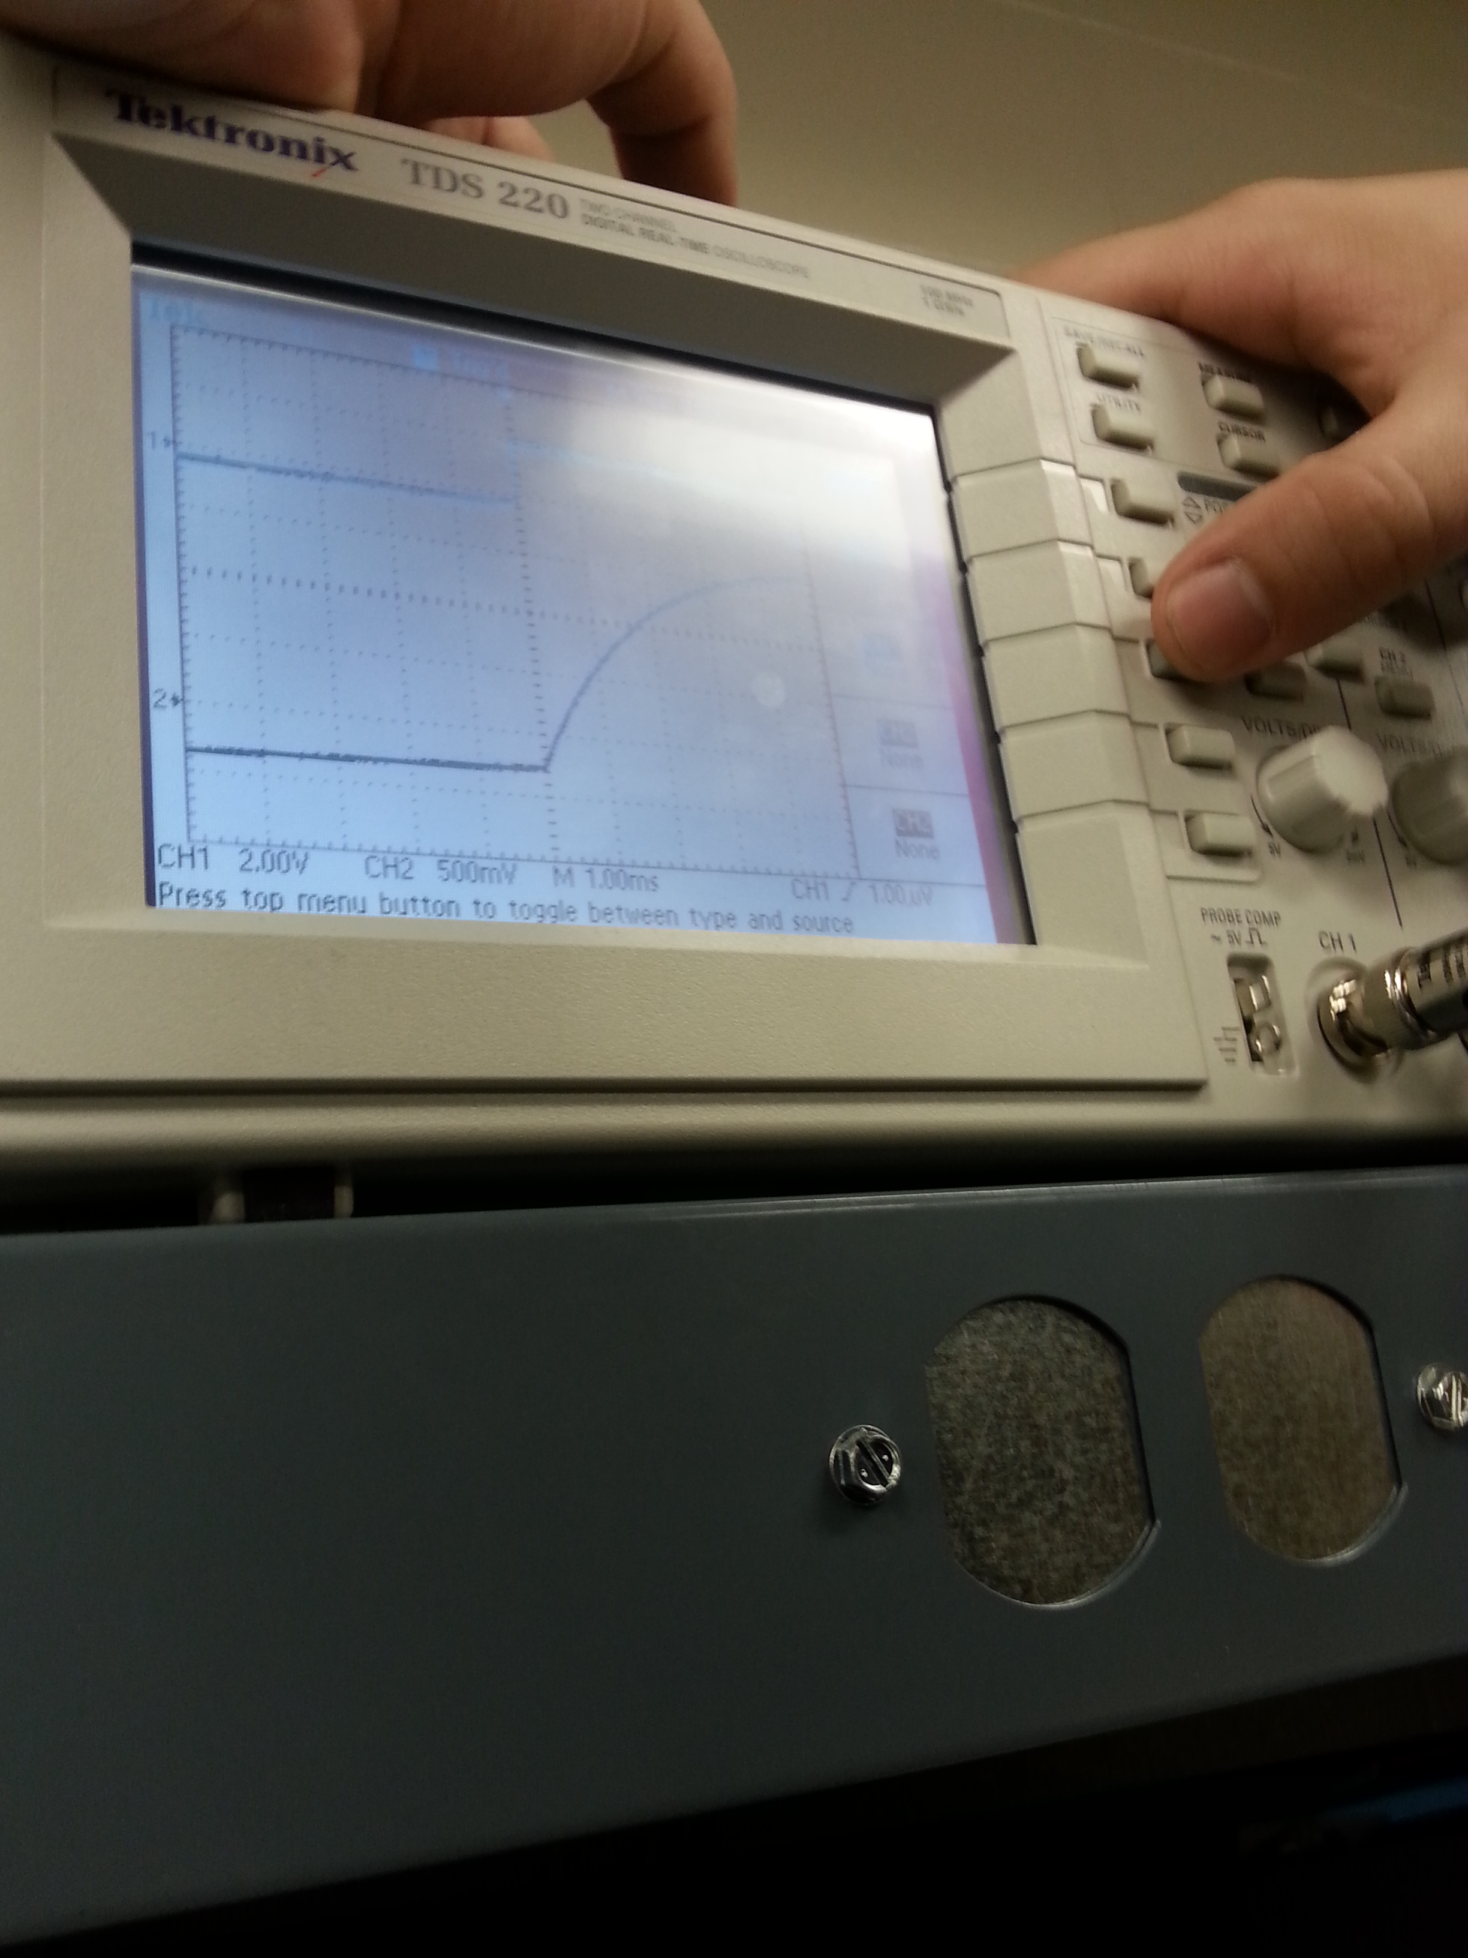
Lab 11 – RC Lab
The purpose of this lab is to experiment with resistor and capacitor circuits. The capacitors utilized 1 each of the 0.47 uF, 1.0 uF, and 2.2 uF. Measure and record the resistors value using DMM and measure and record the capacitor values using the LCR meter in Table 1. Connect the resistor and capacitor. Connect the Func. Generator to input at V1 and connect Channel 1 of the Oscilloscope to the input and Channel 2 to the output. Adjust the voltage of the Func. Generator to 1 Vpp at the frequencies shown in Table 2. Measure the input and out put voltages using the Oscilloscope. Record the results in Table 2. Change the capacitor and retest.

Slide 22
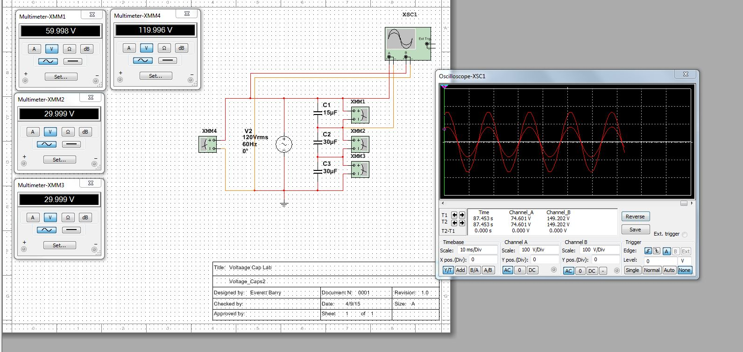
Lab 11 – RC Lab
Lab 11 Results:

Slide 23



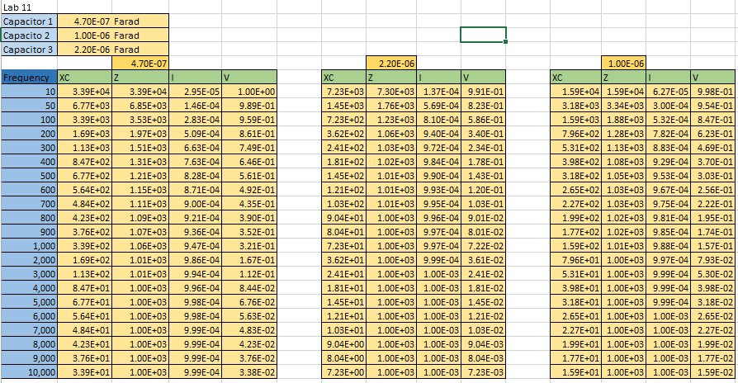
Lab 11 – RC Lab
Lab 11 Results Continued:

Slide 24
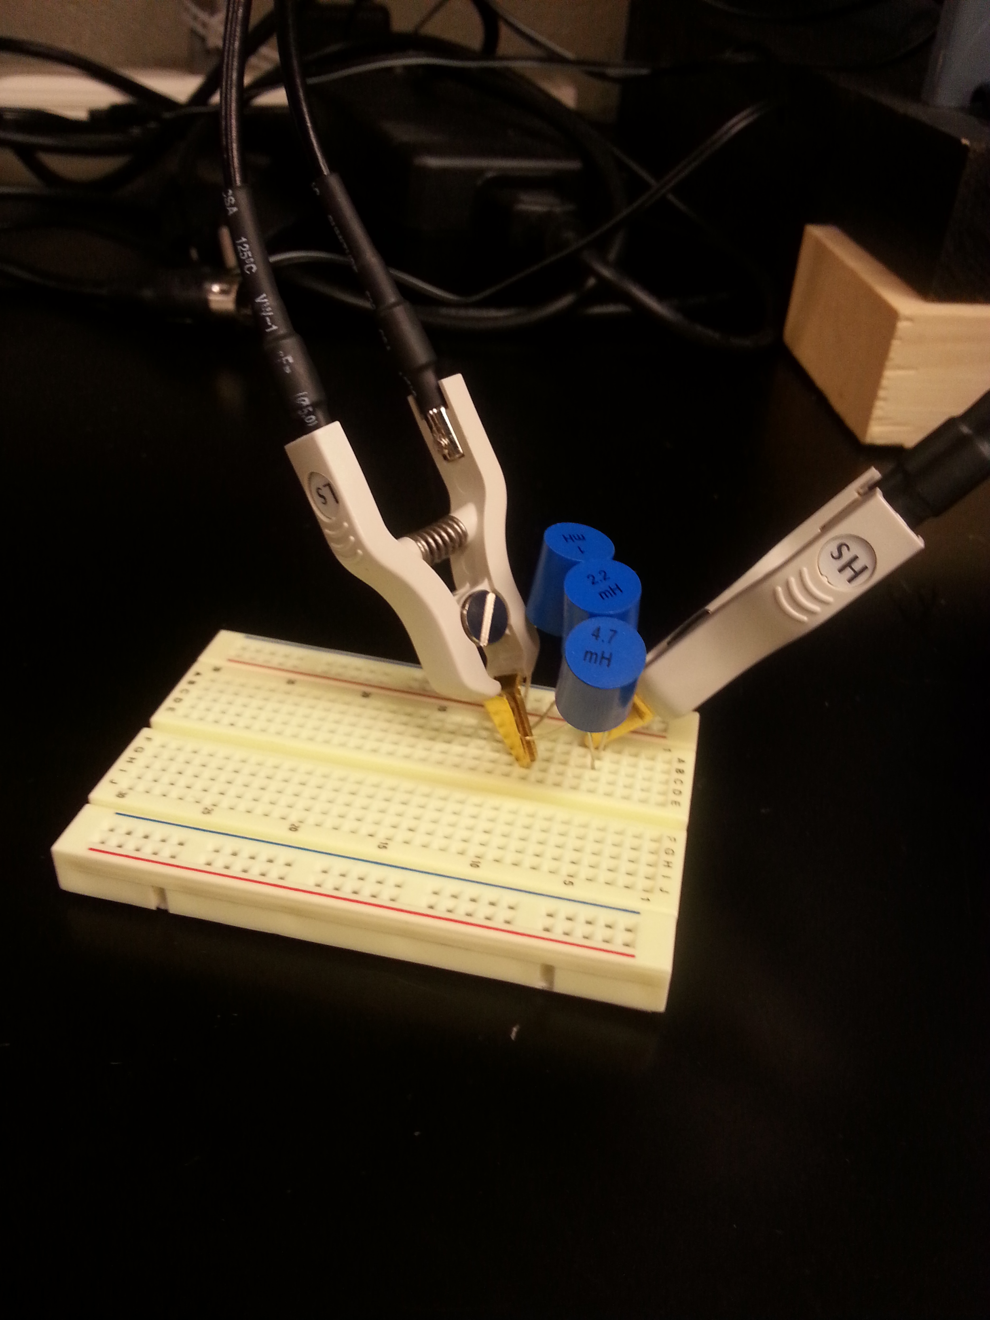
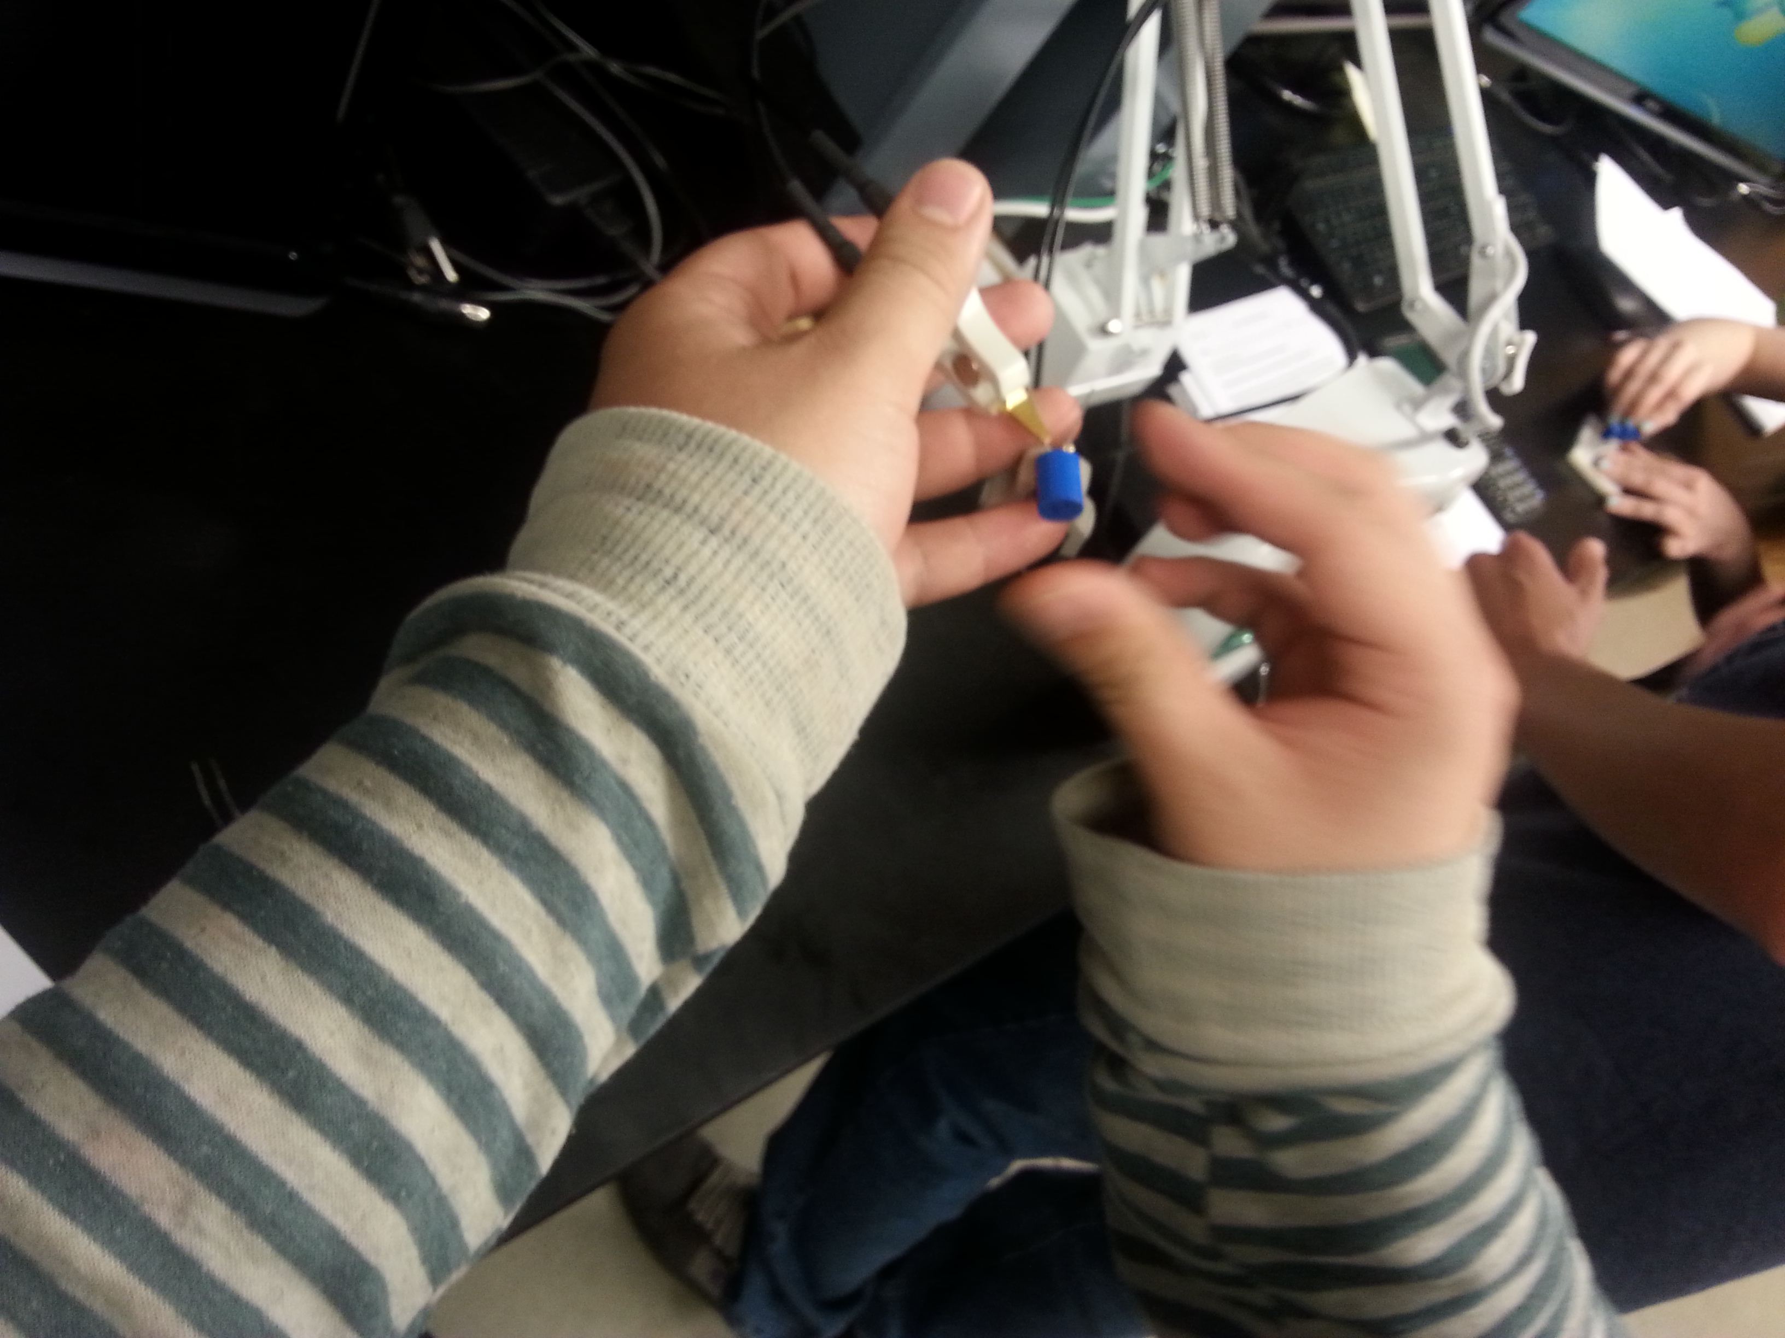
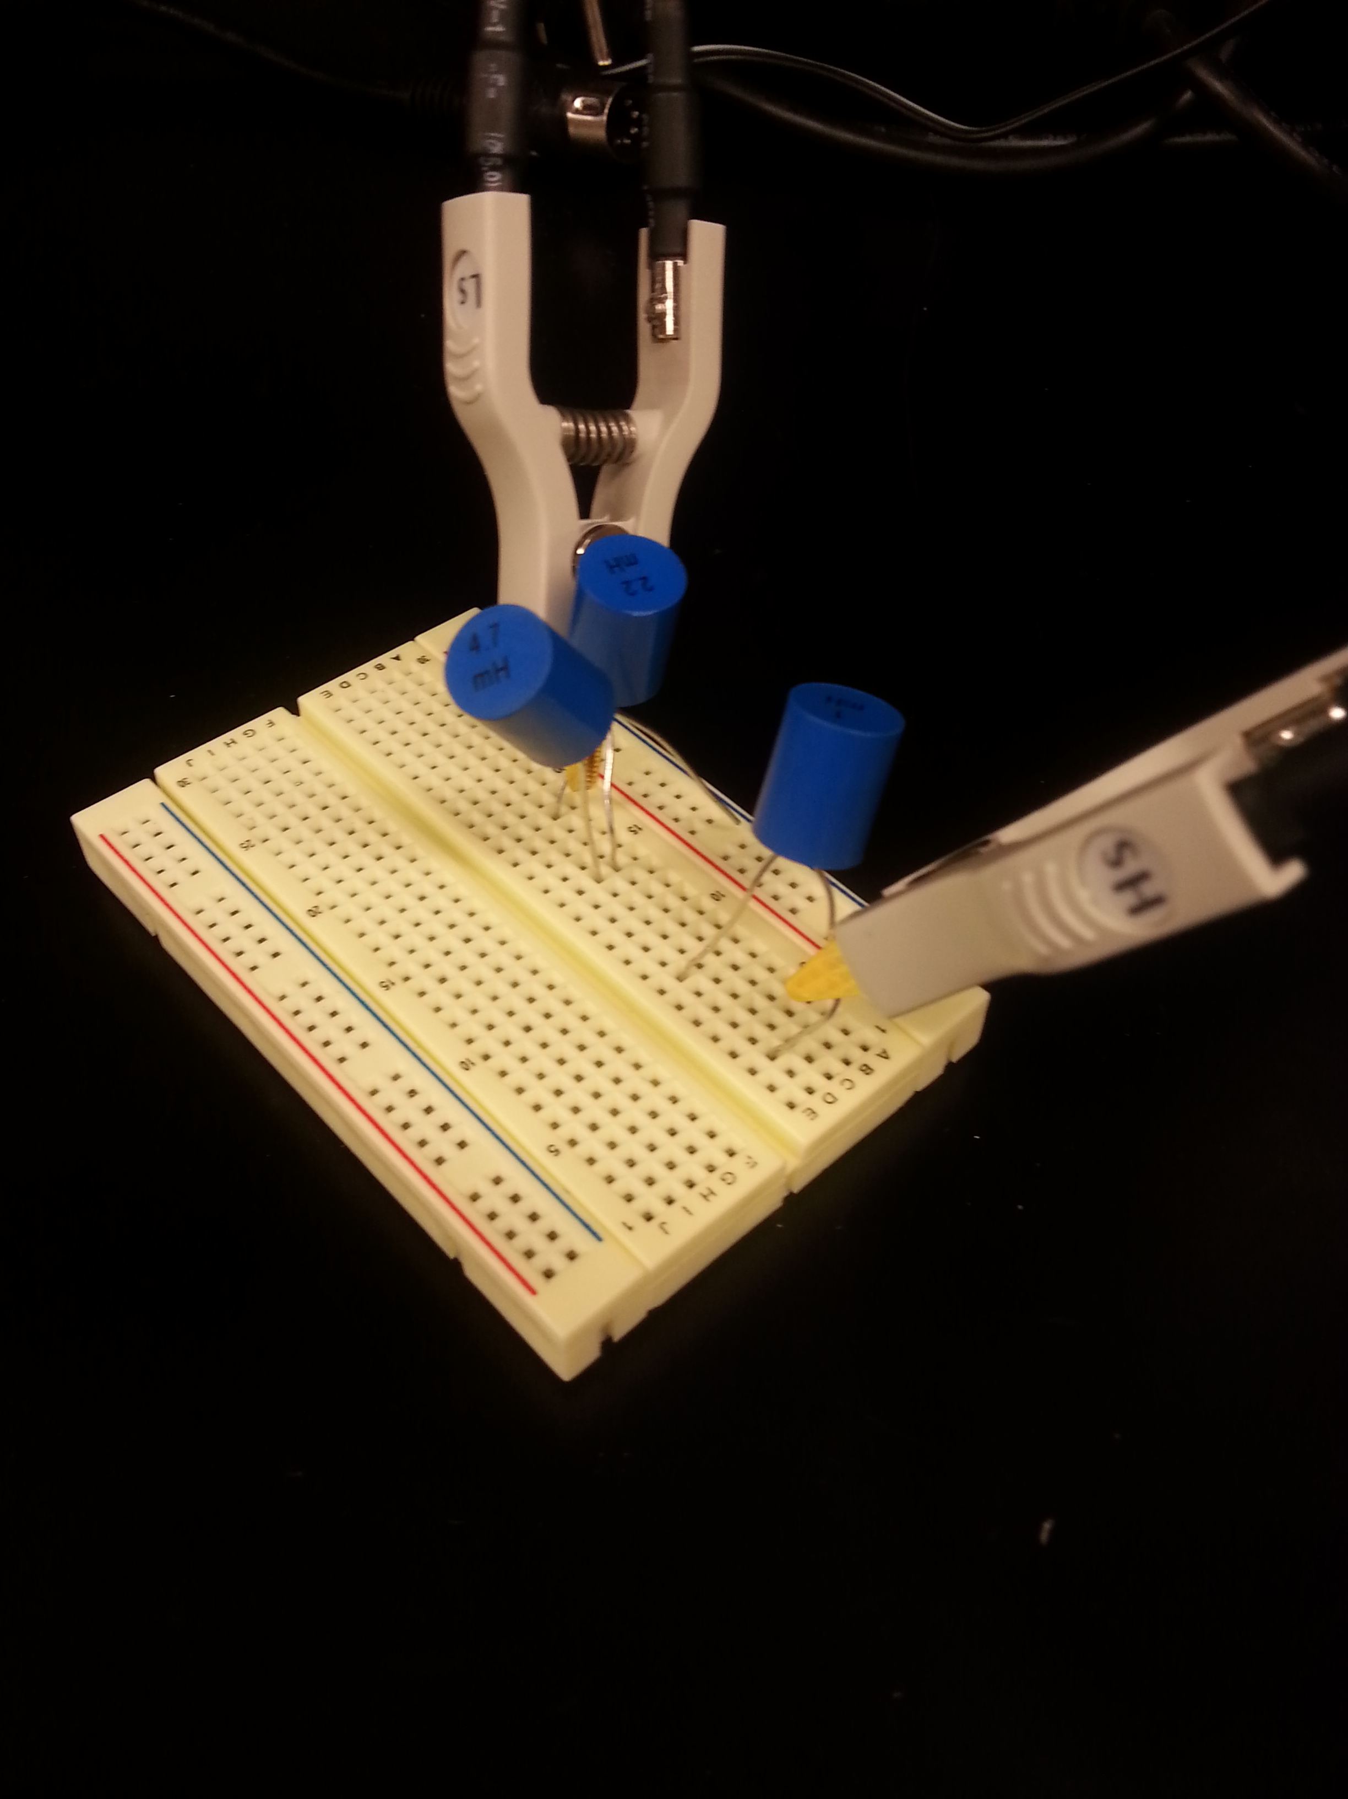
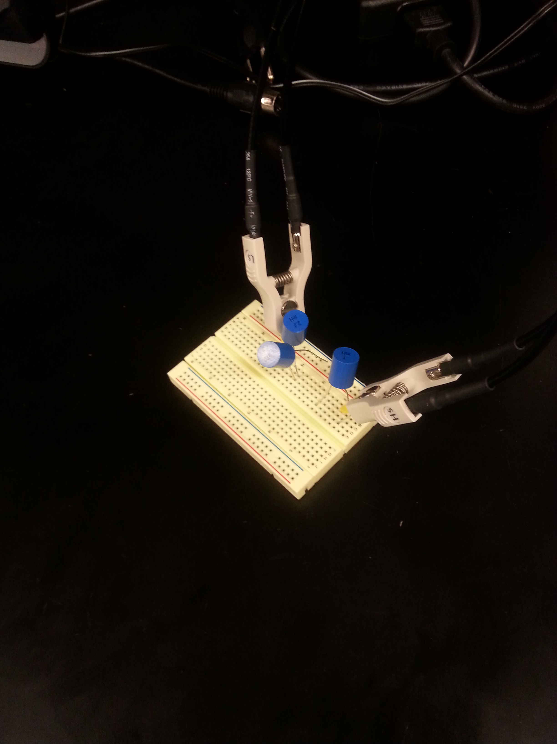
Lab 12 – Series and Parallel Inductors
The purpose of this lab is to experiment with series circuits and parallel combinations of inductors. Inductors required: 1 mH, 2.2 mH and 4.7 mH. Measure and record the inductance of each inductor using the LCR meter. Connect the inductors as shown in Figure 1 and measure and record the total inductance, LT. Then connect the inductors as shown in Figure 2 and measure and record the total inductance, LT.

Slide 25


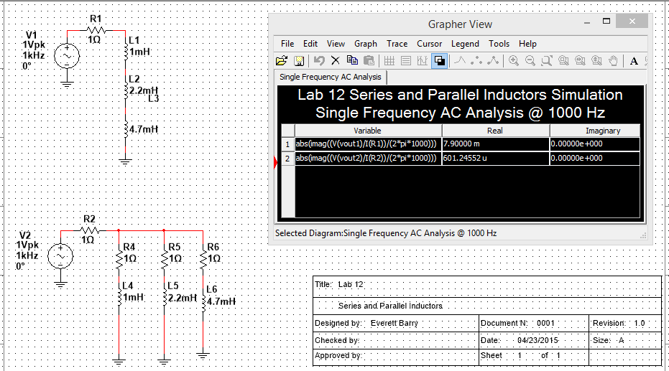
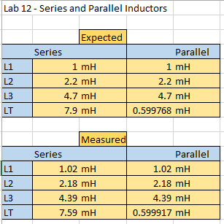
Lab 12 – Series and Parallel Inductors
Lab 12 Results:
Conclusion: The inductors has the same measurement and calculation concept as resistors only with different values.

Slide 26
Thank You.
Before this class I literally had no experience what so ever with electrical circuits and the various equipment and components that they may consist of. I also had very mediocre experience with Microsoft Excel. I have not dealt with spreadsheets since middle school back in 2008.
After taking this course I feel that I am fully more knowledgeable on electrical components. Also I have gained very useful experience and skills dealing with Microsoft Excel than I have ever expected. I feel that the information that I have gained in this course will be applicable to the workforce in real life situations in my future career.
I will continue on seeking and learning new skills in the electrical engineering field. Also I will continue to develop my Microsoft Excel skills after this course. This has been a very technical, useful, interesting course. This has been a good semester. Thank you.

