Slide 1
Sue Hlaing Win EECT112-50C LAB NOTEBOOK
DIGITAL FUNDIMENTALS
PROFESSOR- MASHESHWAR SAH

Slide 2
TABEL OF CONTENTS
Lab 1 – AND/OR
Lab 2 – AND, OR, INVERT (AOI)
Lab 3 - NAND Alternative
Lab 4 – Car Alarm
Lab 5 – NAND SR Latch
Lab 6 – Binary to 7-Segment Counter
Lab 7a – BASIC Stamp LED Flasher
Lab 7b – BASIC Stamp Temp Sensor/Heater
Lab 8 – BASIC Stamp LED Binary Counter

Slide 3
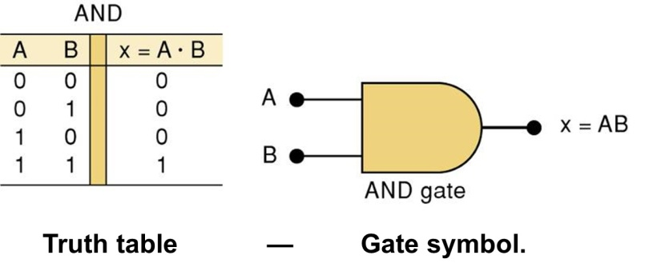
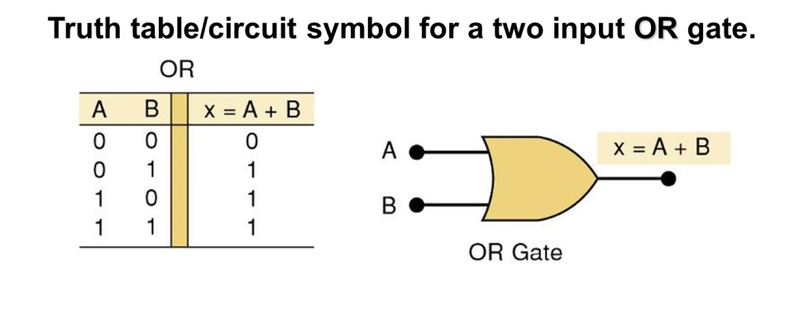
Lab -1: AND / OR Gates
Objective: Design, Simulate, and Build an AND/OR Gate circuit that will light 2 LEDs (one off of the AND Gate, the other off of the OR Gate). To show the functions of AND and OR gates.
Equipment used:74LS08P AND Gate, 74LS32P OR Gate, 4 Pin Dipswitch,
Various Wires, and 2 10K Resistors.

Slide 4
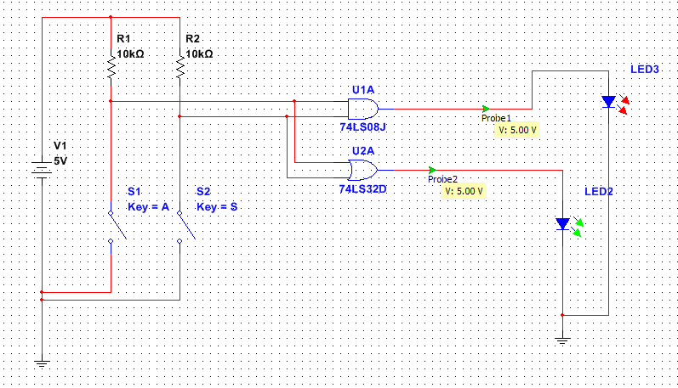
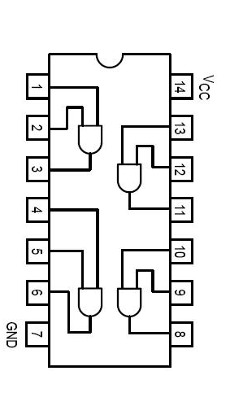
Lab 1 And/Or Gates
Schematics for the chips
Resistors
Or Gate
And Gate
Multisim
Schematics:
Individual gates
Power to the chip
Gate inputs
Gate output
Ground for the chip
Switches
LED Lights

Slide 5
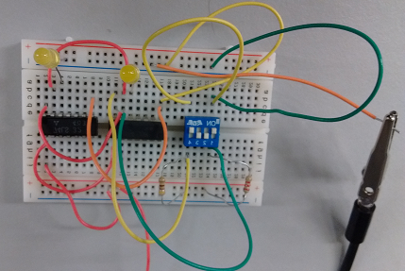
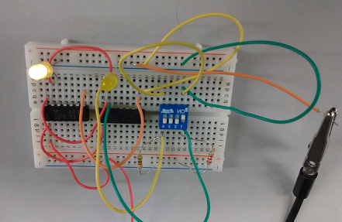
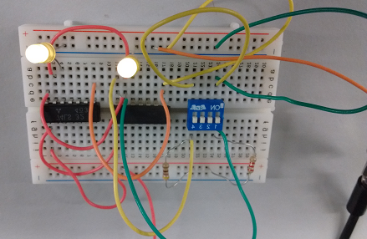
Lab 1: AND, OR

Slide 6
LAB 2 ( AOI)
Objective:
Revise a logic system that contains three separate chips (including 74LS04D Hex Inverter chip, 74LS32D OR Gate chip, and 74LS08D AND Gate chip), into a similar logic system using less chips to save power, space and cost.
Equipment: Breadboard,2 - 10KΩ Resistors1 – AND Gate (74LS08D), 1 – NAND Gate (74LS00D), 1 – OR Gate (74LS32D), 1 – Inverter Gate (74LS04D), 1 – 4 Pin Dipswitch.

Slide 7
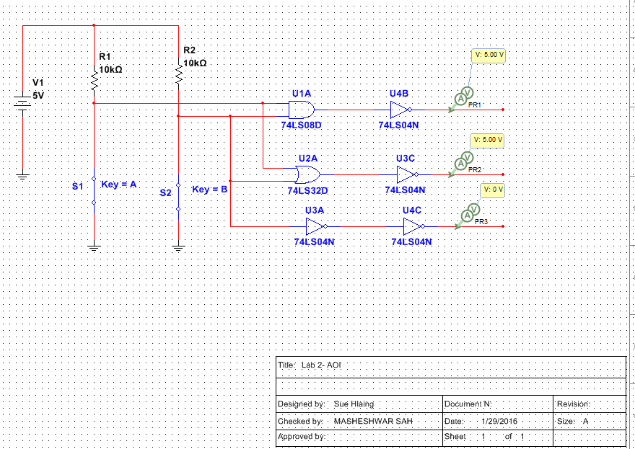
Multisim Diagram
Resistor
And gate
Or gate
Switch
Inverter

Slide 8
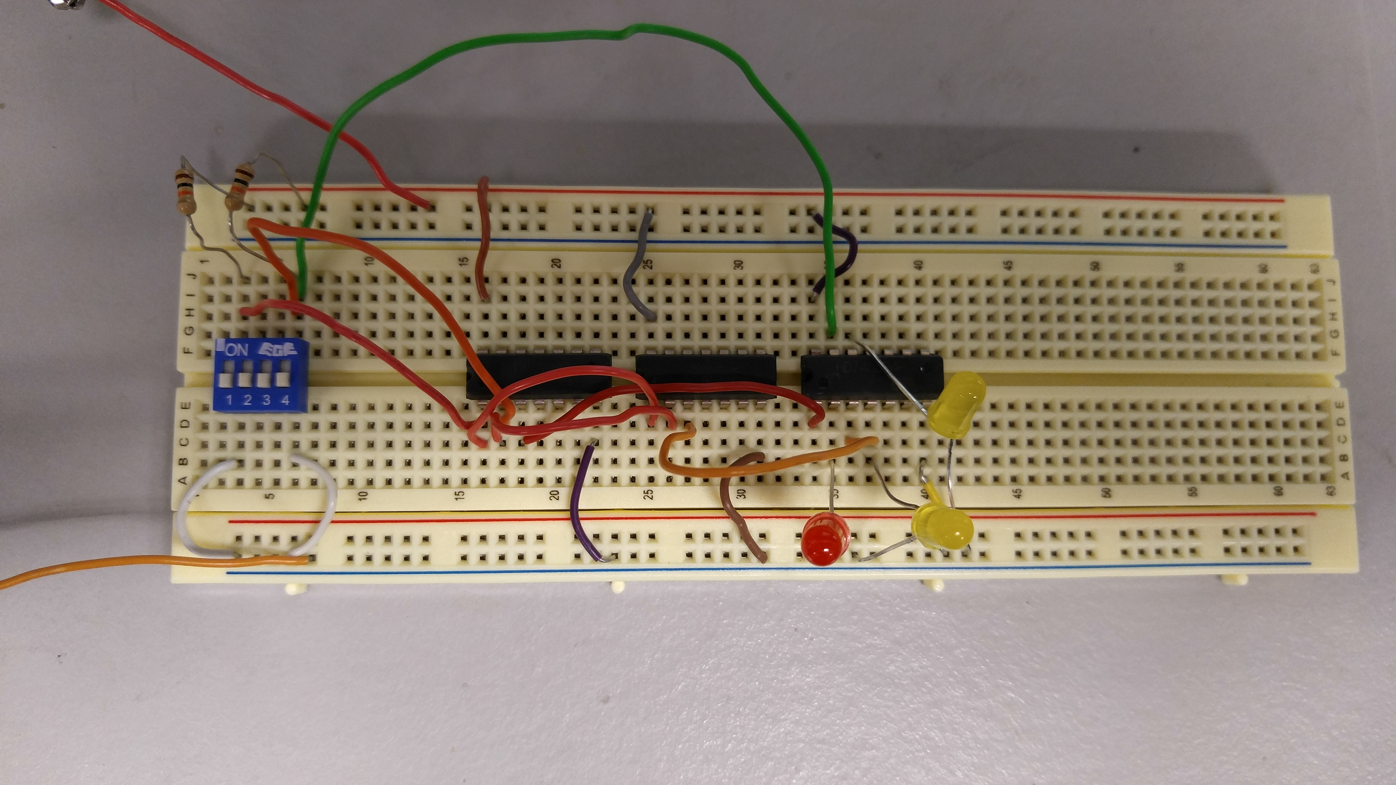
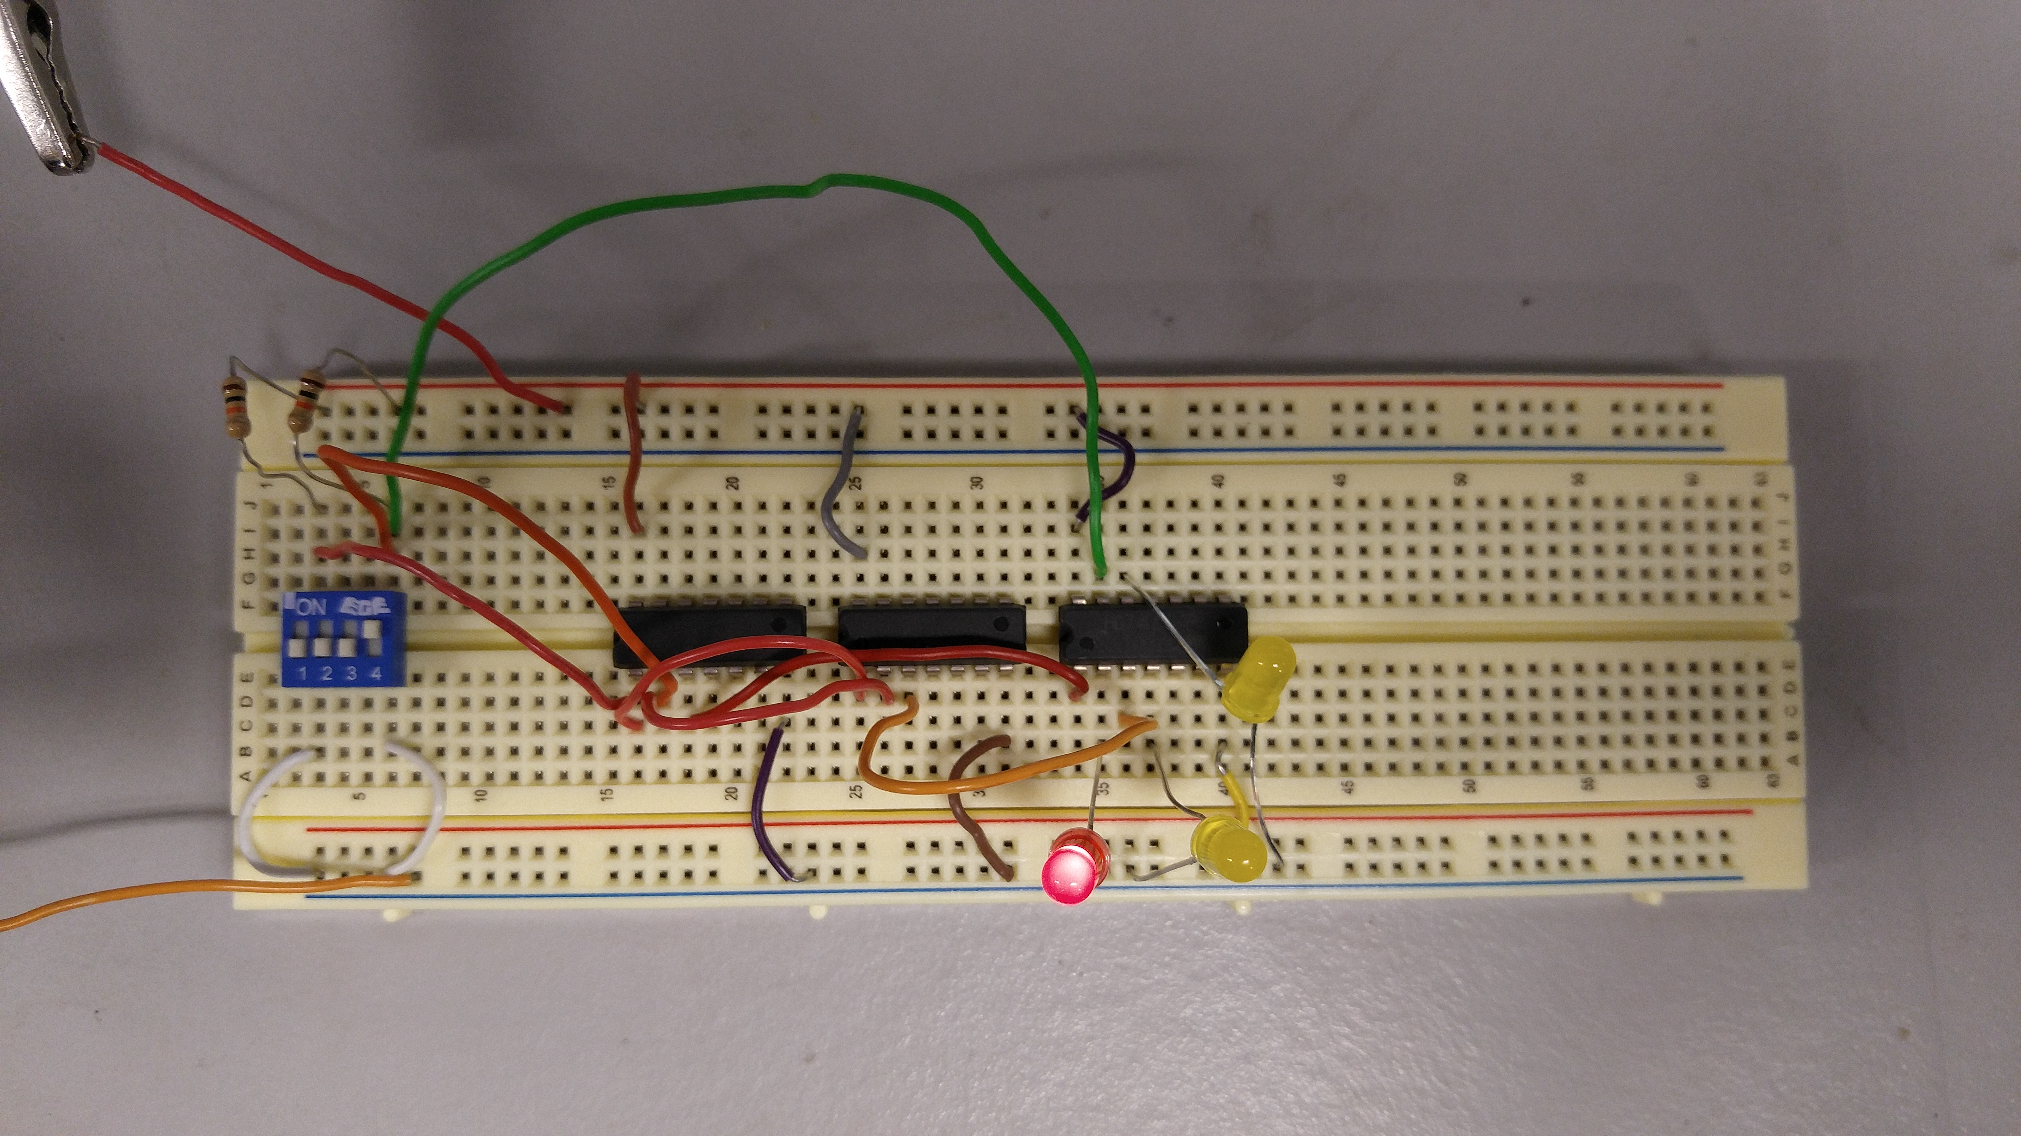
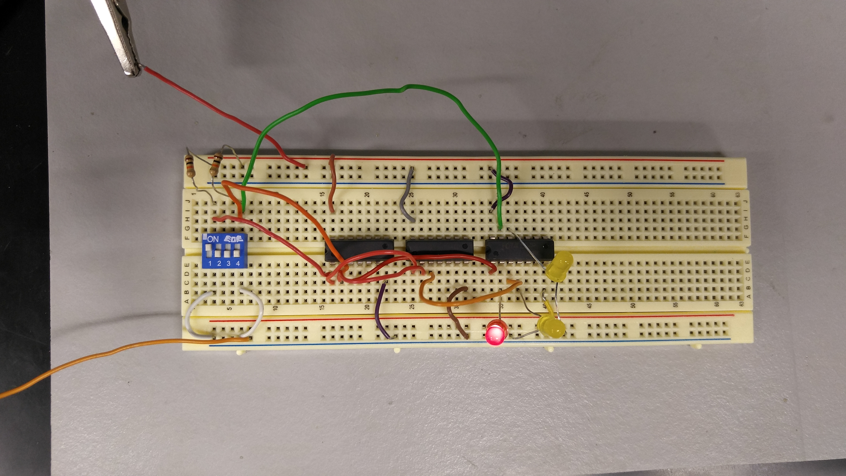
Lab-2

Slide 9
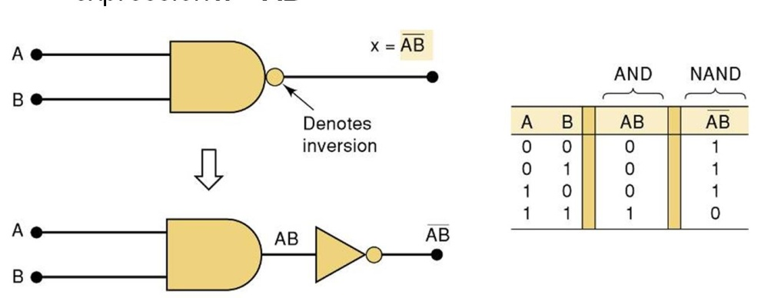
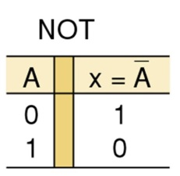
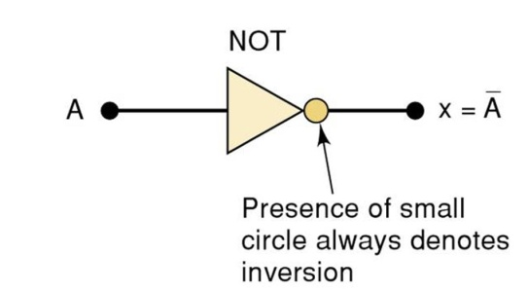
Lab-3 NAND ALTERNATIVE
Equipment:
Breadboard
Digital Multimeter
Brand: GWINSTEK
GDM: 8245
SN: CL860332
-AND Gate
Chip: 74LS08D
OR Gate
Chip: 74LS32D
-NOT Gate
Chip: 74LS04D
-NAND Gate
Chip: 74LS00D
-Miscellaneous Wire
Objective: To show how a logic circuit can be reduced to a single kind of gate.
Background: Not gates work by inverting whatever signal is going into it. Nand gates behave like the inverse of an And gate so a Nand gate will send an output when one or both of the signals have a logic state of 0 and will not send a signal when both of the signals are a logic state of 1. Nand gates also have a universal property. This means that you can build a circuit using only Nand gates.

Slide 10
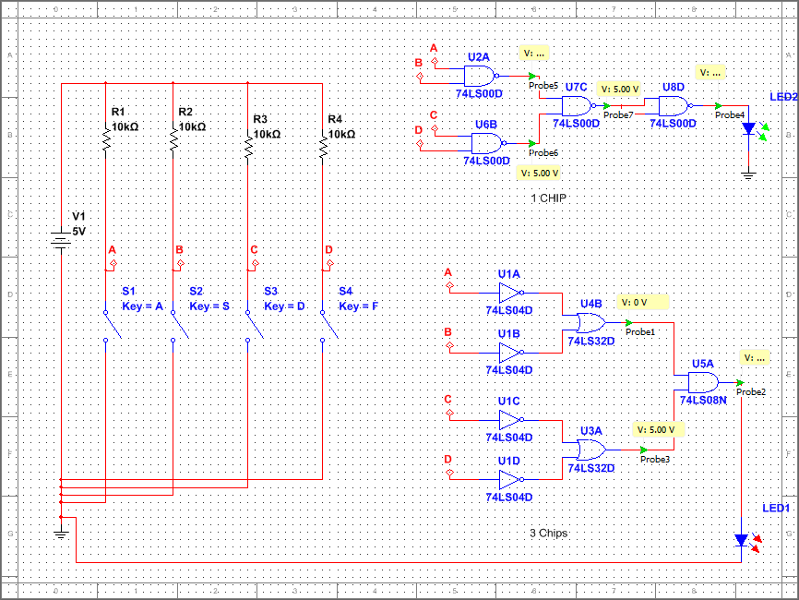
Nand Alternative
Schematics:
Multisim
Nand Gates
Resistors
Switches
LED Lights
Not Gates
Or Gates
And Gate

Slide 11
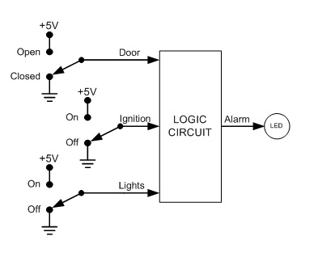
Lab -4 Car-Alarm
Equipment:
SN: 14C6E29
-AND Gate
Chip: 74LS08D
OR Gate
Chip: 74LS32D
-Miscellaneous Wire
Objective: To build a functioning logic circuit given the inputs and desired outputs
Background: The diagram below was given. The desired outputs were when the door was open and the ignition was on, when the door was open and the lights were on, and when the ignition was off and the lights were on

Slide 12
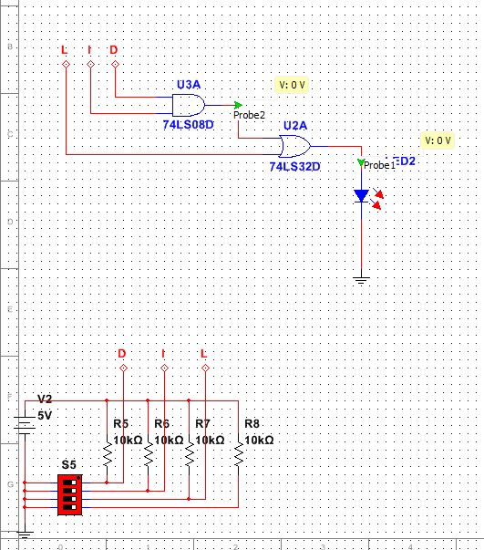
Schematics:
Multisim
Truth Table
Ignition Input
Light Input
Door Input
L | D | I | X
0 | 0 | 0 | 0
0 | 0 | 1 | 0
0 | 1 | 0 | 0
0 | 1 | 1 | 1
1 | 0 | 0 | 1
1 | 0 | 1 | 0
1 | 1 | 0 | 1
1 | 1 | 1 | 1
LED representing car alarm
And Gate
Or Gate
Resistors
Equation found from truth table*
Switches
X = (ID)+L

Slide 13
Lab 5- NAND SR Latch
Objective
Learning how latches or flip flops works.
Equipment and Material
Breadboard DMM Chips Resistors DIP Switch LEDS Brand: GW instek 74LS00 (NAND) (2) 10k ohm 2
Model #: GDM8245
SN: CL860332
Research and Information
Chapter 5 lecture

Slide 14
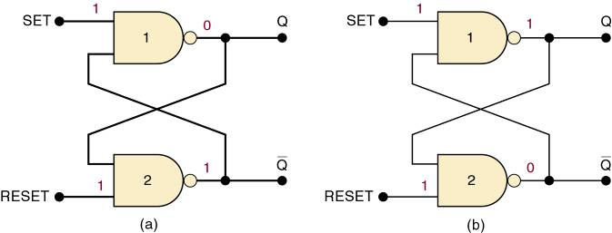
Information about a Latch
Summary of the NAND latch:
SET = 1, RESET = 1—Normal resting state, outputs remain in state they were in prior to input.
SET = 0, RESET = 1—Output will go to Q = 1 and remains there, even after SET returns HIGH.
Called setting the latch.
SET = 0, RESET = 0—Will produce Q = 0 LOW and remains there, even after RESET returns HIGH.
Called clearing or resetting the latch.
Inputs are SET and CLEAR (RESET).
Inputs are active-LOW—output will change when the input is pulsed LOW.

Slide 15
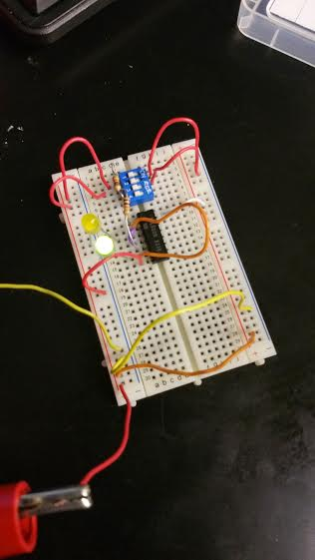
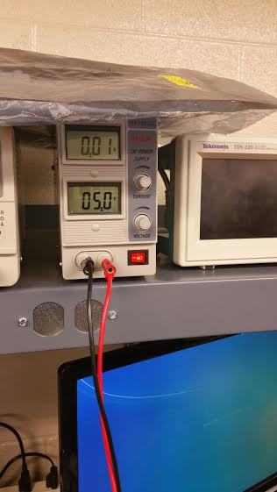
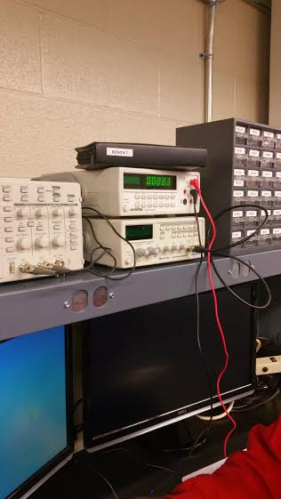
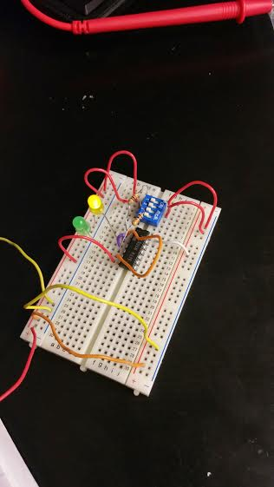
Pictures

Slide 16
Conclusion
In the lab, we wired up the circuit without using the dip switch which gave us a hard time to set and to reset so we had to put one in.
I think we need to spend more time on latches because I still don’t know the purpose of it.

Slide 17
Lab 6 Binary Counter
Equipment
Breadboard
SN: 1677D3B
-BCD to 7 Segment Decoder
Chip: 74LS48D
4 Bit Ripple Counter
Chip: 74LS93D
Tektronix TDS 220 Two Channel Digital Real-Time Oscilloscope
SN:B068379
-Man 74-7 Segment display
-Miscellaneous Wire
Objective: To have a 7 segment display count from 0 to F in hexadecimal.
Background: A clock when used with a flip flop latch can be used to store information and count.

Slide 18
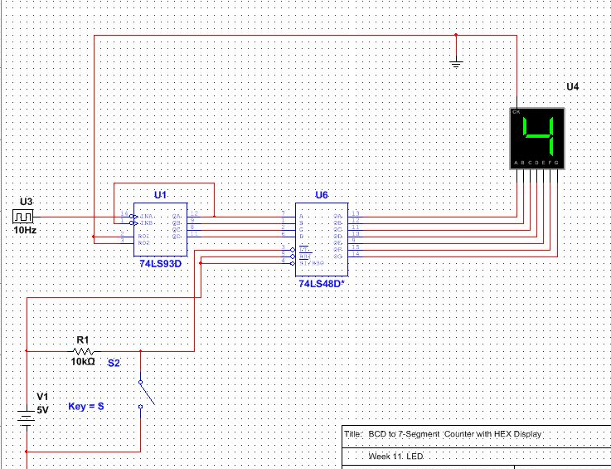
Multisim
Schematics:
7 Segment Display
4-Bit Ripple Counter
BCD to 7 Segment Decoder
Clock

Slide 19
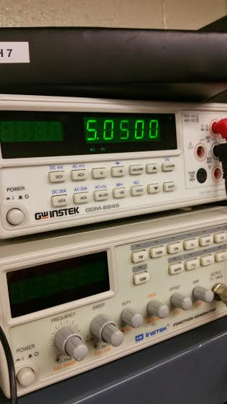
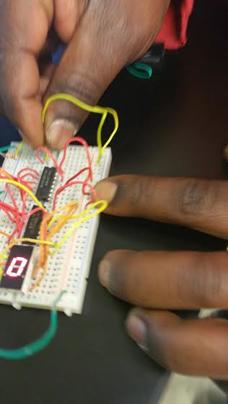
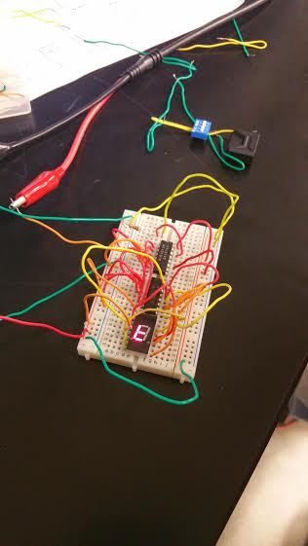

Slide 20
Conclusion
This was a fun lab for me but took a long time to hook it up because not only we had to looked up the datasheets for the chips but also the 7 segments display.
After the circuit had been wired up, it didn’t work. We found out that we had fried up the 74LS193 chip and the 7 segments display.
I’d like to mess more with this lab and maybe add more stuff to it.

Slide 21
Lab 7a LED Flasher(Basic Stamp 1)
Equipment
-LED Light
-220 ohm resistor
-10k ohm resistor
-Basic Stamp
-Basic Stamp Program
-Miscellaneous Wire
Objective: To program a chip to flash an LED light
Background: The basic stamp program allows you to program a chip to do different functions.

Slide 22
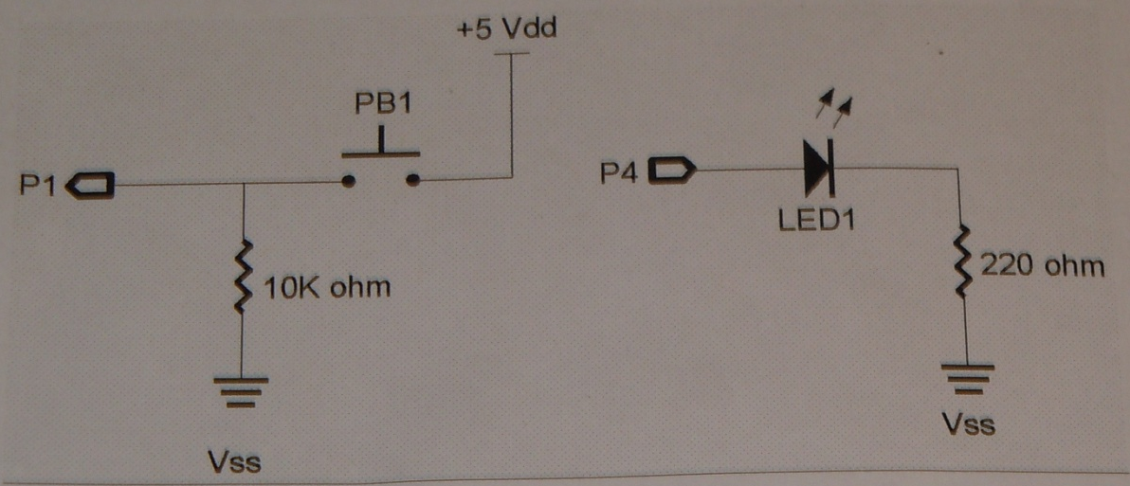
Schematics:
Hardware
LED Light
Switch
Resistors

Slide 23
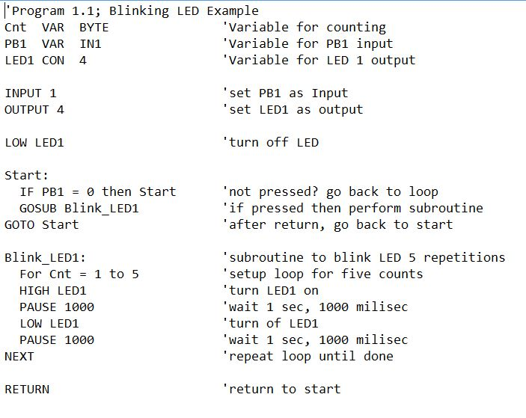
Schematics:
Program
Defining Variables and Constants
Defining Inputs and Outputs
Initial Conditions
Comments about what the program is doing
Main Program
Sub-routine

Slide 24
Conclusion
Though there was a schematic to follow to wire up, I still needed help and my partner helped me on it.
This lab went really fast and we were happy with the result.

Slide 25
Lab 7b Temp Sensor/Heater (Basic Stamp 2)
Equipment
-LED Light
-220 ohm resistor
-10k ohm resistor
-10K ohm Multi-turn Potentiometer
-1uF Capacitor
-Basic Stamp
-Basic Stamp Program
-Miscellaneous Wire
Objective: To show how analog data can be used in a digital circuit.
Background: Digital data comes in two states on or off. Analog data can come in varying degrees of states. There are multiple was to get analog data into a digital circuit in this experiment we will be using a resistor/capacitor network for the analog data and the input will be the time it take for the capacitor to discharge.

Slide 26
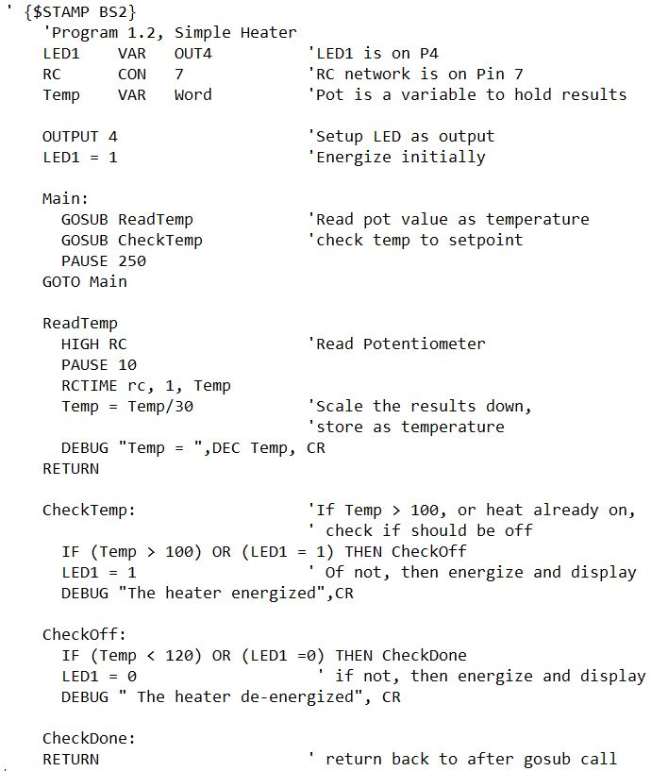
Program
Schematics:
Defining Variables and Constants
Defining Inputs and Outputs
Main Program
Comments about what the program is doing
Sub-routines

Slide 27
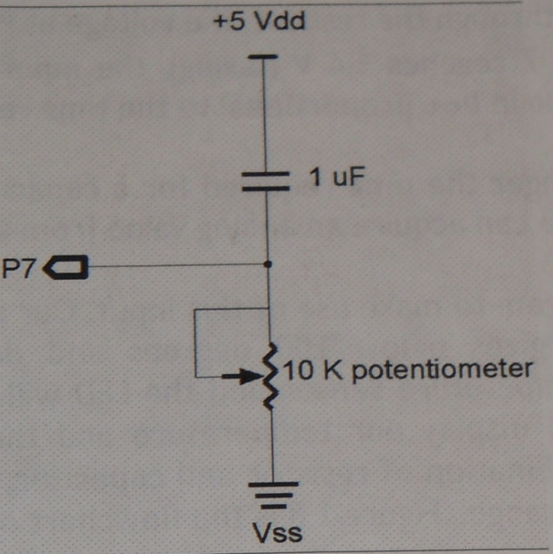
Schematics:
Hardware
LED Light
Switch
Capacitor
Resistors
Potentiometer

Slide 28
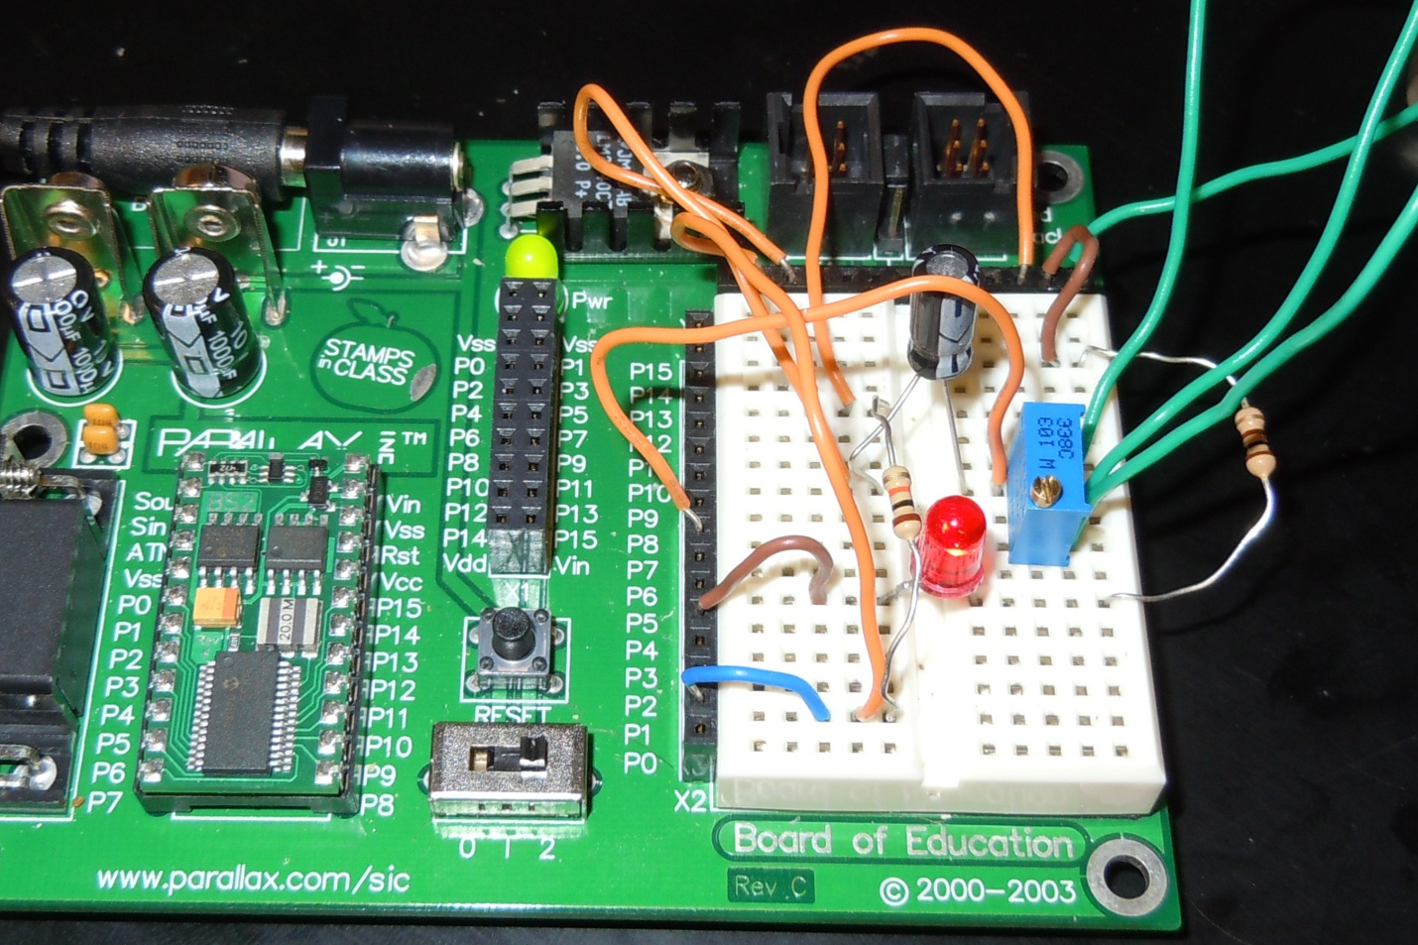
Lab Work:
Switch
Capacitor
Programmable Chip
220 ohm resistor
Potentiometer
10k ohm resistor
LED Light

Slide 29
Conclusion
The first problem we had with this lab was that I didn’t put in the pot right because I didn’t know that we can’t have the pin put in in the same row across. After we had it figure out, it still didn’t work because there was no power going to the capacitor which should be across from the wire that is providing power. It was my fault for thinking that the power was going up and down just like in Elvis.
What we had learned was that the greater resistance, the longer for capacitor to discharge.

Slide 30
Lab 8 – BASIC Stamp LED Binary Counter
Objective
Use BASIC Stamp to build and program a circuit that counts a 4-bit binary count from 0000 to 1111 in binary using 4 LEDs.
Equipment and Material
Basic Stamp 2, serial cable, power supply, 4 LEDs, 3 resistors.
Research and Information
Overviews at the www.ivytechengineering.com/basic_stamps site provided.

Slide 31
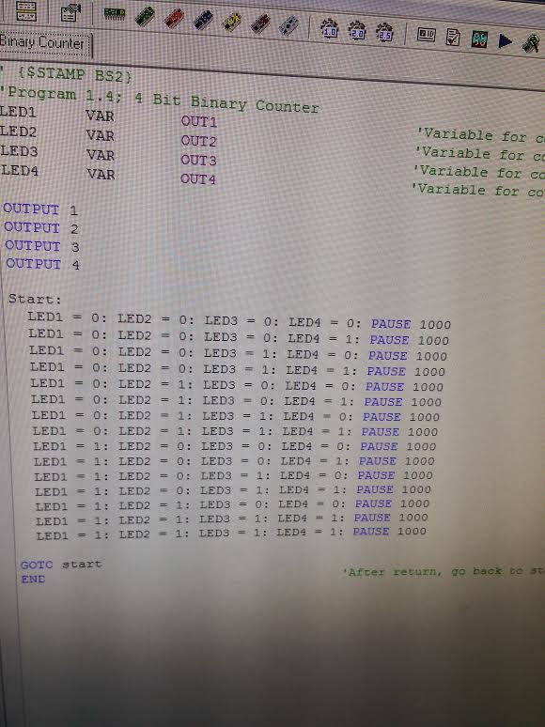
Code

Slide 32
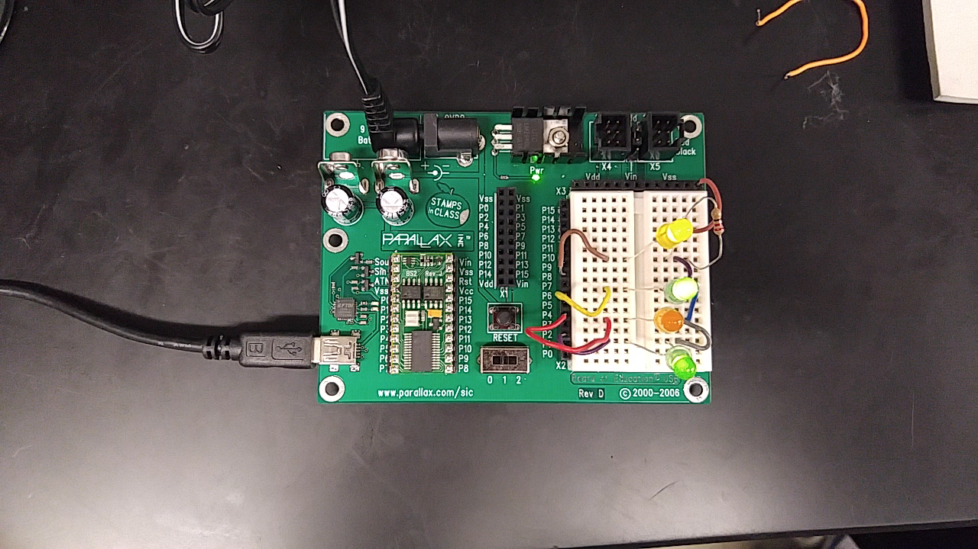
Video

Slide 33
Conclusion
Figuring out the code for this exercise was a little tricky. It took some times to think 0f how to program it to make it work.
This one the step to our final project.
It all came to make sense when we had it working.

