Slide 1
MECT 143-50C Lab Notebook
Sue Hlaing
May 6, 2015
Spring 2015

Slide 2
Lab 1-Wilson Rockwell 5JR Hardness Tester
Jan 21, 2015

Slide 3
Wilson Rockwell 5JR Hardness Tester By Sue Hlaing, Zackary Reigelman

Slide 4
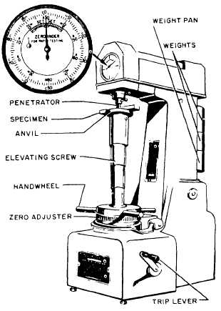
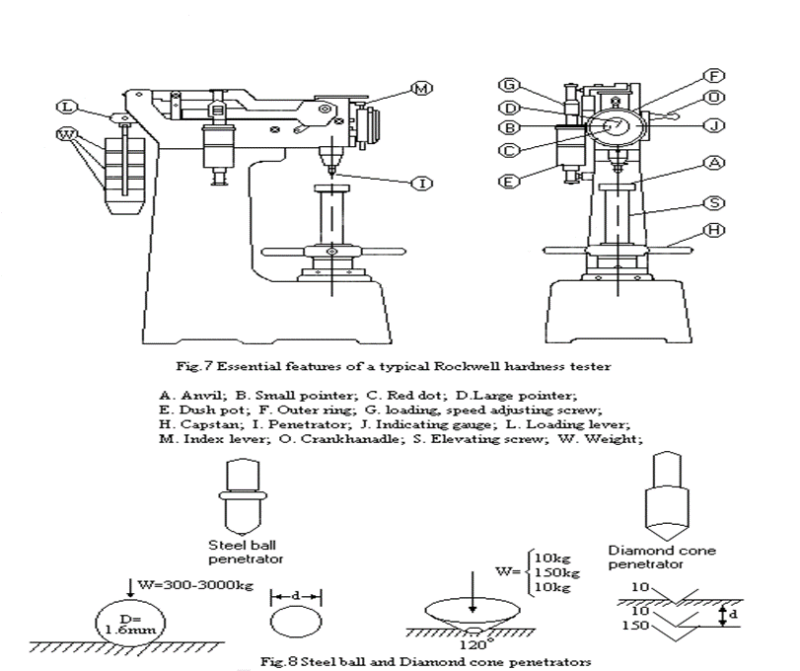
Parts of instruments

Slide 5
How does it works?
Rockwell hardness testing methods are a fast and reliable approach to determine the hardness of metals, alloys, small precision parts, wires, and in some cases, plastics.
The Rockwell hardness scales cover a range from the softest bearings to the hardest steels.
For testing steels, coppers, cast irons, thin materials, cemented carbides, and both deep and shallow case hardened materials, quickly and directly obtained without the need for a secondary, dimensional measurement requirement.

Slide 6
What does it measure? It measures hardness of the of the material.

Slide 7
Features & Benefits
Virtually Friction-Free Operation The only contact points in the load system are a set of bearings at the end of the lever beam carrying the major load and a leaf spring at the end of the lever beam carrying the minor load.
Dead Weights for Full Load and Preload Most competitive testers use dead weights for the full load due to their accuracy, but use springs to apply the preload. Dead weights are used on the INDENTRON Series for both full load and preload due to their excellent accuracy and stability under a wide range of conditions.
Full Load Is Applied Precisely at Preload Automation in the timing reduces the variations introduced by the flow of the material under load.
Preload Error Monitoring The system prevent the operator for completing a test if the preload is over- or under-applied. egad Weights for Full Load and Preload egad Weights for Full Load and Preload Most competitive testers use dead weights for the full load due to their accuracy, but use springs to apply the preload. Dead weights are used on the INDENTRON Series for both full load and preload due to their excellent accuracy and stability under a wide range of conditions. Automation in the timing reduces the variations introduced by the flow of the material under load. The system prevent the operator for completing a test if the preload is over- or under-applied

Slide 8
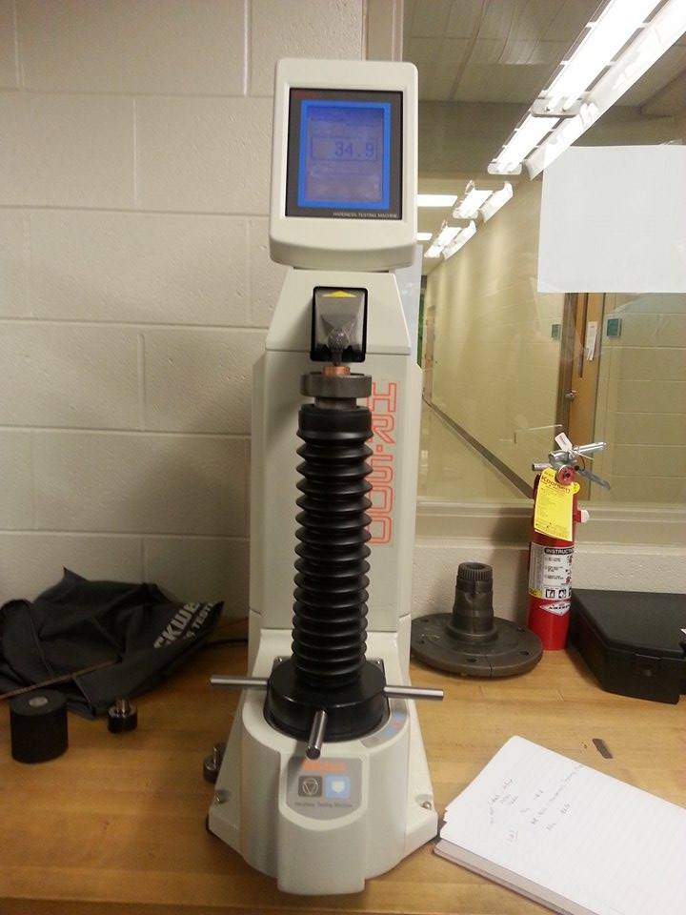
Lab 2 How to use the hardness Testing Machine HR- 500

Slide 9
Lab 2 : How to use the hardness Testing Machine HR 500
Procedure
We are using Hardness Testing Machine HR 500 to test Aluminum and copper.

Slide 10
Lab 2 : How to use the hardness Testing Machine HR 500
Tested between Aluminum and Copper
Set up each of the Aluminum and copper
Test each of the material in Hardness machine HR 500
Aluminum- 42.5
Copper – 34.9

Slide 11
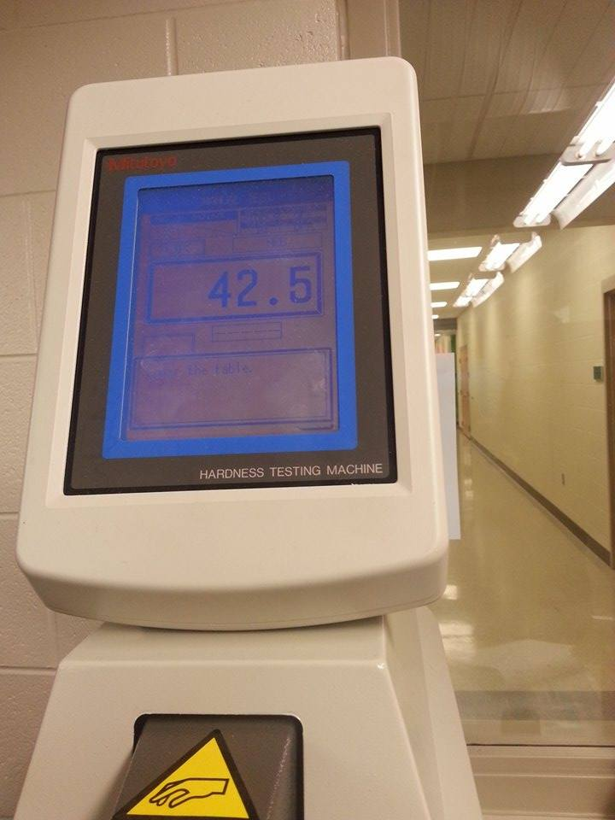
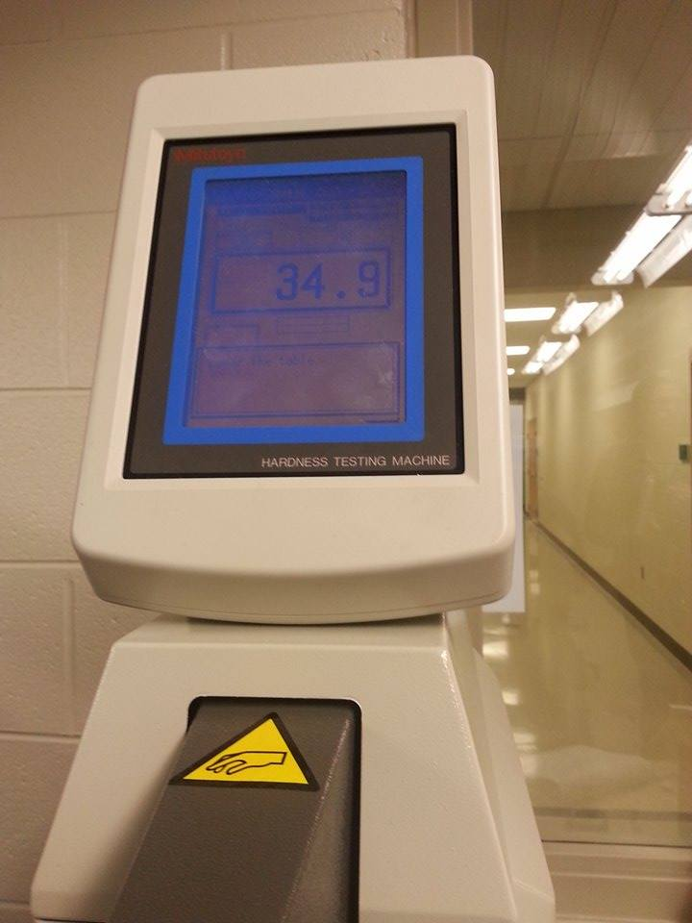
Lab 2 : How to use the hardness Testing Machine HR 500 -
Aluminum : 42.5
Copper: 34.9

Slide 12
Lab 2 : How to use the hardness Testing Machine HR 500 ( Conclusion)
We got the results of the Aluminum and copper.
Aluminum has the highest hardness than Copper.

Slide 13
Lab 3-Hardness Test: Rockwell Hardness Testing Machine

Slide 14
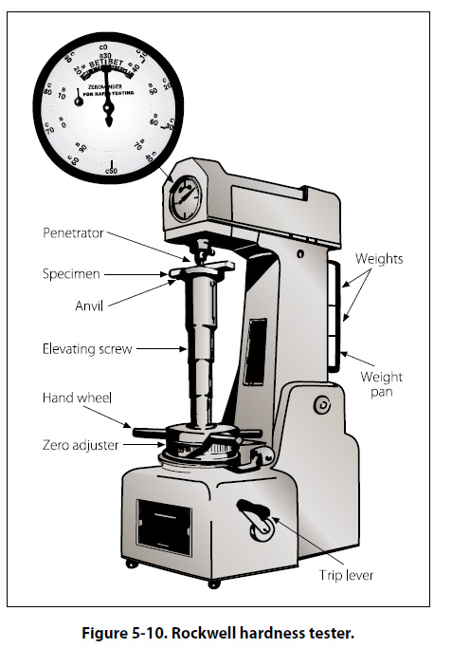
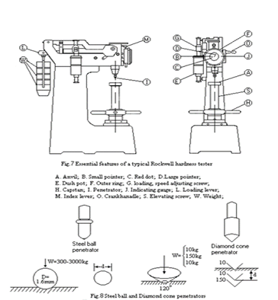
Lab 3-Hardness Test: Rockwell Hardness Testing Machine
Used 2 different materials
Steel 4140
Steel 1018

Slide 15
Lab 3-Hardness Test: Rockwell Hardness Testing Machine
Procedure
Set two different materials on the Rockwell
Measured 3 times of each materials
Used the C-scale of HRC is 150 load
Used the 4140 steel and 1018 steel

Slide 16
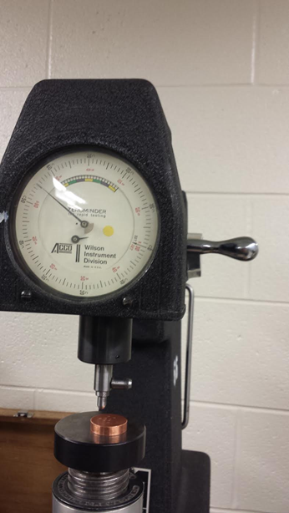
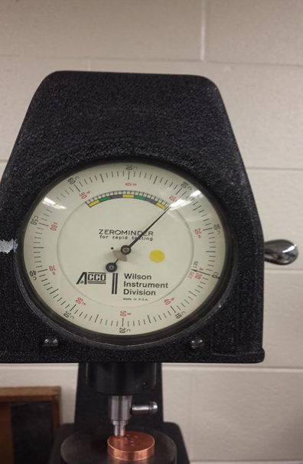
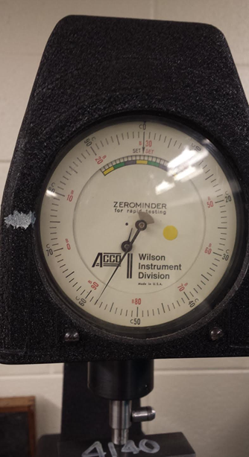
Lab 3-Hardness Test: Rockwell Hardness Testing Machine ( Picture)

Slide 17
Lab 3-Hardness Test: Rockwell Hardness Testing Machine
Steel ( 4140 ) C-Scale | Steel ( 1080) C- Scale
57 | 36
58 | 37
65 | 36

Slide 18
Lab 4-Crystal Lab( origami shapes)

Slide 19
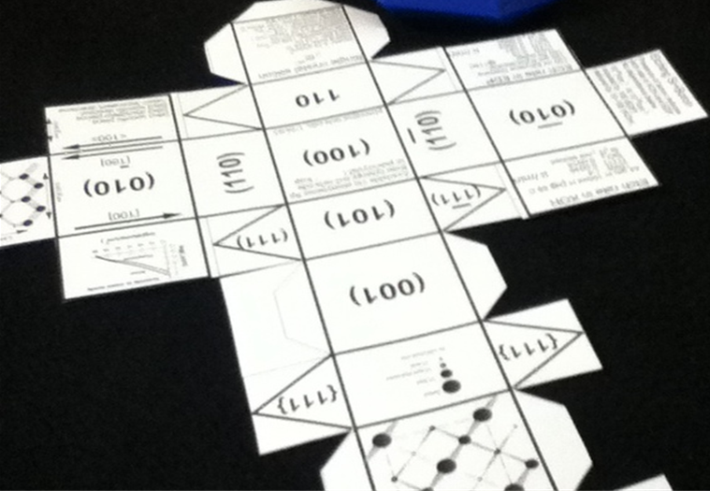
Lab 4-Crystal Lab( origami shapes)
First we cut the paper to get the origami crystal shape
Based on mechanical materials

Slide 20
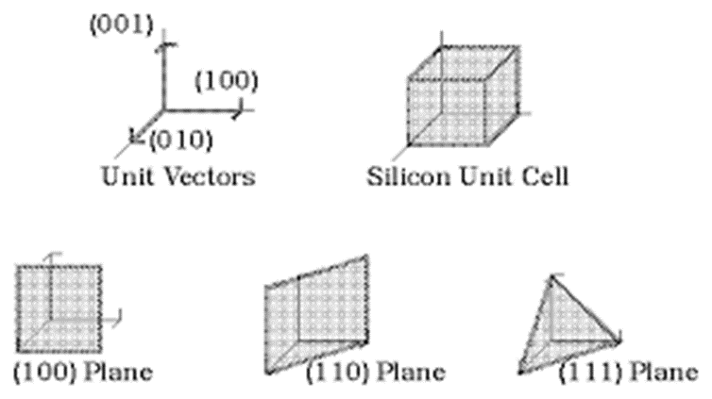
Lab 4-Crystal Lab( origami shapes)
They have a different unit cells

Slide 21
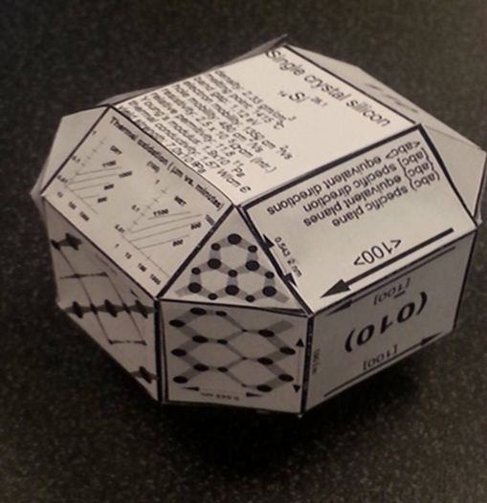
Lab 4-Crystal Lab( origami shapes)
The Last step we get the origami as a crystal shape

Slide 22
Lab 4-Crystal Lab( origami shapes)
Conclusion
We describe mechanical properties created by folding flat sheets in the tradition of origami, the art of paper folding, and study them in terms of their basic geometric and stiffness properties, as well as load bearing capability.

Slide 23
Lab 5- Tensile Strength Test

Slide 24
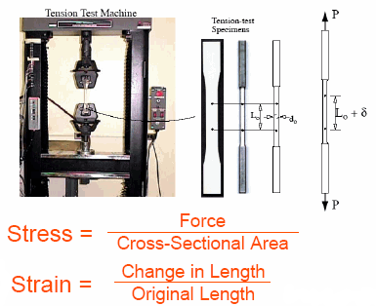
Lab 5- Tensile Strength Test

Slide 25

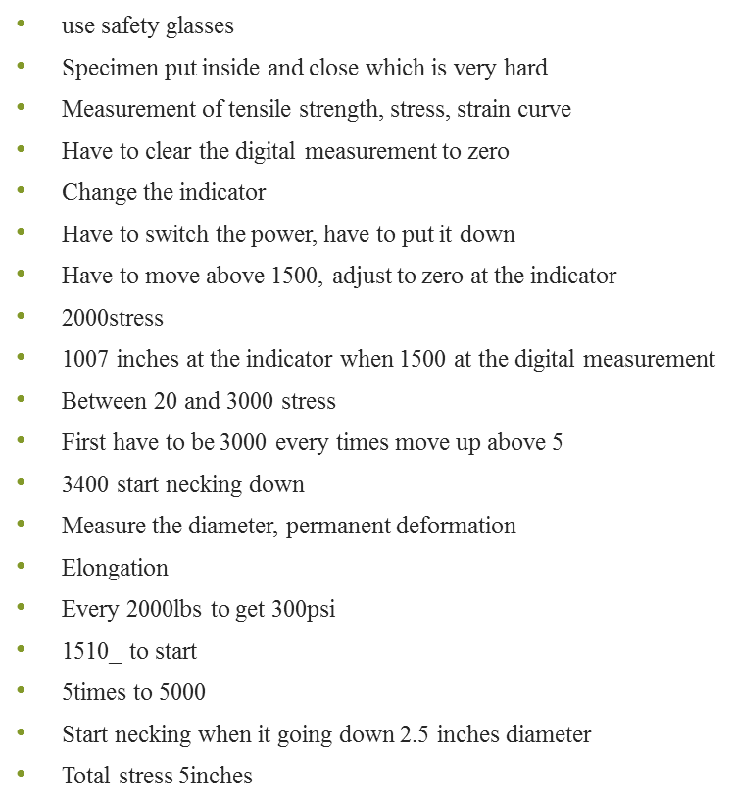

Slide 26

S | Thousand at 30
0 | 1540
0.002 | 3500
0.004 | 3800
0.006 | 4200
0.008 | 4550
0.01 | 4810
0.012 | 5000
0.014 | 5150
0.016 | 5275
0.018 | 5400
0.02 | 5460
0.022 | 5530
0.024 | 5555
0.026 | 5600
0.028 | 5625
0.03 | 5650
0.033 | 5665
0.04 | 5720
0.045 | 5730

Slide 27
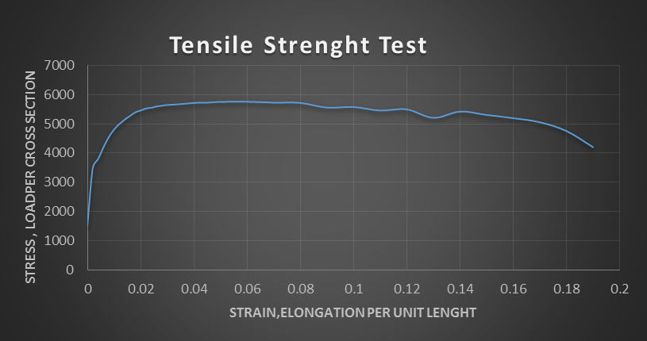
Lab 5- Tensile Strength Test

Slide 28
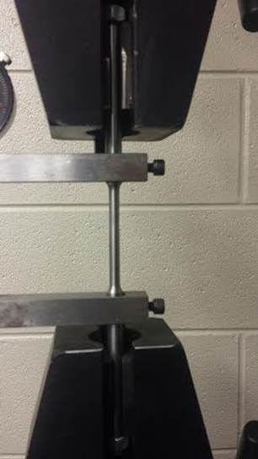
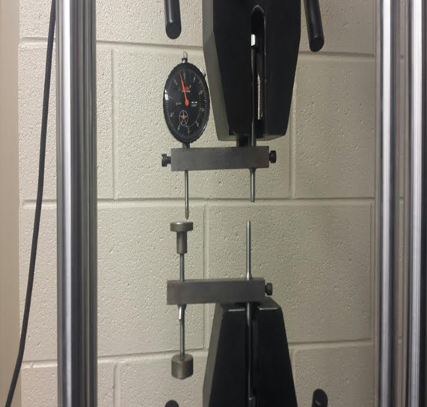
Lab 5- Tensile Strength Test
After Test
Before Test

Slide 29
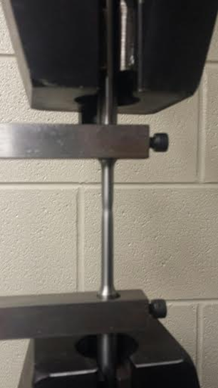
Lab 5- Tensile Strength Test
Start Necking
Fracture

Slide 30
Lab 5- Tensile Strength Test
Original length is 2.00 inches
Final length is 2.625 inches

