Slide 1
EECT 122
Robert Knight
Lab Notebook

Slide 2
LAB0

Slide 3
Equipment List
And Gate:74LS08
Or Gate: 74LS32
Nand Gate: 74LS00
Nor Gate:74LS02
DC Power Supply :RSR HY1802D
Voltmeter: GW Instek GDM-8245
Bench 7

Slide 4
A | B | Output
1 | 0 | 0
0 | 1 | 0
1 | 1 | 1
0 | 0 | 0
 | 74LS00N | Nand Gate
A | B | Output
1 | 0 | 1
0 | 1 | 1
1 | 1 | 0
0 | 0 | 1
 | 74LS32D | Or Gate
A | B | Output
1 | 0 | 1
0 | 1 | 1
0 | 0 | 0
1 | 1 | 1
 | 74ls02N | Nor Gate
A | B | Output
1 | 0 | 0
0 | 1 | 0
0 | 0 | 1
1 | 1 | 0

Slide 5
LAB NOTES
When doing the lab I learned that using the 74ls04 inverter that it is input then output then input again. So in other words every other pin is and input.
While doing the multisim I realized that the parts I used in the program needed to match the parts we have available in the lab

Slide 6
Conclusion
After building the and, or, nand and or gates

Slide 7
Lab A

Slide 8
Equipment
74LS04
74LS08
74LS01
74LS11
1K resistors x6

Slide 9
Lab Notes
After continuously trying to figure out why my top circuit was not operating, I figured out I had the A,C inputs mixed up.
Figured out that that it doesn't matter what input you use as long as you follow what's going on.
Figured out how to organize the Kmap so its not such a hot mess.
Found out how to use a logic converter.

Slide 10
Conclusion
After doing this lab I was able to prove that, in fact, my simplified circuit matched the original with the same output.

Slide 11
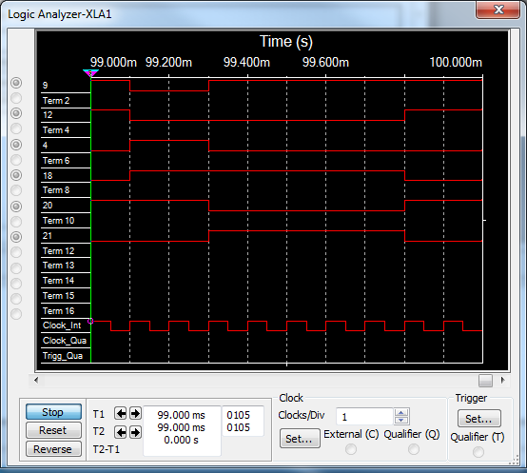
Lab B

Slide 12
Equipment
74LS00
74LS02
74LS08
74LS86
74LS32
74Ls04
Logic Analyzer

Slide 13
Lab Notes
One Clock had to be twice as much as the other in order to get it to operate properly.
After doing this lab the incorrect way, using resistors and switch's, I figured out that those were not needed to use the logic analyzer. Rather, instead using a digital power source instead of a DC source.

Slide 14
Conclusion
After figuring out that the power source had to be a digital clock instead of a Dc power source I was able to find the right frequency to get the gates to act the way they should.

Slide 15
Lab C Theorem Proof

Slide 16
Theorems
Proving theorems 8-15b
Simulation only

Slide 17
Theorems 1-8

Slide 18
Lab Notes Theorem 1-8
While doing this lab I was able to prove all the theorems to be correct
While using multisim I learned about hooking the inputs up the way I needed to get my outcomes.
These theorems were proved to be correct by following the schematic in the book on page 92

Slide 19
Theorem 13A

Slide 20
Lab Notes for 13A
In this simulation I was pretty confused on how to hook the inputs up in order to get x(y+z)=xy+xz.
After numerous try’s I was able to figure it out for both the first part of the equation also the product of the equation.
The first part of the equation is simply an or gate also and gate the product is two and gates going into an or gate to get your outcome

Slide 21
Theorem 13B

Slide 22
Lab Notes for 13B
This one took me the shortest amount of to get done due to having figured out 13A.
If you follow the equation you will figure out that two separate or gates lead in into one single and gate.
The second part of the equation in 4 separate and gates leading into or gates.

Slide 23
Theorem 14-15B

Slide 24
Lab Notes 14-15B
These feed off each other in ways.
As long as you understand the inverter 15a and 15b are pretty easy to get.

Slide 25
Conclusion for Lab C
Doing these lab really help me understand more in depth how to come with circuits from looking at an equation. I learned how to figure out the equation by looking at the multiplication as and gates and addition as or gates. Learning this I feel will drastically help my understanding of the digital side out and equation and how to build it.

Slide 26
Lab D
Simulate and build jk flip flop

Slide 27
Equipment
74la73
Tektronix TDS 220
RSR HY1802D
Gw instek GDM-8245
GW instek GFG-8210

Slide 28
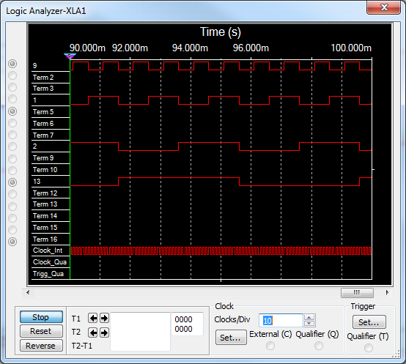

Slide 29
Lab Notes
Simulation was not to hard to build due to it being in to the book.
I did have a bit of trouble figuring out whether the clear needed a high or low signal to get it to operate properly.
Building it we had everything hooked up properly except the ch.2 had a 10 times multiplier on it so we sat trouble shooting it for 20 minutes before we figured what it was.
Learning how to use the scope was very helpful also. This allowed me to be able to figure out about the 10 times multiplier on ch2.

Slide 30
Lab 1
Charecterizing the D flip flop

Slide 32
Equipment
74LS74
74LS08
74LS04
RSR HY1802D

Slide 33
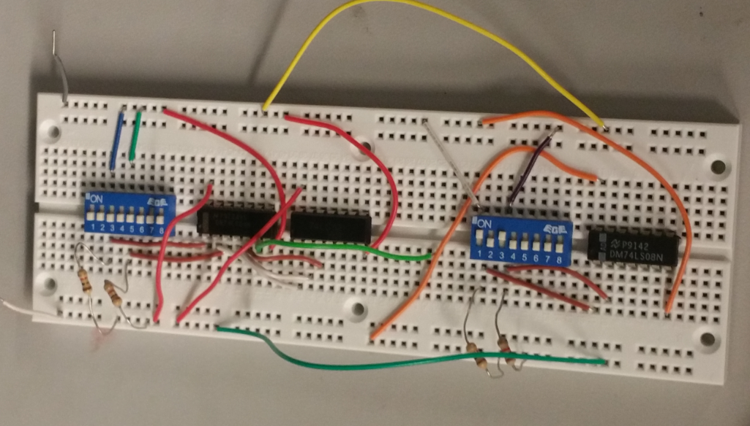

Slide 34
Lab Notes
This lab reminded of a lab we did in the last part of this class.

Slide 35
Conclusion
After doing both the3 multisim and building this flip flop it helped me realize exactly what it does.
When running wire if you do separate color wires for each pin in and out it’s a lot easier to debug.

Slide 36
Lab 2
Charectrerizing jk flip flop

Slide 37
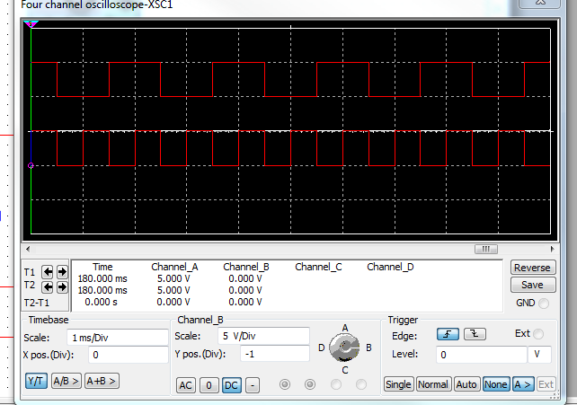

Slide 38
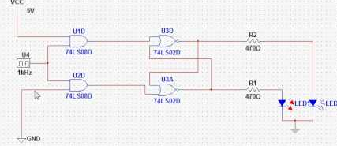
Logic diagram

Slide 39
Logic
When J is low and K is low and the clock is high the result is no change. So when they are both low the result will remain the same.
When j is high and k is low and have a positive clock the result will be a high output
When j is low and k is high and have a positive going clock the result will be a low reading.
When both j and k are high you will toggle. So it will be the opposite of what the reading was previously to this happening.

Slide 40
Equipment
74ls76
Logic analyzer
scope

Slide 41
Lab 3
SR Flip flop

Slide 42
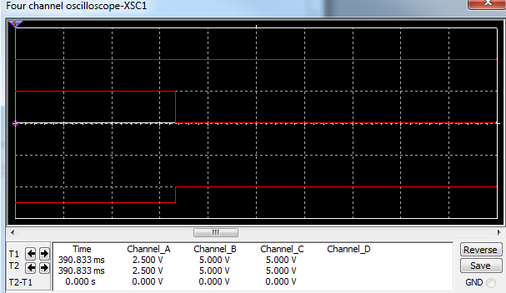

Slide 43
Equipment
S-R Flip Flop

Slide 44
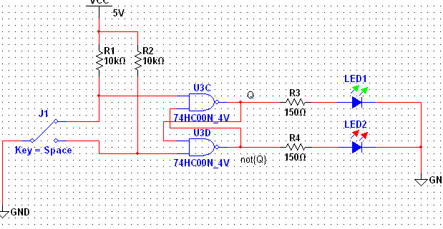
Logic

Slide 45
Lab Notes
When S and R are low like the jk flip flop there is no change in the output.
When S is high and R is low the result is high
The s is low and r is high the result is a low signal
When they are both high it results in a ambiguous outcome.

Slide 46
Lab 4
Nand gate latch

Slide 47
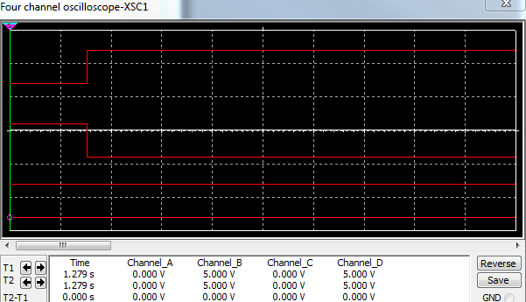
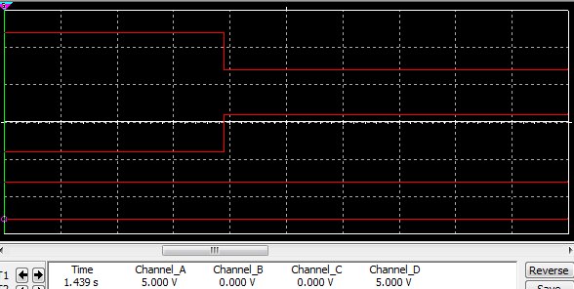

Slide 48
Lab Notes
When the set is low and the reset is set to high the Q output will be high nad the q not output will be low
The q and q not are inverses of each other.

Slide 49
Equipment
74ls00

Slide 50
Lab 5
2’s compliment

Slide 52
Equipment
74LS04
74LS283
Multisim

Slide 53
Lab 6
4 bit adder

Slide 55
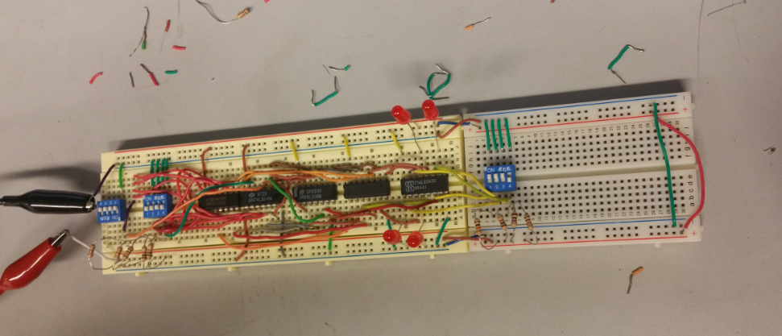
Build

Slide 56
Equipment
74ls283
74ls04

Slide 57
Lab notes
The first couple try’s in the simulation I couldn’t figure out how to get it to work properly. After careful trouble shooting, checking voltage input and outputs, I figured out that I had power flowing correctly. However, it took me a couple more minutes to figure out that my that my inputs didn’t match my outputs. After fixing that problem I figured out that my circuit worked properly.

Slide 58
Conclusion
After building this adder I realized a lot of the problems I encountered were silly little input mistakes.

Slide 59
Lab 7
Adder Subtractor

Slide 61
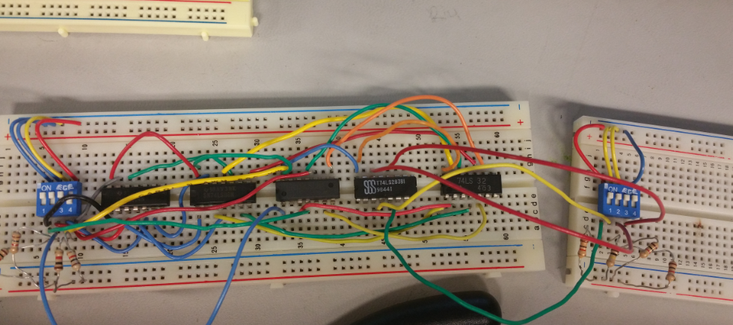
Build

Slide 62
Equipment
74LS08
74LS32
74LS283

Slide 63
Lab Notes
The diagram in the book was a little difficult at first to follow.
After looking at the diagram for a little bit I figured out how to build it on multisim.
Building it on a board was easier than building it on multisim was.

Slide 64
Conclusion
After building it on the board I figured out it was as easy as I thought it was going to be to be. After breaking out the voltmeter for about an hour I found my mistake I didn’t invert one of the and gates like I needed too. After fixing this problem the adder subtractor worked flawlessly.

Slide 65
Lab 8
Seven Segment Display

Slide 66
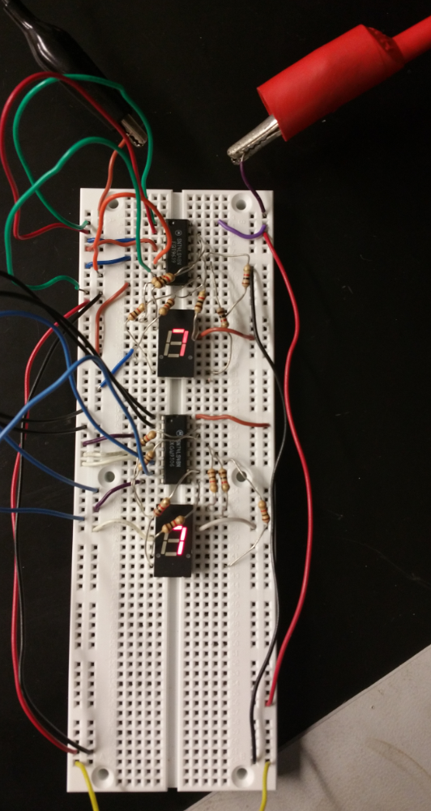
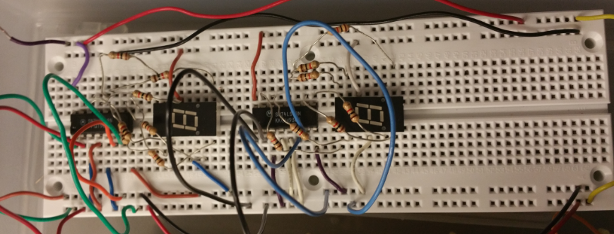
Build

Slide 67
Equipment
Man74
74LS48

Slide 68
Lab Notes
This lab was easy once I got going.
Hardest part was figurin common cathode or common anode.
74LS48 is what we needed.

Slide 69
Conclusion
After figuring out that I needed the 74ls48 for oman74 the display lit right up with out a problem. This lab was helpful in the aspect of making sure you have the right parts for the right job.

Slide 70
Lab 9
Minilou/ aruduino

Slide 71
Part Build
.Model 74lsbob d_chip (behavior"
+;74lsbob Binary-to-BCD Converter
+/ inputs D C B A
+/outputs Y5 Y4 Y3 Y2 Y1
+/ table 16
+; inputs ;outputs
+ 0 0 0 0 0 0 0 0 0
+ 0 0 0 1 0 0 0 0 1
+ 0 0 1 0 0 0 0 1 0
+ 0 0 1 1 0 0 0 1 1
+ 0 1 0 0 0 0 1 0 0
+ 0 1 0 1 0 0 1 0 1
+

Slide 72
Excel sheet
DEC | C | B | A | BIN |  | ADD | BIN |  | D | C | B | A |  | BCD |  |  | BCD |  |  | Y5 | Y4 | Y3 | Y2 | Y1 |  | Model Code
0 | 0 | 0 | 0 | 0 |  | 0 | 0 |  | 0 | 0 | 0 | 0 |  | 0 | 0 |  | 0 | 0 |  | 0 | 0 | 0 | 0 | 0 |  | + 0 0 0 0 0 0 0 0 0 | 1
1 | 0 | 0 | 1 | 1 |  | 1 | 1 |  | 0 | 0 | 0 | 1 |  | 0 | 1 |  | 0 | 1 |  | 0 | 0 | 0 | 0 | 1 |  | + 0 0 0 1 0 0 0 0 1 | 2
2 | 0 | 1 | 0 | 10 |  | 2 | 10 |  | 0 | 0 | 1 | 0 |  | 0 | 2 |  | 0 | 10 |  | 0 | 0 | 0 | 1 | 0 |  | + 0 0 1 0 0 0 0 1 0 | 3
3 | 0 | 1 | 1 | 11 |  | 3 | 11 |  | 0 | 0 | 1 | 1 |  | 0 | 3 |  | 0 | 11 |  | 0 | 0 | 0 | 1 | 1 |  | + 0 0 1 1 0 0 0 1 1 | 4
4 | 1 | 0 | 0 | 100 |  | 4 | 100 |  | 0 | 1 | 0 | 0 |  | 0 | 4 |  | 0 | 100 |  | 0 | 0 | 1 | 0 | 0 |  | + 0 1 0 0 0 0 1 0 0 | 5
5 | 1 | 0 | 1 | 101 |  | 5 | 101 |  | 0 | 1 | 0 | 1 |  | 0 | 5 |  | 0 | 101 |  | 0 | 0 | 1 | 0 | 1 |  | + 0 1 0 1 0 0 1 0 1 | 6
6 | 1 | 1 | 0 | 110 |  | 6 | 110 |  | 0 | 1 | 1 | 0 |  | 0 | 6 |  | 0 | 110 |  | 0 | 0 | 1 | 1 | 0 |  | + 0 1 1 0 0 0 1 1 0 | 7
7 | 1 | 1 | 1 | 111 |  | 7 | 111 |  | 0 | 1 | 1 | 1 |  | 0 | 7 |  | 0 | 111 |  | 0 | 0 | 1 | 1 | 1 |  | + 0 1 1 1 0 0 1 1 1 | 8
 |  |  |  |  |  | 8 | 1000 |  | 1 | 0 | 0 | 0 |  | 0 | 8 |  | 0 | 1000 |  | 0 | 1 | 0 | 0 | 0 |  | + 1 0 0 0 0 1 0 0 0 | 9
DEC | F | E | D | BIN |  | 9 | 1001 |  | 1 | 0 | 0 | 1 |  | 0 | 9 |  | 0 | 1001 |  | 0 | 1 | 0 | 0 | 1 |  | + 1 0 0 1 0 1 0 0 1 | 10
0 | 0 | 0 | 0 | 0 |  | 10 | 1010 |  | 1 | 0 | 1 | 0 |  | 1 | 0 |  | 1 | 0 |  | 1 | 0 | 0 | 0 | 0 |  | + 1 0 1 0 1 0 0 0 0 | 11
1 | 0 | 0 | 1 | 1 |  | 11 | 1011 |  | 1 | 0 | 1 | 1 |  | 1 | 1 |  | 1 | 1 |  | 1 | 0 | 0 | 0 | 1 |  | + 1 0 1 1 1 0 0 0 1 | 12
2 | 0 | 1 | 0 | 10 |  | 12 | 1100 |  | 1 | 1 | 0 | 0 |  | 1 | 2 |  | 1 | 10 |  | 1 | 0 | 0 | 1 | 0 |  | + 1 1 0 0 1 0 0 1 0 | 13
3 | 0 | 1 | 1 | 11 |  | 13 | 1101 |  | 1 | 1 | 0 | 1 |  | 1 | 3 |  | 1 | 11 |  | 1 | 0 | 0 | 1 | 1 |  | + 1 1 0 1 1 0 0 1 1 | 14
4 | 1 | 0 | 0 | 100 |  | 14 | 1110 |  | 1 | 1 | 1 | 0 |  | 1 | 4 |  | 1 | 100 |  | 1 | 0 | 1 | 0 | 0 |  | + 1 1 1 0 1 0 1 0 0 | 15
5 | 1 | 0 | 1 | 101 |  | 15 | 1111 |  | 1 | 1 | 1 | 1 |  | 1 | 5 |  | 1 | 101 |  | 1 | 0 | 1 | 0 | 1 |  | + 1 1 1 1 1 0 1 0 1 | 16
6 | 1 | 1 | 0 | 110
7 | 1 | 1 | 1 | 111

Slide 73
Multisim

Slide 74
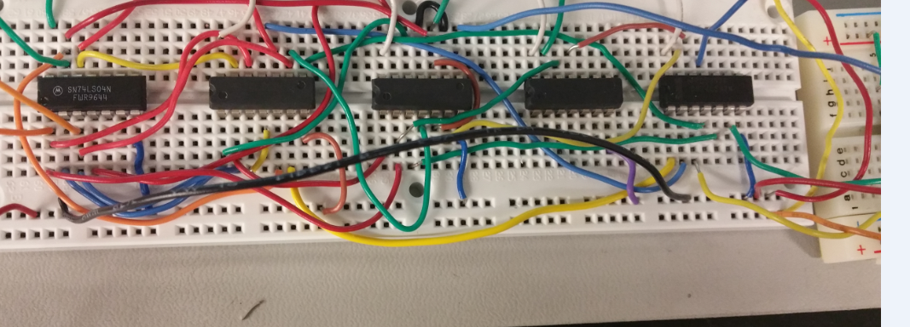
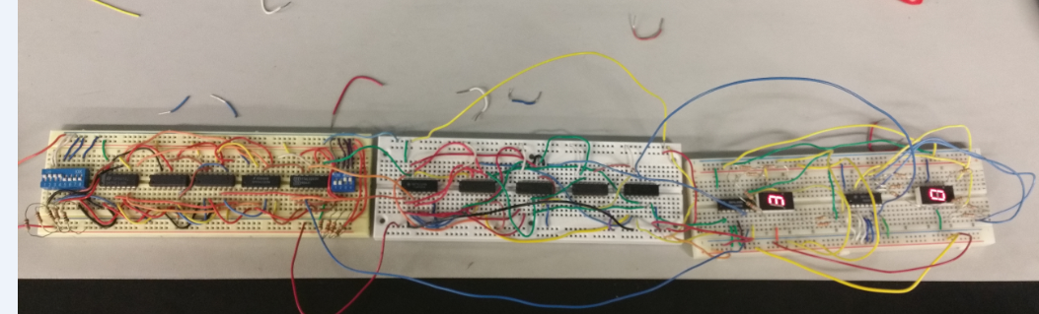
Build minilou

Slide 75
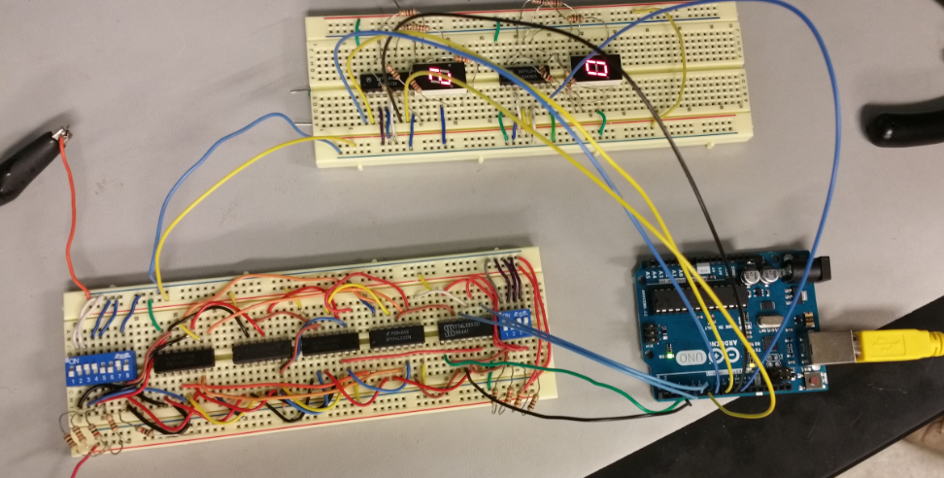
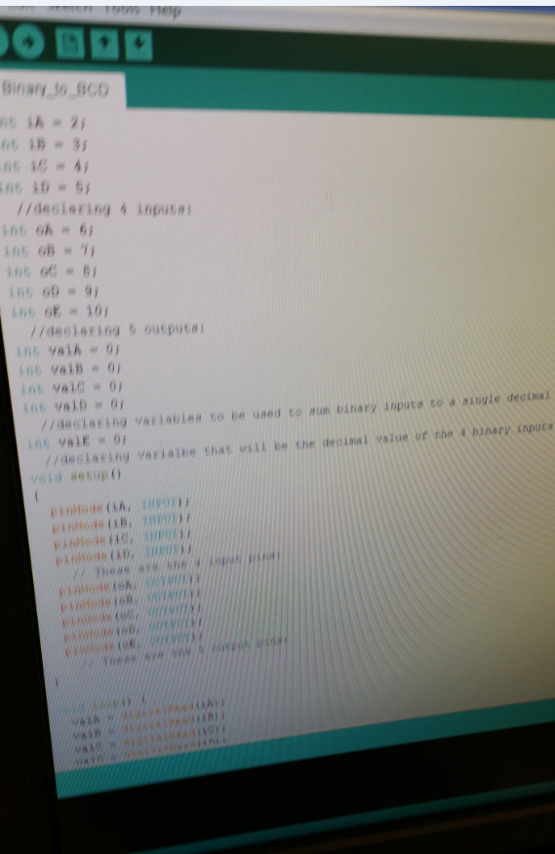
Arduino Build

Slide 76
Lab Notes
Mini Lou wasn’t working due to bad IC
Arduino code not working due to bad code and not being able to figure out how to upload.
Arduino not working due to input graph in code.

Slide 77
Equipment
Arduino Uno
74Ls04
74Ls32
74LS08
74Ls283
Arduino code compiler

Slide 78
Conclusion
This was the first time I was ever introduced to an Arduino. However, after taking a C++ class also during this semester I could figure out the Arduino code was just c++ just with an Arduino library called in program. Writing a Program in c++ didn’t work though so we decided to just stick with the code in the Ardunio program. We had problems with the code writing so we put or heads together and figured it out. After figuring pout the code and the pin outs and pin ins in the Arduino we found out the it worked flawlessly like every other lab we all di together.

