Slide 1
Theorems 1-4
Evan Wilson
March 10, 2017

Slide 2
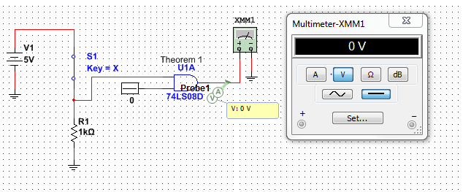
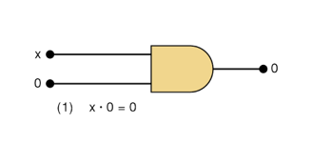
Theorem 1
Theorem 1 | A | B | X | Test
 | 0 | 0 | 0 | 0V
 | 1 | 0 | 0 | 0V
The A input is 0 when there is a short in the circuit or the switch is open and a 1 one when it is closed. The B input is 0. With an open or closed circuit the output is always 0.

Slide 3
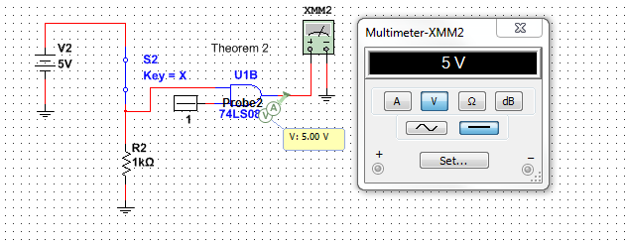
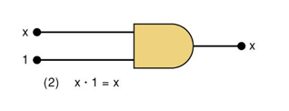
Theorem 2
Theorem 2 | A | B | X
 | 0 | 1 | 0 | 0V
 | 1 | 1 | 1 | 5V
The A input is 0 when there is a short in the circuit or the switch is open and a 1 one when it is closed. The B input is 1. When the circuit is open the output is 0 and when the circuit is closed the output is 1 or 5V.

Slide 4
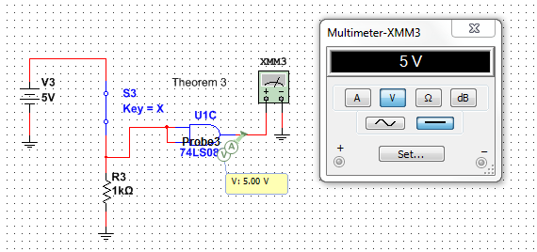
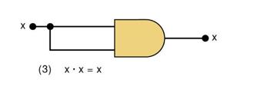
Theorem 3
Theorem 3 | A | B | X
 | 0 | 0 | 0 | 0V
 | 1 | 1 | 1 | 5V
The A input is 0 when there is a short in the circuit or the switch is open and a 1 one when it is closed. When the B input is 0 the output is 0 and when B input is 1 the output is 1 or 5V.

Slide 5
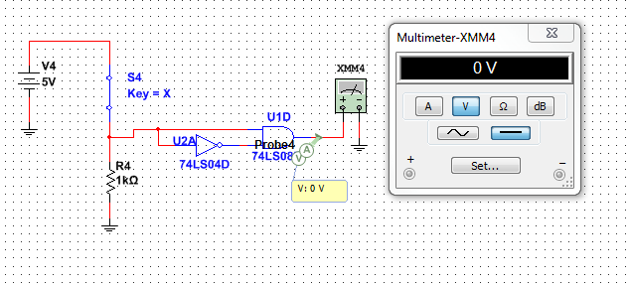
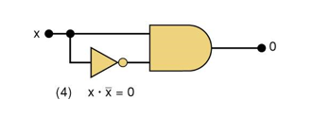
Theorem 4
Theorem 4 | A | B | X
 | 0 | 1 | 0 | 0V
 | 1 | 0 | 0 | 0V
The A input is 0 when there is a short in the circuit or the switch is open and a 1 one when it is closed. The B input is the inverse of A. When the circuit is open or closed the output will be 0.

