Slide 1
Or, AND, NAND, NOR Gates
Evan Wilson, Nick church, Mustafa smaili

Slide 2
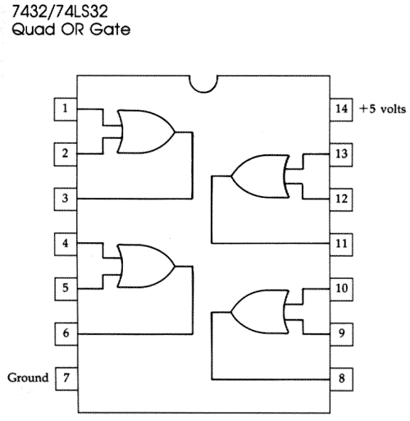
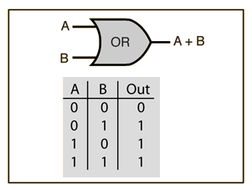
74ls32 Or Gate

Slide 3
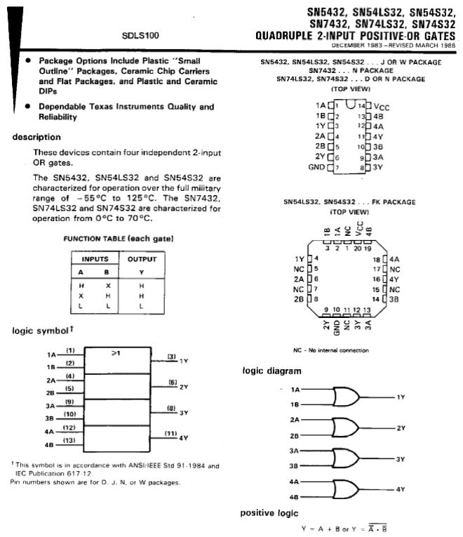
74ls32 or gate

Slide 4
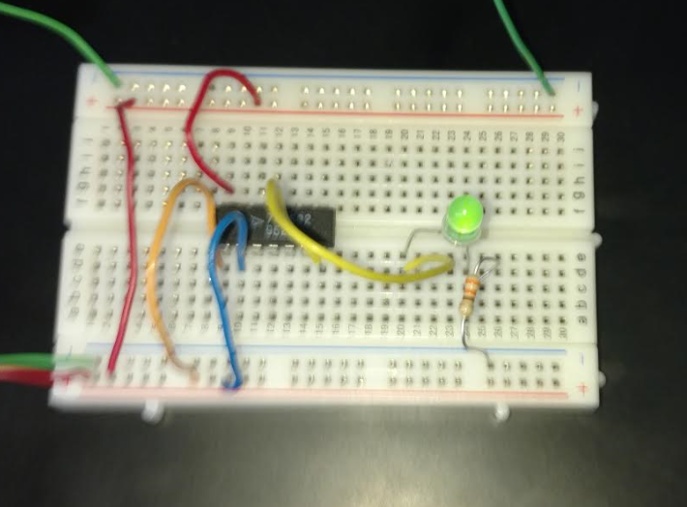
74ls32 Or Gate

Slide 5
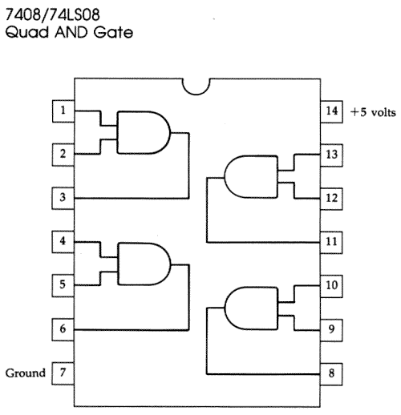

74LS08 And gate

Slide 6
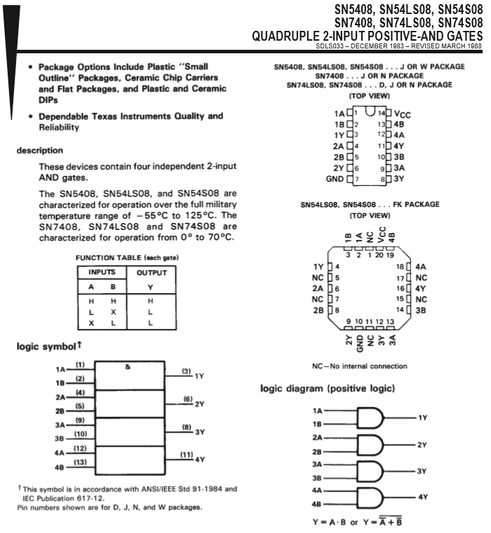
74ls08 and gate

Slide 7
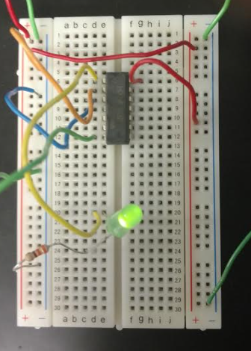
74ls08 and gate

Slide 8
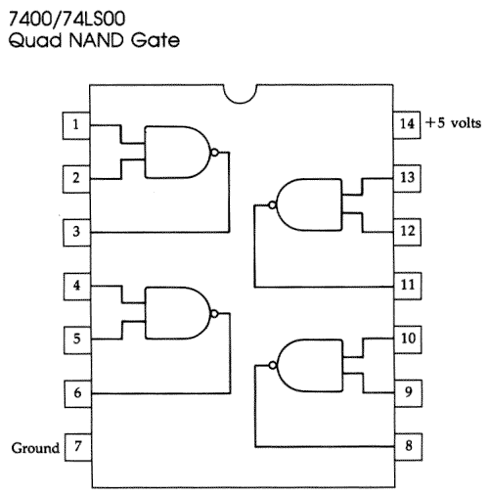
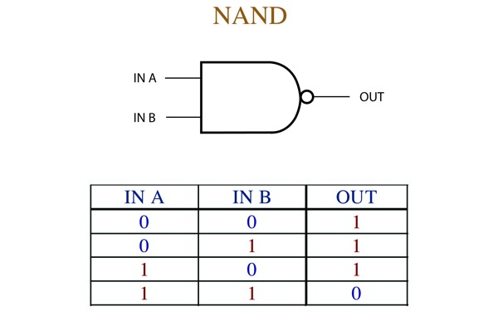
74ls00 NAND gate

Slide 9
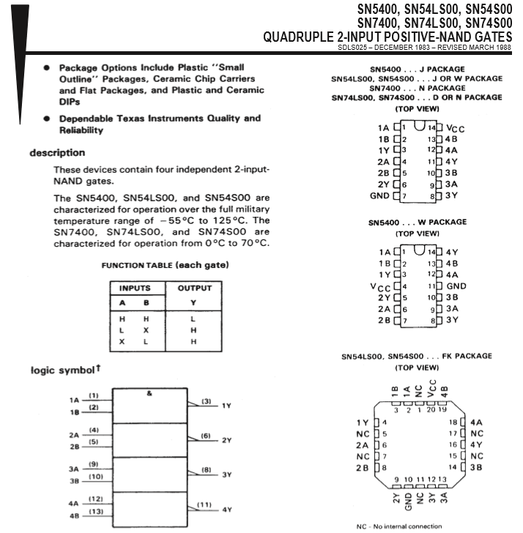
74ls00 nand gate

Slide 10
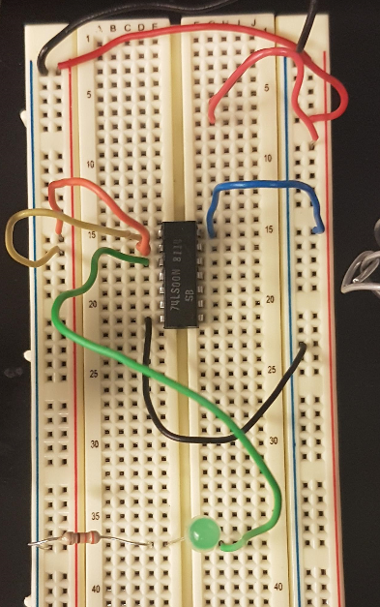
74ls00 nand gate

Slide 11
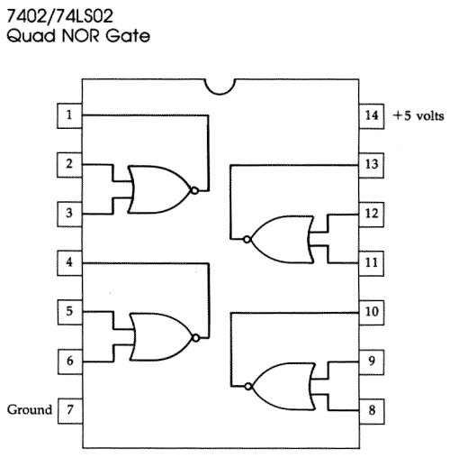
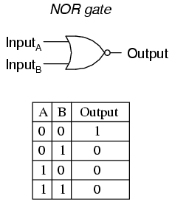
74ls02 nor gate

Slide 12
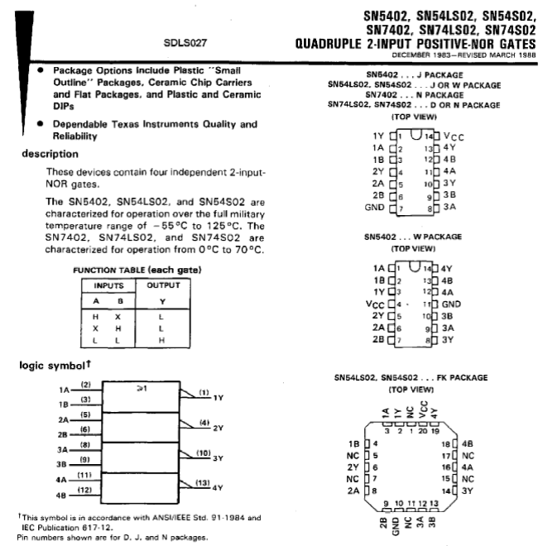
74ls02 nor gate

Slide 13
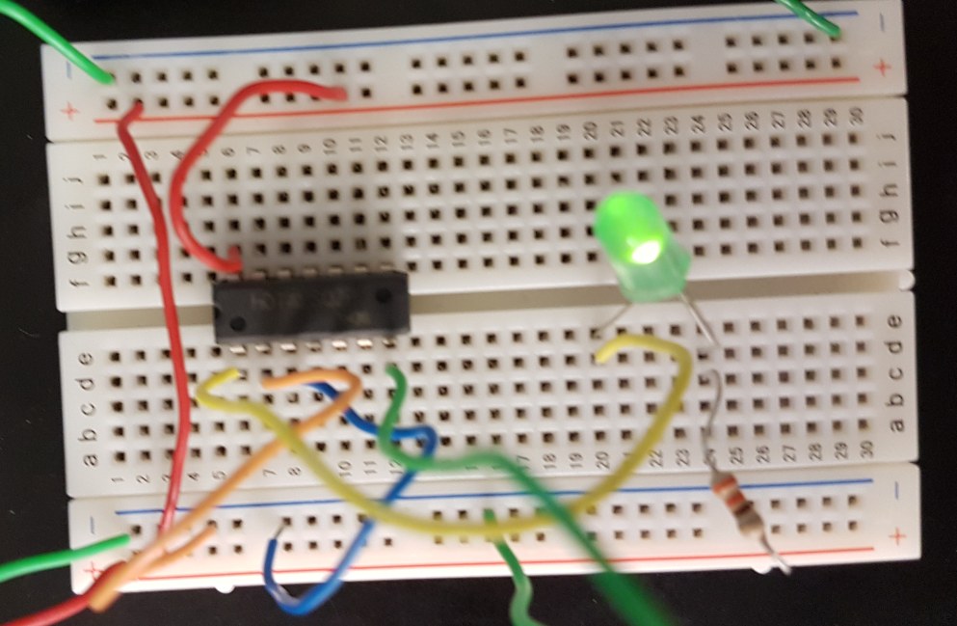
74ls02 nor gate

