Slide 1
Final project xor and xnor gates
Eect 112
Evan, Mustafa, nick

Slide 2
objective
This lab #8 is intended to introduce the students to be more comfortable of using the Lab Equipment:
The logic designer, the test equipment, and of course the TTL chips. Most of all you’ll learn more about Design Logic Circuits

Slide 3
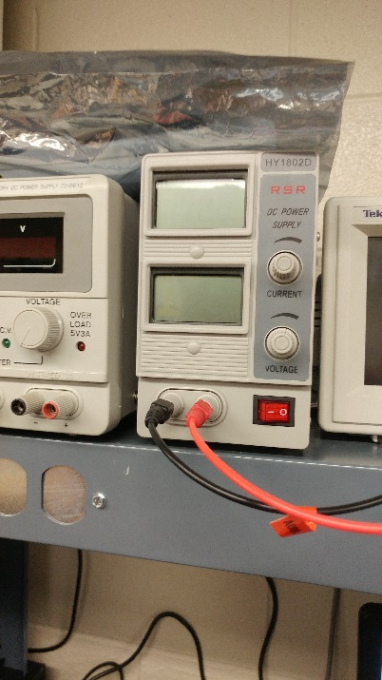
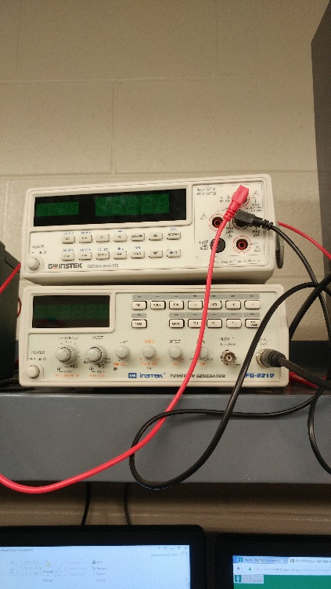
Equipment used
1 – Power Supply
1 – Digital Multimeter
2– 1Kohm
1 – 4 position dip switch
1 – 74LS86N - XOR
2– 74LS05N- NOT
2 – 74LS08N- AND
1 – 74LS32N - OR
3 – LED (light Emitted Diode)

Slide 4
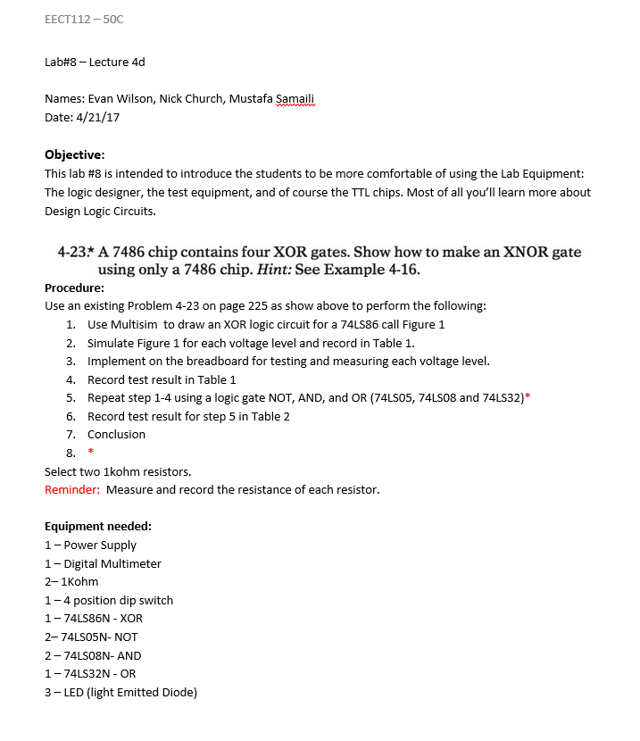
Lab instructions

Slide 5
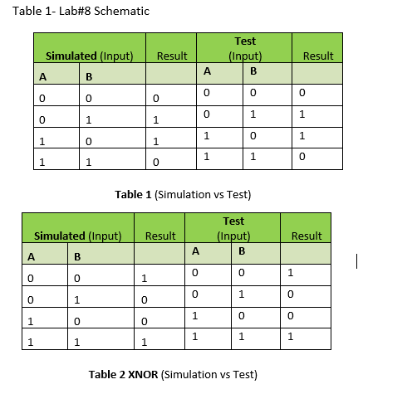
Truth table

Slide 6
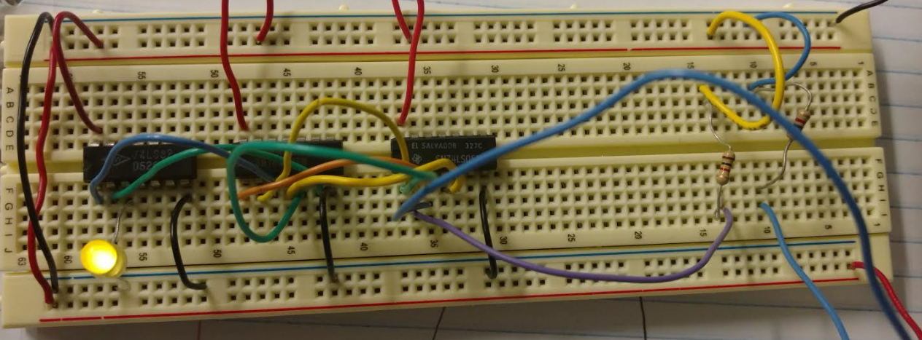
Xor A High, B Low

Slide 7
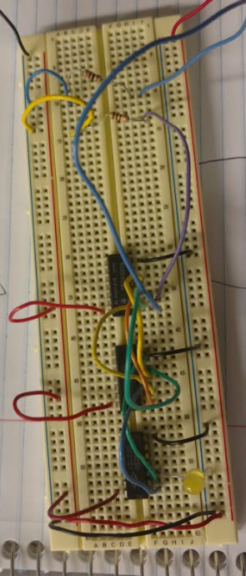
Xor Both inputs low

Slide 8
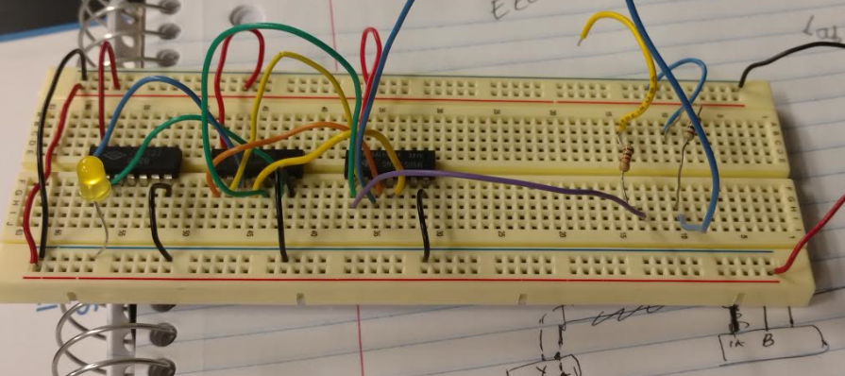
Xor a low, b high

Slide 9
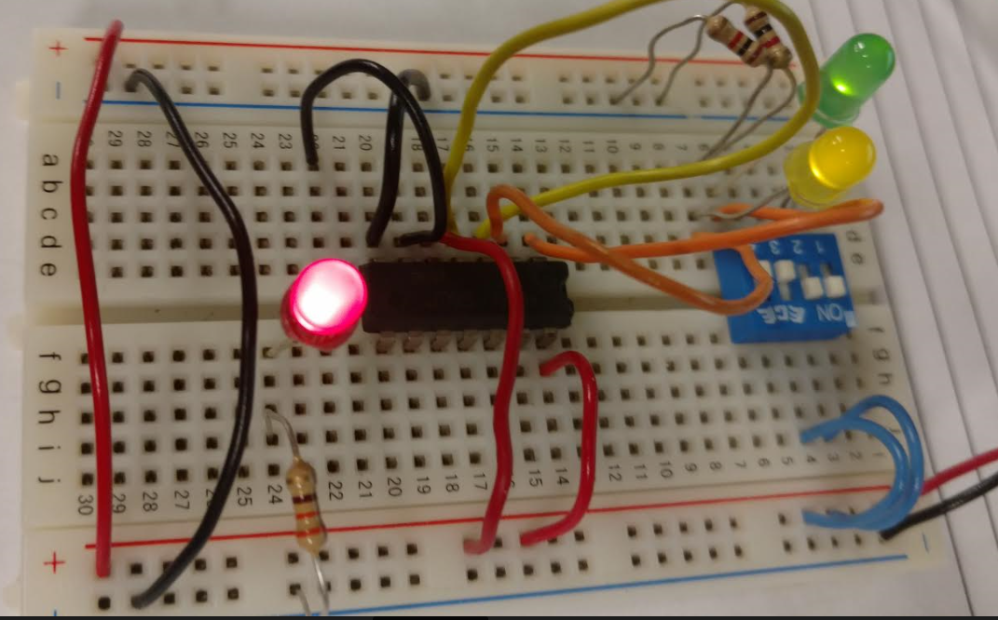
Xnor both inputs high

Slide 10
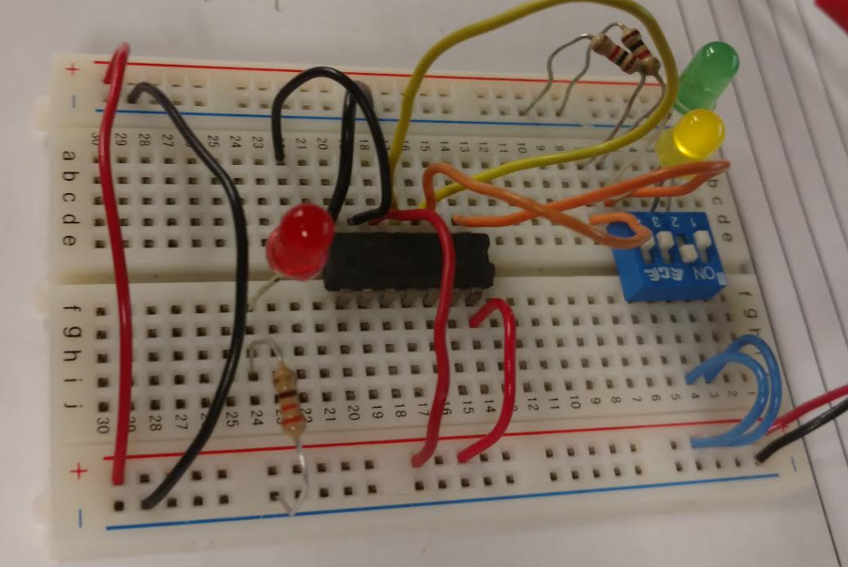
Xnor b high, a low

Slide 11
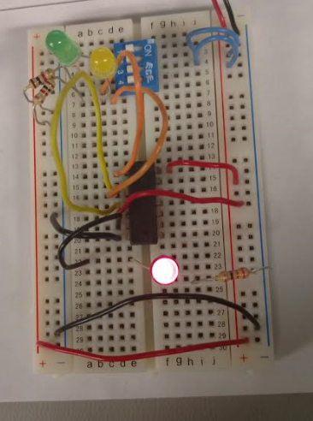
Xnor both inputs low

Slide 12
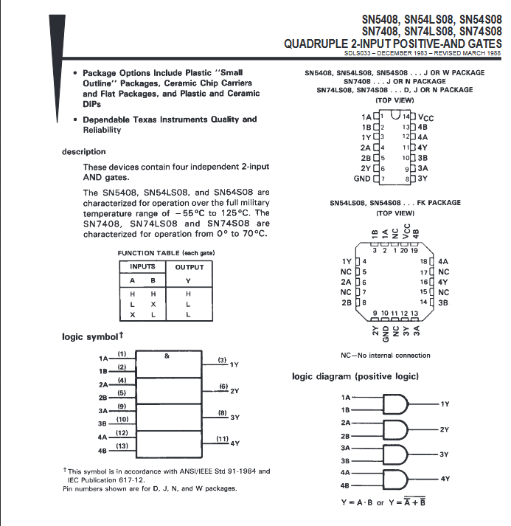
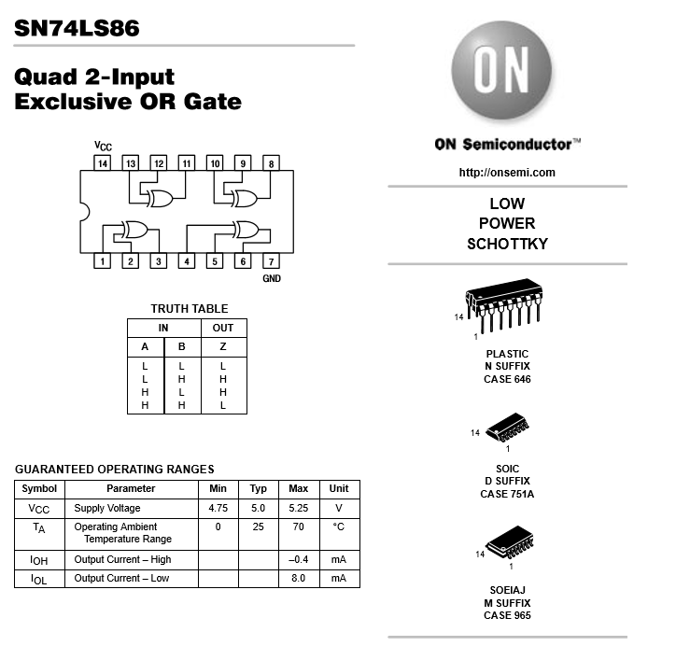
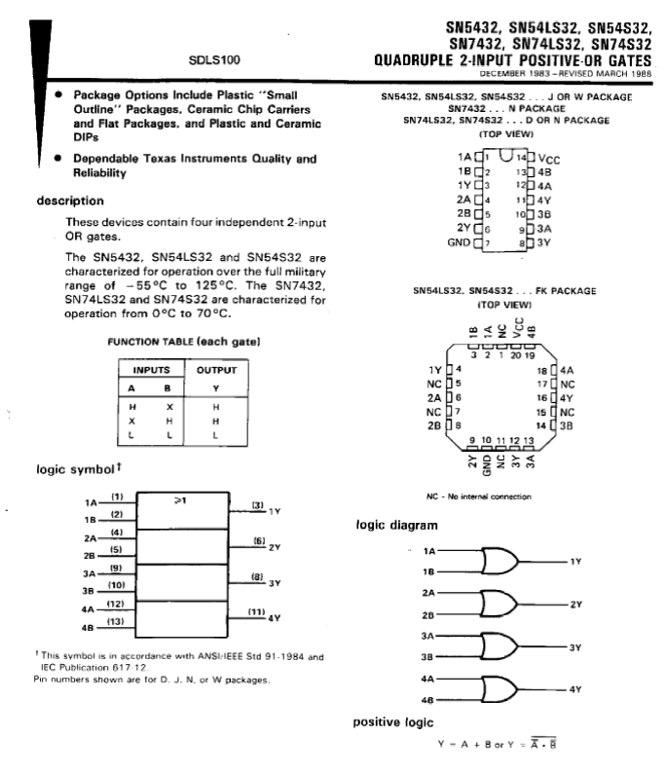
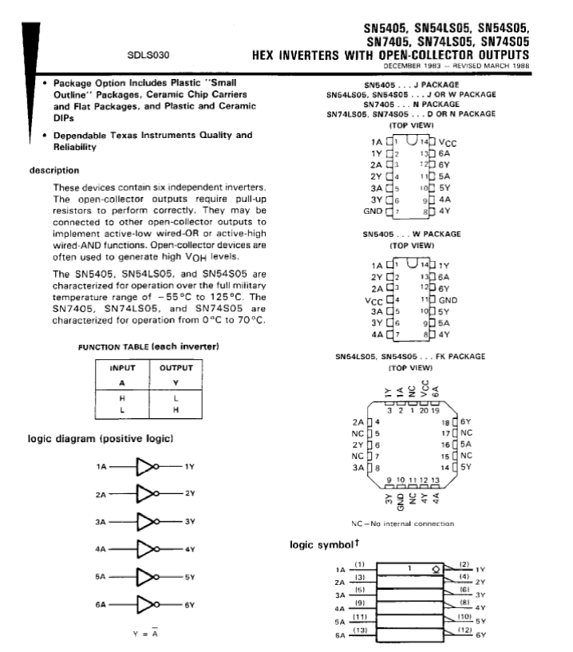
Data sheets

Slide 13
observations
Wiring up the XOR gate took awhile to wire properly, but once we did everything worked as it was supposed too. This class was awesome. We learned many things from circuits to logic gates. I hope to see you next semester.

Slide 14
resources
http://www.ivytechengineering.com/info/stores/74ls/index.html

