Slide 1
Mastermind in C++
Caitlin Crowley, Lucas Bazile, Oscar Guzman

Slide 2
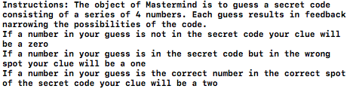
How to play mastermind
Notes:
-possibly explain classic rules vs gameplay
-what the classic boardgame experience was

Slide 3
Design practices
Naming format
Encapsulation
Bottom up Programming
Formatting
Working separately on program functions
Text style

Slide 4
The use of notes
void printInstr(); // prints instructions to game
void secretcode(); // generates the secret code
void winScreen(); // prints after successful game
cout << "Input your guess with spaces between numbers." << endl;
for (int i = 0; i < 4; i++) // player makes their guess here
cin >> guess[i];
switch (intro) {
case 1: //call mastermind function
secretcode();
game();
break;
case 2:
printInstr();
break;
case 3:
exit(0);
break;
default: //call mastermind function
secretcode();
game();
break;
Purpose of functions
Explanation of features
Instructions for changes should be made to the code.

Slide 5
Functions
Built in
srand((unsigned int)time(NULL)); // code that will randomly generate numberes
for the secret code
sort(clue, clue + 4);
exit(0);
Team designed
void checktwo(); // function that checks the user’s guess to the elements of the array containing the secret code
void game(); // function that runs main code of game
void instr();
void printInstr(); // prints instructions to game
void secretcode(); // generates the secret code
void winScreen(); // prints after successful game
void level();

Slide 6
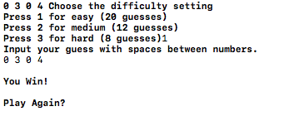
Randomize
srand((unsigned int)time(NULL)); // code that will randomly generate numbers for the secret code
for (int i = 0; i < 4; i++) {
code[i] = rand() % 10; // assigns the randomly generated numbers to the secret code
cout << code[i] << " ";
“Seeds the pseudo-random number generator used by rand() with the value seed. If rand() is used before any calls to srand(), rand() behaves as if it was seeded with srand(1). Each time rand() is seeded with the same seed, it must produce the same sequence of values. srand() is not guaranteed to be thread-safe.
Parameters - the seed value (time)
Return value - none”
-http://en.cppreference.com/w/c/numeric/random/srand

Slide 7
Instructional screens
void printInstr() {
cout << "Instructions: The object of Mastermind is to guess a secret code consisting of a series of 4 numbers. Each guess results in feedback narrowing the possibilities of the code." << endl << "If a number in your guess is not in the secret code your clue will be a zero" << endl
<< "If a number in your guess is in the secret code but in the wrong spot your clue will be a one" << endl << "If a number in your guess is the correct number in the correct spot of the secret code your clue will be a two" << endl << endl;
instr(); //goes back to options
}
void winScreen() {
cout << "\nYou Win!\n\nPlay Again?\n\n";
void instr() {
int intro;
cout << "Welcome to Mastermind!!" << endl;
cout << "Press 1 to start a game: " << endl << "Press 2 to read the rules for mastermind: " << endl << "Press 3 to exit the game: " << endl;
cin >> intro;
switch (intro) {
case 1: //call mastermind function
secretcode();
game();
break;
case 2:
printInstr();
break;
case 3:
exit(0);
break;
default: //call mastermind function
secretcode();
game();
break;

Slide 8
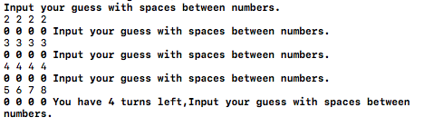
Game turns
for (int n = 0; n < dif; n = n + 1){
if (n == dif / 2){
cout << "You have " << n << " turns left,";
}

Slide 9
Difficulty
void level(){
int difficulty;
cout << "Choose the difficulty setting" << endl << "Press 1 for easy (20 guesses)" << endl << "Press 2 for medium (12 guesses)" << endl << "Press 3 for hard (8 guesses)";
cin >> difficulty;
switch (difficulty) {
case 1: //easy level
dif = 20; // 20 guesses
break;
case 2:
dif = 12; // 12 guesses
break;
case 3:
dif = 8; // 8 guesses
break;
default:
dif = 12;
break;
}
}

Slide 10
Examples of class topics

Slide 11
Control flow
void game() {
level();
for (int n = 0; n < dif; n = n + 1){
if (n == dif / 2){
cout << "You have " << n << " turns left,";
}
for (int i = 0; i < 4; i++) {
clue[i] = 0;
hold[i] = 0;
}
cout << "Input your guess with spaces between numbers." << endl;
for (int i = 0; i < 4; i++) // player makes their guess here
cin >> guess[i];
checktwo();
sort(clue, clue + 4);
if (clue[0] == 2 && clue[1] == 2 && clue[2] == 2 && clue[3] == 2) {
winScreen();
instr();
}
else {
for (int i = 0; i < 4; i++)
cout << clue[i] << " "; /* space between clues added*/
}
}
//if the code reaches this point, the user has lost. Correct 2 2 2 2 triggers a win screen.
cout << "\nYou lose!\nPlay Again?\n\n";
}

Slide 12
Arrays
void checktwo() {
for (int i = 0; i < 4; i++) {
if (guess[i] == code[i]) {
clue[i] = 2;
hold[i] = 2;
}
else
for (int j = 0; j < 4; j++) {
if (guess[i] == code[j] && clue[j] == 0 && hold[i] == 0) {
clue[j] = 1;
hold[i] = 1;

Slide 13
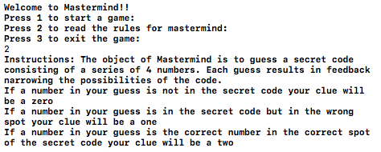
Input and output
int intro;
cout << "Welcome to Mastermind!!" << endl;
cout << "Press 1 to start a game: " << endl << "Press 2 to read the rules for mastermind: " << endl << "Press 3 to exit the game: " << endl;
cin >> intro;
switch (intro) {
case 1: //call mastermind function
secretcode();
game();
break;
case 2:
printInstr();
break;
case 3:
exit(0);
break;
default: //call mastermind function
secretcode();
game();
break;

Slide 14
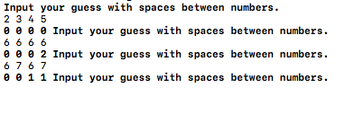
If/else
void checktwo() {
for (int i = 0; i < 4; i++) {
if (guess[i] == code[i]) {
clue[i] = 2;
hold[i] = 2;
}
else
for (int j = 0; j < 4; j++) {
if (guess[i] == code[j] && clue[j] == 0 && hold[i] == 0) {
clue[j] = 1;
hold[i] = 1;
}

Slide 15

Switch case
void level(){
int difficulty;
cout << "Choose the difficulty setting" << endl << "Press 1 for easy (20 guesses)" << endl << "Press 2 for medium (12 guesses)" << endl << "Press 3 for hard (8 guesses)";
cin >> difficulty;
switch (difficulty) {
case 1: //easy level
dif = 20; // 20 guesses
break;
case 2:
dif = 12; // 12 guesses
break;
case 3:
dif = 8; // 8 guesses
break;
default:
dif = 12;
break;
}
}

Slide 16
Libraries
#include <stdlib.h>
#include <time.h>
#include <algorithm>
#include <iostream>

Slide 17
Debugging
Mostly done by displaying the secretcode while running the program to properly test all cases.
0 - incorrect
1 - incorrect placement
2 - correct

Slide 18
Getting wrong clues
Example:
Secret Code: 8 4 4 6
First guess: 4 5 5 2
First Clue: 0 0 0 1
2nd Guess: 5 5 5 5
2nd Clue: 0 0 0 1
Got “repeat” clues that ended up being a result of the clue array not being re initialized to zero.
Example:
SecretCode: 8 4 4 6
User guess: 4 2 9 5
Clues given: 0 0 1 1
Correct Clue: 0 0 0 1
We were also getting a problem with the clues the player would receive, if the user’s guess contained one correct number but that number was in the code twice, the program would give the users two clues for that number.

Slide 19
Turn Counter
The turn counter was shortening the length of subsequent games relative to how many guesses it took to win the first game.

Slide 20
Global vs local variables
int dif; // number of tries
int difficulty; // temp difficulty variable
int code[4]; // array that holds the secret code
int guess[4]; // array the player will input their guess of the secret code into
int clue[4] = { 0 }; // array which will store the clues for the player
int hold[4] = { 0 }; // array that will keep track of which numbers in the player’s guess have been accounted for
Int main()
Int game()
Int difficulty;
Clue[];
Guess[];

