Slide 1
EECT 121 Lab 2
Lucas Bazile

Slide 2
Objective
Calculate behavior of half wave rectifier, full wave rectifier, and bridge F. W R.
Simulate the rectifiers
Build and measure results

Slide 3
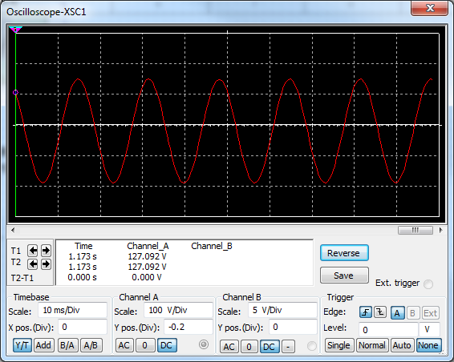
Half Wave-Rectifier Simulation

Slide 4
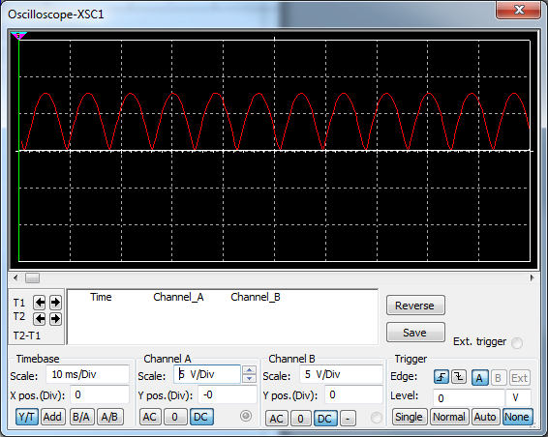
Full Wave-Rectifier Simulation

Slide 5
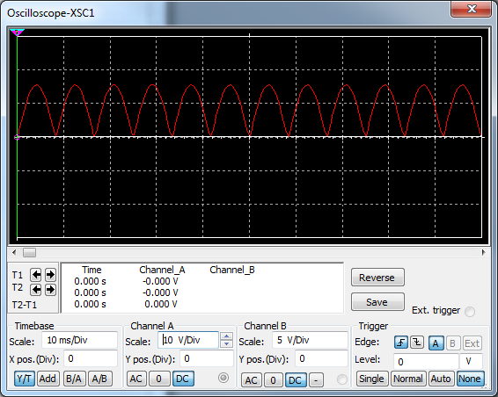
Wheatstone Bridge Full Wave-Rectifier Simulation

Slide 6
Data
 | Half Wave-Rectifier
 | Vs1 | Vs2 | Peak Load Current | DC Load Current
Calculation | 170V | 17V | 16.3mA | 5.18mA
Simulation | 170V | 17V | 16.3mA | 5.07mA
Measurement
 | Full Wave-Rectifier
 | Vs1 | Vs2 | Peak Load Current | DC Load Current
Calculation | 170V | 17V | 7.8mA | 4.9mA
Simulation | 170V | 17V | 7.8mA | 4.81mA
Measurement
 | Bridge F. Wave-Rectifier
 | Vs1 | Vs2 | Peak Load Current | DC Load Current
Calculation | 170V | 17V
Simulation | 170V | 17V | 15.6mA | 9.543mA
Measurement

Slide 7
Notes
The half wave rectifier has maximum voltage but only half of the time and the full wave rectifier has half voltage but for full period duration. This means power is similar at the load of these rectifiers.
The wheatstone bridge rectifier has

