Slide 1
EECT 211 Lab Notebook
Lucas Bazile

Slide 2
Resistance Review

Slide 3
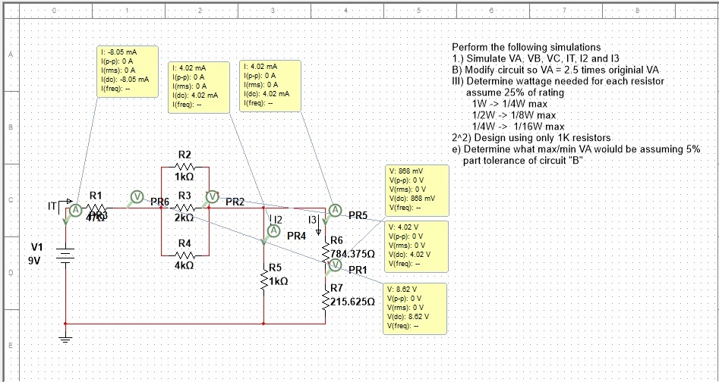
VA=2.5 x original (.345V)

Slide 4
Capacitor Review
Test caps 10 uF, 22 uF, and 47 uF with LCR meter and compare them with theoretical values and simulations in multisim.
Multisim does not have a tool to test capacitance, but using ohm’s law with capacitive reactance, we can calculate what capacitance the simulation is using.
Capacitive reactance = Xc = 1/(2pifC), Ohms law: R = V/I
For calculating total in parallel capacitance: CT = The sum of all caps (same as resistors in series)
For calculating total capacitance in series:
CT = (C1^-1+C2^-1+C3^-1+….)^-1 (same as with resistors in parallel)

Slide 5
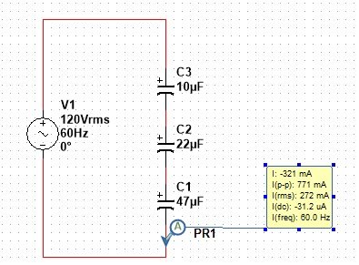
In Series
 | Expected | Measured | Simulated
C1 | 10 uF | 8.0382 uF | 10.03 uF
C2 | 22 uF | 18.147 uF | 22.06 uF
C3 | 47 uF | 37.494 uF | 47.08 uF
CT | 5.998 uF | 4.871 uF | 6.013 uF

Slide 6
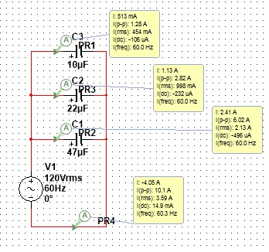
In Parallel
 | Expected | Measured | Simulated
C1 | 10 uF | 8.0382 uF | 10.03 uF
C2 | 22 uF | 18.147 uF | 22.06 uF
C3 | 47 uF | 37.494 uF | 47.08 uF
CT | 79 uF | 63.596 uF | 79.35 uF

Slide 7
RC Circuit Review
With caps .47 uF, 1 uF, and 2.2 uF, assemble circuit and compare to expected values and simulated values
Out of Circuit | Expected | Measured | Simulated
C1 | .47 uF | .432 uF | .471 uF
C2 | 1 uF | .812 uF | 1.004 uF
C3 | 2.2 uF | 2.035 uF | 2.206 uF
R1 | 1k ohms | .998 ohms | 1k ohm

Slide 8
Test results
Input Voltage is 1.04V pk-pk
C1 = .47 uF
C2 = 1 uF
C3 = 2.2 uF
C1 = .47 uF
C2 = 1 uF
C3 = 2.2 uF
Frequency | Theory | Measured | Theory | Measured | Theory | Measured
10 | 1.04mV | 1.04V | 1.04 | 1.04V | 1.04mV | 1.04V
50 | 1.04mV | 1.04V | 984mV | 992mV | 830mV | 848mV
100 | 1.04mV | 1.01V | 892mV | 896mV | 621mV | 632mV
200 | 872mV | 864mV | 645mV | 632mV | 355mV | 376mV
300 | 786mV | 752mV | 502mV | 496mV | 245mV | 264mV
400 | 697mV | 648mV | 404mV | 392mV | 196mV | 200mV
500 | 601mV | 568mV | 354mV | 336mV | 149mV | 160mV
Frequency | Theory | Measured | Theory | Measured | Theory | Measured
1k | 375mV | 368mV | 221mV | 192mV | 90mV | 96mV
2k | 214mV | 200mV | 120mV | 112mV | 44mV | 48mV
3k | 147mV | 144mV | 91mV | 80mV | 24mV | 32mV
4k | 114mV | 112mV | 62mV | 64mV | 29mV | 32mV
5k | 92mV | 96mV | 42mV | 56mV | 18mV | 24mV
7.5k | 60mV | 64mV | 34mV | 48mV | 12mV | 16mV
10k | 44mV | 48mV | 24mV | 32mV | 8mV | 16mV

Slide 9
Inductor Review
Test inductors of 1mH, 2.2mH and 4.7mH
Multisim does not have a tool to test inductance, but using ohm’s law with inductive reactance, we can calculate what inductance the simulation is using.
Inductive reactance = Xl = 2pifH, Ohms law: R=V/I

Slide 10
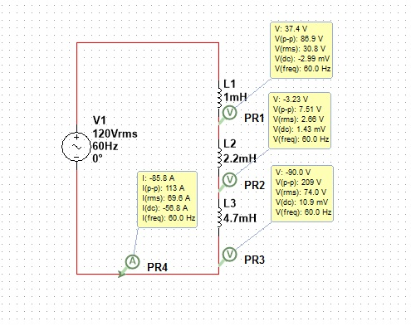
Series Inductance
 | Expected
I1 | 1mH
I2 | 2.2mH
I3 | 4.7mH
IT | 7.9mH

Slide 11
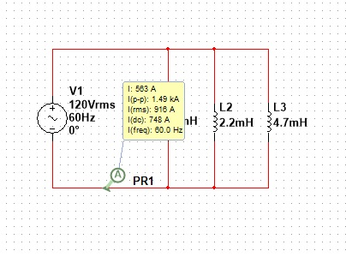
Inductance in Parallel
 | Expected
I1 | 1mH
I2 | 2.2mH
I3 | 4.7mH
IT | .59977mH

Slide 12
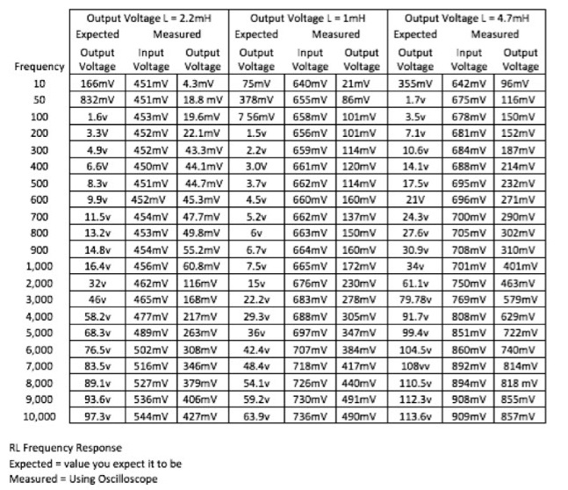
Test Results

Slide 13
7 Basic Questions
1.) Show how multiple resistors behave in series and parallel.
2.) Give example of total R, I and P in a resistor network as well as nodal voltages.
3.) Calculate Thevenin Resistance and Voltage or resistor network.
4.) How multiple capacitors combine in series and parallel
5.) How multiple inductors combine in series and parallel
6.) Using a simple RC circuit determine
  A.) The time constant
  B.) Create a graph that shows the Rc time constant as function of time
  C.) Determine Xc at a fixed frequency
  D.) Create a graph that shows how Xc changes as a function of frequency
  E.) Plot the frequency response

Slide 14
7 Basic Questions
7.) Using a simple RL circuit determine the
  A.) The time constant
  B.) Create a graph that shows the Rl time constant as function of time
  C.) Determine Xl at a fixed frequency
  D.) Create a graph that shows how Xl changes as a function of frequency
  E.) Plot the frequency response

Slide 15
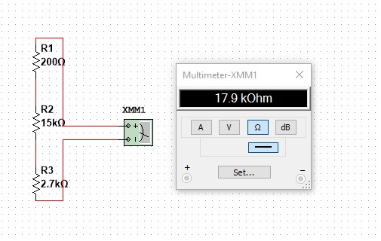
1: Resistors
When resistors are in series, the total resistance of the branch will be equal to the sum of all the resistors in the branch.
The total resistance of this branch is equal to the sum of the resistors.
200 ohms + 15k ohms + 2.7k ohms = 17.9k ohms

Slide 16
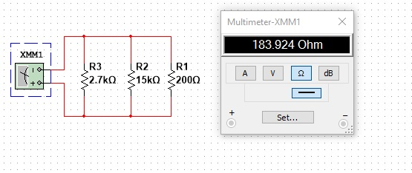
1: Resistors
When resistors are in parallel, the total resistance of the network will be equal to the inverse of the sum of the inverse of each resistor.
Rt = 1/((1/R1)+(1/R2)+(1/R3)….)
The total resistance of this network is
Rt = 1/((1/2.7k ohm) + (1/15k ohms) + (1/200 ohms)) = 183.924 ohms

Slide 17
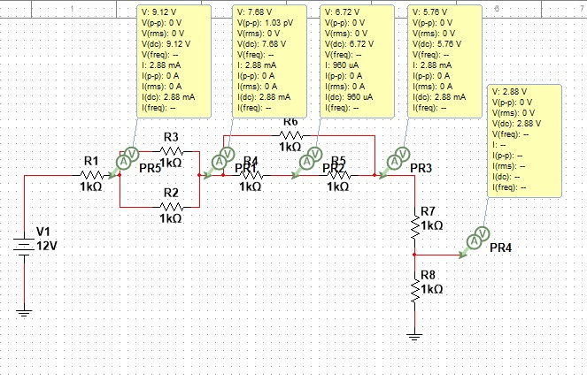
2 Resistor Network

Slide 18
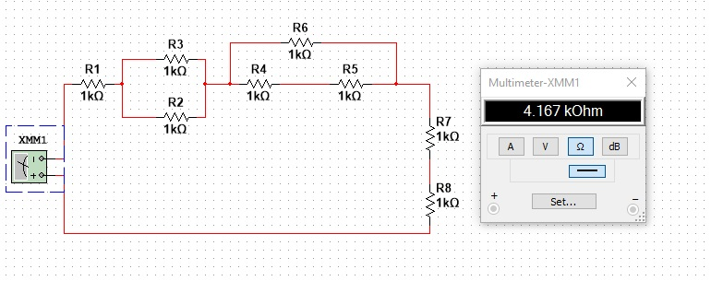
2 Resistor Network
Begin by calculating the resistance of parallel branches and treating them as a single resistor, once done, you should only have a series circuit left, which is easy to sum to get total circuit resistance.

Slide 19
3: Thevenin Resistance and Voltage
Thevenin’s theorem states that in any linear electrical network with voltage and current sources and resistances will have an equivalent circuit at terminals A and B with a voltage V_{th} and a resistance V_{th}
V_{th} is the open-circuit voltage at the terminals
To find V_{th}, short all voltage sources and calculate resistance from the perspective of terminals A and B.

Slide 20
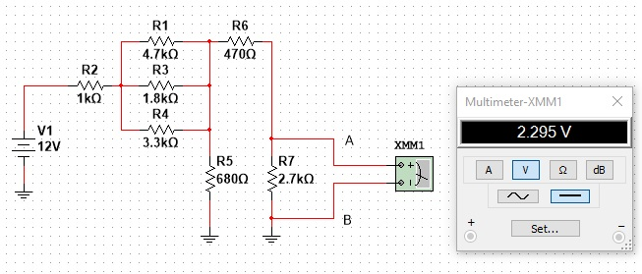
3: Thevenin Voltage
To find thevenin voltage, analyze the circuit to find the voltage at the terminals A and B.
In this case V_{th}=2.295V

Slide 21
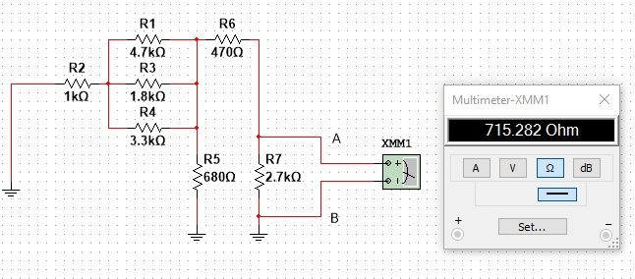
3: Thevenin Resistance
To find thevenin resistance, you first short any voltage sources, then measure the resistance from the perspective of terminals A and B. In this circuit, the V_{th}=715.282ohms

Slide 22
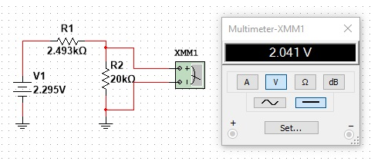
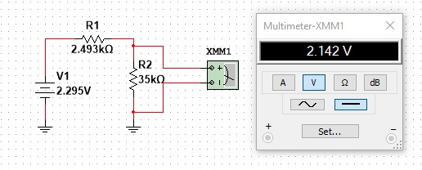
3: Thevenin Circuit
Now an equivalent circuit can be made that allows you to easily analyze changes in the circuit due to changes of the load

Slide 23
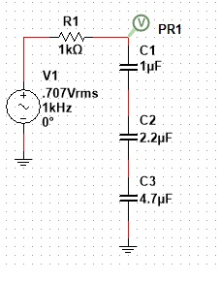
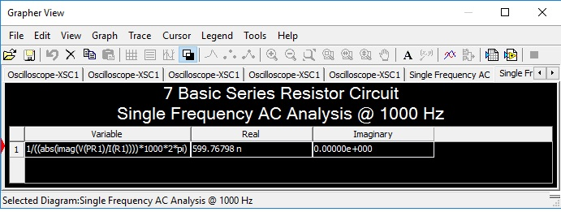
4: Capacitors
Capacitors in series will have a total capacitance equal to the inverse of the sum of the inverse of each caps, just like resistors in parallel.
CT = 1/((1/C1)+(1/C2)+(1/C3)+…)

Slide 24
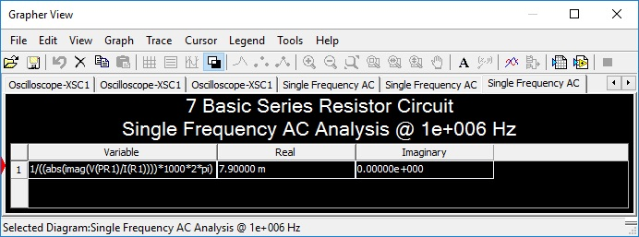
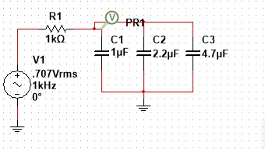
4: Capacitors
Capacitors in parallel will have a total capacitance equal to their sum, just like resistors in series.
Ct = C1 + C2 + C3 +…

Slide 25
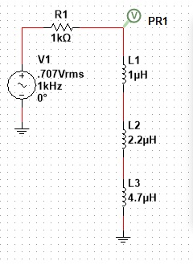
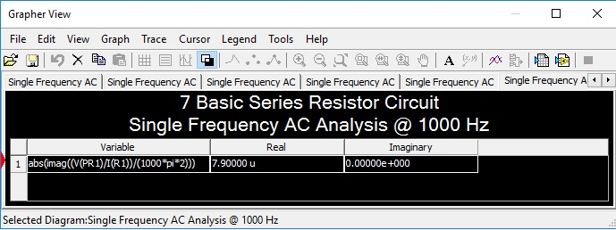
5: Inductors
Inductors in series will have a total inductance equal to their sum, just like resistors.
It = I1 + I2 + I3 +…

Slide 26
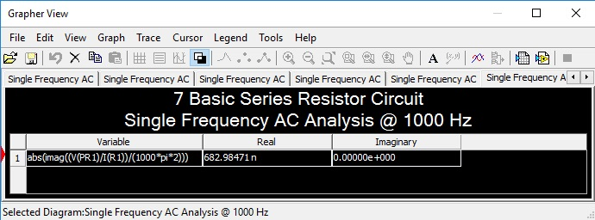
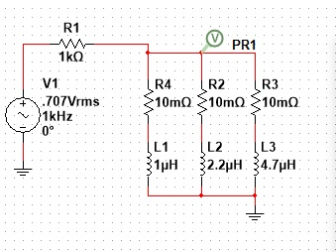
5: Inductors
Inductors in parallel will have a total inductance equal to the inverse of the sum of their inverses, just like resistors in parallel
It = 1/((1/I1)+(1/I2)+(1/I3)+…)

Slide 27
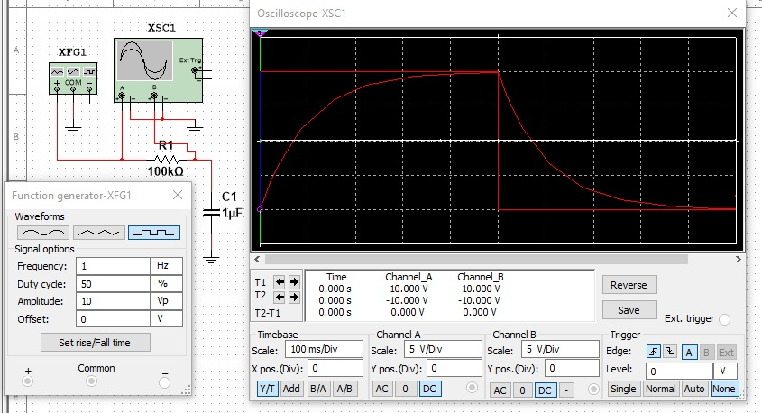
6: Capacitor Time Constant
For charging capacitor q=Q_{f} – Q_{f}e^{-t/RC}
Let t = RC to get q = Q_{f}(1– e⁻¹)
For Discharging capacitor q=Q_{o}e^{-t/RC}
Let t = RC to get q=Q_{o}/e
In this circuit, with a C of 1uF and a R of 100kohms the time constant = 100ms.
Mathematically, the capacitor will never fully charge or discharge, but it is accepted that after 5 time constants, the capacitor is considered to be either fully charged or discharged.
The scope is set to 100ms per division so seeing the 5 time constant rule is easy.

Slide 28
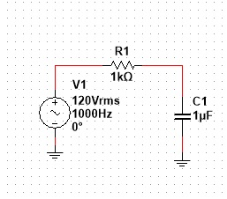
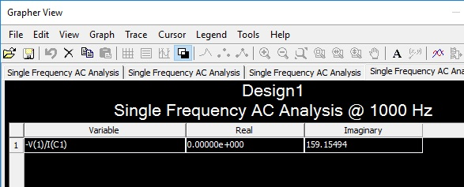
6: Capacitive Reactance
Capacitive reactance = Xc = 1/(2pifC)
In this circuit, f = 1000hz and C = 1uF so Xc = 1/(2*pi*1000*1uF) = 159.15494

Slide 29
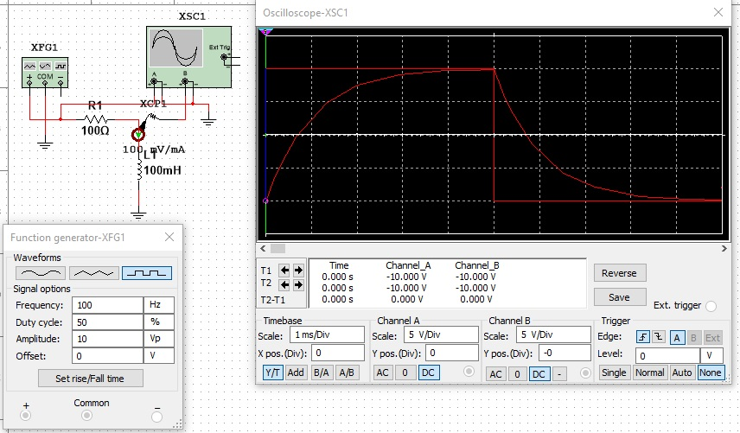
7: Inductor Time Constant
For growing current i= E/R – (E/R) e^{-(R/L)t}
Let t = L/R to get I = (E/R)(1-e⁻¹)
For decaying current I = I_{o}e^{-(R/L)t}
Let t = L/R to get I = I_{o}e⁻¹
In this circuit, the time constant will be t = 100mH/100ohm = 1ms.
The 5 times constant rule applies to inductors as well as capacitors.
The scope is set to 1 ms so the 5 time constant can easily be seen.

Slide 30
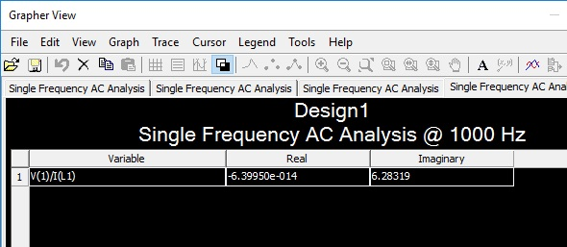
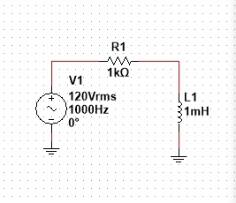
7: Inductive Reactance
Inductive Reacance = Xl = 2pifL
In this circuit f = 1000 and L = 1mH so Xl = 2*pi*1000*1mH = 6.28319

Slide 31
Operational Amplifiers
Operational amplifiers are used to amplify signals. The inherently have infinite gain, so feedback is needed to limit the gain to usable levels in circuits.

Slide 32
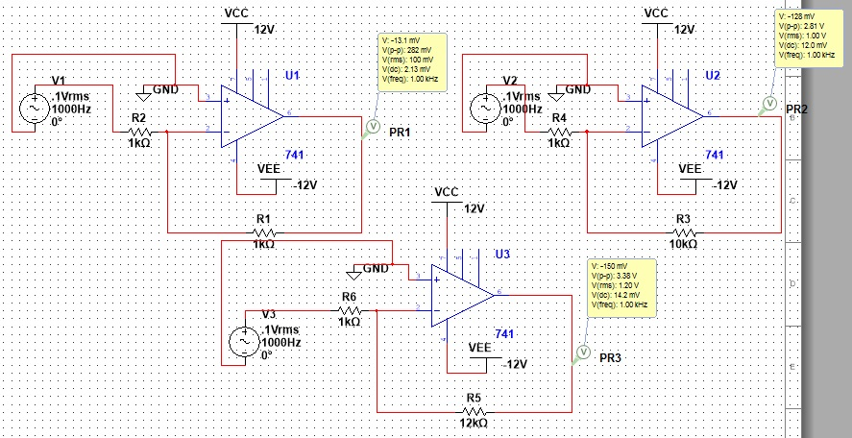
Inverting Amplifier
The inverting amplifier circuit can be used to amplify a signal.
The amplified signal is inverted from the original

Slide 33
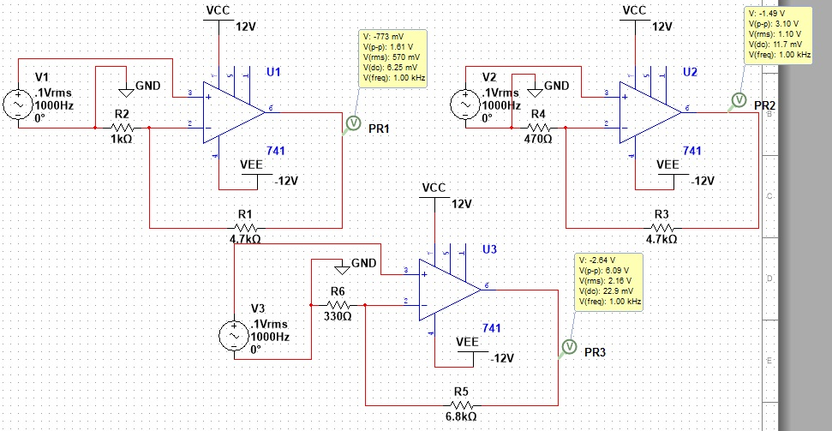
Non-inverting Amplifier
The non-inverting amplifier circuit does not invert the amplified signal, they will be in the same phase.

Slide 34
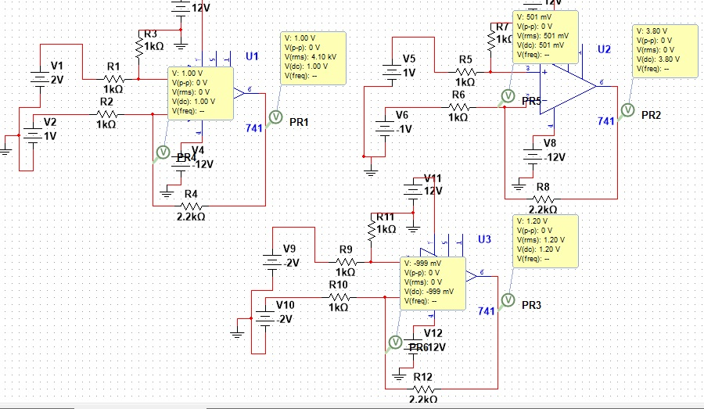
Differential Amplifier
The differential amplifier circuit amplifies the difference between the signals on its inverting and non-inverting inputs.

Slide 35
Creating a +-9V/+-3V Power Supply
There are 4 major parts to a DC power supply circuit, Transformer, Rectifier, Filter, Regulator
The Transformer is used to step down high voltages to the level desired
Rectifiers will change an ac signal to a pulsating DC signal
Filters will further smooth the DC signal
Regulators are used to ensure the circuit outputs a steady voltage or current even with potential changes to input voltage or load demand

Slide 36
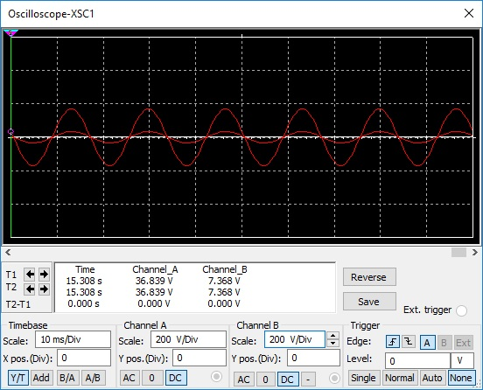
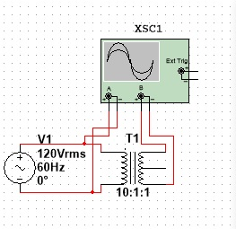
Transformer
The transformer can be used to step up or down the source ac signal.

Slide 37
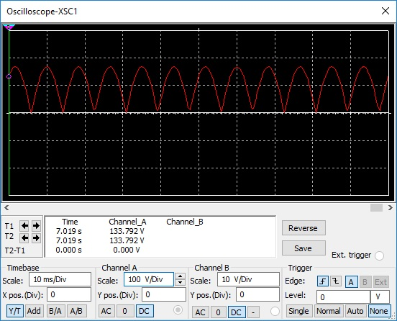
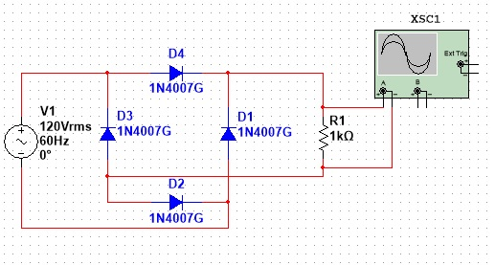
Rectifier
I will be using a bridge rectifier for my +-9V power supply

Slide 38
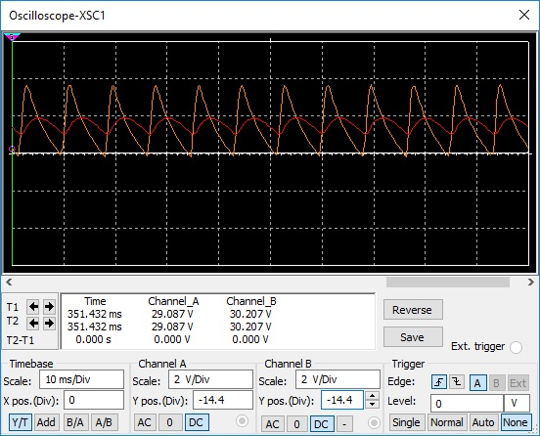
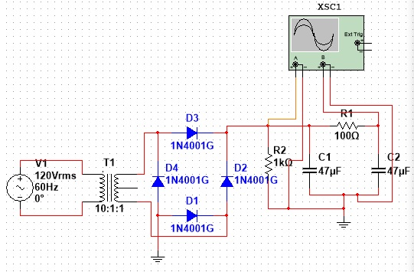
Filter
The rectifier will be used to take the pulsating DC and further convert it into a steady DC signal.
I’ll be using a pi filter

Slide 39
Regulator
The regulator will allow us to maintain control over the output voltage even with changes to the input or demand of the load.
The output voltage of the power supply will also be determined by a relationship between the adj and out pins on the regulator.

Slide 40
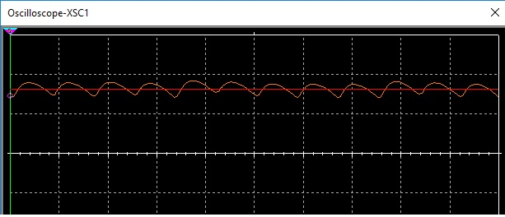
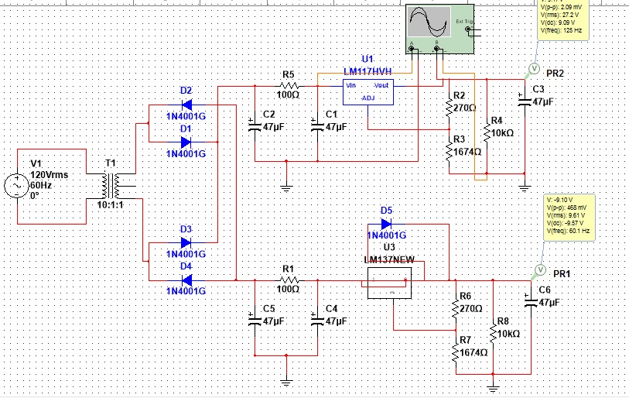
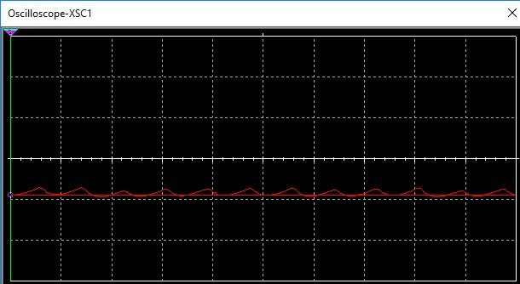
Regulator

Slide 41
Regulator
Looking at the scope in the last sims you can really see how the regulator smooths out the voltage to a near perfect DC signal.
There was no negative regulator (LM137) in multisim so we had to use the component wizard to create a custom part, it seems to take longer to stabilize in the multisim circuit but that won’t show up in the real circuit.

Slide 42
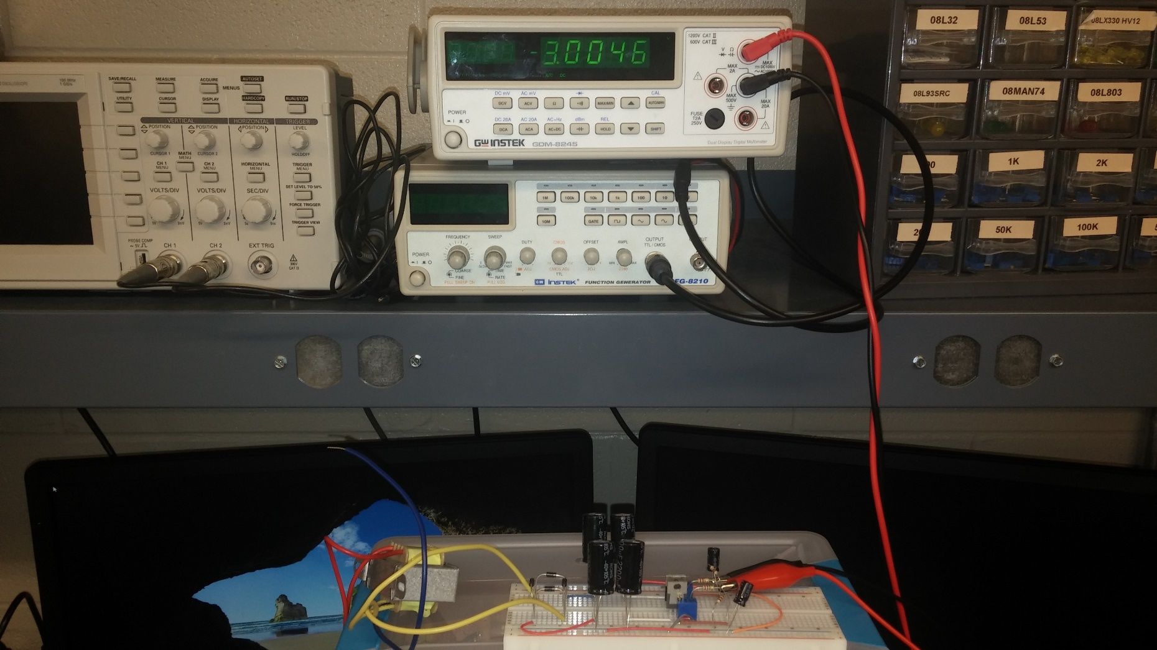
+-3V Bread Board

Slide 43
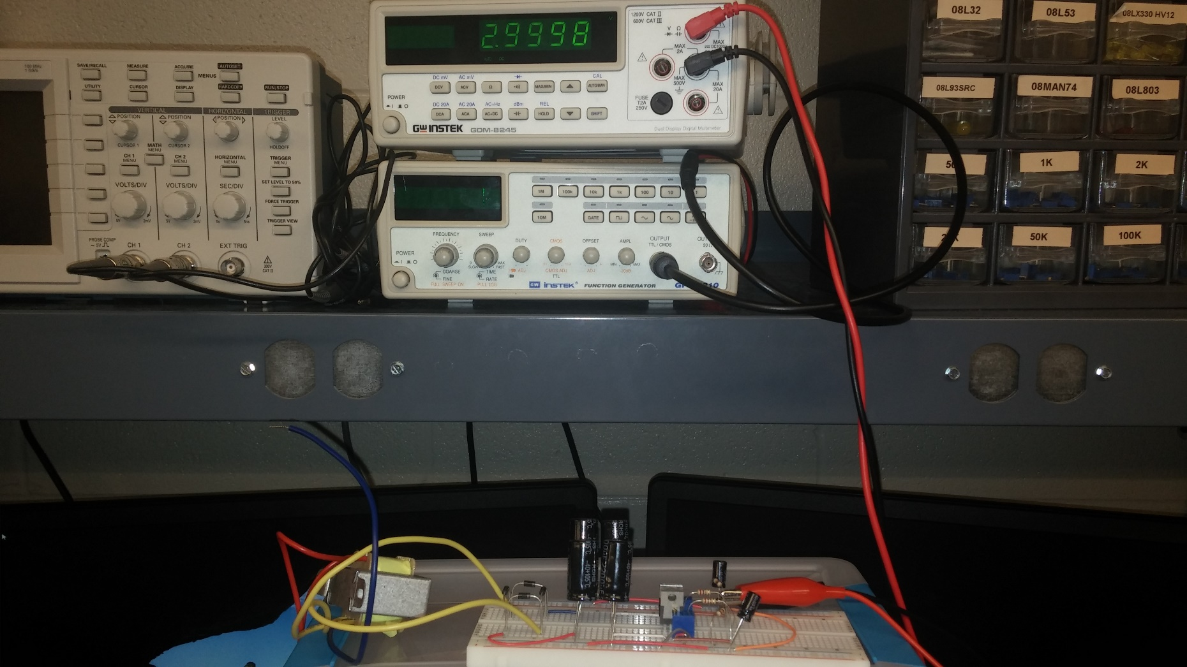
+-3V Bread Board

Slide 44
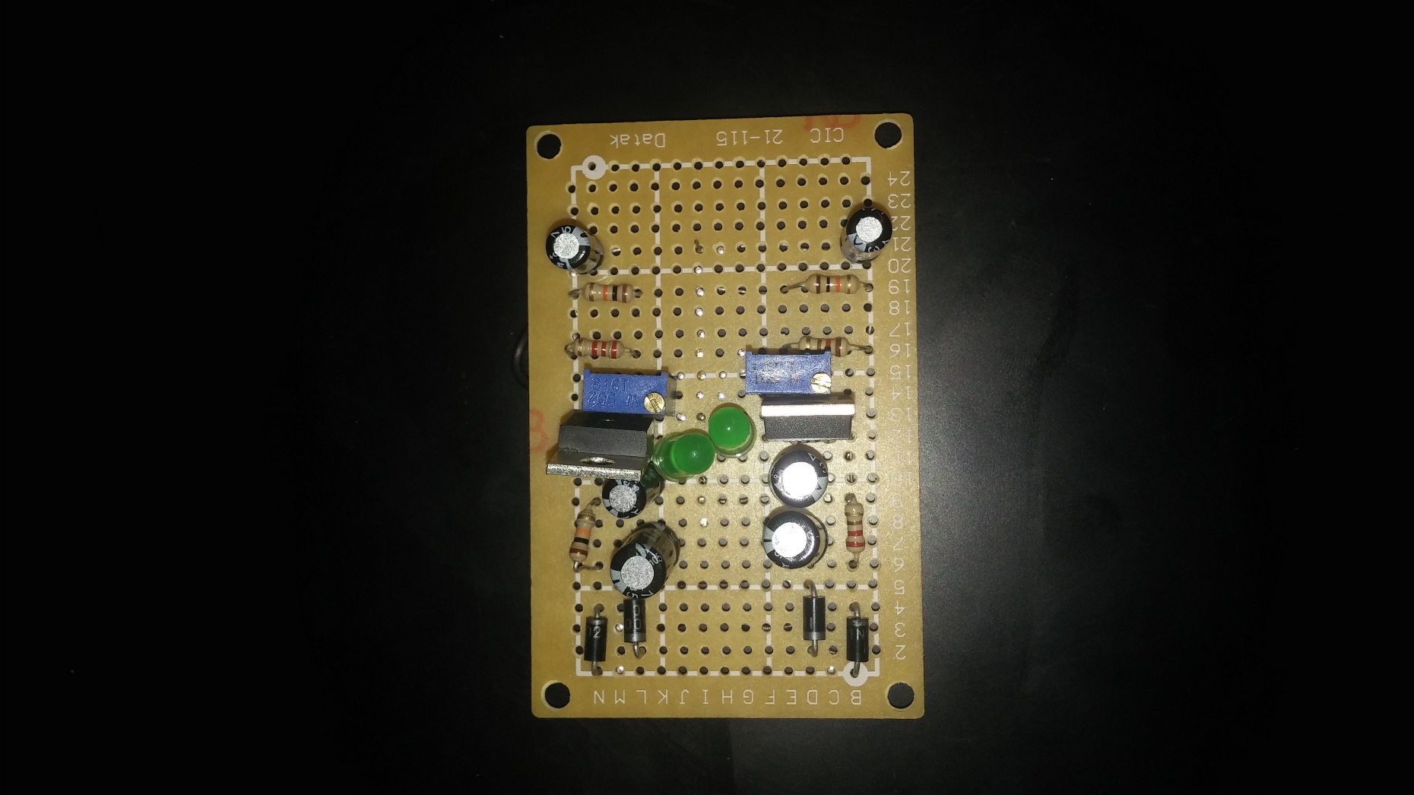
+-3V Build

Slide 45
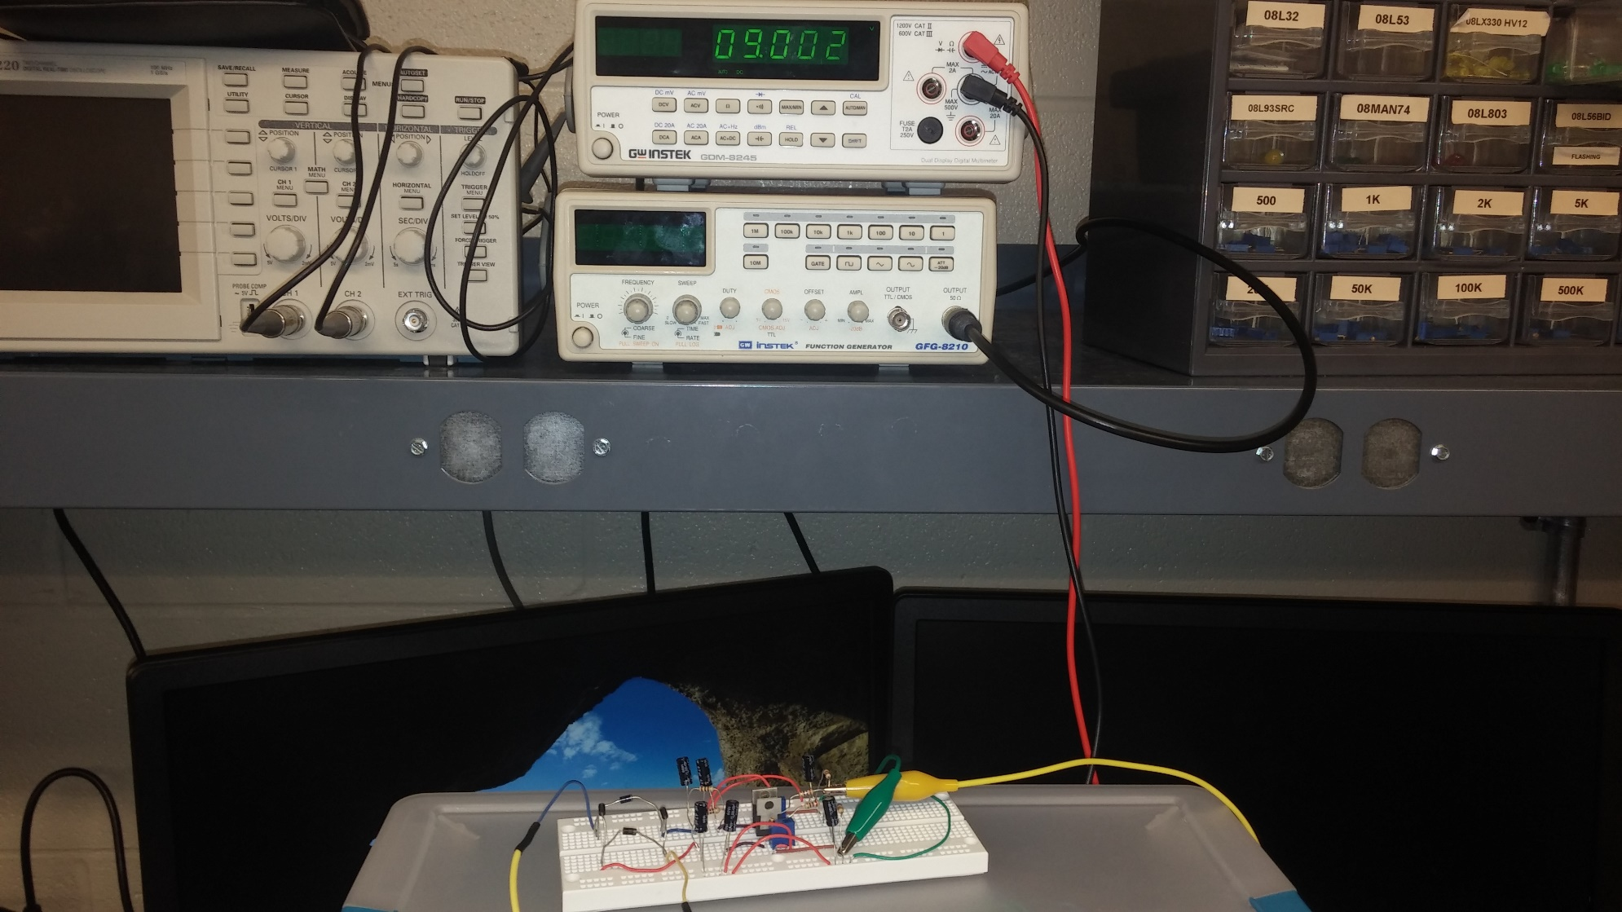
+-9V Bread Board

Slide 46
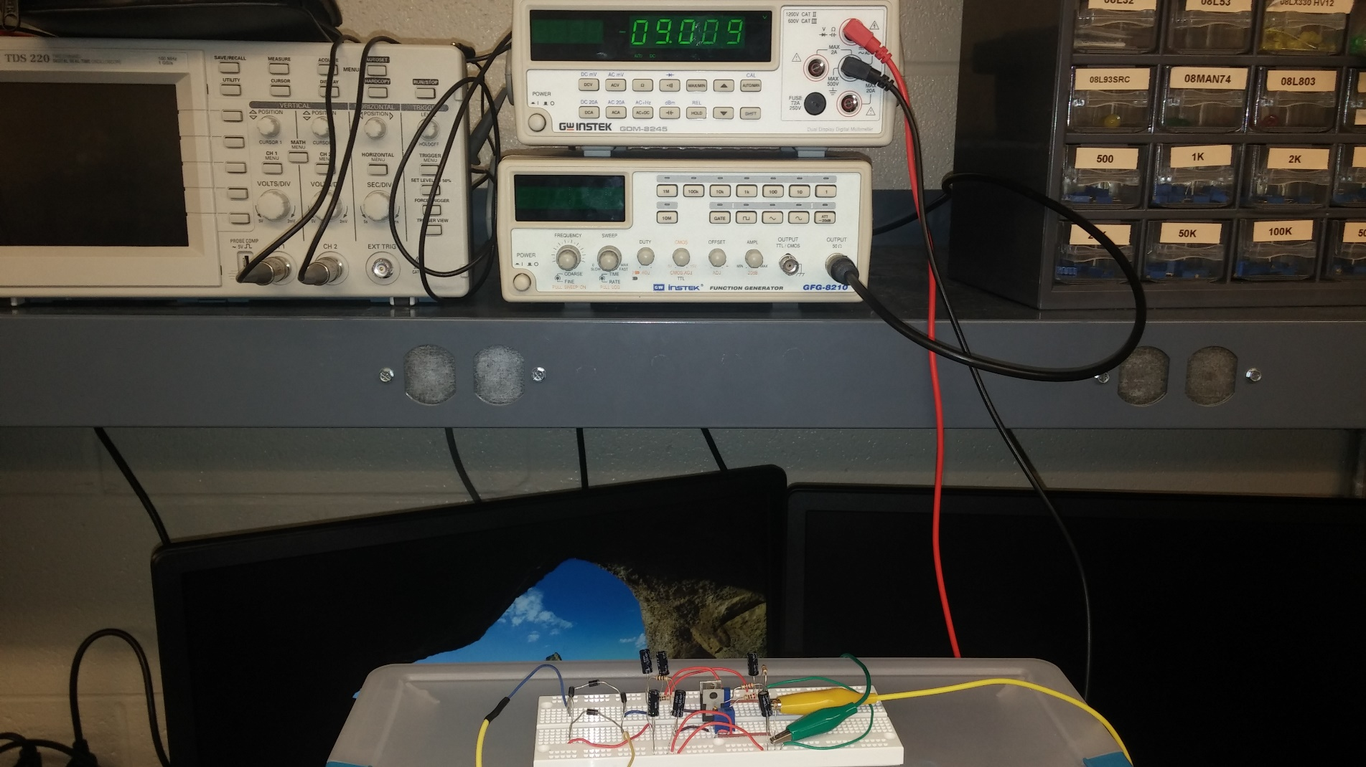
+-9V Bread Board

Slide 47
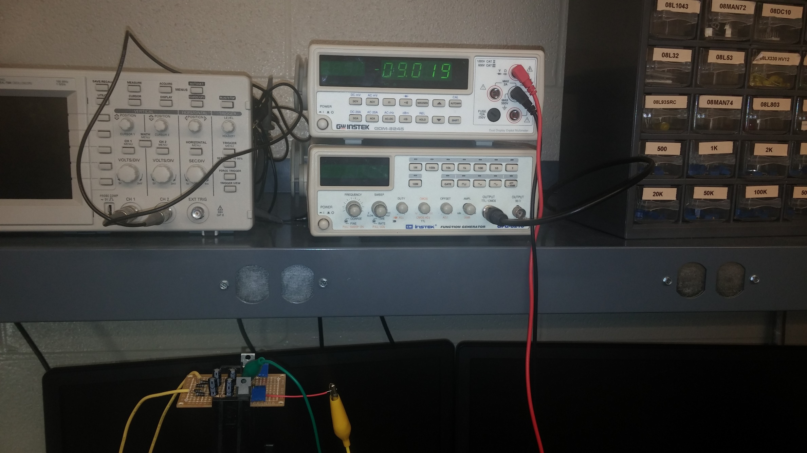
+-9V build

Slide 48
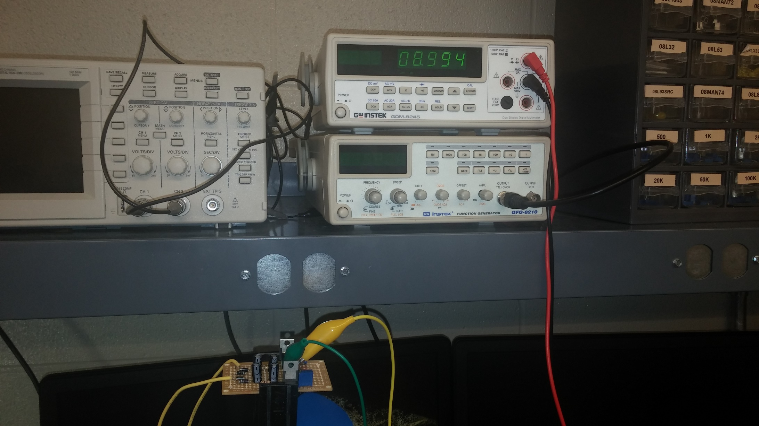
+-9V Build

Slide 49
Parts List
+-9V Power Supply
Parts
4-1n4007 diodes
6-47uF capacitors
2-100ohm resistors
2-10kohm resistors
2-270ohm resistors
2-2kpots (127t 202m)
LM317
LM337
+-3V Power Supply
Parts
4-1n4007 Diodes
4-2200uF Capacitors
2-47 uF Capacitors
2-100ohm resistors
2-270 ohm resistors
2-10kohm resistors
2-500ohm pots
LM317
LM337

