Slide 1

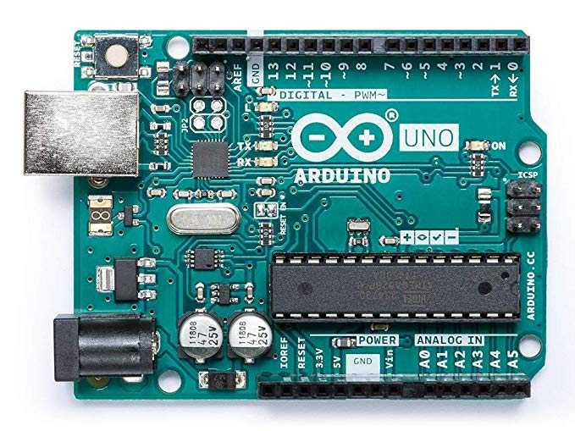
EECT 222
Introduction to micro-controllers
Fall 2019
By: Seth Wills
Lab Partner Jarred Clark

Slide 2
Lab 1: ACTIVITY #2: ON/OFF CONTROL WITH THE BASIC STAMP
The purpose of this lab is to build and test a stop light using the BASIC STAMP
Equipment Needed:
3 470 Nominal ohm Resistors
Basic Stamp 2
Red LED
Green LED
Yellow LED

Slide 3
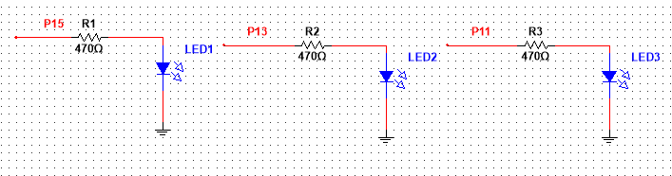
Lab 1: Part 1
The Multi-sim schematic

Slide 4
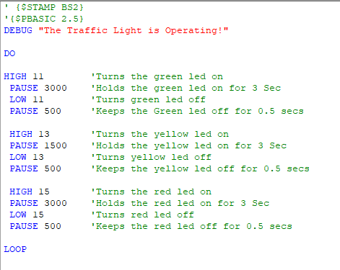
Lab 1: Part 2
Programming for the basic stamp

Slide 5
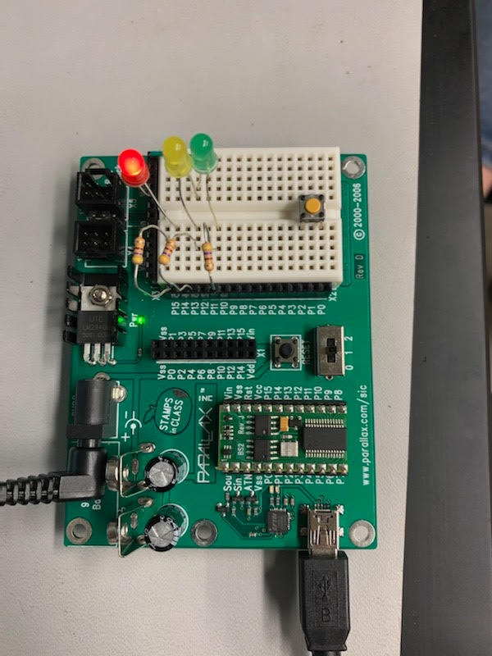
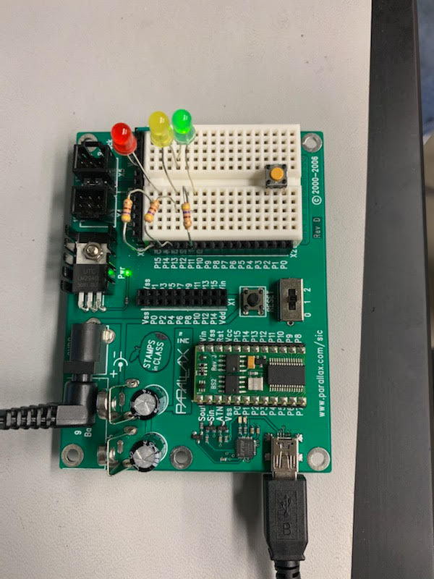
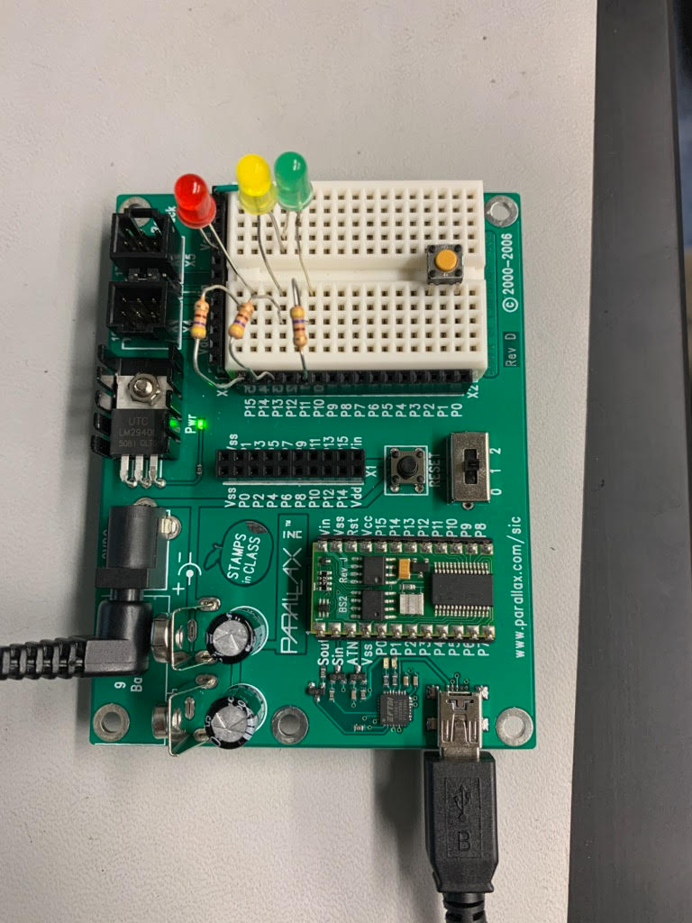
Lab 1: Part 3
This is our fully operating circuit cycling through each LED just like a traffic light at different time intervals between each LED

Slide 6
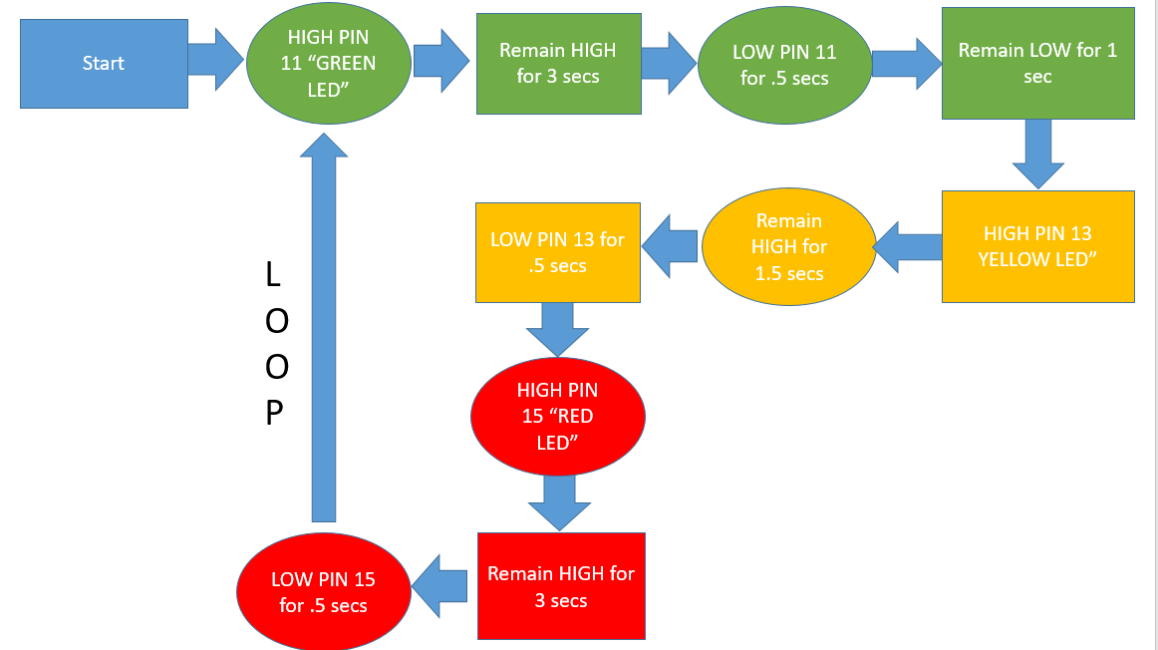
Lab 1: Part 4
The flow chart used

Slide 7
Lab 1: Observations
This was a sample program used from the Industrial Control Student Workbook. The flashing LEDs were used accidentally instead of a steady burning.

Slide 8
Lab 2: Modified the function of Lab 1 with a push Button using the Basic Stamp 2
The purpose of this lab is to modify the timing of Lab to make the lights transition faster.
Equipment Needed:
Three 470-ohm Resistors
Basic Stamp 2
Red LED
Green LED
Yellow LED
Push Button
10k Ohm Resistor
220 Ohm Resistor

Slide 9
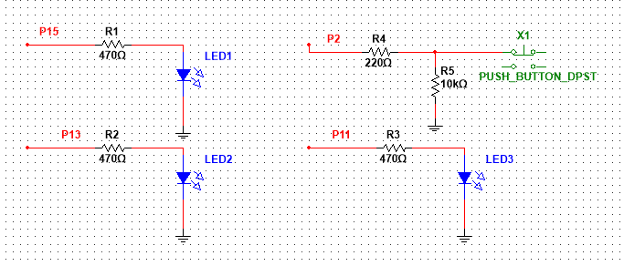
Lab 2: part 1
This Multi-sim schematic that is used to modify Lab 1 to modify the timing

Slide 10
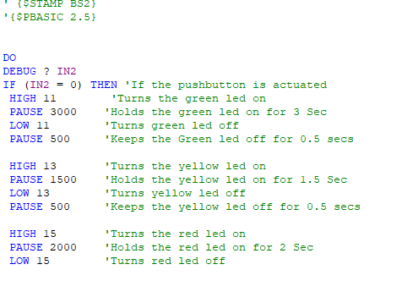
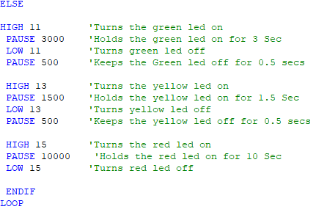
Lab 2: Part 2
This is our whole code for the modification for lab 2 which if the push button is pressed. The button was used to transition the lights.

Slide 11
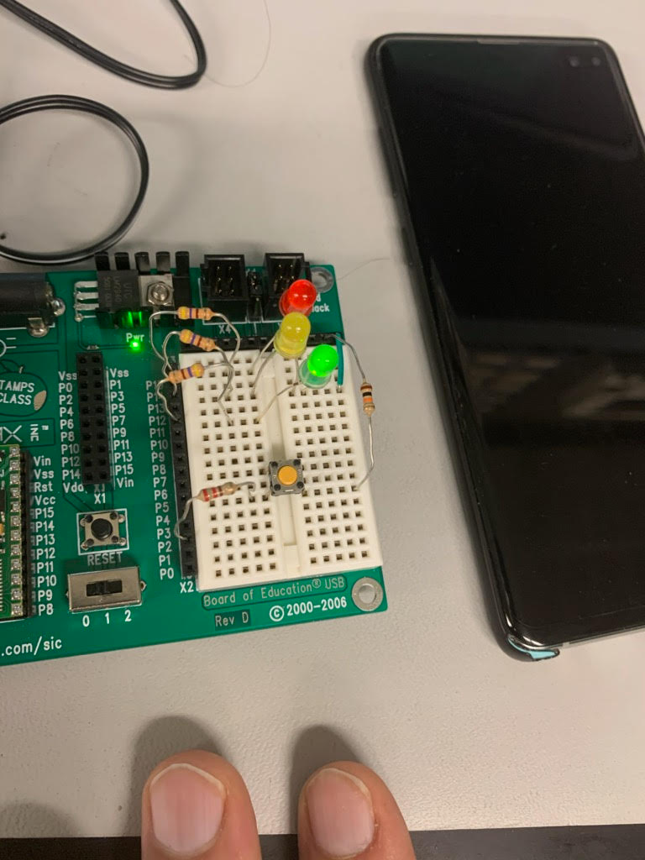
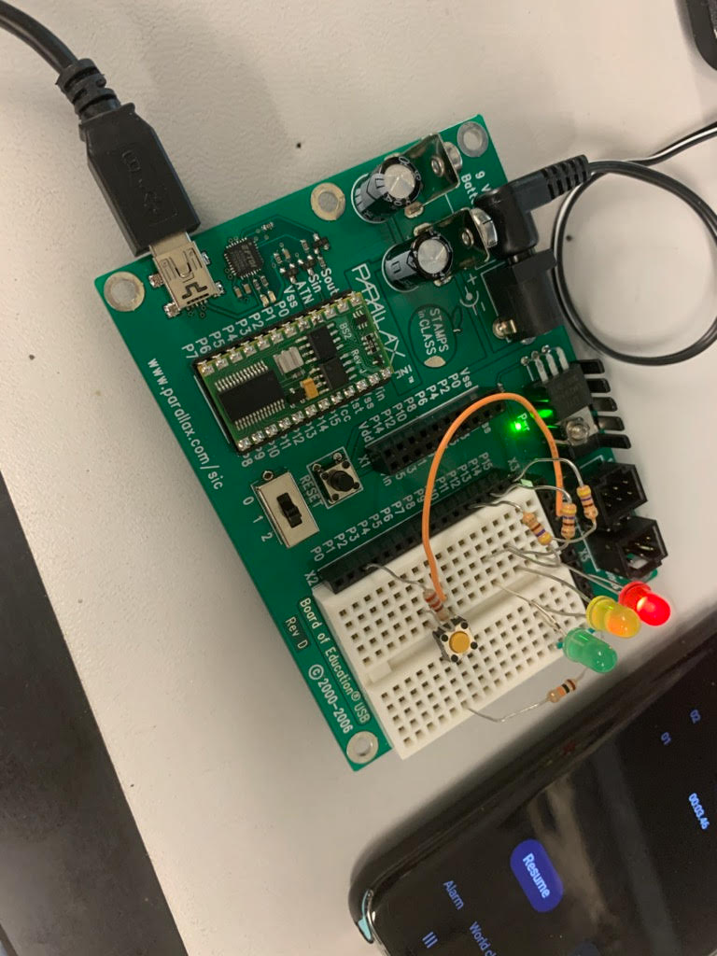
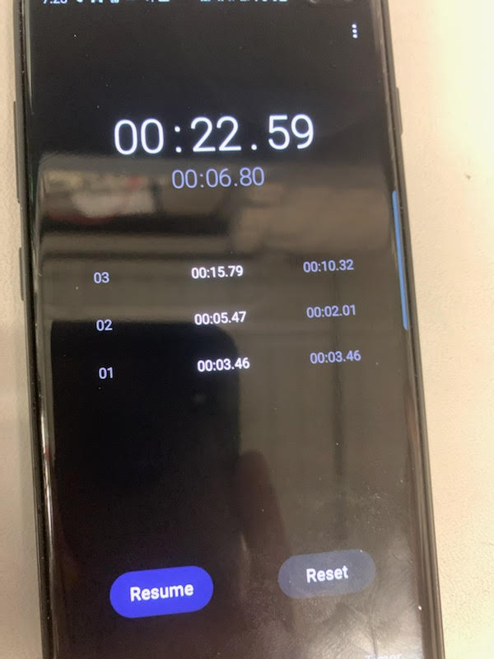
Lab 2: Part 3
Pictures shown of the LEDs beginning the cycle. The phone was used to record the timings.

Slide 12
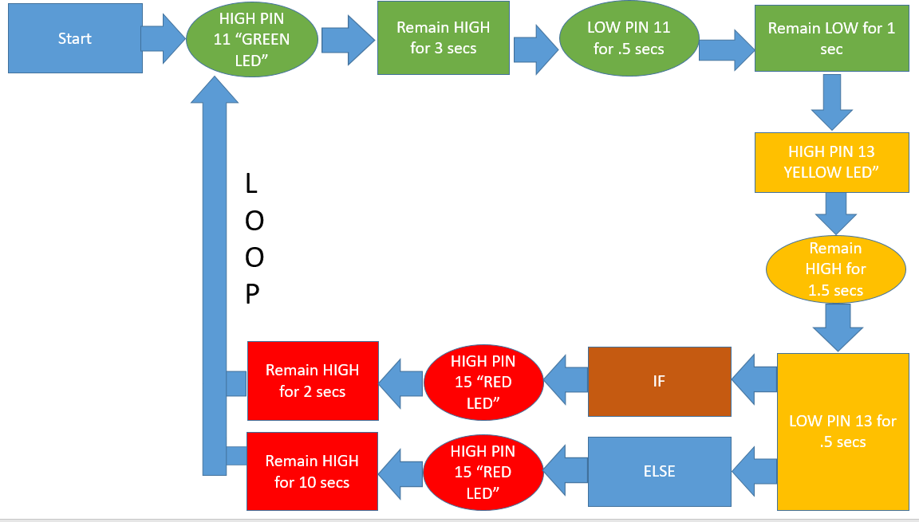
Lab 2: Part 4
This the flow chart used for circuit

Slide 13
Lab 2: Observations
The lab was meant to give us more experience using the basic stamp. The program was supposed to function to make the lights cycle quickly. Issues encountered was the configuration of the button.

Slide 14
Lab 3: Using two push buttons to operate a two way stop light
The purpose of this lab is to expanded on knowledge from Lab 1 and Lab 2 Which included the use of 2 two push button switches
Equipment Needed:
Six 470 Nominal ohm Resistors
Basic Stamp 2
Two Red LEDs
Two Green LEDs
Two Yellow LEDs
Two Push Buttons
Two 10k Ohm Resistors
Two 220 Ohm Resistors

Slide 15
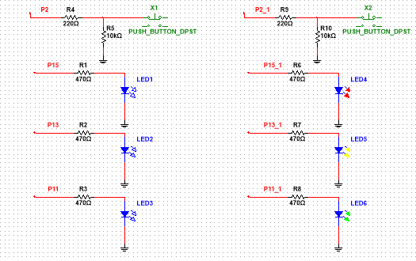
Lab 3: Part 2
This is the Multi-sim schematic for the basic setup of all the LED’s

Slide 16
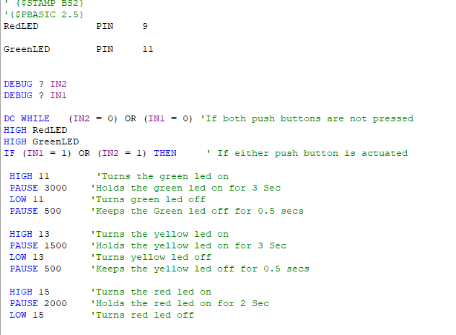
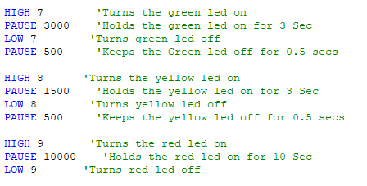
Lab 3: Part 3
This is our incomplete code for lab 3.

Slide 17
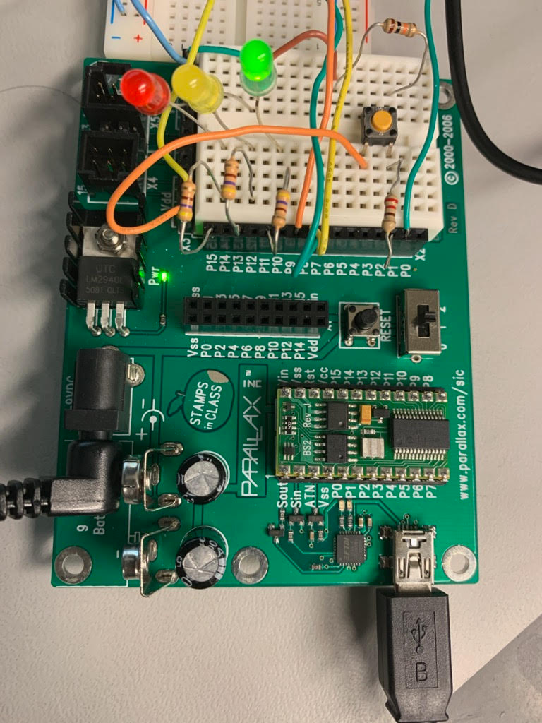
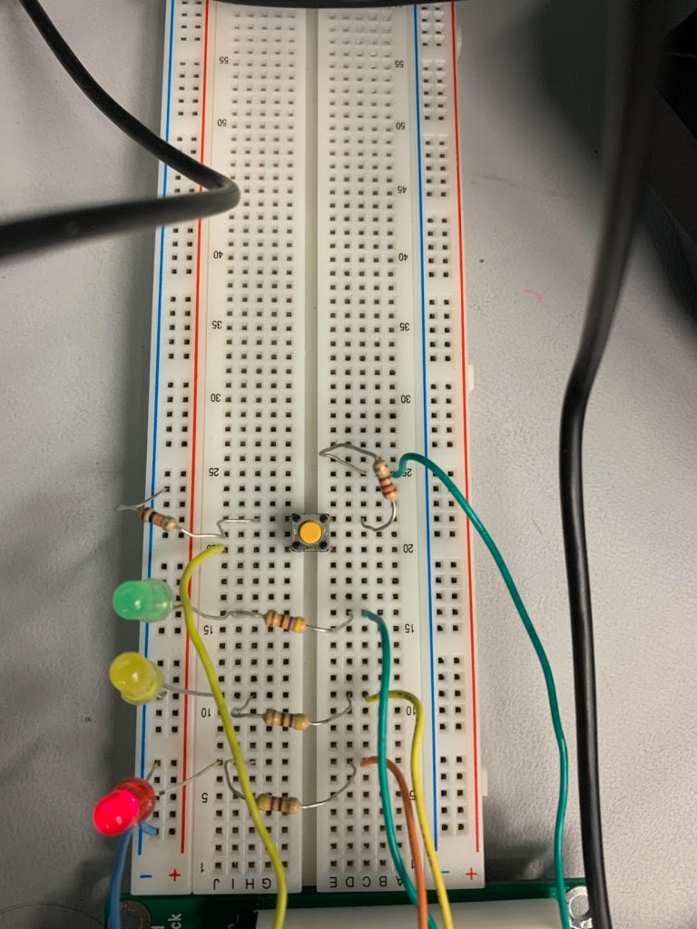
Lab 3: PART 4
The primary 3 lights is on the Basic Stamp board. The 2nd set is the other facing street lights.

Slide 18
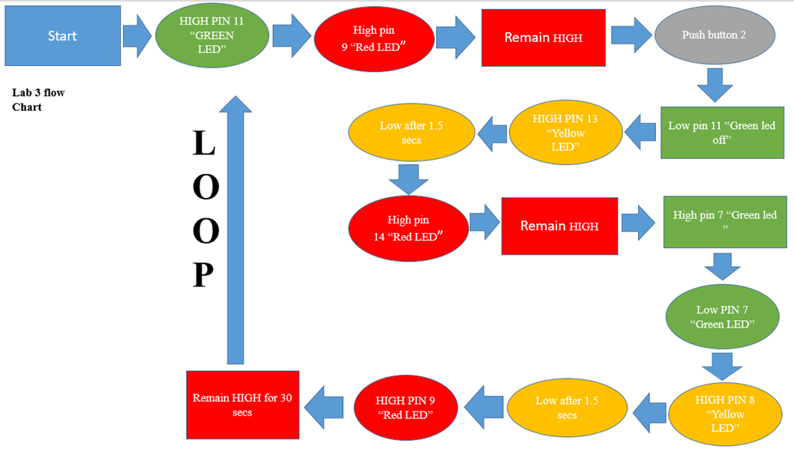
Lab 3: Part 4
The flow chart for the circuit

Slide 19
Lab 3: Observations
Lab 3 was difficult to get working. This lab was to simulate pulling up to a stop light in the middle of night. The push button on the side would cause the lights to cycle, but would pause on the red LED on the 2nd set of lights. We suspect a programming problem.

Slide 20
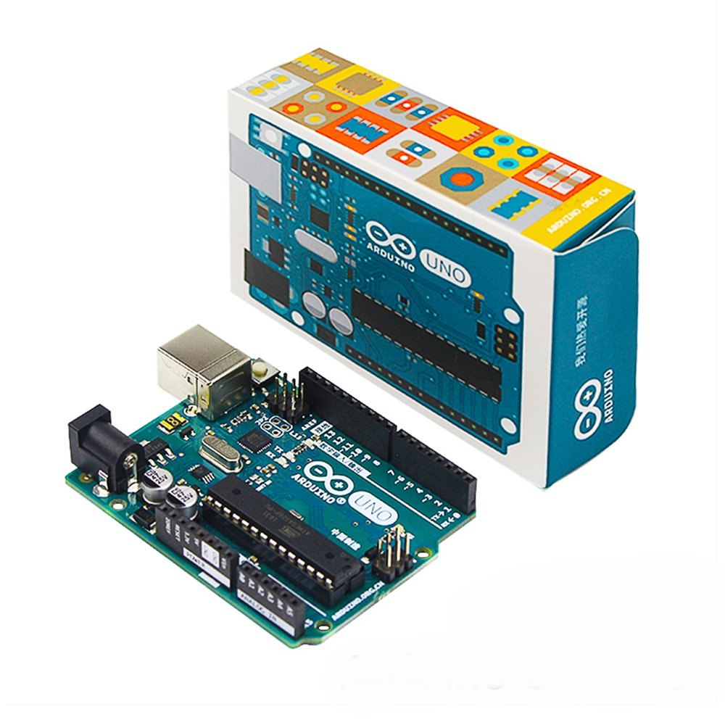
Arduino Uno Lab 1
The purpose of this lab is to create a program and circuit that measures the three analog input voltages
Equipment Needed:
Arduino Uno
220-ohm resistor
10k Potentiometer
5v Red LED

Slide 21
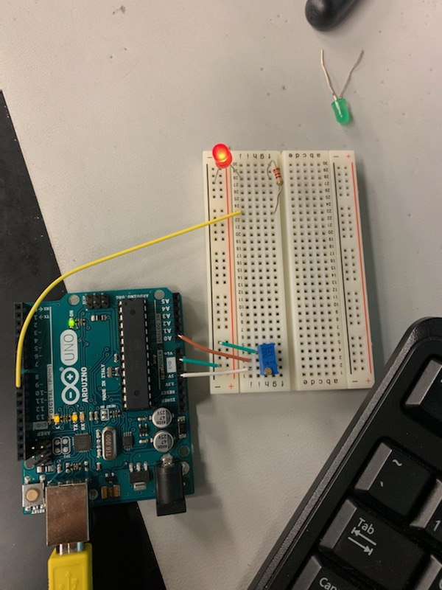
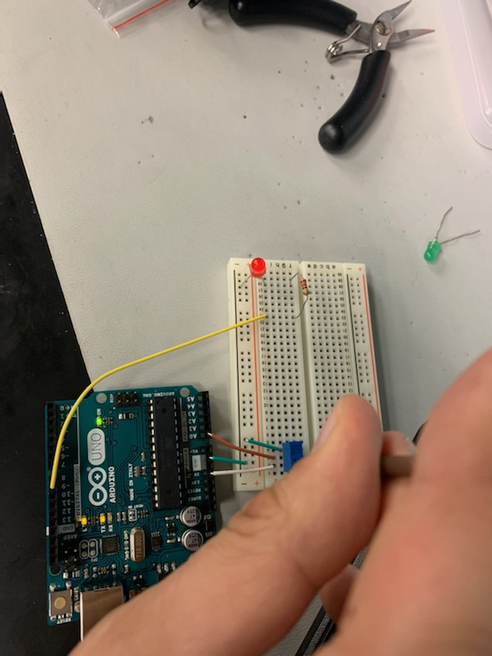
Arduino Uno Lab 1
Part 2
Demonstrating the circuit functioning. Turning the wiper reported an analog signal adjusted the brightness of the LED.

Slide 22
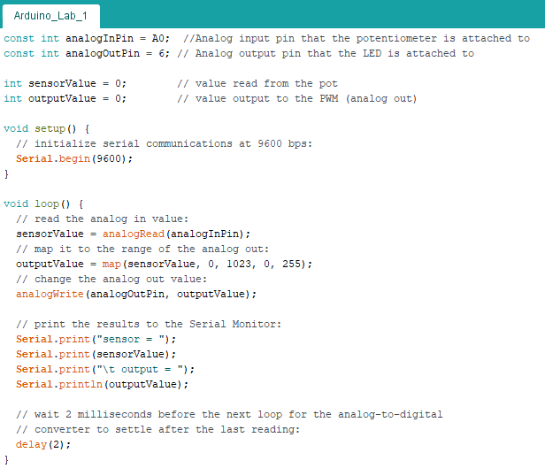
Arduino Uno Lab 1
Part 3
This is the code used. Input was read on analogRead. Would output value to analogWrite. Which gives the value to the LED.

Slide 23
Arduino Uno Lab 1 observations
A variable introduce was a different value of potentiometer. It seemed to no effect on our findings

Slide 24
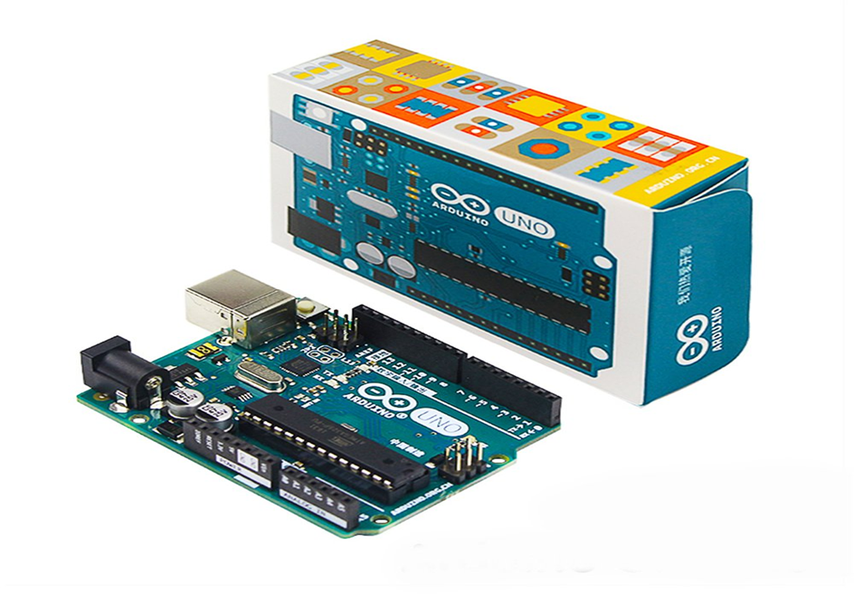
Arduino Uno Lab 2
The purpose of this lab is to demonstrate and create a program and circuit with an analog input (or output) and digital output (or input). Demonstrated a digital voltmeter.
Equipment Needed:
DC Power Supply HY1802D
Digital Multimeter GDM-8245
Arduino Uno
10K Potentiometer
Digital Display for Aruduino
Connecting Wires

Slide 25
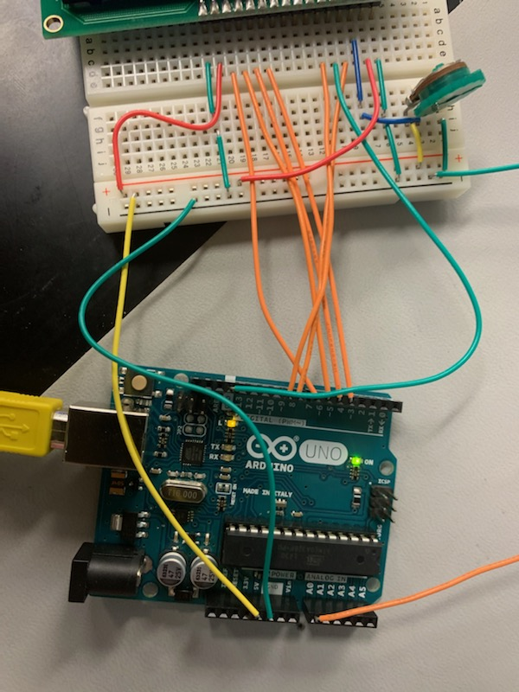
Arduino Uno Lab 2
Part 1
We had applied multiple voltages to circuit
Test setup of the experiment

Slide 26
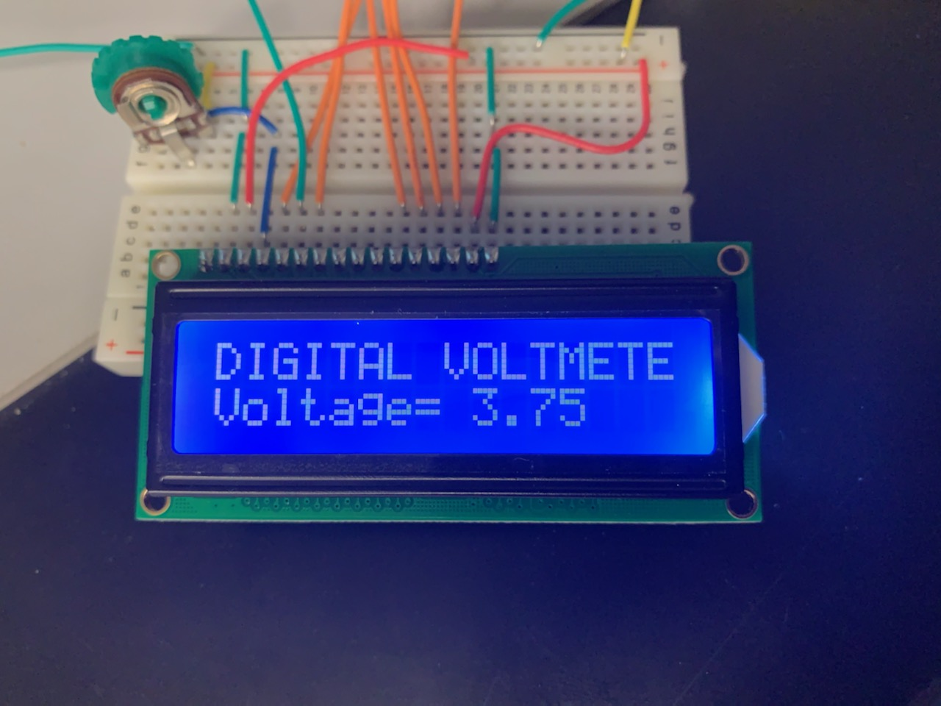
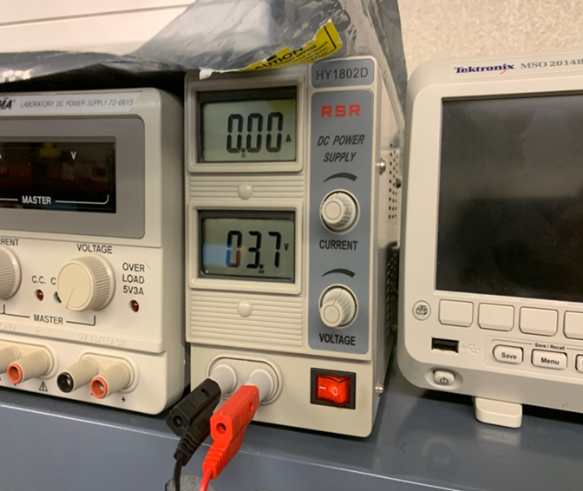
Arduino Uno Lab 2
Part 3
Test voltage applied
Voltage read

Slide 27
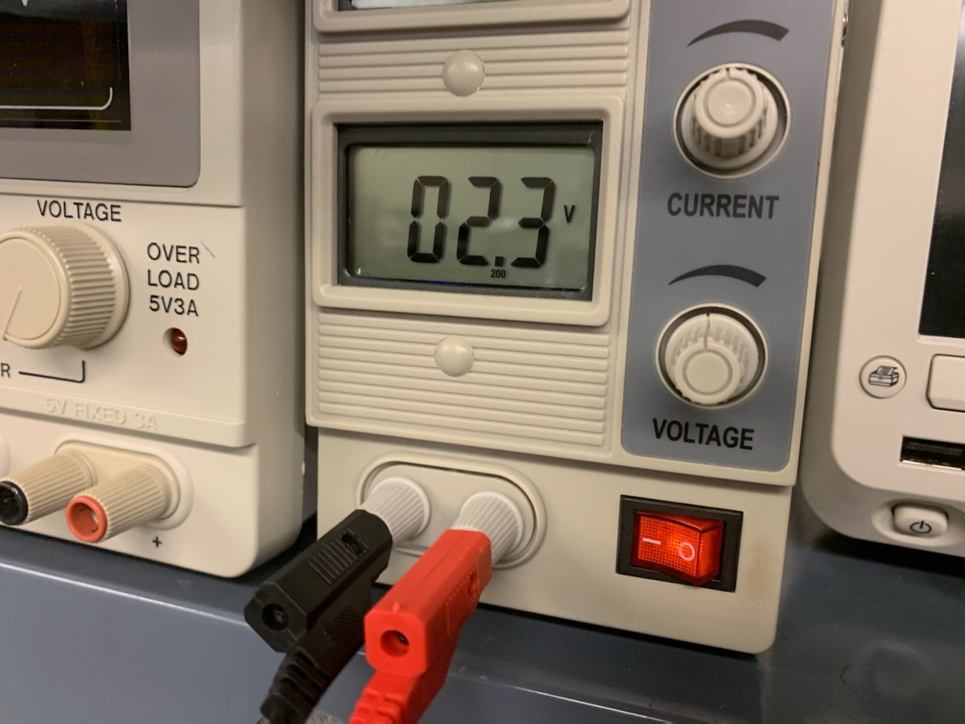
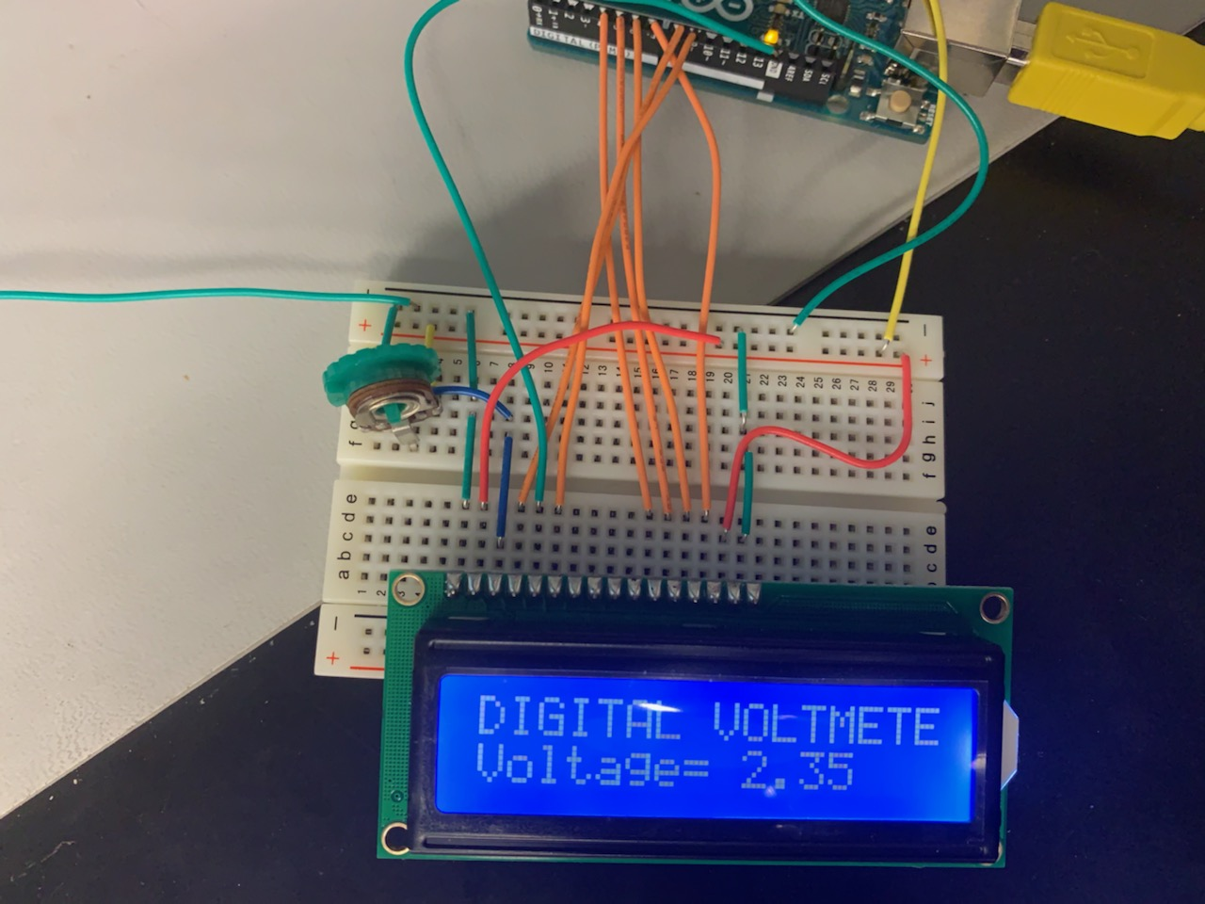
Arduino Uno Lab 2
Part 4
Voltage applied
Voltage read

Slide 28
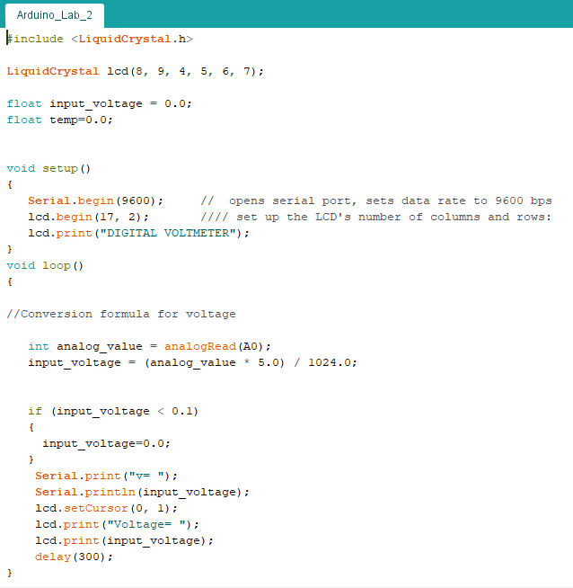
Arduino Uno Lab 2
Part 5
Arduino program code is as follows. Analog int value was input on A0. The input formula was applied to (analog value * 5.0) /1024. The display print values up 5.0 volts.

Slide 29
Arduino Lab 2 Observations
The Display for the Voltmeter in order to read the printed data. The backlighting had to be adjusted in order for it to be readable. It would only read up to 5 volts. Which corresponds to the input voltage applied from the DC Power Supply. We attempted to adjust the voltage beyond 5 volts and it did not read at all.

Slide 30

Arduino Uno Lab 3
Lab Partner was Seth Wills
The purpose of this lab is to demonstrate detailed information on the Arduino can be found at https://www.arduino.cc/en/Tutorial/BuiltInExamples (Links to an external site.) - complete at least 4 of each for the "4. Communication" examples.
Then create a program and circuit which demonstrates what you have learned.
Equipment Needed:
Sonar Eyes for the Arduino
Arduino UNO Connecting Wires
Processing 3

Slide 31

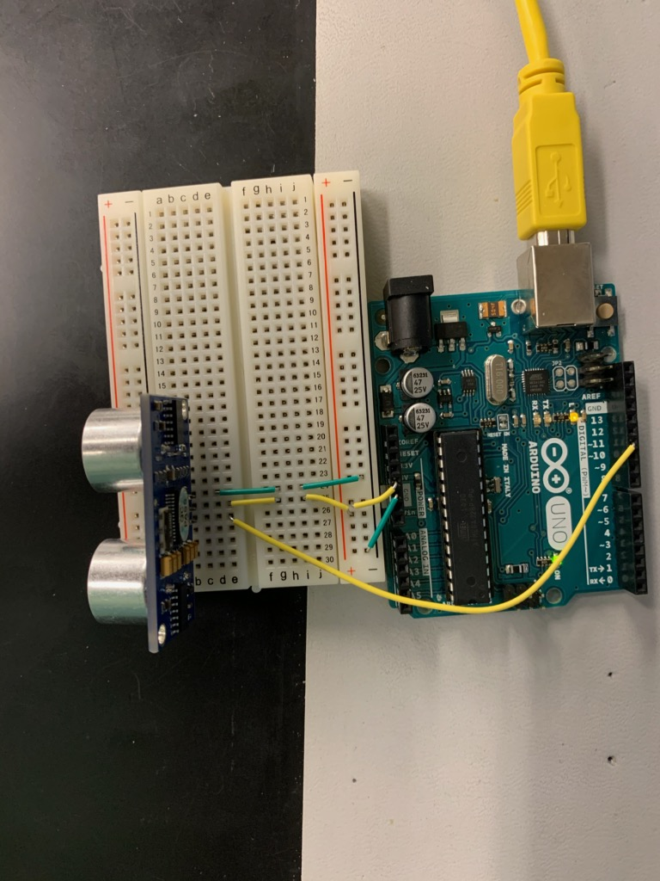
Arduino Uno Lab 3
Part 2
This is our image depicted in the program
The circuit layout

Slide 32
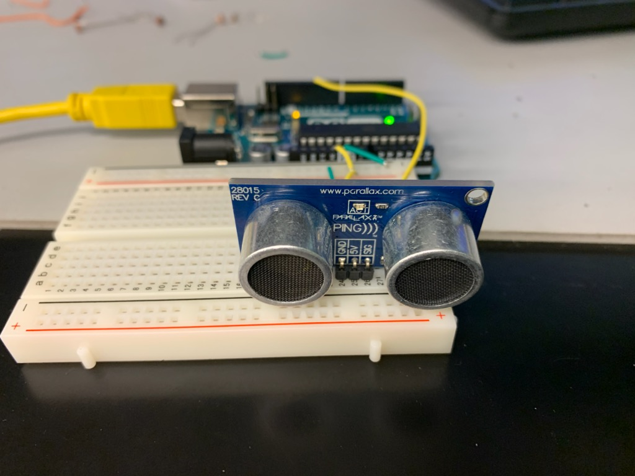
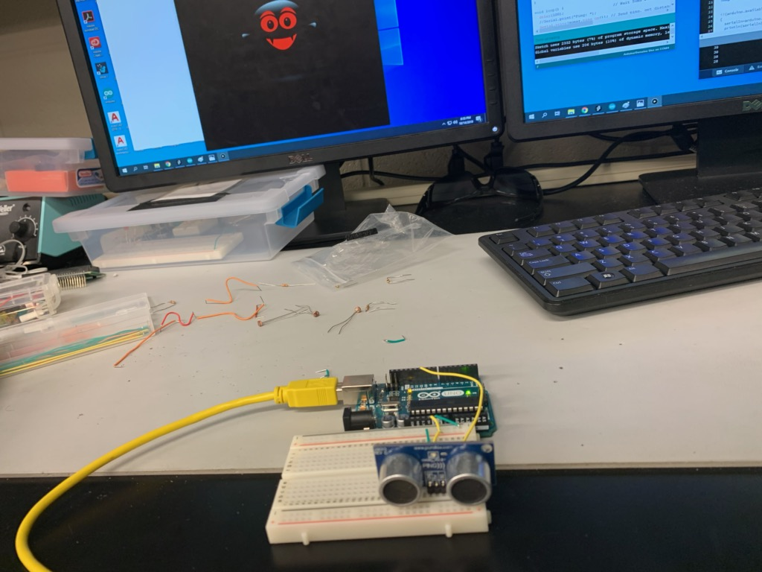
Arduino Uno Lab 3
Part 3
This is our complete setup for the Arduino Lab 3

Slide 33
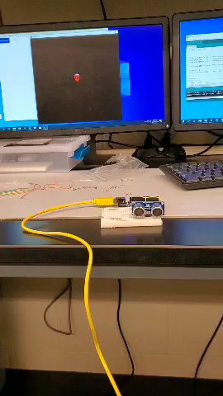
Arduino Uno Lab 3
Part 3
This is the video demonstrating the lab fully functioning

Slide 34
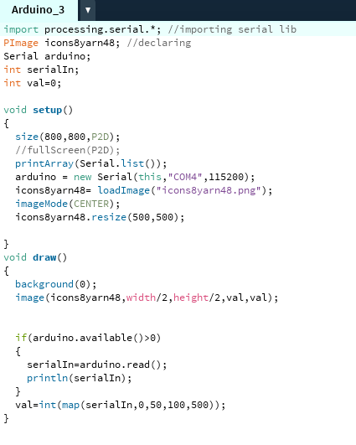
Arduino Uno Lab 3
Part 4
Program used to run to simulation

Slide 35
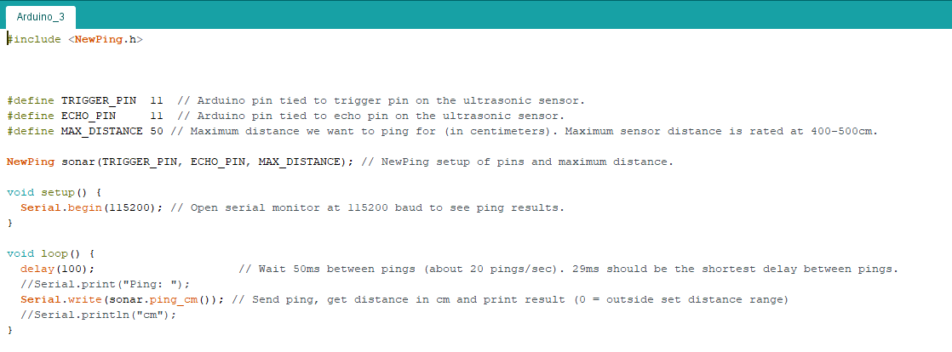
Arduino Uno Lab 3
Part 5
Program header file

Slide 36
Arduino Uno Lab 3 observations
This was an interesting project. Had an issue trying to get the picture to write to screen. The issue was corrected by renaming picture and inserting into header file program folder.

Slide 37

Arduino Uno Lab 4
The purpose of this lab is to demonstrate more detailed information on the Arduinos can be found @ https://www.arduino.cc/en/Tutorial/BuiltInExamples (Links to an external site.)
review the Sensor Examples.
Using the 27 Pcs Sensor Set build and test one of the sensor modules with the Arduino.

Slide 38
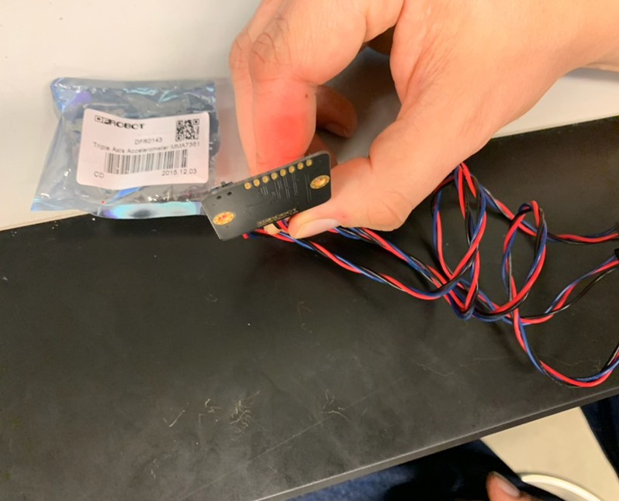
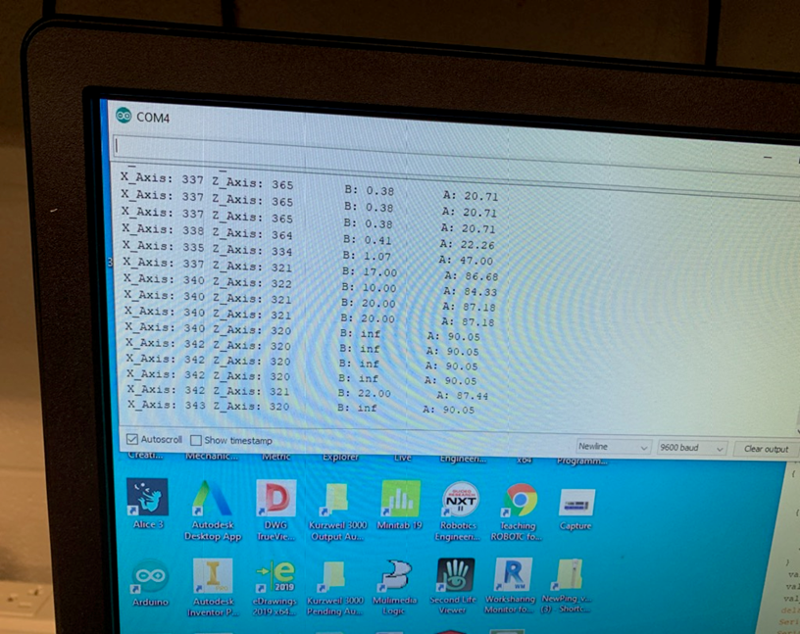
Arduino Uno Lab 4
Part 1
Accelerometer at approximately 90
Console window reporting data

Slide 39
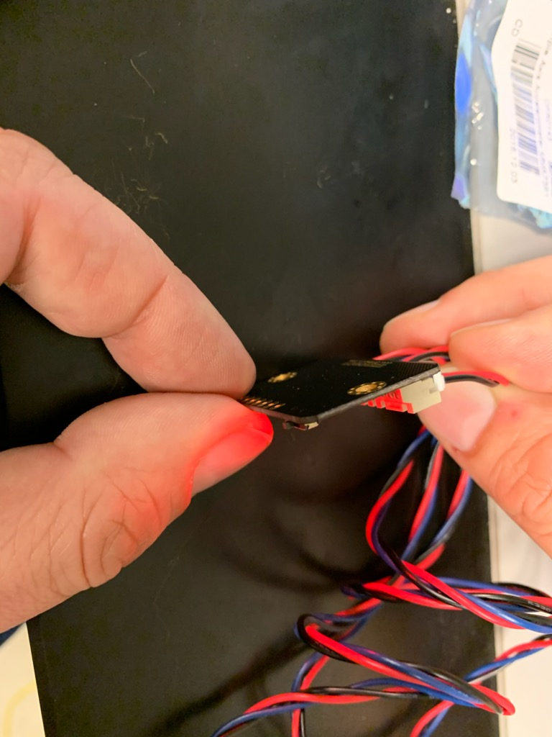
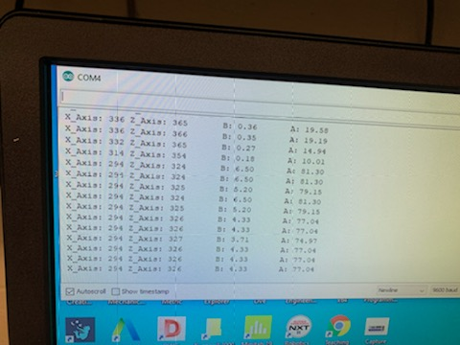
Arduino Uno Lab 4
Part 2
Accelerometer rotated in the along the X axis
Console window reporting data

Slide 40
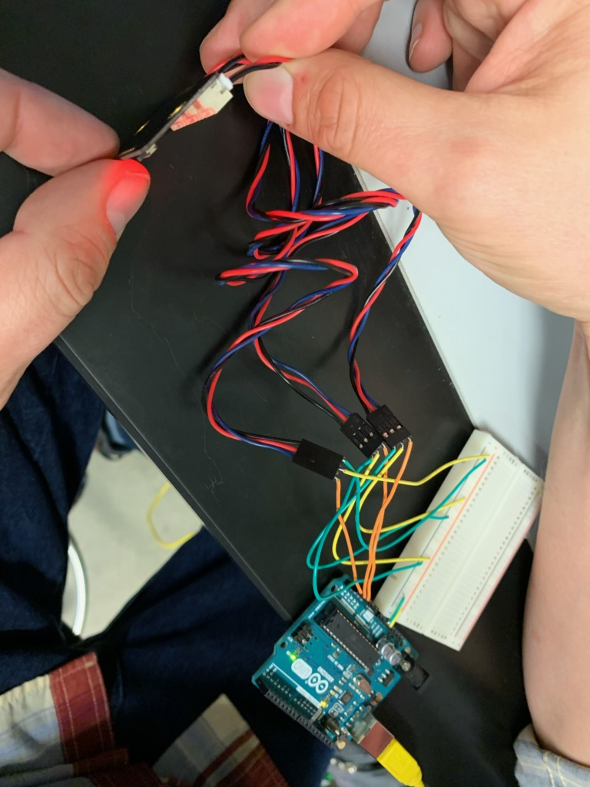
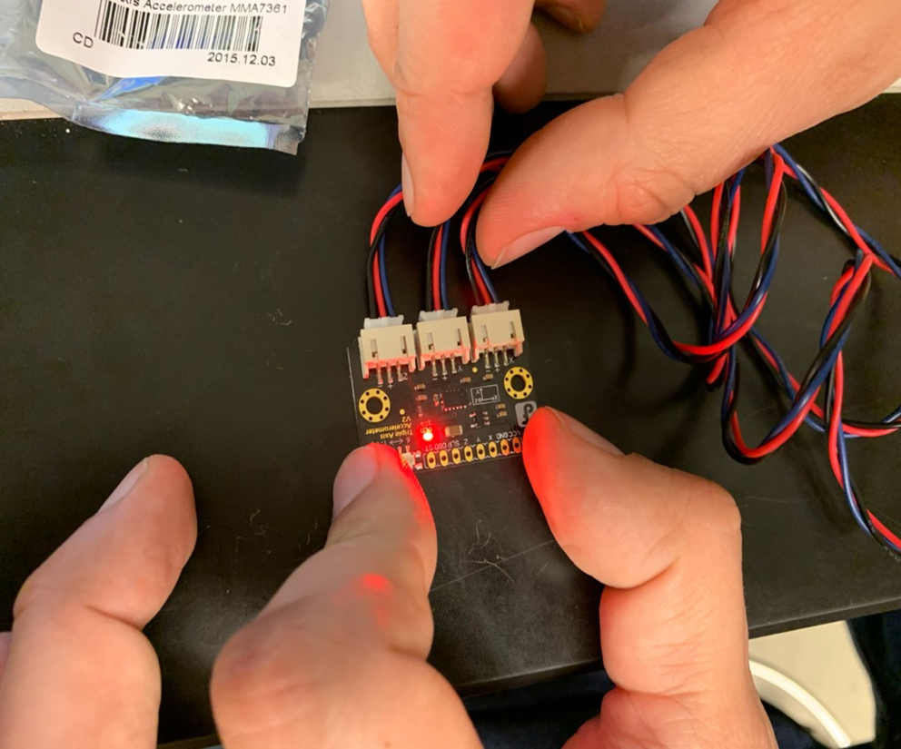
Arduino Uno Lab 4
Part 3
Experiment configuration and the accelerometer sensor

Slide 41
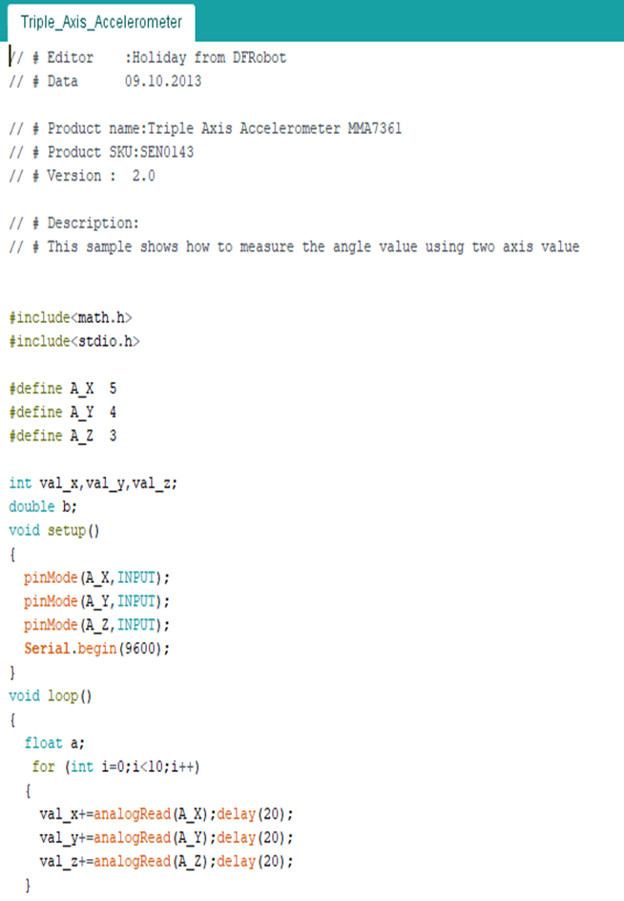
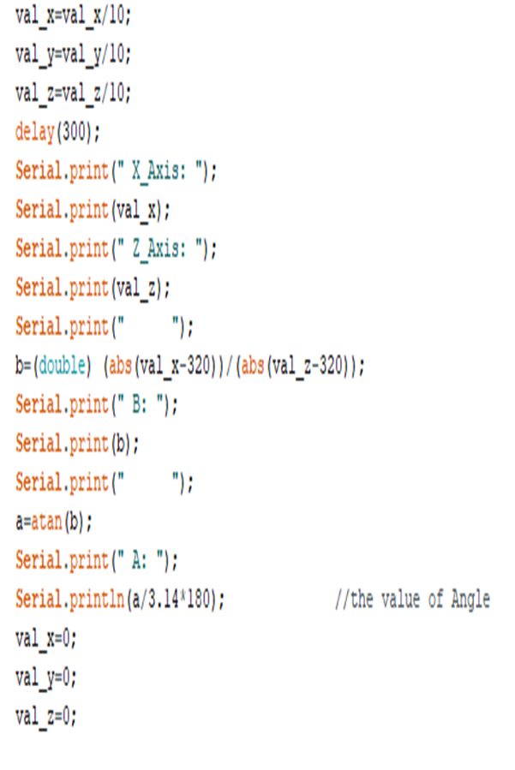
Arduino Uno Lab 4
Part 4
Program used in experiment

Slide 42
Arduino Uno Lab 4 observations
Coding for this experiment was difficult. The output was not easily understood. After some research and seeking help. Found that the samples were taken as result of an acceleration in a direction.

Slide 43
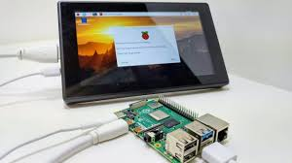
Final project with the Raspberry PI
7 inch segmented display
The purpose of this lab is to build and test a 7 inch touch screen display using the raspberry pie.
Equipment needed:
Raspberry Pi
3D printed case for the tablet
7 inch touch screen display
Connecting wires
Display Card
Power Booster
3.7 Volt lithuim Battery
Soldering Iron
SD card for the Noobz OS
Wireless Keyboard
Power Cables and Connectors

Slide 44
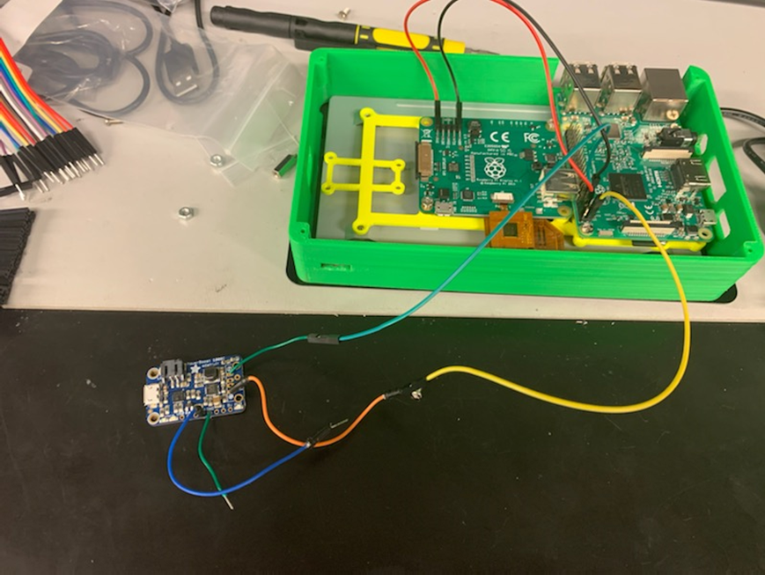
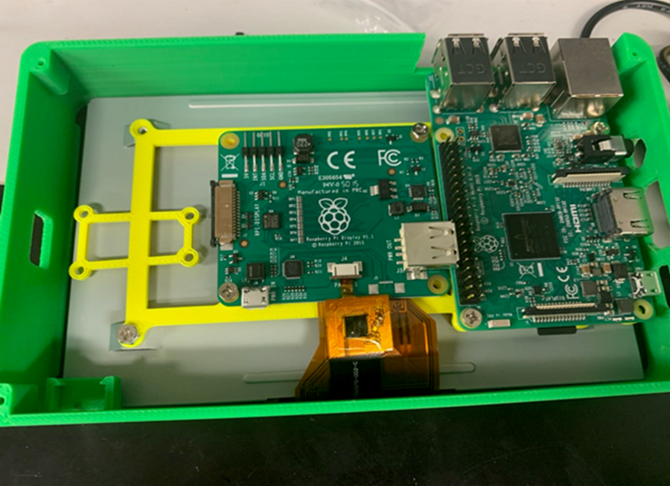
Raspberry Pi lab – Part 1
Mounting the hardware to the 3d printed components to the back of the 7 inch screen

Slide 45
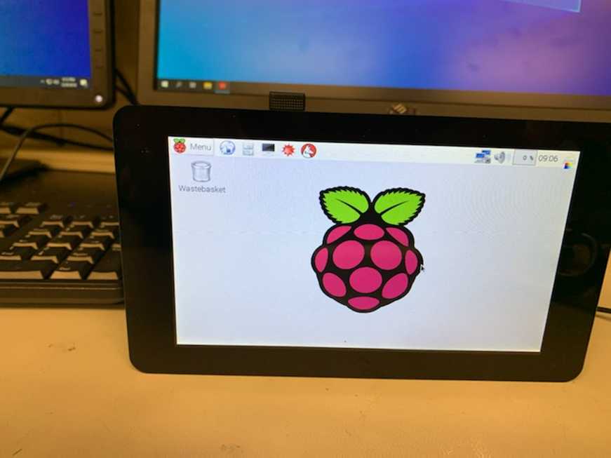
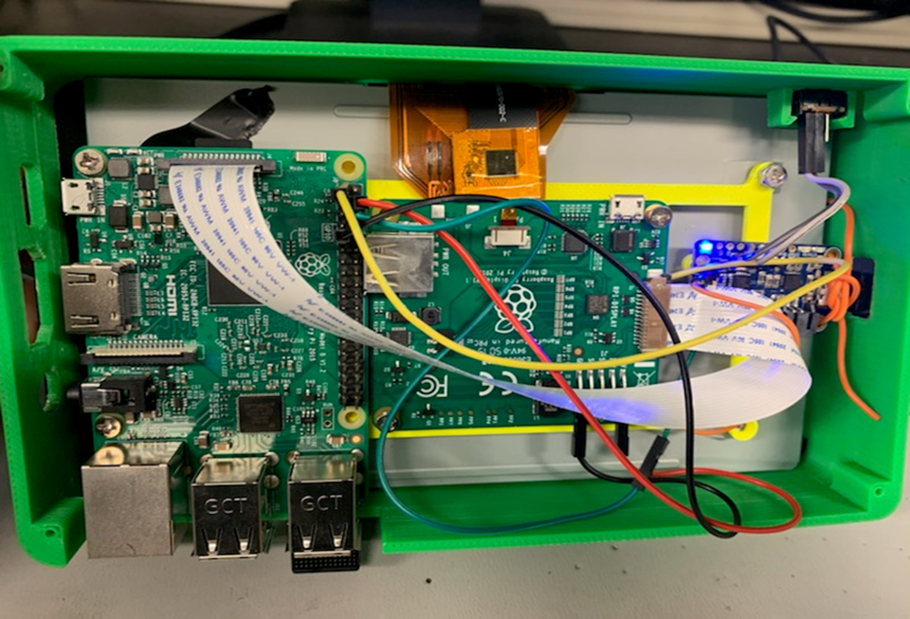
Raspberry Pi lab – Part 2
The unit is fully assembled with OS installed
Back of the tablet with all components installed

Slide 46


Raspberry Pi lab – Part 3
Testing the network for stability
On screen cursor for conformation that the touch screen was functioning

Slide 47
Raspberry Pi final lab Observations
The experiment was a success. A few issues arose was mounting hardware was not easy to locate. The tablet would randomly shut off and reboot the system to a full install. We suspect a bad sd card. The cursor would unsuspiciously begun to jump around. Found that initializing the keyboard would alleviate the problem. The Wi-Fi connection was very weak even after installing a Wi-Fi booster it was still erratic.

